Slide 1
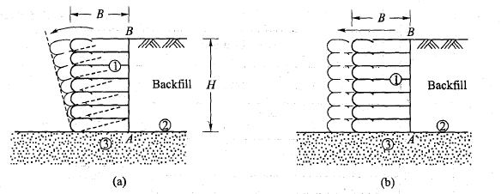
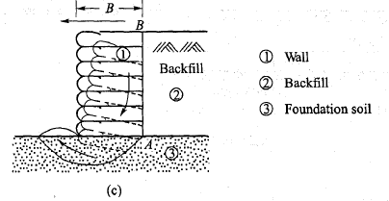
EXTERNAL STABILITY
The MSE wall system consists of three zones. They are:
1. The reinforced earth zone.
2. The backfill zone.
3. The foundation soil zone.
The reinforced earth zone is considered as the wall for checking the internal stability whereas all
three zones are considered for checking the external stability. The soils of the first two zones are
placed in layers and compacted whereas the foundation soil is a normal one. The properties of the
soil in each of the zones may be the same or different. However, the soil in the first two zones is
normally a free draining material such as sand.
It is necessary to check the reinforced earth wall (width= B) for external stability which includes
overturning, sliding and bearing capacity failure. These are illustrated in Fig. 16.9. Active earth
pressure of the backfill acting on the internal face AB of the wall is taken in the stability analysis.
The resultant earth thrust P a is assumed to act horizontally at a height HI 3 above the base of the
wall. The methods of analysis are the same as fo~ concrete retaining walls.

Slide 2
Example 16.1
A typical section of a retaining wall with the backfill reinforced with metal strips is shown in
Fig. Ex. 16.1. The following data are available:
Height H = 9 m; b = 100 mm; t = 5 mm;/y = 240 MPa; Fs for steel= 1.67; Fs on soil friction= 1.5;
<1> = 36°; y = 17.5 kN/m3; 8 = 25°; h x s = 1 x 1 m.
Required
(a) Lengths Land Le at varying depths.
(b) The largest tension Tin the strip.
(c) The allowable tension in the strip.
(d) Check for external stability.

Slide 3
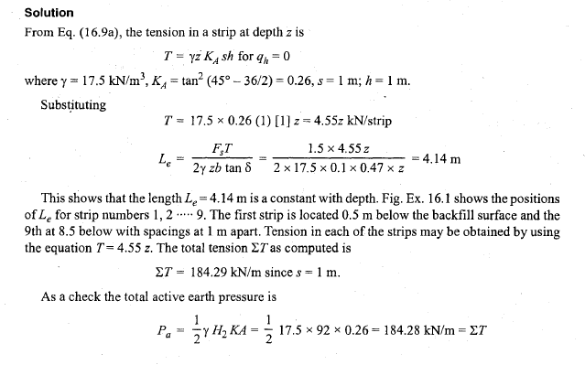
Solution
From Eq. (16.9a), the tension in a strip at depth z is
T= yiKAsh forqh=O
where y = 17.5 kN/m3, KA = tan2 (45°- 36/2) = 0.26, s = 1 m; h = 1 m.
Subs~ituting
T = 17.5 x 0.26 (1) [1] z = 4.55z kN/strip
FsT
L =
e 2y zb tan 8
1.5 x 4.55z
-------- =4.14m
2x17.5x0.1x0.47xz
This shows that the length Le = 4.14 m is a constant with depth. Fig. Ex. 16.1 shows the positions
of Lefor strip numbers 1, 2 ····· 9. The first strip is located 0.5 m below the backfill surface and the
9th at 8.5 below with spacings at 1 m apart. Tension in each of the strips may be obtained by using
the equation T= 4.55 z. The total tension LTas computed is
LT = 184.29 kN/m since s = 1 m.
As a check the total active earth pressure is
1 1
Pa = 2Y H2KA = 2 17.5 x 92 x 0.26 = 184.28 kN/m = LT

Slide 4
The maximum tension is in the 9th strip, that is, at a depth of 8.5 below the backfill surface.
Hence
T = yz KA sh = 17.5 x 85 x 0.26 x 1 x 1 = 38.68 kN/strip
The allowable tension is
where
Ta = fatb
240 X 10 3
fa = --- = 143.7 x 103 kN/m2
1.67
Substituting Ta = 143.7 x 10 3 x 0.005 x 0.1 ""72 kN > T OK.
The total length of strip L at any depth z is
L = LR+Le=(H-z)tan(45-<j>/2)+4.14=0.51 (9-z)+4.14m
where H= 9m
The lengths as calculated have been shown in Fig. Ex. 16.1. It is sometimes convenient to use the
same length L with depth or stepped in two or more blocks or use a linear variation as shown in the
figure.
Check for External Stability
Check of bearing capacity

Slide 5
It is necessary to check the base of the wall with the backfill for the bearing capacity per unit length
of the wall. The width of the wall may be taken as equal to 4.5 m (Fig. Ex. 16.1). The procedure as
explained under shallow Foundation may be followed. For all practical purposes, the shape, depth,
and inclination factors may be taken as equal to 1.
Check for sliding resistance
Sliding resistance FR
Fs = Driving force Pa
4.5 + 8.5
where FR=Wtan8= xl7.5x9tan36°
2
= 1024 X 0.73 == 744 kN
where 8 = <!> = 36° for the foundation soil, and W= weight of the reinforced wall
Pa = 184.28 kN
744
Fs = 184.28 = 4 > 1.5 OK
Check for overturning
MR
Fs =
Mo
From Fig. Ex. 16.1 taking moments of all forces about 0,. we have
4.5 1 4
MR = 4.5x9x 17.5x l + 2 x9x(8.5-4.5)(4.5+ 3)x 17.5

Slide 6
= 1595 + 1837 = 3432 kNm
H 9
M = P x - = 184 28 x - = 553 kNm o a 3 . 3
3432
Fs =
553
= 6.2 > 2 OK.

