Slide 1
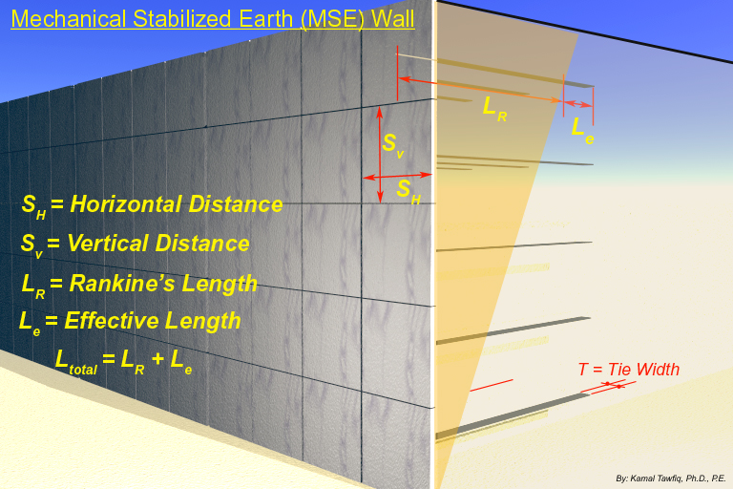
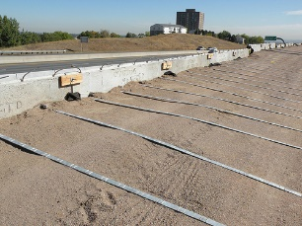

Design Concept
= 3’
Extend the tie beyond the active wedge to provide enough support against earth pressure of the panel
= 3’
$${45}^{0}+\frac{∅}{2}$$
= 4’’
Homework Problem:
A reinforced earth retaining wall is to be 20 ft high. The properties of the backfill material are γ = 110 lb/ft³ and φ = 30^{ο}. Galvanized steel ties are to be used for the construction of the wall. Design the Reinforcements with FS_{(B)} = 3, FS_{(p)} = 3, f_{y} = 29,000psi and φ_{tie}= 20^{ο}.
Kamal Tawfiq, Ph.D., P.E.

Slide 2
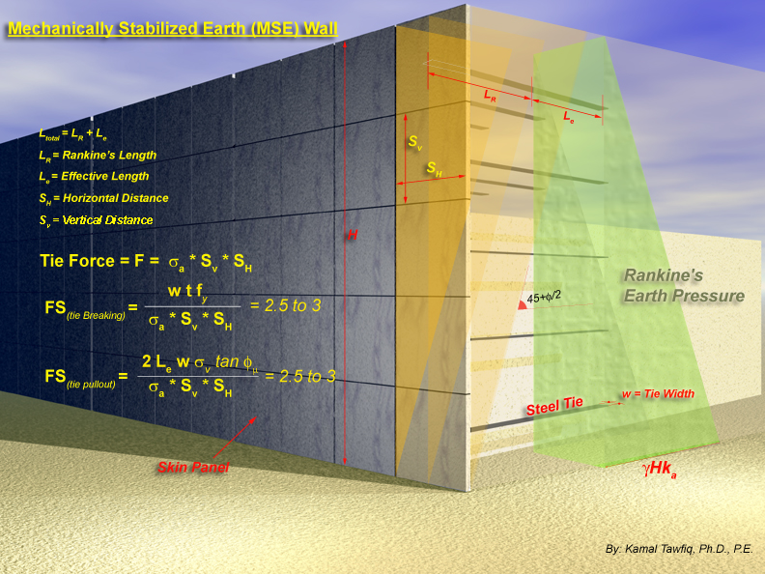
Yield Strength of Steel
t = thickness of tie
Friction angle between steel and soil (given)

Slide 3
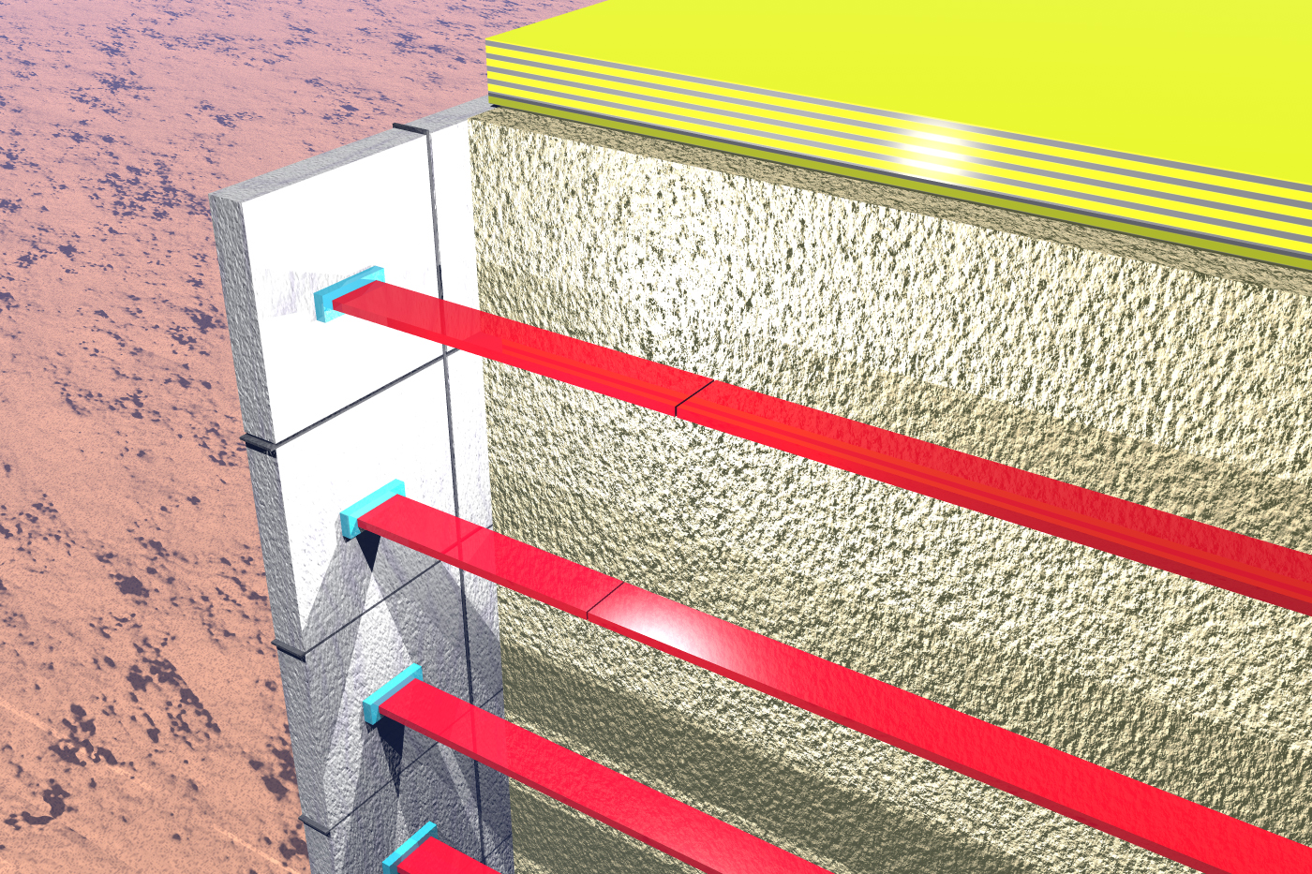

Slide 4



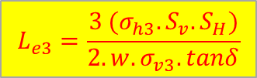




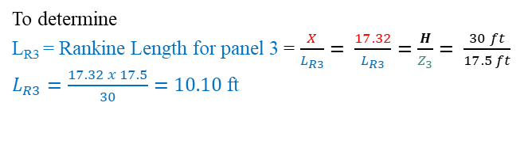

Example:
A reinforced earth retaining wall is to be 30 ft high. The properties of the backfill material are γ = 110 lb/ft³ and φ = 30^{ο}. Galvanized steel ties are to be used for the construction of the wall. Find the lengths (L_{total}) and thicknesses (t) of the steel ties with FS_{(B)}= 3, FS_{(p)} = 3, f_{y}= 60000 psi, width of ties (w)= 4in, and δ_{tie}= 20^{ο}
This equation came from $→→→$ Factor of Safety against Pull Out Failure = 3 =$\frac{Resisting Force}{Driving Force}=\frac{Frctional Force}{Active Force P_{a}}=\frac{2.w.L_{e3}.σ_{v3}.tanδ}{σ_{h3}.S_{v}.S_{H}}=3$
$$tan{30}^{o}=\frac{X}{30′} …… X=17.32 ft$$
= point 1
$$L_{total 3}= L_{R3}+L_{e3}$$
1
σ_{a1} = 0
$$L_{e3}=\frac{3 (σ_{h3}.S_{v}.S_{H})}{2.w.σ_{v3}.tanδ}$$
$$Driving Force Pa$$
1
σ_{v1}= 2.5’ x 110 = 275 psf
$$Resisting Force$$
5’
L_{R1} = Rankine Length for panel 1
L_{e1} = Effective Length
γ = 110 lb/ft³
φ = 30º
2
σ_{a2} = 5’x110=550 psf
σ_{v2}= 7.5’ x 110 = 825 psf
Z₃ = 12.5 ft
S_{H} = 5’
3
σ_{a3}
σ_{v3}= 12.5’ x 110 = 1,375 psf
3
σ_{a3}
S_{v} = 5’
σ_{a4}
L_{e3} = Effective length for panel 3
4
L_{R3} = Rankine length for panel 3
H=30ft
5
σ_{a5}
4
σ_{a4}
6
σ_{a6}
To determine
L_{R3} = Rankine Length for panel 3 = $\frac{X}{L_{R3}}= \frac{17.32}{L_{R3}}=\frac{H}{Z_{3}}= \frac{30 ft}{17.5 ft}$
$L_{R3}=\frac{17.32 x 17.5}{30}=10.10$ ft
45 + φ/2
7
σ_{a7}
5’ + 5’ +2.5’
σ_{v3}= 12.5’ x 110 = 1,375 psf
$$w$$
Width of the tie
$$L_{e3}$$
Two sides of the tie (top and bottom sides)
$Friction Force= σ_{v3} x tanδ x w x L_{e3} x 2$

Slide 5
Thickness of the tie
Width of the tie
Yield strength of the tie
Factor of safety against tie breaking = 3 = $\frac{Resisting Force}{Driving Force}=\frac{Resistance of the steel cross section}{Active Force P_{a}}=\frac{t . w. { f}_{y}}{σ_{h3 }.{ S}_{v} . S_{H}}=3$
Solution

