Slide 1
Mechanically Stabilized Earth (MSE) Wall Project
Geotechnical Design
CEG 4801
Kamal Tawfiq, Ph.D., P.E.

Slide 2
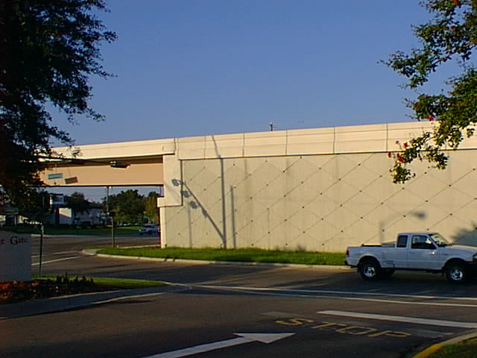
Mechanically Stabilized Earth Wall (MSE Wall)

Slide 3
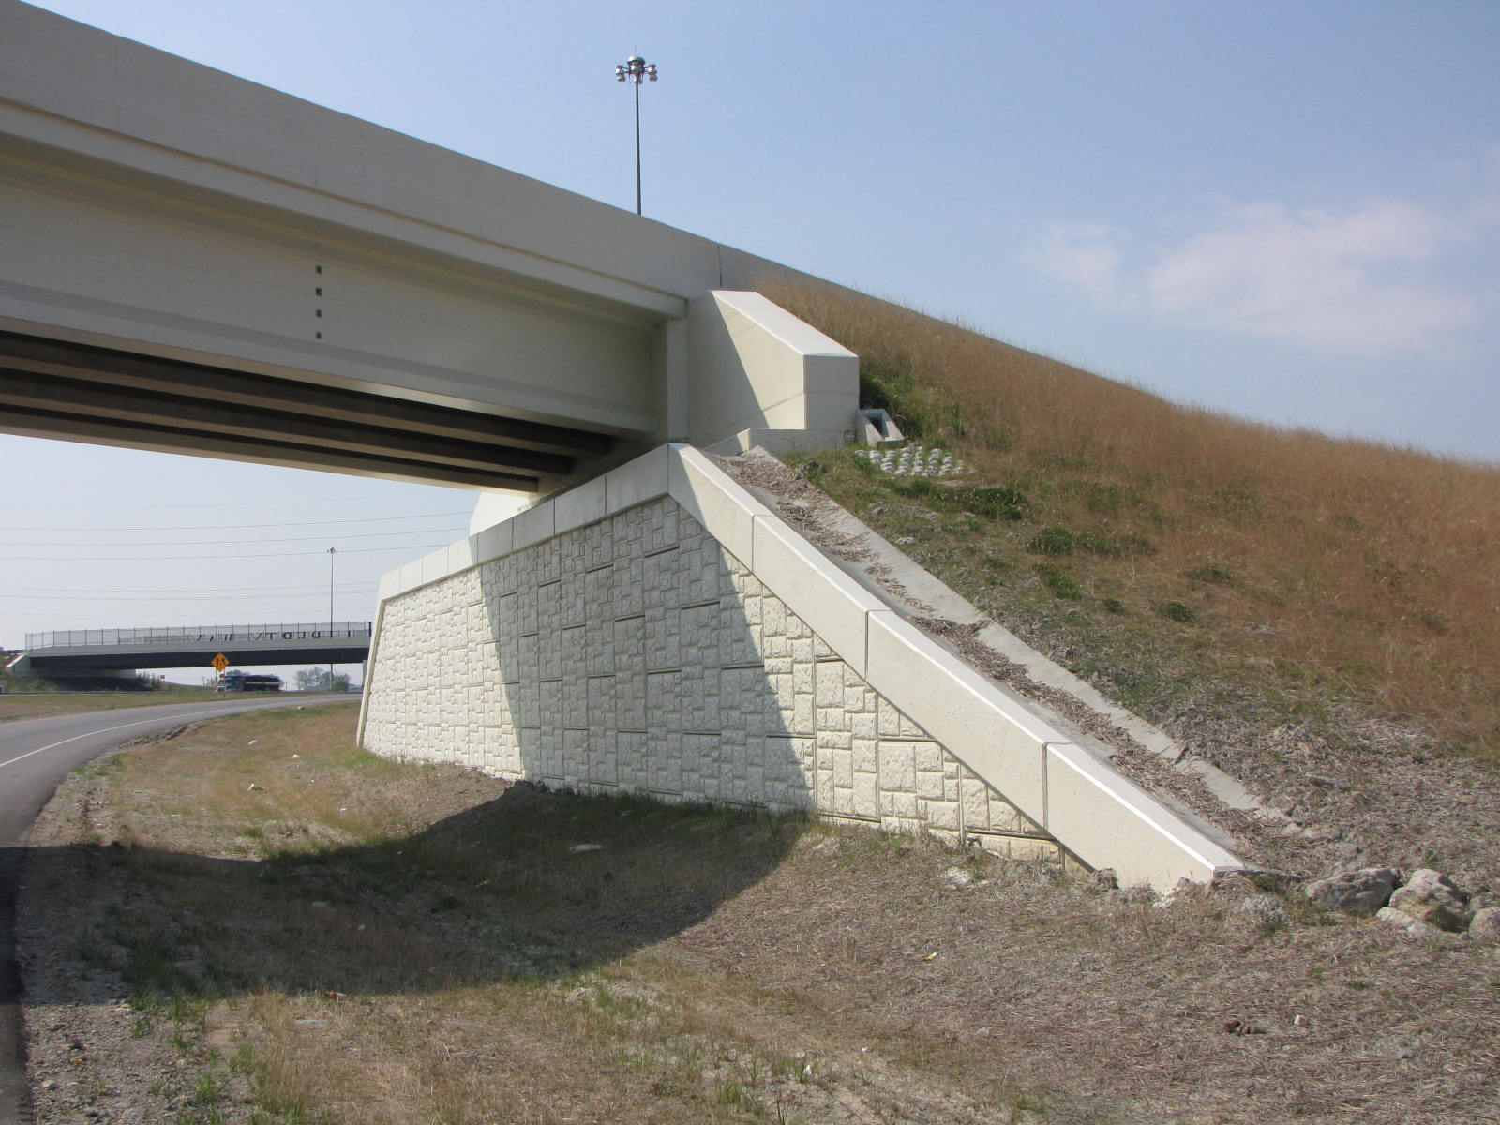
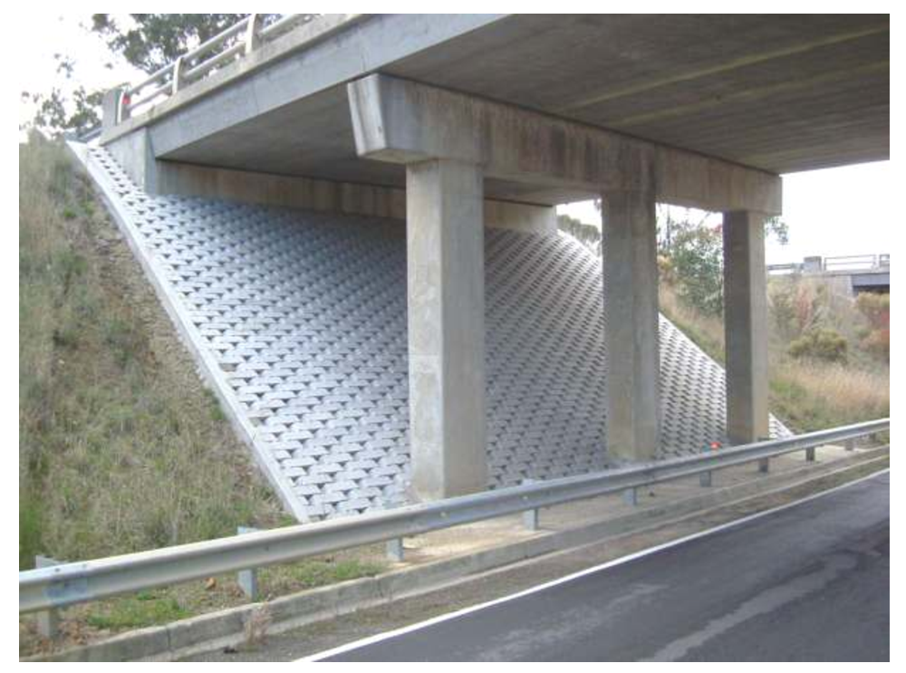
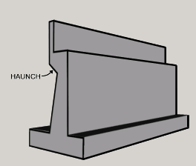
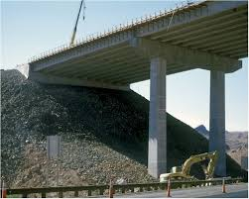
Choices for Bridge Abutments
3
2
1
4

Slide 4
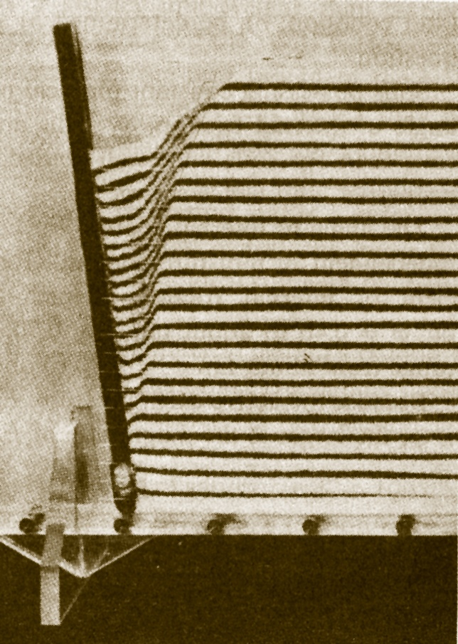
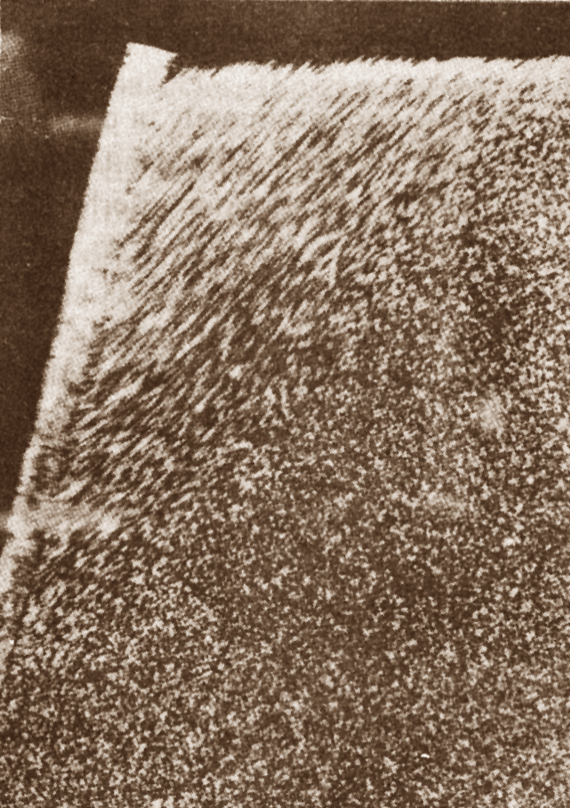
Geotechnical Design
CEG 4801
Fall 2010
By: Dr. Kamal Tawfiq
Active
Passive
Earth Pressure Behind Retaining Wall

Slide 5
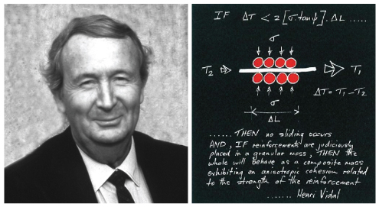
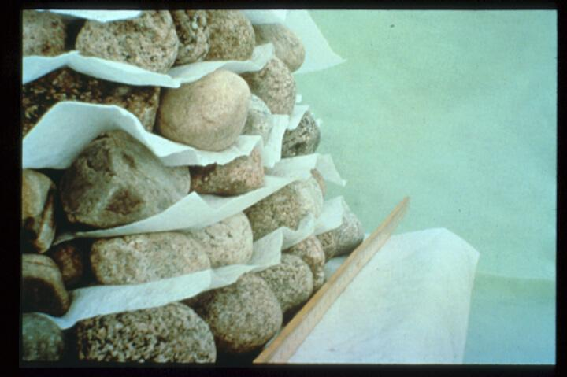
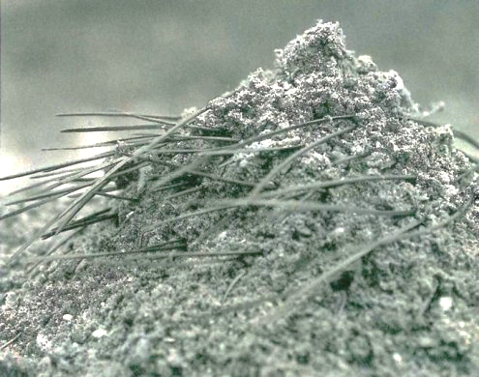
French architect and engineer Henri Vidal in the early 1960s

Slide 6
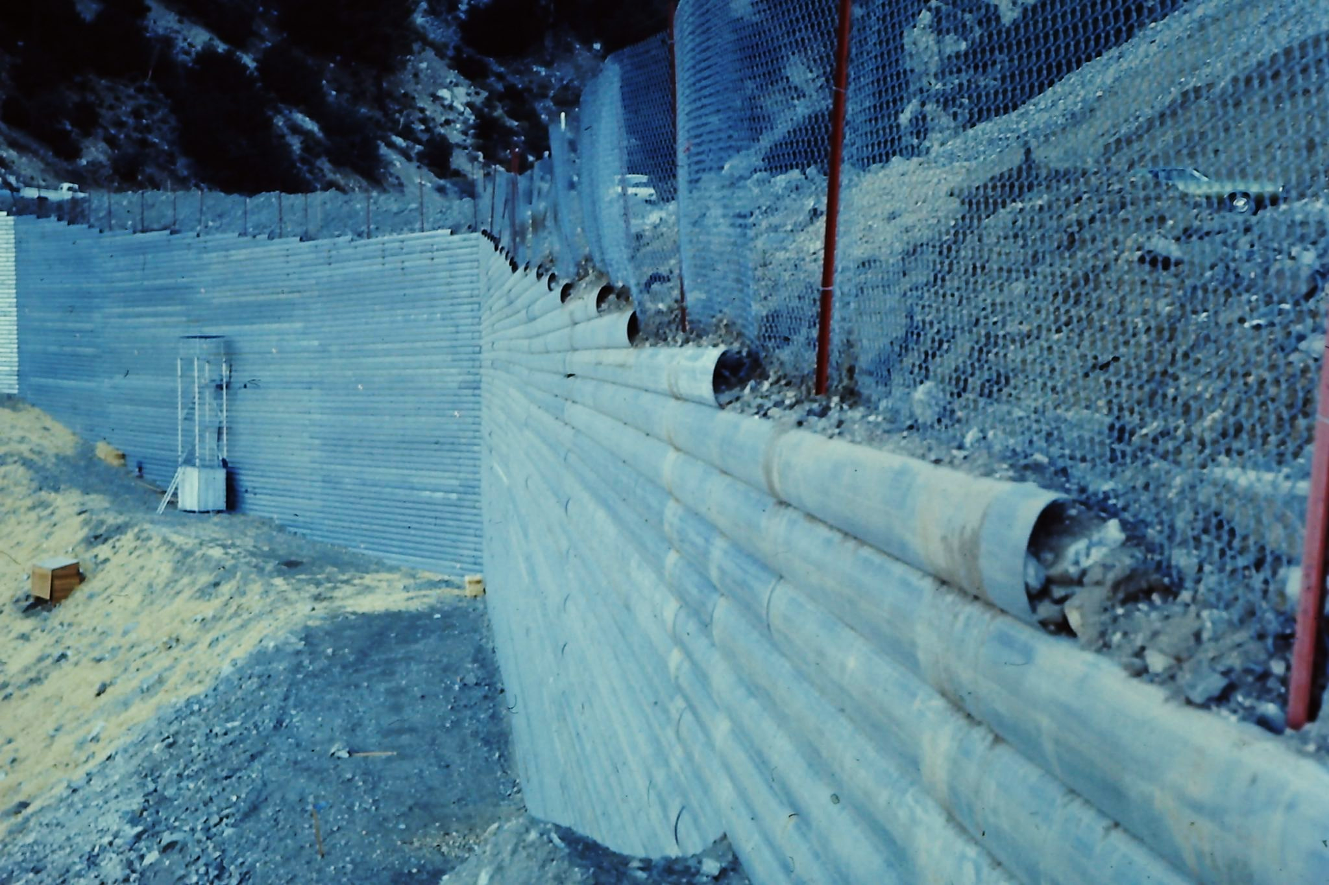
RECo’s first project in the early 1970’s, still in use today – Angeles National Forest, California.

Slide 7
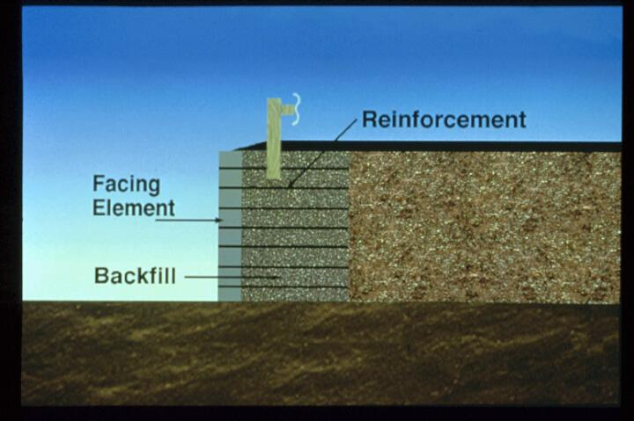
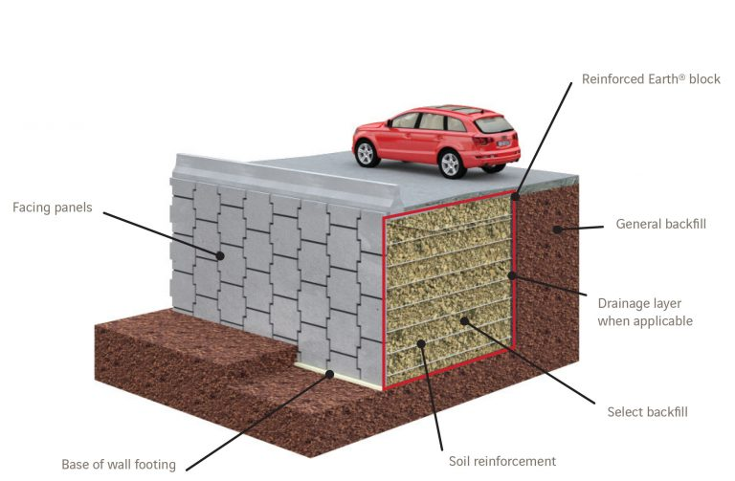

Slide 8
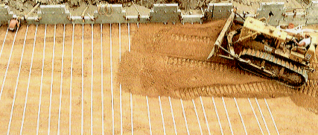
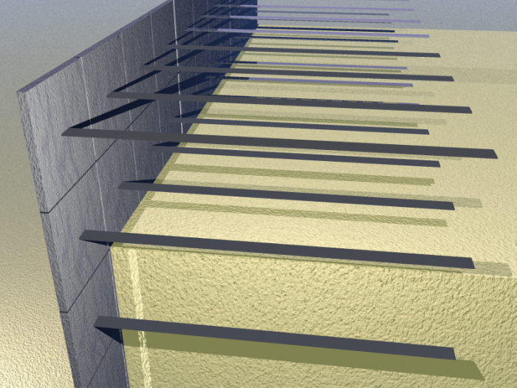
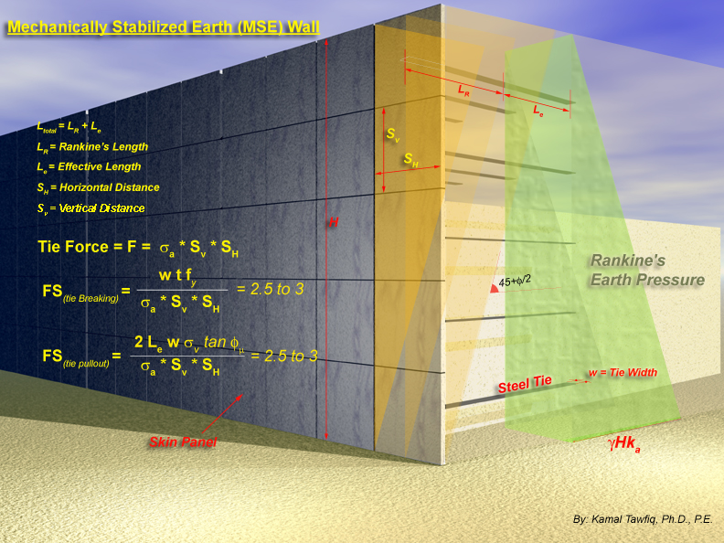
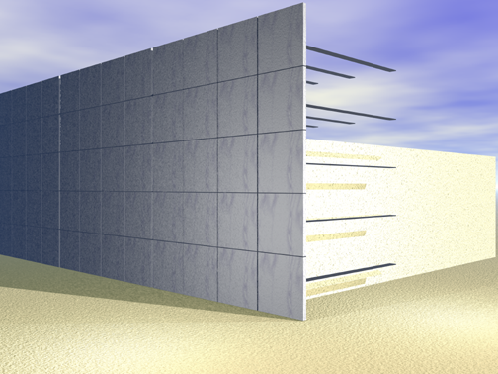
Mechanically Stabilized Earth (MSE) Walls
or Segmental Walls
H = 30 ft
φ = 30o
γ = 110 pcf

Slide 9
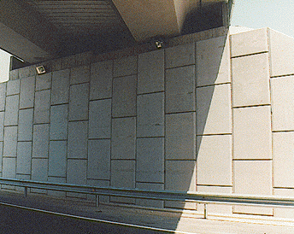
Mechanically Stabilized Earth Wall (MSE Wall)

Slide 10
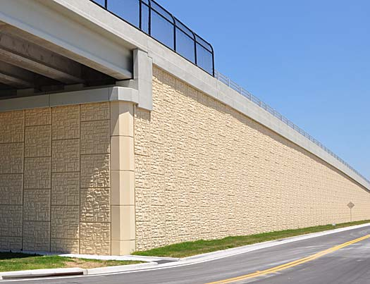

Slide 11
Mechanically Stabilized Earth Wall (MSE Wall)

Slide 12
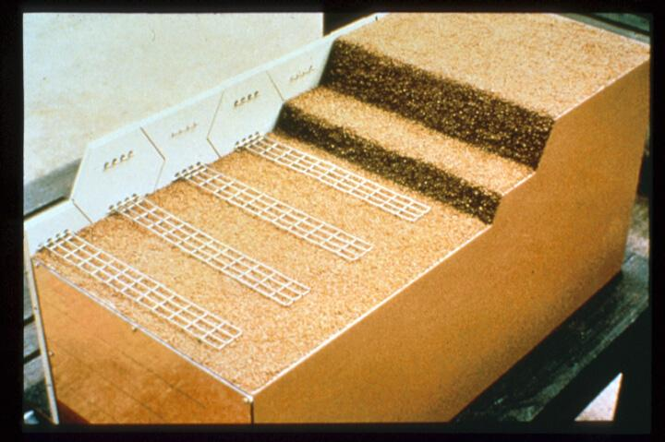
Using Galvanized Steel

Slide 13
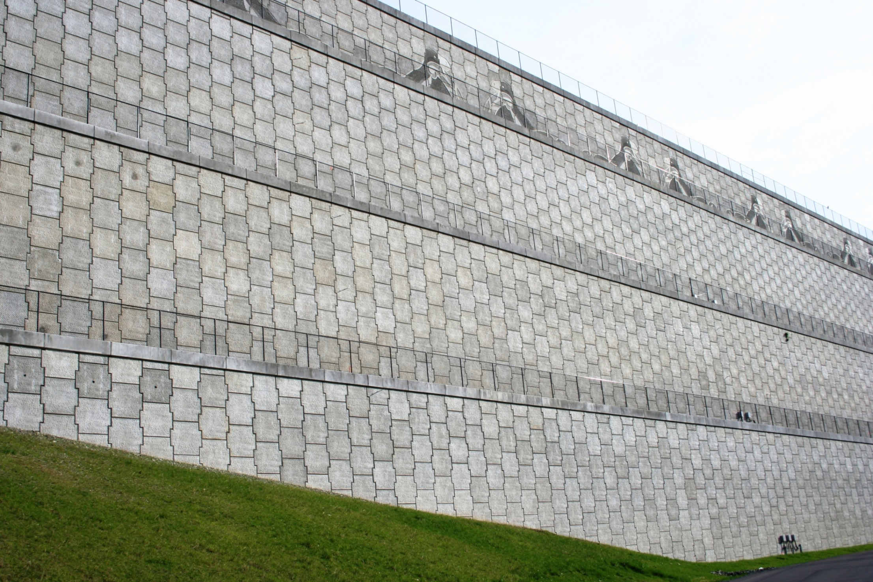
Seattle-Tacoma International Airport, WA

Slide 14
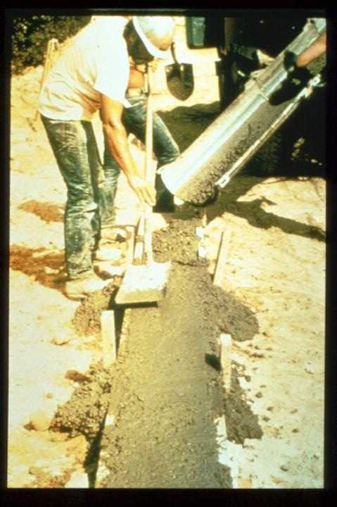
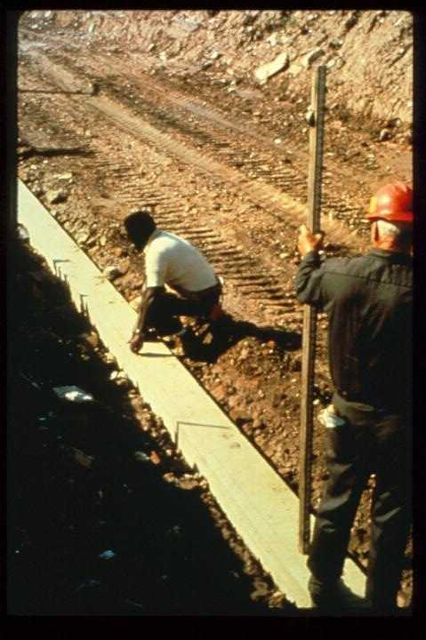

Slide 15
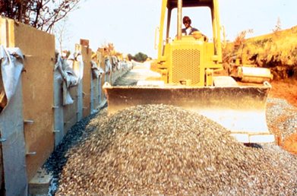
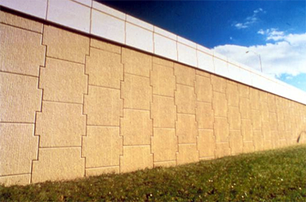
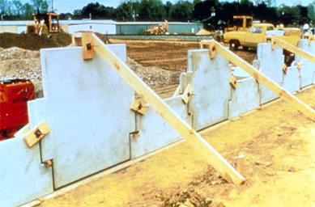
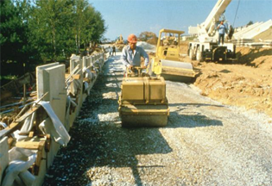
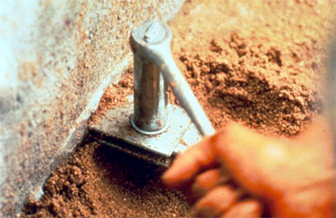
Kamal Tawfiq, Ph.D., P.E.

Slide 16
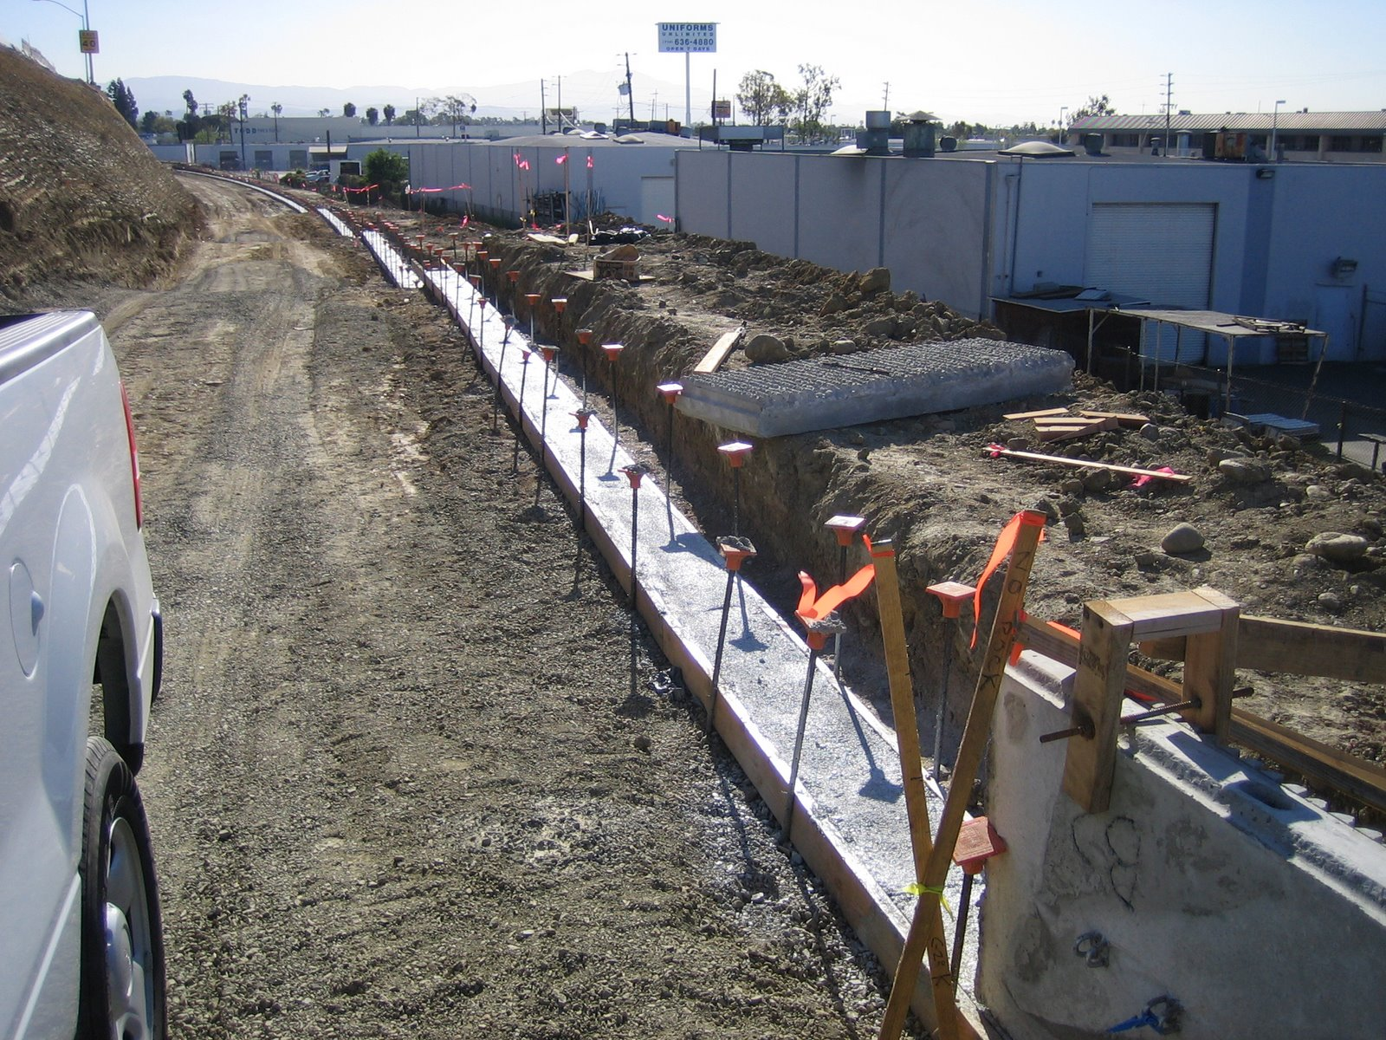

Slide 17
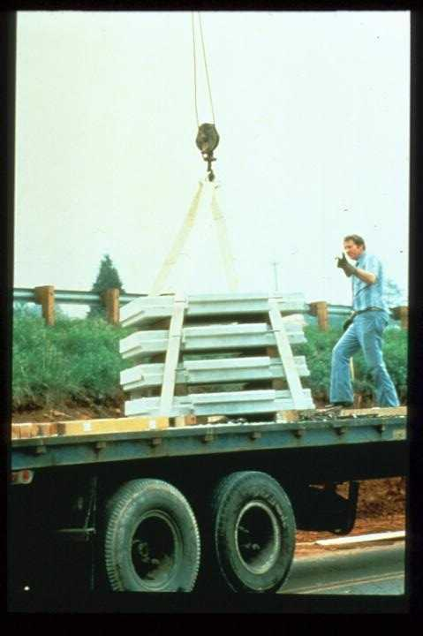

Slide 18
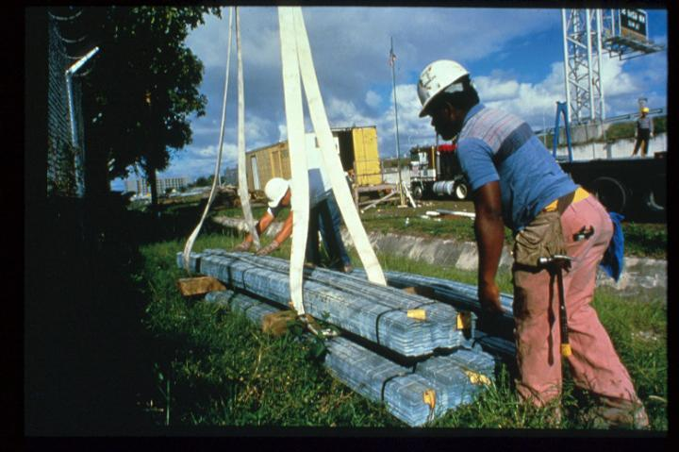

Slide 19
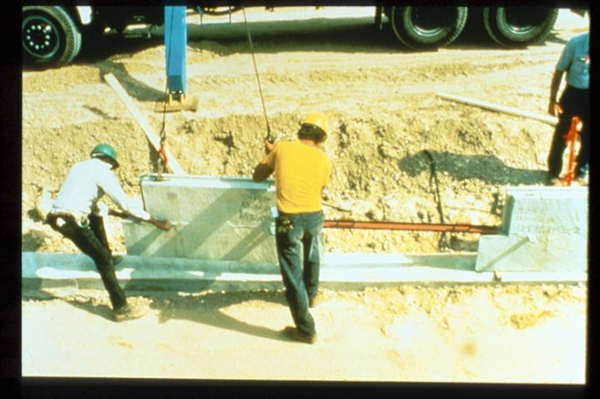

Slide 20
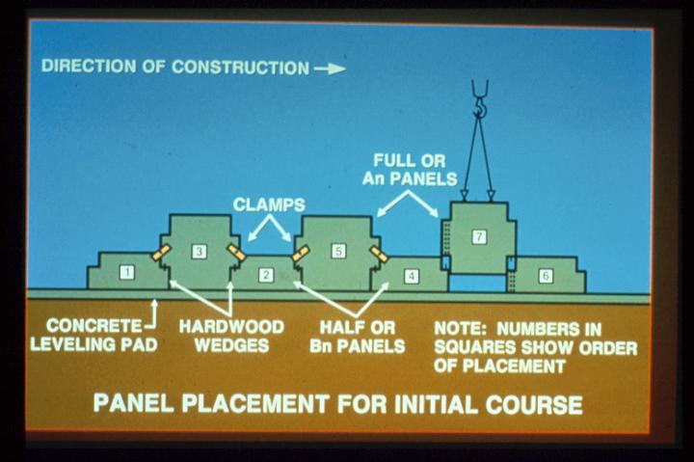

Slide 21
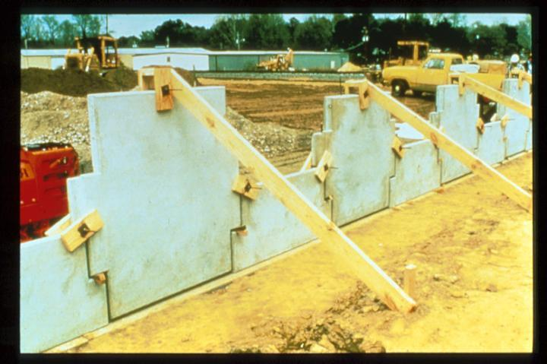

Slide 22
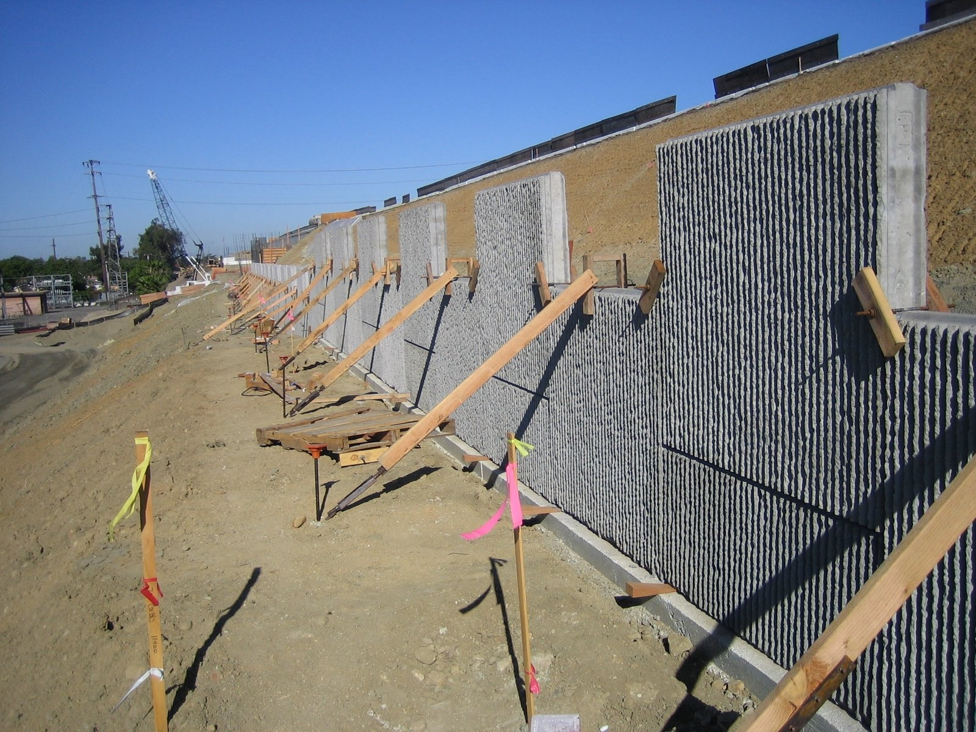

Slide 23
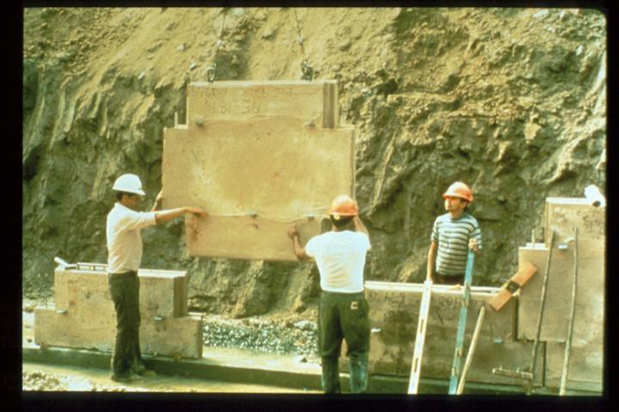

Slide 24
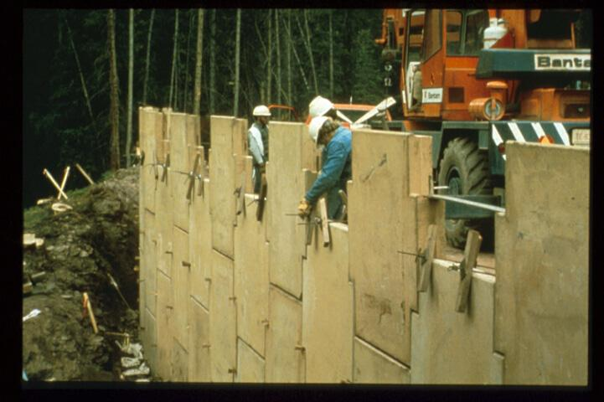

Slide 25
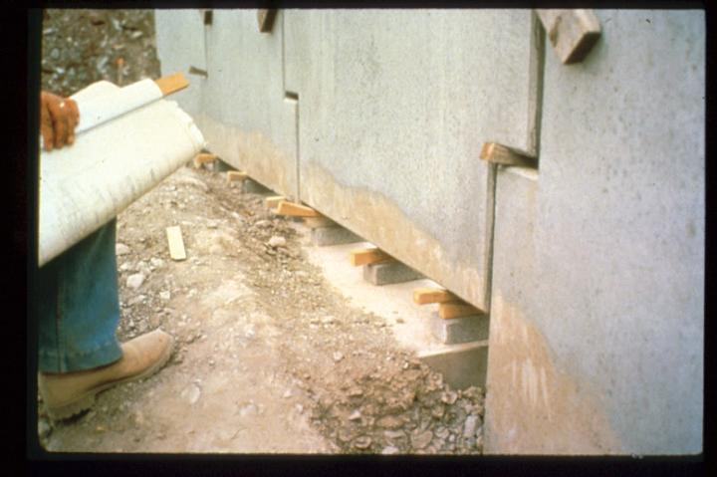

Slide 26
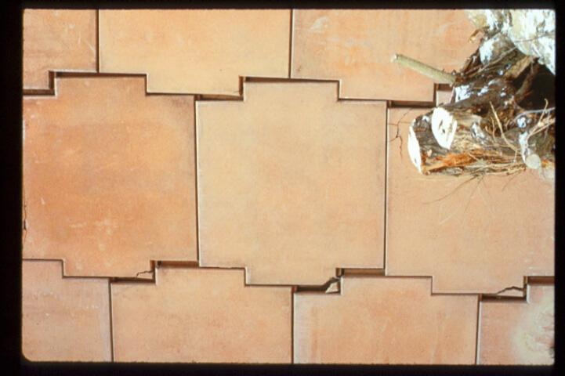
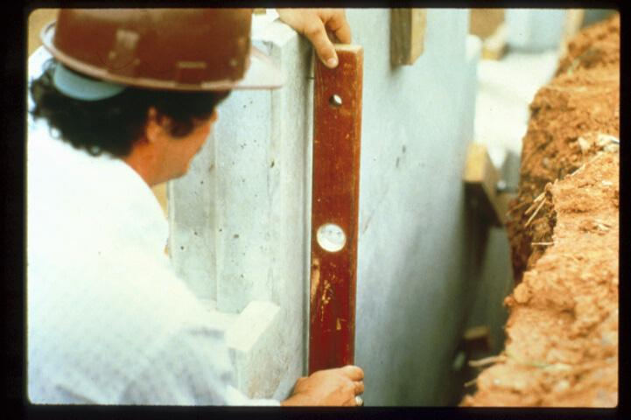

Slide 27
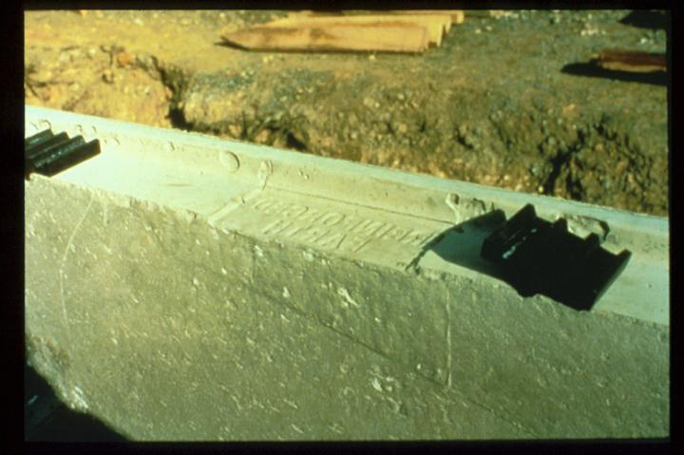

Slide 28
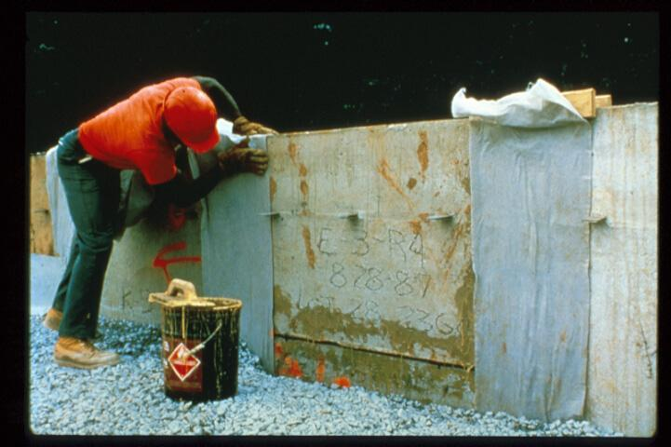

Slide 29
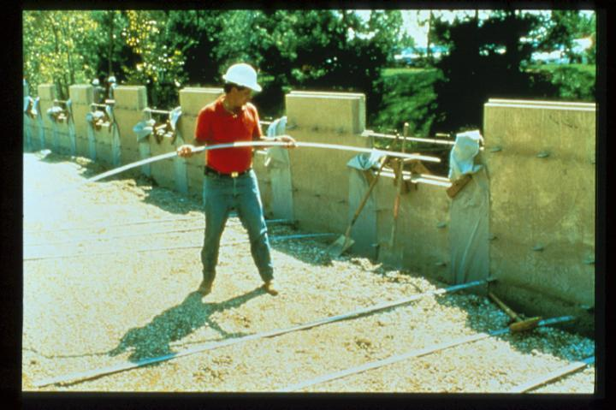

Slide 30
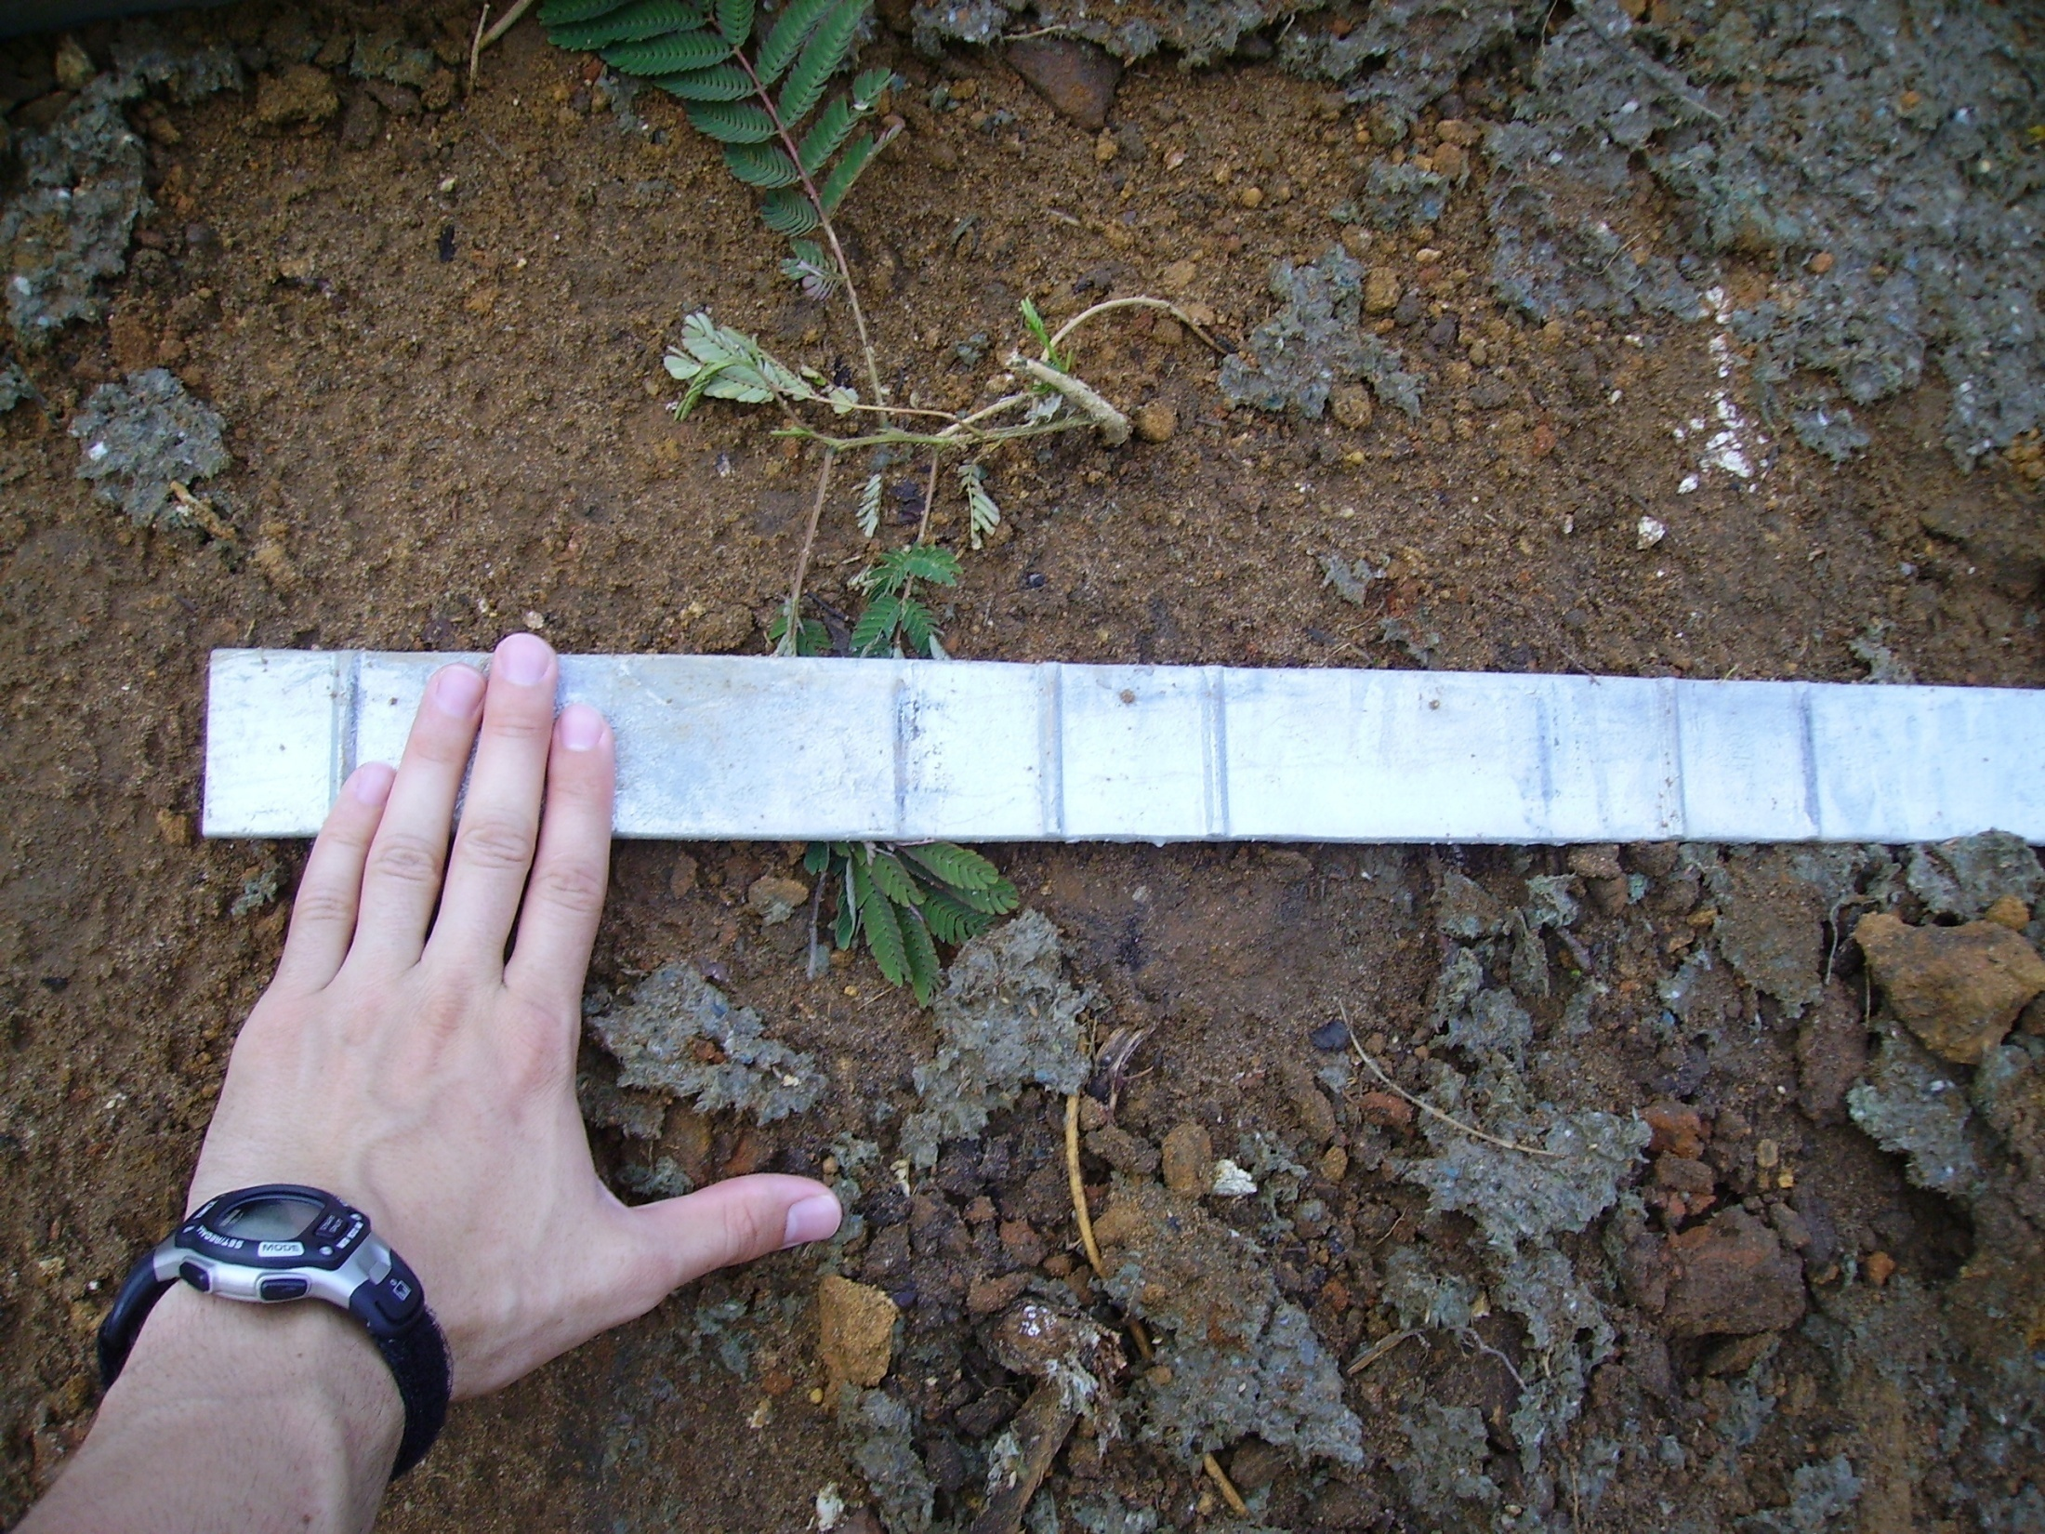

Slide 31
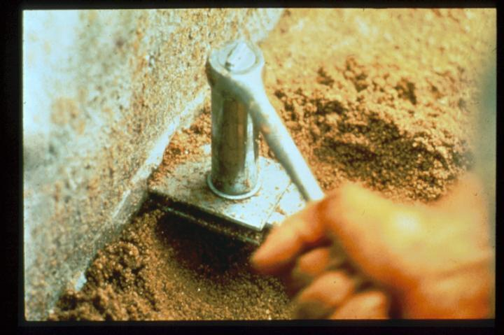

Slide 32
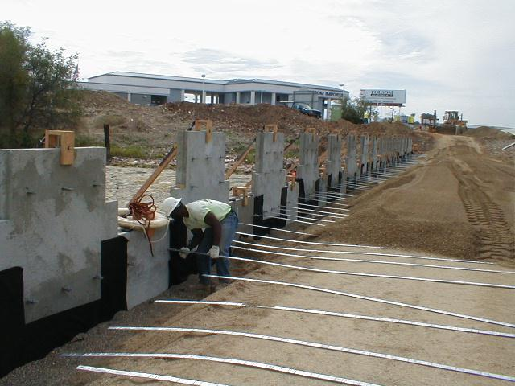

Slide 33
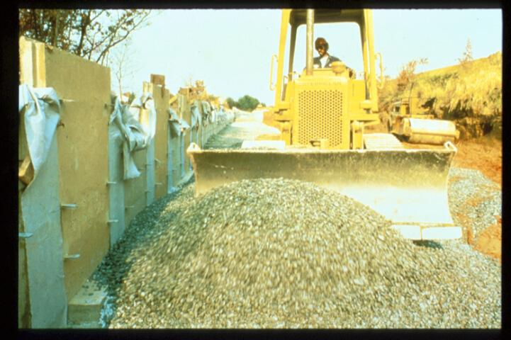

Slide 34
Mechanically Stabilized Earth Wall (MSE Wall)

Slide 35
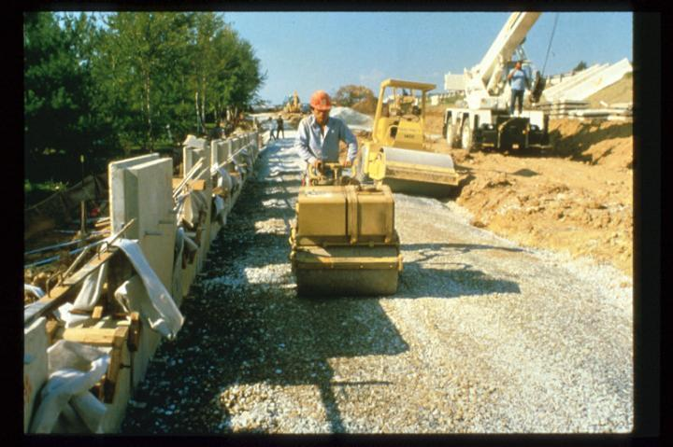

Slide 36
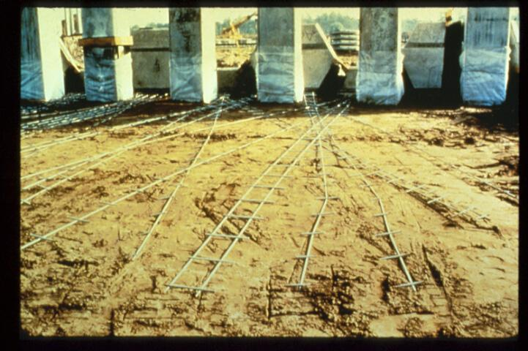

Slide 37
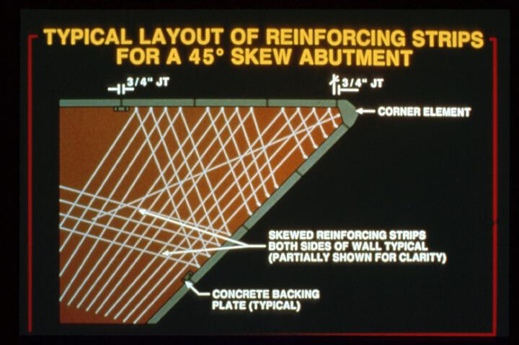

Slide 38


Slide 39


Slide 40


Slide 41


Slide 42


Slide 43


Using Geogrids

Slide 44


Slide 45


Slide 46

Tom Landry Highway, TX

Slide 47
Stability of MSE Walls

Slide 48


Stability of MSE Walls

Slide 49

Block Failure

Slide 50

Geotechnical Design
CEG 4801
Fall 2004
By: Dr. Kamal Tawfiq
Mechanically Stabilized Earth Wall (MSE Wall)

Slide 51

Mechanically Stabilized Earth Wall (MSE Wall)

Slide 52
MSE Key Stone Wall

Slide 53



MSE Key Stone Wall

Slide 54


Slide 55





Slide 56


Slide 57



Slide 58


Slide 59



Slide 60





Slide 61


Geotextile Walls

Slide 62




Gabion Walls
Gabion Retaining Wall Design

Slide 63





Gabion Walls

Slide 64

Gabion Walls
HESCO CONCERTAINER
Military Accommodation Roofing, Personnel & Material Bunker Sets

Slide 65


Interior of Fort Sumter with gabions
Petersburg, Virginia. Fort Sedgwick. Gabions

Slide 66


Slide 67

Rebel fortifications in front of Atlanta, Georgia, in 1863 or 1864

Slide 68

Gabions with cannon, from a late 16th century illustration.

Slide 69
MSE Wall
Analysis and Design

Slide 70

= 3’
= 3’
A reinforced earth retaining wall is to be 20 ft high. The properties of the backfill material are γ = 110 lb/ft³ and φ = 30^{ο}. Galvanized steel ties are to be used for the construction of the wall. Design the Reinforcements with FS_{(B)} = 3, FS_{(p)} = 3, f_{y} = 29,000psi and φ_{tie}= 20^{ο}.

Slide 71


Slide 73
MSE Wall Problem
Geotechnical Design
CEG 4801
Fall 2022
Kamal Tawfiq, Ph.D., P.E.

Slide 74








Slide 75



Design Concept
= 3’
Extend the tie beyond the active wedge to provide enough support against earth pressure of the panel
= 3’
$${45}^{0}+\frac{∅}{2}$$
= 4’’
Problem:
A reinforced earth retaining wall is to be 18 ft high. The properties of the backfill material are γ = 110 lb/ft³ and φ = 30^{ο}. Galvanized steel ties are to be used for the construction of the wall. Design the Reinforcements with FS_{(B)} = 3, FS_{(p)} = 3, f_{y} = 29,000psi and φ_{tie}= 20^{ο}.
Kamal Tawfiq, Ph.D., P.E.

Slide 76
Yield Strength of Steel
t = thickness of tie
Friction angle between steel and soil (given)

Slide 77


Slide 78


Tie 1
Panel 1
0.5S_{v}
W = width of the tie = 4”
L_{R1} =
(H- 0.5 S_{v}) tan (45-φ/2)
L_{R1} = Rankine Length
L_{e1} = Effective Length
2.5(σ_{a}.S_{v}.S_{H})
L_{e1}=
Panel 2
2 w σ_{v} tanφ_{μ}
L₁ = L_{R1} + L_{e1}
Panel 3
H
Panel 4
Panel 5
L_{R5}
L_{e5}
H = 30 ft
φ = 30o
γ = 110 pcf
Panel 6
45 - φ/2
Panel 7
45 + φ/2
Kamal Tawfiq, Ph.D., P.E.

Slide 79
σ_{a1}
σ_{v1}
L_{R1} =
(H- 0.5 S_{v}) tan (45 - φ/2)
(σ_{a1 +} σ_{a2})_{/2}
2.5(σ_{a}.S_{v}.S_{H})
σ_{a2}
σ_{v2}
L_{e1}=
2 w σ_{v} tanφ_{μ}
Tie width
L₁ = L_{R1} + L_{e1}
σ_{a3}
σ_{v3}
H
σ_{a4}
S_{H}
σ_{a3}
σ_{a5}
S_{v}
σ_{a6}
σ_{a4}
σ_{a7}
(σ_{a3 +} σ_{a4})_{/2}
σ_{a8}
Kamal Tawfiq, Ph.D., P.E.

Slide 80




Example:
A reinforced earth retaining wall is to be 30 ft high. The properties of the backfill material are γ = 110 lb/ft³ and φ = 30^{ο}. Galvanized steel ties are to be used for the construction of the wall. Design the Reinforcements with FS_{(B)}= 3, FS_{(p)} = 3, f_{y}= 29,000 psi and φ_{tie}= 20^{ο}
$$tan{30}^{o}=\frac{X}{30′} …… X=17.32 ft$$
σ_{a1} = 0
1
= point 1
1
σ_{v1}
5’
γ = 110 lb/ft³
φ = 30º
L_{R1} = Rankine Length for panel 1
L_{e1} = Effective Length
2
σ_{a2} = 5’x110=550 psf
σ_{v2}
Z₃ = 12.5 ft
S_{H} = 5’
3
σ_{a3}
σ_{v3}
3
σ_{a3}
S_{v} = 5’
σ_{a4}
L_{R3} = Rankine Length for panel 3
4
H=30ft
5
σ_{a5}
4
σ_{a4}
σ_{a6}
6
To determine
L_{R3} = Rankine Length for panel 3=$\frac{X}{L_{R3}}= \frac{17.32}{L_{R3}}=\frac{X}{Z_{3}}= \frac{30 ft}{12.5 ft}$
$L_{R3}=\frac{17.32 x 12.5}{30}=7.217$ ft
45 + φ/2
7
σ_{a7}
5’ + 5’ +2.5’

Slide 81







Reinforced Earth is The Reinforced Earth Company’s flagship MSE retaining wall product, first introduced in the United States in 1971. The system’s soil reinforcements are inextensible High-Adherence (HA) steel reinforcing strips or ladders, which are bolted to tie strips embedded in precast concrete facing panels.
Basic Reinforced Earth Components.
High-Adherence (HA) Ribbed Reinforcing Strips
High-Adherence Ladders
GeoStrap® Geosynthetic Reinforcing Strips
Back face of Cruciform panel with embedded tie strips
Reinforcing strip connection at back face of panel

Slide 83



Slide 85
Kamal Tawfiq, Ph.D., P.E.

Slide 86
Kamal Tawfiq, Ph.D., P.E.

Slide 87
Kamal Tawfiq, Ph.D., P.E.

Slide 88
Kamal Tawfiq, Ph.D., P.E.

Slide 89
H = 30 ft
φ = 30o
γ = 110 pcf

Slide 90
Abutments and Retaining Structures
Mechanical Stabilized Earth (MSE).

Slide 91
MSE Walls
The loading and earth pressure diagram for an MSE wall shall be developed in accordance
with LRFD [11.11.2]
MSE Wall with Horizontal Backslope and Traffic Surcharge
Figure 14.4-2 shows a procedure to estimate the earth pressure. The active earth
pressure for horizontal backslope is computed using a simplified version of Coulomb theory
tan2 (45 / 2)
K a = −φ f
Where:
Ka = Coefficient of active earth pressure
φf = Angle of internal friction of retained earth
MSE Walls Earth Pressure for Horizontal Backslope with Traffic Surcharge
LRFD Figure 11.10.5.2-1

Slide 94
MSE Wall with Sloping Surcharge
The active earth pressure coefficient Ka is computed using Coulomb’s equation. The force on
the rear of the reinforced soil mass (Ft) and the resulting horizontal (Fh) and vertical (Fv)
forces are determined from the following equations:
FT = 1/2 γfh2Kaf
Fh = Ft cos β
Fv = Ft sin β
Where:
γf = Unit weight of retained fill material
β = Slope angle of backfill behind wall
δ = Angle of friction between retained backfill and reinforced backfill
h = See Figure 14.4-3
Kaf = Use Coulomb’s equation

Slide 96
Variation of the Coefficient of Lateral Stress Ratio with Depth
(Source AASHTO LRFD Figure 11.10.6.2.1-3)

Slide 99
Modular Block Gravity Wall with Sloping Surcharge
When designing a “Modular Block Gravity Wall” without setback and with level backfill, the
active earth pressure coefficient may be determined using Rankine theory from the following
formula.
tan2 (45 / 2)
When designing a "Modular Block Gravity Wall" with setback, the active earth pressure
coefficient Ka shall be determined from the following Coulomb formula. The interface friction
angle between the blocks and soil behind the blocks is assumed to be zero.
No live load traffic and live load surcharge shall be allowed on modular block gravity walls
although they are designed for a minimum live load of 100psf. The density of the blocks is
assumed to be 135 pcf and the drainage aggregate inside or between the blocks 120 pcf.
The forces acting on a modular block gravity wall are shown in Figure 14.4-5.

Slide 100


Slide 101


Slide 102


Slide 103


Slide 104


Slide 105


Slide 106


Slide 107


Slide 108


Slide 109


Slide 110


Slide 111


Slide 112


Slide 113


Slide 114


Slide 115


Slide 116


Slide 117


Slide 118


Slide 119

F* = COEFFICIENT OF FRICTION

Slide 120


Slide 121


Slide 122


