Slide 1
Slope Stability Analysis
Homework # 4
Spring 2023
Problem 1
The following figure shows a 15-ft cut through two soil strata. The lower is a highly impermeable cohesive soil. Shearing strength data between the two strata are as follows:
Cohesion=150 psf
Angle of internal friction= 25º
Unit weight of the upper layer= 105 pcf
Find: Driving force and resisting force and factor of safety against sliding
Home Work Set Number 7 Geotechnical Engineering
= 105 pcf
φ =25º
C= 150 psf
1
10’
1
15’
30º
L =??
5’
45º
Failure Surface

Slide 2
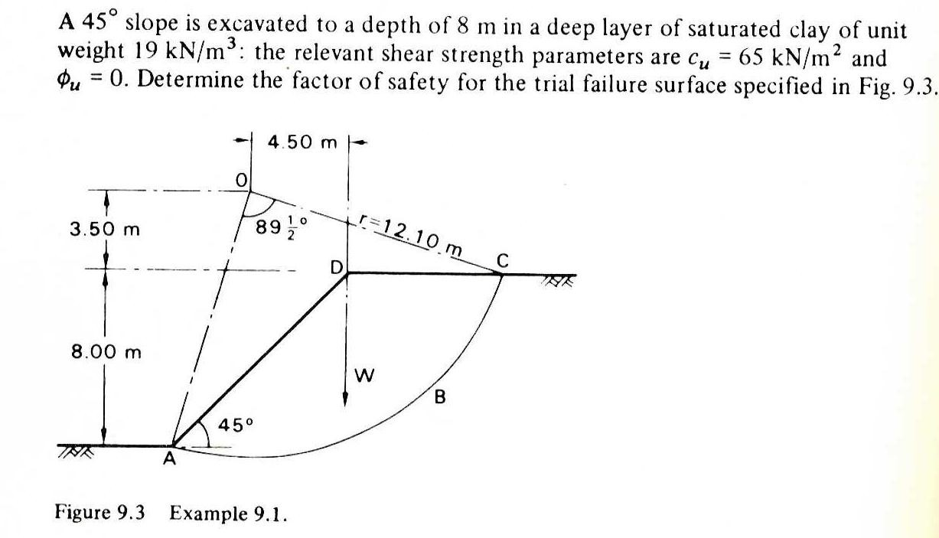
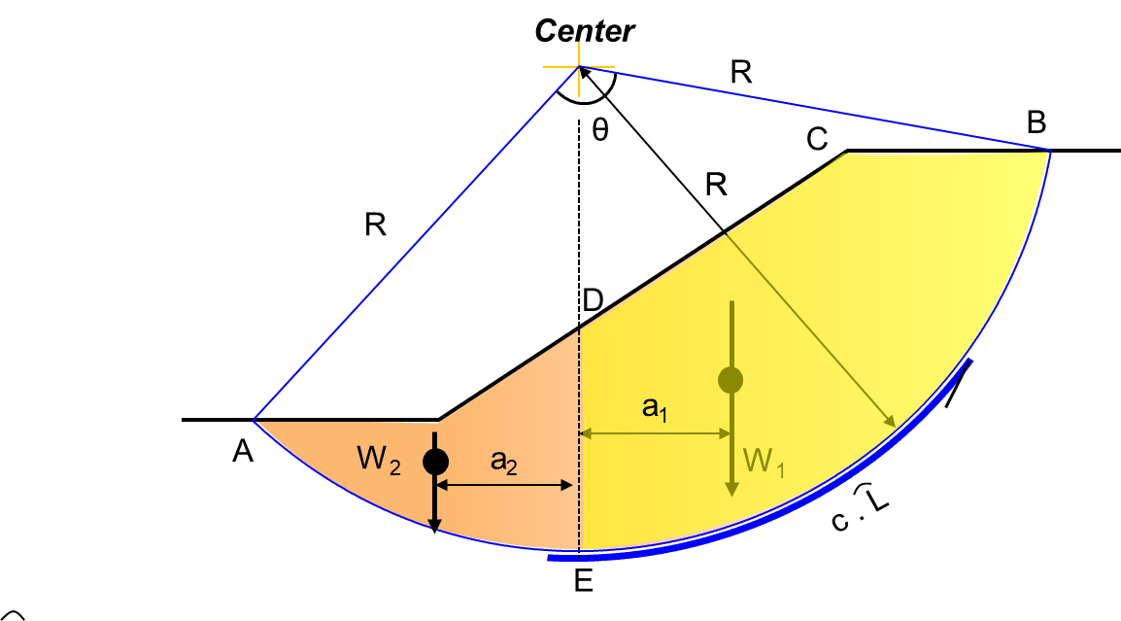
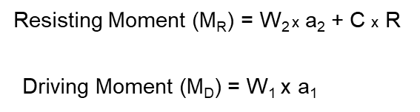
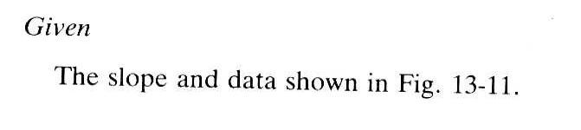
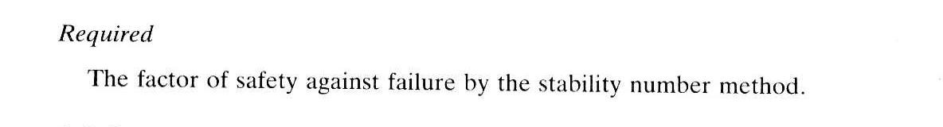
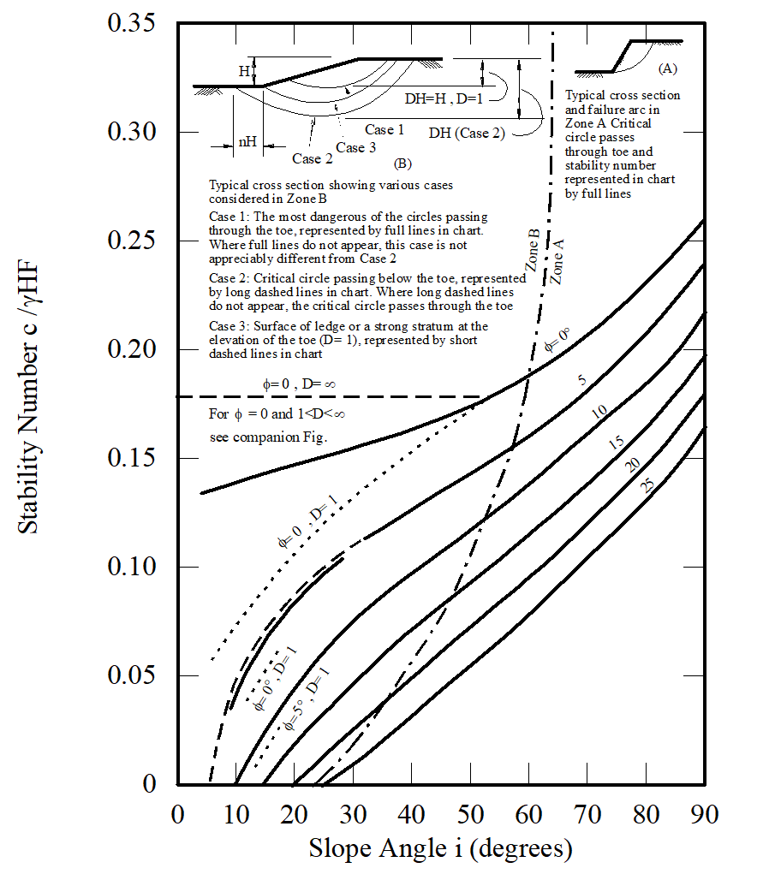
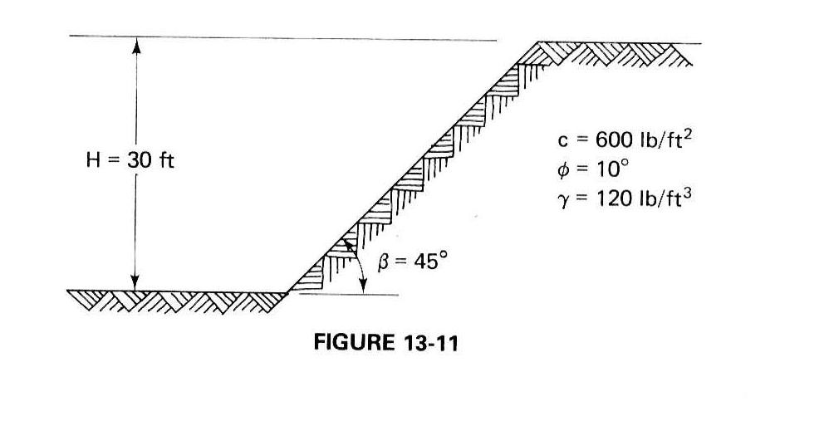
Problem 2
Problem 1)
Problem 3
Problem 2)

Slide 3
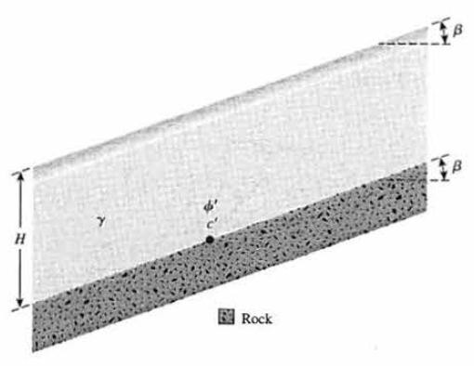
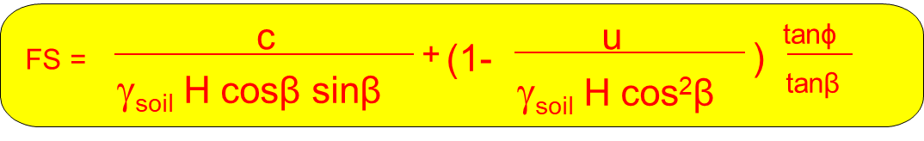
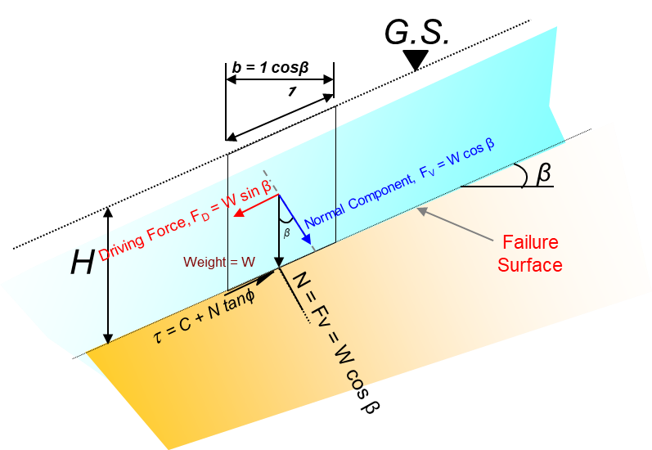
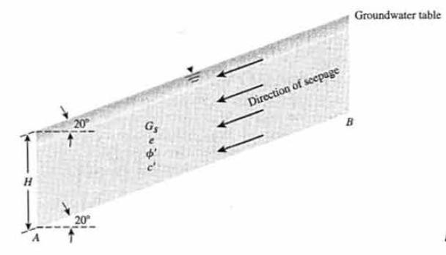


$$H=\frac{c_{dev}}{γ_{soil}\left[sinβ cosβ − {tan∅}_{dev}\left(\cos^{2}β − r_{u}\right)\right]}$$
Problem 4
Refer to Figure 4, Given: β = 20º, γ = 18 kN/m³, φ = 25º, and c' = 14 kN/m². Find the height, H, that will have a factor of safety, F_{s} of 2.5 against sliding along the soil-rock interface.
Figure 4
Problem 5
For the infinite slope shown in Figure 5, find the factor of safely against sliding along the plane AB, given that H = 20 ft. γ = 110 pcf, φ = 20º, and c' = 500 psf. Note that there is seepage through the soil and that the groundwater table coincides with the ground surface.
Figure 5
$$H=\frac{c_{dev}}{γ_{soil}\left[sinβ cosβ − {tan∅}_{dev}\left(\cos^{2}β − r_{u}\right)\right]}$$

Slide 4
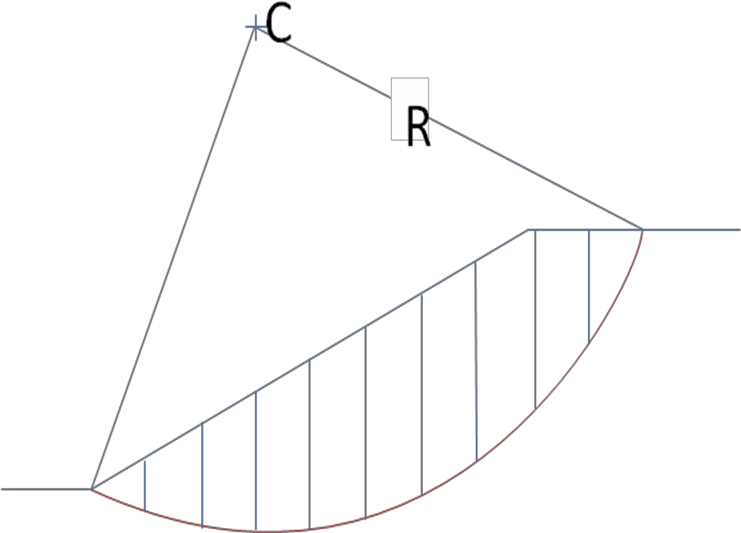
Problem 6
Find the factor of safety for a 20 meter high 2H - l V slope shown in the following figure using ordinary method of slices. Each slice has a width of 5 meters.
γ = 16 kN/m³
c = 20 kPa
φ = 20O
R = 38.1 m

Slide 5
Example of how to determine W₁ and W₅.
= 38.1 m
2x20 = 40 m
2
1
3
W₁
b₁
4
Tangent
H=20m
5
1m
h₁
8
2m
6
α₁
9
7
Tangent
10
W₁= 0.5x b₁ x h₁ x γ
α₁ =
h₅
b₅
W₅= b₅ x h₅ x γ
α₅ =
α₅
This is not to scale

Slide 6
Center
Radius
2x20 = 40 m
H=20m
1m
2m

