Slide 1
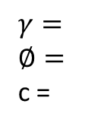
Slope Stability Analysis
Homework #5
Fall 2022
Problem 1
The following figure shows a 15-ft cut through two soil strata. The lower is a highly impermeable cohesive soil. Shearing strength data between the two strata are as follows:
Cohesion=400 psf
Angle of internal friction= 25º
Unit weight of the upper layer= 105 pcf
Height of the slope, H= 10 ft
β = 45º
= 30^{ο}
Find if the slope is safe or not
Home Work Set Number 7 Geotechnical Engineering
C
B
$$γ=$$
$$∅=$$
c =
H
A
β
θ

Slide 4
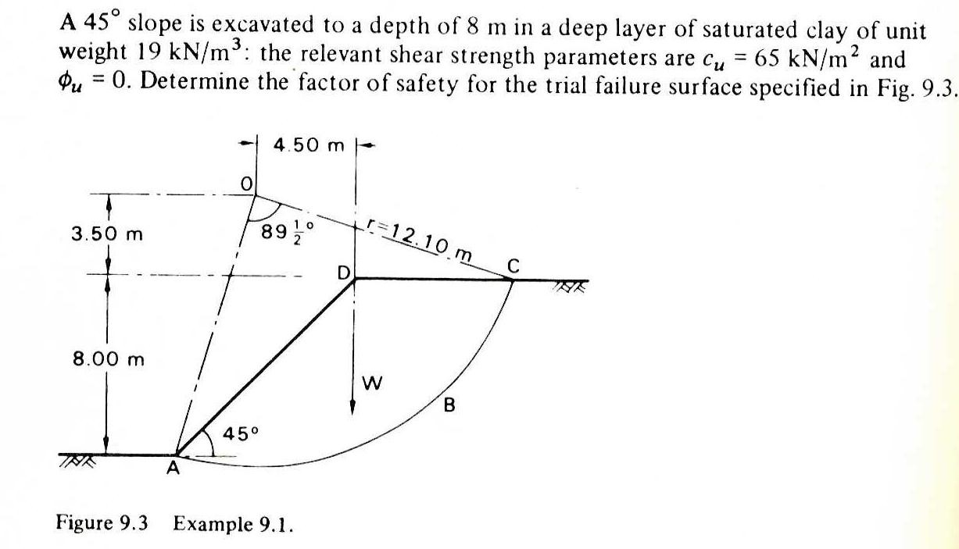
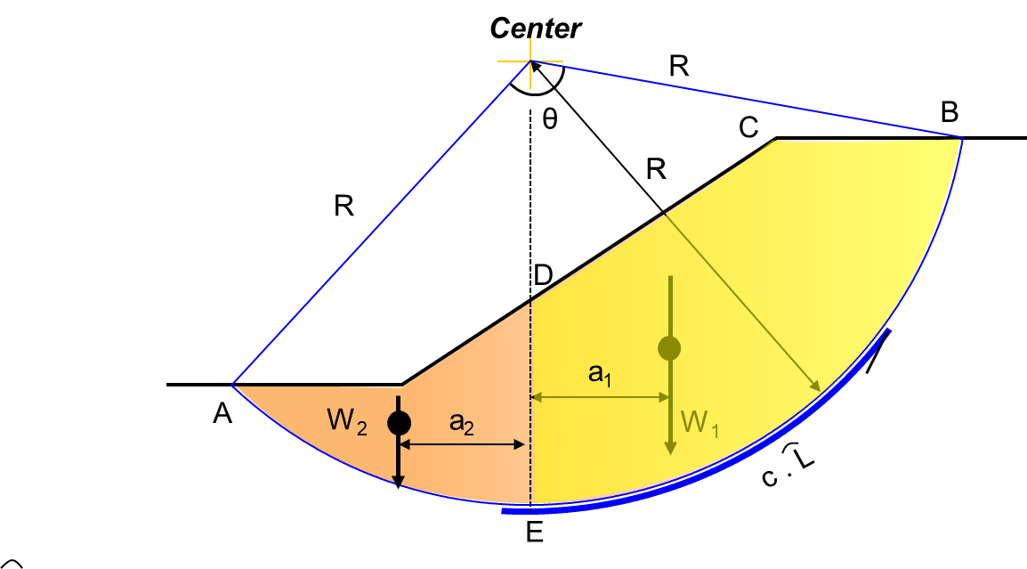
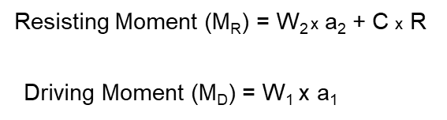
Problem 2
Problem 1)
θ=
a₁
CG₁
CG₂
W₁
a₂
a₃
CG₃
CG₄
W₂
W₃
a₄
W₄
Draw the problem to scale
Divide the shapes to smaller areas (1, 2, 3, and 4)
Find the weight of each area (For example A₁xγ_{soil} = W₁)
Find where is the center of gravity for each area (CG₁, CG₂, …)
Using the scale, measure the arms (a1, a2, a3, ..)
For A₄ you can approximate the area to triangle.
Now determine the driving moments (W₁xa₁ + W₂xa₂+ W₃xa₃)
Determine the resisting moments (W₄xa₄ + c x L_{curve})
L_{curve} = θ x r … θ in radians

Slide 5
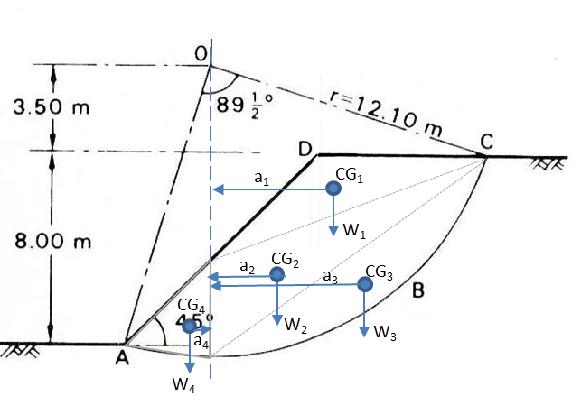

Slide 7
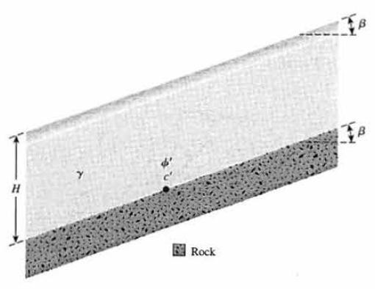
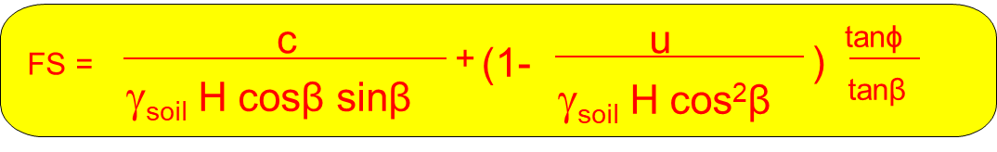
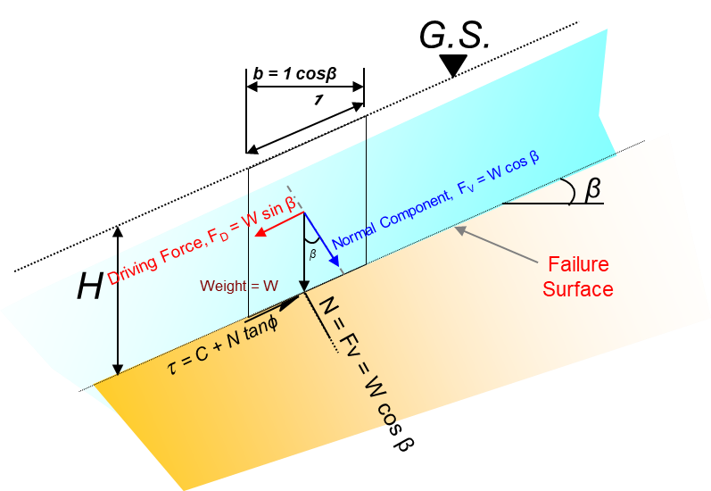
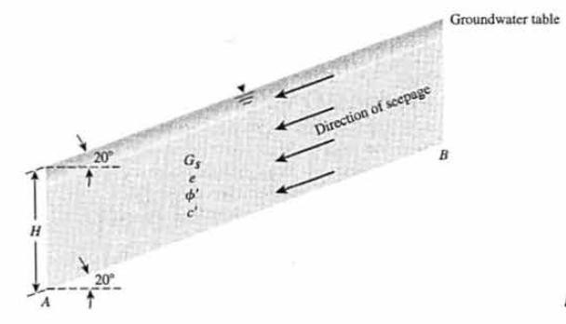
Problem 3
Refer to Figure 4, Given: β = 20º, γ = 18 kN/m³, φ = 25º, and c' = 14 kN/m². Find the height, H, that will have a factor of safety, F_{s} of 2.5 against sliding along the soil-rock interface.
Figure 4
Problem 4
For the infinite slope shown in Figure 5, find the factor of safely against sliding along the plane AB, given that H = 20 ft. γ = 110 pcf, φ = 20º, and c' = 500 psf. Note that there is seepage through the soil and that the groundwater table coincides with the ground surface.
Figure 5

Slide 10
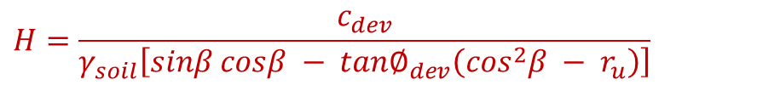
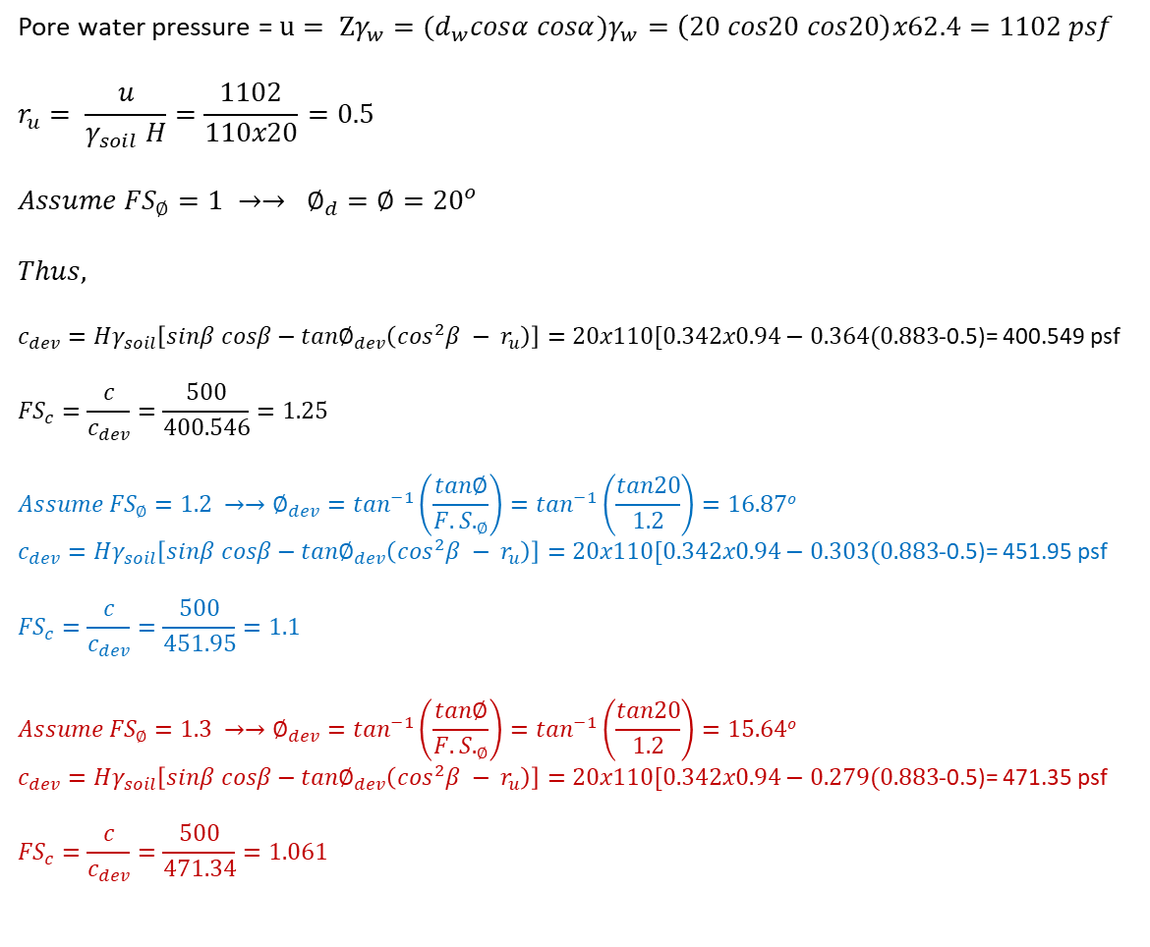
4
$$H=\frac{c_{dev}}{γ_{soil}\left[sinβ cosβ − {tan∅}_{dev}\left(\cos^{2}β − r_{u}\right)\right]}$$
Pore water pressure = $u= Zγ_{w}={(d}_{w}cosα cosα)γ_{w}=\left(20 cos20 cos20\right)x62.4=1102 psf$
$$r_{u}= \frac{u}{γ_{soil} H}=\frac{1102}{110x20}=0.5$$
$$Assume {FS}_{∅}=1 →→ ∅_{d}=∅={20}^{o}$$
$$Thus,$$
$c_{dev}=Hγ_{soil}\left[sinβ cosβ−{tan∅}_{dev}\left(\cos^{2}β − r_{u}\right)\right]=20x110[0.342x0.94−0.364(0.883$-0.5)= 400.549 psf
$${FS}_{c}=\frac{c}{c_{dev}}=\frac{500}{400.546}=1.25$$
$$Assume {FS}_{∅}=1.2 →→∅_{dev}=\tan^{−1}\left(\frac{tan∅}{{F.S.}_{∅}}\right)=\tan^{−1}\left(\frac{tan20}{1.2}\right)=16.87o$$
$c_{dev}=Hγ_{soil}\left[sinβ cosβ−{tan∅}_{dev}\left(\cos^{2}β − r_{u}\right)\right]=20x110[0.342x0.94−0.303(0.883$-0.5)= 451.95 psf
$${FS}_{c}=\frac{c}{c_{dev}}=\frac{500}{451.95}=1.1$$
$$Assume {FS}_{∅}=1.3 →→∅_{dev}=\tan^{−1}\left(\frac{tan∅}{{F.S.}_{∅}}\right)=\tan^{−1}\left(\frac{tan20}{1.2}\right)=15.64o$$
$c_{dev}=Hγ_{soil}\left[sinβ cosβ−{tan∅}_{dev}\left(\cos^{2}β − r_{u}\right)\right]=20x110[0.342x0.94−0.279(0.883$-0.5)= 471.35 psf
$${FS}_{c}=\frac{c}{c_{dev}}=\frac{500}{471.34}=1.061$$
The actual Factor of Safety = 1.14

Slide 11
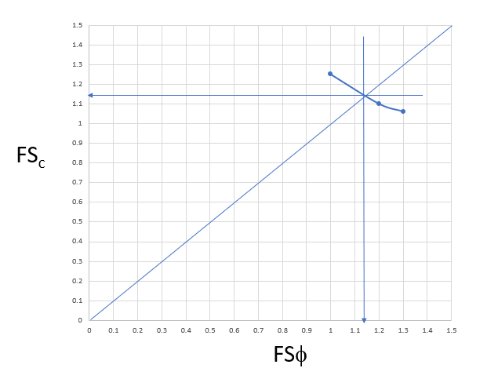
The actual Factor of Safety = 1.14

Slide 12
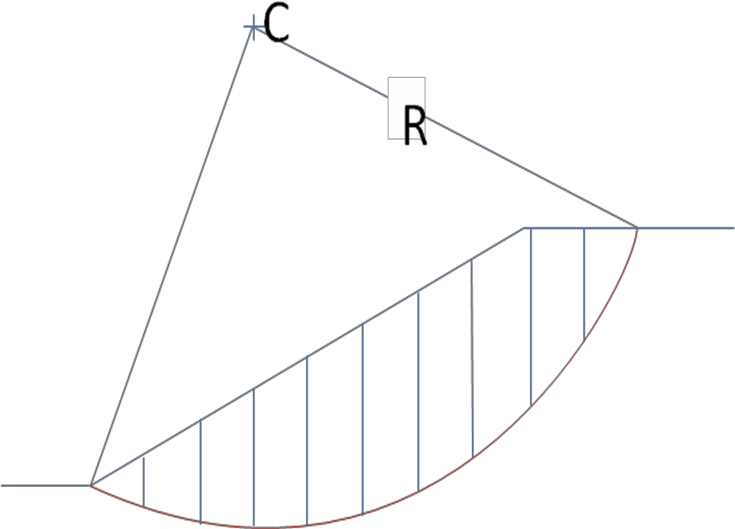

Problem 5
Find the factor of safety for a 20 meter high 2H - l V slope shown in the following figure using ordinary method of slices. Each slice has a width of 5 meters.
γ = 16 kN/m³
c = 20 kPa
φ = 20O
R = 38.1 m
R
Slice | Width Δx (ft) | Ave Height (ft) | Weight (Kips) | θ_{i} | W_{i} sin θ_{i} | W_{i} cos θ_{i} | u_{i} | Δl_{i} | U_{i} = u_{i} Δl_{i} | N_{i} = W_{i} cosθ_{i} - U_{i}
1 | 4.5 | 1.6 | 0.9 | -1.7 | 0 | 0.9 | 0 | 4.4 | 0 | 0.9
2 | 3.2 | 4.2 | 1.7 | 2.9 | 0.1 | 1.7 | 0 | 3.2 | 0 | 1.7
3 | 1.8 | 5.8 | 1.3 | 8.05 | 0.2 | 1.3 | 0.03 | 1.9 | 0.05 | 1.25
4 | 5.0 | 7.4 | 4.6 | 14.5 | 1.2 | 4.5 | 0.21 | 5.3 | 1.1 | 3.4
5 | 5.0 | 9.0 | 5.6 | 24.8 | 2.3 | 5.1 | 0.29 | 5.6 | 1.6 | 3.5
6 | 5.0 | 9.3 | 5.8 | 35.4 | 3.4 | 4.7 | 0.25 | 6.2 | 1.55 | 3.15
7 | 4.4 | 8.4 | 4.6 | 47.7 | 3.4 | 3.1 | 0.11 | 6.7 | 0.7 | 2.4
8 | 0.6 | 6.7 | 0.5 | 55.1 | 0.4 | 0.3 | 0 | 1.2 | 0 | 0.3
9 | 3.2 | 3.8 | 1.5 | 60.4 | 1.3 | 0.7 | 0 | 7.3 | 0 | 0.7
10
 |  |  |  |  | 12.3 |  |  | 41.8 |  | 17.3
$$\text{F}\text{.}\text{S}\text{.}=\frac{cL+\tan{φ}\sum_{i=1}^{i=n}{(W_{i}cosθi−u_{i}Δl_{i})}}{\sum_{i=1}^{i=n}{W_{i}sinθi}}$$

