Slide 1
89 1 o--... r
0
3 . 50 m
- -- --
I 2 '
' I
8 .0 0 m
I
W I
4

Slide 2
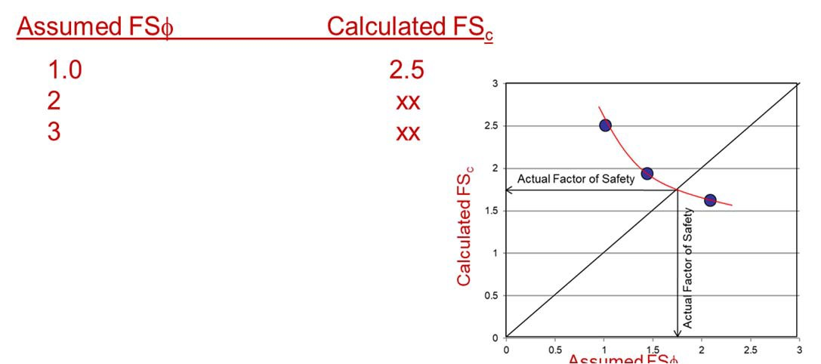
𝐻 = |  |  | ^{𝑐}dev
^{𝛾}soil | 𝑠𝑖𝑛𝛽 𝑐𝑜𝑠𝛽 | - | 𝑡𝑎𝑛∅_{dev} | 𝑐𝑜𝑠²𝛽 | - | 𝑟_{u}
Use this equation
𝑟 =
𝑢
u
^{𝛾}soil ^{𝐻}
See next page
How to solve slope stability problems:
2- Given
^{𝛾}soil ⁼
∅ =
Solution
1- Assume F.S_{φ} = …
1- Given
^{𝛾}soil ⁼
∅ =
Solution
𝑡𝑎𝑛∅
𝑡𝑎𝑛∅
₌ 𝑡𝑎𝑛∅
𝑡𝑎𝑛∅_{dev} = _{𝐹. 𝑆.}
dev
𝐹. 𝑆.∅
∅
𝑐
𝑐 =
??
𝑐
^{𝑐dev =} 𝐹. 𝑆.
r_{u} = H =
𝐻 =
dev
𝑐 =
c
𝛾_{soil} 𝑠𝑖𝑛𝛽 𝑐𝑜𝑠𝛽 - 𝑡𝑎𝑛∅_{dev} 𝑐𝑜𝑠²𝛽 - 𝑟_{u}
𝐻 = | ^{𝑐}dev
 | ^{𝛾}soil | 𝑠𝑖𝑛𝛽 𝑐𝑜𝑠𝛽 - 𝑡𝑎𝑛∅_{dev} 𝑐𝑜𝑠²𝛽 - 𝑟_{u}
c ^{c}dev
r_{u} =
Find ……
^{𝑐}dev ⁼
… . . 𝑎𝑛𝑑 𝐹. 𝑆._{c} =
If 𝐹𝑆_{c} = 𝐹𝑆_{<p} … . . 𝐴𝑠𝑠𝑢𝑚𝑒 𝑑𝑖𝑓𝑓𝑒𝑟𝑒𝑛𝑡 𝑣𝑎𝑙𝑢𝑒 𝑓𝑜𝑟 𝐹𝑆_{<p} 𝑎𝑛𝑑
𝑟𝑒𝑝𝑒𝑎𝑡 𝑡ℎ𝑒 𝑡𝑟𝑖𝑎𝑙 𝑎𝑛𝑑 𝑒𝑟𝑟𝑜𝑟
F.S. =
Find: F.S. = ???
Find: H = ???

Slide 3
For the infinite slope shown below, what is the pore water pressure at points A, B and C ?
Z = d_{w} cos α (cos α)
u_{Α} = 𝑍 𝛾_{w}
b = 1 cosβ
Soil Surface
Water Table
Z = Pressure Head
Pore Water Pressure (u) = γ_{water} * z
W
Assumed failure surface
d
d_{w}
T
Z
N’
α
C
H d cos α
Z
w
A
U
B
α

Slide 4
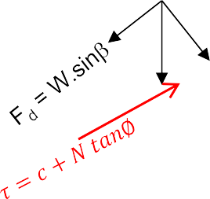
Solved Example: Given:
γ = 112 pcf
β= 55º
φ= 26º
θ = 35º
c = 520 psf H = 8’
C
B
𝛾 =
∅ =
c =
H
W
N = W.cosβ
A
β
θ
Find:
F.S. = ?????
𝐻
₌ 2𝑐
𝑆𝑖𝑛𝛽
cr
𝛾 𝑠𝑖𝑛 𝛽- 𝜃 𝑠𝑖𝑛𝜃 - 𝑐𝑜𝑠𝜃𝑡𝑎𝑛∅
Solution 2:
Since we don’t know the F.S of the slope (F.S_{c} = F.S_{φ}), then
𝐻
₌ 2𝑐_{d}
𝑆𝑖𝑛𝛽
des
𝛾 𝑠𝑖𝑛 𝛽 - 𝜃 𝑠𝑖𝑛𝜃 - 𝑐𝑜𝑠𝜃𝑡𝑎𝑛∅_{d}
1- First Trial
₌ 𝛾𝐻 𝑠𝑖𝑛 𝛽 - 𝜃 𝑠𝑖𝑛𝜃 - 𝑐𝑜𝑠𝜃𝑡𝑎𝑛∅_{d} 2 𝑆𝑖𝑛𝛽
Assume F.S = 1 ….. ∅_{d}= 𝑡𝑎𝑛⁻¹
tan∅
tan26
𝑐
φ
2- Find F.S_{c}
F.S
= 𝑡𝑎𝑛⁻¹ = 26º
d
1
𝑐
₌ 𝛾 𝐻 𝑠𝑖𝑛 𝛽 - 𝜃
𝑠𝑖𝑛𝜃 - 𝑐𝑜𝑠𝜃𝑡𝑎𝑛∅_{d}
₌ 112 𝑥 8 𝑠𝑖𝑛 55 - 35 𝑠𝑖𝑛35 - 𝑐𝑜𝑠35 𝑡𝑎𝑛26
=
d
2
𝑐
𝑆𝑖𝑛𝛽
2 𝑆𝑖𝑛55
𝑐 =
→→→→→ 𝐹. 𝑆 = ⁵²⁰ = 27.8
d
𝐹. 𝑆_{c}
c
18.68
3- Second Trial
Assume F.S_{φ}= 2 ….. ∅_{d}= 𝑡𝑎𝑛⁻¹
tan∅
= 𝑡𝑎𝑛⁻¹
tan26
= 13.7º
F.S
2

Slide 5
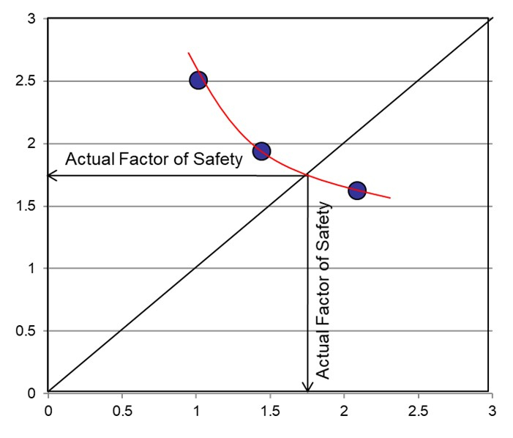
𝑐
₌ 𝛾 𝐻 𝑠𝑖𝑛 𝛽 - 𝜃
𝑠𝑖𝑛𝜃 - 𝑐𝑜𝑠𝜃𝑡𝑎𝑛∅_{d}
d
2 𝑆𝑖𝑛𝛽
₌ 112 𝑥 8 𝑠𝑖𝑛 55 - 35 𝑠𝑖𝑛35 - 𝑐𝑜𝑠35 𝑡𝑎𝑛13.7 2 𝑆𝑖𝑛55
𝑐
d
=
𝑐 =
𝑐
→→→→→ 𝐹. 𝑆 = ⁵²⁰ =
d
𝐹. 𝑆_{c}
c
18.68
If 𝐹. 𝑆_{c} = 2 →→ → → → → Assume another value for F.Sφ Trial 3
After 3 or 4 trials, draw the relationship between Assumed FS_{φ} and Calculated FS_{C}
Assumed FSφ Calculated FS_{c}
1.0
2
3
2.5
xx xx
Calculated FS_{c}
Assumed FSφ

Slide 6
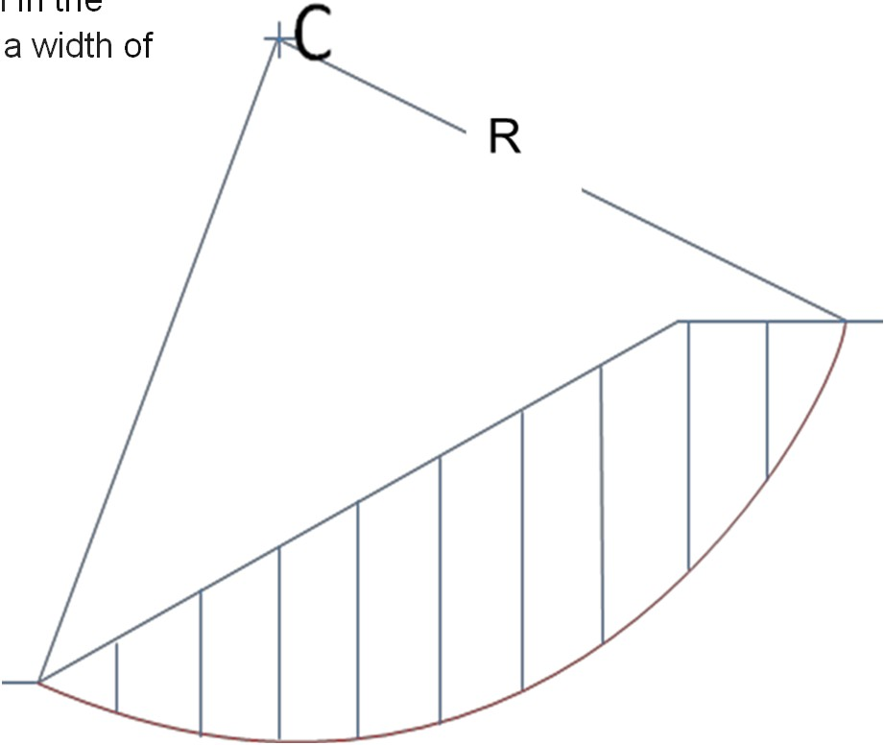

Problem 5
Find the factor of safety for a 20 meter high 2H - l V slope shown following figure using ordinary method of slices. Each slice has
5 meters.
in the
a width of
γ = 16 kN/m³
c =20 kPa
φ = 20O
R =38.1 m
Draw the slope to scale
2
1
3
h₂ d₂
Δl₃
θ₂
10
Slice | Width Δx (ft) | Ave Heig ht (ft) | Weigh t (Kips) | θ_{i} | W_{i} sin θ_{i} | W_{i} cos θ_{i} | u_{i} | Δl_{i} | U_{i} = u_{i} Δl_{i} | N_{i} = W_{i} cosθ_{i} - U_{i}
1
2
3
4
5
6
7
8
9
10
W = h x b x 𝛾
2 2 2 soil
𝑐𝐿 + tan 𝜑 ∑^{i=n}(𝑊_{i}𝑐𝑜𝑠𝜃_{𝑖} - 𝑢_{i}Δ𝑙_{i})
F.S. =
i=1
∑^{i=n} 𝑊_{i}𝑠𝑖𝑛𝜃_{𝑖}
i=1

