Slide 1
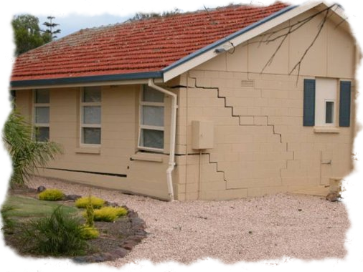
Soil Settlement
Elastic Settlement
&
Consolidation Settlement
By
Kamal Tawfiq, Ph.D., P.E., F.ASCE
Spring 2022

Slide 2
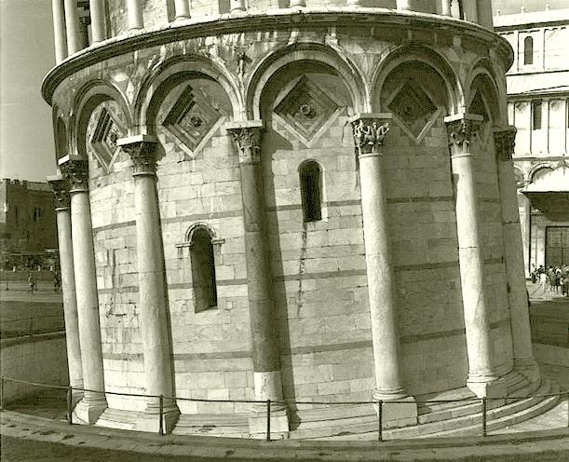
3- Foundation Design
Differential Settlement

Slide 3
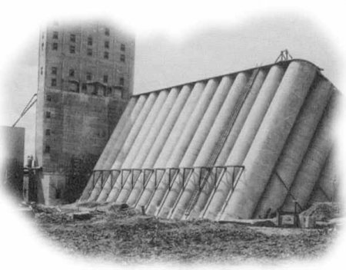

Slide 4
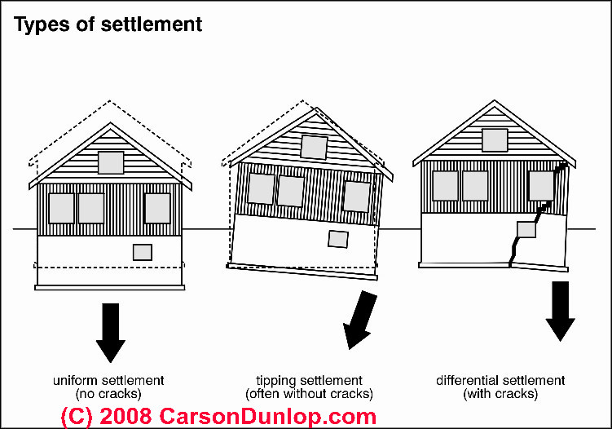

Slide 5
Soil Settlement:
Total Soil Settlement = Elastic Settlement + Consolidation Settlement
S_{total} = S_{e} + S_{c}
S_{e} = Elastic Settlement or Immediate Settlement
S_{c} = Consolidation Settlement
By: Kamal Tawfiq, Ph.D., P.E.

Slide 6
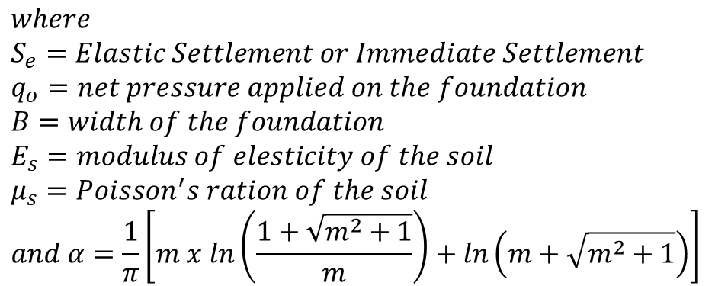
Elastic Settlement
Bq_{o}
2
S_{e} = (1 - μ_{s}) α
E_{s}
$$where$$
$$S_{e}=Elastic Settlement or Immediate Settlement$$
$$q_{o}=net pressure applied on the foundation$$
$$B=width of the foundation$$
$$E_{s}=modulus of elesticity of the soil$$
$$μ_{s}=Poisson^{′}s ration of the soil$$
$$and α=\frac{1}{π}\left[m x ln\left(\frac{1+\sqrt{m^{2}+1}}{m}\right)+ln\left(m+\sqrt{m^{2}+1}\right)\right]$$
m = L/B
B = width of foundation
L = length of foundation
By: Kamal Tawfiq, Ph.D., P.E.

Slide 7
Bq_{o} (1 - μ_{s}) α
S_{e} =
E_{s}
3.0
2.5
α_{av}
2.0
α_{av},
1.5
1.0
0.98
0.0
1
2
3
4
5
6
7
8
9
10
L / B
Square Footing
By: Kamal Tawfiq, Ph.D., P.E.

Slide 8

By: Kamal Tawfiq, Ph.D., P.E.
Consolidation Settlement (Time Dependent Settlement)
* Consolidation settlement occurs in cohesive soils due to the expulsion of the water from the voids.
* Because of the soil permeability the rate of settlement may varied from soil to another.
* Also the variation in the rate of consolidation settlement depends on the boundary conditions.
S_{Consolidation} = S_{primary} + S_{secondary}
Primary Consolidation Volume change is due to reduction in pore water pressure
Secondary Consolidation Volume change is due to the rearrangement of the soil particles
(No pore water pressure change, Δu = 0, occurs after the primary consolidation)
Water Table (W.T.)
Expulsion of the water
When the water in the voids starts to flow out of the soil matrix due to consolidation of the clay layer. Consequently, the excess pore water pressure (Δu) will reduce, and the void ratio (e) of the soil matrix will reduce too.
Water
Solids
Voids

Slide 9

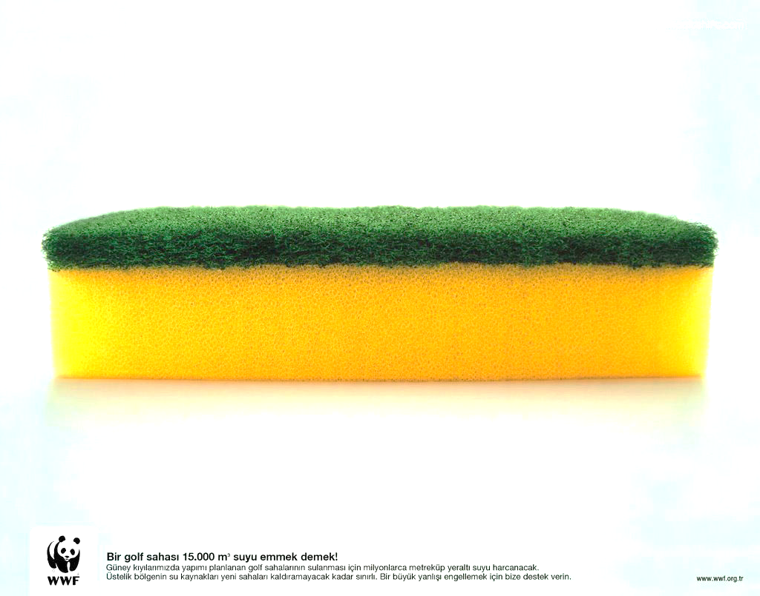
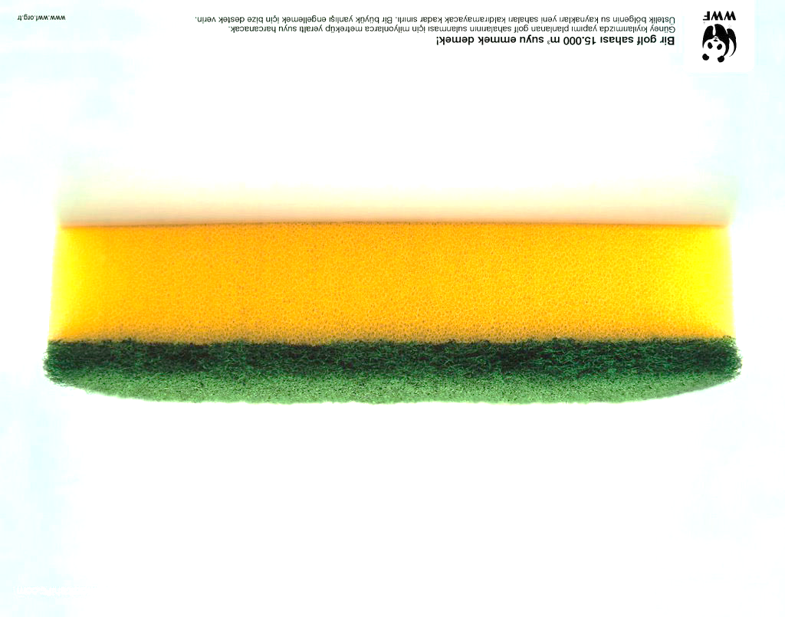
Consolidation Settlement
Time Dependent Settlement
Assume a fully saturated Sponge
H/2
H
Two way
drainage path

Slide 10
Consolidation Settlement
Assume a fully saturated Sponge
Settlement
ΔH
H
One way
drainage
path

Slide 11
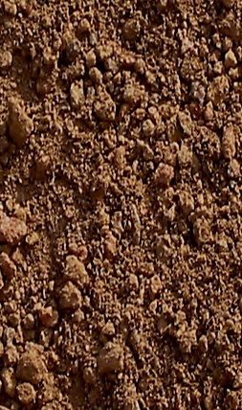
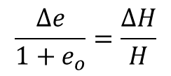
Consolidation Settlement
p
Sand
Sand
H
Settlement
ΔH
Clay
Sand
Sand
p
p
Δe
ΔH
p
Δu
p
V_{v}
e_{o}
p
p
Water
Water
Δu
1+e_{o}
Δu
H
H
V_{s}
1
Solids
Solids
p
Δu
Δu
p
Δu
Δu
p
Soil Block
Phase Diagram
p
p
p

Slide 12
P_{n}
.
.
.
.
Δe
P
ΔH
e
Water
e
Virgin
Consolidation
Curve
slope = c_{c}
Solids
e₁
c_{c}
Δe
e₂
Δp
p
p₁
p₂
log p

Slide 13
Normally Consolidated Clay
e
Compression Index
e₁
c_{c}
Δe
e₂
Δp
c_{s}
Swelling Index
p₁
p₂
log p

Slide 14
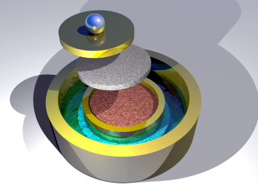
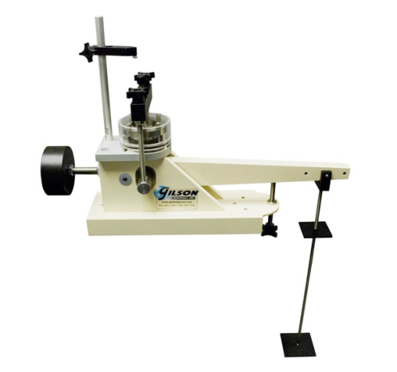
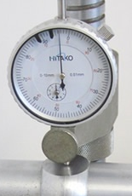


Consolidation Test:
Soil
Sample
Sample was sent to the lab
And placed in the consolidometer
Sample was removed
No pressure on the sample
G.S.
Sand
3 ft
γ_{sand} = 96 pcf
W.T.
4 ft
γ_{clay} = 110 pcf
P_{o}
Clay
w_{c} = 0.3
16 ft
Dial gauge to determine ΔH
Soil
Sample
e
Δp₇
Stress
Increments
Δp
Δp₁
Δp₂
Δp₃
Δp₃
Δp
Δp₁
Δp₄
Void Ratio
C_{c}
Δp₅
In the lab the stresses are
added to the soil sample
C_{s}
Δp₆
log p
P_{o}

Slide 15
Dr. Kamal Tawfiq
Example:
Figure 1
G.S.
Soil sample was obtained from the clay layer
Conduct consolidation test [9 load increments ]
Plot e vs. log (p) (Figure 2)
Determine Compression Index (C_{c} ) & Swelling Index (C_{s})
γ_{sand} = 96 pcf
W.T.
3 ft
Sand
4 ft
Clay
P_{o}
γ_{clay} = 110 pcf
w_{c} = 0.3
16 ft
e_{o} = 0.795
Soil Sample
In the lab and after removing
the soil sample from the ground,
the stresses on the soil sample = 0
Δp₁
Δp₂
Soil Sample
In the ground, the sample was subjected to geostatic stresses.
In the lab and before the consolidation test the stresses on the sample = 0.
During testing, the geostatic stress is gradually recovered
e_{o} = 0.795
Δp₁
C_{c} = 0.72
C_{s} = 0.1
Stress
Increments
Δp
Δp₇
Void Ratio (e)
Δp
Δp₉
C_{c}
Soil Sample
In the lab the stresses are
added to the soil sample
C_{s}
Δp₉
P_{o}
Log (p)
Figure 2
5. Determine P_{o} = 3.(96) + 4.(96-62.4) + 8.(110-62.4) = 803.2 lb/ft²

Slide 16
Example 1:
Soil sample was obtained from the clay layer
Conduct consolidation test [9 load increments ]
Plot e vs. log (p) (Figure 2)
Determine Compression Index (C_{c} ) & Swelling Index (C_{s})
P= 800 psf
G.S.
γ_{sand} = 110 pcf
W.T.
3 ft
Sand
4 ft
γ_{clay} = 120 pcf
Clay
P_{o}
ΔP
Find
Consolidation settlement of the clay layer
16 ft
e_{o} = 0.795
Soil Sample
Solution
Δp₁
Δp₂
e_{o} = 0.795
Void Ratio (e)
C_{c}
C_{s}
Δp₉
Figure 2
Log (p)

Slide 17
Example:
P= 800 psf
G.S.
Soil sample was obtained from the clay layer
Conduct consolidation test [9 load increments ]
Plot e vs. log (p) (Figure 2)
Determine Compression Index (C_{c} ) & Swelling Index (C_{s})
γ_{sand} = 110 pcf
W.T.
3 ft
Sand
4 ft
γ_{clay} = 120 pcf
Clay
P_{o}
ΔP
16 ft
e_{o} = 0.795
Soil Sample
Δp₁
Δp₂
e_{o} = 0.795
C_{c} = 0.72
C_{s} = 0.1
Void Ratio (e)
C_{c}
C_{s}
Δp₉
Log (p)
Figure 2

Slide 18
Example 2:
Q= 10000 lb
Approximate Method
Or
2:1 Method
Soil sample was obtained from the clay layer
Conduct consolidation test [9 load increments ]
Plot e vs. log (p) (Figure 2)
Determine Compression Index (C_{c} ) & Swelling Index (C_{s})
BxB = 3’x3’
G.S.
γ_{sand} = 110 pcf
W.T.
3 ft
Sand
2
2
4 ft
1
1
γ_{clay} = 120 pcf
Clay
P_{o}
ΔP
Find
Consolidation settlement of the clay layer
16 ft
e_{o} = 0.795
Soil Sample
Solution
Δp₁
Δp₂
e_{o} = 0.795
Void Ratio (e)
C_{c}
C_{s}
Δp₉
Figure 2
Log (p)

Slide 19

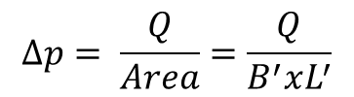

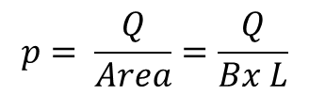



Approximate Method (2:1 Method)
Q
$$p= \frac{Q}{Area}=\frac{Q}{Bx L}$$
p
$$B$$
Z
$$L$$
2
2
1
1
$$B^{′}=B+Z$$
2
2
1
Δp
1
$$∆p= \frac{Q}{Area}=\frac{Q}{B^{′}xL^{′}}$$
$$L^{′}=L+Z$$

Slide 20

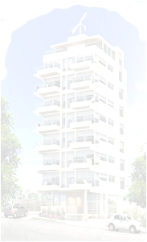


Normally Consolidated and Overconsolidated Clay
When clay particles are deposited by deposition agents like water, wind, ice or gravity, layers after layers are deposited with time which induces effective stresses in the clay layer below. The clay layer in this case is called “Normally Consolidated Clay.”
If the to soil layers experienced cycles of erosion and deposition
with time such as case 1, the clay layer will be called “Over Consolidated Clay.”
Overconsolidation can also be developed from loading and unloading the clay layer such as
case 2.
Case 2
Past
Case 1
Past
Today
G.S.
Sand
Clay
Past
Glacial covered Chicago
P_{o}

Slide 21
Consolidation Test:
Soil
Sample
Sample was sent to the lab
And placed in the consolidometer
Sample was removed
No pressure on the sample
G.S.
Sand
3 ft
γ_{sand} = 96 pcf
W.T.
4 ft
γ_{clay} = 110 pcf
P_{o}
Clay
w_{c} = 0.3
16 ft
Dial gauge to determine ΔH
Soil
Sample
e
Δp₇
Stress
Increments
Δp
Δp₁
Δp₂
Δp₃
Δp₃
Δp
Δp₁
Δp₄
Void Ratio
C_{c}
Δp₅
In the lab the stresses are
added to the soil sample
C_{s}
Δp₆
log p
P_{o}

Slide 23
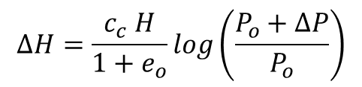
Δp
Δp
Δp
Δp
Loading
Compression
c_{c}
c_{s}
Unloading
Swelling
Δp
Δp
$$∆H=\frac{c_{c} H}{1+e_{o}}log\left(\frac{P_{o}+∆P}{P_{o}}\right)$$

Slide 24
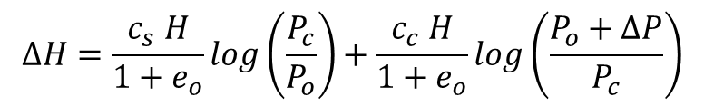
Δp₂
Δp₂
Δp₂
Δp
Δp
c_{s}
c_{c}
Δp
Δp
2
$$∆H=\frac{c_{s} H}{1+e_{o}}log\left(\frac{P_{c}}{P_{o}}\right)+\frac{c_{c} H}{1+e_{o}}log\left(\frac{P_{o}+∆P}{P_{c}}\right)$$

Slide 25
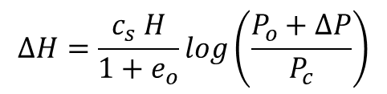
Δp₂
Δp₂
Δp₂
Δp
Δp₂
c_{s}
$$∆H=\frac{c_{s} H}{1+e_{o}}log\left(\frac{P_{o}+∆P}{P_{c}}\right)$$

Slide 26
Normally Consolidated Clay
e
Compression Index
e₁
c_{c}
Δe
e₂
Δp
c_{s}
Swelling Index
p₁
p₂
log p

Slide 27
Normally Consolidated and Overconsolidated Clay
Casagrande’s Method to Determine Preconsolidation Pressure (Pc)
1
Normally Consolidated Soil
G.S.
γ_{sand} = 96 pcf
W.T.
3 ft
Sand
4 ft
γ_{clay} = 110 pcf
w_{c} = 0.3
Gs = 2.65
P_{o}
Clay
P_{o} = 3x (96) + 4 (96-62.4) + 8 (110-62.4) = 803.2 psf
16 ft
_{Soil Sample}
P_{o}
Void Ratio (e)
803.2 psf
P_{c}
Log (p)
Overconsolidation Ratio OCR = = 1
The soil is Normally Consolidated (N.C.) soil
P_{o}

Slide 28
Casagrande’s Method to Determine Preconsolidation Pressure (Pc)
1
Normally Consolidated Soil
γ_{sand} = 96 pcf
W.T.
3 ft
Sand
4 ft
γ_{clay} = 110 pcf
w_{c} = 0.3
Gs = 2.65
P_{o}
Clay
_{Soil Sample}
16 ft
Point of
maximum curvature
6 Intersection of 4 & 5
2 Horizontal line
1
X
X
Void Ratio (e)
4 divide the angle between 2 & 3
3
Tangent to point 1
Extend the straight line
7
P_{o} = P_{c}
Log (p)
P_{c}
Overconsolidation Ratio OCR = = 1
The soil is Normally Consolidated (N.C.) soil
P_{o}

Slide 29
Example 1:
P= 800 psf
G.S.
Given
The clay layer shown in the figure
Find
The ultimate consolidation settlement of the clay layer
γ_{sand} = 110 pcf
W.T.
3 ft
Sand
4 ft
γ_{clay} = 120 pcf
Clay
P_{o}
ΔP
16 ft
e_{o} = 0.795
Soil Sample
Normally Consolidated
Δp₁
Δp₂
e_{o} = 0.795
C_{c} = 0.72
C_{s} = 0.1
Void Ratio (e)
C_{c}
C_{s}
Δp₉
Log (p)
P_{o}
Figure 2

Slide 30
Example 2:
P= 800 psf
G.S.
Given
The clay layer shown in the figure
Find
The ultimate consolidation settlement of the clay layer
γ_{sand} = 110 pcf
W.T.
3 ft
Sand
4 ft
γ_{clay} = 120 pcf
Clay
P_{o}
ΔP
16 ft
e_{o} = 0.795
Soil Sample
P_{c}=1200 psf
Δp₁
Δp₂
e_{o} = 0.795
C_{c} = 0.72
C_{s} = 0.1
Void Ratio (e)
C_{c}
C_{s}
Δp₉
Log (p)
P_{o}
Figure 2

Slide 31
Example 3:
P= 800 psf
G.S.
Given
The clay layer shown in the figure
Find
The ultimate consolidation settlement of the clay layer
γ_{sand} = 110 pcf
W.T.
3 ft
Sand
4 ft
γ_{clay} = 120 pcf
Clay
P_{o}
ΔP
16 ft
e_{o} = 0.795
Soil Sample
P_{c}=2000 psf
Δp₁
Δp₂
e_{o} = 0.795
C_{c} = 0.72
C_{s} = 0.1
Void Ratio (e)
C_{c}
C_{s}
Δp₉
Log (p)
P_{o}
Figure 2

