Slide 1
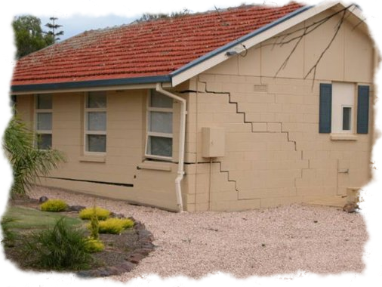
Soil Settlement
By
Kamal Tawfiq, Ph.D., P.E., F.ASCE
Spring 2022

Slide 2
Soil Settlement:
Total Soil Settlement = Elastic Settlement + Consolidation Settlement
S_{total} = S_{e} + S_{c}
Elastic Settlement
Consolidation Settlement
{
Theory of Elasticity – Immediate Settlement
Elastic Settlement
Time Depended Elastic Settlement (Schmertmann Method (1978)
Not in this course
Elastic settlement occurs in all soil ---- sand, silt, and clay.
By: Kamal Tawfiq, Ph.D., P.E.

Slide 3
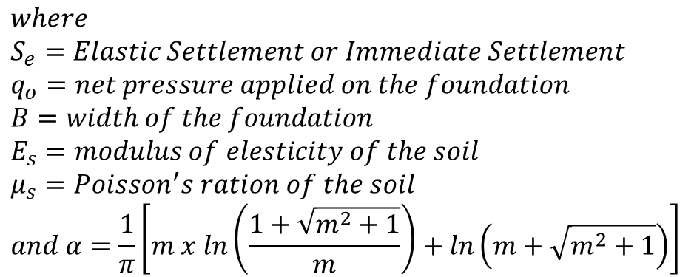
Elastic Settlement
Bq_{o}
2
S_{e} = (1 - μ_{s}) α
E_{s}
$$where$$
$$S_{e}=Elastic Settlement or Immediate Settlement$$
$$q_{o}=net pressure applied on the foundation$$
$$B=width of the foundation$$
$$E_{s}=modulus of elesticity of the soil$$
$$μ_{s}=Poisson^{′}s ration of the soil$$
$$and α=\frac{1}{π}\left[m x ln\left(\frac{1+\sqrt{m^{2}+1}}{m}\right)+ln\left(m+\sqrt{m^{2}+1}\right)\right]$$
m = L/B
B = width of foundation
L = length of foundation
By: Kamal Tawfiq, Ph.D., P.E.

Slide 4
Bq_{o} (1 - μ_{s}) α
S_{e} =
E_{s}
3.0
2.5
α_{av}
2.0
α_{av},
1.5
1.0
0.98
0.0
1
2
3
4
5
6
7
8
9
10
L / B
Square Footing
By: Kamal Tawfiq, Ph.D., P.E.

Slide 5
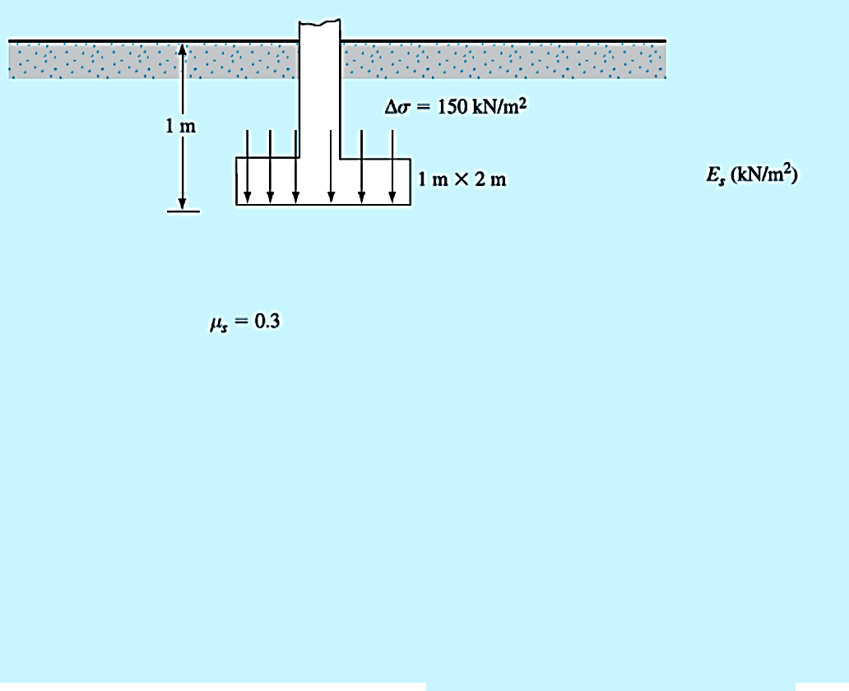
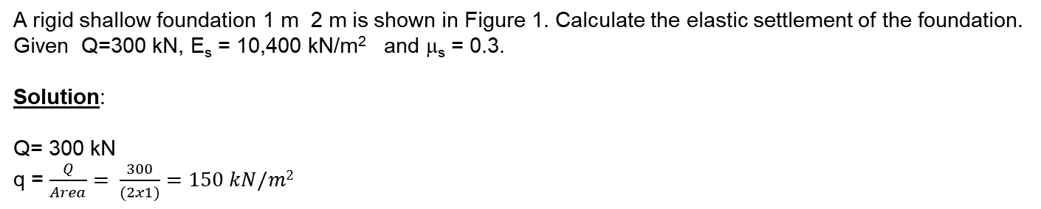
Example
A rigid shallow foundation 1 m 2 m is shown in Figure 1. Calculate the elastic settlement of the foundation.
Given Q=300 kN, E_{s} = 10,400 kN/m² and μ_{s} = 0.3.
Solution:
Q= 300 kN
q = $\frac{Q}{Area}= \frac{300}{(2x1)}=150 kN/m2$
=10,400 kN/m²

Slide 6
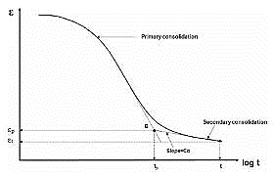

By: Kamal Tawfiq, Ph.D., P.E.
Consolidation Settlement (Time Dependent Settlement)
* Consolidation settlement occurs in cohesive soils due to the expulsion of the water from the voids.
* Because of the soil permeability the rate of settlement may varied from soil to another.
* Also the variation in the rate of consolidation settlement depends on the boundary conditions.
S_{Consolidation} = S_{primary} + S_{secondary}
Primary Consolidation Volume change is due to reduction in pore water pressure
Secondary Consolidation Volume change is due to the rearrangement of the soil particles
(No pore water pressure change, Δu = 0, occurs after the primary consolidation)
_{Primary Consolidation}
Settlement ΔH
_{Secondary Consolidation}
Log Time
Water Table (W.T.)
Expulsion of the water
When the water in the voids starts to flow out of the soil matrix due to consolidation of the clay layer. Consequently, the excess pore water pressure (Δu) will reduce, and the void ratio (e) of the soil matrix will reduce too.
Water
Solids
Voids

Slide 7

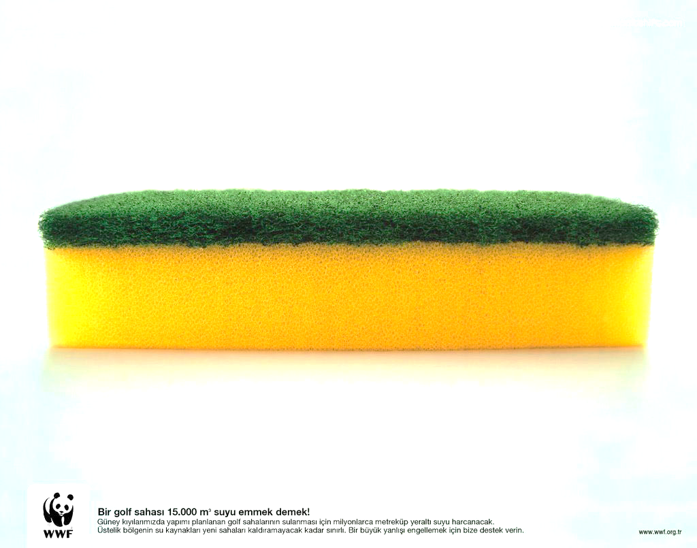

Consolidation Settlement
Assume a fully saturated Sponge
P
$$\frac{H}{2}$$
Δσ
ΔP
H/2
Seepage
H
Two way
drainage path

Slide 8
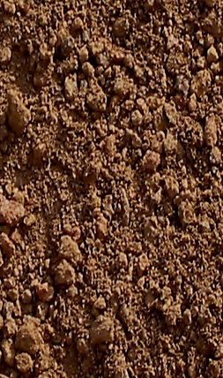
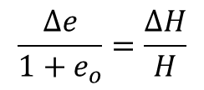
Consolidation Settlement
p
Sand
Sand
H
Settlement
ΔH
Clay
Sand
Sand
p
p
Δe
ΔH
p
Δu
p
V_{v}
e_{o}
p
p
Water
Water
Δu
1+e_{o}
Δu
H
H
V_{s}
1
Solids
Solids
p
Δu
Δu
p
Δu
Δu
p
Soil Block
Phase Diagram
p
$$\frac{∆e}{1+e_{o}}=\frac{∆H}{H}$$
p
p

Slide 9
P_{n}
.
.
.
.
Δe
P
ΔH
e
Water
e
Virgin
Consolidation
Curve
slope = c_{c}
Solids
e₁
c_{c}
Δe
e₂
Δp
p
p₁
p₂
log p

Slide 10
Normally Consolidated Clay
e
Compression Index
e₁
c_{c}
Δe
e₂
Δp
c_{s}
Swelling Index
p₁
p₂
log p

Slide 11
Normally Consolidated
Stress of the building at the mid height of the clay layer
ΔP₁
Void Ratio (e)
P_{o}
P_{o} + ΔP
Log (p)

Slide 12
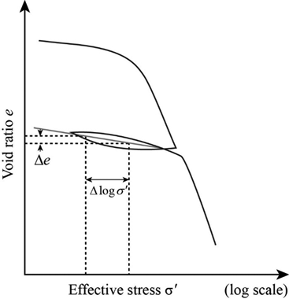
Laboratory Consolidation Test
- One Dimensional Consolidation
Depth of Sampling
Soil Sample
Δe
1
H
e
1st Load Increment
Δe₁ vs. ΔP₁
Δe₁
2st Load Increment
Plot all
Δe vs. Load increments
C_{s}
Δe₂ vs. ΔP₂
C_{c}
C_{c}
4st Load
Increment
ΔP₂

Slide 13

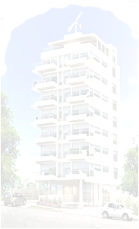


Normally Consolidated and Overconsolidated Clay
When clay particles are deposited by deposition agents like water, wind, ice or gravity, layers after layers are deposited with time which induces effective stresses in the clay layer below. The clay layer in this case is called “Normally Consolidated Clay.”
If the to soil layers experienced cycles of erosion and deposition
with time such as case 1, the clay layer will be called “Over Consolidated Clay.”
Overconsolidation can also be developed from loading and unloading the clay layer such as
case 2.
Case 2
Past
Case 1
Past
Today
G.S.
Sand
Clay
Past
Glacial covered Chicago
P_{o}

Slide 14
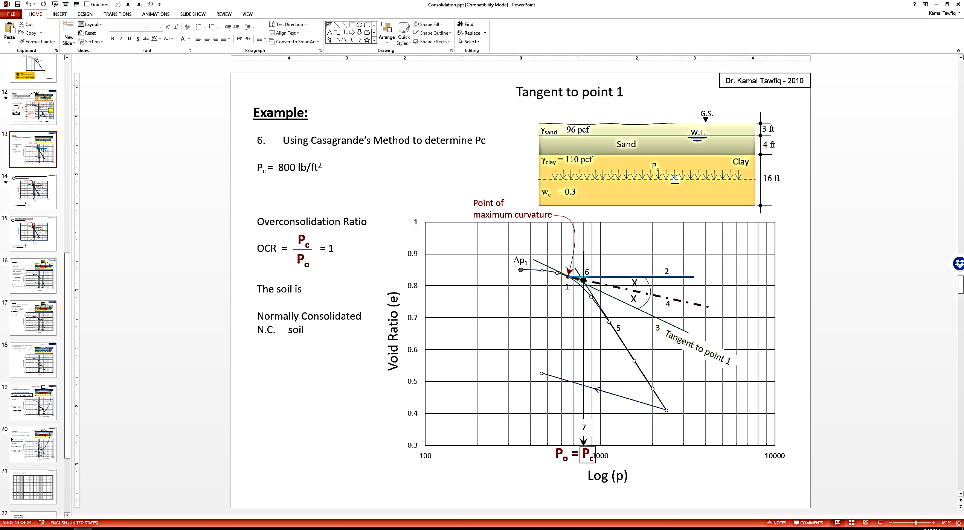

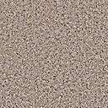
Normally Consolidated and Overconsolidated Clay
Question
How do you know if the clay layer at the site is
normally consolidated or
Over-consolidated ???
Case 2
Past
Case 1
Past
Today
G.S.
Use Casagrande Graphical Method to determine Pc
Sand
P_{o}
Clay
If P_{c} = P_{o} .. Soil is NC
If P_{c} > P_{o} .. Soil is OC
P_{o} = Vertical effective stress at the mid of the clay layer,
It is known

Slide 16
Casagrande’s Method to Determine Pc
Determine the Preconsolidation Pressure
Void Ratio (e)
100
1000
10000
Log (p)

Slide 17
Casagrande’s Method to Determine Preconsolidation Pressure (Pc)
ΔP
1
Normally Consolidated Soil
γ_{sand} = 96 pcf
W.T.
3 ft
Sand
4 ft
γ_{clay} = 110 pcf
w_{c} = 0.3
Gs = 2.65
P_{o}
Clay
_{Soil Sample}
16 ft
Point of
maximum curvature
6 Intersection of 4 & 5
2 Horizontal line
1
X
X
Void Ratio (e)
4 divide the angle between 2 & 3
3
Tangent to point 1
Extend the straight line
7
P_{o} = P_{c}
Log (p)
P_{c}
Overconsolidation Ratio OCR = = 1
The soil is Normally Consolidated (N.C.) soil
P_{o}

Slide 18
Casagrande’s Method to Determine Pc
ΔP
2
Overconsolidated Soil
γ_{sand} = 96 pcf
W.T.
1.5 ft
Sand
3 ft
γ_{clay} = 110 pcf
w_{c} = 0.3
Gs = 2.65
P_{o}
Clay
P_{o} = 1.5 x (96) + 3 (96-62.4) + 7 (110-62.4) = 803.2 psf
14 ft
_{Soil Sample}
Point of
maximum curvature
578 psf
6 Intersection of 4 & 5
2 Horizontal line
1
X
X
Void Ratio (e)
4 divide the angle between 2 & 3
3
Tangent to point 1
5 Extend the stright line
7
100
P_{o}
P_{c}
1000
10000
P_{c}
Log (p)
Overconsolidation Ratio OCR = > 1
The soil is oversonsolidated (O.C.) soil
P_{o}

Slide 19
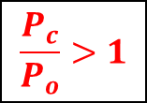
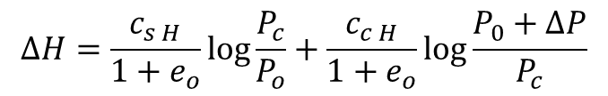
Over-consolidated
Case 2-1
Stress of the building at the mid height of the clay layer
Δp₁
ΔP₂
ΔP₁
Void Ratio (e)
C_{S}
C_{C}
P_{o}
P_{c}
P_{o} + ΔP
$$∆H=\frac{c_{s H}}{1+e_{o}}\log{\frac{P_{c}}{P_{o}}+\frac{c_{c H}}{1+e_{o}}\log{\frac{P_{0}+∆P}{P_{c}}}}$$
$$\frac{P_{c}}{P_{o}}>1$$

Slide 20
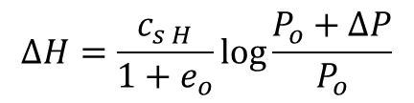
Over-consolidated
Case 2-2
Stress of the building at the mid height of the clay layer
Δp₁
ΔP₂
Void Ratio (e)
C_{S}
C_{C}
P_{o}
P_{c}
$$∆H=\frac{c_{s H}}{1+e_{o}}\log{\frac{P_{o}+∆P}{P_{o}}}$$
P_{o} + ΔP
$$\frac{P_{c}}{P_{o}}>1$$

Slide 21


Slide 22
Δp
Δp
Δp
Δp
Δp
Δp
ΔΗ =
C_{S} H
P_{o} + ΔP
log ( )
1 + e_{O}
P₀

Slide 23
Δp₂
Δp₂
Δp₂
Δp
Δp
Δp
Δp
C_{S} H
P_{C}
C _{C} H
P_{o} + ΔP
ΔΗ = log ( ) +
log ( )
1 + e_{O}
P_{o}
1 + e_{O}
P_{C}

Slide 24
Δp₂
Δp₂
Δp₂
Δp
Δp₂
C_{S} H
P_{o} + ΔP
( )
ΔΗ = log
1 + e_{O}
P_{o}
2

Slide 27
Name:_____________
ID:_____________
FAMU-FSU College of Engineering
Department of Civil and Environmental Engineering
Fall 2021
Quiz # 6
From the consolidation test results shown in he Figure, find what is the compression index of the given soil

