Slide 1
Foundation Engineering
CEG 5115
FLORIDA A&M UNIVERISTY – FLORIDA STATE UNIVERSITY
COLLEGE Of ENGINEERING
DEPARTMENT OF CIVIL & ENVIRONMENTAL ENGINEERING
By
Kamal Tawfiq, Ph.D., P.E, F.ASCE

Slide 2
Session 3
Bearing Capacity of Shallow Foundations
Objectives: To analyze and design shallow foundations
Outcomes: Solve shallow foundation problems
Learning Tasks: Homework
Online quiz

Slide 3
…
Structural Foundations
Foundations are structural elements which transfer the superstructure loads to the subsurface soil or rock layers.
The mechanism of load transfer varies from one foundation type to another.
The best foundation is the one which maintains both the short and long term stability of the structure at a reasonable cost.

Slide 4
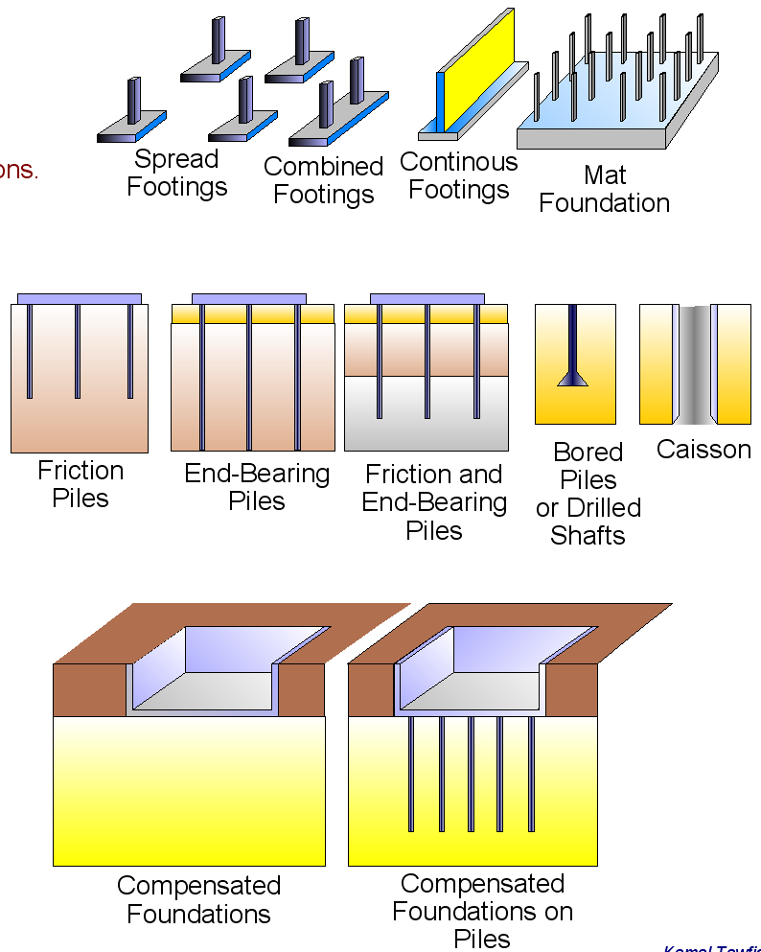
Structural Foundations are grouped into two main groups.
1- Shallow Foundation
  Spread Footings
  Continuous Footings
  Combined Footings
  Mat Foundation
2- Deep Foundation
  Driven Piles
  Drilled Shaft
  Auger Cat Piles
…
3- Compensated or floating foundations

Slide 5
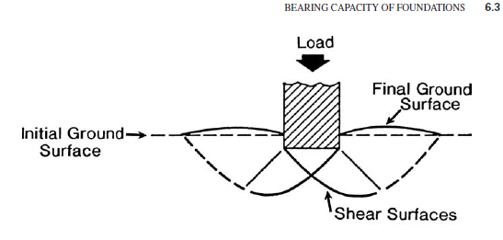
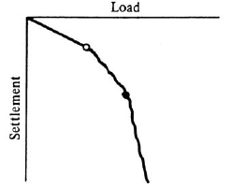
Shallow Foundations
Shallow foundations represent the simplest form of load transfer from a structure to the ground beneath.
The analysis and design of shallow foundation involves both the bearing capacity of the foundation material and the settlement of the foundation.
Bearing capacity failures of shallow foundations can be grouped into three categories, as follows
1
Local shear foundation failure. (After Vesic, 1963)

Slide 6
Bearing Capacity of Shallow Foundations
A bearing capacity failure is defined as a foundation failure that occurs when the shear stresses in the soil exceed the shear strength of the soil.
Bearing capacity failures of foundations can be grouped into three categories, as follows
1
Local shear foundation failure. (After Vesic, 1963)

Slide 7
Concept of Stress – Strain and Failure of Soil
Linear elastic
Non-linear elastic
Non-linear elastic - plastic
Rigid Plastic
Rigid Plastic
Limit Equilibrium Method of Analysis
Mohr –Coulomb Domain

Slide 8
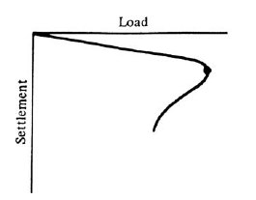
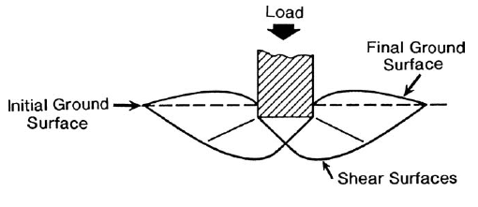
Bearing Capacity of Foundations
2
General shear foundation failure. (After Vesic, 1963)

Slide 9
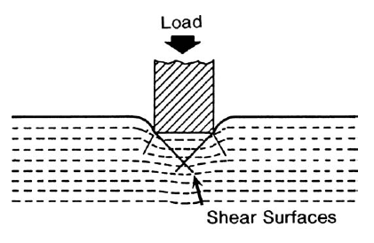
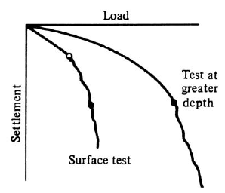
Bearing Capacity of Foundations
3
Punching shear foundation failure. (After Vesic, 1963)

Slide 10
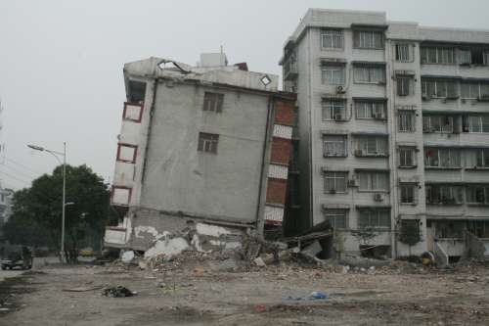
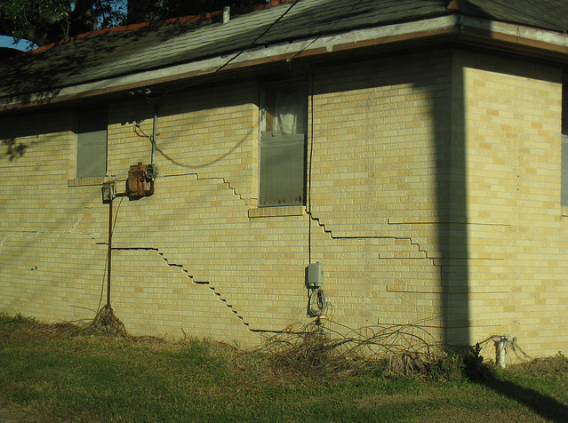
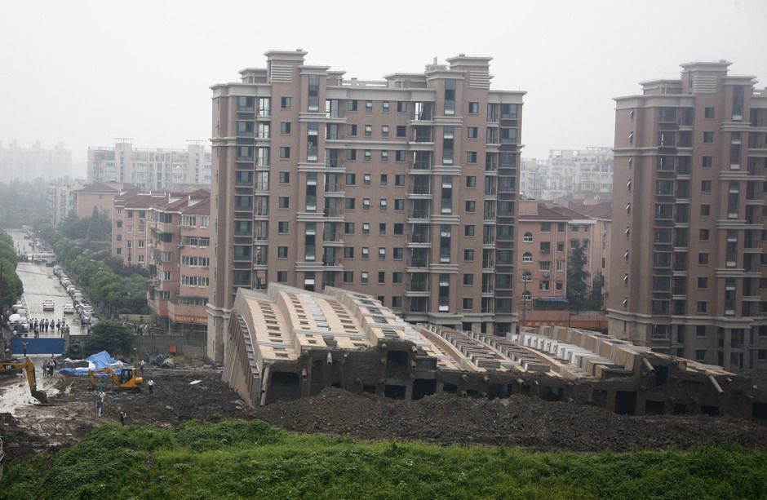
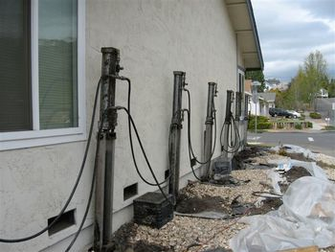
Structural Foundations

Slide 11
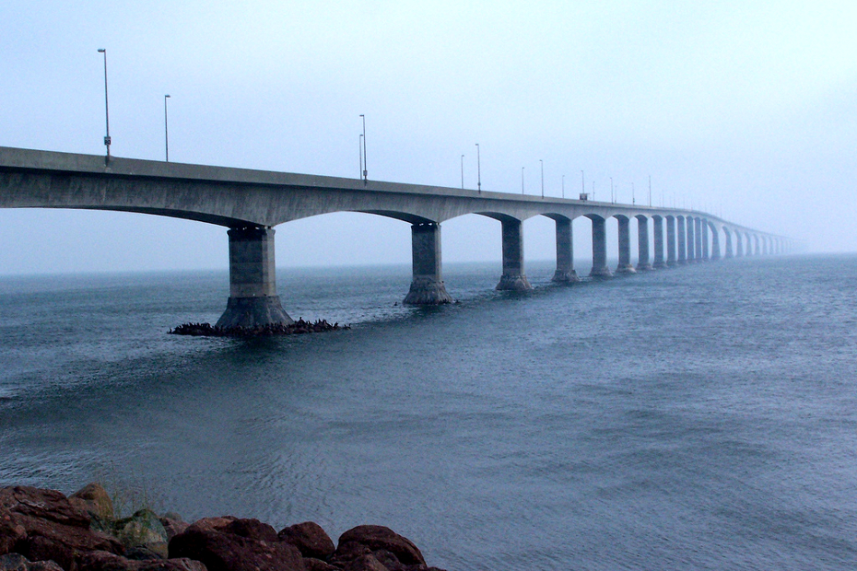
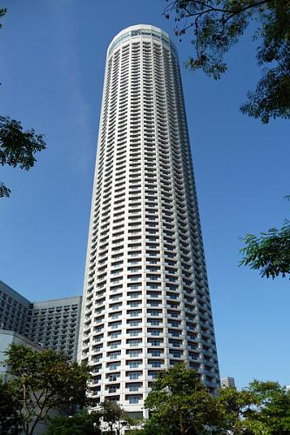
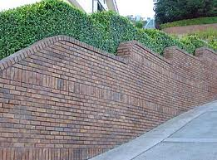

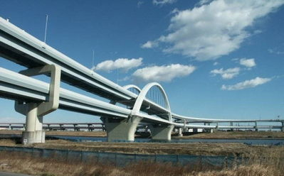
Structural Foundations

Slide 12
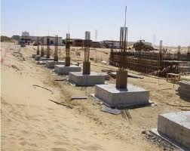
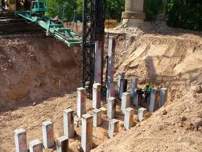
Bearing Capacity of Foundations
Soil Bearing capacity was determined empirically based on practical experience.
With the advancement of engineering mechanics in the 18th and 19th centuries, modern bearing capacity of shallow and deep foundations started by using the classical earth pressure theory which was originally developed by Charles Augustin Coulomb(1736-1806).
Soil bearing earth pressure theory assumes that upon exceeding a certain stress condition, rupture surfaces are formed in the soil mass. Thus, the stress causing the formation of these rupture surfaces may be considered as the Ultimate Bearing Capacity of the soil.

Slide 13
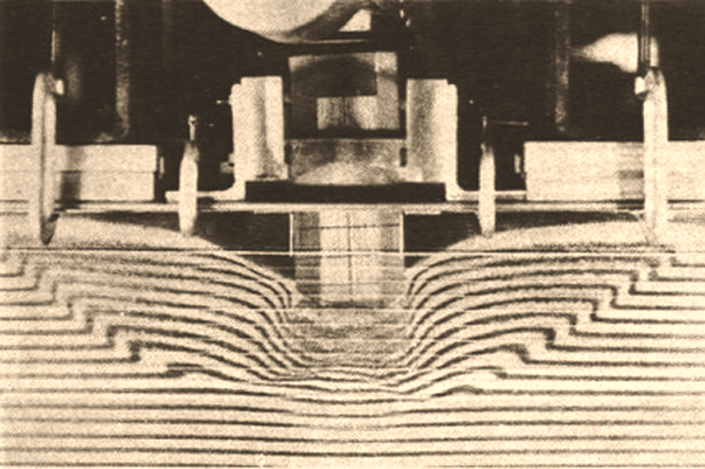
Laboratory Testing on Bearing capacity failures of foundations
General shear foundation failure

Slide 14
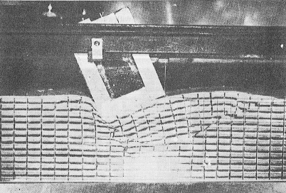
General shear foundation failure
one-sided rupture surface from a vertical, eccentrical load.

Slide 15
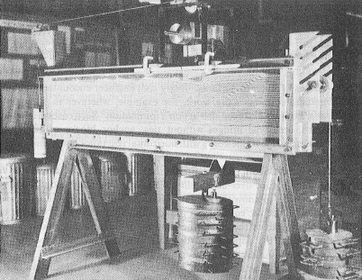
Apparatus

Slide 16
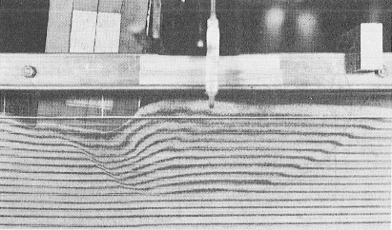
General shear foundation failure
One-sided rupture surface in Raritan sand under an obliquely loaded foundation model.

Slide 17
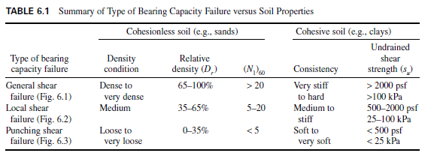
Bearing Capacity of Foundations

Slide 18
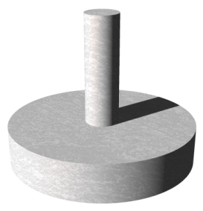
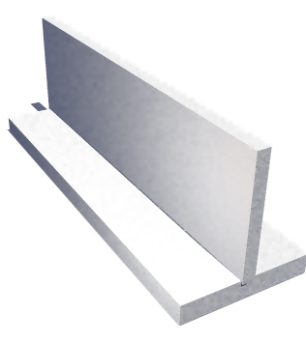
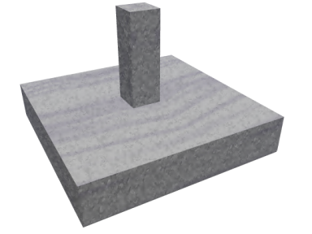
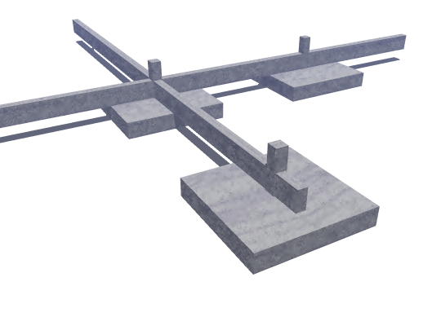
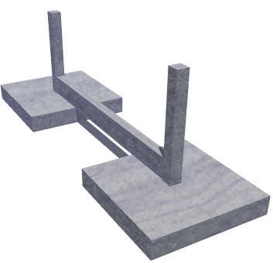
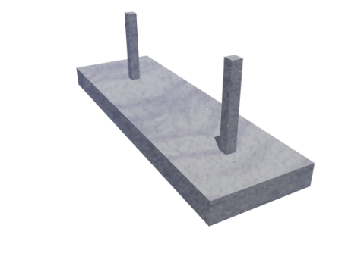
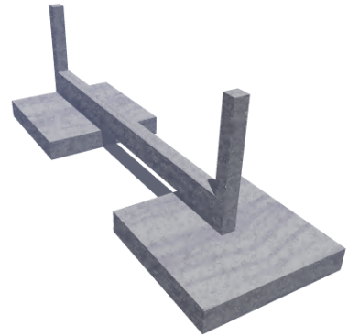
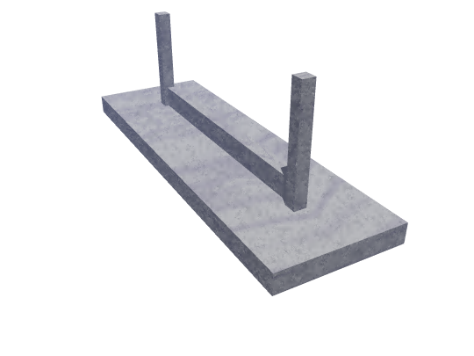
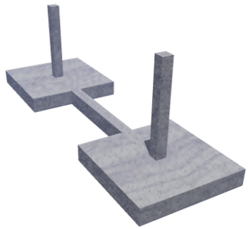
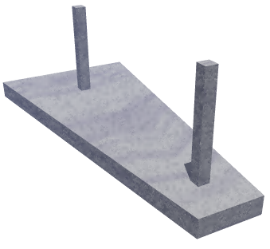
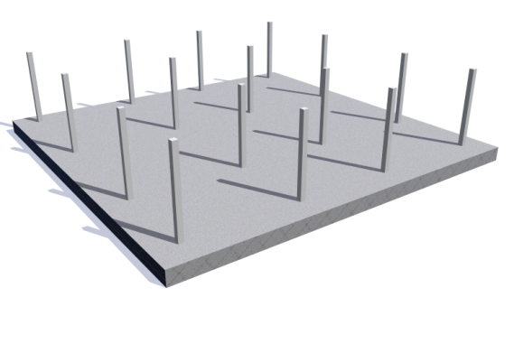
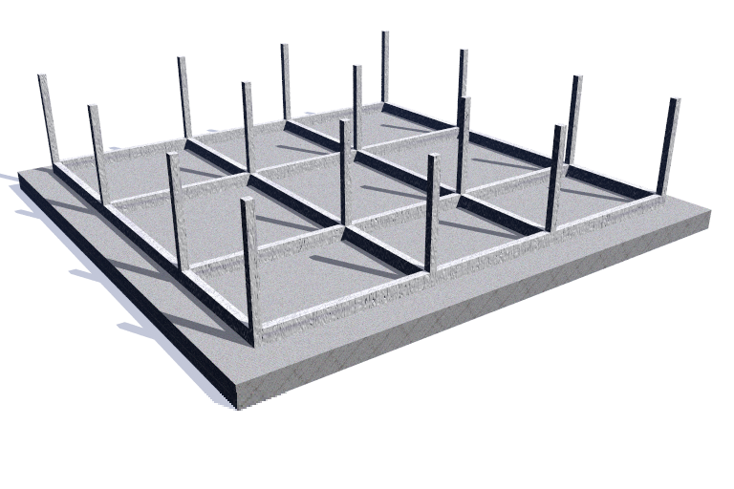
Section 4 Lecture # 4
BEARING CAPACITY OF SHALLOW FOUNDATIONS
Types
Strip Footings
Spread Footings
Combined Footings
Mat Foundation
Examples of shallow foundations. (a) Combined footing;
(b) combined trapezoidal footing; (c) cantilever or strap footing;
(d) octagonal footing;
(e) eccentric loaded footing with resultant coincident with area so soil pressure is uniform.
(Reproduced from Bowles, 1982; McGraw-Hill, Inc.)

Slide 19
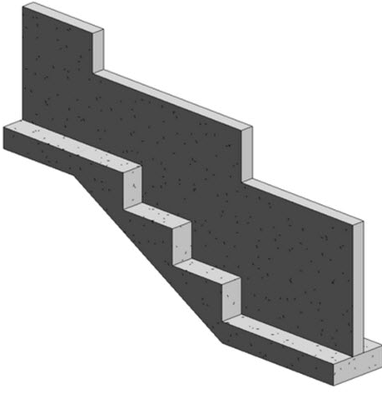

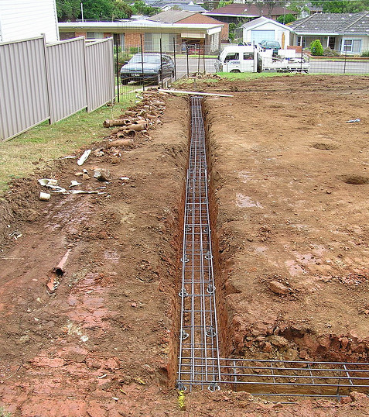
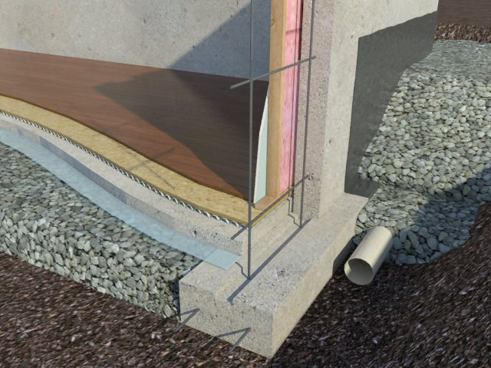
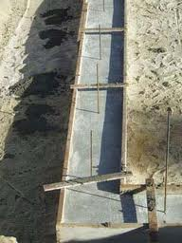
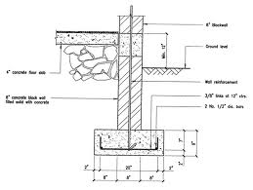
BEARING CAPACITY OF SHALLOW FOUNDATIONS
Types
Strip Footings

Slide 20

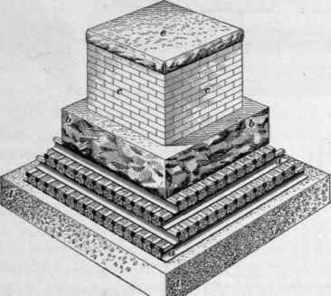
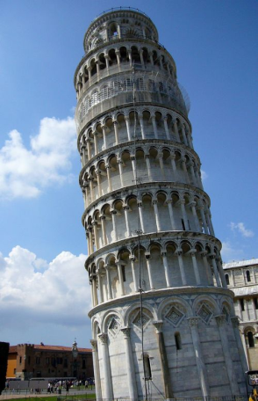
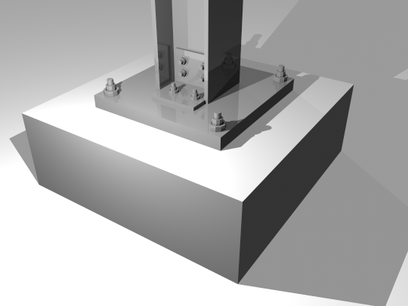
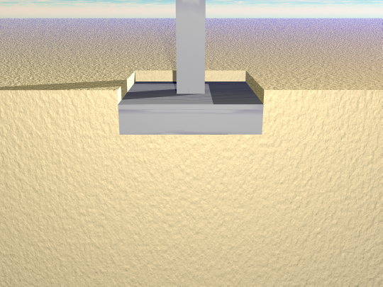
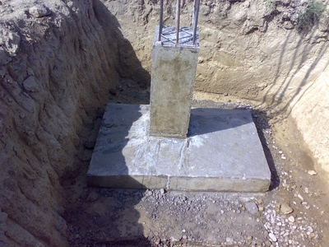
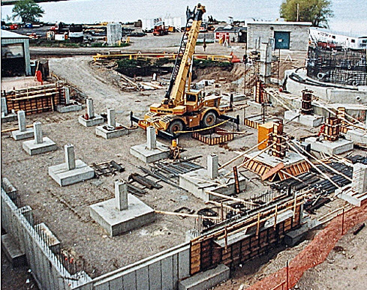
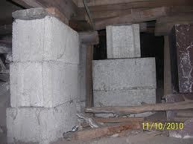
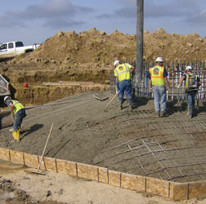
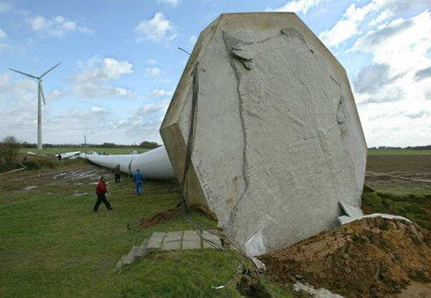
BEARING CAPACITY OF SHALLOW FOUNDATIONS
Types
Spread Footings

Slide 21
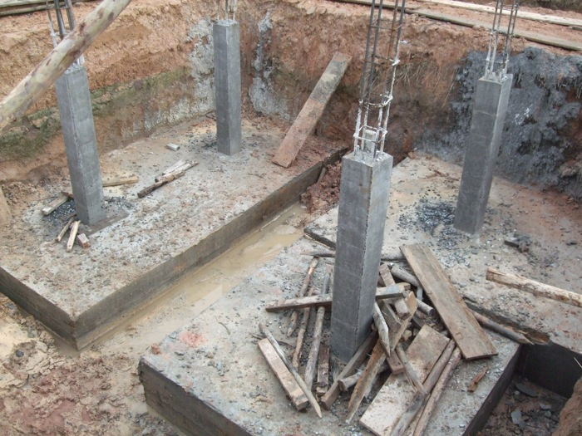
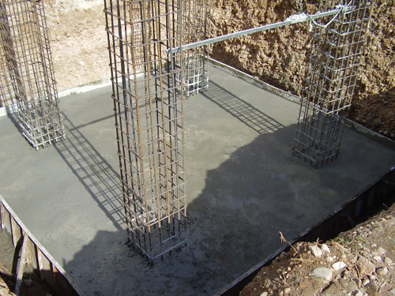
BEARING CAPACITY OF SHALLOW FOUNDATIONS
Types
Combined Footing

Slide 22




BEARING CAPACITY OF SHALLOW FOUNDATIONS
Types
Mat Foundation

Slide 23

Depth of Shallow Foundation

Slide 24

Section 5 Lecture # 4
Other Types of Shallow Foundations

Slide 25

Other Types of Shallow Foundations

Slide 26




Other Types of Shallow Foundations
Spread Footing with Cantilever Stemwall at Bridge Abutment
Spill-Through Abutment on Combination Strip Footing
Footing at Bridge Abutment

Slide 27






Wind Turbine Foundation
Types
Spread Footings

Slide 28
Bearing Capacity of Foundations
Historic Review
Pauker's Method (1850):
Pauker developed one of the oldest formula for the determination of the soil bearing capacity and the depth of foundations.
Colonel Pauker was a Russian military engineer and derived his formula while constructing fortifications and sea-batteries in the 1850's for the Czarist navel base of Kronstadt.
In his derivations Pauker operated skillfully with Coulomb's earth pressure theory.
Pauker's theory is good for sandy soils, although the effect of cohesion can also be considered.
His theory was once very popular in the: technical literature and was extensively used in the pre-revolutionary days in Czarist Russia
(φ soil).

Slide 29

Pauker's Method (1850):
The principle of Pauker's theory is the equilibrium condition of a point, say, point A, within a soil mass.
At depth z, the strip foundation contact
pressure is σ_{u} .
The bearing capacity equation
was derived based on the
following assumptions.
The soil is cohesionless.
2) The weight of the structure is
replaced by an equivalent height,
H_{e} (or head) of soil whose
unit weight, γ is the same as that of the foundation soil.
So H_{e} can be defined as:
3) At depth h and point A the active pressure from the σ_{u} is equal to the passive stress from the soil wedge ABC.
F
N
G
γ
H_{e}
p
B
c
γ
z
M
D
J
A₁
(π/4 + φ/2)
σ_{u}
h
σ_{a}
σ_{p}
A
Expulsion of soil from underneath a foundation after Pauker.
H_{e} = σ_{u} / γ

Slide 30
where σ_{p} = lateral stress at point A from passive earth pressure, and
σ_{a} = lateral stress at point A from active earth pressure.
From earth pressure theory:
σ_{p} = γ (z + h) tan²(45° + φ/2)
σ_{a} = γ (H_{e} + h) tan²(45º - φ/2),
where φ = angle of internal friction of soil.
For z = H_{e} tan⁴ (45º – φ/2)
The ultimate bearing capacity of the soil is
σ_{u} = γ z tan⁴ (45º + φ/2)
Pauker's Method (1850):
F
N
G
γ
H_{e}
p
B
c
γ
z
M
D
J
A₁
(π/4 + φ/2)
σ_{u}
h
σ_{a}
σ_{p}
A
Expulsion of soil from underneath a foundation after Pauker.
Pauker's formula is a simple one, but it has some limitations, namely:
If z = 0 (as on the ground surface), then by this formula the bearing capacity is σ_{u} = 0.
When φ = 0, then σ_{u} =γz, or H_{e} = z.
Also, Pauker's equation does not consider the width of the foundation.
The angle of internal friction at the vertical plane, AA1 , is not taken into account.

Slide 31
Pauker's Method (1850):
One the oldest methods for determining bearing capacity of soil
Developed based on Coulomb earth pressure theory
It is used for sandy soils only
Where σ_{u}= Ultimate Bearing Capacity = f(γ, φ, z)
The bearing capacity increases linearly with the depth of foundation (Z)
This formula is valid only when Z > 0 why ???????
Because the weight of the soil wedges below the footing are not included.
When φ = 0 ......
No consideration for the cohesion of the soil (c)
This equation does not consider the width of the footing
The angle of internal friction at the vertical plane, A-A1, is not included.

Slide 32
Section 1 Lecture # 5
Rankine's Formula (1885) (φ soil).
Based on the theory of stress limit equilibrium conditions in an ideal soil at a point, the ratio of the major and minor principal stresses and a plane rupture surface, Rankine calculated the bearing capacity of soil as
2
( )
σ_{u} = γz
1+ sin φ
1- sin φ
Comparing Rankine's equation with Pauker's one notes that the results are identical.
Hence, the limitations and deficiencies of the Rankine's formula are the same
as in Pauker's Equation.
G.S.
z
σ_{u =} σ₁
σ₃ ₌ γz
σ₃
σ₁
σ₃ ₌ σ₁
σ₁
σ₃ ₌ γz
Bell’s System

Slide 33
Bell's Equation (1915) (c – φ soil)
- Bell modified Pauker-Rankine's equations to be applicable for cohesive soils. In
- His equation is also based on the classical earth
pressure theory.
- Bell considered the equilibrium of two adjacent elements
of soil prisms, one just beneath the edge of a strip
foundation and the other just outside, at a depth, z,
below the ground surface.
The ultimate bearing capacity, or critical stress on a c - φ soil exerted by a footing is:
σ_{u} = γ z tan⁴(π/4 + φ/2) + 2c tan(π/4 + φ/2) [ tan² (π/4 + φ/2) +1]
G.S.
z
σ_{u =} σ₁
σ₃ ₌ γz
σ₃
σ₁
σ₃ ₌ σ₁
σ₁
σ₃ ₌ γz
Bell’s System
When c = 0, then σ_{u} is equal to the Pauker-Rankine formula for φ –soil
When φ = 0, then σ_{u} = γz + 4c
When φ = 0, and z = 0, then σ_{u} = 4c
which is Bell's ultimate bearing capacity of a pure cohesive soil.

Slide 34


A. Casagrande & R. Fadum (1948)
(c - soil)
They presented an illustration relative to major and minor principal stress conditions presented by Bell
For long strip foundation the ultimate bearing capacity is
σ_{u} = 4c
This is the same as of Bell’s
Harvard University
Dean NC State University's
b
b
σ_{u}
G.S.
σ₃ ₌ γz
σ₁
σ₃ ₌ γz
σ₁
σ₁
σ₃
σ₁
σ₃
σ₁
2b
σ₃ ₌ γz
σ₁
σ₃ ₌ γz
2b
2b
2b

Slide 35


SOIL BEARING CAPACITY CALCULATIONS
BY MEANS OF THEORY OF PLASTIC EQUILIBRIUM
Prandtl's Theory (1920): Modern Bearing Capacity Theory
Prandtl studied the process of penetration of hard bodies into another softer, homogeneous, isotropic material from the viewpoint of plastic equilibrium.
German Scientist.
One of his systems of study was a two dimensional penetration problem in which a vertical puncher of width, 2b, was applied to the horizontal
surface of an infinitely extending
body.
Ludwig Prandtl
1875 -1953
The puncher was considered as a strip loading perpendicular to the surface
The contact surface between the puncher and the other material is assumed to be smooth
Prandtl's system of study.

Slide 36


Section 2 Lecture # 5
SOIL BEARING CAPACITY CALCULATIONS
BY MEANS OF THEORY OF PLASTIC EQUILIBRIUM
Prandtl's Theory (1920):
From Mohr's stress theory and, using Airy's stress function Prandtl obtained a differential equation of the second order,
The solution of which gives the analytical expression for the ultimate compressive stress, σ_{u} :
c
σ_{u} = [ tan² (π/4 + φ/2) e^{π tanφ} - 1]
tan φ
Christian Otto Mohr
1835 –1918
Forces in Prandtl's system

Slide 37


SOIL BEARING CAPACITY CALCULATIONS
BY MEANS OF THEORY OF PLASTIC EQUILIBRIUM
Prandtl's Theory (1920):
Terzaghi's Correction (1943):
To prevent Prandtl's ultimate bearing capacity, σ_{u}, from becoming equal to zero when c = 0,
Terzaghi suggested an improvement to account for the weight (surcharge) of the soil: to the original quantity c in Prandtl's equation a factor c' was added, where
c' = γ t tanφ
t =
Area of the wedges and sector
Length of CDF
c + c’
σ_{u} = [ tan² (π/4 + φ/2) e^{π tanφ} - 1]
tan φ

Slide 38

SOIL BEARING CAPACITY CALCULATIONS
BY MEANS OF THEORY OF PLASTIC EQUILIBRIUM
Terzaghi's Bearing Capacity Equation:
Based on Prandtl's theory of plastic Failure (in soil) Terzaghi presented a modified system as illustrated in Fig. 1
The system is devised for a shallow strip footing (z < 2b)
The ground surface at the base line of the footing is loaded with a uniformly distributed load,
q = γz
Figure 1. Prandtl-Terzaghi's system

Slide 39

SOIL BEARING CAPACITY CALCULATIONS
BY MEANS OF THEORY OF PLASTIC EQUILIBRIUM
Terzaghi's Bearing Capacity Equation:

Slide 40
SOIL BEARING CAPACITY CALCULATIONS
BY MEANS OF THEORY OF PLASTIC EQUILIBRIUM
Terzaghi's Bearing Capacity Equation:
Q
Active Wedge
σ_{u or} q_{u}
z
q = γz
B
A
φ
φ
π/4 − φ/2
π/4 − φ/2
C (BD)
C (AD)
W
D
Passive Wedge
P_{p}
P_{p}
Local shear failure
General shear failure

Slide 41
SOIL BEARING CAPACITY CALCULATIONS
BY MEANS OF THEORY OF PLASTIC EQUILIBRIUM
Terzaghi's Bearing Capacity Equation:
Β = 2b
Q_{ult} = σ_{u} 2b x 1
σ_{u}
B
A
ΣV = 0
φ
H = b tanφ
b
Q_{ult} + γ b² tanφ – 2P_{p} – 2bc tanφ = 0
C = c(BD)
C = c(AD)= c
cosφ
Weight of
Soil wedge
Soil
reaction
Force of
cohesion
D
P_{p}
P_{p}
W = γ b² tanφ
(
K_{pc}
)
K_{pq}
(
K_{pγ}
)
Q_{ult} = 2bc – 2bq + γb² tanφ
- 1
cos² φ
+ tanφ
cos² φ
cos² φ
Effect of
cohesion
Effect of
Surcharge
Effect of
Weight of wedge ABD
Force
Q_{ult} = Q_{c} + Q_{q} + Q_{γ} 2bq = 2bcN_{c} + 2b qN_{q} + 2b² γ N_{γ}
Stress
q_{ult} = q_{c} + q_{q} + q_{γ} = cN_{c} + qN_{q} + 0.5 γ Β N_{γ}

Slide 42




Section 3 Lecture # 5
Ultimate Bearing Capacity
Terzaghi's Bearing Capacity Equation:
q_{ult} = cN_{c} + qN_{q} + 0.5 γ Β N_{γ}
where N_{c} , N_{q} and N_{γ} = bearing capacity factors
Equations
Tables
Charts
K_{pγ} is obtained graphically. Simplifications have been made to eliminate the need for K_{pγ}. One such was done by Coduto, given below, and it is accurate to within 10%.

Slide 44

SOIL BEARING CAPACITY CALCULATIONS
BY MEANS OF THEORY OF PLASTIC EQUILIBRIUM
Terzaghi's Bearing Capacity Equation:
q_{ult} = c N_{c} + q N_{q} + 0.5 γ Β N_{γ}
q_{ult} = 1.3 c N_{c} + qN_{q} + 0.4 γ Β N_{γ}
q_{ult} = 1.3 c N_{c} + q N_{q} + 0.3 γ Β N_{γ}
L
β
θ
B

Slide 45

Section 4 Lecture # 5
Effect of Water Table
W.T
γ_{soil}
D_{f}
B
W.T
W.T

Slide 46
Effect of Water Table
Q
γ_{soil}
W.T
D_{f}
B
W.T
W.T

Slide 47

Section 5 Lecture # 5
SOIL BEARING CAPACITY CALCULATIONS
BY MEANS OF THEORY OF PLASTIC EQUILIBRIUM
MEYERHOF'S (1951, 1963) BEARING CAPACITY EQUATION
In 1951, Meyerhof published a bearing capacity theory which can be applied to rough shallow and deep foundations.
The failure surface at ultimate load under a continuous foundation as assumed by Meyerhof (1951) is shown in Fig. 1.
q_{ult} = c N_{c} s_{c} d_{c} i_{c}+ q N_{q} s_{q} d_{q} i_{q} + 0.5 γ Β N_{γ} s_{γ} d_{γ} i_{γ}
Q_{v}
Where
S_{c} ,S_{q ,} S_{γ} are shape factors
d_{c} , d_{q ,}d_{γ} are depth factors
I_{c} , i_{q ,} i_{γ} are load inclination factors
R
D_{f}
Q_{h}
Terzaghi’s
Theory
Meyerof’s
Theory

Slide 48


Shape, Depth, and Inclination Factors for Meyerhof’s Expression (Meyerhof, 1951, 1963)
φ
V
R
θ < φ
H
Note: Where is the load inclination to the vertical and K_{P} = tan²(45 + φ/2).
Source: From Bowles, J.E., 2002, Foundation Analysis and Design, McGraw-Hill, New York.

Slide 49
SOIL BEARING CAPACITY CALCULATIONS
BY MEANS OF THEORY OF PLASTIC EQUILIBRIUM
Brinch Hansen’s (1970) Bearing Capacity Equation
q_{ult} = c N_{c} s_{c} d_{c} i_{c} g_{c} b_{c} + q N_{q} s_{q} d_{q} i_{q} g_{q} b_{q} + 0.5 γ Β N_{γ} s_{γ} d_{γ} i_{γ} g_{γ} b_{γ}
For undrained conditions
q_{ult} = 5.14 cu (1+ s’_{c} + d’_{c} - i’_{c} - g’_{c} - b’_{c} )+ q
Q_{v}
Where
S_{c} , S_{q} , S_{γ} are shape factors
d_{c} , d_{q} , d_{γ} are depth factors
i_{c} , i_{q} , i_{γ} are load inclination factors
g_{c} , g_{q} , g_{γ} are ground slope factors
b_{c} , b_{q} , b_{γ} are base slope factors
R
D_{f}
Q_{h}
g
b

Slide 50


Shape and Depth Factors for Hansen’s Expression (Hansen, 1970). Primed Factors are for φ = 0
φ
Source: From Bowles, J.E., 2002, Foundation Analysis and Design, McGraw-Hill, New York.

Slide 51

Inclination, Ground Slope, and Base Tilt Factors for Hansen’s Expression
(Hansen, 1970) . Primed Factors are for φ
V
γ
φ
c
β
D
H
B
V
R
θ < φ
η
H
Source: From Bowles, J.E., 2002, Foundation Analysis and Design, McGraw-Hill, New York.

Slide 52
Section 1 Lecture # 6
SOIL BEARING CAPACITY CALCULATIONS
BY MEANS OF THEORY OF PLASTIC EQUILIBRIUM
Prandtl
Terzaghi
Meyerhof
Hansen
Vesic’s (1973) Bearing Capacity Equation
Based on the work of Prandtl, Vesic (1973) assumed the foundation is subjected to general shear failure and the foundation is smooth. Vesic arrived at the same expression for the ultimate bearing capacity as proposed by Terzaghi. The expressions for N_{q} and N_{c} are the same as for Hansen and Meyerhof, but a new expression for N_{γ} is proposed
Vesic also proposed a series of correction factors for the ultimate bearing capacity including the change of failure mode due to soil compressibility. His bearing capacity equation takes the following factors into account:
Where:
S_{c} , S_{q} , S_{γ} are shape factors
d_{c} , d_{q} , d_{γ} are depth factors
i_{c} , i_{q} , i_{γ} are load inclination factors
g_{c} , g_{q} , g_{γ} are ground slope factors
b_{c} , b_{q} , b_{γ} are base inclination factors
ξ_{c} , ξ_{q} , ξ_{γ}, are soil compressibility factors

Slide 53


Shape and Depth Factors for Vesic’s Expression (Vesic, 1973, 1975). Primed Factors are for φ = 0
φ
Source: From Bowles, J.E., 2002, Foundation Analysis and Design, McGraw-Hill, New York

Slide 54

Inclination, Ground Slope, and Base Tilt Factors for Vesic’s Expression (Vesic 1973, 1975). 3.2). Primed Factors are for φ = 0
m = 1.5 for square footing
V
γ
φ
c
β
D
H
B
η
Notes: c = cohesion, that is, attraction between the same material; c_{a} = adhesion, that is, attraction between two different materials (e.g., concrete and soil). Bowles (2002) suggests c_{a} = 0.6 -1.0c. The actual value depends on the concrete finish. If concrete foundation base is smooth, then ca would be higher than that of a rough base.
Source: From Bowles, J.E., 2002, Foundation Analysis and Design, McGraw-Hill, New York.

Slide 55
Soil Compressibility Factors
The soil compressibility factors ξ_{c}, ξ_{q} ξ_{γ} can be determined as follows:
Step 1- Calculate the rigidity index, I_{r} , of the soil at a depth approximately B/2
below the bottom of the foundation, or
G_{s}
Young’s Modulus
I_{r} =
c’ + q’ tanφ
E_{s}
G_{s}=
Where:
G_{s} = shear modulus of the soil
q’ = effective overburden pressure at a depth of D_{f} + BI2
2(1 + μ_{s} )
Poisson's ratio
Step 2- Calculate the critical rigidity index, I_{r(cr)}
Step 3- If I_{r} ≥ I_{r(cr)} then
ξ_{c}, ξ_{q} , ξ_{γ} = 1
However, If I_{r} < I_{r(cr)} then
D_{f}
B
B/2
q’
Continue
I_{r}

Slide 56
For φ > 0,

Slide 57
Meyerhof Bearing Capacity Factors
Hansen Bearing Capacity Factors
Vesic Bearing Capacity Factors
φ
φ
φ

Slide 58

where
General Bearing Capacity Equation
To take into account the realistic variables likely to be present in a practical foundation case, the bearing capacity factors are modified by empirical factors. Thus, to take into account shape, inclination of resultant load, depth to base, surface slope, base slope, soil compressibility and thickness of supporting layer, the following expression can be used
Where:
S_{c} , S_{q} , S_{γ} are shape factors
d_{c} , d_{q} , d_{γ} are depth factors
i_{c} , i_{q} , i_{γ} are load inclination factors
g_{c} , g_{q} , g_{γ} are ground slope factors
b_{c} , b_{q} , b_{γ} are base inclination factors
h_{c}, h_{q} , h_{γ} are layer thickness factors
Q
γ_{soil}
B
H
Bedrock
Footing on a Finite Layer Underlain by Bedrock

Slide 59

Values of Layer Thickness Factors he, hq , hy • Strip Footing on a Layer of Finite
Thickness Overlying a Bedrock. (SOURCE: From Mandel and Salencon, 1969.)
h_{c}
h_{q}
h_{γ}
Q
γ_{soil}
B
H
Bedrock

Slide 60

SOIL BEARING CAPACITY CALCULATIONS
BY MEANS OF THEORY OF PLASTIC EQUILIBRIUM
Skempto’s Bearing Capacity Equation
For saturated soft clays under undrained conditions (φ_{u} = 0),
the failure surface is a circular arc.
Skempton (1951) proposed the following expression for the
ultimate bearing capacity of a footing:
where
c_{u} = Undrained shear strength of the soil (the average value at depth 2/3 b below the bottom of the foundation is used),
D = depth of the foundation,
γ_{o} = unit weight of soil above base of the foundation
N_{c} = a function of the shape of the footing and the depth/breadth ratio (D/b).

Slide 61
Skempton’s values of N_{c} for φ_{u} = 0

Slide 62
Factor of Safety
Calculating the gross allowable load-bearing capacity of shallow foundations requires the application of a factor of safety (FS) to the gross ultimate bearing capacity, or
q_{ult}
q_{all} =
FS
Some practicing engineers prefer to use a factor of safety such that
Net ultimate bearing capacity
Net stress Increase on soil =
FS
The net ultimate bearing capacity is defined as
Q
q_{net(u)} = q_{ult} - q
q_{ult}

Slide 63
Section 2 Lecture # 6
Where
q_{net(u)} = Net ultimate bearing capacity
q = γ D_{f}
So
q_{ult} - q
q_{all(net)} =
FS ≈ 3
FS
q_{all(net)} = (q_{ult} – q) / FS = [c N_{c} + q (N_{q} - 1)+ 0.5 γ Β N_{γ} ] / FS
Another factor of safety with respect to shear failure (FS_{shear}) can also be used. In most cases, a value of FS_{shear} = 1.4 to 1.6. So the developed cohesion and the angle of friction are
c’
tan φ
c’_{d} =
φ’_{d} = tan⁻¹ ( )
FS_{shear}
FS_{shear}
{
N_{c}
N_{q}
N_{γ}
q_{ult} = c’_{d} N_{c} + q N_{q} + 0.5 γ Β N_{γ}
φ’_{d}
q_{all(net)} = q_{all} – q = c’_{d} N_{c} + q (N_{q} -1)+ 0.5 γ Β N_{γ}

Slide 64
Suggested Values for q_{all}
Category | Types of rocks and soils | Allowable bearing value
Non-cohesive soils | Dense gravel or dense sand and gravel | >600 kN/m²
 | Medium dense gravel, or medium dense sand and gravel | <200 to 600 kN/m²
 | Loose gravel, or loose sand and gravel | <200 kN/m²
 | Compact sand | >300 kN/m²
 | Medium dense sand | 100 to 300 kN/m²
 | Loose sand | <100 kN/m² depends on degree of looseness
Cohesive soils | Very stiff bolder clays & hard clays | 300 to 600 kN/m²
 | Stiff clays | 150 to 300 kN/m²
 | Firm clay | 75 to 150 kN/m²
 | Soft clays and silts | < 75 kN/m²
 | Very soft clay | Not applicable
Peat |  | Not applicable
Made ground |  | Not applicable

Slide 65
Ultimate Bearing Capacity under Eccentric Loading
Often times foundations are subjected to moments in addition to the vertical load, as shown in Figure 1. In such cases, the distribution of pressure by the foundation on the soil is not uniform. The nominal distribution of pressure is
Q.e = M
e
q_{max} = Q/BL + 6M/B²L
Q
M
Q
and
γ_{soil}
γ_{soil}
q_{min} = Q/BL + 6M/B²L
=
Where:
Q = total vertical load
M = moment on the foundation
e = eccentricity = M/Q
B x L
B
e < B/6
q_{min}
q_{max}
L’
q_{max} = Q/BL (1+ 6e/B)
q_{min} = Q/BL (1- 6e/B)
e > B/6
q_{max}
Figure 1
2e
B’

Slide 66
Ultimate Bearing Capacity under Eccentric Loading
Meyerhof (1953) proposed a method to determine the ultimate load that the soil can support and the factor of safety against bearing capacity failure.
Step 1 - Determine the effective dimensions of the foundation (Figure 1)
B' = effective width = B - 2e
L' = effective length = L
Step 2. The ultimate bearing capacity:
Use B’ and L’ for s_{c} , s_{q} , s_{γ}
Use B and L for d_{c} d_{q} d_{γ}
Q_{ult} = q’_{ult} (B’) (L’)
FS = Q_{ult} / Q
Also
FS = q’_{ult} / q_{max}
e
Q
γ_{soil}
q’_{ult} = c N_{c} s_{c} d_{c} i_{c}+ q N_{q} s_{q} d_{q} i_{q} + 0.5 γ Β N_{γ} s_{γ} d_{γ} i_{γ}
B
L’
2e
B’

Slide 67
Bearing Capacity of Layered Soils: Stronger Soil Underlain by Weaker Soil
In real field conditions and in layered soil failure surface at ultimate load may extend through two or more soil layers. In these cases, determining the ultimate bearing capacity can only be made for shallow continuous foundation supported by a stronger soil layer, underlain by a weaker soil that extends to a great depth.
B
B
q_{u}
q_{u}
D_{f}
D_{f}
a
b
Shallow
Stronger Soil
γ₁
φ₁
c₁
Deep
Stronger Soil
γ₁
φ₁
c₁
C_{a}
C_{a}
H
H
δ
δ
p_{p}
p_{p}
a’
b’
Weaker Soil
γ₂
φ₂
c₂
Weaker Soil
γ₂
φ₂
c₂
1
2

Slide 68
Bearing Capacity of Layered Soils: Stronger Soil Underlain by Weaker Soil
If the depth H is relatively small compared with the foundation width B, a
punching shear failure will occur in the top soil layer, followed by a general shear failure in the bottom soil layer
if the depth H is relatively large. then the failure surface will be completely located in the top soil layer, which is the upper limit for the ultimate bearing capacity.
The ultimate bearing capacity for this problem, is given as
c_{a} H
(1)
where
q_{b} = bearing capacity of the bottom soil layer
B = width of the foundation
C_{a} = adhesive force = c_{a} H c_{a} = adhesion
P_{p} = passive force per unit length of the faces aa' and bb'
δ' = inclination of the passive force p_{p} with the horizontal

Slide 69
Equation (1) can be simplified to the form
(2)
where K_{pH} = horizontal component of passive earth pressure coefficient.
However. let
c_{a} H
c_{a} H
K_{pH} tanδ
K_{pH} tanδ
where K_{s} = punching shear coefficient. Then,
(3)
The punching shear coefficient, K_{s} is a function of q₂/q₁ and φ, or, specifically
Note that q₁ and q₂ are the ultimate bearing capacities of a continuous foundation
of width B under vertical load on the surfaces of homogeneous thick beds of
upper and lower soil, or

Slide 70


q₁ = c₁ N_{c1} + 0.5 γ₁ Β N_{γ1}
q₂ = c₂ N_{c2} + 0.5 γ₂ Β N_{γ2}
for the top layer to be a stronger soil, q₂ /q₁ < 1
K_{s} = 4
Meyerhof and Hanna's
punching shear coefficient Ks
Variation of c_{a}/c₁ with q₂/q₁ based On the theory of Meyerhof and Hanna (1978)

Slide 71
B
q_{u}
D_{f}
If the height H is relatively large, then the failure surface in soil will be completely located in the stronger upper-soil layer.
For this case,
Deep
Stronger Soil
γ₁
φ₁
c₁
H
Weaker Soil
γ₂
φ₂
c₂
q_{ult} = q_{t} = c₁ N_{c1} + q N_{q1} + 0.5 γ₁ Β N_{γ1}
(4)
where N_{q1} = bearing capacity factor for φ' = φ‘₁ and q = γ₁D_{f}
Combining Eqs. (3) and (4) yields
4500 lb/ft²
5000 lb/ft²
Use this value for design

Slide 72
For rectangular foundations, the preceding equation can be extended to the form
where
q_{b} = c₂ N_{c2} s_{c2} + γ₁ (D_{f} + H) N_{q2} s_{q2} + 0.5 γ₂ Β N_{γ2} s_{γ2}
q_{t} = c₁ N_{c1} s_{c1} + γ₁ D_{f} N_{q1} s_{q1} + 0.5 γ₁ Β N_{γ1} s_{γ1}
s_{c1}, s_{q1} , s_{γ1} = shape factors with respect to top soil layer
s_{c2}, s_{q2} , s_{γ2} = shape factors with respect to bottom soil layer

Slide 73
B
q_{u}
D_{f}
Stronger Soil
γ₁
φ₁
c₁
a
b
C_{a}
C_{a}
H
δ
δ
p_{p}
p_{p}
a’
b’
Weaker Soil
γ₂
φ₂
c₂

Slide 74
B
q_{u}
D_{f}
Stronger Soil
γ₁
φ₁
c₁
H
Weaker Soil
γ₂
φ₂
c₂

Slide 75
Section 3 Lecture # 6
Example 1:
Given:
γ₁ = 110 lb/ft³
γ₂ = 120 lb/ft³
φ₂ = 30^{ο}
c₂ = 200 lb/ft²
D_{f} = 4ft
B x B = 6’ x 6’
F.S. = 3
Find:
Q_{all} = ???
Using Terzaghi’s B.C Equation
Using Meyerhof’s B. C. Equation
Using Hansen’s B. C. Equation
Using Vesic’s B. C. Equation
Q
γ₁
D_{f}
B x B
γ₂ = 120 lb/ft³
φ₂ = 30^{ο}
c₂ = 300 lb/ft²

Slide 77
φ

Slide 80
Section 4 Lecture # 6
φ
Find:
Q_{all} = ???
Using Hansen’s B.C Equation
Using Vesic’s B. C. Equation

Slide 83
Use Vesic’s Equation
φ

Slide 86


Section 5 Lecture # 6
Vesic’s Equation
using compressibility correction factor
D_{f}
B
q’ = effective overburden pressure at D_{f} + BI2
B/2
q’
From
Section 1 Lecture # 6
I_{r}
G_{s}
E_{s}
I_{r} =
G_{s}=
c’ + q’ tanφ
2(1 + μ_{s} )
If I_{r} ≥ I_{r(cr)} then
ξ_{q} , ξ_{γ}
Tables
ξ_{c}, ξ_{q} , ξ_{γ} = 1
If not
Equations in Section 1 lecture 6

Slide 87
Typical Elastic Moduli of soils (E_{s})
Soil | E_{s} (tsf)
very soft clay | 5 - 50
soft clay | 50 - 200
medium clay | 200 - 500
stiff clay, silty clay | 500 - 1000
sandy clay | 250 - 2000
clay shale | 1000 - 2000
loose sand | 100 - 250
dense sand | 250 - 1000
dense sand and gravel | 1000 - 2000
silty sand | 250 - 2000
500,000 to 4000,000 psf

Slide 89
ξ_{q} = ξ_{γ}
ξ_{q} = ξ_{γ}
0.22
ξ_{q} = ξ_{γ}

Slide 91
Section 1 Lecture # 7
Example 2:
Given:
γ₁ = 110 lb/ft³
γ₂ = 120 lb/ft³
φ₂ = 30^{ο}
c₂ = 200 lb/ft²
D_{f} = 4ft
B x B = 6’ x 6’
F.S. = 3
β = 20º
= 15^{ο}
Q_{all} = 120 kips
Find:
q_{all} = ???
Using Vesic’s B. C. Equation
Q_{all} = 120,000 lb
V
=
15^{ο}
γ₁ = 110 lb/ft³
D_{f}
β = 20º
H
q_{all}
γ₂ = 120 lb/ft³
φ₂ = 30^{ο}
c₂ = 200 lb/ft²
B = 6’
H
V
B = 6’
B = 6’

Slide 92
Vesic Bearing Capacity Factors
φ

Slide 96

Section 2 Lecture # 7
Ultimate Bearing Capacity under Eccentric Loading
Meyerhof (1953) proposed a method to determine the ultimate load that the soil can support and the factor of safety against bearing capacity failure.
Step 1 - Determine the effective dimensions of the foundation (Figure 1)
B’ = effective width = B - 2e
L = effective length = L
Step 2. The ultimate bearing capacity:
Use B’ and L for s_{c} , s_{q} , s_{γ} , i_{c}, i_{q}, i_{γ}
Use B and L for d_{c} d_{q} d_{γ}
Q_{ult} = q’_{ult} (B₁) (L)
FS = Q_{ult} / Q
Also
FS = q’_{ult} / q_{max}
Q
M
e
Q_{v}
γ_{soil}
Q_{H}
B
q’_{ult} = c N_{c} s_{c} d_{c} i_{c}+ q N_{q} s_{q} d_{q} i_{q} + 0.5 γ Β’ N_{γ} s_{γ} d_{γ} i_{γ}
L
Q_{v}
Q_{H}
2e
B’
Figure 1

Slide 97
For one-way eccentricities
In order to prevent tensile forces at the bottom that tend to uplift the footing, the following conditions must be satisfied (Case 1 and 2):
e_{B}
Q e_{B} = M
B
e_{B} = M/Q
e_{B} ≤
Effective Width = B’ = B - 2e_{B}
Q
6
q_{max} = Q/BL + 6M/B²L
γ_{soil}
B/6
1
q_{min} = Q/BL + 6M/B²L
B
B
B
e_{B} <
6
q_{min}
+
Q
+
q_{max}
L
0
2
+
uplift
-
B
B
+
e_{B} =
3
B/3
6
L
B
Q
B
e_{B} >
L
6
L/3
Q

Slide 98
For two-way eccentricities
In order to prevent tensile forces at the bottom that tend to uplift the footing, the following conditions must be satisfied (Case 1 and 2):
B
L
e_{B}
e_{B}
e_{B} ≤
e_{L} ≤
Q
Q
6
6
γ_{soil}
γ_{soil}
B/6
1
B
B
B
L
+
+
Q
e_{B}
0
L
L’
2
+
e_{L}
-
B
+
2e_{L}
L/6
3
B' = B - 2e_{B}
L
B
Q
2e_{B}
B’
L' = L - 2e_{L}
L
Q

Slide 99
I- e_{L} /L < 1/6 & e_{B} /B < 1/6
Knowing B₂ and L₂ , the effective area A´ can be calculated.
A’ = L.B – 0.5 (B-B₂) . (L-L₂)
For this case,
L´ = L
and
B´ = A´/L´
+
+
+
L₂
Effective
area
A´
e_{B}
Q
L
e_{L}
B₂
Example
A shallow foundation measuring 4 ft × 6 ft in plan is subjected to a centric load and a moment. If e_{B} = 0.45 ft, e_{L} = 0.90 ft
B

Slide 100


Solution
e_{B} /B
e_{B} /B
0.06
B₂ = 4x0.06 = 0.24’
B₂ /B
0.24
L₂ = 0.24 x 6 = 1.44’
L₂ /L
e_{B} /B versus B₂ /B for e_{L} /L < 1/6 and e_{B} /B < 1/6
Highter, W. H., and J. C. Anders. 1985
e_{B} /B versus L₂ /L for e_{L} /L < 1/6 and e_{B} /B < 1/6
Highter, W. H., and J. C. Anders. 1985

Slide 101
Section 3 Lecture # 7
II- e_{L} /L < 0.5 & 0 < e_{B} /B < 1/6
This case is shown in the Figure. Knowing the magnitudes e_{L} /L and e_{B} /B, the values of L₁ /L and L₂ /L (and thus L₁ and L₂) can be obtained from Chart s1 & 2. The effective area is given as
+
+
+
L₂
e_{B}
The effective area = A’ = 0.5 (L₁ + L₂) B
Q
L₁
L
e_{L}
The effective length L’ is larger of the two values L₁ and L₂.
The effective width is equal to
B’ = A’ / L’
-
Example
A shallow foundation measuring 4 ft × 6 ft in plan is subjected to a centric load and a moment. If e_{B} = 0.45 ft, e_{L} = 1.2 ft
B

Slide 102


e_{L} /L
e_{L} /L
L₁ /L
L₂ /L
e_{L} /L versus L₁ /L for e_{L} /L < 0.5 and 0 < e_{B} /B < 1/6
e_{L} /L versus L₂ /L for e_{L} /L < 0.5 and 0 < e_{B} /B < 1/6

Slide 103
III- e_{L}/L < 1/6 & 0 < e_{B} /B < 0.5
The effective area can be obtained as
-
A’ = 0.5 (B₁ + B₂) L
+
B₁
+
The effective length is equal to
e_{B}
L’ = L
Q
L
e_{L}
The effective width can be given as
B’ = A’ / L’
Example
A shallow foundation measuring 4 ft × 6 ft in plan is subjected to a centric load and a moment. If e_{B} = 0.75 ft, e_{L} = 0.9 ft
B₂
B

Slide 104


e_{B} /B
e_{B} /B
B₁ /B
B₂ /B
e_{B} /B versus B₁ /B for e_{L} /L < 1/6 and 0 < e_{B} /B < 0.5
Highter, W. H., and J. C. Anders. 1985
e_{B} /B versus B₂ /B for eL /L < 1/6 and 0 < e_{B} /B < 0.5
Highter, W. H., and J. C. Anders. 1985

Slide 105
IV- e_{L} /L ≥ 1/6 & e_{B} /B ≥ 1/6
3e_{B}
-
B₁ = B (1.5 - )
B
+
3e_{L}
L₁ = L (1.5 - )
B₁
L
+
The effective area = A’ = 0.5 B₁ L₁
e_{B}
Q
L₁
The effective width B′ is equal to the
smaller of B₁ or L₁.
L
e_{L}
Example
A shallow foundation measuring 4 ft × 6 ft in plan is subjected to a centric load and a moment. If e_{B} = 0.75 ft, e_{L} = 1.2 ft
-
B

Slide 106


V- Circular Foundation
M
In the case of circular foundations under eccentric loading, the eccentricity is always one way. The effective area A´ and the effective width B´ for a circular foundation are given in a non-dimensional form in Figure 1.
Q
A’ /R²
& B’ /R
e_{R}
Q
R
Figure 1
e_{R} /R

Slide 107
Figure 1
Example 3
Figure 1 shows a windmill on a shallow foundation. The foundation measures 15 ft × 15 ft in plan and is subjected to a centric load and a moment. If e_{B} = 2.0 ft, e_{L} = 3 ft, and the depth of the foundation is 6 ft, determine the allowable load (Q_{all}) the foundation can carry. Use a factor of safety of 4. For the soil given unit weight, γ = 115 lb/ft³ ; friction angle, φ = 35º; and cohesion, c = 0.
Solution
+
+
+
e_{B}
L₂
e_{B}
Q
L₁
Q
e_{L}
e_{L}
L
L
-
B
B

Slide 108
Section 4 Lecture # 7
Foundation Resistance Due to Lateral Load Q_{H}
Q_{v}
Q_{v}
For one -way eccentricities
e_{B}
Factor of Safety =
Resisting Force
α
Driving Force
h
D
Driving Force = Q_{H} = Q sinα
P_{p}
Q_{H}
Resisting Force = F_{R} + P_{p}
F_{R}
q_{min}
F_{R} = B c_{a} + Q_{v} tanδ
q_{max}
P_{p} = {[(h γ k_{p}+D γ k_{p})/2] (D-h)} .1 or B
B c_{a} + (Q_{v}) tanδ +
[(h γ k_{p}+D γ k_{p})/2] (D-h)
Factor of Safety =
≥ 1.5
Q sinα
c_{a}
= 0.5 c to 2/3 c
δ
= 0.5 φ to 2/3 φ

Slide 109
Foundation Resistance Due to Lateral Load Q_{H}
P_{pL}
For two-way eccentricities
+
+
e_{L} /L < 0.5 & 0 < e_{B} /B < 1/6
+
L₂
e_{B}
Q_{B}
Effective Area (A’) = Area at which adhesion and friction takes place
L₁
β
e_{L}
P_{pB}
L
Q_{L}
e_{R}
Q
Q_{H}
Q
-
B
R
Inactive earth pressure zone

Slide 110
Foundation Resistance Due to Lateral Load Q_{H}
For two-way eccentricities
-
-
+
+
+
B₁
+
B₁
+
+
+
e_{B}
e_{B}
L₂
Effective
area
A´
e_{B}
Q
Q
L₁
Q
L
e_{L}
L
e_{L}
L
e_{L}
B₂
-
B₂
B
B
B

Slide 111
Foundation Resistance Due to Lateral Load Q_{H}
Q
α
Q_{v}
D_{f} = 5 ft
h = 2 ft
Example
Given:
= 115 pcf
c = 180 psf
φ = 30º
D_{f} = 5 ft
h = 2 ft
R = 12 ft
e_{R} = 2 ft
Q = 200,000 lb
= 18º
Find:
Factor of safety against lateral load failure
Q_{H}
e_{R}
Q_{H}
Q
R

Slide 112
Solution:
A’ /R²
& B’ /R
0.167
e_{R} /R

Slide 113
Section 5 Lecture # 7
Bearing Capacity of Layered Soils: Stronger Soil Underlain by Weaker Soil
In real field conditions and in layered soil failure surface at ultimate load may extend through two or more soil layers. In these cases, determining the ultimate bearing capacity can only be made for shallow continuous foundation supported by a stronger soil layer, underlain by a weaker soil that extends to a great depth.
B
B
q_{u}
q_{u}
D_{f}
D_{f}
a
b
Shallow
Stronger Soil
γ₁
φ₁
c₁
Deep
Stronger Soil
γ₁
φ₁
c₁
C_{a}
C_{a}
H
H
δ
δ
p_{p}
p_{p}
a’
b’
Weaker Soil
γ₂
φ₂
c₂
Weaker Soil
γ₂
φ₂
c₂
1
2
Case 1

Slide 114
B
q_{u}
D_{f}
If the height H is relatively large, then the failure surface in soil will be completely located in the stronger upper-soil layer.
For this case,
Deep
Stronger Soil
γ₁
φ₁
c₁
H
Weaker Soil
γ₂
φ₂
c₂
Case 2
q_{ult} = q_{t} = c₁ N_{c1} + q N_{q1} + 0.5 γ₁ Β N_{γ1}
(4)
where N_{c1 ,} N_{q1} and N_{γ1} = bearing capacity factor for φ' = φ‘₁ & q = γ₁ D_{f}
How do we know which case governs the design?
(5)
4500 lb/ft²
5000 lb/ft²
Use this value for design

Slide 115
For rectangular foundations, the preceding equation can be extended to the form
where
q_{b} = c₂ N_{c2} s_{c2} + γ₁ (D_{f} + H) N_{q2} s_{q2} + 0.5 γ₂ Β N_{γ2} s_{γ2}
q_{t} = c₁ N_{c1} s_{c1} + γ₁ D_{f} N_{q1} s_{q1} + 0.5 γ₁ Β N_{γ1} s_{γ1}
s_{c1}, s_{q1} , s_{γ1} = shape factors with respect to top soil layer
s_{c2}, s_{q2} , s_{γ2} = shape factors with respect to bottom soil layer

Slide 116
EXAMPLE
Given:
A continuous footing & soil parameters
Find:
Ultimate bearing capacity q_{ult} .
D_{f} = 0.8 m
Shallow
Stronger Soil
γ₁
φ₁
c₁
H = 1 m
B = 2 m
= 16.5 kN/m³
= 32º
= 0
Weaker Soil
γ₂
φ₂
c₂
Solution
1- Determine q_{b}
2- Determine q_{t}
3- Determine K_{s}
4- Find qult by using the equation shown below
= 18.5 kN/m³
= 30º
= 0

Slide 119
q₁ = c₁ N_{c1} + 0.5 γ₁ Β N_{γ1}
q₂ = c₂ N_{c2} + 0.5 γ₂ Β N_{γ2}
for the top layer to be a stronger soil, q₂ /q₁ < 1
K_{s} = 1
Meyerhof and Hanna's
punching shear coefficient Ks
Variation of c_{a}/c₁ with q₂/q₁ based On the theory of Meyerhof and Hanna (1978)

Slide 120
Bearing Capacity of Layered Clay Soils
q_{ult} = c₁ N_{c} s_{c} d_{c}+ q s_{q} d_{q}
D_{f}
Clay
ϕ₁ = 0
c₁ = ✓
B
q_{u}
Z
Clay
ϕ₂ = 0
c₂ = ✓
Cylindrical
Failure
Surface

Slide 121
10
0.1
Z/B = 0
0.2
8
0.3
0.4
6
0.5
N_{c}
1.5
1.0
4
0.75
0.5
0.25
Z/B = 0
2
0
0.4
0.8
1.2
1.6
2.0
C₂ / C₁
Bearing capacity on layered clay soils (ϕ = 0) (Reddy and Srinivasan, 1967)

Slide 122
EXAMPLE
Given:
A continuous footing & soil parameters
Find:
Ultimate bearing capacity q_{ult} .
D_{f} = 0.8 m
γ₁
φ₁
c₁
= 16.5 kN/m³
= 32º
= 78 kN/m²
H = 1 m
B = 2 m
γ₂
φ₂
c₂
= 18.5 kN/m³
= 30º
= 78 kN/m²
q_{ult} = c₁ N_{c} s_{c} d_{c}+ q s_{q} d_{q}
Meyerhof Bearing Capacity Factors
φ

