Slide 1
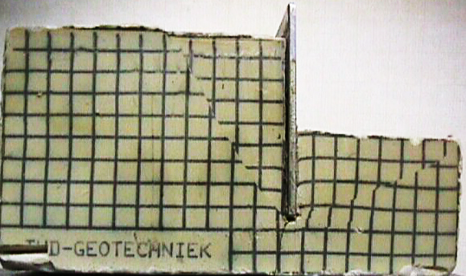








Rankine’s Earth Pressure Method for (c- φ) Soil
Rankine’s Active and Passive Earth Pressure in (c- f) Soil
Active Wedge
Rankine’s Active Earth Pressure in ( f) Soil with inclined backfill
√
α
θ = 45 ⁰− φ/2
K_{a} = cosα .
Cosα – (cos²α – cos² φ)
φ
Cosα + (cos²α – cos² φ)
√
√
γ =
φ =
τ
θ = 45 ⁰ + φ/2
τ = c + σ_{n} tan φ
Passive Earth Pressure
Active
Earth Pressure
Passive Wedge
√
δ = 0
c
Passive
Earth Pressure
P_{a} = 0.5 γ H² K_{a}
σ_{f}’
σ_{h}’
σ_{v}’
σ_{f}’
H
α
Active Earth Pressure
σ_{h} is increasing until failure
Effect of Cohesion of the Rankine’s Active and Passive Earth Pressure
Rankine’s Active Earth Pressure in f - Soil & Water Table
α
Active Earth Pressure
-2c K_{a}
-2c K_{a}
Flexible Wall
G.S.
Fig.1
$σ_{f}^{′}$= $σ_{V}^{′} \tan^{2}\left({45}^{o}−\frac{∅}{2}\right)+2 c \tan\left({45}^{o}−\frac{∅}{2}\right)$
-
h₁
γ_{soil}
φ
Effect of Two Soil Layers on Active Earth Pressure
Or
Tension Crack Z_{cr} = $\frac{2c}{γ\sqrt{K_{a}}}$
+
+
σ_{h} = γ_{soil}h₁ K_{a}
W.T.
P_{w}
K_{a1} < K_{a2}
G.S.
$σ_{f}^{′}$= $σ_{V}^{′} K_{a}−2 c \sqrt{Ka}$
-
h₂
+
+
+
σ_{h} = γ_{soil}h₁K_{a1}
γ₁
φ₁
+
+
=
+
P_{w} = 0.5 γ_{w} (h₂)²
h₁
K_{a1}
$K_{a}^{}$= $\tan^{2}\left({45}^{o}−\frac{∅}{2}\right)= \frac{1− \sin{∅}}{1+ \sin{∅}}$
σ_{h} = γ_{soil}h₁K_{a2}
Coefficient of active earth pressure
+
$σ_{h}= h_{1}γsoil k_{a}$ +
$$h_{2 }\left(γsoil− γwater\right)k_{a}$$
σ_{w} = γ_{w}h₂
γ₂
φ₂
h₂
K_{a2}
Passive Earth Pressure
-2c K_{a}
γ H K_{a}
γ H K_{a} -
2c K_{a}
$σ_{f}^{′}$= $σ_{V}^{′} \tan^{2}\left({45}^{o}+\frac{∅}{2}\right)+2 c \tan\left({45}^{o}+\frac{∅}{2}\right)$
+2c K_{p}
+2c K_{p}
Effect of Surcharge (q) Load on Active Earth Pressure
σ_{h} = (γ₁ h₁ + γ₂ h₂) k_{a2}
Or
q
K_{a1} > K_{a2}
G.S.
$σ_{f}^{′}$= $σ_{V}^{′} K_{p}+2 c \sqrt{Kp}$
qk_{a}
qk_{a}
σ_{h} = γ_{soil}h₁K_{a1}
γ₁
φ₁
h₁
K_{a1}
$K_{p}^{}$= $\tan^{2}\left({45}^{o}+\frac{∅}{2}\right)= \frac{1+ \sin{∅}}{1 − \sin{∅}}$
σ_{h} = γ_{soil}h₁K_{a2}
Coefficient of passive earth pressure
+
+
+
=
+
+
+
+
+
=
+
γ₂
φ₂
h₂
K_{a2}
qk_{a}
γ H K_{a}
qk_{a}
+2c K_{p}
γ H K_{p}
γ H K_{p} +
2c K_{p}
Effect of Surcharge Load
Effect of Soil Pressure
+ γ H K_{a}
σ_{h} = (γ₁ h₁ + γ₂ h₂) k_{a2}
Kamal Tawfiq

Slide 2
Active Earth Pressure in φ − Soil
Example -1
Given:
Vertical retaining wall (flexible)
Wall height (H) = 12 ft
Backfill unit weight (γ) = 115 pcf
Angle of soil friction (φ) = 30º
Assume wall to be smooth
Find:
Lateral force P_{a} acting on the wall
Solution:
Δ
Flexible Wall
P_{a}=γ H k_{a}
2
y_{a} = 12/3
σ_{h} = σ_{v} k_{a}
σ_{h} = σ_{v} k_{a}
P_{a} = γ H² k_{a}
1 - sinφ
K_{a}
=
1 + sinφ
P_{a} = 115 x 12² x 0.5= 8280 lb/ft

Slide 3
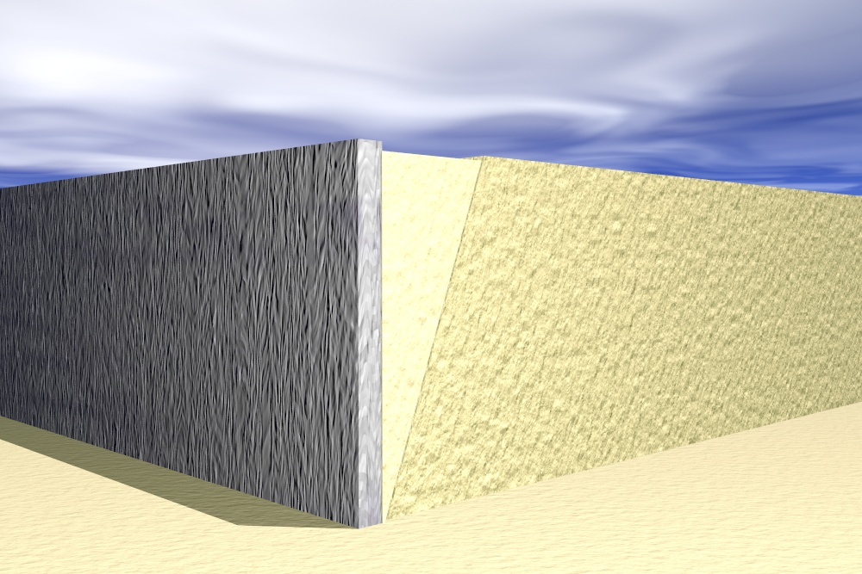
Coulomb Earth Pressure Method
Forces acting on the wall.
Wall Displacement = Δ
This active wedge will slide along the failure surface and will exert pressure on the wall. Also, the sliding wedge will push the wall away from the backfill.
W
Soil-Wall Friction
Soil-Soil Friction
Failure surface
Pressure from the sliding wedge
By: Kamal Tawfiq, Ph.D., P.E.

Slide 4
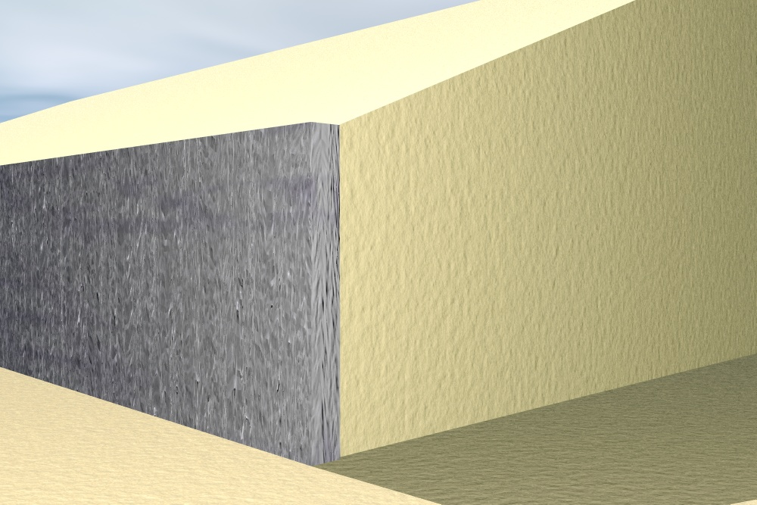
Coulomb Earth Pressure Method
Forces acting on an inclined wall.
β
Wall Displacement = Δ
Active Wedge. Exerting pressure on the wall
W
α
γ
φ
φ
Normal
θ
Normal
δ
Shear
F
Pa
Shear
δ
P_{a}
By: Kamal Tawfiq, Ph.D., P.E.

Slide 5
Coulomb Earth Pressure Method
Forces acting on the wall.
Wall Displacement = Δ
Active Wedge. Exerting pressure on the wall
W
φ
Normal
Normal
δ
Shear
F
Pa
Shear
By: Kamal Tawfiq, Ph.D., P.E.

Slide 6

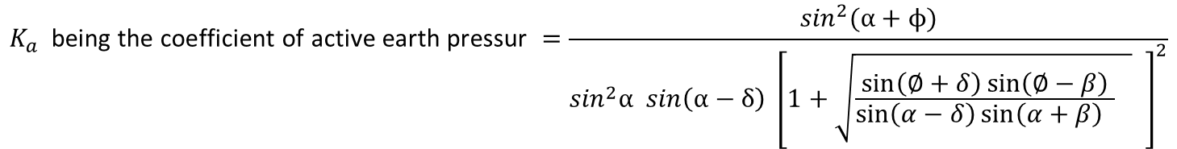


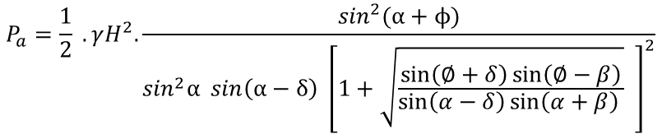

COULOMB’S WEDGE THEORY
C
P_{a}
B
β
Sliding
Surface
ψ
W = weight of the soil wedge
R = resultant of the shear and normal forces on the failure surface BC
P_{a} = the active force per unit length of the wall. The direction of Pa is inclined at an angle δ to the normal drawn and the face of the wall that supports the soil
δ = the angle of friction between the soil and the wall
Sliding
Wedge
ψ =(α − δ)
Friction
Wall
Friction
(180^{ο} − ψ − θ + φ)
H
W
S
R
W = g (area of wedge ABC)
δ
N
From the triangles of forces,
H/3
P_{a}
ψ
S
φ
(θ − φ)
W
α
θ
$$\frac{P_{a}}{\sin{(θ−∅)}}= \frac{W}{sin⁡({180}^{o}−ψ−θ+ϕ)}$$
A
(θ − φ)
R
Force Triangle
$$P_{a}= \frac{W\sin{(θ−∅)}}{sin⁡({180}^{o}−ψ−θ+ϕ)}$$
Sliding Wedge
δ = 0.5φ to 0.7φ
β
Sand
γ = ̸
φ = ̸
Substituting for W,
Draw this perpendicular line first
Then draw P_{a} with an angle = α
$$P_{a}=\frac{1}{2} .\frac{γH^{2}}{\sin^{2}{α }}.\frac{sin (θ −∅)}{sin⁡({180}^{o}−ψ−θ+ϕ)}.\frac{\sin{(θ+α)}.sin(α+β)}{sin⁡(θ−β)}$$
P_{a}
P_{v}
The maximum value of Pa is obtained by equating the first derivative of Pa with respect
to θ to zero; or
H
δ
P_{h} = cos [δ + (90^{ο}−α)]
(∂P_{a})/∂θ = 0, and substituting the corresponding value of θ.
σ_{h} = γHK_{a}
The value of P_{a} so obtained is written as
H/3
α
$$P_{a}=\frac{1}{2} .γH^{2}.\frac{\sin^{2}(α+ϕ)}{\sin^{2}α sin\left(α−δ\right) {\left[1+\sqrt{\frac{\sin\left(∅+δ\right)\sin\left(∅−β\right)}{\sin\left(α−δ\right)\sin\left(α+β\right) }} \right]}^{2}}$$
q
qk_{a}
β
This is usually written as
Sand
γ = ̸
φ = ̸
$P_{a}=\frac{1}{2} .γH^{2}.$ $K_{a}$
P₁
P_{a}
$$K_{a} \text{being} \text{the} \text{coefficient} \text{of} \text{active} \text{earth} \text{pressur} =\frac{\sin^{2}(α+ϕ)}{\sin^{2}α sin\left(α−δ\right) {\left[1+\sqrt{\frac{\sin\left(∅+δ\right)\sin\left(∅−β\right)}{\sin\left(α−δ\right)\sin\left(α+β\right) } } \right]}^{2}}$$
H
δ
Where
+
δ
H/3
H/2
σ_{h} = γHK_{a}
α
qk_{a}
δ + (90^{ο}−α)
Kamal Tawfiq

Slide 7
Coulomb’s Earth Pressure
= √
= 0
= 0
α = 0
α = 0
K_{a} =
cos² (φ− θ)
[
sin( δ + φ) sin (φ − α)
]
2
γ
φ
cos² θ cos( δ − θ)
1+
cos ( δ + θ) cos (θ − α)
H
Under the given wall and backfill conditions, K_{a} of Coulomb’s active earth pressure
becomes equivalent to K_{a} of Rankine’s
1 - sinφ
K_{a}
=
Vertical
Surface
θ = 0
Smooth Surface
1 + sinφ
δ = 0
P_{a} = ½ K_{a} γ H²
By: Kamal Tawfiq, Ph.D., P.E.

Slide 8
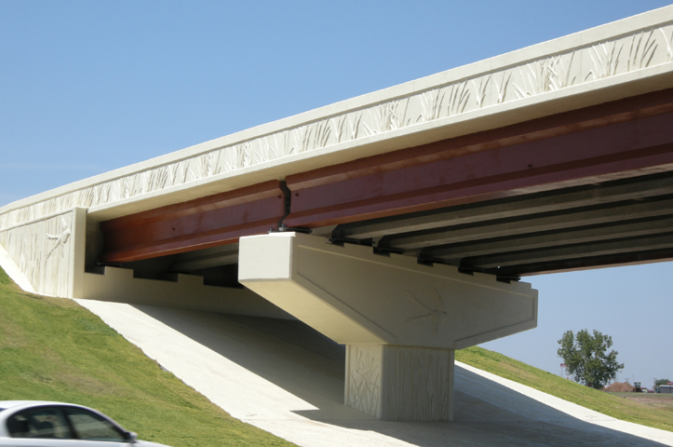
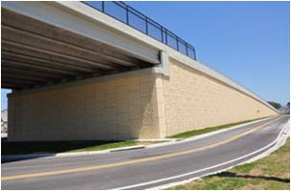
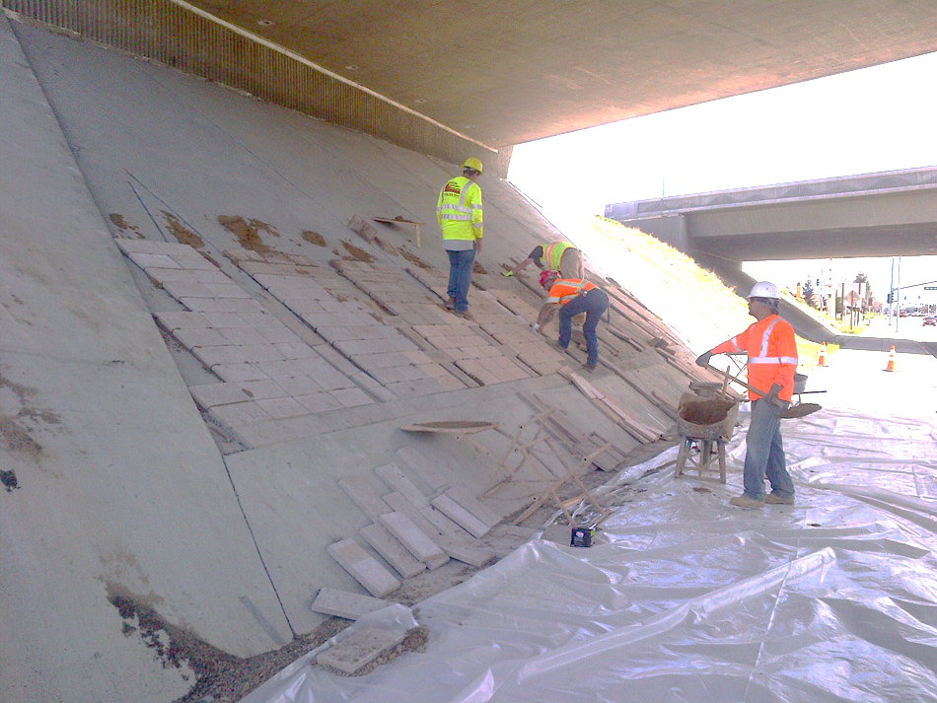
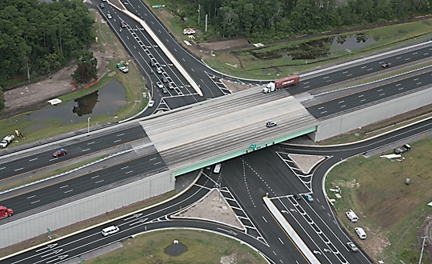
Earth Retaining Walls
Wall
Slope
Slope
Wall

Slide 9
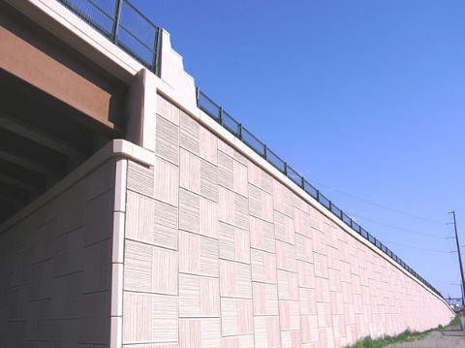
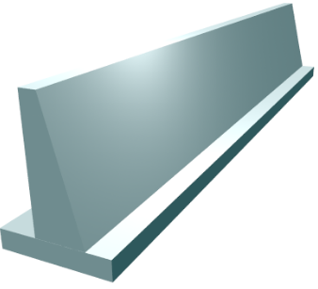
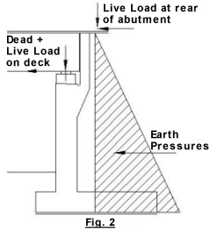
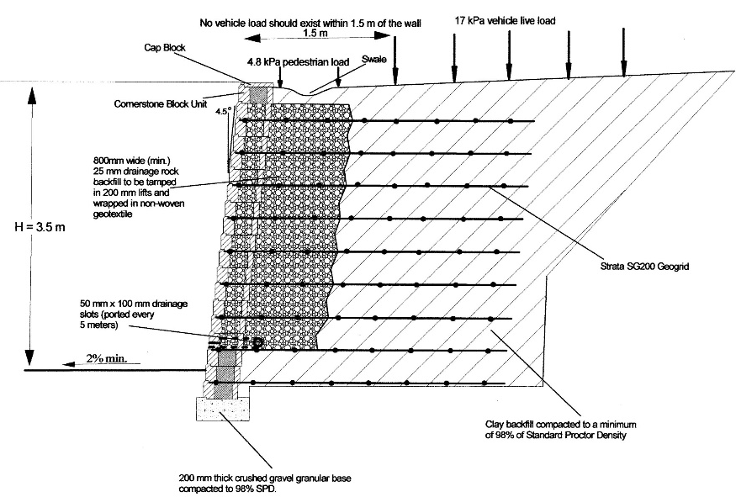
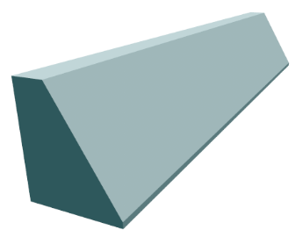
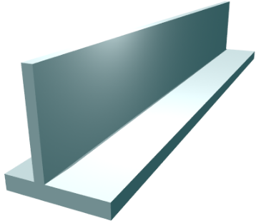
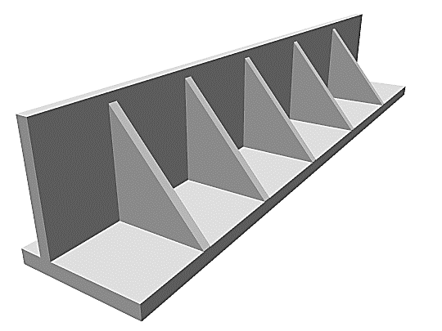
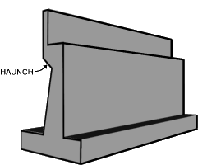
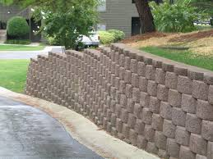
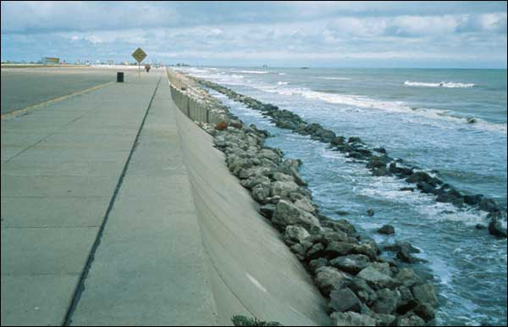
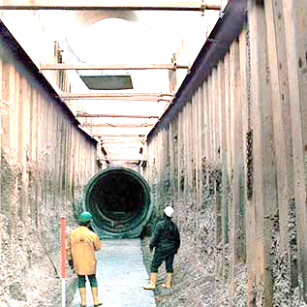
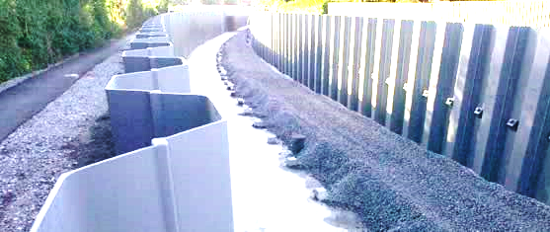
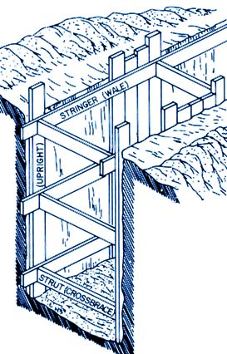
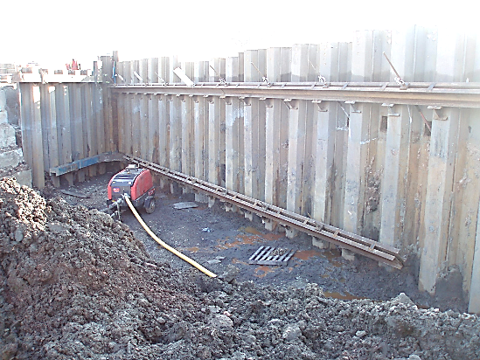
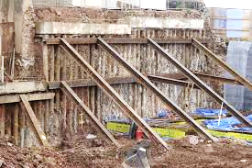
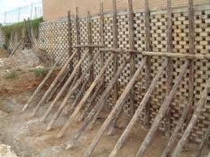
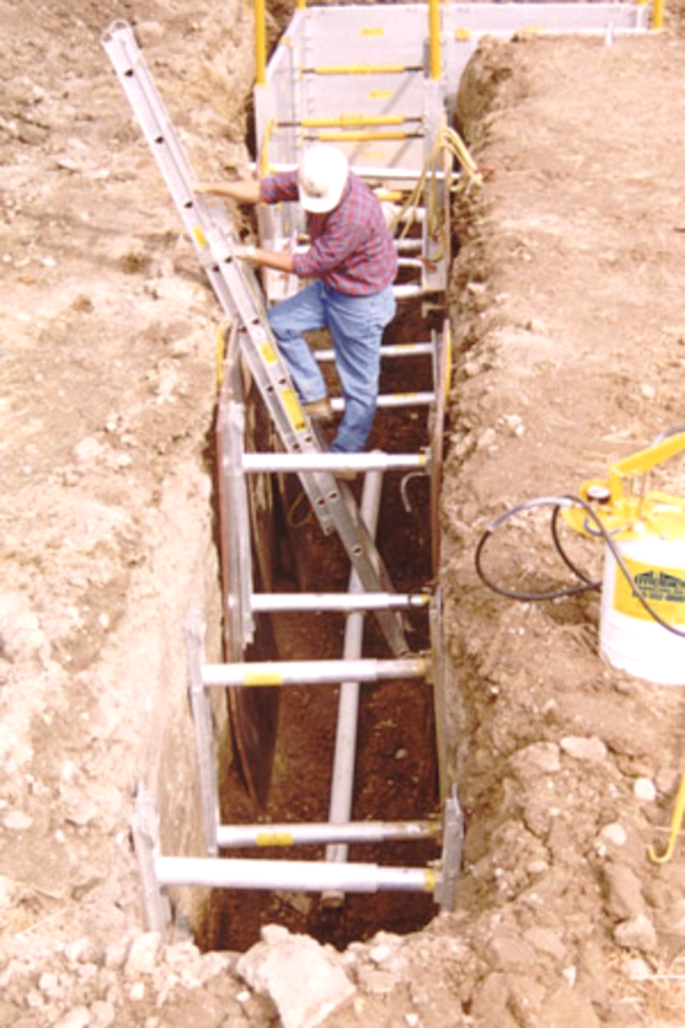
Design of Retaining Wall
Types of Earth Retaining Walls
I- Permanent Walls
Gravity Wall
Semi-Gravity Wall
Segmental Walls
MSE Walls
Cantilever Wall
Counterfort wall
Segmental Walls
Sea Walls
II- Temporary Walls
Braced cuts
Sheet pile wall
Kamal Tawfiq

Slide 10
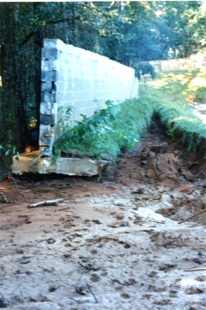
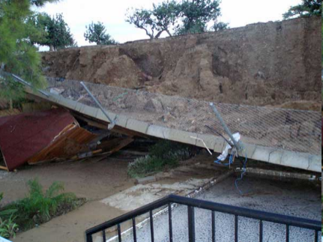
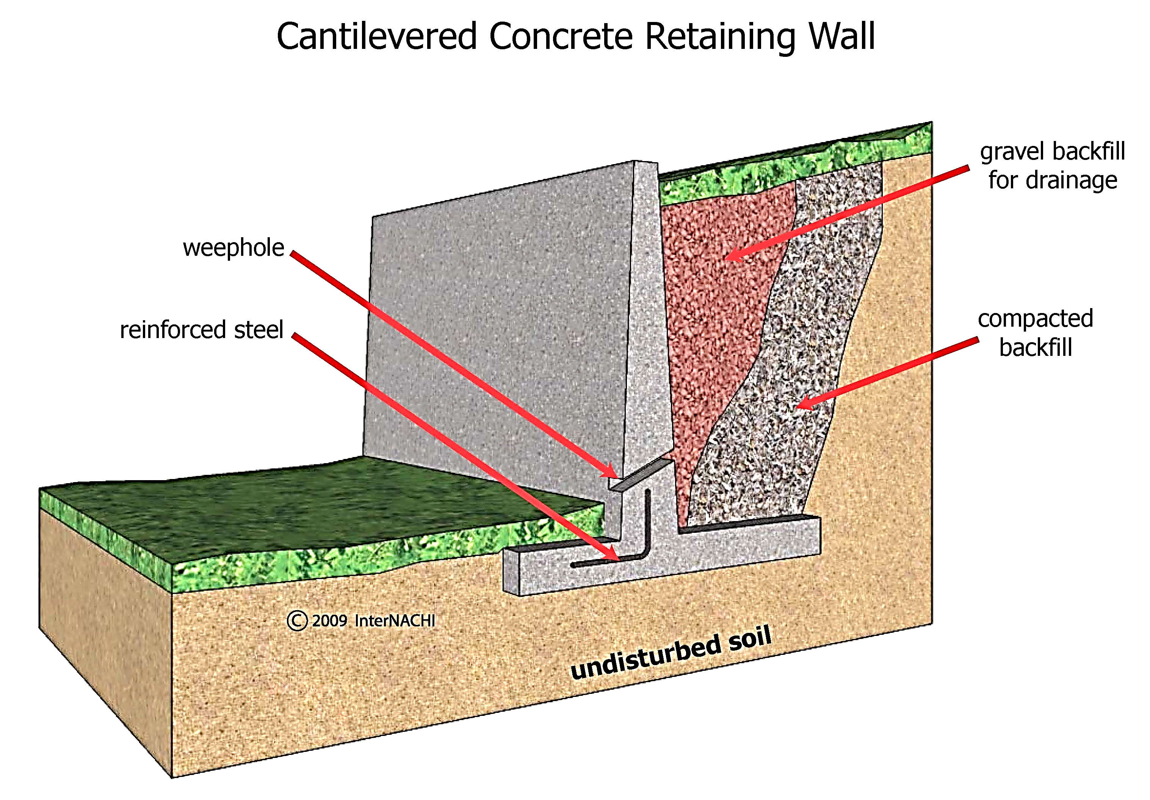
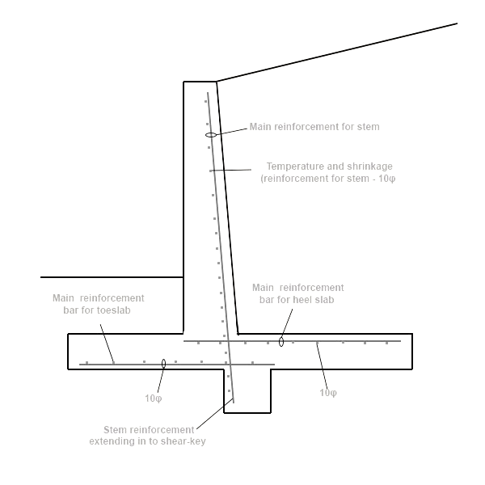
Design of Retaining Wall
By Kamal Tawfiq, Ph.D., P.E
1- External Stability
2- Internal Stability
1
2
1. External Stability
1- Sliding
2- Overturning
3- Settlement
4- Overall Failure
3
4
Internal Stability
Steel Reinforcement and Thicknesses

Slide 11
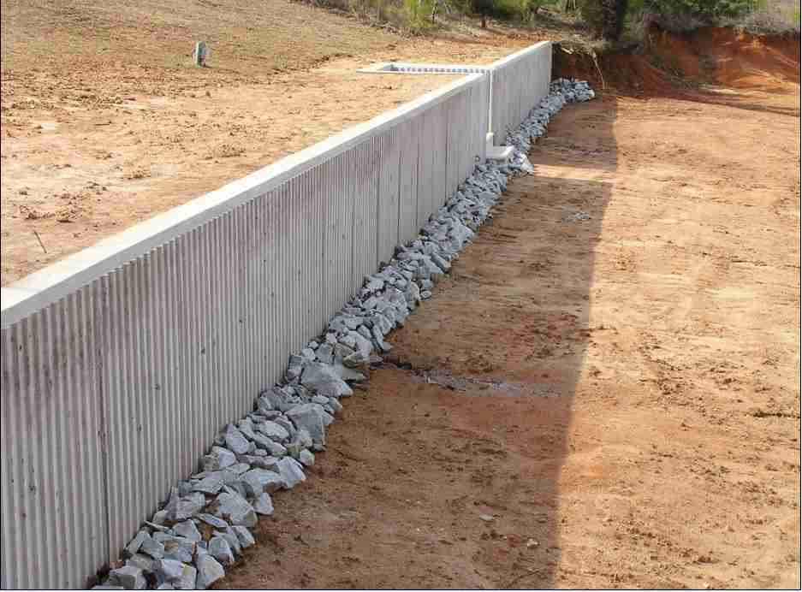
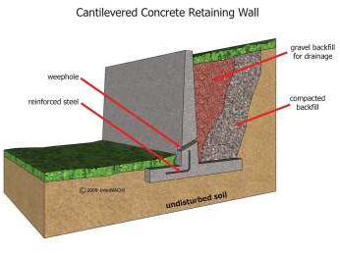
Common Proportions of Cantilever Wall
12 in Preferable minimum
Minimum batter = 1/50
Vertical
Stem
H
Toe Slab
H/10 to H/8
Thickness
H/12 to H/10
Heel of Slab
D_{f}
_{Thickness = H/12 to H/10}
_{B = 0.4 to 0.7 H}
Base of footing

Slide 12
Approximate Dimensions
0.25 m to 0.4 m
0.3 m to H/12
1
48
H
H
B/3
D/2 to D
H/12 to H/10
>1m
>1m
B =
0.4 H to 0.7 H
H/12 to H/8
B =
0.5 H to 0.7 H
D = H/8 to H/6
Cantilever Retaining Wall
Gravity Retaining Wall
Kamal Tawfiq, 2011

Slide 13
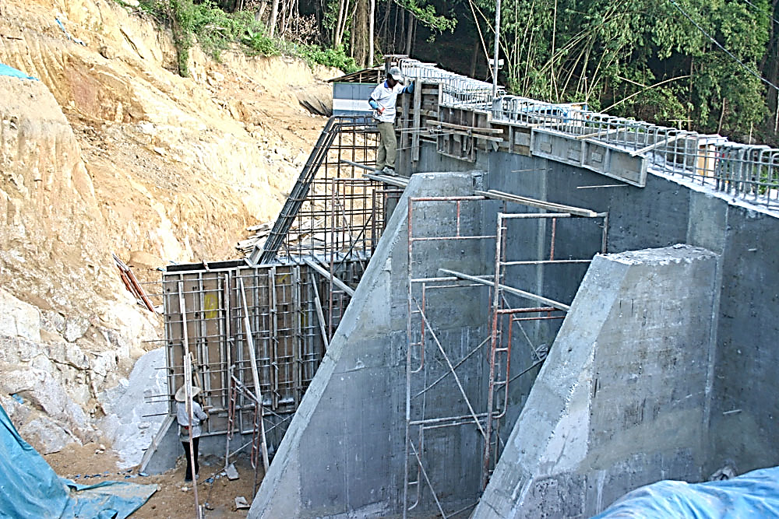
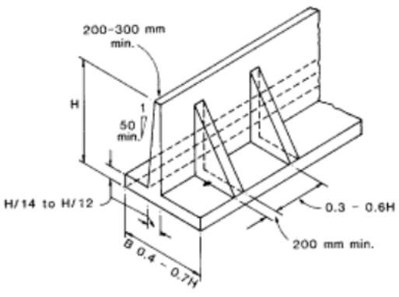
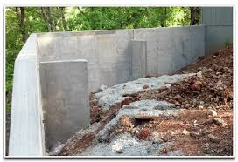
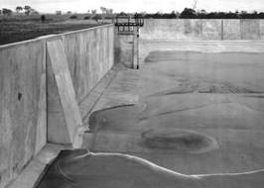
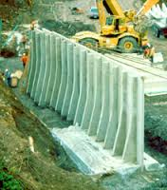
Counterfort Retaining Wall

Slide 14
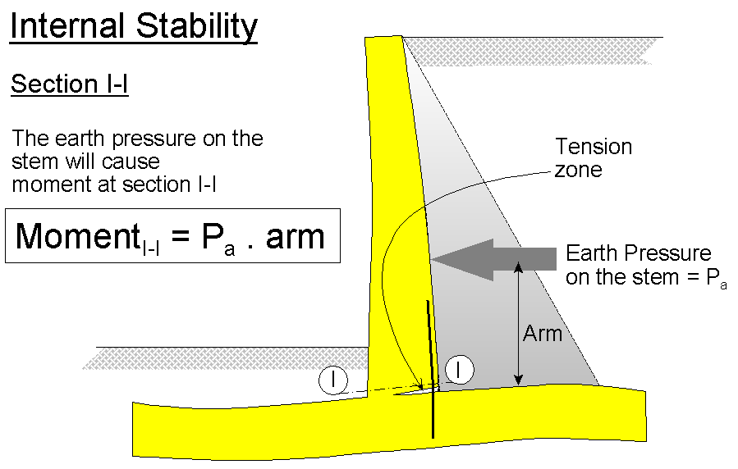
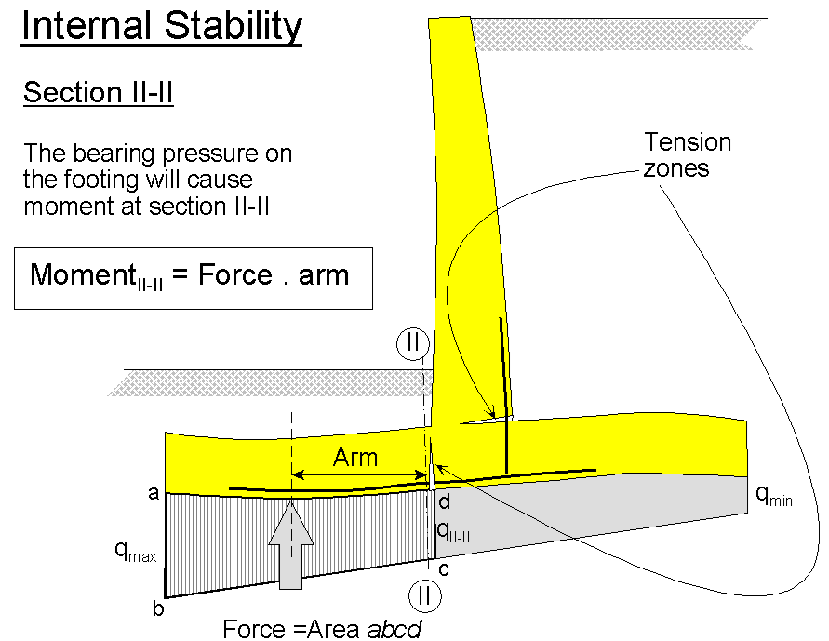
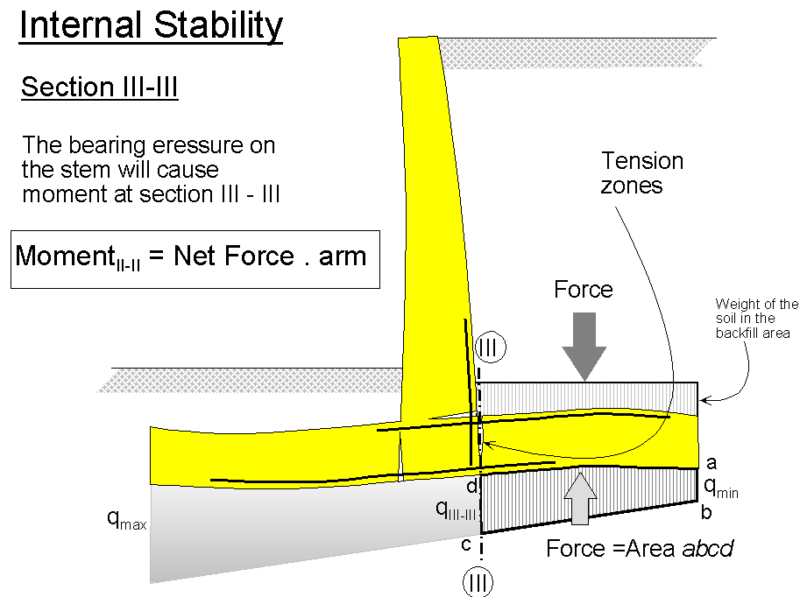
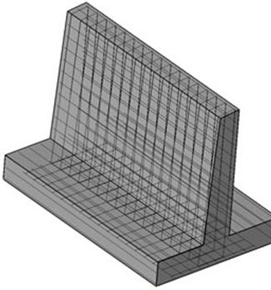
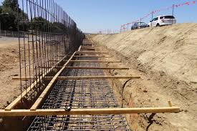
Internal Stability
Structural Design
Steel Reinforcement
and Thicknesses
Structural Design
2-

Slide 15
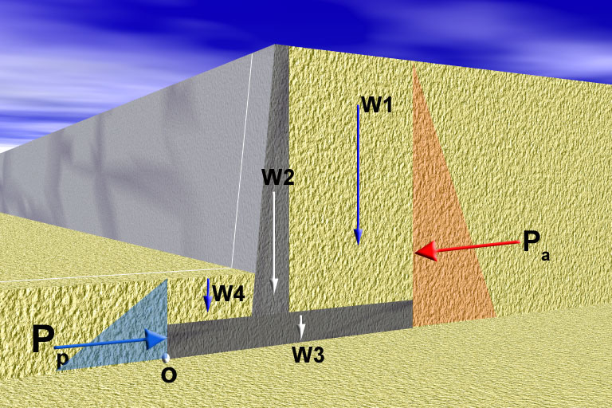
I. External Stability
Factor of Safety Against Sliding =
Resisting Force
=
F_{R}
1- Sliding
Driving Force
F_{D}
δ = 0.5 to 2/3 φ
Cohesion
Friction = (∑W) tan δ + B.c
B
If the soil is cohesive, add (BC) to the shear resistance
F_{D} = P_{a}
F_{R} = P_{p} + Friction
By: Kamal Tawfiq

Slide 16
I. External Stability
Factor of Safety Against Sliding =
Resisting Moment
=
M_{R}
2- Overturning
Driving Moment
M_{D}
Resisting Moment
M_{R}
Driving Moment
M_{D}
a₁
a₂
a₄
y_{a}
a₃
y_{p}
B
Moment About o
M_{D} = P_{a} . y_{a}
M_{R} = P_{p}.y_{p} + W₁ a₁ + W₂ a₂ +W₃ a₃ +W₄ a₄
By: Kamal Tawfiq

Slide 17
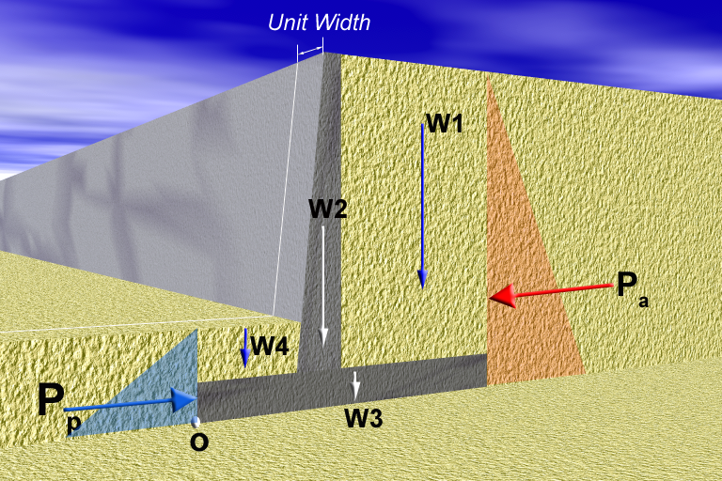
I. External Stability
3- Bearing Capacity Failure
q_{min}
q_{max}
B

Slide 18
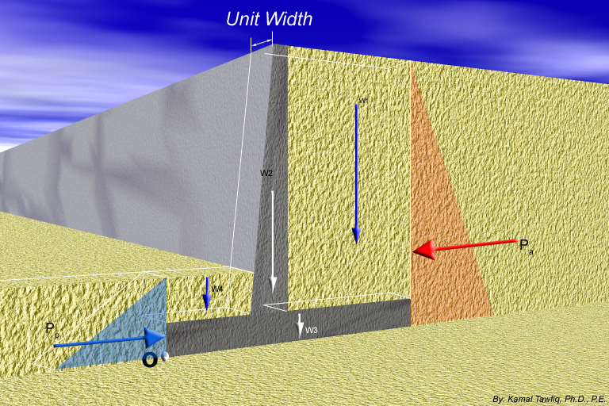
q_{all}
3- Check for Bearing Capacity Failure
Factor of Safety Against Bearing Capacity Failure =
q_{max}
q_{min} = 0
√
q_{max}
+
q_{min} = +
√
q_{min} = 0
q_{max}
+
X
q_{max}
+
1
-
q_{min} = -
q_{max}
+
q_{min} = +
q_{max}
+
ΣV
2
-
q_{min} = -
R
q_{max}
+
3
L
B/3
X
3
1
2
L/3
B
ΣH
q_{min}
Kern
B
q_{max}
e
x
V = sum of all vertical loads
ΣH = sum of all horizontal loads
R = (ΣV)² ⁺ (ΣH)²
M_{net} = ΣM_{R} – ΣM_{D}
ΣV X =
B
e = - X
2
M_{net}
ΣV
M_{net} y
q
ΣV
(
+
6e
)
+
=
1
-
q =
A
-
I
max
B
B
min

Slide 19
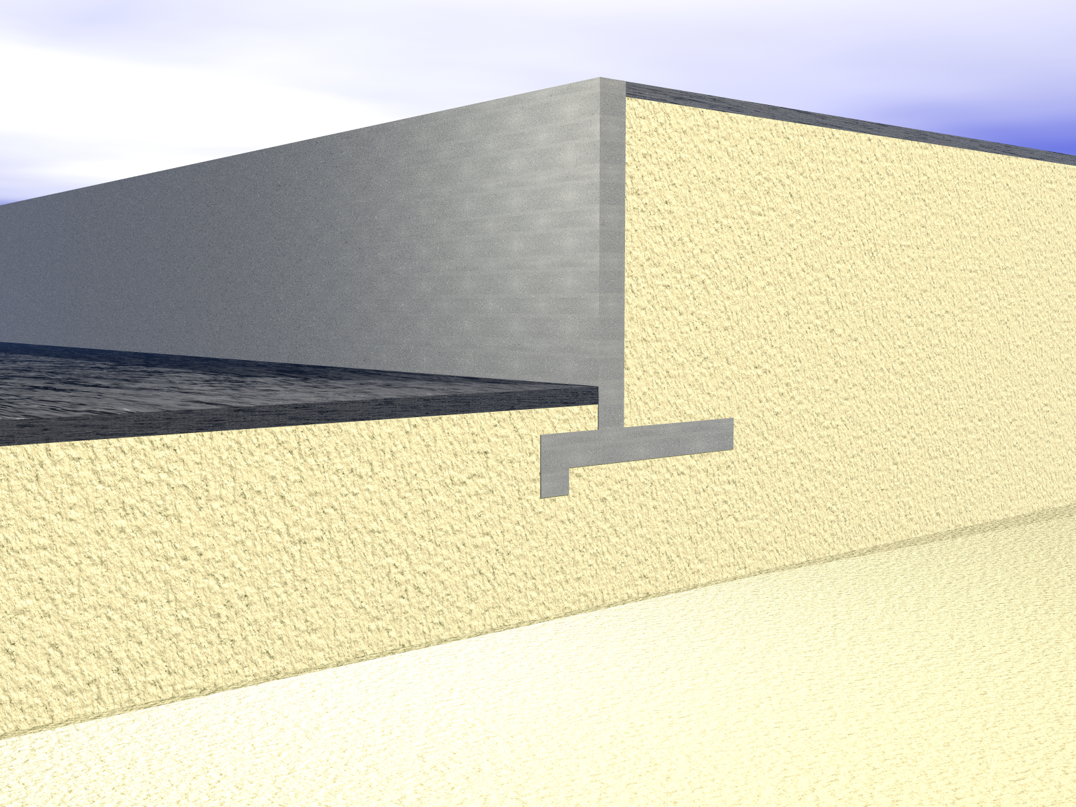
Retaining wall with a key at the base:
x₂
Pavement
W₂
x₃
x₁
Sand
γ =
φ =
Cantilever Retaining Wall
H
P₁
W₃
x₄
W₁
x₅
P₂
W₅
Y₁
Pavement
Y₂
W₆
P₄
W₄
D
P₃
D/2
D/3
W₇
F = Friction
Sand
γ =
φ =
O
x₇
Surcharge
Stem
Backfill
Toe
Heel
key
Kamal Tawfiq

Slide 20
Using Key at the Base to Improve Sliding Resistance
Extent of the Passive
Pressure
Key
Friction Surface of along the Base

Slide 21
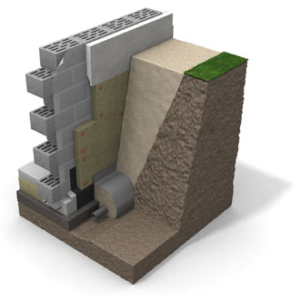
Masonry wall
Coarse soil
insulate the footing externally
In situ soil
Plain
concrete
or
4” gravel
Geofabric
Geofabric
French drain

Slide 22
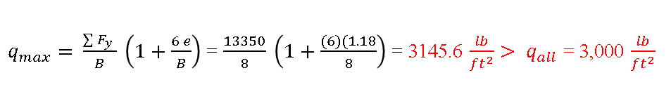

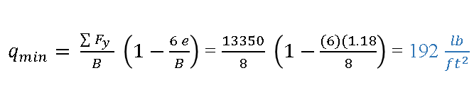
Active Earth Pressure in φ − Soil
3 ft
Rigid Wall
Example -1
q_{max} = +
+
q_{min} = 0
Δ = 0
1
q_{min} = +
Given:
Vertical retaining wall (Rigid)
Wall height (H) = 12 ft
Backfill unit weight (γ) = 115 pcf
Angle of soil friction (φ) = 30º
Assume wall to be smooth
Angle of friction between the base and the soil δ = 20º
Determine:
The stability of the wall
Solution:
q_{max} = +
+
2
-
q_{min} = -
x₁ = 6.33’
γ = 115 pcf
φ = 30º
q_{max} = +
+
3
B/3
H = 12 ft
L
L/3
W1
P_{a}=γ H k_{o}
3
1
2
x₃ = 1.5’
2
B
1- Factor of Safety Against Sliding
FS_{(sliding)} = $\frac{\sum{V\tan\left(20\right)+Pp}}{Pa}$ P_{p} = 0
= $\frac{[\left(13350\right)\tan{20o]}}{4140}=1.2>1.5 Not OK$
2- Factor of Safety Against Overturning
FS_{(overturning)} = $\frac{\sum{M_{R}}}{M_{D}}$ = $\frac{50908.5}{16560}=3.1>2 OK$
x₂ = 4.66’
W3
y_{a} = 4’
W2
σ_{h} = σ_{v}k_{o}
σ_{h} = σ_{v} k_{o} For Rigid Wall use k_{o}
O
Friction
P_{o} = 0.5 γ H² k_{o}
8 ft
K_{o}
1 - sinφ
=
P_{o} = 0.5x115x12²x0.5 = 4,140 lb/ft
3- Factor of Safety Bearing Capacity Failure = FS_{(BC)}
X - Force (lb)/ft) | Vertical Distance (ft) | F_{y} (lb)/ft | Moment Arm X (ft) | Driving Moment (ft.lb)/ft | Resisting Moment (ft.lb)/ft
P_{a}= 4,140 | 4 |  |  | 4,140 x 4 = 16,560
 |  | W₁= 0.5x5x12x115 = 3,450 | 6.33 |  | 3,450x6.33=21,838.5
 |  | W₂ =0.5x5x12x150 = 4,500 | 4.66 |  | 4,500x4.66 = 20,970
 |  | W₃ = 3x12x150 = 5400 | 1.5 |  | 5,400 x 1.5 = 8,100
P_{p} = 0 | 0 |  |  |  | o
 |  | 13,350 |  | 16,560 | 50,908.5
M_{net} = ∑M_{R} - ∑M_{D} = 50908.5 -13350 = 37558.5 ft.lb/ft
M_{net} = 37,558.5 = ∑F_{y}(X) = 13350 (X)
X = (M_{net} / ∑F_{y} ) = 2.81 ft
e = (8/2) – 2.81 = 1.18 ft < B/6 or 8/6 = 1.33 (Full contact)
$q_{max}= \frac{\sum{F_{y}} }{B} \left(1+\frac{6 e}{B}\right)$ = $\frac{13350}{8} \left(1+\frac{(6)(1.18}{8}\right)$ = 3145.6 $\frac{lb}{{ft}^{2}}> q_{all}$ = 3,000 $\frac{lb}{{ft}^{2}}$
$q_{min}= \frac{\sum{F_{y}} }{B} \left(1−\frac{6 e}{B}\right)$ = $\frac{13350}{8} \left(1−\frac{(6)(1.18}{8}\right)$ = 192 $\frac{lb}{{ft}^{2}}$

Slide 23
Active & Passive Earth Pressure in φ − Soil
Example -2
Given:
Vertical retaining wall (flexible)
Wall height (H) = 12 ft
Backfill unit weight (γ) = 115 pcf
Angle of soil friction (φ) = 30º
Assume wall to be smooth
γ_{concrete} = 150 lb/ft³
D = 4 ft
Find:
Resultant Force of the Wall
Solution:
t = 1 ft
W
H=12 ft
D = 4 ft
P_{a}=0.5 H² γ k_{a}
P_{p}= 0.5 D² γ k_{p}
L = 4 ft
σ_{h} = σ_{v} k_{p}
σ_{h} = σ_{v} k_{a}
σ_{h} = σ_{v} k_{a}
B = 8 ft
1 - sinφ
1+ sinφ
K_{a}
=
K_{p}
=
1 + sinφ
1- sinφ
P_{a} = 0.5 γ H² k_{a}
P_{p} = 0.5 D² γ k_{p}
P_{a} = 0.5 x 12² x115x 0.33 = 2,732.4 lb/ft²
P_{p} = 0.5x 4² x115x3 = 2,760 lb/ft²

Slide 24






t = 1 ft
F_{x} (lb)/ft | Y (ft) | F_{y} (lb)/ft | Moment Arm X (ft) | Driving Moment (ft.lb)/ft | Resisting M (ft.lb)/ft
P_{a}= 2,732.4 | 4 |  |  | 2,732.4x4 = 10,929.6
 |  | W₁= 4x10x115 = 4,600 | 6 |  | 4600x6=27,600
 |  | W₂ =1x10x150 = 1,500 | 3.5 |  | 1,500x3.5=5,250
 |  | W₃ = 8x1x150=1,200 | 4 |  | 1,200x4=4,800
 |  | W₄ =2x3x115 = 690 | 1.5 |  | 690x1.5= 1,035
P_{p}= 2,760 | 1.33 |  |  |  | 2,760x1.33= 3,680
 |  | 7,990 |  | 10,929.6 | 42,365
q_{max}
+
q_{min} = 0
1
q_{min} = +
q_{max}
+
2
-
q_{max}
q_{min} = -
W₁
+
3
L
B/3
R
3
1
2
L/3
W₂
B
P_{a}= 2,732.4 lb/ft²
h = 2 ft
P_{p}= 2,760 lb/ft²
W₄
Y_{a} = 4 ft
∑F_{y}
L = 4 ft
1- Factor of Safety Against Sliding = FS_{(sliding)} = $\frac{\sum{Fy\tan\left(20\right)+Pp}}{Pa}$ = $\frac{[\left(7,990\right)\tan{20o]+2,760}}{2,732.4}=2.1>1.5 OK$
2- Factor of Safety Against Overturning = FS_{(overturning)} = $\frac{\sum{M_{Resisting}}}{M_{Driving}}$ = $\frac{42,365}{10,929.6}=3.8>2 OK$
3- Factor of Safety Bearing Capacity Failure = FS_{(BC)}
∑F_{x}
O
Friction
= (∑V)tanδ
W₃
B = 8 ft
X
e
$$\sum{F_{y}}$$
M_{net} = ∑M_{r} - ∑M_{o} = 42,365 -10,929.6 = 31,435.4 ft.lb/ft
M_{net} = 31,435.4 = ∑F_{y}(X) = 7,990.(X)
X = (M_{net} / ∑F_{y} ) = 3.93 ft
e = (8/2) – 3.93 = 0.0656 ft < B/6 or 8/6 = 1.33 (Full contact)
e
O
x
q_{min}
q_{max}
+
Kern
$q_{max}= \frac{\sum{F_{y}} }{B} \left(1+\frac{6 e}{B}\right)$ = $\frac{7,990}{8} \left(1+\frac{(6)(0.0656}{8}\right)$ = 1,047.8 $\frac{lb}{{ft}^{2}}< q_{all}$ = 3,000 $\frac{lb}{{ft}^{2}}$
B/3
$q_{min}= \frac{\sum{F_{y}} }{B} \left(1−\frac{6 e}{B}\right)$ = $\frac{7,990}{8} \left(1−\frac{(6)(0.0656}{8}\right)$ = 949.6 $\frac{lb}{{ft}^{2}}$
O
L/3
$q_{max}$ = 1,047 $\frac{lb}{{ft}^{2}}$
+
$q_{min}$ = 949.6 $\frac{lb}{{ft}^{2}}$
x
e
B = 8 ft

Slide 25
Example 1
Given
The cross section of a cantilever retaining wall is shown in Figure 1. Calculate the factors of safety with respect to overturning, sliding, and bearing capacity.
Solution
From the figure,
H* = H₁ + H₂ + T₁ = 8 tan 10° + 19.5 + 2 = 22.91 ft
The Rankine active force per unit length of wall =
q = 120 lb/ft
1 ft
10º
3
H₁ = 1.41 ft
a₁
W₁
W₃
γ₁ = 115 lb/ft³
φ₁ = 30º
c₁ = 0
a₃
P_{v1}
H₂ = 19.5 ft
a₂
P_{a1}
a_{v}
W₂
P_{v}
10º
P_{h1}
a₄
4
2
P_{v2}
P_{a2}
10º
P_{h2}
a₆
6
W₄
W₆
y_{a}
4.5 ft
a₅
W₅
5
T₁ = 2 ft
O
γ₂ = 112 lb/ft³
φ₂ = 20º
c₂ = 800 lb/ft²
2.25 ft
2.25 ft
8 ft

Slide 26

Driving Pressure (lb/ft²)/ft | Resisting Pressure (lb/ft²)/ft | Weight/Unit Length (lb/ft) | Moment Arm from Point O (ft) | Driving Moment (ft.lb/ft) | Resisting Moment (ft.lb/ft)
P_{h1} = 920.13 |  |  | 11.45 | 920.13x11.45 = 10535.49
P_{h2} = 10096.45 |  |  | 7.64 | 10096.45x7.64 = 77136.88
 |  | W₁ = 120 x 8 = 960 | 8.5 |  | 960x8.5 = 8,160
 |  | W₂ = 8X19.2X112 = 17,203.2 | 8.5 |  | 17,203.2x8.5 = 146,227.2
 |  | W₃ = 0.5X1.41X8X112 = 631.7 | 9.83 |  | 631.7x9.83 = 6,209.6
 |  | W₄ = 1X19.5X150 = 2,925 | 4.0 |  | 2925x4 = 11,700
 |  | W₅ = 12.5X2X150 = 3,750 | 6.25 |  | 3750x6.25 = 23,437.5
 |  | W₆ = 0.5X1.25X19.2X150 = 1,800 | 3.08 |  | 1800x3.08 = 5,544
 |  | ∑Pv = 162.24+1780.28 = 1,942.52 | 12.5 |  | 1942.52x12.5 = 24,281.5
∑P_{h} = 11,016.58 | 0 | ∑ F_{y} = 29,212.4 |  | ∑M_{D} = 87,672.37 | ∑M_{R} = 225,559.86
1- Factor of Safety Against Sliding = FS_{(sliding)} = $\frac{\sum{Fy\tan\left(20\right)+Pp}}{Pa}$ = $\frac{[\left(29,212.4\right)\tan{20o]+0}}{11,016.58}=0.96<1.5 Not OK$
Add Passive Resistance
P_{p} = 0.5 x 4.5² x 115 x 3 = 3493.13 lb/ft
2- Factor of Safety Against Sliding = FS_{(sliding)} = $\frac{\sum{Fy\tan\left(20\right)+Pp}}{Pa}$ = $\frac{[\left(29,212.4\right)\tan{20o]+3493.13}}{11,016.58}=1.28<1.5 Not OK$
3- Factor of Safety Against Overturning = FS_{(overturning)} = $\frac{\sum{M_{R}}}{\sum{M_{D}}}$ = $\frac{225,559.86}{87,672.37}=2.57>20 OK$
4- Factor of Safety Bearing Capacity Failure = FS_{(BC)} =

Slide 27


M_{net} = ∑M_{R} - ∑M_{D} = 225,559.86 - 87,672.37 = 137,887.5 ft.lb/ft
M_{net} = 137,887.5 = ∑F_{y}(X) = 29,212.4 (X)
X = (M_{net} / ∑F_{y} ) = 4.72 ft
e = (12.5/2) – 4.72 = 1.53 ft < B/6 or 12.5/6 = 2.083 (Full contact)
q = 120 lb/ft
10º
3
H₁ = 1.41 ft
W₁
W₃
γ₁ = 115 lb/ft³
φ₁ = 30º
c₁ = 0
$q_{max}= \frac{\sum{F_{y}} }{B} \left(1+\frac{6 e}{B}\right)$ = $\frac{29,212.4}{12.5} \left(1+\frac{(6)(1.53)}{12.5}\right)$ = 4053.28 $\frac{lb}{{ft}^{2}}> q_{all}$ = 3,000 $\frac{lb}{{ft}^{2}}$ No good
P_{v1}
H₂ = 19.5 ft
$q_{min}= \frac{\sum{F_{y}} }{B} \left(1−\frac{6 e}{B}\right)$ = $\frac{29,212.4}{12.5} \left(1−\frac{(6)(1.53}{12.5}\right)$ = $621\frac{lb}{{ft}^{2}}$
P_{a1}
$$\sum{F_{y}}$$
W₂
P_{v}
10º
P_{h1}
e
4
2
P_{v2}
P_{a2}
x
10º
P_{h2}
O
6
W₄
q_{min} = 621 lb/ft²
R
q_{max} ⁼
4053.28 lb/ft²
+
∑F_{y}
y_{a}
W₆
B/3
4.5 ft
a₅
W₅
5
T₁ = 2 ft
O
∑F_{x}
L/3
γ₂ = 112 lb/ft³
φ₂ = 20º
c₂ = 800 lb/ft²
O
2.25 ft
2.25 ft
8 ft
x
e
B = 12.5 ft
Kern

