Slide 1
Stresses in Soil
Geostatic Stresses
Superimposed Stresses
Lateral Earth Pressure
By
Kamal Tawfiq, Ph.D., P.E.
Spring 2017

Slide 2
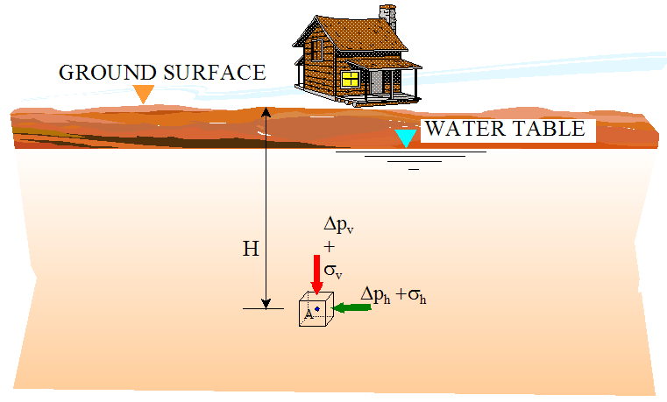
Stresses in Soil
Geostatic Stresses
Superimposed Stresses
Lateral Earth Pressure
Added Stress
Due to the
weight of the
house
Geostatic Stress
Total Stress
Effective Stress
Pore Water Pressure

Slide 3
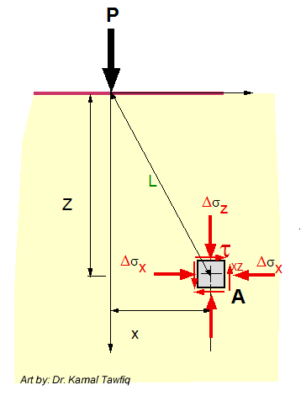
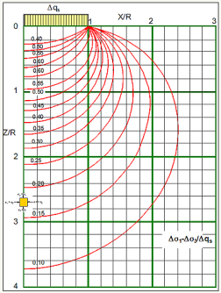
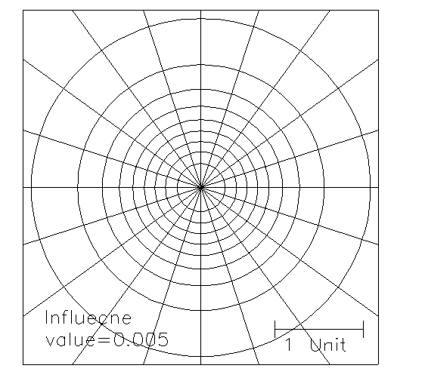
Added
Stress
By: Kamal Tawfiq, Ph.D., P.E
Stress Distribution in Soils
Geostatic
Stress
Geostatic Stresses
Added Stresses (Point, line, strip, triangular, circular, rectangular)
Total Stress
Effective Stress
Pore Water Pressure
Westergaard’s Method
(For Pavement)
Bossinisque Equations
Point Load
Line Load
Strip Load
Triangular Load
Circular Load
Rectangular Load
σ_{y}
σ_{x}
τ_{xy}
Approximate Method
1:2 Method
Total Stress= Effective Stress+ Pore Water Pressure
σ_{total} = σ_{eff} + u
Stress Bulbs
Newmark Charts
Influence Charts
A

Slide 4
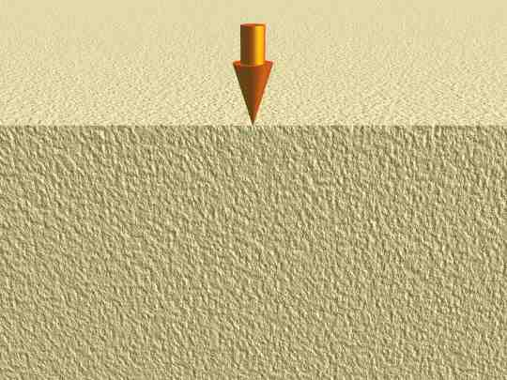
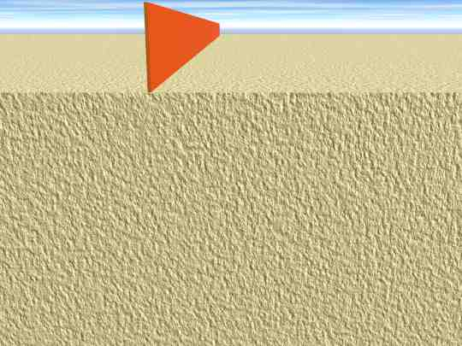
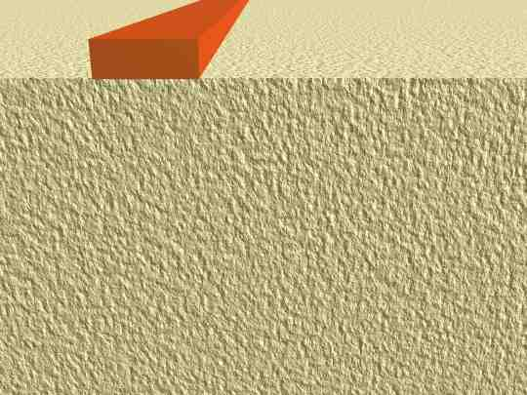
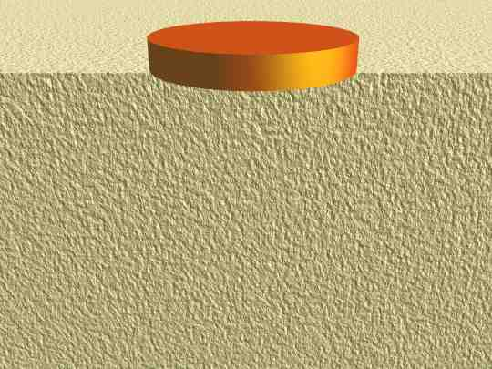
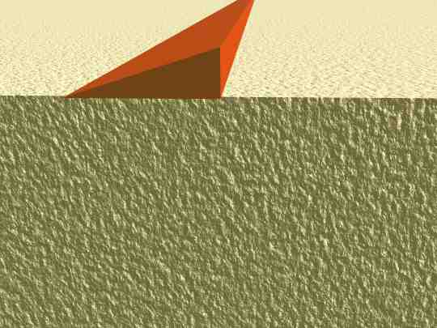
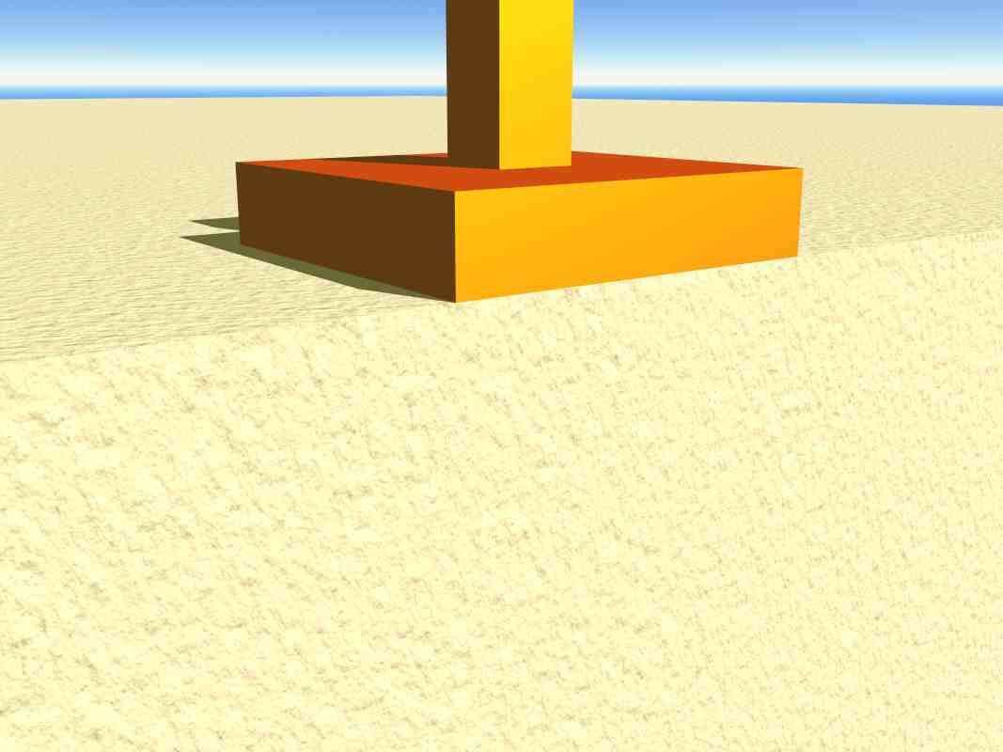
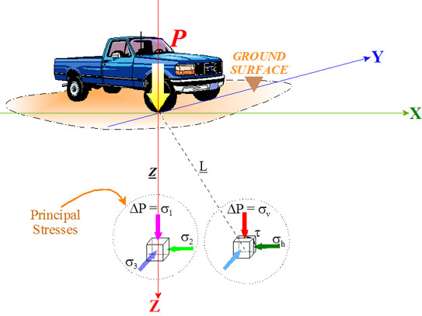

Slide 10
Stress Bulbs
q_{s}
Circular Load
1
X/R
2
3
0
R
Δq_{s}
0.95
0.90
X
0.80
Z
0.70
1
0.60
0.50
σ_{z}
0.40
σ₁
σ₂
Z/R
τ_{xy}
0.30
σ_{x}
σ_{x}
2
σ_{z} = σ₁
σ₁
σ_{z}
τ_{xy}
σ₂
σ_{x} = σ₂
σx = σ₂
0.20
σ_{x}
σ_{x}
σ_{z}
σ_{z} = σ₁
σ_{z}
θ
σ_{z} = σ₁
σ_{x} = σ₂
σx = σ₂
σ_{z} = σ₁
0.15
3
q_{s}
Δσ₁/q_{s}
A
3 ft
0.10
9 ft
4
Circular Load: (Major Principal Stress)/(Surface Stress)

Slide 11
Geostatic Stresses
&
Stress Distribution in Soils
Self-weight of the soil
Or
Geostatic Stress
Stresses from the house

Slide 12
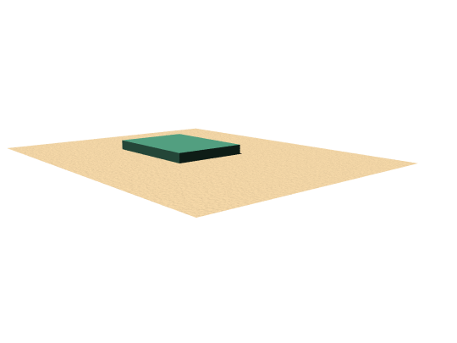
Newmark’s Charts
Find:
Vertical Stress at Point A
q = 800 lb/ft²
11 ft
15 ft
12 ft
Z = 10 ft
Vertical Stress
Point A

Slide 13
15’
11’
q = 800 psf
12’
Z= 10’
x
x
x
x
x
x
A
x
x
x
x
x
x
x
x
Steps to determine Vertical Stress Using Newmark’s Charts:
1- Select a scale to draw the shape shown above
2- The scale is
Z = length of line ab
3- Draw the shape using the selected scale
4- Place the shape on Newmark chart so that point A is at the center
5- Count the stress fields n
6- The stress at point A = n x q x 0.005
x
x
x
a
b
Influence Value = 0.005

Slide 14
a
b
Influence Value = 0.005

Slide 15
Lateral stresses due
to self-weight of soil

Slide 16
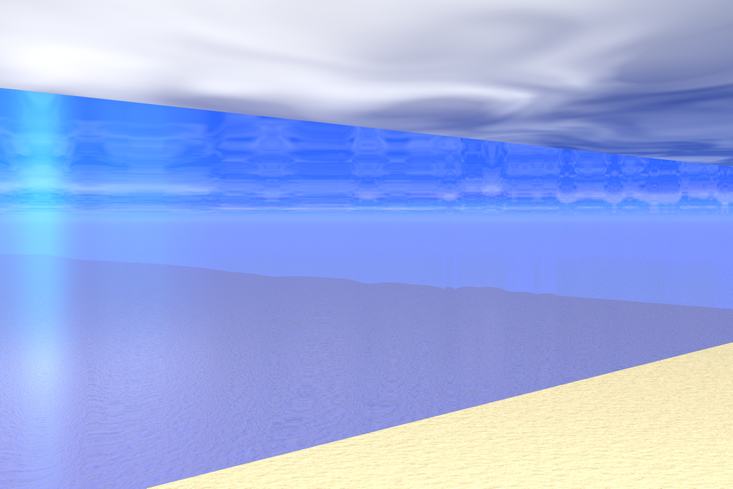
Vertical and Horizontal Stress in Water
Hydrostatic Stress or Pressure
Isotropic Stress
Water Table
d
σ_{v} = d γ_{water}
.
σ_{h} = d γ_{water} = σ_{v}
By: Kamal Tawfiq, Ph.D., P.E.

Slide 17
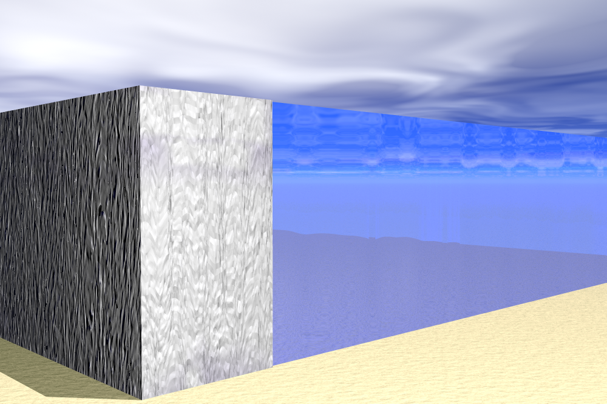
Vertical and Horizontal Stress in Water
Assume a massive wall retaining water. What is the pressure on this wall??
Is the wall stable???
Water Table
d
σ_{v} = d γ_{water}
.
σ_{h} = d γ_{water} = σ_{v}
P_{w} = H γ_{water}
Water pressure on the wall
By: Kamal Tawfiq, Ph.D., P.E.

Slide 18
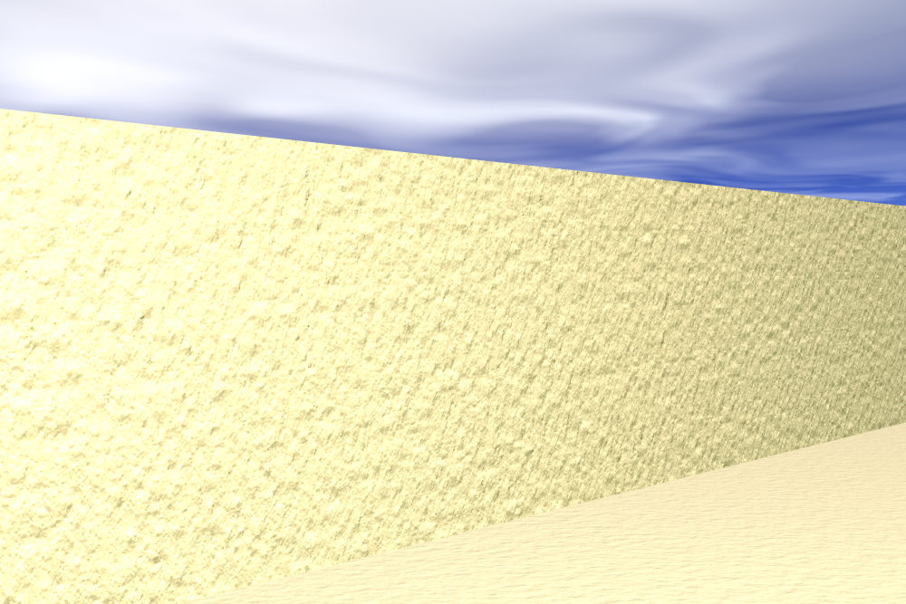
Vertical and Horizontal Stress in Soil
Geostatic Stress
Anisotropic Stress
Ground Surface
d
σ_{v} = d γ_{soil}
.
σ_{h} = (d γ_{soil} ) K_{o} = σ_{v} K_{o}
By: Kamal Tawfiq, Ph.D., P.E.

Slide 19
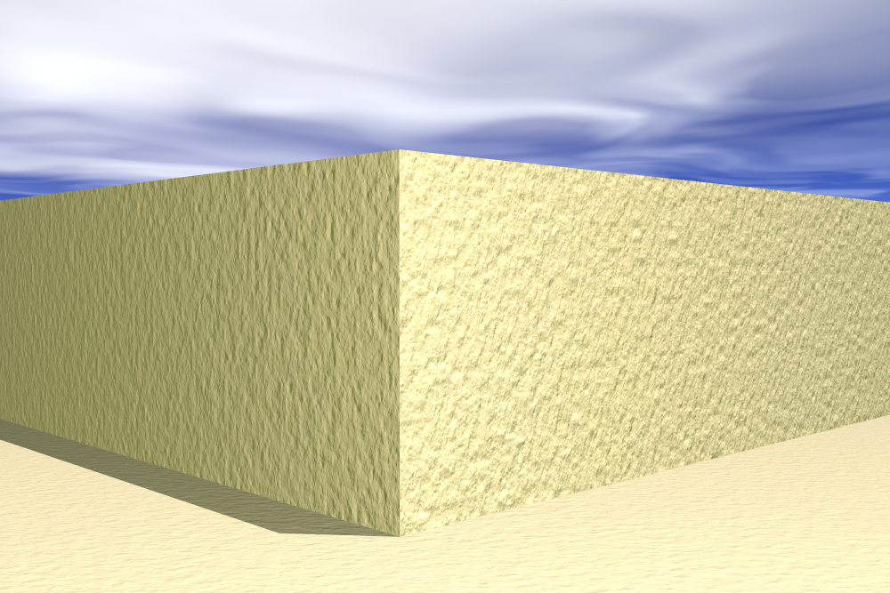
Vertical and Horizontal Stress in Soil
Assume a vertical cut in sand soil. Is this cut safe????
Soil Displacement = ??
Ground Surface
d
σ_{v} = d γ_{soil}
.
σ_{h} = (d γ_{soil} ) ?? = σ_{v} ??
By: Kamal Tawfiq, Ph.D., P.E.

Slide 20
AT REST CONDITIONS
Δ= 0
The soil remains undisturbed.
Structure is rigid, does not move and can be placed in the soil without allowing any lateral soil movement.
Lateral pressures existing in the soil before installations are still prevailing
no movement

Slide 21
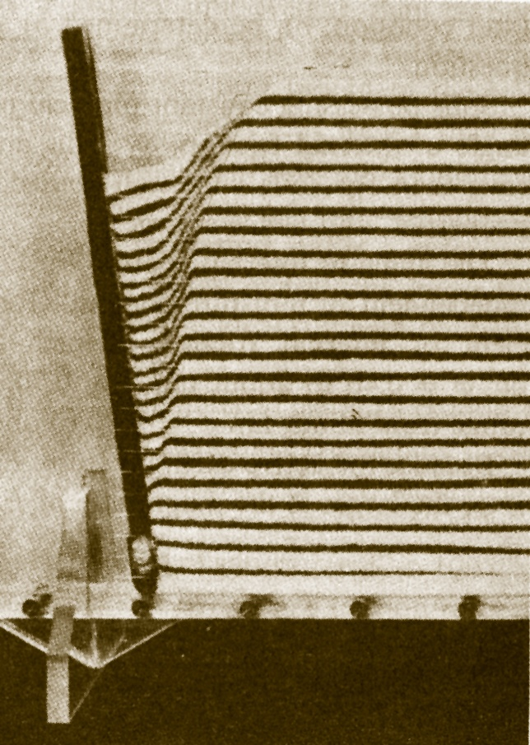
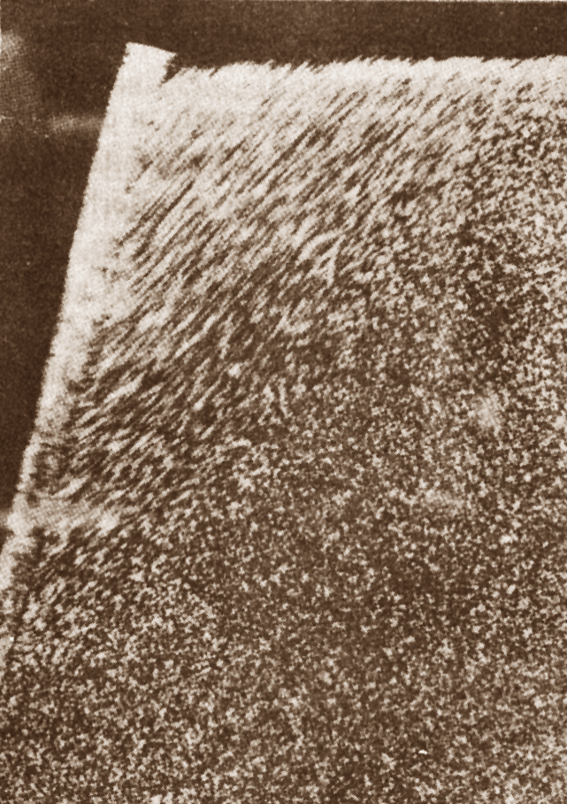
Geotechnical Design
CEG 4801
Spring 2014
By: Dr. Kamal Tawfiq
Active Wedge
Passive Wedge
Active
Passive
Earth Pressure Behind Retaining Wall

Slide 22
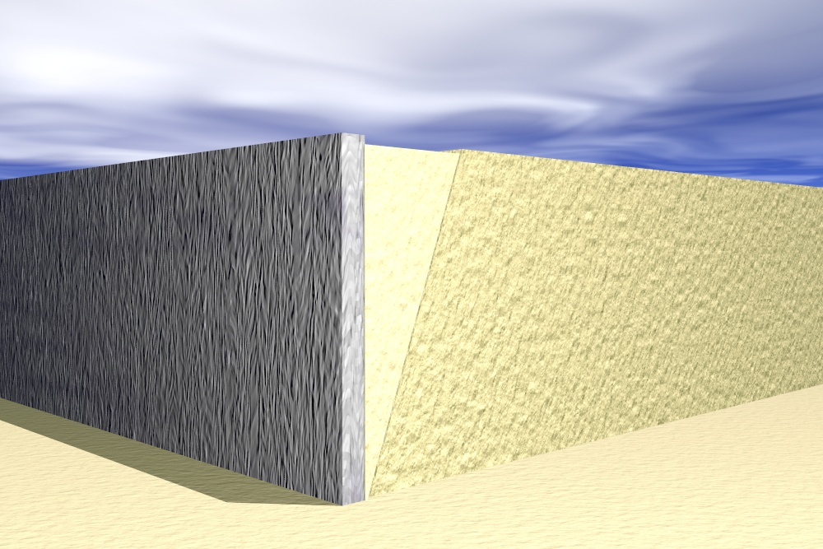
Vertical and Horizontal Stress in Soil
Stability of a retaining wall.
Deformation
Active Wedge. Exerting pressure on the wall
d
σ_{v} = d γ_{soil}
.
σ_{h} = (d γ_{soil} ) K_{a} = σ_{v} K_{a}
By: Kamal Tawfiq, Ph.D., P.E.

Slide 23
Rankine’s Active Earth Pressure in φ − Soil
Δ
τ
W
γ
φ
φ
failure envelope
P_{a}
φ
F
θ = 45 ⁰+ φ/2
Δ
σ_{f}’
σ_{h}’
σ_{v}’
σ
At failure the active wedge will develop in the backfill
active earth pressure
σ_{v}’
σ_{h} is decreasing until failure
σ_{f}’
Coefficient of active earth pressure
σ_{f}’
σ_{v}’
tan² (45 – φ/2)
=
1 - sinφ
K_{a} = tan² (45 – φ/2)
=
1 + sinφ
By: Kamal Tawfiq, Ph.D., P.E.

Slide 24
Rankine’s Passive Earth Pressure in φ − Soil
Δ
φ
W
γ
φ
τ
failure envelope
passive earth pressure
P_{a}
θ = 45 ⁰− φ/2
θ = 45 ⁰− φ/2
Δ
At failure the passive
wedge will develop in the backfill
σ_{f}’
σ_{h}’
σ_{v}’
σ_{f}
active earth pressure
σ_{h} is increasing until failure
σ_{v}’
Coefficient of passive earth pressure
σ_{f}’
σ_{f}’
σ_{v}’
tan² (45 + φ/2)
=
1 + sinφ
K_{p} = tan² (45 + φ/2)
=
1 - sinφ
By: Kamal Tawfiq, Ph.D., P.E.

Slide 25

Rankine’s Active Earth Pressure in φ − Soil
α = 0
δ = 0
Active Wedge
σ_{v}’
σ_{f}’
β = 0
1 - sinφ
K_{a} = tan² (45 – φ/2)
=
1 + sinφ

Slide 26
G.S.
γ_{soil}
φ
h₁
W.T.
σ_{h} = γ_{soil}h₁
+
h₂
σ_{h} = γ_{soil}h₁ + (γ_{soil} + γ_{w})h₂
σ_{w} = γ_{w}h₂

Slide 27
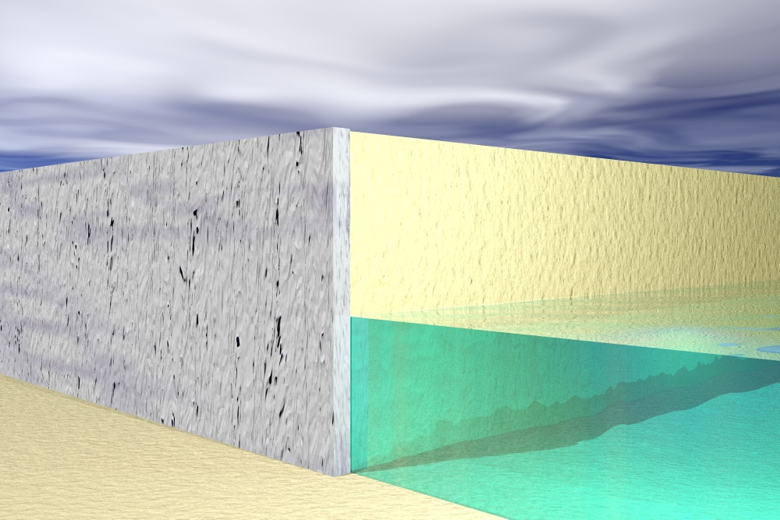
By: Kamal Tawfiq, Ph.D., P.E.

Slide 28
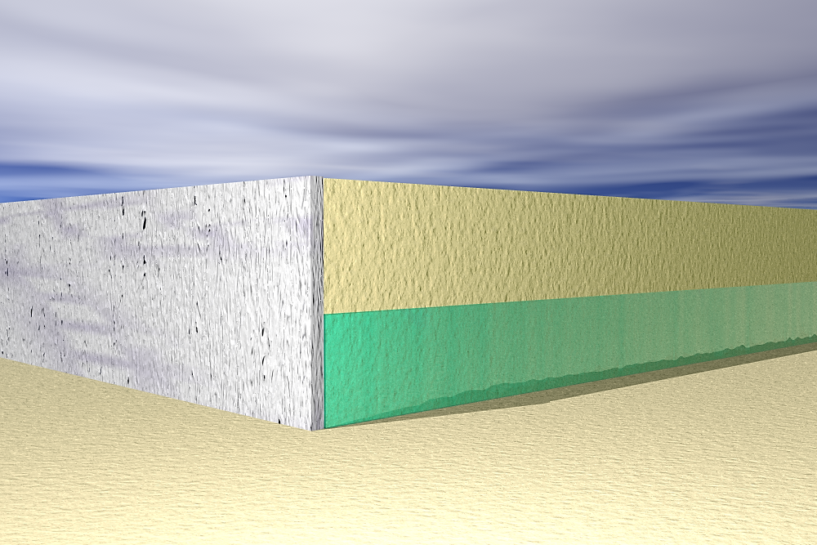
Point | Depth | Unit Weight (pcf) | Vertical Stress = σ_{v} (psf) | Lateral Stress = σ_{h} (Psf)
1 | 0 | 110 | 0 | 0
2 | 6 | 110 | 110 x 6 = 660 | 660x0.33 = 217.8
3 | 10 | 110 - 62.4= 47.6 | [(110x6)+(110-62.4)(4)] = 850.4 | 283.18
1
σ_{h1}
γ_{soil}
110 pcf
=
=
6’
φ = 30º
h₁
P₁
Water Table
2
σ_{h2}
γ_{sub}
γ_{soil -}γ_{water}
=
4’
=
P₂
h₂
P₃
K_{a} = 0.33
3
σ_{h3}
P₁ | = 0.5 x σ_{h2} x 6 = 0.5 x 217.8 x 6 = 653.4 lb/ft
P₂ | = σ_{h2} x 4 = 217.8 x 4 = 871.2 lb/ft
P₃ | = 0.5 x (σ_{h3} - σ_{h2}) x 4 = 0.5 x 65.38 x 4 = 130.76 lb/ft

Slide 29
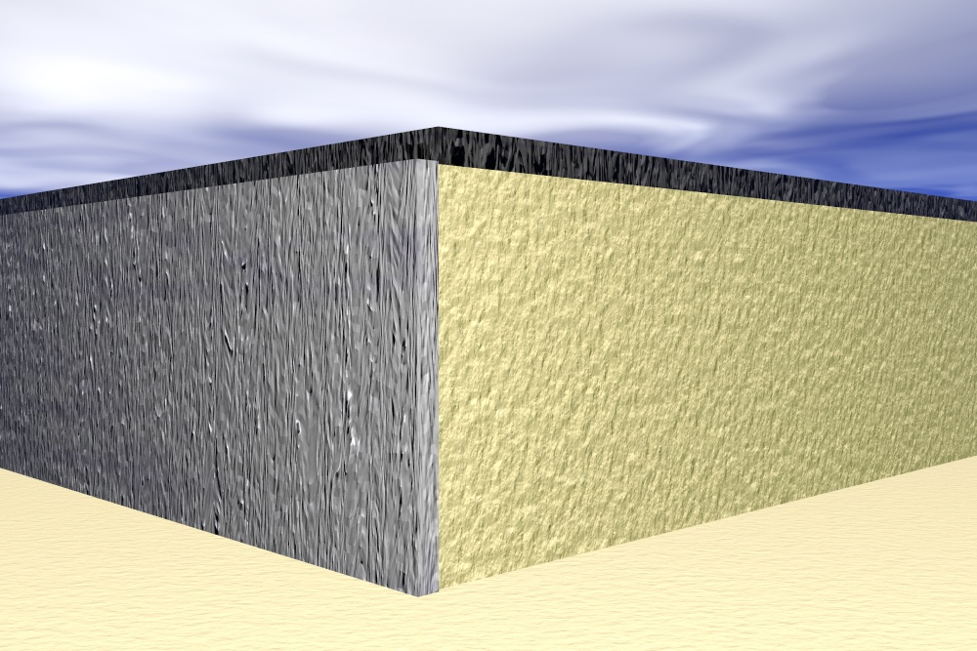
Effect of Surcharge Load on Earth Pressure
q
q k_{a}
q k_{a}
+
+
+
=
+
Qk_{a} + γHk_{a}
γHk_{a}
q k_{a}
By: Kamal Tawfiq, Ph.D., P.E.

Slide 30
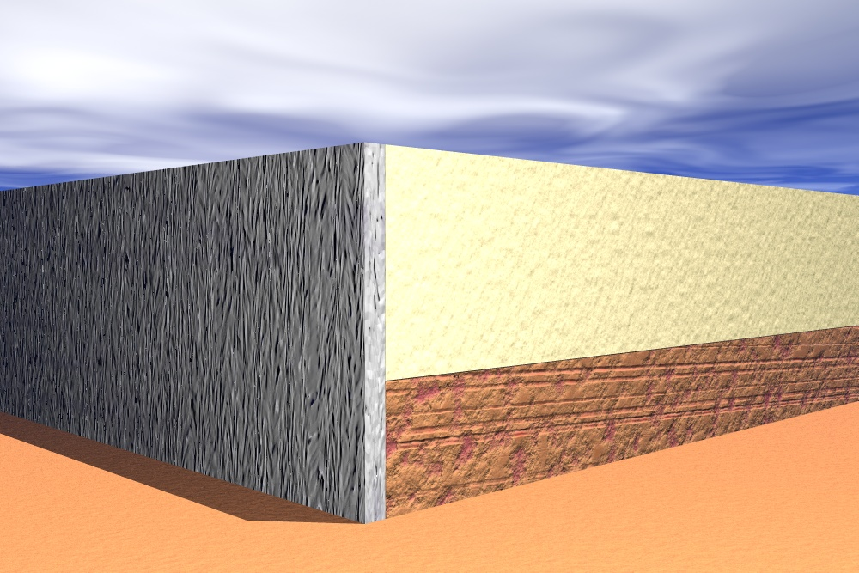
By: Kamal Tawfiq, Ph.D., P.E.

Slide 31
Rankine’s Active Earth Pressure
Case 2: c- φ Soil
τ
Δ
γ =
φ =
c=
√
φ
σ_{v}’
√
failure envelope
√
σ_{f}’
c
σ_{f}’
σ_{h}’
σ_{v}’
σ
-2c K_{a}
-2c K_{a}
active earth pressure
-
σ_{h} is decreasing until failure
Coefficient of active earth pressure
-
+
=
+
σ_{f}’
σ_{v}’
tan² (45 – φ/2) – 2 c tan (45 – φ/2)
=
1 - sinφ
+
where K_{a} = tan² (45 – φ/2)
=
1 + sinφ
γ H K_{a}
-2c K_{a}
-2c K_{a}
γ H K_{a}
σ_{f}’
σ_{v}’
√
=
K_{a} – 2 c K_{a}
By: Kamal Tawfiq, Ph.D., P.E.

Slide 32
Rankine’s Passive Earth Pressure in c- φ Soil
Δ
γ =
φ =
c=
√
φ
failure envelope
√
σ_{v}’
τ
√
passive earth pressure
σ_{f}’
θ = 45 ⁰− φ/2
σ_{f}’
σ_{h}’
σ_{v}’
σ_{f}
+2c K_{p}
+2c K_{p}
active earth pressure
σ_{h} is increasing until failure
Coefficient of passive earth pressure
+
+
+
=
+
+
σ_{f}’
σ_{v}’
tan² (45 + φ/2) + 2 c tan (45 + φ/2)
=
1 + sinφ
where K_{p} = tan² (45 + φ/2)
=
1 - sinφ
γ H K_{p}
+2c Kp
+2c K_{p}
γ H K_{a}
σ_{f}’
σ_{v}’
√
=
K_{p} + 2 c K_{p}
By: Kamal Tawfiq, Ph.D., P.E.

Slide 33
Rankine’s Active Earth Pressure in φ − Soil
Case 1: For Inclined Surface
α
K_{a} = cosα
Cosα – (cos²α – cos² φ)^{1/2}
Cosα + (cos²α – cos² φ)^{1/2}
P_{a} = 0.5 γ H² K_{a}
H
α
Fig.1

Slide 34
Coulomb Earth Pressure
Method (1776)

Slide 35
Coulomb Earth Pressure Method (1776)
Forces acting on the wall.
Wall Displacement = Δ
This active wedge will slide along the failure surface and will exert pressure on the wall. Also, the sliding wedge will push the wall away from the backfill.
W
Soil-Wall Friction
Soil-Soil Friction
Failure surface
Pressure from the sliding wedge
By: Kamal Tawfiq, Ph.D., P.E.

Slide 36
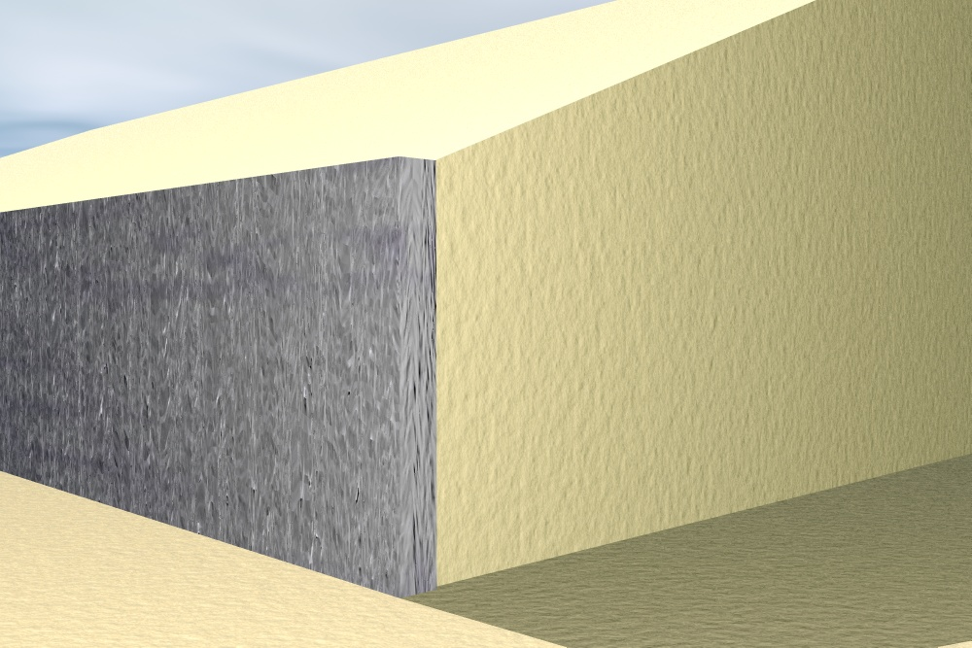
Coulomb Earth Pressure Method (1776)
Forces acting on an inclined wall.
β
Wall Displacement = Δ
Active Wedge. Exerting pressure on the wall
α
W
γ
φ
Normal
φ
Normal
θ
P_{a}
δ
H
F
δ
Pa
Shear
Shear
H/3
By: Kamal Tawfiq, Ph.D., P.E.

Slide 37
Coulomb Earth Pressure Method (1776)
Forces acting on the wall.
Wall Displacement = Δ
Active Wedge. Exerting pressure on the wall
W
φ
Normal
Normal
δ
Shear
F
Pa
Shear
By: Kamal Tawfiq, Ph.D., P.E.

Slide 38
Coulomb Earth Pressure Method (1776)
W = weight of the soil wedge
R = resultant of the shear and normal forces on the failure surface BC
P_{a} = the active force per unit length of the wall. The direction of Pa is inclined at an angle d to the normal drawn and the face of the wall that supports the soil
Δ = the angle of friction between the soil and the wall
α
The force triangle for the wedge is shown in the Figure 2. From the sine law, the forces can be set as follows:
β−α
W
P_{a}
(1)
Sin (90 + θ + δ − β +φ)
=
Sin (β − φ)
W
γ
φ
Sin (β − φ)
W
θ
P_{a}
(2)
=
Sin (90 + θ + δ − β +φ)
H
Substitute for W, Eq. 2 can be written as
φ
0.5 γ H² [
cos (β − φ) cos (φ − α) sin (β − φ)
]
(2)
δ
R
90 − θ − δ
P_{a}
=
cos² θ sin( β − α) sin (90 + θ − δ − β + φ)
P_{a}
P_{a}
To determine the critical value for β for maximum P_{a}
β
(dP_{a}/dβ) = 0
Fig.1
W
P_{a} = ½ K_{a} γ H²
90 + θ + δ − β +φ
β − φ
Where K_{a} = Coulomb’s active earth pressure coefficient
R
K_{a} =
cos² (φ− θ)
Fig.2
sin( δ + φ) sin (φ − α)
2
[
]
cos² θ cos( δ − θ)
1+
cos ( δ + θ) cos (θ − α)
By: Kamal Tawfiq, Ph.D., P.E.

Slide 39
Coulomb’s Earth Pressure
= √
= 0
= 0
α = 0
α = 0
K_{a} =
cos² (φ− θ)
sin( δ + φ) sin (φ − α)
2
[
]
cos² θ cos( δ − θ)
1+
cos ( δ + θ) cos (θ − α)
γ
φ
Under the given wall and backfill conditions, K_{a} of Coulomb’s active earth pressure
becomes equivalent to K_{a} of Rankine’s
H
1 - sinφ
K_{a}
=
1 + sinφ
Vertical
Surface
θ = 0
Smooth Surface
P_{a} = ½ K_{a} γ H²
δ = 0
By: Kamal Tawfiq, Ph.D., P.E.

Slide 40
Active Earth Pressure in φ − Soil
Δ
Example -1
Given:
Vertical retaining wall (flexible)
Wall height (H) = 12 ft
Backfill unit weight (γ) = 115 pcf
Angle of soil friction (φ) = 30º
Assume wall to be smooth
Find:
Lateral force P_{a} acting on the wall
Solution:
W
γ
φ
P_{a}
φ
F
θ = 45 ⁰+ φ/2
Δ
P_{a}=γ H k_{a}
σ_{h} = σ_{v} k_{a}
1/2
P_{a} = γ H^{0.5} k_{a}
1 - sinφ
y_{a} = 12/3
K_{a}
=
1 + sinφ
σ_{h} = σ_{v} k_{a}
P_{a} = 115 x 12² x 0.5
By: Kamal Tawfiq, Ph.D., P.E.

Slide 41
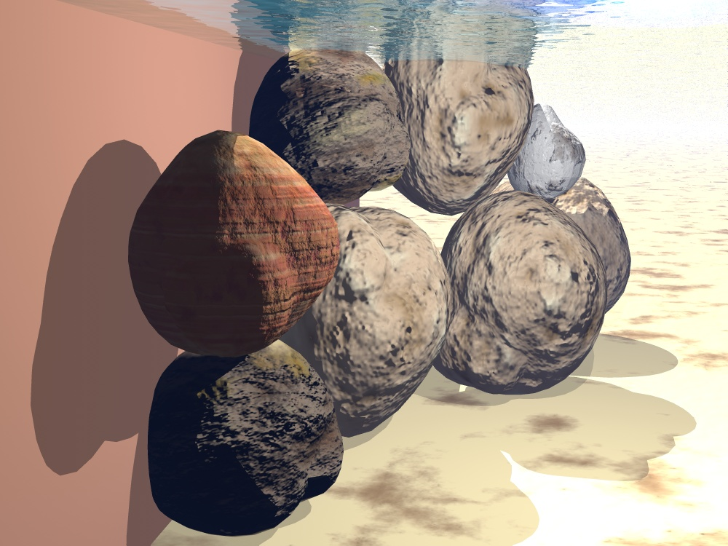
P_{water}
+
P_{soil}
+
P_{soil}
P_{water}
By: Kamal Tawfiq, Ph.D., P.E.

Slide 42
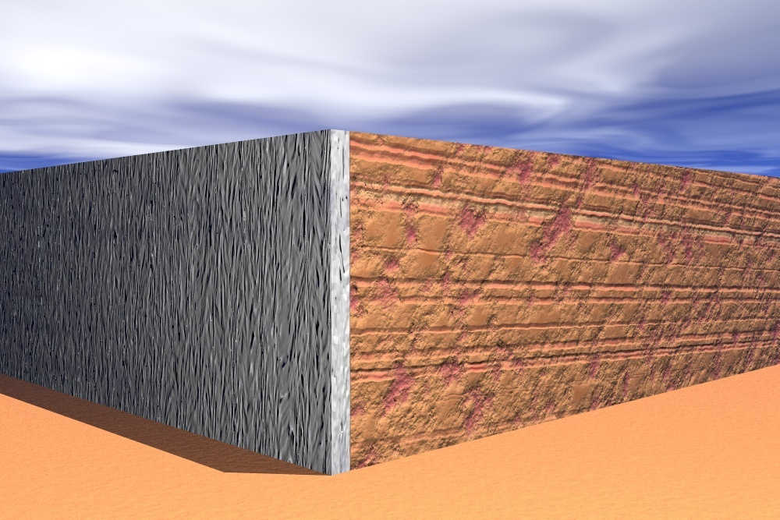
q
q k_{a}
q k_{a}
Pavement
+
+
+
=
+
γHka
q k_{a}
By: Kamal Tawfiq, Ph.D., P.E.

Slide 43
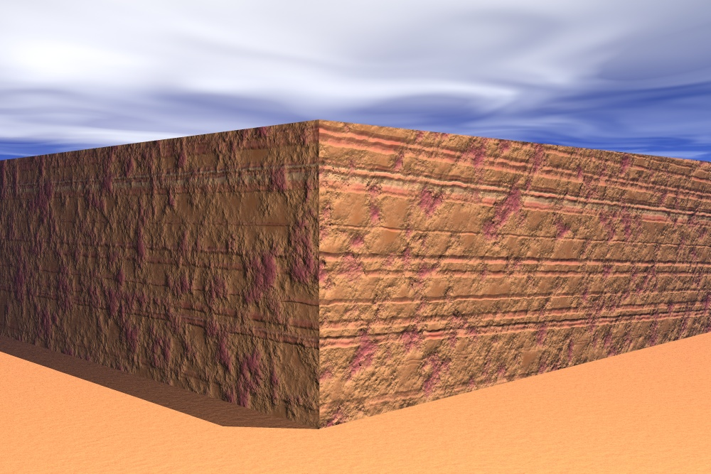
-2c√k_{a}
-
-
-
+
+
+
+
=
=
+
+
-2c√k_{a}
γHka
By: Kamal Tawfiq, Ph.D., P.E.

Slide 44
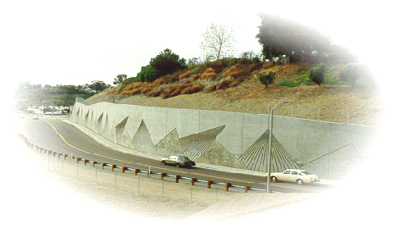
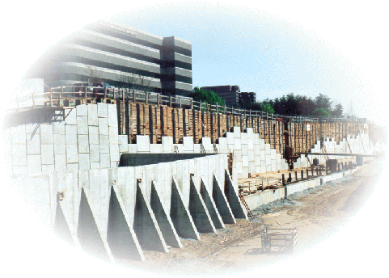
Earth Pre
ssure
&
Retaining W
all Design
By
Kamal Tawfiq,
Ph.D., P.E.

Slide 45
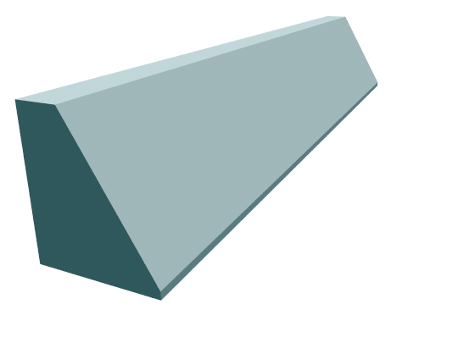
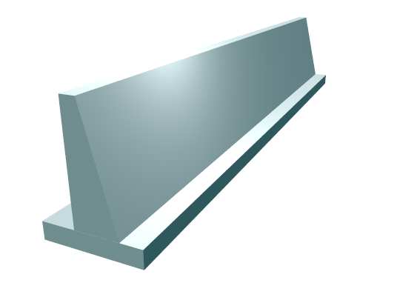
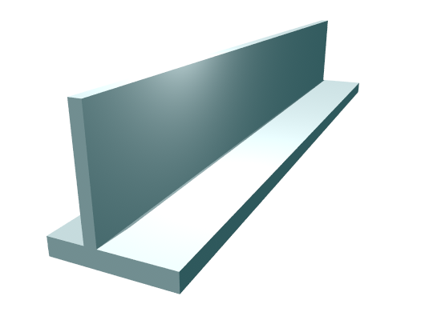
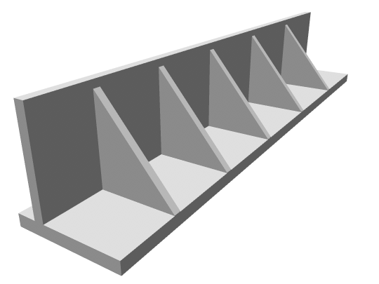
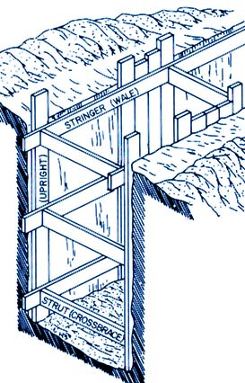
Types of Earth Retaining Walls
I- Permanent Walls
II- Temporary Walls ......
1
I- Permanent Walls
1- Gravity Wall
2
2- Semi-gravity wall
3
3- Cantilever wall
4- Counterfort wall
5-
Sheet pile wall & Braced cuts
4
5
By: Kamal Tawfiq

Slide 46
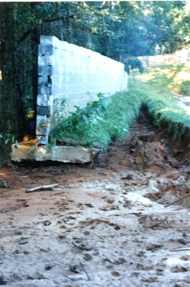
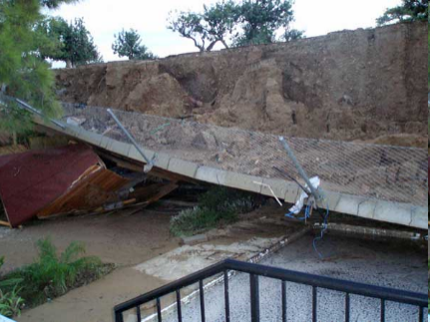
Design of Retaining Wall
1- External Stability
2- Internal Stability
1
2
1. External Stability
1- Sliding
2- Overturning
3- Settlement
4- Overall Failure
3
4
By Kamal Tawfiq, Ph.D., P.E

Slide 47
Common Proportions of Cantilever Wall
12 in Preferable minimum
Minimum batter = 1/50
Vertical
Stem
H
Toe Slab
H/10 to H/8
Thickness
H/12 to H/10
Heel of Slab
D_{f}
_{Thickness = H/12 to H/10}
_{B = 0.4 to 0.7 H}
Base of footing

Slide 48
Approximate Dimensions
0.25 m to 0.4 m
0.3 m to H/12
1
48
H
H
B/3
D/2 to D
H/12 to H/10
>1m
>1m
B =
0.4 H to 0.7 H
H/12 to H/8
B =
0.5 H to 0.7 H
D = H/8 to H/6
Cantilever Retaining Wall
Gravity Retaining Wall
Kamal Tawfiq, 2011

Slide 49
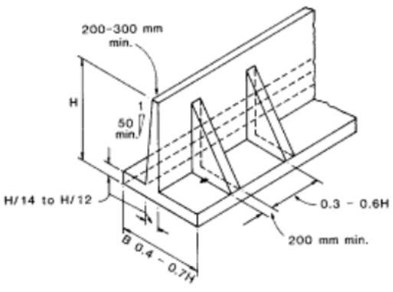
Counterfort Retaining Wall

Slide 50
Coulomb Earth Pressure Method
α
γ
φ
P_{a} = ½ K_{a} γ H²
Where K_{a} = Coulomb’s active earth pressure coefficient
θ
P_{a} = 0.5 γ H² K_{a}
K_{a} =
cos² (φ− θ)
H
sin( δ + φ) sin (φ − α)
2
[
]
δ
cos² θ cos( δ − θ)
1+
cos ( δ + θ) cos (θ − α)
Angle of Friction between the wall and the soil
δ
Fig.1
By: Kamal Tawfiq, Ph.D., P.E.

Slide 51
Rankine’s Earth Pressure
= √
= 0
= 0
α = 0
α = 0
P_{a} = ½ K_{a} γ H²
γ
φ
1 - sinφ
K_{a}
=
1 + sinφ
H
P_{a}=γ H k_{a}
1/2
Vertical
Surface
θ = 0
Smooth Surface
δ = 0
By: Kamal Tawfiq, Ph.D., P.E.

Slide 52
Rankine’s Active Earth Pressure in φ − Soil
Case 1: For Inclined Surface
α
K_{a} = cosα
Cosα – (cos²α – cos² φ)^{1/2}
Cosα + (cos²α – cos² φ)^{1/2}
P_{a} = 0.5 γ H² K_{a}
H
α
Fig.1

Slide 53
Active Earth Pressure in φ − Soil
Δ
Example -1
Given:
Vertical retaining wall (flexible)
Wall height (H) = 12 ft
Backfill unit weight (γ) = 115 pcf
Angle of soil friction (φ) = 30º
Assume wall to be smooth
Find:
Lateral force P_{a} acting on the wall
Solution:
P_{a}=γ H k_{a}
1/2
y_{a} = 12/3
σ_{h} = σ_{v} k_{a}
W
H
σ_{h} = σ_{v} k_{a}
P_{a} = γ H^{0.5} k_{a}
P_{a}=γ H k_{a}
1/2
1 - sinφ
D
K_{a}
=
1 + sinφ
P_{a} = 115 x 12² x 0.5
P_{p}= γ D k_{p}
1/2

Slide 54
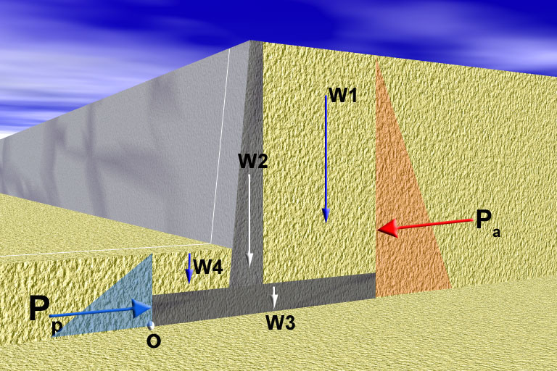
I. External Stability
Factor of Safety Against Sliding =
Resisting Force
=
F_{R}
1- Sliding
Driving Force
F_{D}
Friction = (∑W) tan δ
F_{D} = P_{a}
F_{R} = P_{p} + Friction
By: Kamal Tawfiq

Slide 55
I. External Stability
Resisting Moment
M_{R}
2- Overturning
Factor of Safety Against Sliding =
=
M_{D}
Driving Moment
Resisting Moment
M_{R}
Driving Moment
M_{D}
a₁
a₂
a₄
y_{a}
a₃
y_{p}
Moment About o
M_{D} = P_{a} . y_{a}
M_{R} = P_{p}.y_{p} + W₁ a₁ + W₂ a₂ +W₃ a₃ +W₄ a₄
By: Kamal Tawfiq

Slide 56
Using Key at the Base to Improve Sliding Resistance
Extent of the Passive
Pressure
Key
Friction Surface of along the Base

Slide 57
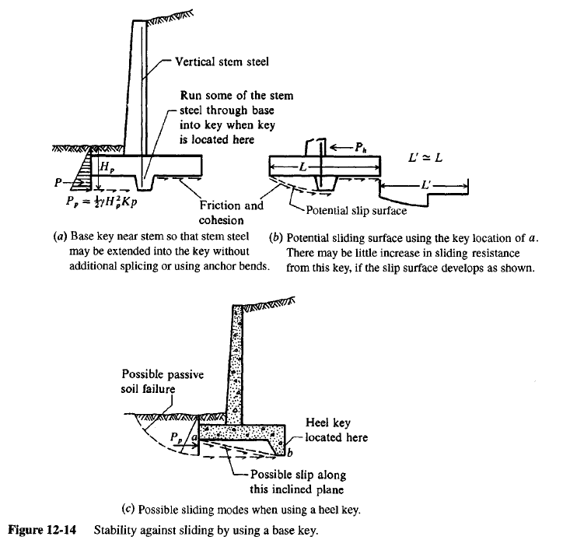

Slide 58
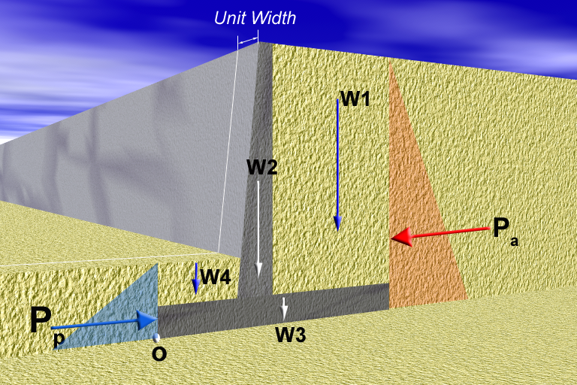
I. External Stability
3- Bearing Capacity Failure
q_{min}
q_{max}

Slide 59
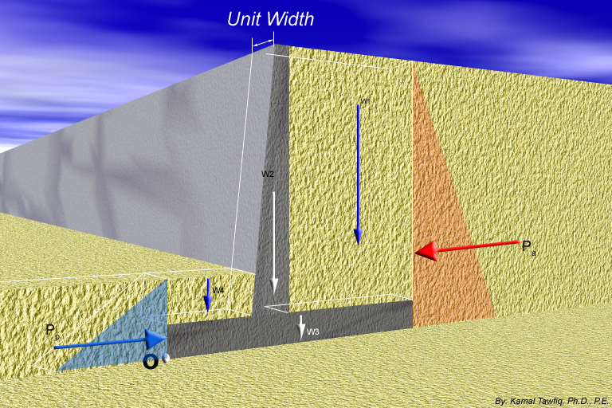
q_{all}
3- Check for Bearing Capacity Failure
Factor of Safety Against Bearing Capacity Failure =
q_{max}
q_{min} = 0
√
q_{max}
+
q_{min} = +
√
q_{max}
+
X
-
q_{min} = -
q_{max}
+
ΣV
R
X
ΣH
q_{min}
B
q_{max}
e
V = sum of all vertical loads
ΣH = sum of all horizontal loads
R = (ΣV)² ⁺ (ΣH)²
M_{net} = ΣM_{R} – ΣM_{o}
X =
B
e = - X
2
M_{net}
ΣV
M_{net} y
ΣV
6e
q
(
+
)
+
=
1
q =
-
ΣV
A
-
I
max
B
B
min

Slide 60
Retaining Wall Design
Internal Stability
By
Kamal Tawfiq, Ph.D., P.E.

Slide 64
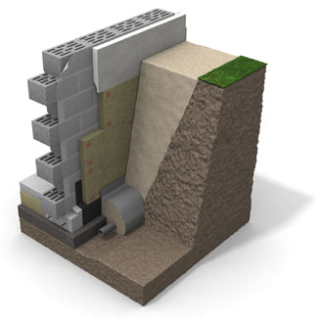
Masonry wall
Coarse soil
insulate the footing externally
In situ soil
Plain
concrete
or
4” gravel
Geofabric
Geofabric
French drain

Slide 65
SOLVED EXAMPLES

Slide 66
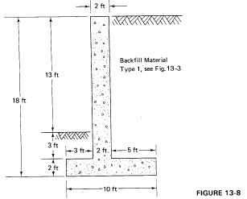
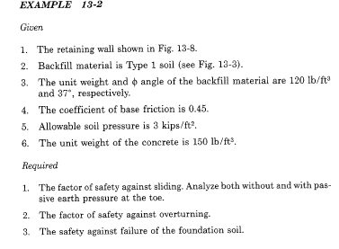
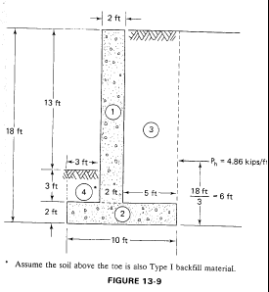
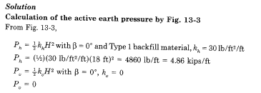
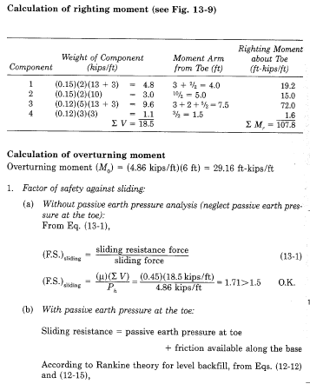

Slide 67
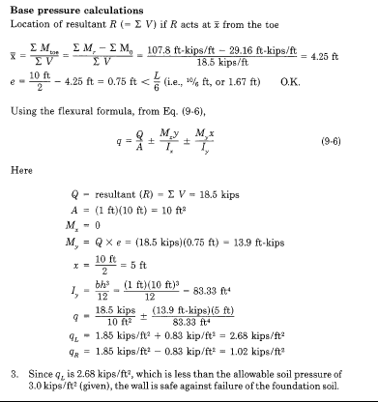
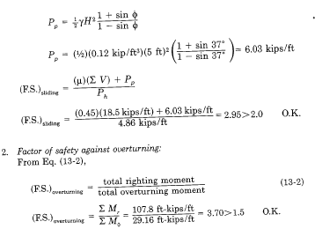

Slide 68

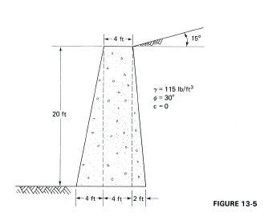


Slide 69




Slide 70


Slide 71



Slide 72
Example 1
Given
The cross section of a cantilever retaining wall is shown in Figure 1. Calculate the factors of safety with respect to overturning, sliding, and bearing capacity.
Solution
From the figure,
H' = H1 + H2 + T1 = 8 tan 10° + 19.5 + 2 = 22.91 ft
The Rankine active force per unit length of wall =
q = 120 lb/ft
1 ft
10º
3
H₁ = 1.41 ft
a₁
W₁
W₃
γ₁ = 115 lb/ft³
φ₁ = 30º
c₁ = 0
a₃
P_{v1}
H₂ = 19.5 ft
a₂
P_{a1}
a_{v}
W₂
P_{v}
10º
P_{h1}
a₄
4
2
P_{v2}
P_{a2}
10º
P_{h2}
a₆
6
W₄
W₆
y_{a}
10º
4.5 ft
a₅
W₅
5
T₁ = 2 ft
O
γ₂ = 112 lb/ft³
φ₂ = 20º
c₂ = 800 lb/ft²
2.25 ft
2.25 ft
8 ft

Slide 73



Slide 74


Slide 76


