Slide 1
Geotechnical
Investigation
By
Kamal Tawfiq, Ph.D., P.E., FASCE

Slide 2
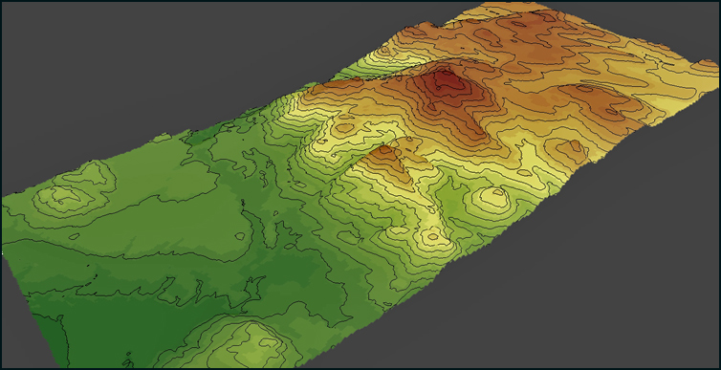
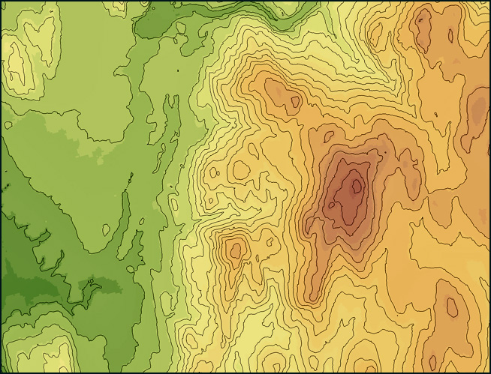

Slide 3
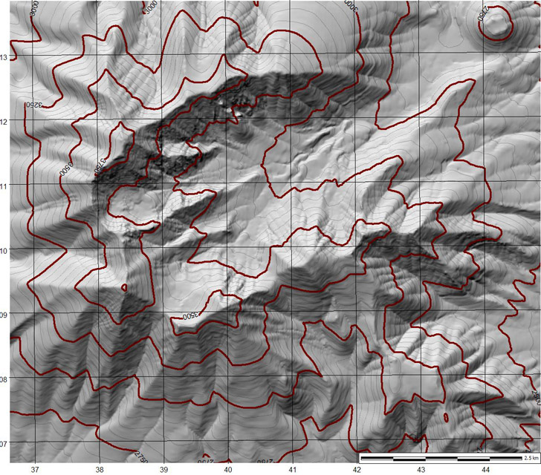
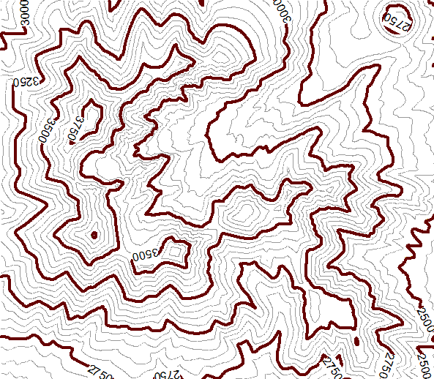

Slide 4
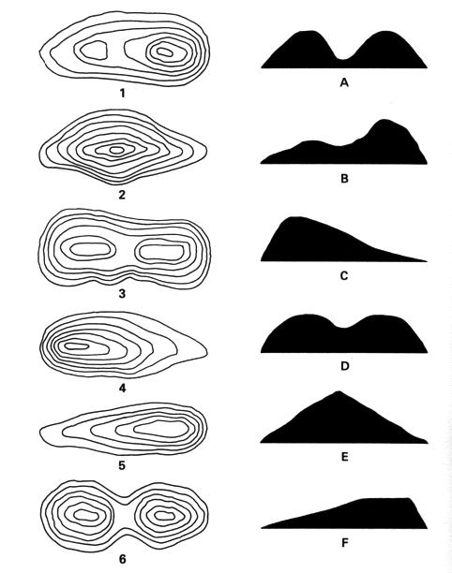
Topographic Maps, contours, and feature recognition

Slide 5
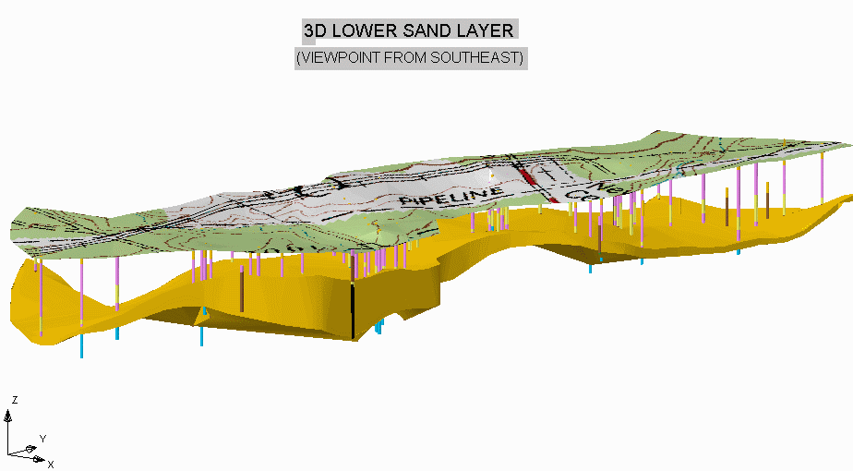

Slide 6
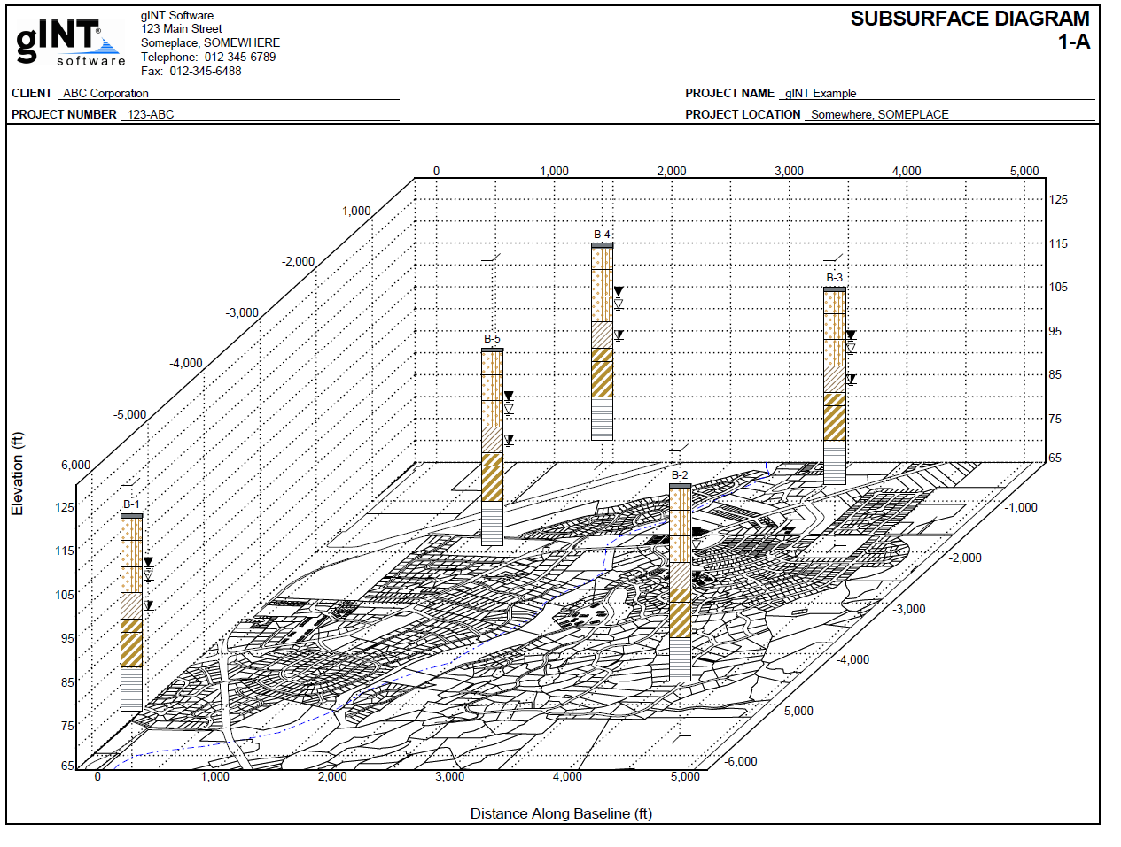

Slide 7
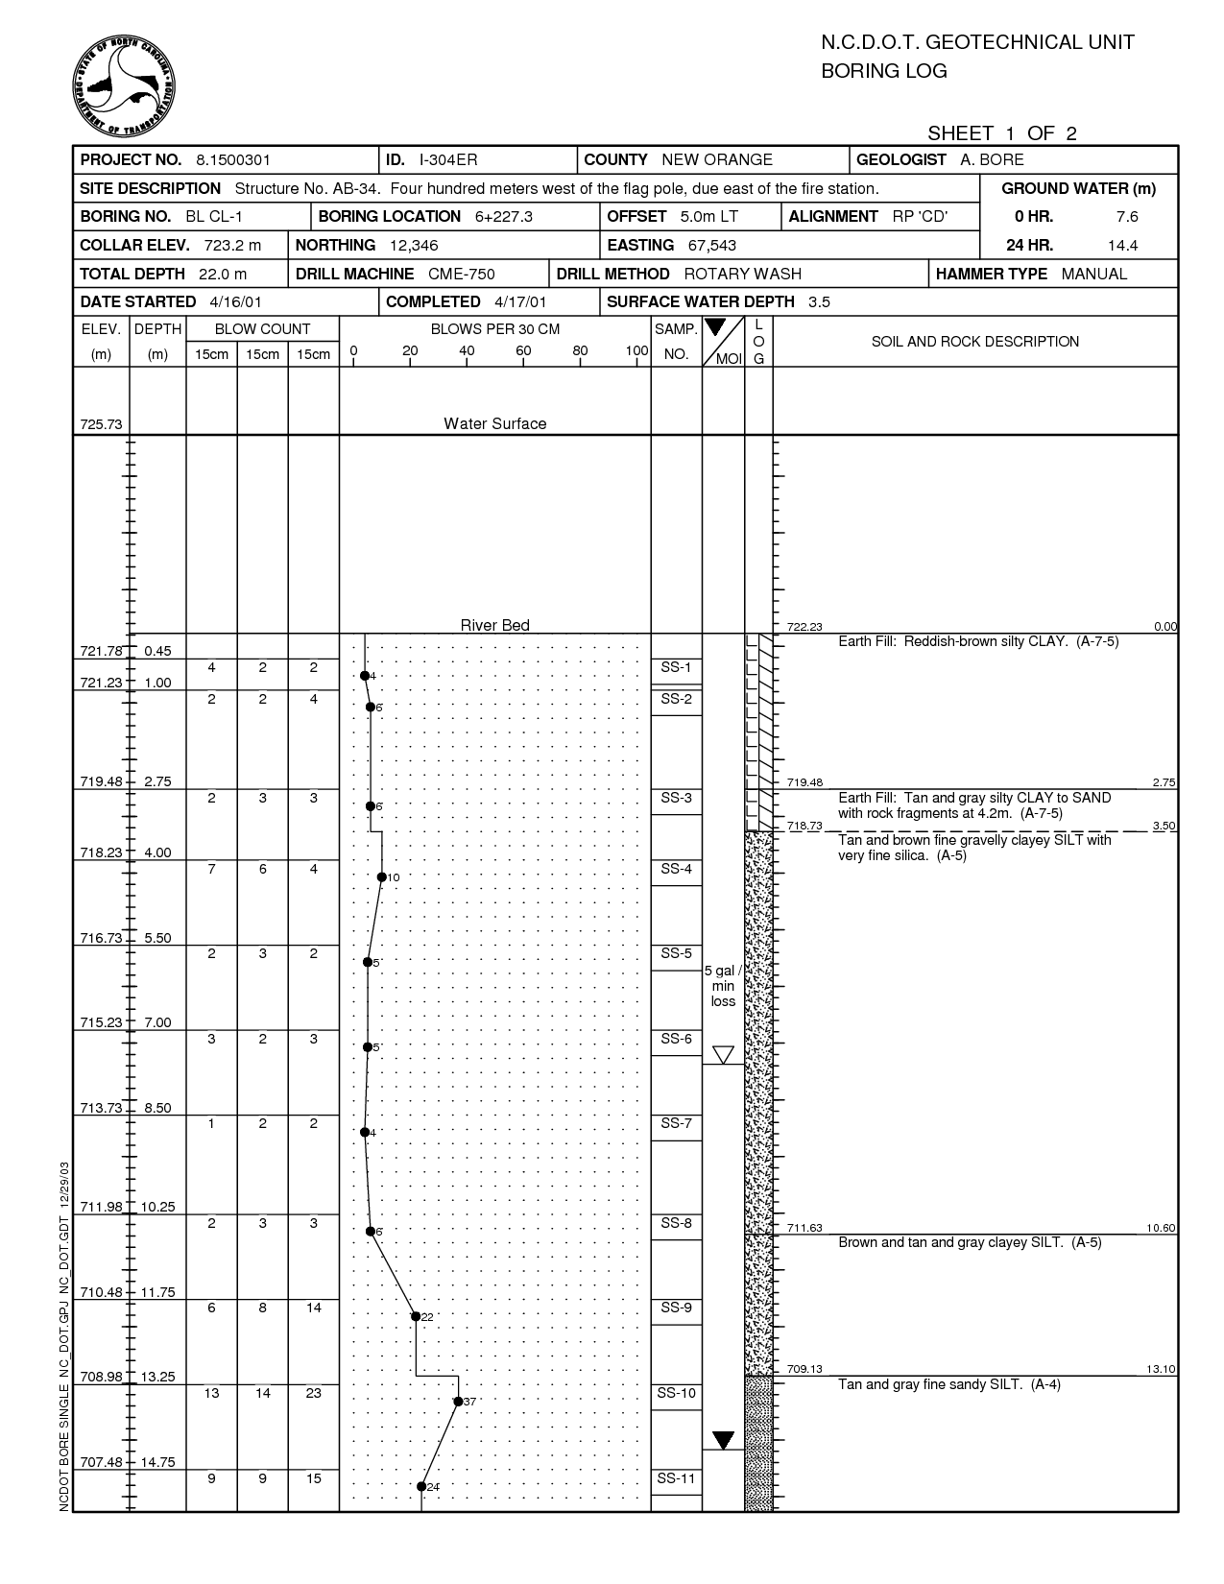

Slide 8
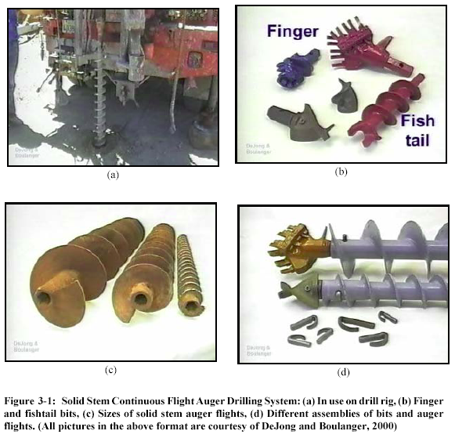
Foundation Engineering CEG 4111-5115
By: Kamal Tawfiq, Ph.D., P.E.

Slide 9
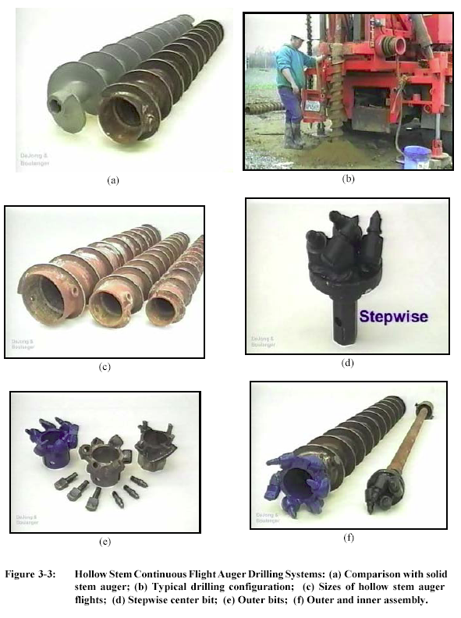

Slide 10
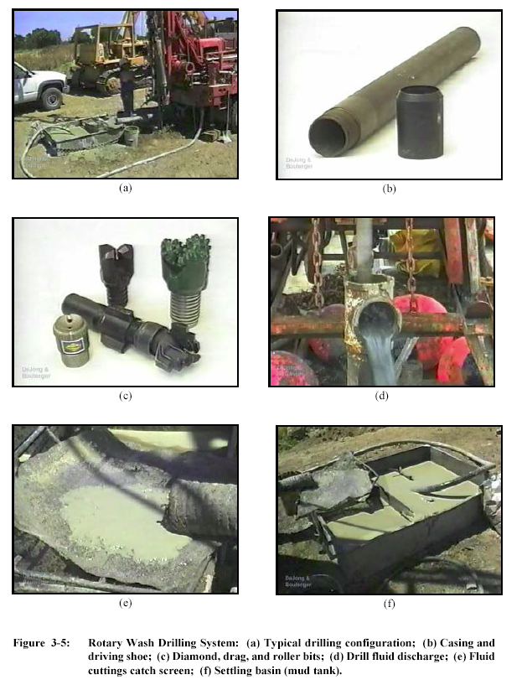

Slide 11
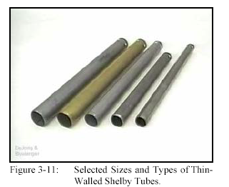
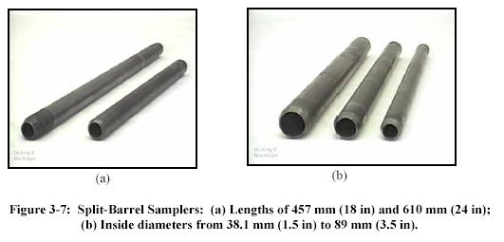
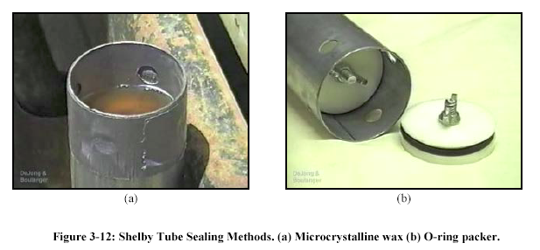
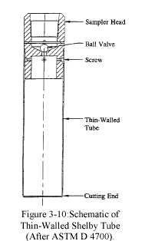

Slide 12
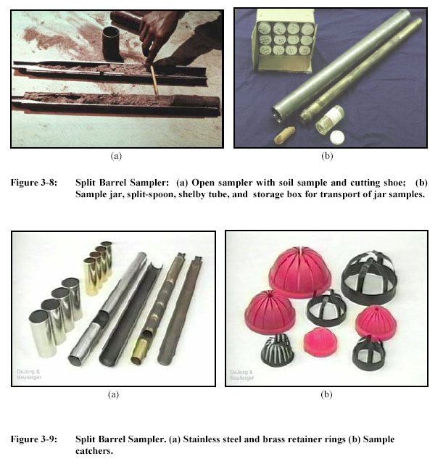

Slide 13
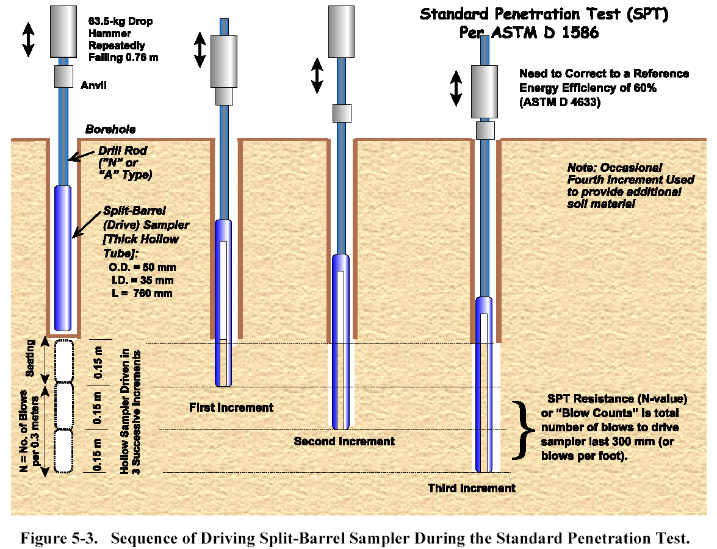

Slide 14
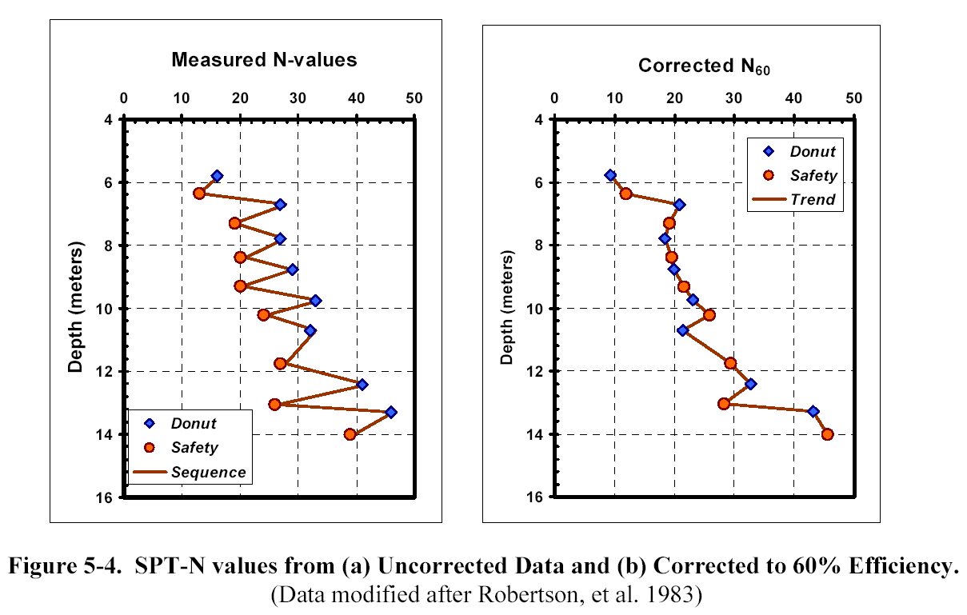

Slide 15
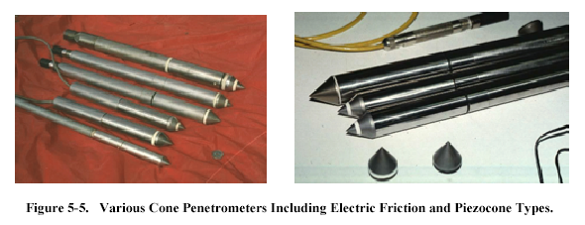

Slide 16
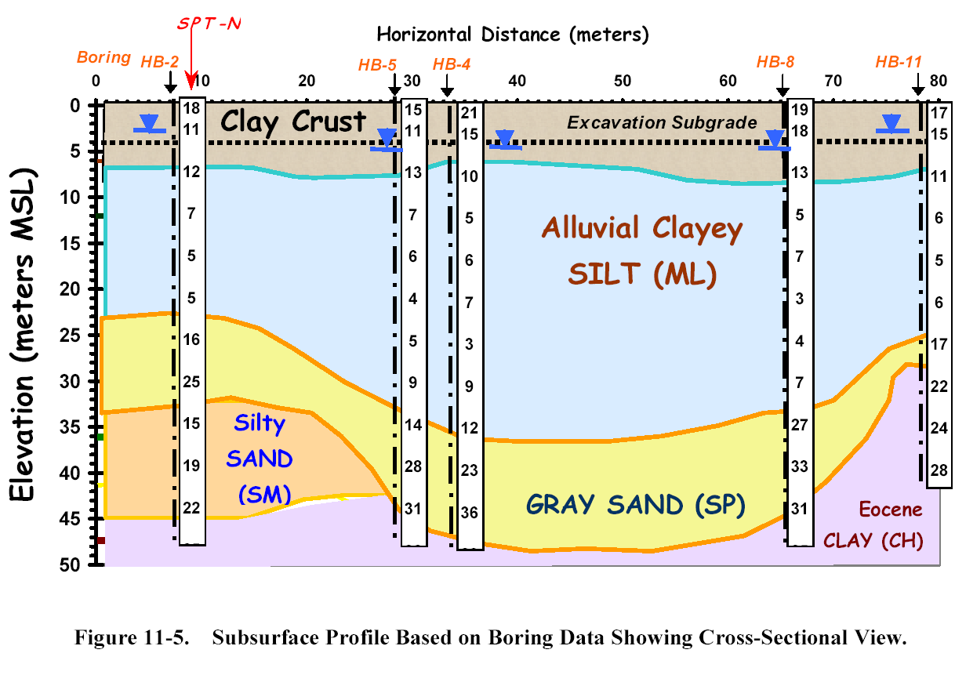

Slide 17
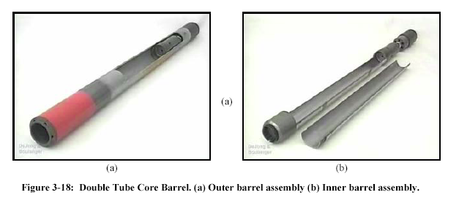
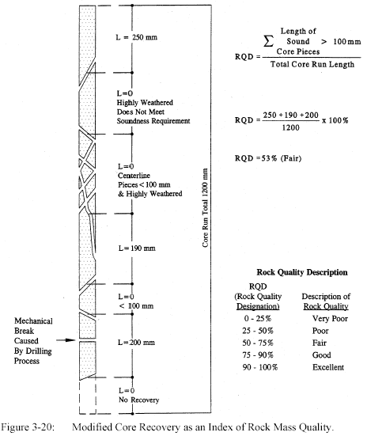
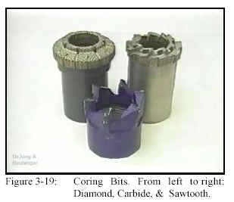
Rock Coring

Slide 18
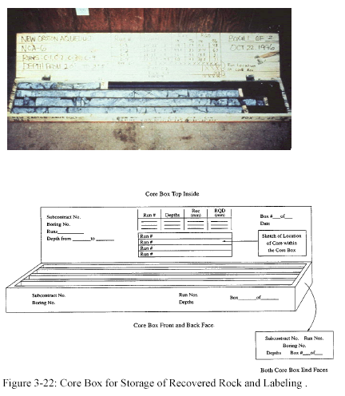

Slide 19
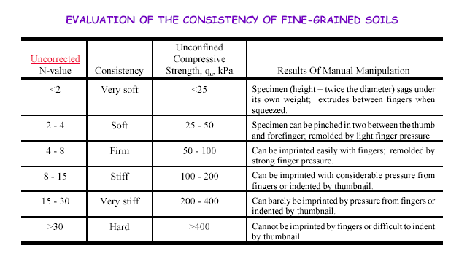

Slide 20
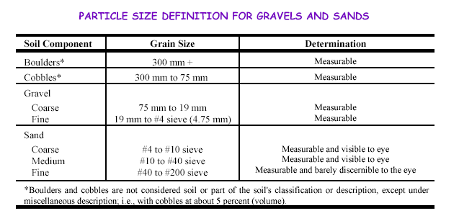

Slide 21
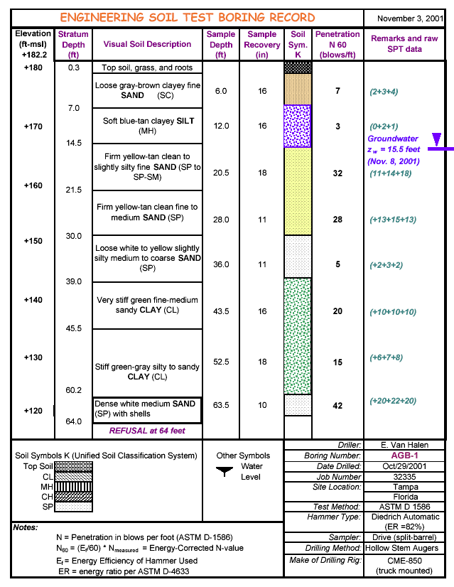

Slide 22
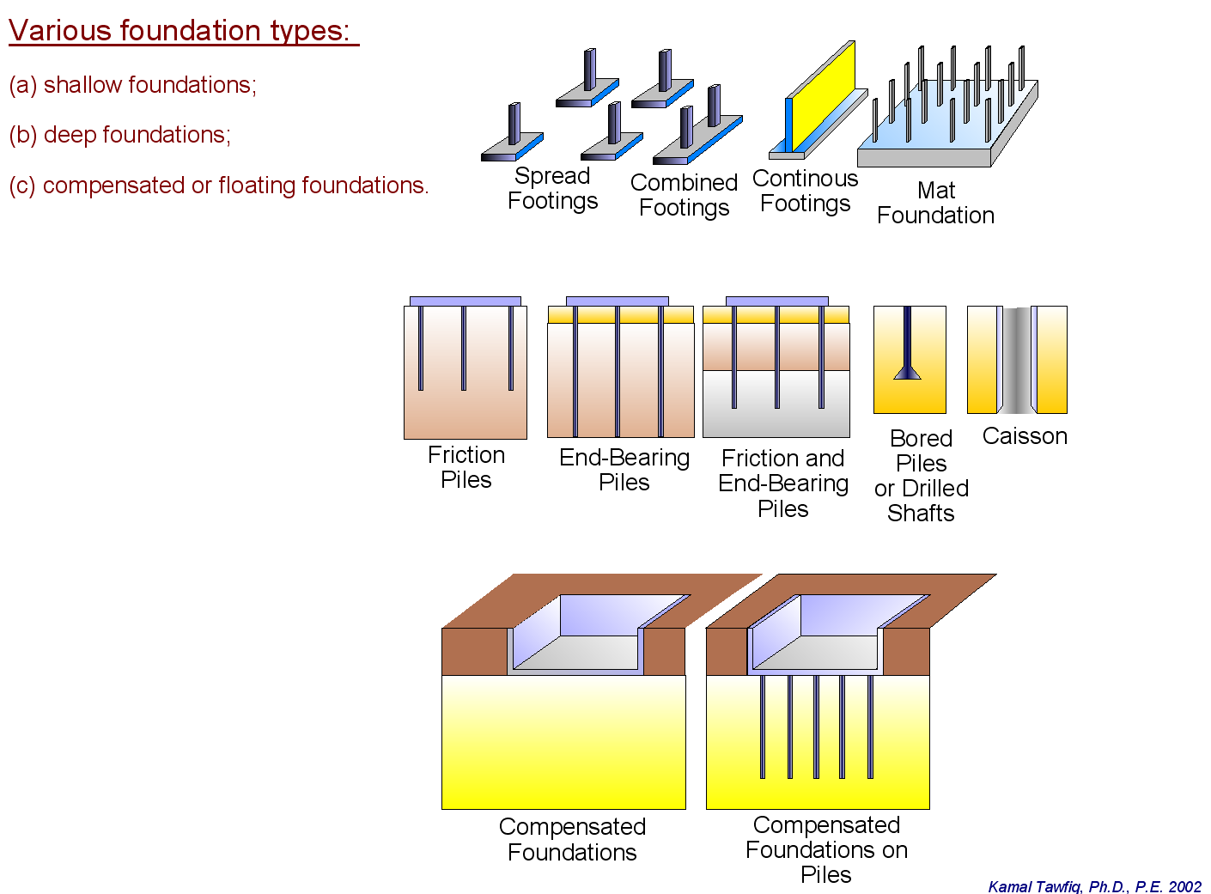
Structural Foundations are grouped into two main groups.
1- Shallow Foundation
Spread Footings
Continuous Footings
Combined Footings
Mat Foundation
2- Deep Foundation
Driven Piles
Drilled Shaft
Auger Cat Piles
3- Compensated or floating foundations

Slide 23
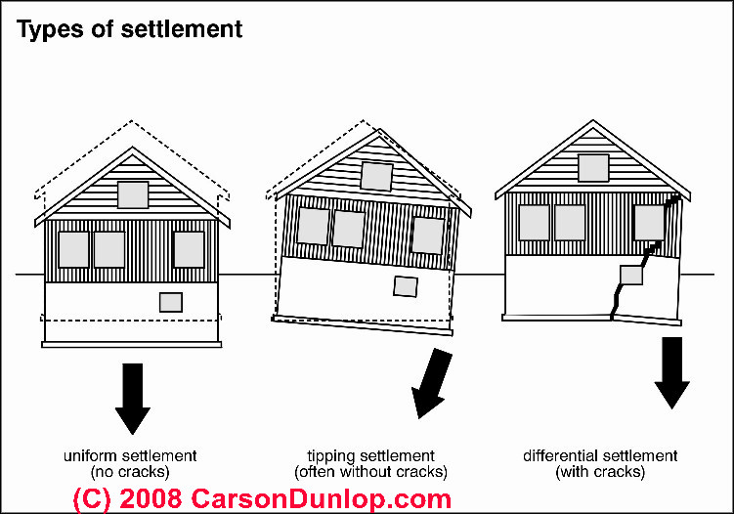

Slide 24
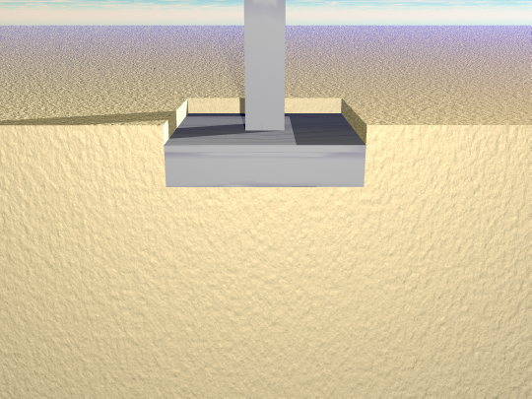
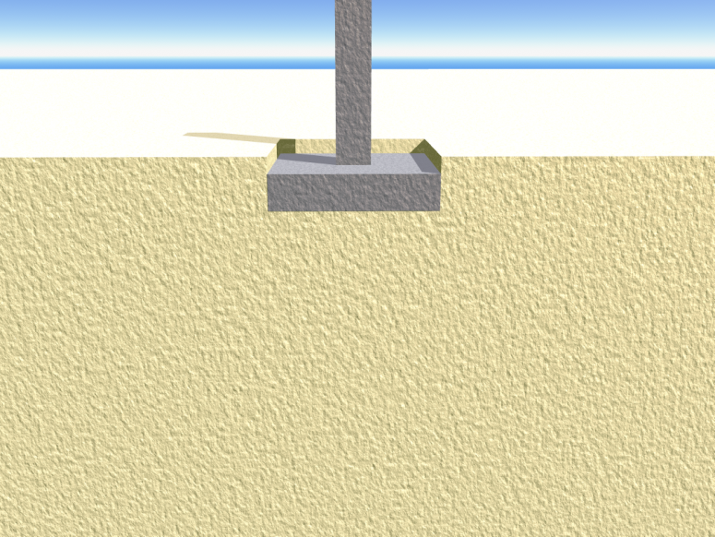
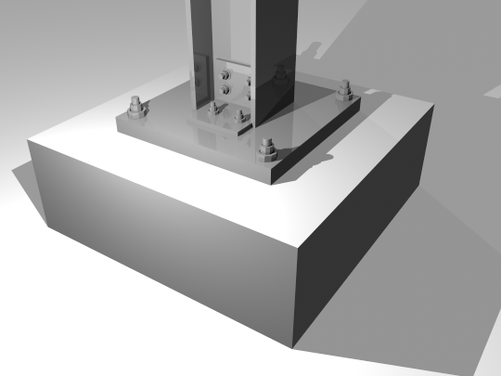
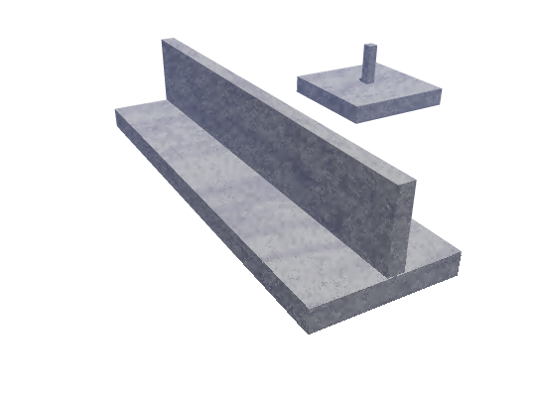
Shallow Foundation
Spread Footings
Spread Footings
Continuous Footings
Spread Footings

Slide 25
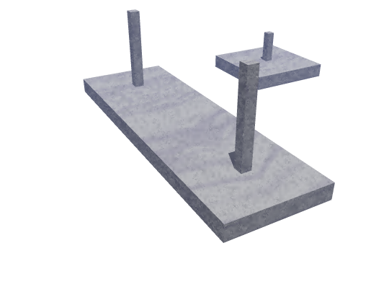
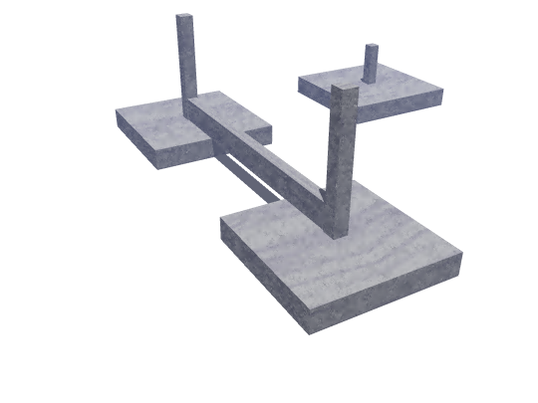
Spread Footings
Combined Footings
Combined Footings

Slide 26
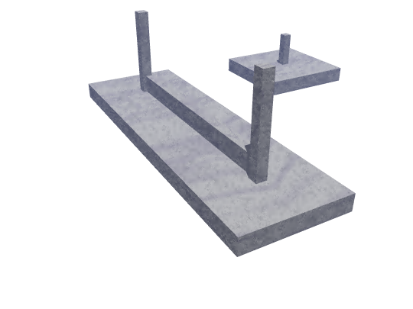
Spread Footings
Combined Footings

Slide 27
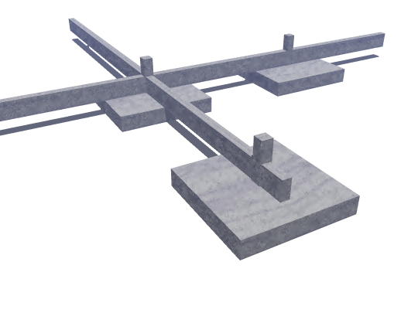
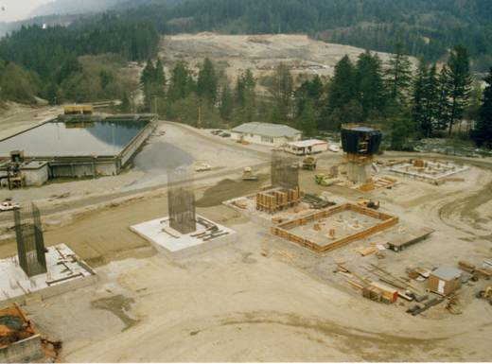
Analysis and Design of Shallow Foundation
I- Bearing Capacity
II- Settlement
I- ULTIMATE BEARING CAPACITY THEORIES:
TERZAGHI’S BEARING CAPACITY THEORY
GENERAL BEARING CAPACITY EQUATION

Slide 28
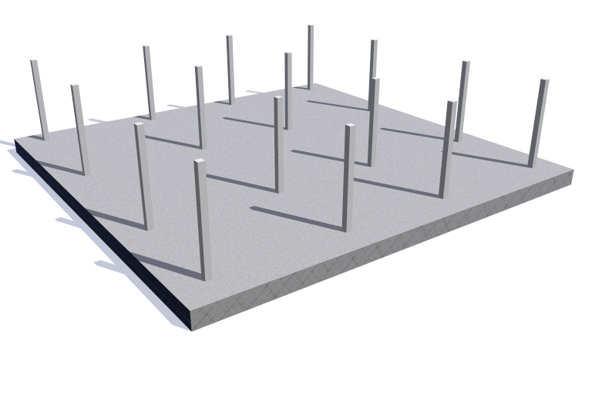
Mat Foundation

Slide 29
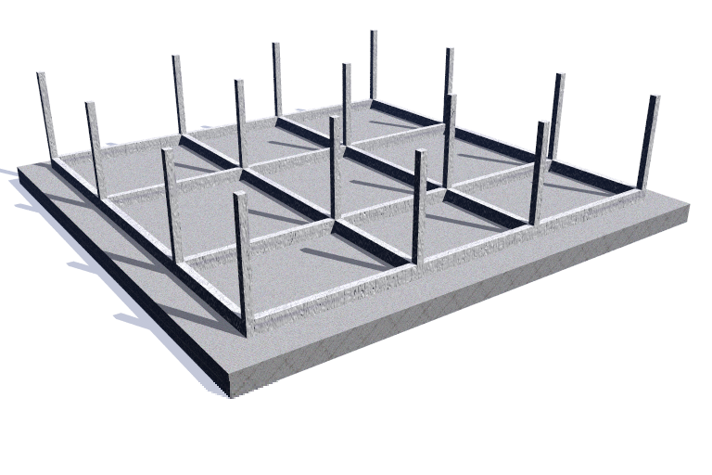
Mat Foundation

Slide 30
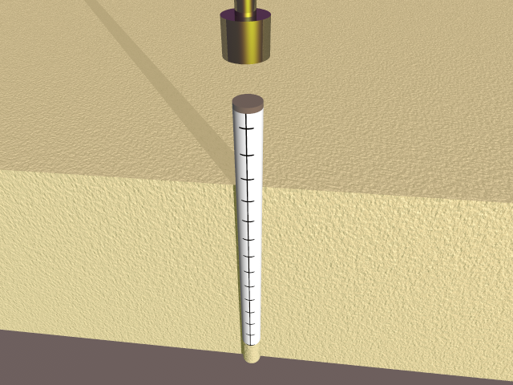
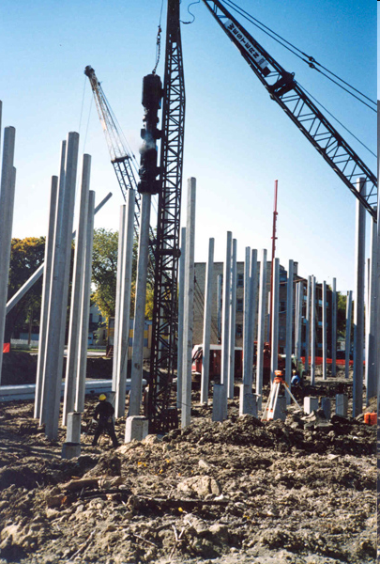
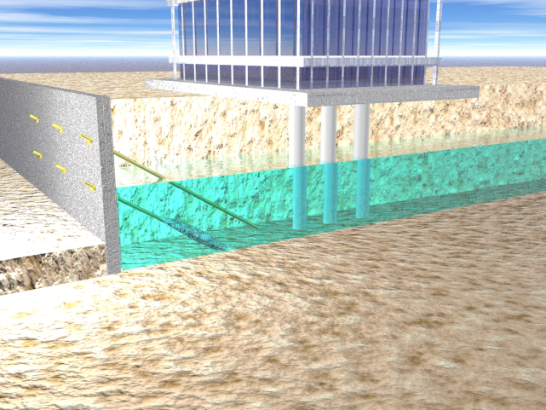
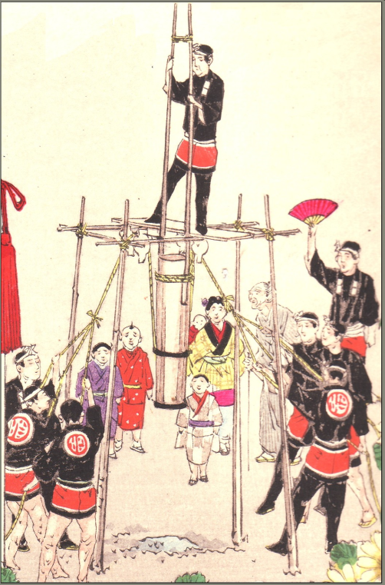
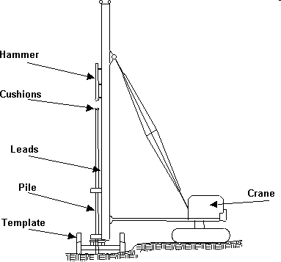
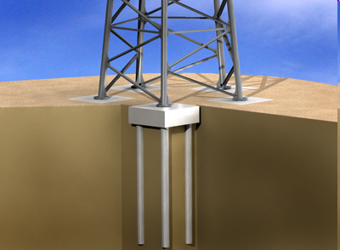
Deep Foundation
Driven Piles

Slide 31
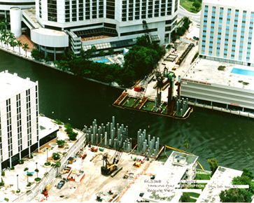
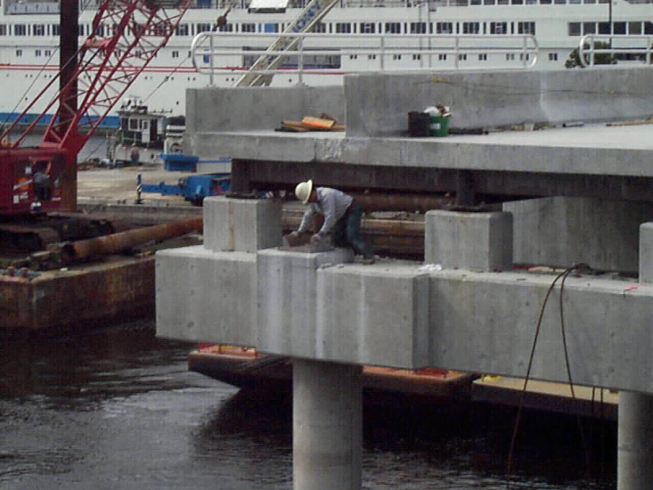
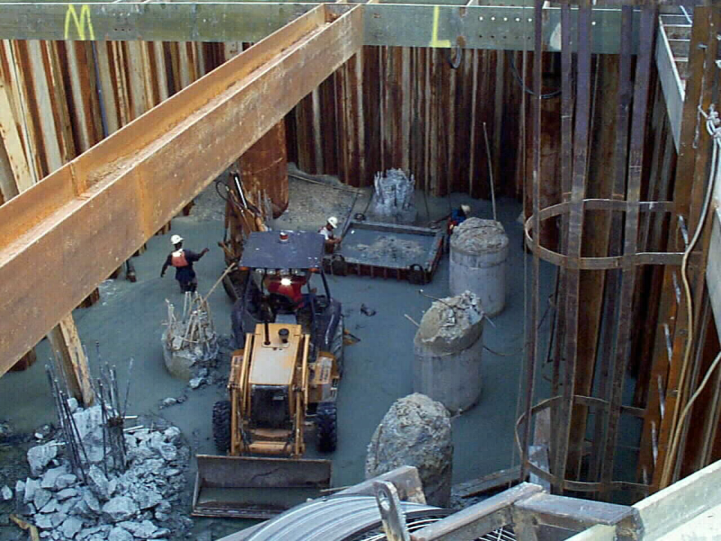
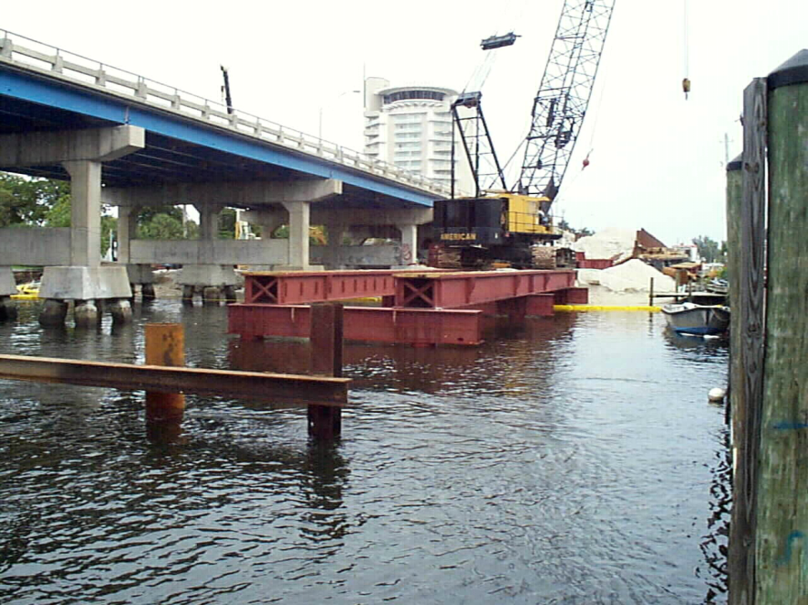
Deep Foundation
By: Kamal Tawfiq, Ph.D., P.E.

Slide 32



Slide 33


Drilled Shafts

Slide 34







Auger Cast Pile

Slide 35

Vibro Piers

Slide 36


Foundation Engineering CEG 4111-5115
Sheet Pile Walls
By: Kamal Tawfiq, Ph.D., P.E.

Slide 37




Foundation Engineering CEG 4111-5115
Drilled Shaft
By: Kamal Tawfiq, Ph.D., P.E.

Slide 38




Foundation Engineering CEG 4111-5115
By: Kamal Tawfiq, Ph.D., P.E.

