Slide 1
Geotechnical Investigation
For Civil and Environmental Engineering projects
FLORIDA A&M UNIVERISTY – FLORIDA STATE UNIVERSITY
COLLEGE Of ENGINEERING
DEPARTMENT OF CIVIL & ENVIRONMENTAL ENGINEERING
By
Kamal Tawfiq, Ph.D., P.E, F.ASCE

Slide 2
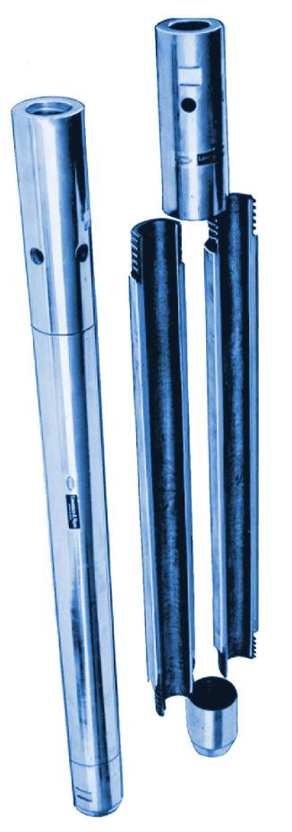
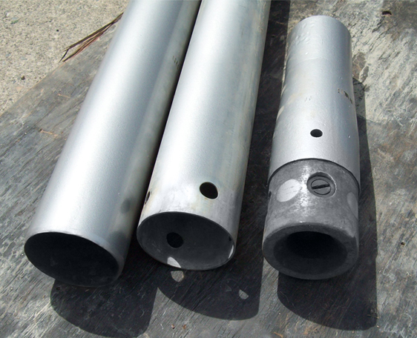
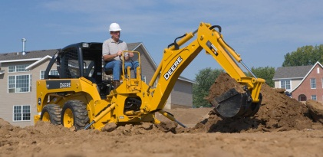
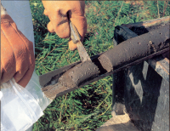
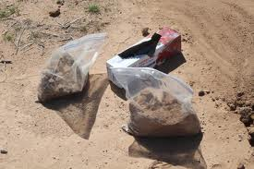
Geotechnical Investigation
5. Sample Recovery
5.1 Methods of Sample Recovery
  Hand auger
  Split spoon
  Backhoe
  Thin wall tube (Shelby tube)
5.2 Soil samples obtained during sectioning are either:
  Disturbed
  Undisturbed
Disturbed soil samples are used for
  Grain size analysis
  Determination of index properties
  Organic content
  Specific gravity
Undisturbed samples are used for
  As for disturbed sample
  Determining mechanical properties
  Determining hydraulic properties

Slide 3
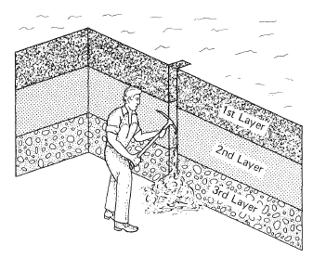
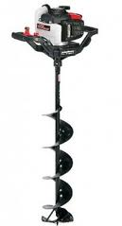
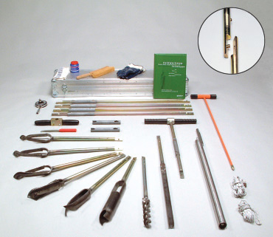
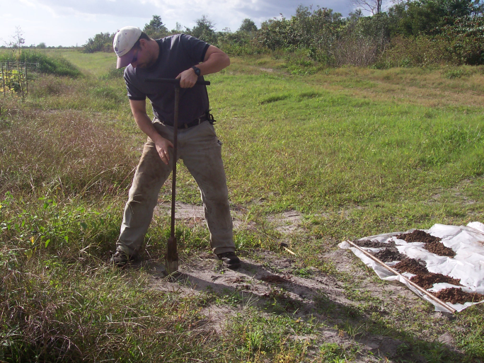
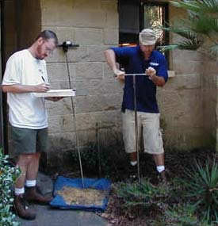
Geotechnical Investigation
Methods of Sample Recovery
  Hand auger
Test pit
The practical depth of investigation using a hand auger
depends upon the soil properties and depth of investigation.

Slide 4
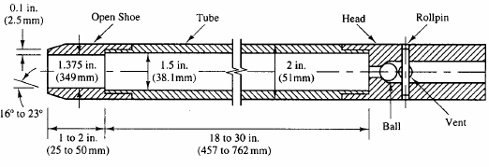
Geotechnical Investigation
Methods of Sample Recovery
  Split spoon
Split spoon sampling methods are used primarily to collect shallow and deep subsurface soil samples.
All split spoon samplers, regardless of size, are basically split cylindrical barrels that are threaded on each end.
Split spoon sampling method is used to obtain disturbed and undisturbed samples.
- The sampler is driven in into the soil by a hammer
- The weight of the hammer is 140 lb
- The number of blows (N) required to penetrate the spoon of three 6 in. intervals are added and recorded.
This procedure is called the Standard Penetration Test (SPT)
Actually, the Standard Penetration Number N is the number of blows of the last two intervals (12 in.) The first interval (6 in.) is usually discarded (why??????????)
18 to 30 in

Slide 5
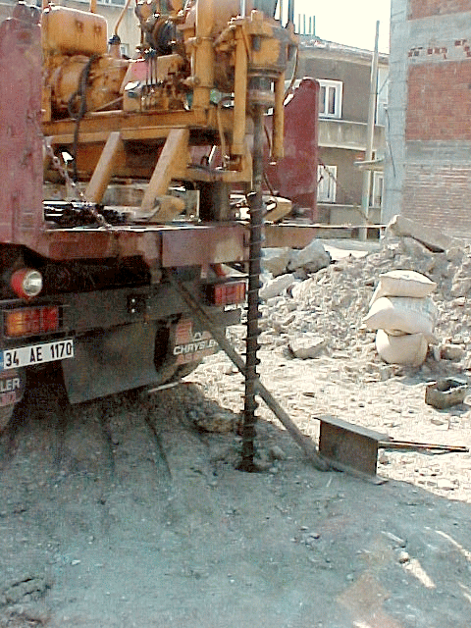
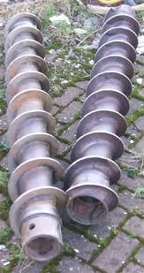
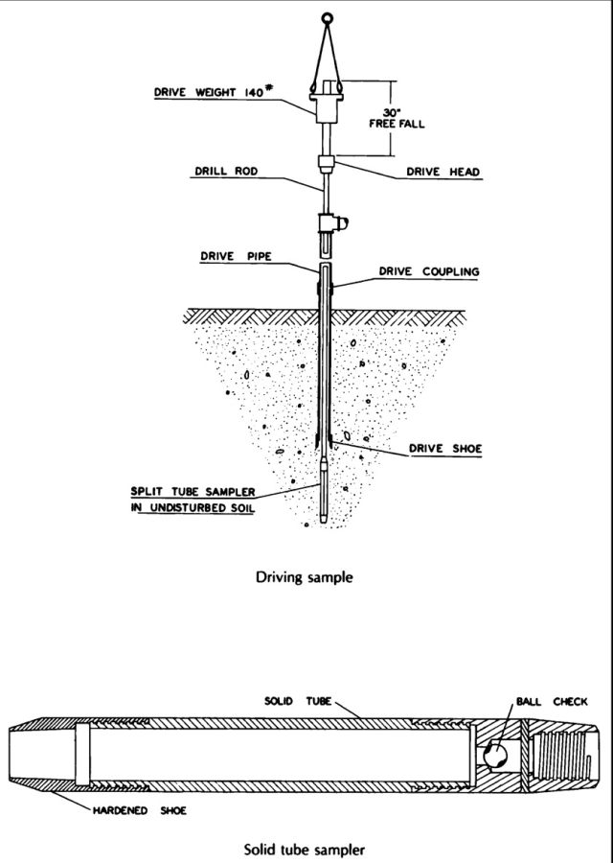
Geotechnical Investigation
THE STANDARD PENETRATION TEST (SPT) ASTM D1586
- The SPT is one of the most popular and economical means to obtain subsurface information.
- The testing method was standardized in 1958 as ASTM D1568
The test consists of:
* A 140 lb driving mass falling from a height of 30 in.
* Drive the standard split spoon sampler a distance of 18 in. into the soil
* Counting the number of blows (N) to drive the sampler 12 in.
(6 in. + 6 in.)
* The boring log should show "refusal" and should be halted if:
a- 50 blows are required for any 150 mm increment
b- 100 blows are obtained
c- 10 successful blows produce no advance
* N should be corrected for the increase of the overburden pressure
Hollow Stem Auger

Slide 6
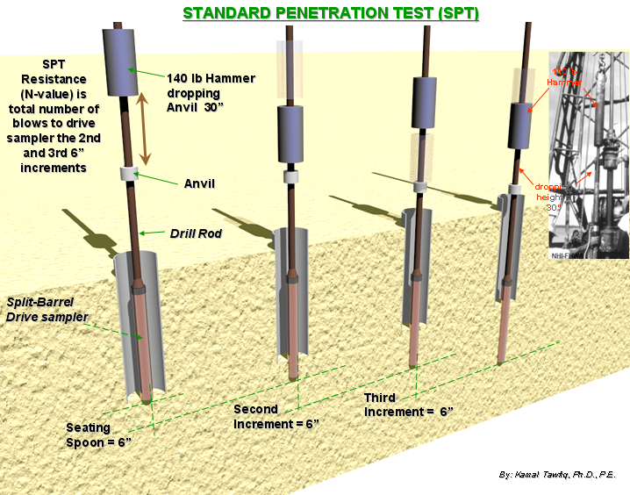
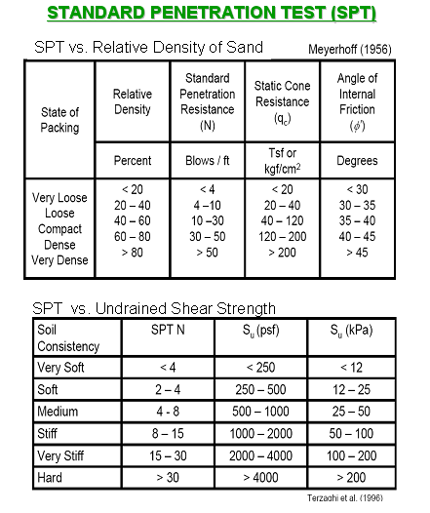
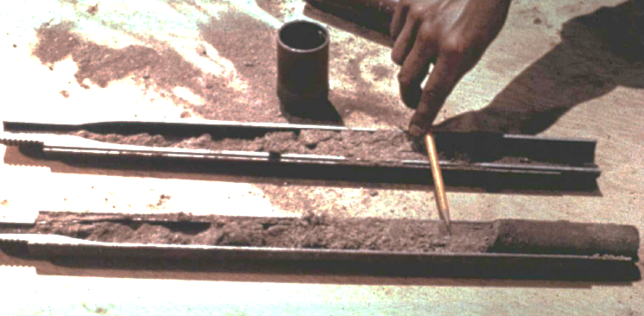
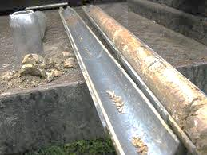

THE STANDARD PENETRATION TEST (SPT) ASTM D1586
See attached SPT video

Slide 7
Corrections for SPT Field Blow-count (N_{Field})
1- Peck & Bazaraa (1969) suggested
N_{cor} = For (σ_{v} < 1.5 kips/ft²)
N_{cor} = For (σ_{v} > 1.5 kips/ft²)
2- Peck, Hanson, and Thornburn (1974) proposed
N_{cor} = ( ) (N_{f}) For (σ_{v} in tons/ft²)
4 N_{f}
1 + 2 σ_{v}
4 N_{f}
Amount of
removed σ_{v}
3.25 + 0.5 σ_{v}
σ_{v} = Vertical effective stress at the sampling depth (kips/ft²)
Example
N_{field} = 40
20
0.77 log
σ_{v}
1 kip = kilopound = 1000 lb = 4448.2216 Newtons (N) = 4.4482216 kilonewtons (kN)
1 US ton = 2000 lb

Slide 8
Corrections for SPT Field Blow-count (N_{Field})
Example 1:
Given:
SPT = 40 at 20’ in sand
γ_{sand} = 115 lb/ft³
Find:
N_{cor} = ??
Solution:
Using Peck, Hanson, and Thornburn (1974) equation
C_{N} = 0.77 log (20/σ_{v})
σ_{v} = (20) (115 )/ 2000(lb/ton) = 1.15 tons/ft²
C_{N} = 0.77 log (20/1.15) = 0.955
N_{cor} = (0.955) (40) = 38
Amount of
removed σ_{v}
Example
N_{field} = 40
20
N_{cor} = ( ) (N_{f}) For (σ_{v} in tons/ft²)
0.77 log
σ_{v}

Slide 9
Corrections for SPT Field Blow-count (N_{Field})
Example 2:
Given:
SPT = 40 at 20’ in sand
γ_{sand} = 115 lb/ft³
Find:
N_{cor} = ??
Solution:
Using Peck & Bazaraa (1969) equation
σ_{v} = [(20)(115) / 1000 (lb/kip)] = 2.3 kips/ft²
Since σ_{v} is > 1.5 kips/ft² use
N_{cor} = 4 (40) / [3.25+(0.5)(2.3)] = 36
Amount of
removed σ_{v}
Example
N_{field} = 40
4 N_{f}
N_{cor} =
For (σ_{v} > 1.5 kips/ft²)
3.25 + 0.5 σ_{v}

Slide 10
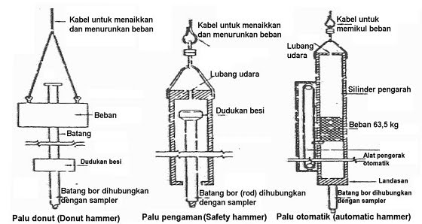
Corrections for SPT Field Blow-count (N_{Field})
Skempton (1986) suggested the following correction for the SPT field blow-count N_{f}
N₆₀ =
Where:
E_{m} = Hammer efficiency (for U.S. equipment, E_{m}= 0.6 for a safety hammer,
and 0.45 for a doughnut hammer). For automatic systems that lift the
hammer and allow it to drop unimpeded can deliver higher energy to the drill rods
with values of E_{m} as high as 95 percent (ASTM D 6066-96, 2004).
C_{b} = Borehole diameter correction (C_{b} = 1.0 for borehole = 65 to 115 mm diameter, 1.05 for 150 mm diameter, and 1.15 for 200 mm diameter)
C_{r} = Rod length correction (C_{r} = 0.75 for up to 4 m for drill rods, 0.85 for 4 to 6 m drill rods, 0.95 for 6 to 10 m drill rods, and 1.00 for rods in excess of 10 m)
As an average value N₆₀ = 0.5 to 0.67N_{f}
doughnut hammer
E_{m} C_{b} C_{r} N_{f}
Assuming 60% hammer efficiency
60
safety hammer
Automatic hammer

Slide 11
Correction of N Value for foundations in an earthquake zone
engineering, such as liquefaction analyses, the standard penetration test N₆₀ value is corrected for the overburden soil pressure, also known as the effective overburden pressure or the vertical effective stress (σ_{v}).
Where:
(N₁)₆₀ = standard penetration test N value corrected for both field testing procedures and overburden pressure
C_{N} = correction factor to account for the overburden pressure, and it is approximately equal to (100/σ_{v})^{0.5} where σ_{v} is the vertical effective stress, in kPa.
Suggested maximum values of C_{N} range from 1.7 to 2.0 (Youd and Idriss, 1997, 2001).
N₆₀ = standard penetration test N value corrected for field testing procedures.
The N₆₀ is calculated by using Skempton’s equation.
E_{m} C_{b} C_{r} N_{f}
0.5
N₆₀ =
60
(N₁)₆₀ = C_{N} N₆₀ =
100
σ_{v}
N₆₀

Slide 12
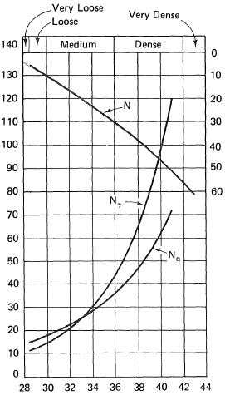
Relationship between bearing capacity factors, φ, and SPT
Example
Given:
N_{f} =40
Water Table = 5’
γ_{soil} = 120 pcf
Find:
N_{q}, N_{γ} and φ
Solution:
σ_{v} = {(5)(120)+[15(120-62.4)]}/2000 lb/ton =
= ton/ft²
N_{cor} = C_{N} N_{f} = 0.77 log (20/ ) =
N_{q}, = N_{γ} = φ =
W.T.
γ_{soil} = 120 pcf
5 ft
15 ft
Standard Penetration Resistance, N ( Blows/ft)
Bearing Capacity Factor, N _{γ} & N _{q}
N_{f} =40
N_{γ}
N_{q}
Curves showing the relationship between bearing capacity factors and φ, as determined by theory, and rough empirical relationship between bearing capacity factors or φ and values of standard penetration resistance N.
Peck et al. (1974)
Angle of Internal Friction, φ (degrees)

Slide 13
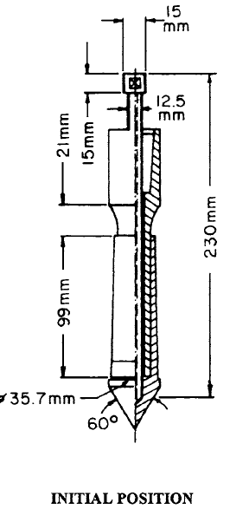
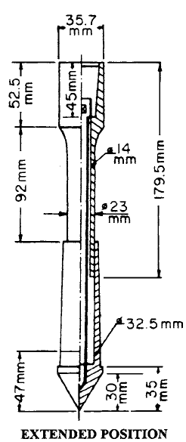
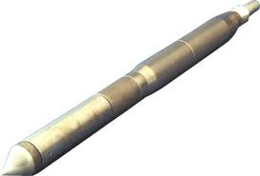
Geotechnical Investigation
Cone Penetration Test (CPT )
The most common type of mechanical penetrometer is the Dutch
mantle cone and is abbreviated CPT.
The cone is pushed into the soil to the desired depth (initial position) and then force is applied to the inner rod, which moves the cone downward into the extended position.
The cone is pushed into the soil at a rate of about 2 to 4 ft/min (10 to 20 mm/sec). The required force to move the cone into the extended position divided by the horizontally projected area (10 cm²) of the cone is defined as the cone resistance q_{c} , also known as the cone bearing or the end bearing resistance.
By continually repeating the two-step process
shown in the figure, the cone resistance q_{c} is
obtained at increments that ordinarily
do not exceed 8 in. (20 cm).
2 to
4 ft/min

Slide 14
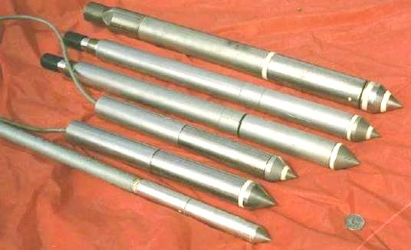
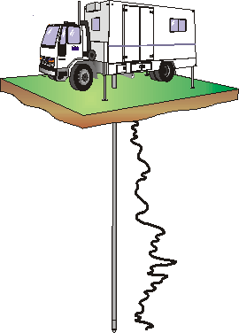
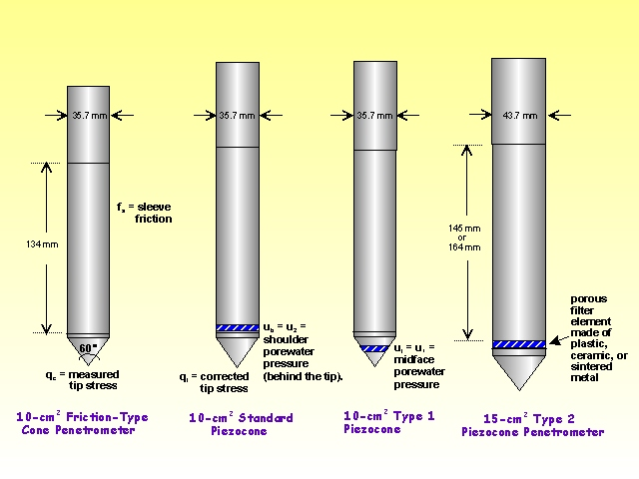
Cone Penetration Test (CPT )
Friction
CPT
Standard
Piezocone
Type 1
Piezocone
Type 2
Piezocone

Slide 15
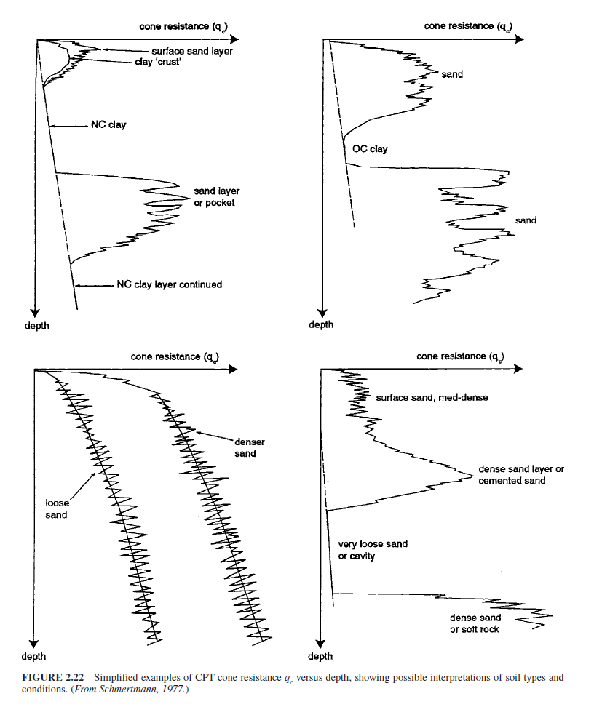
Cone Penetration Test (CPT )
Special features of the cone penetration test are as follows:
Cone resistance versus depth.
A considerable amount of work has been performed in correlating cone resistance q_{c} with subsurface conditions. Figure1 presents four examples, where the cone resistance q_{c} has been plotted versus depth below ground surface. The shape of the cone resistance q_{c} plots versus depth can be used to identify sands, clays, cavities, or rock.
NC Clay
Dense
Sand
NC Clay
Sand
NC Clay
Sand
Figure1: Simplified examples of CPT cone resistance qc versus depth, showing possible interpretations of soil types and conditions. (From Schmertmann, 1977.)

Slide 16
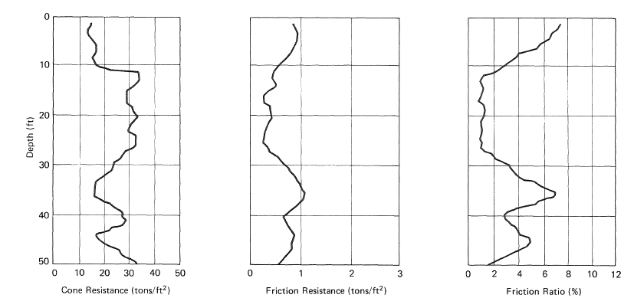
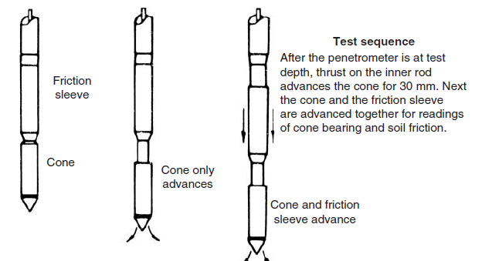
Cone Penetration Test (CPT )
Special features of the cone penetration test are as follows:
2. Friction ratio.
The figure below illustrates the two-step process that can be used to obtain the soil friction along a side sleeve f_{s}.
1- In the first step, the cone resistance is obtained (q_{c}) = 1000 psi
2- in the second step, the cone plus sleeve friction is determined (q_{c} + f_{s}) = 1440 psi
3- Subtraction gives the sleeve friction (f_{s}) = 440 psi
The friction ratio (FR) can then be calculated, defined as FR = sleeve friction (f_{s}) divided by cone resistance = (f_{s}/q_{c} )x100. By knowing the friction ratio (FR) and cone resistance q_{c}, the type of soil can be estimated by using Fig. 2.
Cone Resistance
Friction Resistance
Friction Ratio
Test sequence for obtaining the sleeve friction from the Dutch cone penetrometer and an example of the test data plotted versus depth.

Slide 17
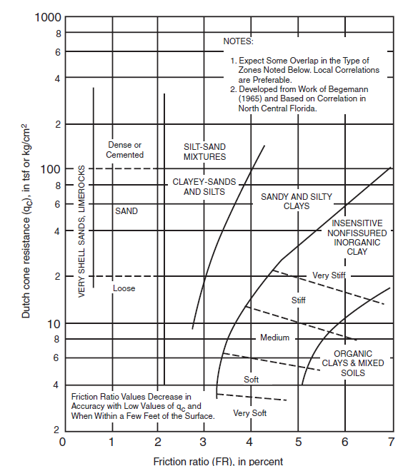
Cone Penetration Test (CPT )
Figure 2: Guide for estimating soil type from Dutch mantle cone
Steps:
1- Enter chart with cone resistance q_{c} and friction ratio
2- FR = sleeve friction divided by cone resistance = (f_{s} / q_{c})x100.
(From Schmertmann, 1977)
q_{c}
Figure 2:
FR

Slide 18
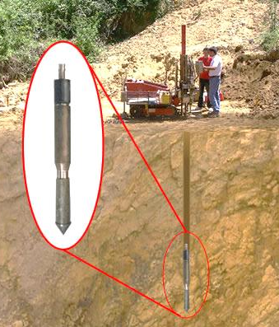
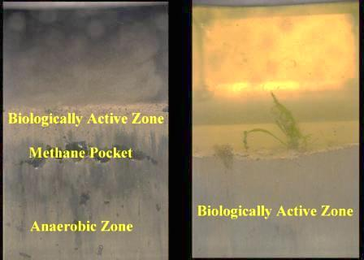
Cone Penetration Test (CPT )
Other Cone Penetrometers.
Besides the mechanical cone, there are other types of cone penetrometers, such as:
Electric cone. A cone penetrometer that
uses electric-force transducers built into the apparatus for measuring cone resistance
and friction resistance.
Piezocone. A cone penetrometer with the additional capability of measuring pore water pressure generated during the penetration of the cone.
Special devices. The cone can even be
equipped with a video camera to enable
the type of soil to be viewed during the
test (Raschke and Hryciw, 1997).

Slide 19
Cone Penetration Test (CPT )
A major advantage of the cone penetration test (CPT)
- It provides almost a continuous subsurface record of the cone resistance q_{c} and f_{s}
This is in contrast to the SPT, which obtains data at much larger intervals in the soil deposit.
Disadvantages of the CPT are that soil samples cannot be recovered and special equipment is required to produce a steady and slow penetration of the cone.
Unlike the SPT, the ability to obtain a steady and slow penetration of the cone is not included as part of conventional drilling rigs.
Because of these factors, in the United States, the CPT is used less frequently than the SPT.

Slide 20
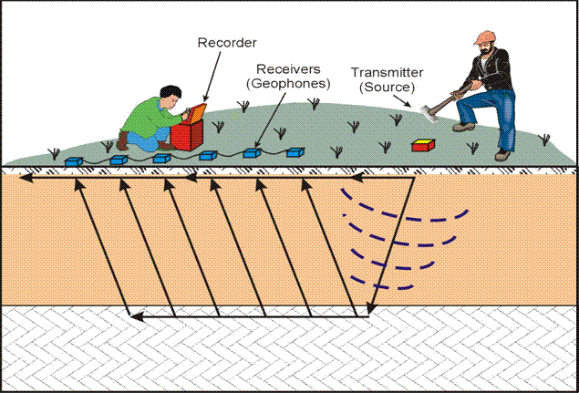
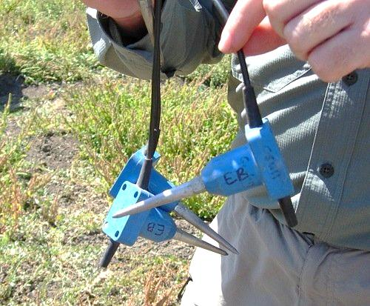
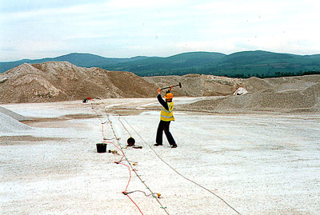
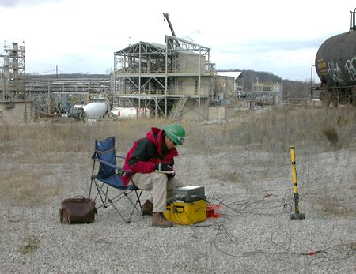
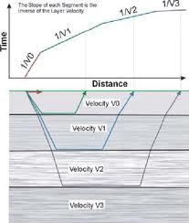
Seismic refraction (for large areas)

Slide 21
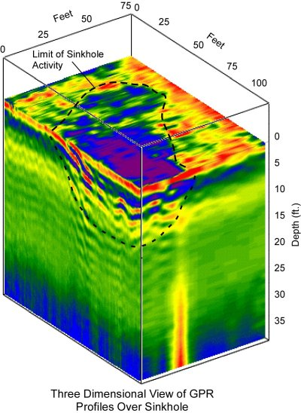
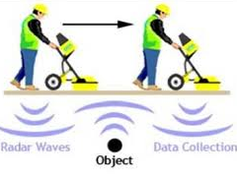
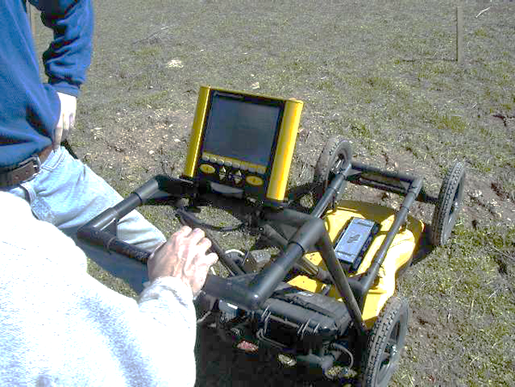
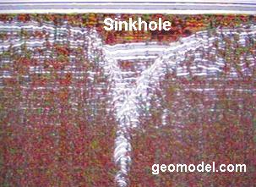
Ground Penetration Radar (GPR)

Slide 22
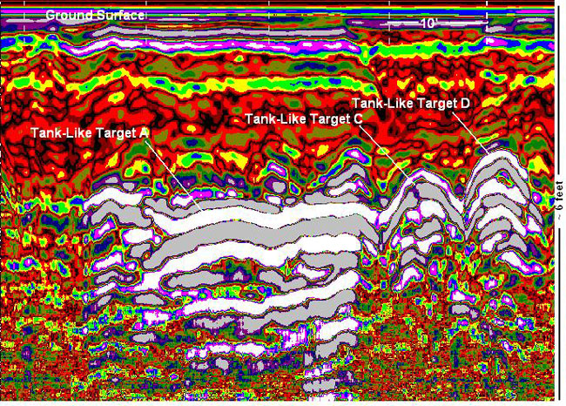
Ground Penetration Radar (GPR)

Slide 23
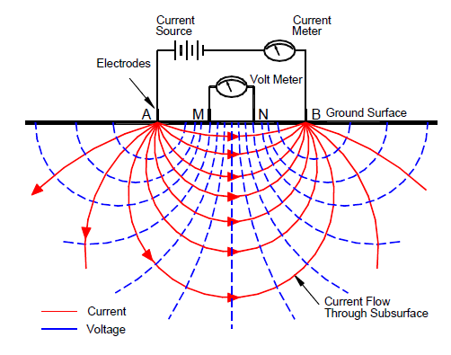
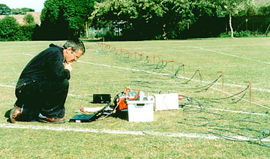
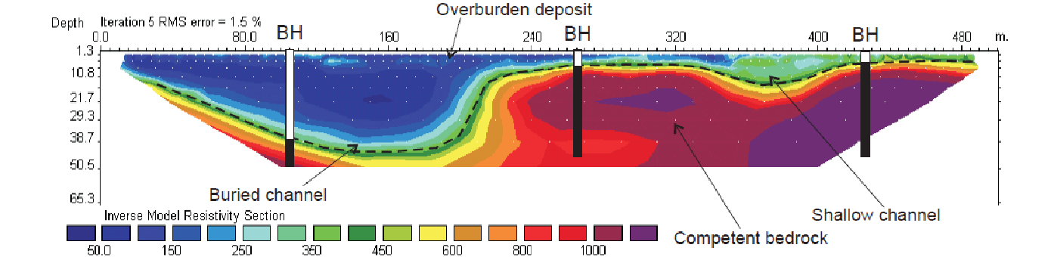
Geo-electrical Profiling using Electrical resistivity or D.C. Resistivity Method
Good for sensing buried wastes and waste migration
Schematic Illustrating Basic Concept of
D.C. Resistivity Crew In Operation Electrical Resistivity Measurement

Slide 24
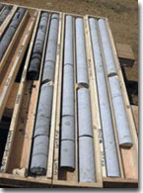
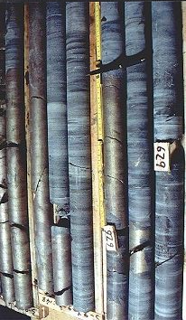
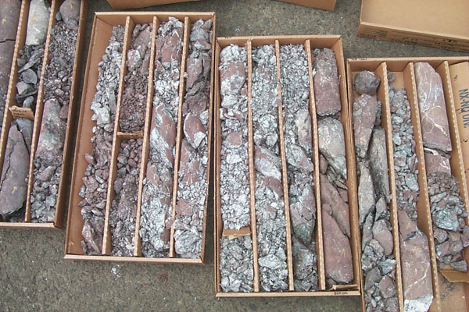
Geotechnical Investigation
top
top
bottom
bottom

Slide 25
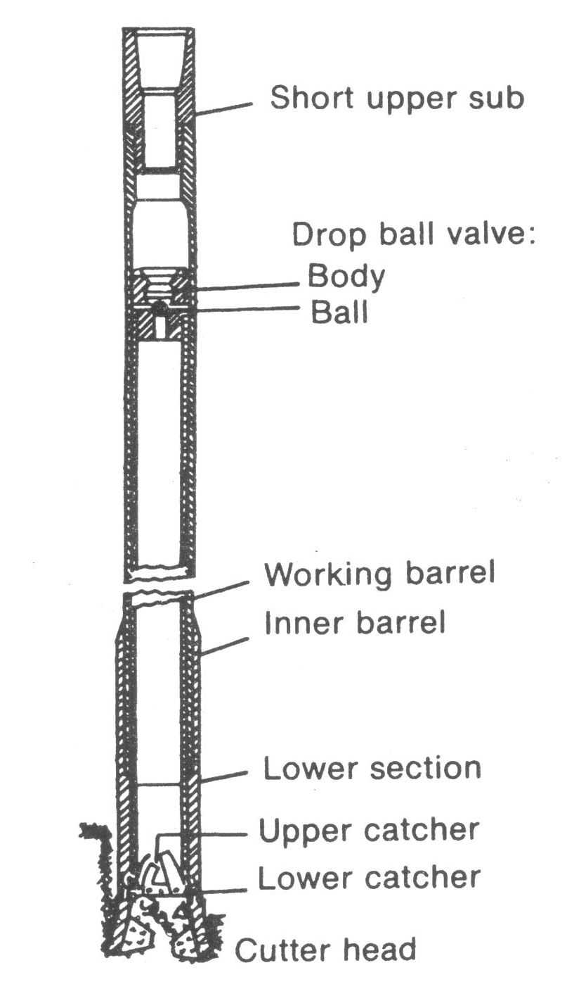
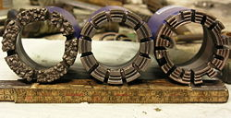

Rotary core barrel
Coring bits are commonly 1.75 to 5.25 inches in diameter.
Diamond or Tungsten carbide insets on rotary coring bit.

Slide 26

Core recovery parameters describe the quality of core recovered from a borehole.
Total core recovery (TCR)
TCR is the borehole core recovery percentage.
TCR is defined as the quotient:
% TCR = ( ) x 100
L_{sum of pieces} = Sum of length of core pieces
L_{total core run} = Total length of core run
∑ L_{sum of pieces}
L_{total core run}

Slide 27
Core recovery parameters describe the quality of core recovered from a borehole.
Solid core recovery (SCR)
Solid core recovery (SCR) is the borehole core recovery percentage of solid, cylindrical, pieces of rock core.
SCR is defined as the quotient:
SCR = ( ) x 100
L_{sum of solid core pieces}
L_{total core run}

Slide 28
Rock Quality Designation (RQD) Factor
Developed in 1964 by Deere
Rock-Quality Designation (RQD) is a rough measure of the degree of jointing or fracture in a rock mass, measured as a percentage of the drill core in lengths of 10 cm or more.
∑ L_{sum of 10cm}
RQD = x 100
L_{total core run}
L_{sum of 10cm} = Sum of length of core sticks longer than
10 cm measured along the center line of the core
From the RQD index the rock mass can be classified as follows:
RQD | Rock mass quality
<25% | very poor
25-50% | poor
50-75% | fair
75-90% | good
90-100% | excellent

Slide 29
Rock Quality
0.8 ft
Sound
0.7 ft
Not sound, highly weathered
Length, L
Not sound, centerline pieces < 4 inches, highly weathered
0.8 ft
0.6 ft
Sound
Core Run
Total = 4 ft
0.2 ft
Not sound
0.7 ft
Sound
CR = 95% RQD = 53%

Slide 30
NEW SECTION

Slide 31



Geotechnical Investigation
MEASUREMENTS OF MATERIAL PROPERTIES
Soil Properties
Physical properties
Index Properties
Hydraulic Properties
Mechanical Properties

Slide 32


MEASUREMENTS OF MATERIAL PROPERTIES
Methods of Measurement
1- Laboratory Testing Methods
2- In-Situ Testing Methods
3- Empirical Correlation's
Terzaghi & Peck (1948): Cc = 0.009 (w_{c} – 10%)
Skempton (1944): Cc 0.007 (w_{c} – 7%)

Slide 33
MEASUREMENTS OF MATERIAL PROPERTIES
Methods of Measurement
1- Laboratory Testing Methods
- Provide better control over the boundary conditions
- Different parameters can be determined individually or in
combination
- Results can be produced

Slide 34


MEASUREMENTS OF MATERIAL PROPERTIES
Methods of Measurement
2- In-Situ Testing Methods
Measurements of properties for large soil masses
Less disturbance
Measurements under real field conditions
Can be performed during site exploration (SPT & CPT)
In-Situ testing methods are used to determine:
1- Hydraulic properties (Wells)
2- Mechanical properties (SPT, CPT, Vane Shear Test,
Pressuremeters, CBR) (See Table 3.20)

Slide 35


MEASUREMENTS OF MATERIAL PROPERTIES
Soil Properties
1- Physical properties: Used to describe the soil. These properties are incorporated with the soil classification systems, and in some cases they are related to the mechanical properties
- Specific gravity
- Grain size
- Density (Saturated, Partially saturated, submerged, minimum,
maximum, relative, optimum moisture content)
- Porosity
- Degree of saturation
- Void ratio
- Moisture content
- Hardness (for rocks)
- Durability (for rocks)
- Reactivity (for rocks)

Slide 36






MEASUREMENTS OF MATERIAL PROPERTIES
Soil Properties
2- Index Properties: Used to classify the soil or to correlate with the mechanical properties.
- Atterberg Limits or Consistency Limits (LL, PL SL)
- Moisture Content vs. Unit Weight Relationship (Compaction)
- Grain Size Distribution
- Relative Density D_{r}
Grain Size Distribution
Proctor Test
Relative Density D_{r}
LL
PL

Slide 37


MEASUREMENTS OF MATERIAL PROPERTIES
Soil Properties
3- Hydraulic Properties
- Permeability or Hydraulic Conductivity (k)
Infiltration Rate
Double Ring Infiltrometer

Slide 38




MEASUREMENTS OF MATERIAL PROPERTIES
Soil Properties
4- Mechanical Properties: To describe the behavior of the soil under different types of stresses
-Deformation Moduli – Young's Modulus (E) & Shear Modulus (G)
Consolidation (C_{c}, C_{s}, C_{v}, P_{c}, m_{v}, K)
Strength (c, φ) Unconfined Compression
Direct Shear,
Triaxial Compression
California Bearing Ratio (CBR) or
Lime Rock Bearing Ration (LBR)
used for pavement design
Direct Shear
Consolidation Test
Unconfined
Compression
Triaxial Compression

Slide 39

MEASUREMENTS OF MATERIAL PROPERTIES
Methods of Measurement
3- Empirical Correlations
- Correlations are usually based on basic or index properties
- These properties are correlated with the mechanical & hydraulic properties
- Used to provide basis for all engineering analysis
- Reduce the cost of geotechnical investigation
- Presented as ----- Tables, Charts, and Equations
For example Beyer formula for coefficient of permeability (k)
K = C . (d₁₀)²
Where :
C = 4.5x10⁻³ log
U = Uniformity coefficient = d₆₀/d₁₀
d₁₀ = Effective diameter (mm)
500
U
10%
Passing
d₁₀

Slide 40
Reporting Geotechnical Investigation
Both an adequate geotechnical investigation and a comprehensive geotechnical report are necessary to construct a safe, cost-effective project.
While the geotechnical report content and format will vary by project size and highway agency, all geotechnical reports should contain certain basic essential information, including:
Cover letter and Executive summery
Scope of the Project
Site Description
Proposed Construction
Summary of all subsurface exploration data, including subsurface soil profile, exploration logs, laboratory or in situ test results, and ground water information;
Interpretation and analysis of the subsurface data; Specific engineering recommendations for design;
Discussion of conditions for solution of anticipated problems; and Recommended geotechnical special provisions.

Slide 41




Geotechnical Report Production

Slide 42

Geotechnical Report Production

Slide 43

Geotechnical Report Production
1- Map of the Project Location

Slide 44

Geotechnical Report Production
2- Boring Locations

Slide 45
Geotechnical Report Production

Slide 46

Geotechnical Report Production
3- Boring Log:
Soil description and classification
Sample depth
SPT field value
Water Table

Slide 47


3- Boring Log:
Soil description and classification
Sample
13
(5+5+8)
SPT field value

Slide 48

4- Profile of Soil Layers:

Slide 49

Geotechnical Report Production
4- Profile of Soil Layers:

Slide 50

4- Profile of Soil Layers:

Slide 51

6- Soil Testing Results

Slide 52


5- Soil Testing Summery

