Slide 1
Geotechnical Investigation
For Civil and Environmental Engineering projects
FLORIDA A&M UNIVERISTY – FLORIDA STATE UNIVERSITY
COLLEGE Of ENGINEERING
DEPARTMENT OF CIVIL & ENVIRONMENTAL ENGINEERING
By
Kamal Tawfiq, Ph.D., P.E, F.ASCE

Slide 2
INTRODUCTION
Lecture 1
Session 1
Introduction to Geotechnical Investigation
Objectives:
To learn how to conduct geotechnical investigation for foundation projects
To review soil and rock properties needed for foundation analysis and design
Outcomes:
To apply fundamental knowledge of soil mechanics and geotechnical engineering to geotechnical investigation
Learning Tasks:
Assignments
Online quizzes

Slide 3
INTRODUCTION
Before we investigate the feasibility of any foundation project one should understand
the interaction between the human activities & the geologic environment

Slide 4
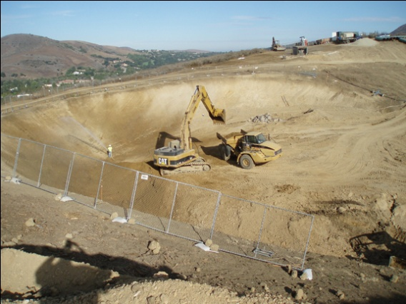
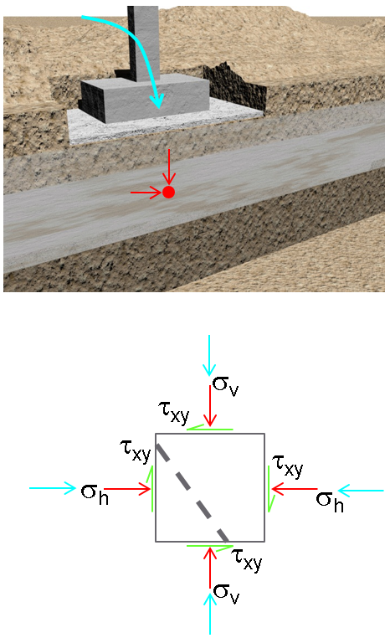
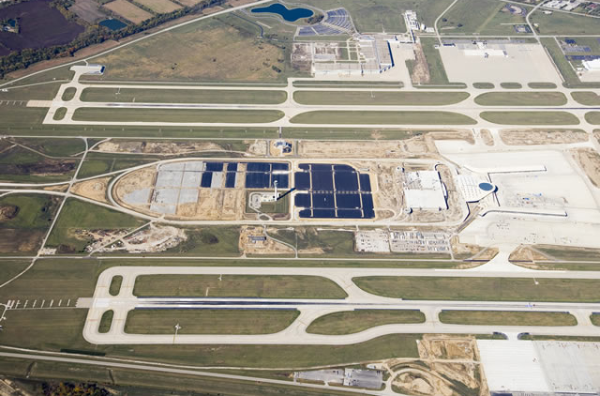
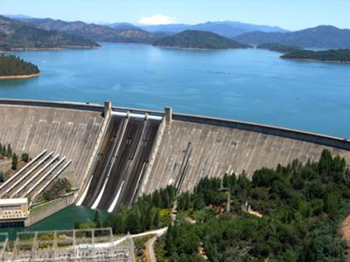
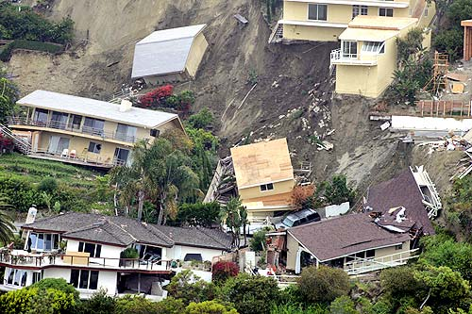
INTRODUCTION
Human Activities
&
Geologic Environment
Geometrical Changes
External Stresses
Altering Stresses in Soil Layers
Active Impact
Building Construction
Dams
Embankments
Roadways/ Railways
Underground Construction
Waterways
Earth Retaining Structures
Dewatering Facilities
Airports
Hydraulic Structures
Towers/Silos
Pipelines
Bridges
Passive Impact
Slope Failure
Flow / Landslides
Erosion
Flooding
Ground Subsidence
Settlement
Ground Failure
Piping
Heave
Earthquake

Slide 5
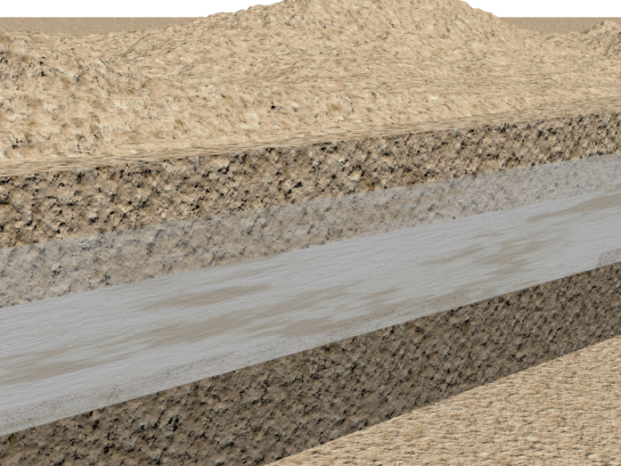
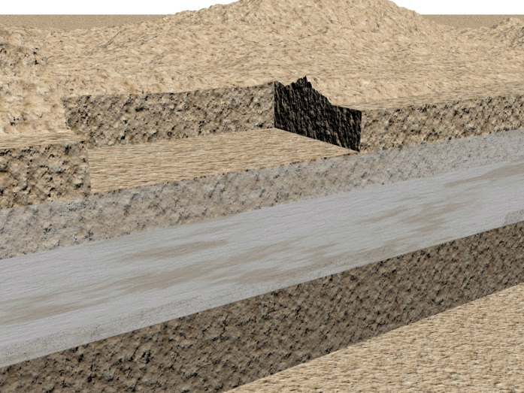
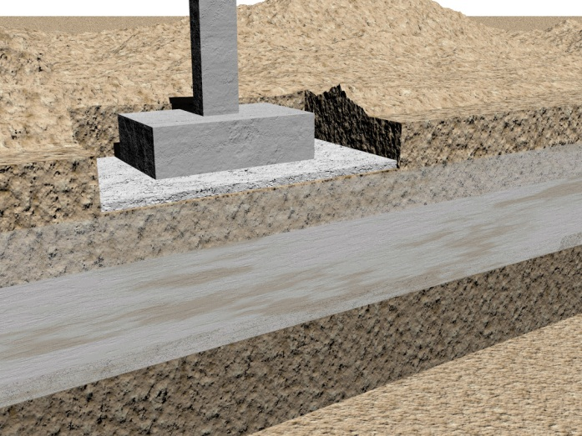
Altering Stresses in Soil Layers
σ_{v}
σ_{v}
σ_{v}
τ_{xy}
τ_{xy}
τ_{xy}
τ_{xy}
τ_{xy}
τ_{xy}
τ_{xy}
τ_{xy}
τ_{xy}
σ_{h}
σ_{h}
σ_{h}
σ_{h}
σ_{h}
σ_{h}
τ_{xy}
τ_{xy}
τ_{xy}
σ_{v}
σ_{v}
σ_{v}

Slide 6
INTRODUCTION
An adequate assessment of the site should be done through
Geotechnical Investigation

Slide 7
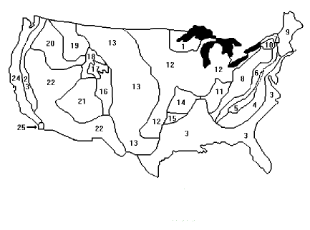
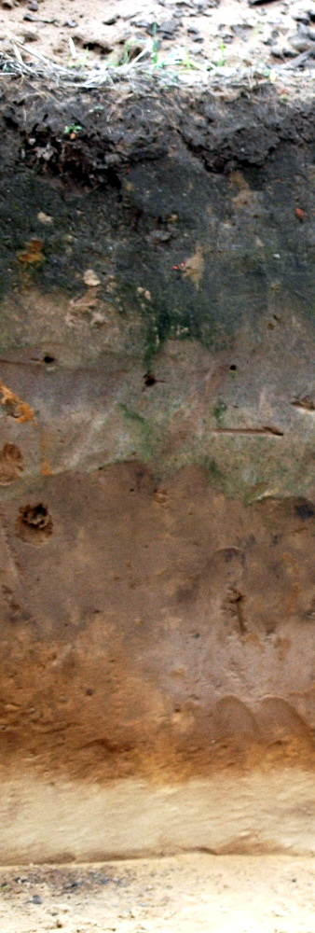
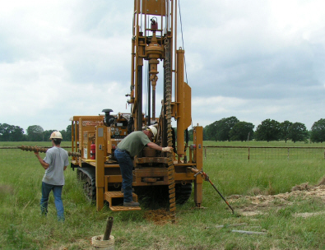
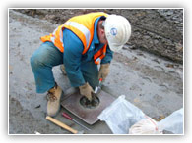
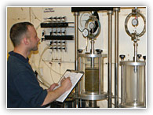
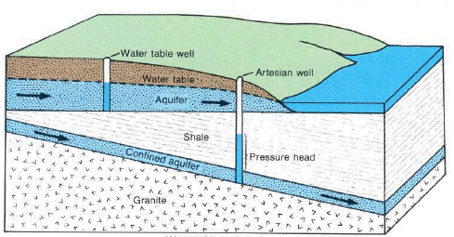
INTRODUCTION
2. Conduct a thorough geotechnical investigation
This requires the skill and the knowledge to
Identify and describe rock & soil formations
Identify geologic hazards
Identify and describe rock & soil types
Define groundwater conditions
Procure samples
Perform field and laboratory testing
Samples
Continental United States Physiographic regions

Slide 8

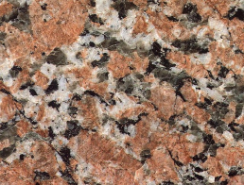
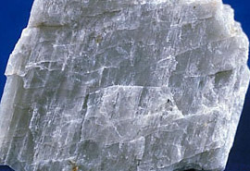
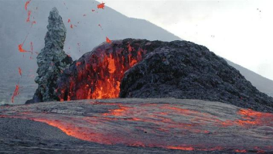
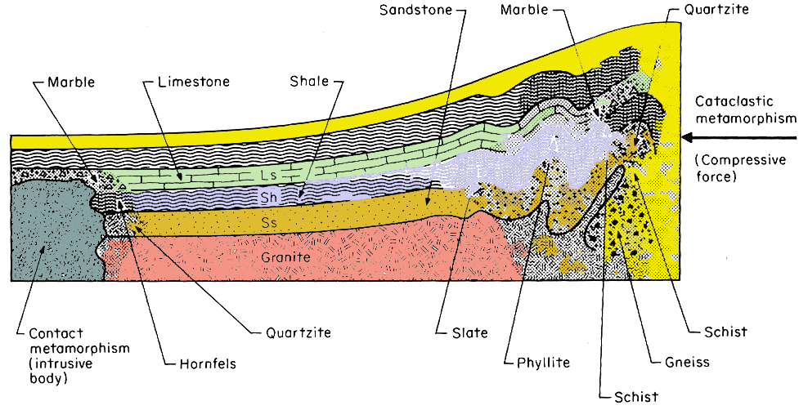
Identify and describe rock & soil formations
1/6
SOIL
Induration
Weathering
Sedimentary
Rock
Weathering
Physical or Chemical
Metamorphosis
Weathering
Physical or Chemical
Pyroclastic Ejection
Igneous
Rock
Metamorphosis
Metamorphic
Rock
Melting
Primary processes in the geologic cycle
Melting
Pyroclastic Ejection
Cooling
Magma

Slide 9
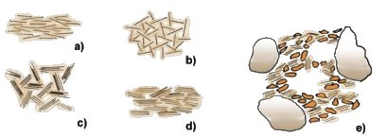
Identify and describe rock & soil formations
2/6
Soil Formation
* Soil material is the product of rock
* The geological process that produce soil is WEATHERING Chemical and Physical
* Variation in Particle size and shape depends on:
1 - Weathering Process
2 - Transportation Process
* Variation in Soil structure depends on:
1 - Soil Minerals
2 - Deposition Process
flocculated
bookhouse
turbostratic
natural structure

Slide 10
Identify and describe rock & soil formations
3/6
Soil Formation
* Transportation and Deposition
Four forces are usually cause the transportation (water, wind, ice, gravity) and deposition of soils
1-Water Alluvial Soil
1- Fluvial
2- Estuarine
3- Lacustrine
4- Coastal
5- Marine

Slide 11
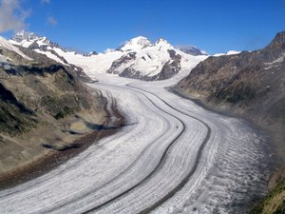
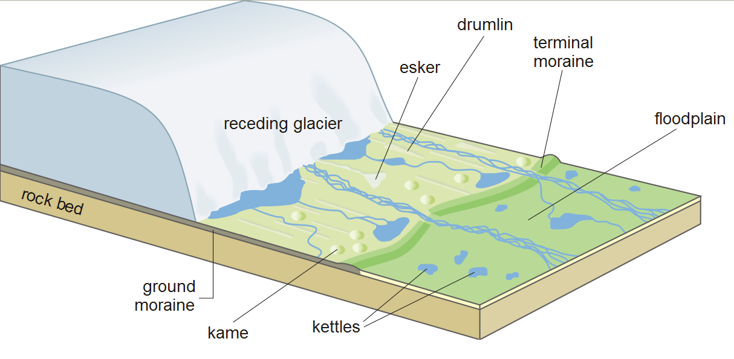
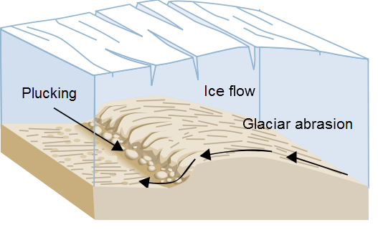
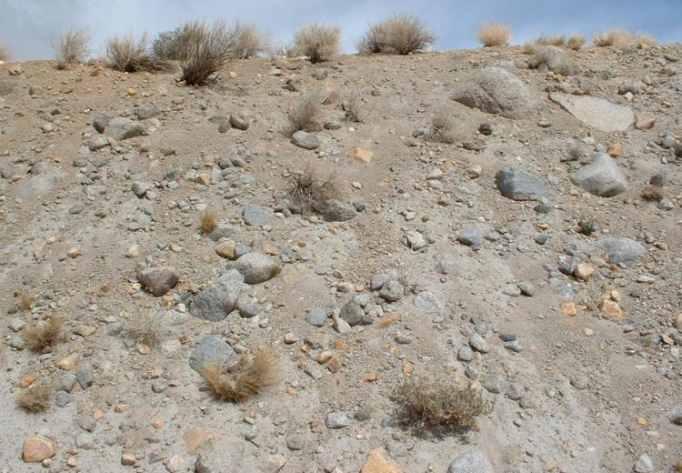
Identify and describe rock & soil formations
4/6
2- Ice Glacial Soils
Hard Pan
Terminal Moraine
Esker
Kettles

Slide 12
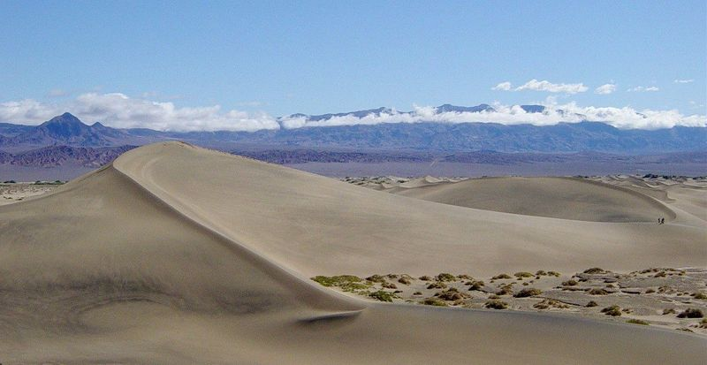
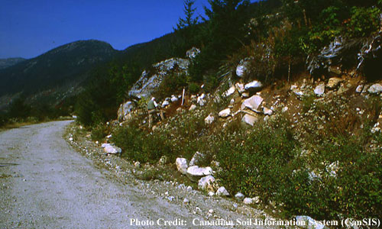
Identify and describe rock & soil formations
5/6
3- Wind Aeolian Soils
4- Gravity Colluvial Soil
1-Talus
Sand Dunes
Loess

Slide 13
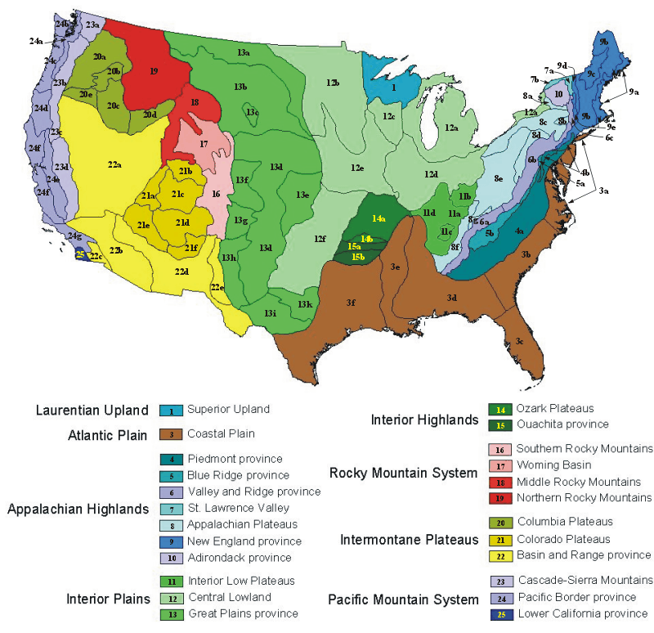
Identify and describe rock & soil formations
6/6
Continental United States Physiographic Regions Include
8 regions,
25 provinces, and
85 sections

Slide 14
Identify and describe rock & soil types
Rock Type
Soil Type
Igneous Rock
Sedimentary Rock
Metamorphic Rock
Residual Soil
Transported Soil

Slide 15
Question
What type of soils are usually produced in nature by the different weathering & Transportation processes?
- Boulders
- Gravel
- Sand
- Silt
- Clay
* These soils can be - Dry
- Saturated -Fully
- Partially
Also they have different shapes , textures , structures
Shapes ....... Elongated
Rounded
Plated
Angular
Texture ......... Coarse
Medium
Fine
Structures..... Loose
Dense
Honeycombed
Dispersed
Flocculated

Slide 16
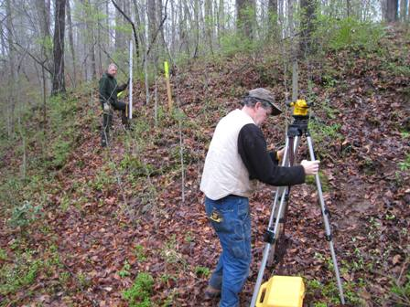
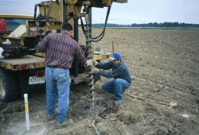
Geotechnical Investigation
Steps of Geotechnical Investigation
Data Collection
Terrain Analysis
Site Exploration
Subsurface Sectioning
Sample Recovery
Soil Testing

Slide 17
Geotechnical Investigation
1. Data Collection
1.1 Type of structure
1.2 General use of the structure
1.3 Column load
1.4 Column spacing
1.5 Building code
1.6 Basement requirements
1.7 Topography maps
1.8 Geological maps
1.9 Soil Maps
1.10 Groundwater maps
1.11 Report, Ariel photographs, satellite images, etc.

Slide 18
Geotechnical Investigation
2 Terrain Analysis
Using remote sensing and landform interpretation techniques to determine:
2.1 Geomorphic characteristics on the site (Landform)
2.2 Relief amplitudes
2.3 Drainage basins
2.4 Vegetation
2.5 Climate conditions, weathering, frost action, erosion, and mass wasting

Slide 19
Geotechnical Investigation
3. Site Exploration
It is a field trip to inspect:
3.1 General topography, existing drainage, ditches, etc.
3.2 General conditions of the soil
3.3 Type of vegetation
3.4 Surface water condition
3.5 Accessibility of the site

Slide 20
Geotechnical Investigation
4. Subsurface Sectioning
This includes the following
4.1 Test Pits (for shallow depths)
4.2 Auger Boring (Manual, Mechanical)
4.3 Wash Boring
4.4 Core boring
4.5 Special Methods - Seismic refraction
GPR
Electric Resistivity
The depth and the interval of the subsurface sectioning is governed by:
Type of construction
Column Load
Column spacing
Test boring is the most usable method.
In planning and executing the test boring
you need to know:
Equipment Selection
Boring Spacing
Boring Depths
Equipment Selection for Subsurface Sectioning
This depends on:
1- Terrain features
2- Accessibility
3- Geological conditions
4- Boring Depths
5- Sample types
6- Nature of the project
Boring Spacing:
Depending on the area under study, a grid systems may be appropriate in uniform conditions.
The spacing usually ranges from 30 ft to 1600 ft. The following spacing may be adopted for wide range of construction:
1- Multistory Buildings 30 ft to 100 ft
2- Residential Subdivision 800 ft to 1600 ft
3- Warehouses, Industrial plants 60 ft to 200 ft
4- Dams and Dikes 130 ft to 260 ft
5- Highways and Railways 800 ft to 1600 ft
** In general spacing may vary depending on the irregularity of the site geology.
Depth of Boring:
1- Boring should be extended through any unsuitable foundation strata (unconsolidated fill, organic soils, compressible layers until soil of acceptable bearing capacity is reached.
2- In general, boring should be extended to at least 1.5 to 2 times the minimum width of the loaded area.
3- In the case of very heavy structures (bridges), boring in most cases are extended to bedrock, or at least one boring should be extended to bedrock.
4- The following empirical equations can be used to estimate the minimum depth of borings in office buildings:
D_{b} = 3 S^{0.7} (for light steel or narrow concrete buildings)
D_{b} = 6 S^{0.7} (for heavy steel or wide concrete buildings)
Where S = number of stories in meters

Slide 21
Geotechnical Investigation
4. Subsurface Sectioning
Areas of investigation | Boring depth
Large structure with separate closely space footings | Extend to depth where increase in vertical stress for combined foundations is less than 10 percent of effective overburden stress. Generally all boring should extend to no less than 9 m (30 ft) below lowest part of foundation unless rock is encountered at shallower depth.
Isolated rigid foundations | Extend to depth where vertical stress decreases to 10 percent of bearing pressure. Generally all borings should extend no less than 9 m (30 ft) below lowest part of foundation unless rock is encountered at shallower depth.
Long bulkhead or wharf wall | Extend to depth below dredge line between 0.75 and 1.5 times unbalanced height of wall. Where stratification indicates possible deep stability problem, selected borings should reach top of hard stratum.
Deep cuts | Extend to depth between 0.75 and 1 times base width of narrow cuts. Where cut is above groundwater in stable materials, depth of 1.2 to 2.4 m (4 to 8 ft) below base may suffice. Where base is below groundwater, determine extent of previous strata below base.
Dams and water retention structures | Extend to depth of 0.5 base width of earth dams or 1 to 1.5 times height of small concrete dams in relatively homogeneous foundations. Borings may terminate after penetration of 3 to 6 m (10 to 20 ft) in hard and impervious stratum if continuity of this stratum is known from reconnaissance.
High embankments | Extend to depth between 0.5 to 1.25 times horizontal length of side slope in relatively homogeneous foundation. Where soft strata are encountered, borings should reach hard materials.
From NAVFAC DM-7.1, 1982.

Slide 22
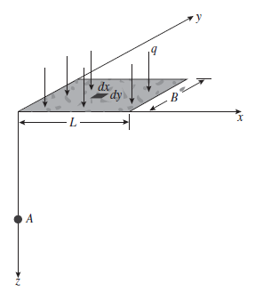
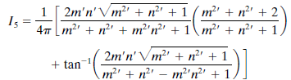
4. Subsurface Sectioning
Boussinesq’s Equation for Vertical Stress Caused by a Rectangularly Loaded Area
Δσ_{c} = q I_{c}
q
0.1 q
Z
0.1 q = q I_{c}
′
′
m = B/Z n = L/Z

Slide 23
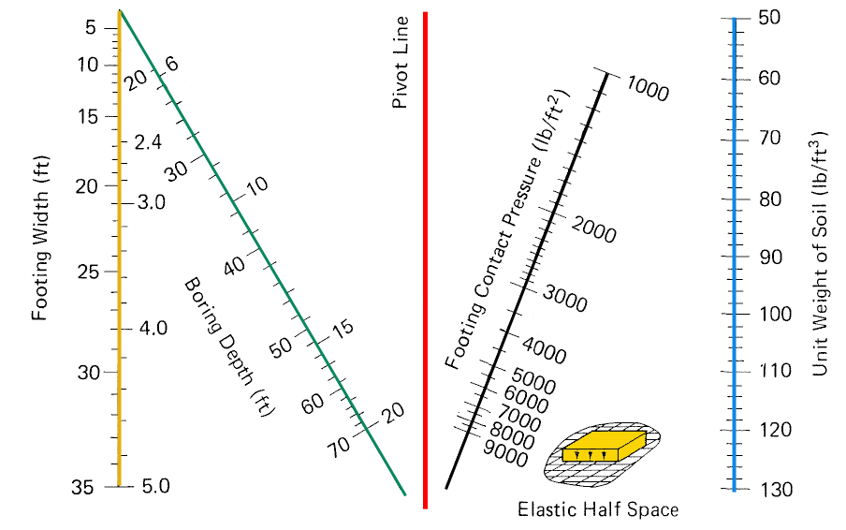
4. Subsurface Sectioning
Boring depth using Richard et al. 1979 Chart
Boring Depth Using Boussinesq’s Equation for Square loading
(RICHARD D. BARKSDALE AND MILTON O. SCHREIBER, 1979)

Slide 24
4. Subsurface Sectioning
Boring depth
Contact pressure of 5000 lb/ft²
7 ft
γ_{wet}= 115 lb/ft³
EXAMPLE
Given
7 ft square footing
Contact pressure of 5000 lb/ft²
Wet unit weight of the soil = 115 lb/ft³. Water table is estimated to be 40 ft beneath the footing.
Find
The minimum depth of test boring
D_{b}

Slide 25
4. Subsurface Sectioning
Boring depth
Contact pressure of 5000 lb/ft²
7 ft
γ_{wet}= 115 lb/ft³
EXAMPLE
Solution
Since the water table is estimated to be 40 ft beneath the footing and the footing's width is 7 ft, the soil's wet unit weight should be used
Using γ_{wet} =115 lb/ft³,
Contact pressure = 5000 lb/ft², and Width of footing =7 ft,
D_{b} ~ 21.5 ft. use 22 ft.

Slide 26
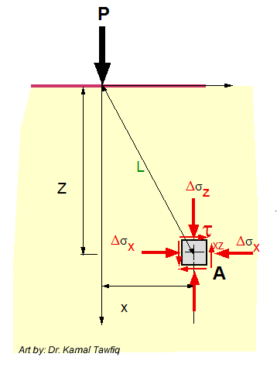
4. Subsurface Sectioning
Δq_{s}
1
X/R
2
3
R
0
R = Radius
Δq_{s}
0.90
X
0.80
0.70
Z
1
0.60
0.50
Z/R
0.40
0.30
2
0.20
σ_{z} = σ₁
σ_{x} = σ₂
σx = σ₂
σ_{z} = σ₁
0.15
3
ΔP_{z}/q_{s}
0.10
0.05
4
Circular Load: (Vertical Stress)/(Surface Stress)

Slide 27
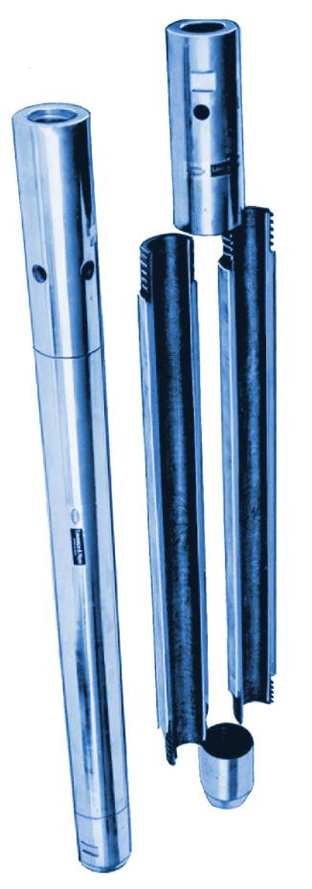
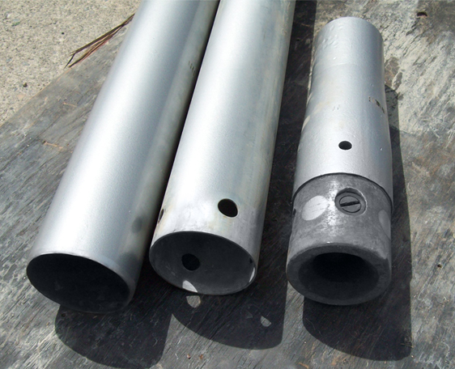
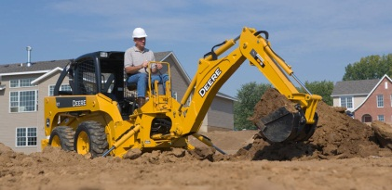
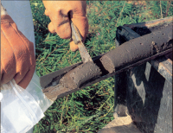
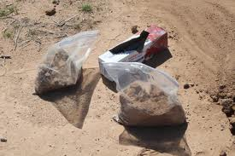
Geotechnical Investigation
5. Sample Recovery
5.1 Methods of Sample Recovery
  Hand auger
  Split spoon
  Backhoe
  Thin wall tube (Shelby tube)
5.2 Soil samples obtained during sectioning are either:
  Disturbed
  Undisturbed
Disturbed soil samples are used for
  Grain size analysis
  Determination of index properties
  Organic content
  Specific gravity
Undisturbed samples are used for
  As for disturbed sample
  Determining mechanical properties
  Determining hydraulic properties

Slide 28
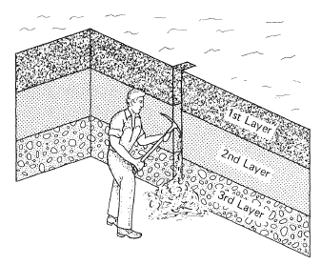
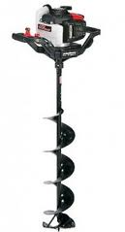
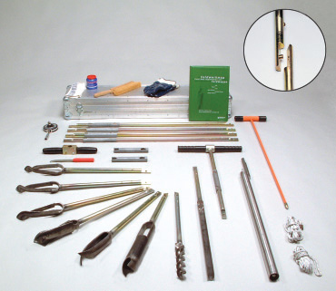
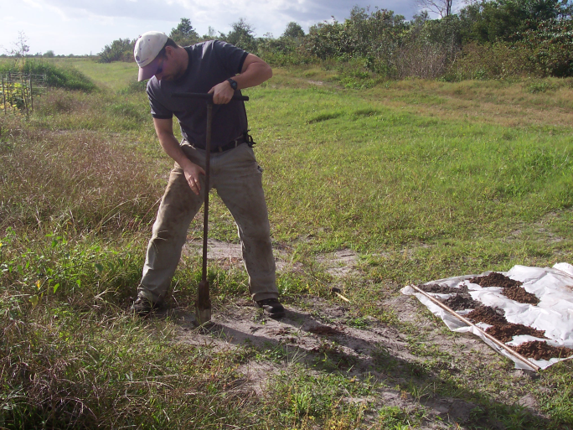
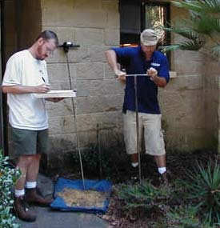
Geotechnical Investigation
Methods of Sample Recovery
  Hand auger
Test pit
The practical depth of investigation using a hand auger
depends upon the soil properties and depth of investigation.

Slide 29
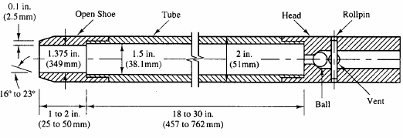
Geotechnical Investigation
Methods of Sample Recovery
  Split spoon
Split spoon sampling methods are used primarily to collect shallow and deep subsurface soil samples.
All split spoon samplers, regardless of size, are basically split cylindrical barrels that are threaded on each end.
Split spoon sampling method is used to obtain disturbed and undisturbed samples.
- The sampler is driven in into the soil by a hammer
- The weight of the hammer is 140 lb
- The number of blows (N) required to penetrate the spoon of three 6 in. intervals are added and recorded.
This procedure is called the Standard Penetration Test (SPT)
Actually, the Standard Penetration Number N is the number of blows of the last two intervals (12 in.) The first interval (6 in.) is usually discarded (why??????????)
18 to 30 in

Slide 30
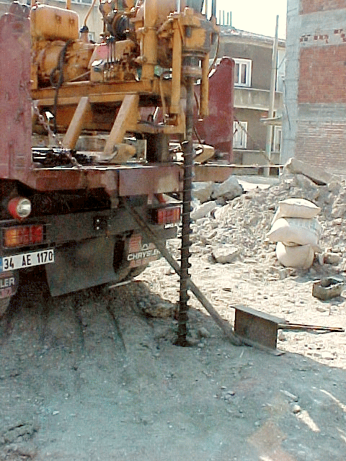
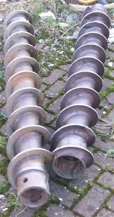
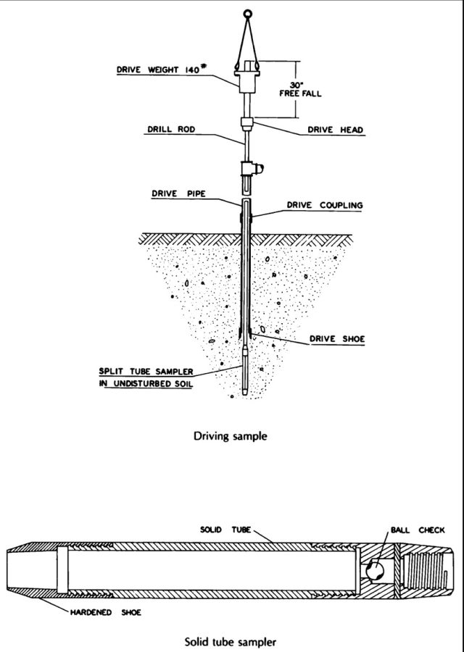
Geotechnical Investigation
THE STANDARD PENETRATION TEST (SPT) ASTM D1586
- The SPT is one of the most popular and economical means to obtain subsurface information.
- The testing method was standardized in 1958 as ASTM D1568
The test consists of:
* A 140 lb driving mass falling from a height of 30 in.
* Drive the standard split spoon sampler a distance of 18 in. into the soil
* Counting the number of blows (N) to drive the sampler 12 in.
(6 in. + 6 in.)
* The boring log should show "refusal" and should be halted if:
a- 50 blows are required for any 150 mm increment
b- 100 blows are obtained
c- 10 successful blows produce no advance
* N should be corrected for the increase of the overburden pressure
Hollow Stem Auger

Slide 31
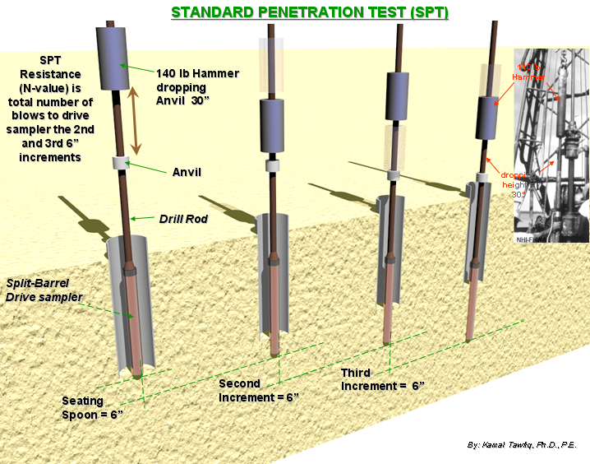
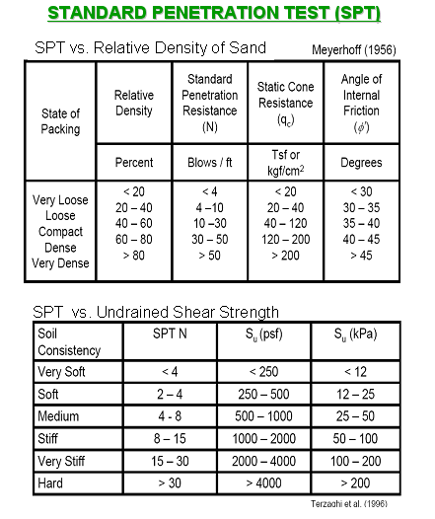
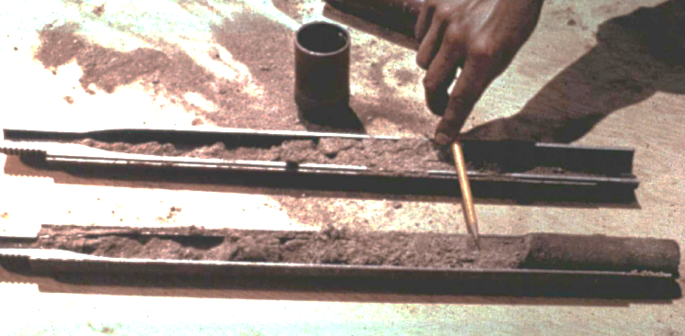
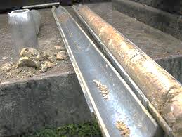

THE STANDARD PENETRATION TEST (SPT) ASTM D1586
See attached SPT video

Slide 32
Corrections for SPT Field Blow-count (N_{Field})
1- Peck & Bazaraa (1969) suggested
N_{cor} = For (σ_{v} < 1.5 kips/ft²)
N_{cor} = For (σ_{v} > 1.5 kips/ft²)
2- Peck, Hanson, and Thornburn (1974) proposed
N_{cor} = ( ) (N_{f}) For (σ_{v} in tons/ft²)
4 N_{f}
1 + 2 σ_{v}
4 N_{f}
Amount of
removed σ_{v}
3.25 + 0.5 σ_{v}
σ_{v} = Vertical effective stress at the sampling depth (kips/ft²)
Example
N_{field} = 40
20
0.77 log
σ_{v}
1 kip = kilopound = 1000 lb = 4448.2216 Newtons (N) = 4.4482216 kilonewtons (kN)
1 US ton = 2000 lb

Slide 33
Corrections for SPT Field Blow-count (N_{Field})
Example 1:
Given:
SPT = 40 at 20’ in sand
γ_{sand} = 115 lb/ft³
Find:
N_{cor} = ??
Solution:
Using Peck, Hanson, and Thornburn (1974) equation
C_{N} = 0.77 log (20/σ_{v})
σ_{v} = (20) (115 )/ 2000(lb/ton) = 1.15 tons/ft²
C_{N} = 0.77 log (20/1.15) = 0.955
N_{cor} = (0.955) (40) = 38
Amount of
removed σ_{v}
Example
N_{field} = 40
20
N_{cor} = ( ) (N_{f}) For (σ_{v} in tons/ft²)
0.77 log
σ_{v}

Slide 34
Corrections for SPT Field Blow-count (N_{Field})
Example 2:
Given:
SPT = 40 at 20’ in sand
γ_{sand} = 115 lb/ft³
Find:
N_{cor} = ??
Solution:
Using Peck & Bazaraa (1969) equation
σ_{v} = [(20)(115) / 1000 (lb/kip)] = 2.3 kips/ft²
Since σ_{v} is > 1.5 kips/ft² use
N_{cor} = 4 (40) / [3.25+(0.5)(2.3)] = 36
Amount of
removed σ_{v}
Example
N_{field} = 40
4 N_{f}
N_{cor} =
For (σ_{v} > 1.5 kips/ft²)
3.25 + 0.5 σ_{v}

Slide 35

Corrections for SPT Field Blow-count (N_{Field})
Skempton (1986) suggested the following correction for the SPT field blow-count N_{f}
N₆₀ =
Where:
E_{m} = Hammer efficiency (for U.S. equipment, E_{m}= 0.6 for a safety hammer,
and 0.45 for a doughnut hammer). For automatic systems that lift the
hammer and allow it to drop unimpeded can deliver higher energy to the drill rods
with values of E_{m} as high as 95 percent (ASTM D 6066-96, 2004).
C_{b} = Borehole diameter correction (C_{b} = 1.0 for borehole = 65 to 115 mm diameter, 1.05 for 150 mm diameter, and 1.15 for 200 mm diameter)
C_{r} = Rod length correction (C_{r} = 0.75 for up to 4 m for drill rods, 0.85 for 4 to 6 m drill rods, 0.95 for 6 to 10 m drill rods, and 1.00 for rods in excess of 10 m)
As an average value N₆₀ = 0.5 to 0.67N_{f}
doughnut hammer
E_{m} C_{b} C_{r} N_{f}
Assuming 60% hammer efficiency
60
safety hammer
Automatic hammer

Slide 36
Correction of N Value for foundations in an earthquake zone
engineering, such as liquefaction analyses, the standard penetration test N₆₀ value is corrected for the overburden soil pressure, also known as the effective overburden pressure or the vertical effective stress (σ_{v}).
Where:
(N₁)₆₀ = standard penetration test N value corrected for both field testing procedures and overburden pressure
C_{N} = correction factor to account for the overburden pressure, and it is approximately equal to (100/σ_{v})^{0.5} where σ_{v} is the vertical effective stress, in kPa.
Suggested maximum values of C_{N} range from 1.7 to 2.0 (Youd and Idriss, 1997, 2001).
N₆₀ = standard penetration test N value corrected for field testing procedures.
The N₆₀ is calculated by using Skempton’s equation.
E_{m} C_{b} C_{r} N_{f}
0.5
N₆₀ =
60
(N₁)₆₀ = C_{N} N₆₀ =
100
σ_{v}
N₆₀

Slide 37

Relationship between bearing capacity factors, φ, and SPT
Example
Given:
N_{f} =40
Water Table = 5’
γ_{soil} = 120 pcf
Find:
N_{q}, N_{γ} and φ
Solution:
σ_{v} = {(5)(120)+[15(120-62.4)]}/2000 lb/ton =
= ton/ft²
N_{cor} = C_{N} N_{f} = 0.77 log (20/ ) =
N_{q}, = N_{γ} = φ =
W.T.
γ_{soil} = 120 pcf
5 ft
15 ft
Standard Penetration Resistance, N ( Blows/ft)
Bearing Capacity Factor, N _{γ} & N _{q}
N_{f} =40
N_{γ}
N_{q}
Curves showing the relationship between bearing capacity factors and φ, as determined by theory, and rough empirical relationship between bearing capacity factors or φ and values of standard penetration resistance N.
Peck et al. (1974)
Angle of Internal Friction, φ (degrees)

Slide 38



Geotechnical Investigation
Cone Penetration Test (CPT )
The most common type of mechanical penetrometer is the Dutch
mantle cone and is abbreviated CPT.
The cone is pushed into the soil to the desired depth (initial position) and then force is applied to the inner rod, which moves the cone downward into the extended position.
The cone is pushed into the soil at a rate of about 2 to 4 ft/min (10 to 20 mm/sec). The required force to move the cone into the extended position divided by the horizontally projected area (10 cm²) of the cone is defined as the cone resistance q_{c} , also known as the cone bearing or the end bearing resistance.
By continually repeating the two-step process
shown in the figure, the cone resistance q_{c} is
obtained at increments that ordinarily
do not exceed 8 in. (20 cm).
2 to
4 ft/min

Slide 39



Cone Penetration Test (CPT )
Friction
CPT
Standard
Piezocone
Type 1
Piezocone
Type 2
Piezocone

Slide 40

Cone Penetration Test (CPT )
Special features of the cone penetration test are as follows:
Cone resistance versus depth.
A considerable amount of work has been performed in correlating cone resistance q_{c} with subsurface conditions. Figure1 presents four examples, where the cone resistance q_{c} has been plotted versus depth below ground surface. The shape of the cone resistance q_{c} plots versus depth can be used to identify sands, clays, cavities, or rock.
NC Clay
Dense
Sand
NC Clay
Sand
NC Clay
Sand
Figure1: Simplified examples of CPT cone resistance qc versus depth, showing possible interpretations of soil types and conditions. (From Schmertmann, 1977.)

Slide 41


Cone Penetration Test (CPT )
Special features of the cone penetration test are as follows:
2. Friction ratio.
The figure below illustrates the two-step process that can be used to obtain the soil friction along a side sleeve f_{s}.
1- In the first step, the cone resistance is obtained (q_{c}) = 1000 psi
2- in the second step, the cone plus sleeve friction is determined (q_{c} + f_{s}) = 1440 psi
3- Subtraction gives the sleeve friction (f_{s}) = 440 psi
The friction ratio (FR) can then be calculated, defined as FR = sleeve friction (f_{s}) divided by cone resistance = (f_{s}/q_{c} )x100. By knowing the friction ratio (FR) and cone resistance q_{c}, the type of soil can be estimated by using Fig. 2.
Cone Resistance
Friction Resistance
Friction Ratio
Test sequence for obtaining the sleeve friction from the Dutch cone penetrometer and an example of the test data plotted versus depth.

Slide 42

Cone Penetration Test (CPT )
Figure 2: Guide for estimating soil type from Dutch mantle cone
Steps:
1- Enter chart with cone resistance q_{c} and friction ratio
2- FR = sleeve friction divided by cone resistance = (f_{s} / q_{c})x100.
(From Schmertmann, 1977)
q_{c}
Figure 2:
FR

Slide 43


Cone Penetration Test (CPT )
Other Cone Penetrometers.
Besides the mechanical cone, there are other types of cone penetrometers, such as:
Electric cone. A cone penetrometer that
uses electric-force transducers built into the apparatus for measuring cone resistance
and friction resistance.
Piezocone. A cone penetrometer with the additional capability of measuring pore water pressure generated during the penetration of the cone.
Special devices. The cone can even be
equipped with a video camera to enable
the type of soil to be viewed during the
test (Raschke and Hryciw, 1997).

Slide 44
Cone Penetration Test (CPT )
A major advantage of the cone penetration test (CPT)
- It provides almost a continuous subsurface record of the cone resistance q_{c} and f_{s}
This is in contrast to the SPT, which obtains data at much larger intervals in the soil deposit.
Disadvantages of the CPT are that soil samples cannot be recovered and special equipment is required to produce a steady and slow penetration of the cone.
Unlike the SPT, the ability to obtain a steady and slow penetration of the cone is not included as part of conventional drilling rigs.
Because of these factors, in the United States, the CPT is used less frequently than the SPT.

Slide 45





Seismic refraction (for large areas)

Slide 46




Ground Penetration Radar (GPR)

Slide 47

Ground Penetration Radar (GPR)

Slide 48



Geo-electrical Profiling using Electrical resistivity or D.C. Resistivity Method
Good for sensing buried wastes and waste migration
Schematic Illustrating Basic Concept of
D.C. Resistivity Crew In Operation Electrical Resistivity Measurement

Slide 49



Geotechnical Investigation
top
top
bottom
bottom

Slide 50



Rotary core barrel
Coring bits are commonly 1.75 to 5.25 inches in diameter.
Diamond or Tungsten carbide insets on rotary coring bit.

Slide 51

Core recovery parameters describe the quality of core recovered from a borehole.
Total core recovery (TCR)
TCR is the borehole core recovery percentage.
TCR is defined as the quotient:
% TCR = ( ) x 100
L_{sum of pieces} = Sum of length of core pieces
L_{total core run} = Total length of core run
∑ L_{sum of pieces}
L_{total core run}

Slide 52
Core recovery parameters describe the quality of core recovered from a borehole.
Solid core recovery (SCR)
Solid core recovery (SCR) is the borehole core recovery percentage of solid, cylindrical, pieces of rock core.
SCR is defined as the quotient:
SCR = ( ) x 100
L_{sum of solid core pieces}
L_{total core run}

Slide 53
Rock Quality Designation (RQD) Factor
Developed in 1964 by Deere
Rock-Quality Designation (RQD) is a rough measure of the degree of jointing or fracture in a rock mass, measured as a percentage of the drill core in lengths of 10 cm or more.
∑ L_{sum of 10cm}
RQD = x 100
L_{total core run}
L_{sum of 10cm} = Sum of length of core sticks longer than
10 cm measured along the center line of the core
From the RQD index the rock mass can be classified as follows:
RQD | Rock mass quality
<25% | very poor
25-50% | poor
50-75% | fair
75-90% | good
90-100% | excellent

Slide 54
Rock Quality
0.8 ft
Sound
0.7 ft
Not sound, highly weathered
Length, L
Not sound, centerline pieces < 4 inches, highly weathered
0.8 ft
0.6 ft
Sound
Core Run
Total = 4 ft
0.2 ft
Not sound
0.7 ft
Sound
CR = 95% RQD = 53%

Slide 55
NEW SECTION

Slide 56



Geotechnical Investigation
MEASUREMENTS OF MATERIAL PROPERTIES
Soil Properties
Physical properties
Index Properties
Hydraulic Properties
Mechanical Properties

Slide 57


MEASUREMENTS OF MATERIAL PROPERTIES
Methods of Measurement
1- Laboratory Testing Methods
2- In-Situ Testing Methods
3- Empirical Correlation's
Terzaghi & Peck (1948): Cc = 0.009 (w_{c} – 10%)
Skempton (1944): Cc 0.007 (w_{c} – 7%)

Slide 58
MEASUREMENTS OF MATERIAL PROPERTIES
Methods of Measurement
1- Laboratory Testing Methods
- Provide better control over the boundary conditions
- Different parameters can be determined individually or in
combination
- Results can be produced

Slide 59


MEASUREMENTS OF MATERIAL PROPERTIES
Methods of Measurement
2- In-Situ Testing Methods
Measurements of properties for large soil masses
Less disturbance
Measurements under real field conditions
Can be performed during site exploration (SPT & CPT)
In-Situ testing methods are used to determine:
1- Hydraulic properties (Wells)
2- Mechanical properties (SPT, CPT, Vane Shear Test,
Pressuremeters, CBR) (See Table 3.20)

Slide 60


MEASUREMENTS OF MATERIAL PROPERTIES
Soil Properties
1- Physical properties: Used to describe the soil. These properties are incorporated with the soil classification systems, and in some cases they are related to the mechanical properties
- Specific gravity
- Grain size
- Density (Saturated, Partially saturated, submerged, minimum,
maximum, relative, optimum moisture content)
- Porosity
- Degree of saturation
- Void ratio
- Moisture content
- Hardness (for rocks)
- Durability (for rocks)
- Reactivity (for rocks)

Slide 61






MEASUREMENTS OF MATERIAL PROPERTIES
Soil Properties
2- Index Properties: Used to classify the soil or to correlate with the mechanical properties.
- Atterberg Limits or Consistency Limits (LL, PL SL)
- Moisture Content vs. Unit Weight Relationship (Compaction)
- Grain Size Distribution
- Relative Density D_{r}
Grain Size Distribution
Proctor Test
Relative Density D_{r}
LL
PL

Slide 62


MEASUREMENTS OF MATERIAL PROPERTIES
Soil Properties
3- Hydraulic Properties
- Permeability or Hydraulic Conductivity (k)
Infiltration Rate
Double Ring Infiltrometer

Slide 63




MEASUREMENTS OF MATERIAL PROPERTIES
Soil Properties
4- Mechanical Properties: To describe the behavior of the soil under different types of stresses
-Deformation Moduli – Young's Modulus (E) & Shear Modulus (G)
Consolidation (C_{c}, C_{s}, C_{v}, P_{c}, m_{v}, K)
Strength (c, φ) Unconfined Compression
Direct Shear,
Triaxial Compression
California Bearing Ratio (CBR) or
Lime Rock Bearing Ration (LBR)
used for pavement design
Direct Shear
Consolidation Test
Unconfined
Compression
Triaxial Compression

Slide 64

MEASUREMENTS OF MATERIAL PROPERTIES
Methods of Measurement
3- Empirical Correlations
- Correlations are usually based on basic or index properties
- These properties are correlated with the mechanical & hydraulic properties
- Used to provide basis for all engineering analysis
- Reduce the cost of geotechnical investigation
- Presented as ----- Tables, Charts, and Equations
For example Beyer formula for coefficient of permeability (k)
K = C . (d₁₀)²
Where :
C = 4.5x10⁻³ log
U = Uniformity coefficient = d₆₀/d₁₀
d₁₀ = Effective diameter (mm)
500
U
10%
Passing
d₁₀

Slide 65
Reporting Geotechnical Investigation
Both an adequate geotechnical investigation and a comprehensive geotechnical report are necessary to construct a safe, cost-effective project.
While the geotechnical report content and format will vary by project size and highway agency, all geotechnical reports should contain certain basic essential information, including:
Cover letter and Executive summery
Scope of the Project
Site Description
Proposed Construction
Summary of all subsurface exploration data, including subsurface soil profile, exploration logs, laboratory or in situ test results, and ground water information;
Interpretation and analysis of the subsurface data; Specific engineering recommendations for design;
Discussion of conditions for solution of anticipated problems; and Recommended geotechnical special provisions.

Slide 66




Geotechnical Report Production

Slide 67

Geotechnical Report Production

Slide 68

Geotechnical Report Production
1- Map of the Project Location

Slide 69

Geotechnical Report Production
2- Boring Locations

Slide 70
Geotechnical Report Production

Slide 71

Geotechnical Report Production
3- Boring Log:
Soil description and classification
Sample depth
SPT field value
Water Table

Slide 72


3- Boring Log:
Soil description and classification
Sample
13
(5+5+8)
SPT field value

Slide 73

4- Profile of Soil Layers:

Slide 74

Geotechnical Report Production
4- Profile of Soil Layers:

Slide 75

4- Profile of Soil Layers:

Slide 76

6- Soil Testing Results

Slide 77


5- Soil Testing Summery

