Slide 1
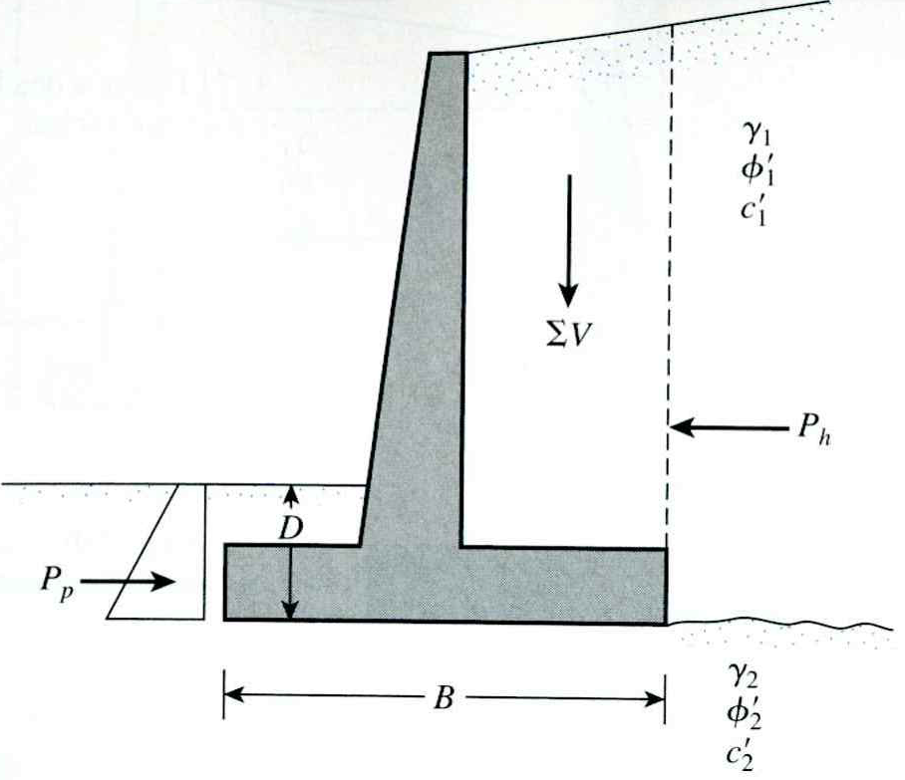
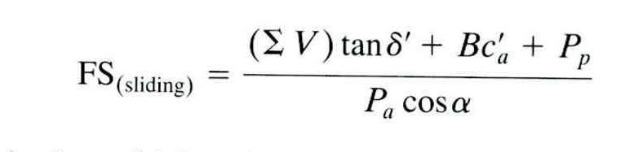
Stability of Cantilever Retaining Wall Against Sliding

Slide 2
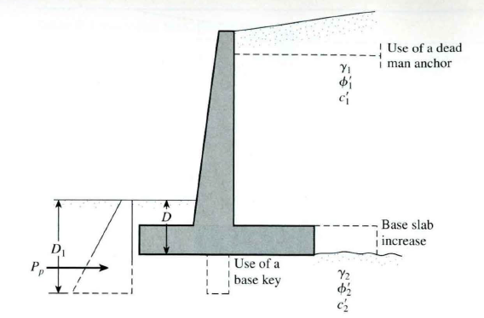
Alternatives for increasing the factor of safety with respect to sliding
Increase the width of the base slab (i.e., the heel of the footing).
Use a key to the base slab. If a key is included, the passive force per unit length of the wall becomes
Use a deadman anchor at the stem of the retaining wall
Base Key
Where sufficient sliding stability is not possible—usually for walls with large H—a base key,
as illustrated in Fig. 12-14, has been used. There are different opinions on the best location
for a key and on its value. It was common practice to put the key beneath the stem as in Fig.
12-14a, until it was noted that the conditions of Fig. Yl-XAb were possible. This approach
was convenient from the view of simply extending the stem reinforcement through the base
and into the key. Later it became apparent that the key was more effective located as in Fig.
12- 14c and, if one must use a key, this location is recommended. The increase in H by the
key depth may null its effect.

Slide 3
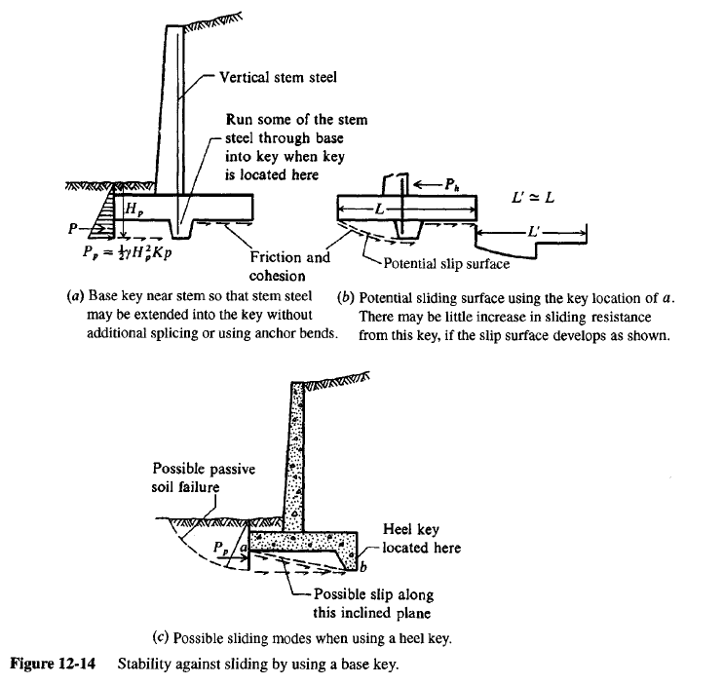

Slide 4
Common Proportions of Cantilever Wall
12 in Preferable minimum
Minimum batter = 1/50
Vertical
Stem
H
Toe Slab
H/10 to H/8
Thickness
H/12 to H/10
Heel of Slab
D_{f}
_{Thickness = H/12 to H/10}
_{B = 0.4 to 0.7 H}
Base of footing

Slide 5
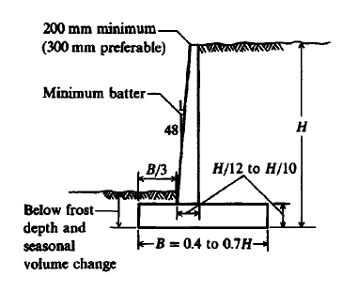
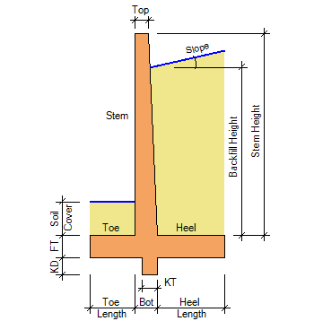
Tentative design dimensions for a cantilever
retaining wall. Batter shown is optional.

Slide 6
Example 1
Given
The cross section of a cantilever retaining wall is shown in Figure 1. Calculate the factors of safety with respect to overturning, sliding, and bearing capacity.
Solution
From the figure,
H' = H1 + H2 + T1 = 8 tan 10° + 19.5 + 2 = 22.91 ft
The Rankine active force per unit length of wall =
q = 120 lb/ft
1 ft
10º
3
H₁ = 1.41 ft
a₁
W₁
W₃
γ₁ = 115 lb/ft³
φ₁ = 30º
c₁ = 0
a₃
P_{v1}
H₂ = 19.5 ft
a₂
P_{a1}
a_{v}
W₂
P_{v}
10º
P_{h1}
a₄
4
2
P_{v2}
P_{a2}
10º
P_{h2}
a₆
6
W₄
W₆
y_{a}
10º
4.5 ft
a₅
W₅
5
T₁ = 2 ft
O
γ₂ = 112 lb/ft³
φ₂ = 20º
c₂ = 800 lb/ft²
2.25 ft
2.25 ft
8 ft

Slide 7
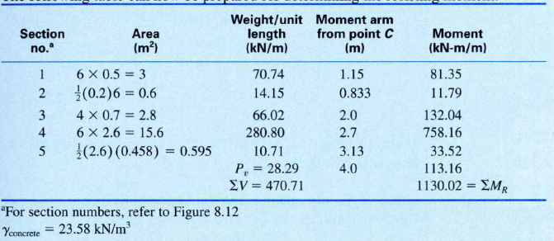
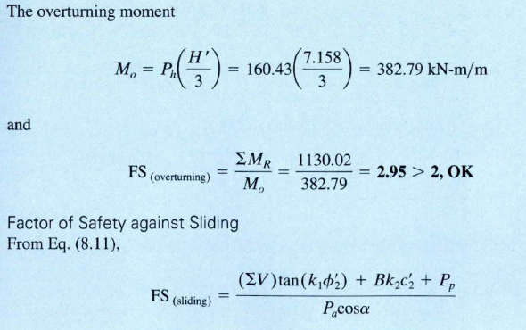

Slide 8
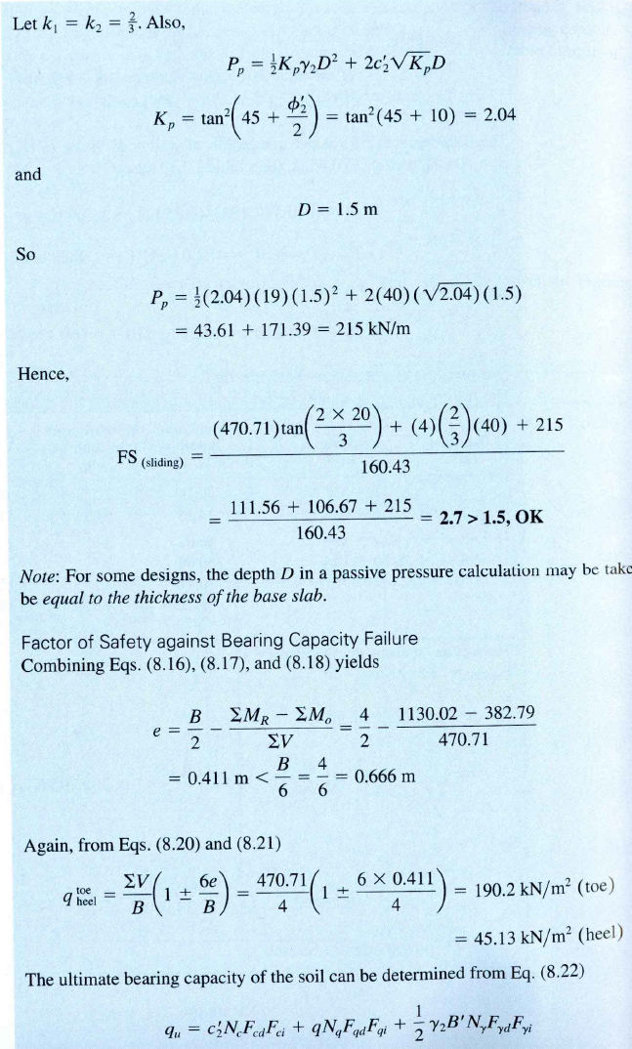

Slide 10
