Slide 1
Mechanically Stabilized Earth (MSE) Wall Project
Geotechnical Design
CEG 4801
Kamal Tawfiq, Ph.D., P.E.

Slide 2
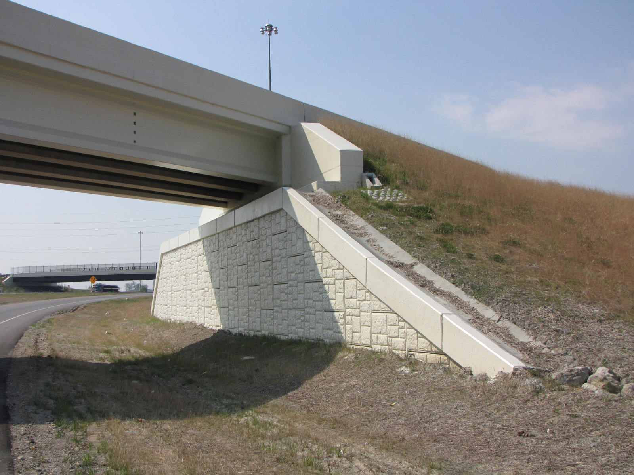
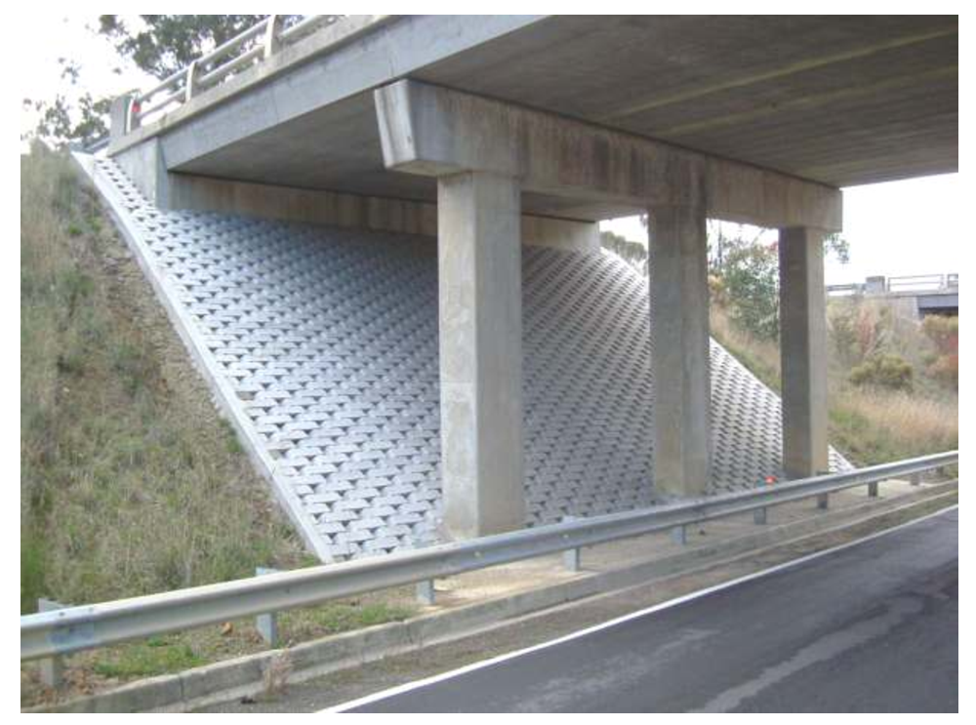
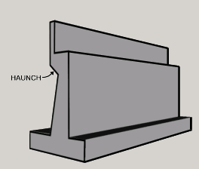
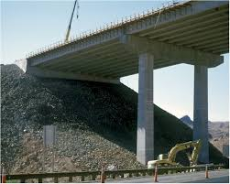
Choices for Bridge Abutments
3
2
1
4

Slide 3
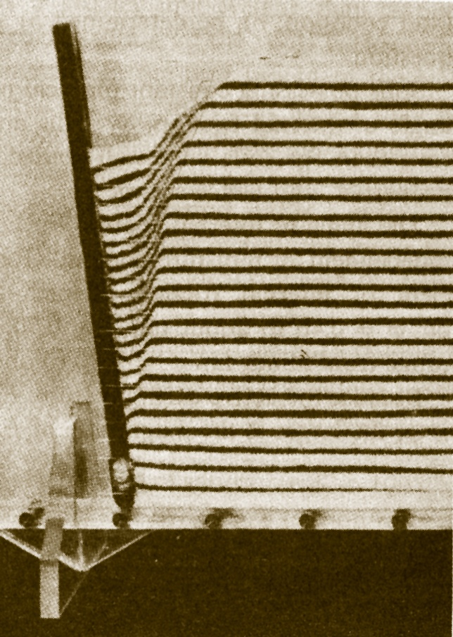
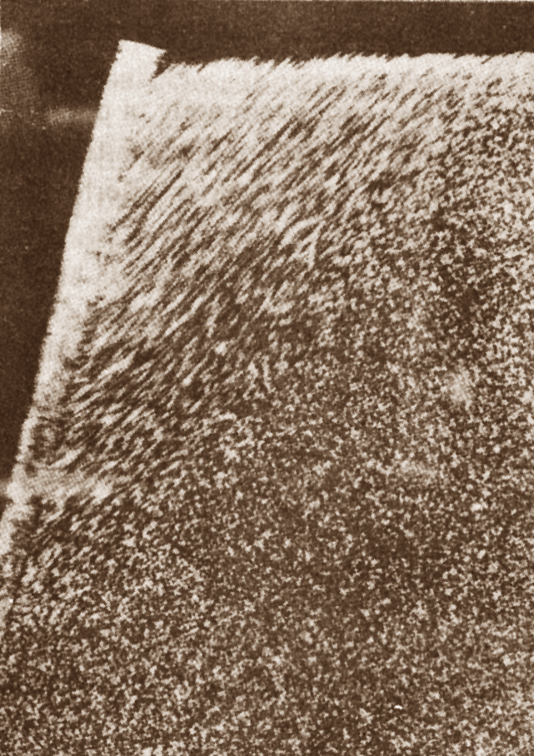
Geotechnical Design
CEG 4801
Fall 2010
By: Dr. Kamal Tawfiq
Active
Passive
Earth Pressure Behind Retaining Wall

Slide 4
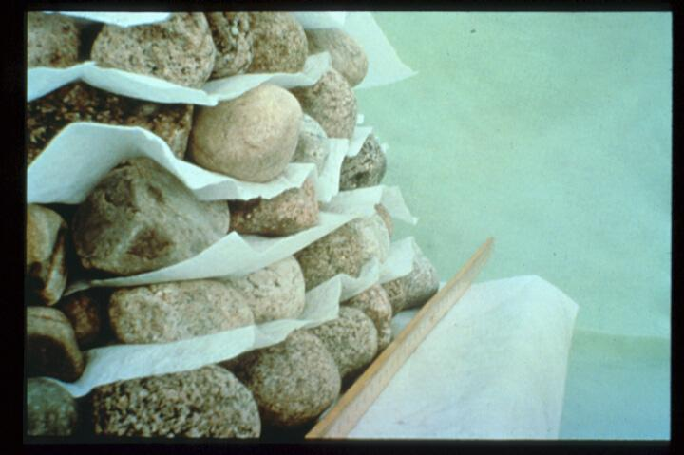
French architect and engineer Henri Vidal in the early 1960s

Slide 5
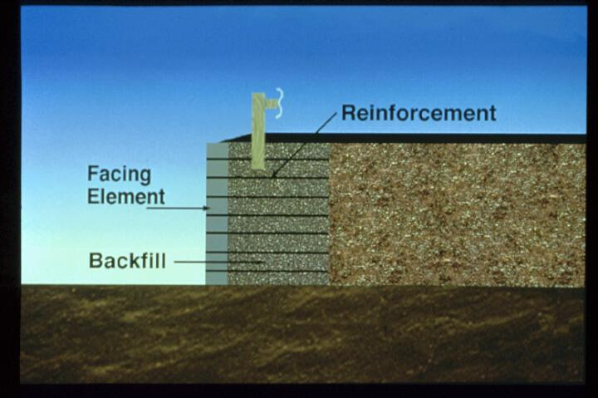

Slide 6
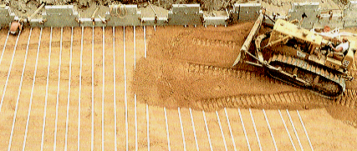
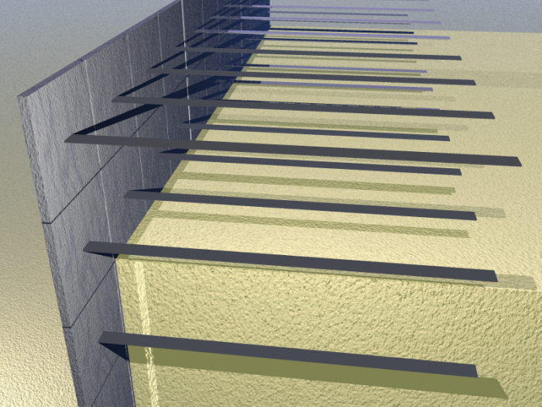
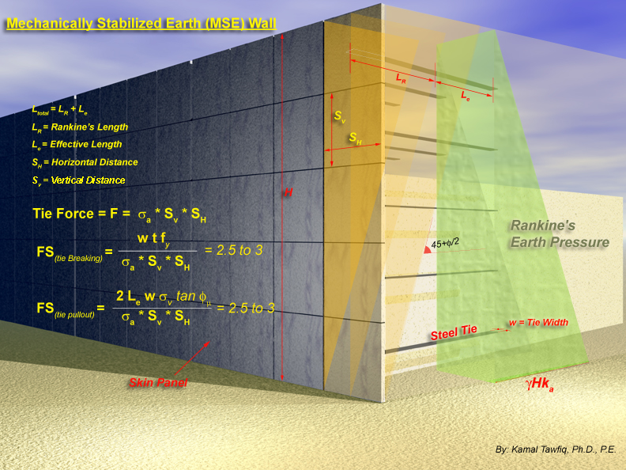
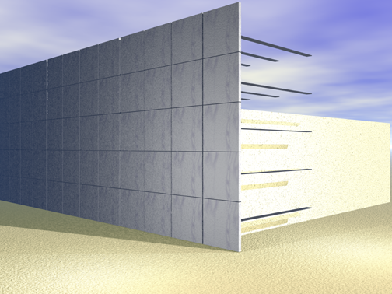
Mechanically Stabilized Earth (MSE) Walls
or Segmental Walls
H = 30 ft
φ = 30o
γ = 110 pcf

Slide 7
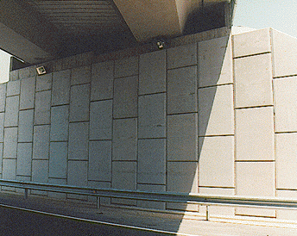
Mechanically Stabilized Earth Wall (MSE Wall)

Slide 8
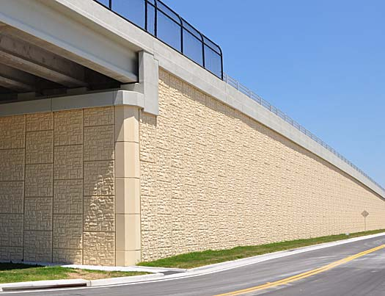

Slide 9
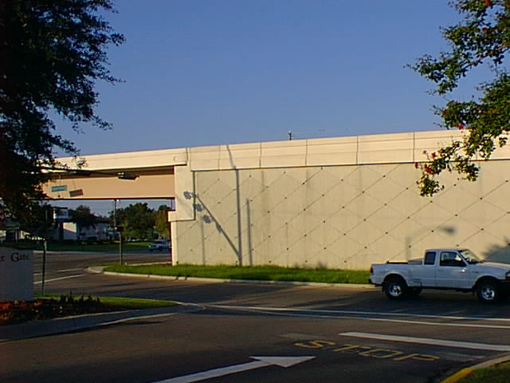
Mechanically Stabilized Earth Wall (MSE Wall)

Slide 10
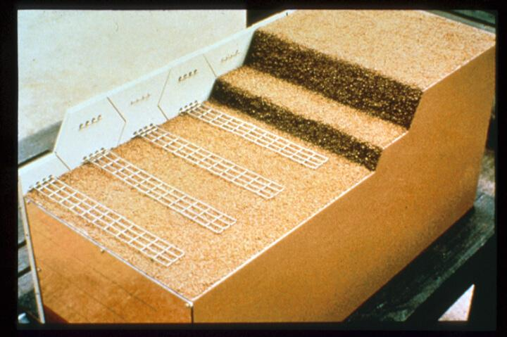
Using Galvanized Steel

Slide 11
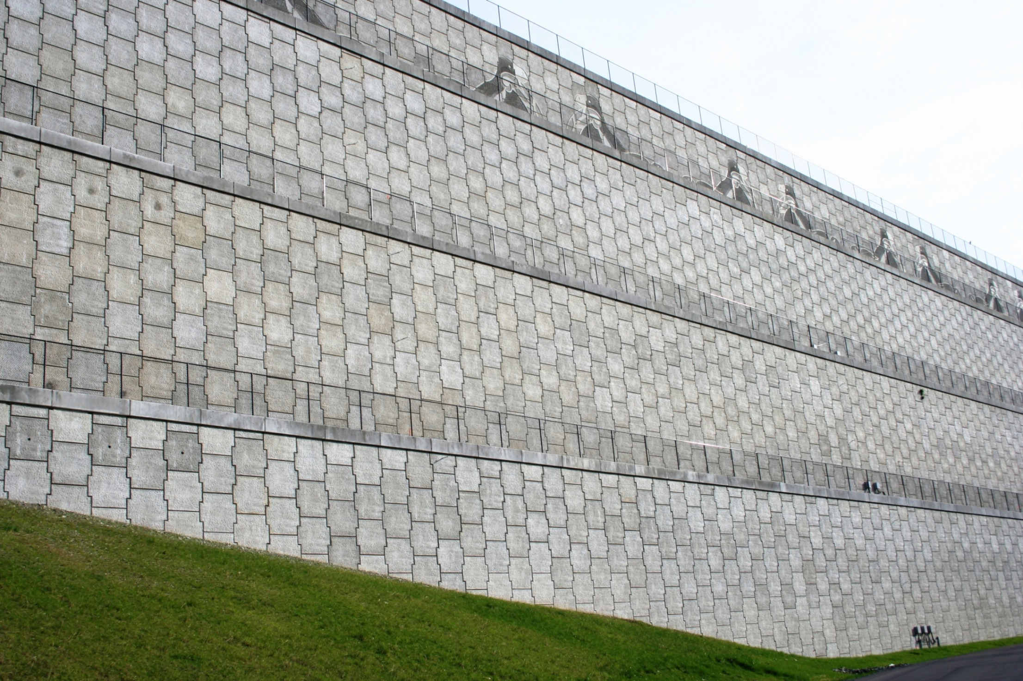
Seattle-Tacoma International Airport, WA

Slide 12
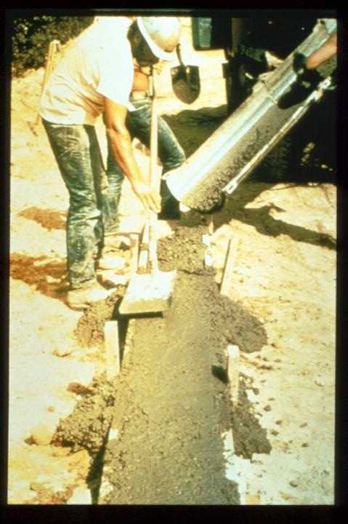
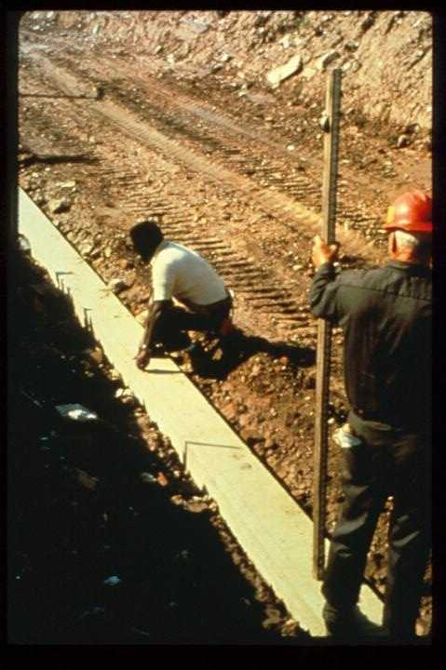

Slide 13
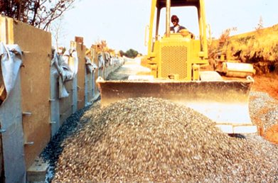
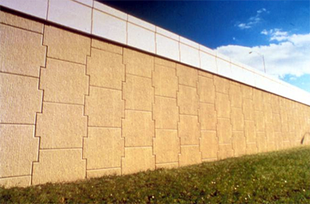
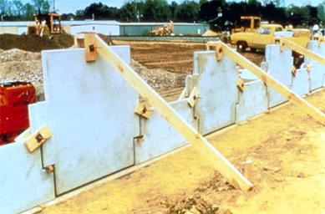
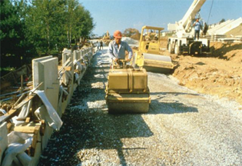
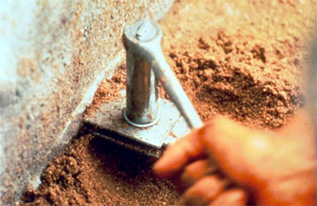
Kamal Tawfiq, Ph.D., P.E.

Slide 14
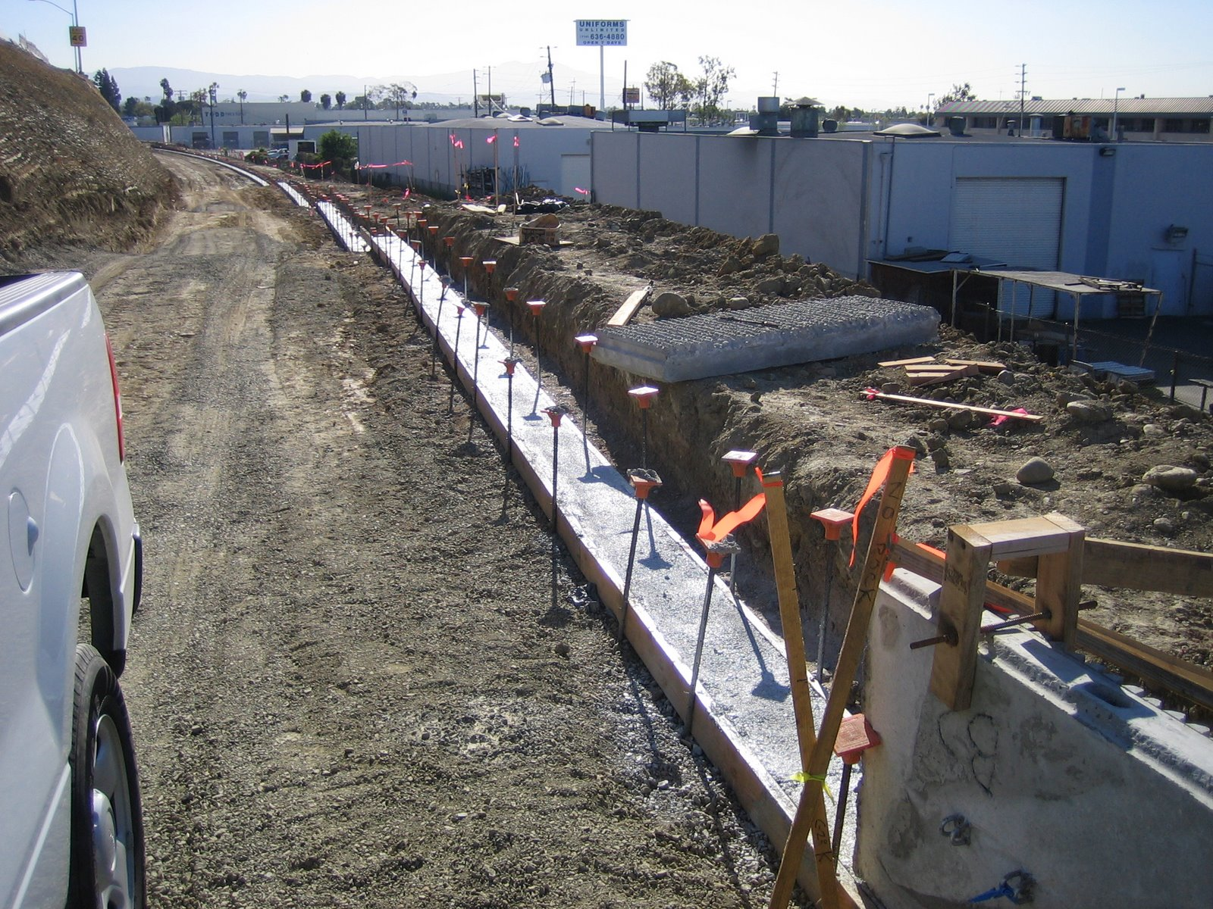

Slide 15
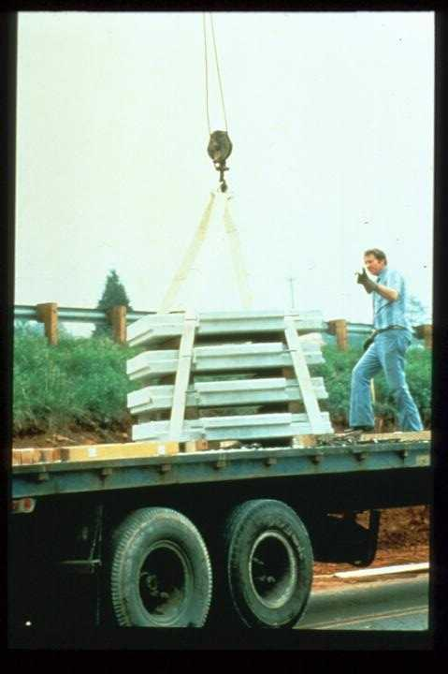

Slide 16
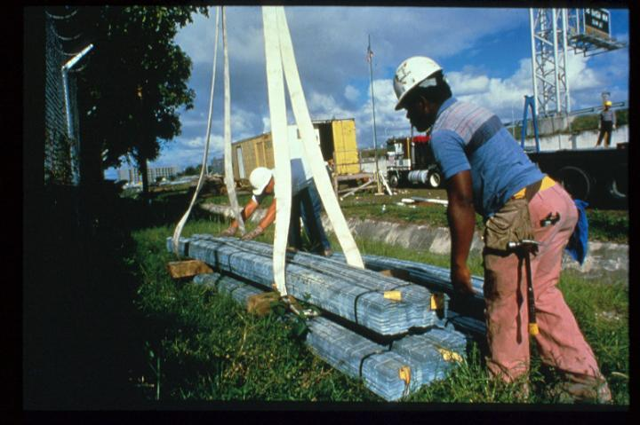

Slide 17
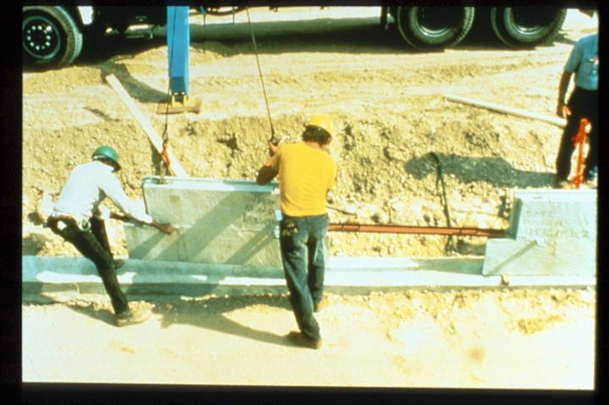

Slide 18
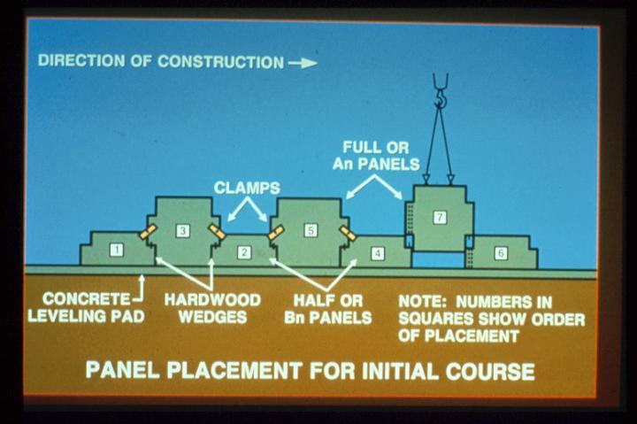

Slide 19
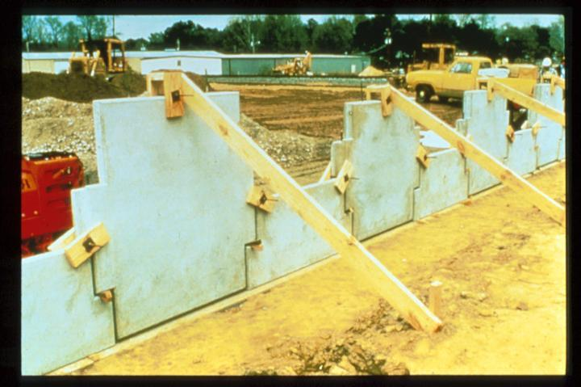

Slide 20
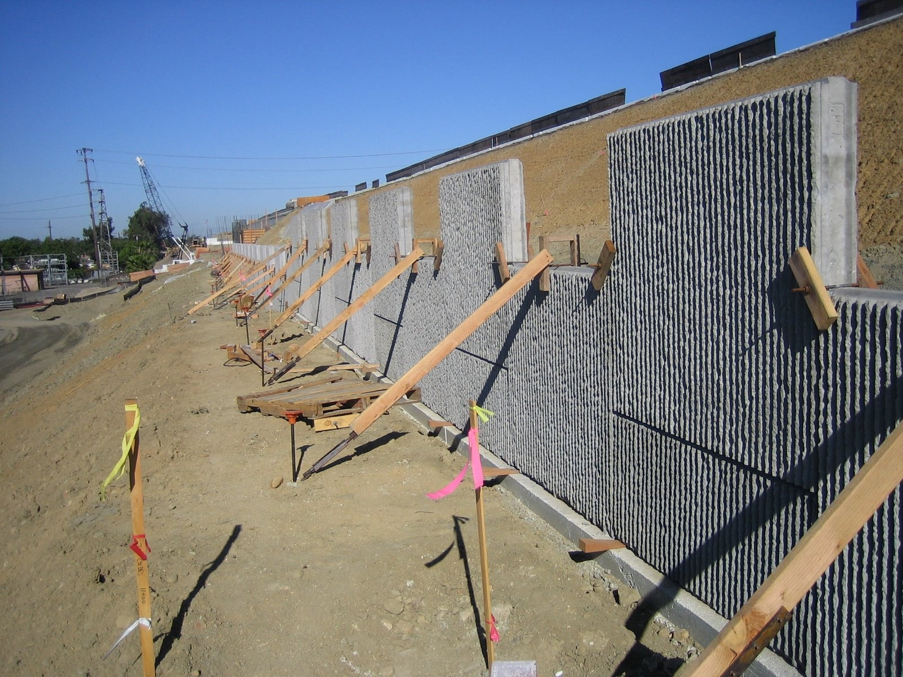

Slide 21
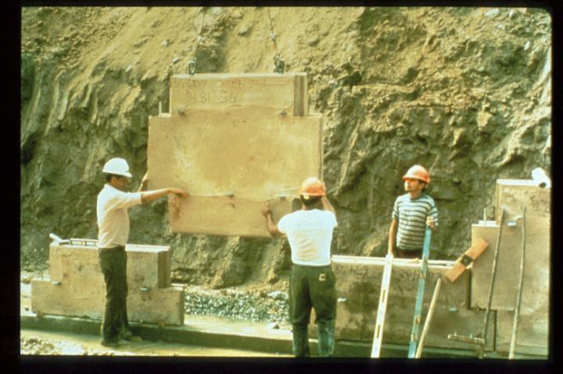

Slide 22
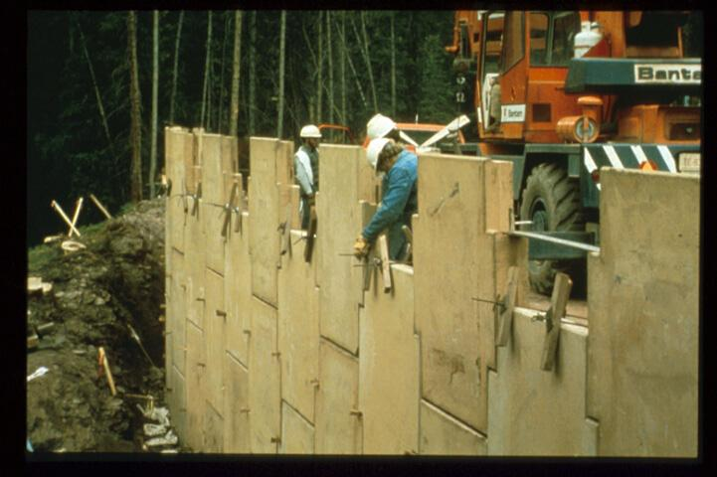

Slide 23
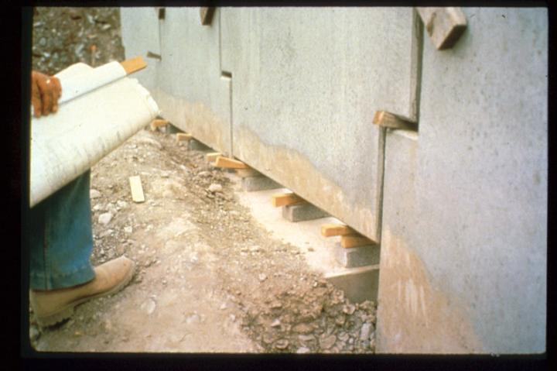

Slide 24
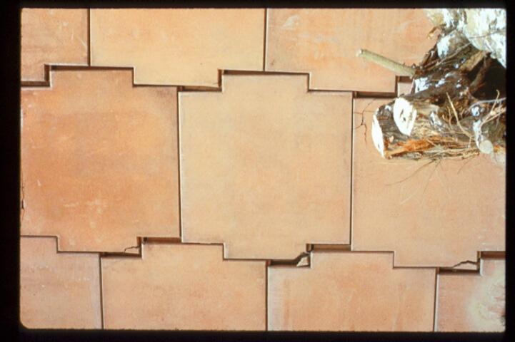
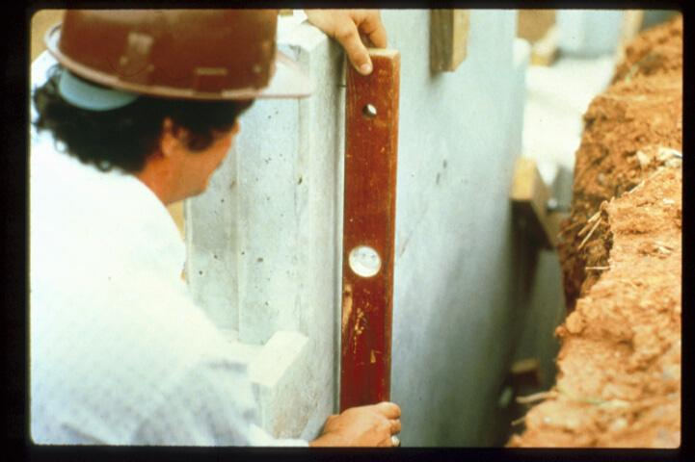

Slide 25
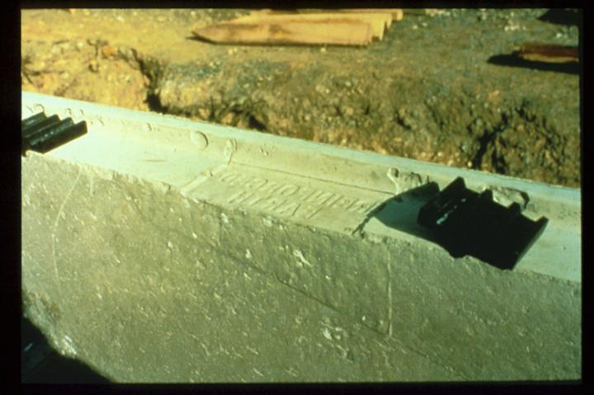

Slide 26
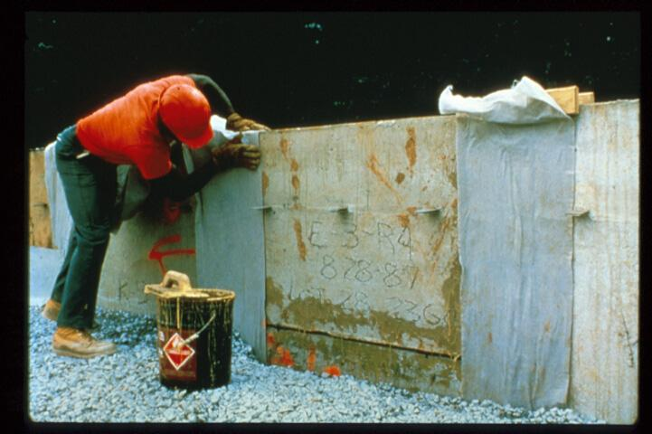

Slide 27
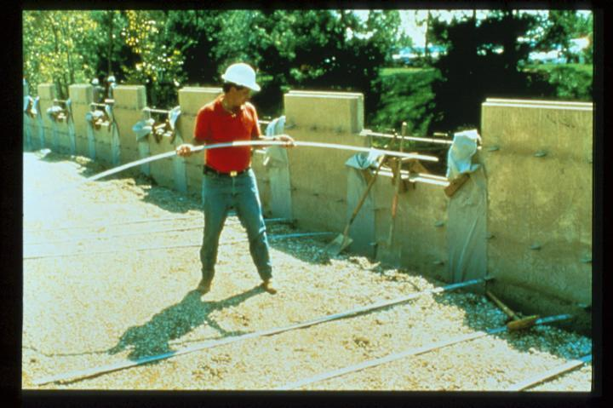

Slide 28
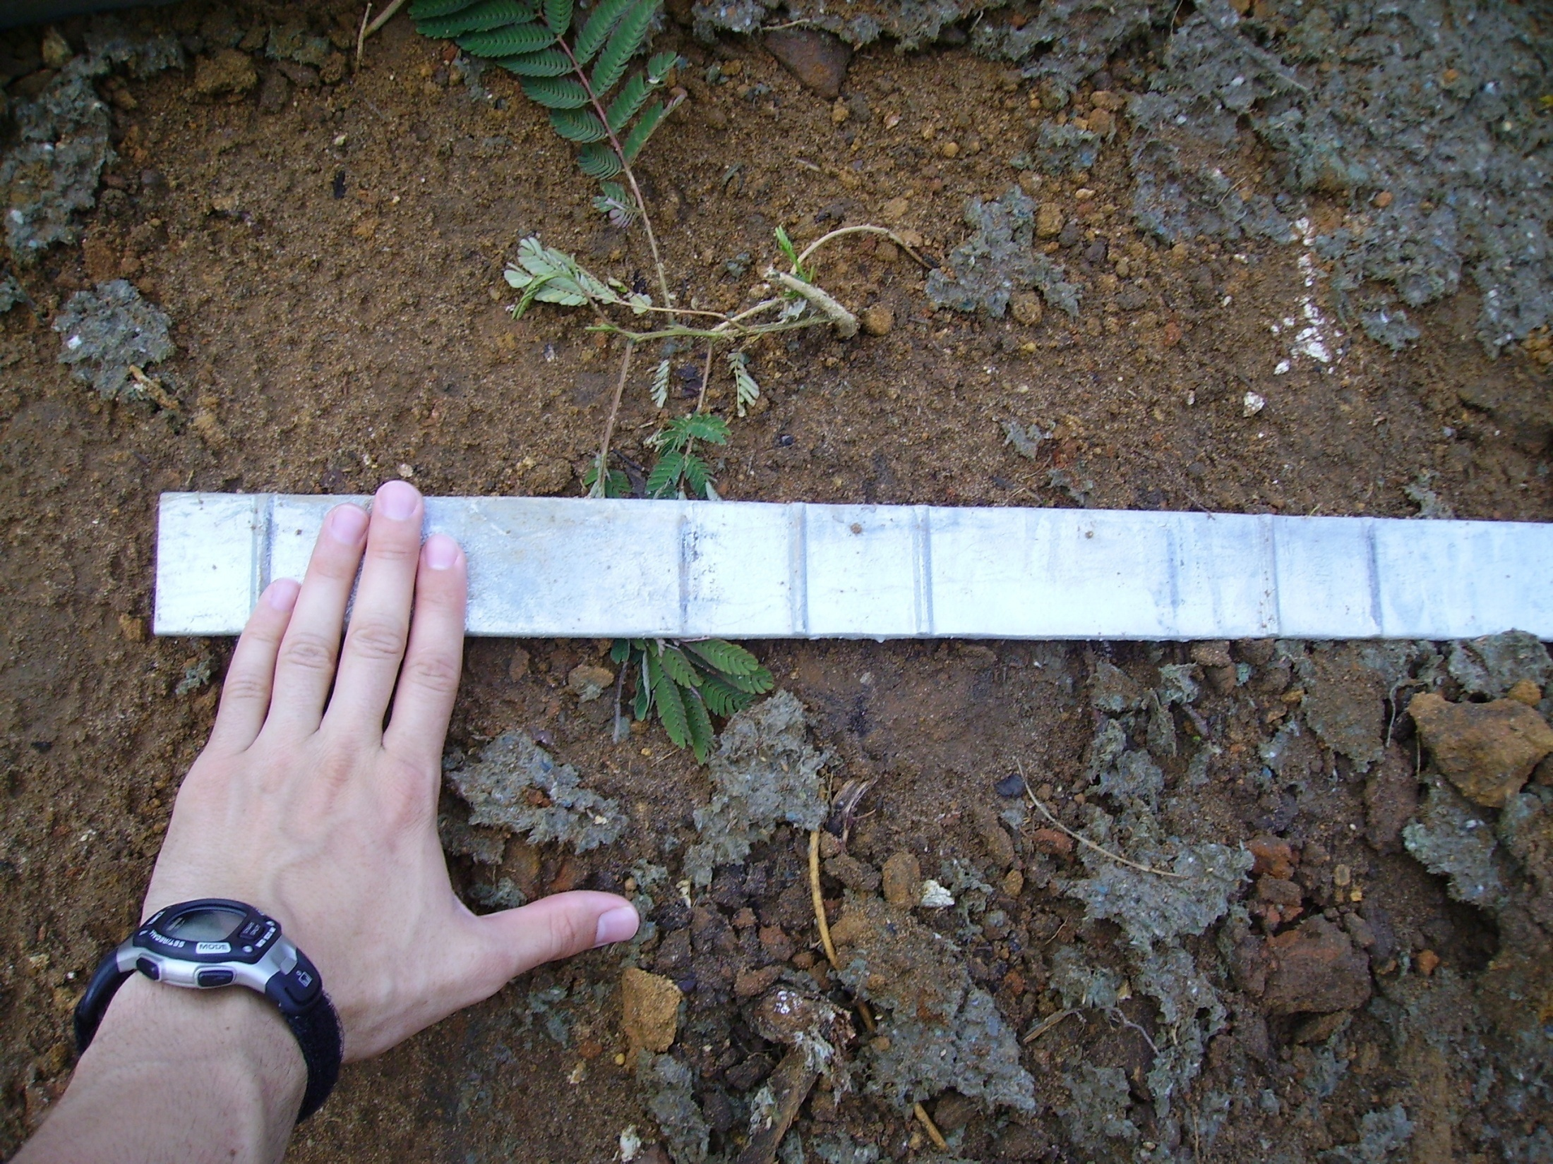

Slide 29
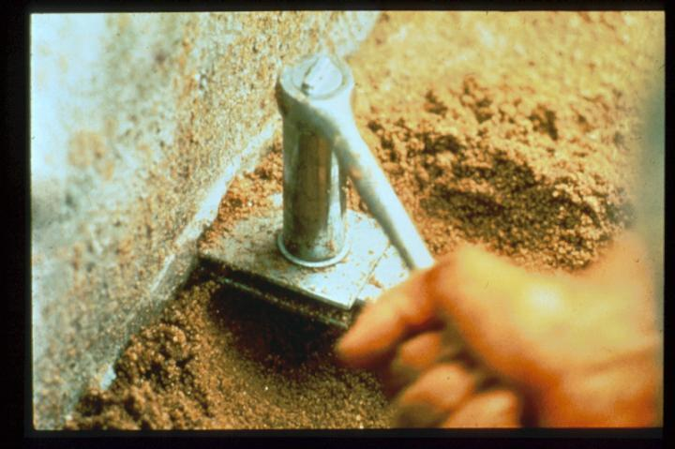

Slide 30
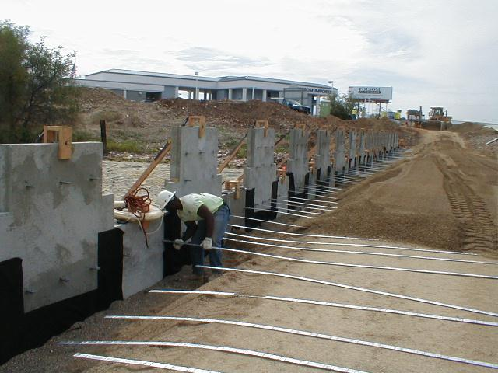

Slide 31
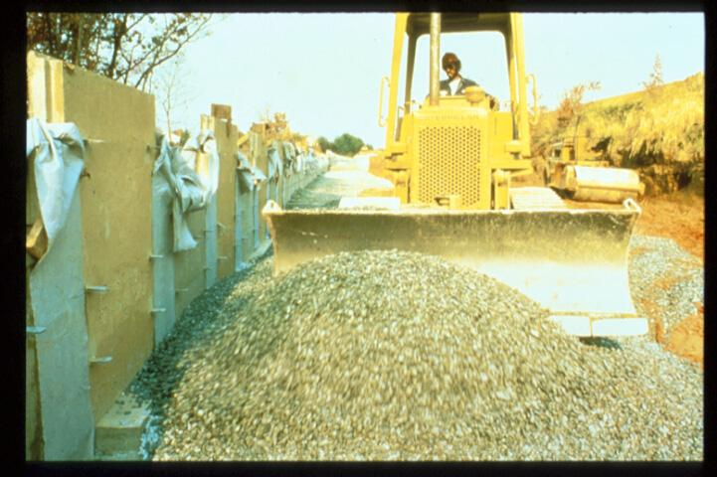

Slide 32
Mechanically Stabilized Earth Wall (MSE Wall)

Slide 33
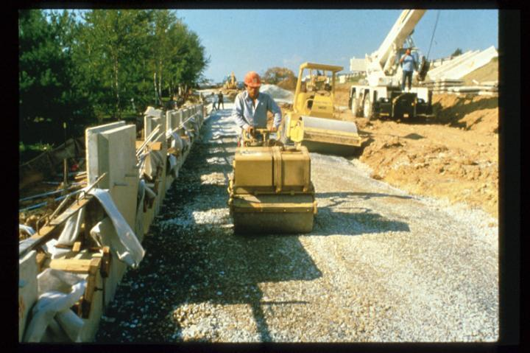

Slide 34
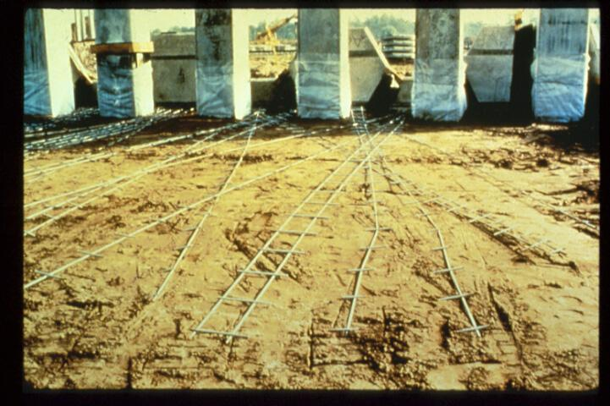

Slide 35
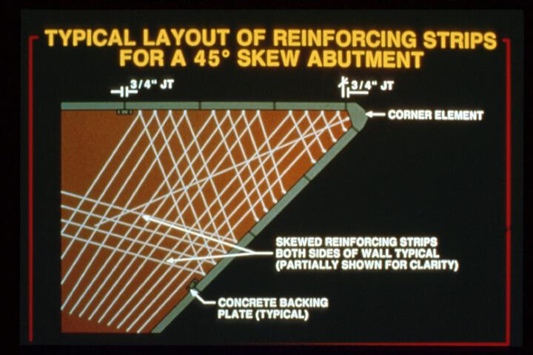

Slide 36
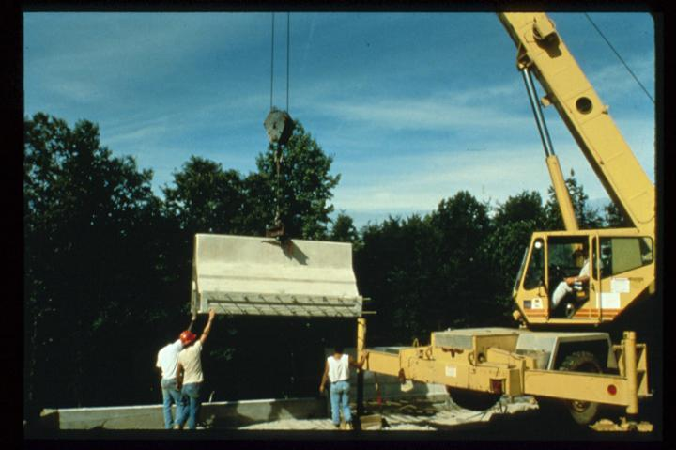

Slide 37
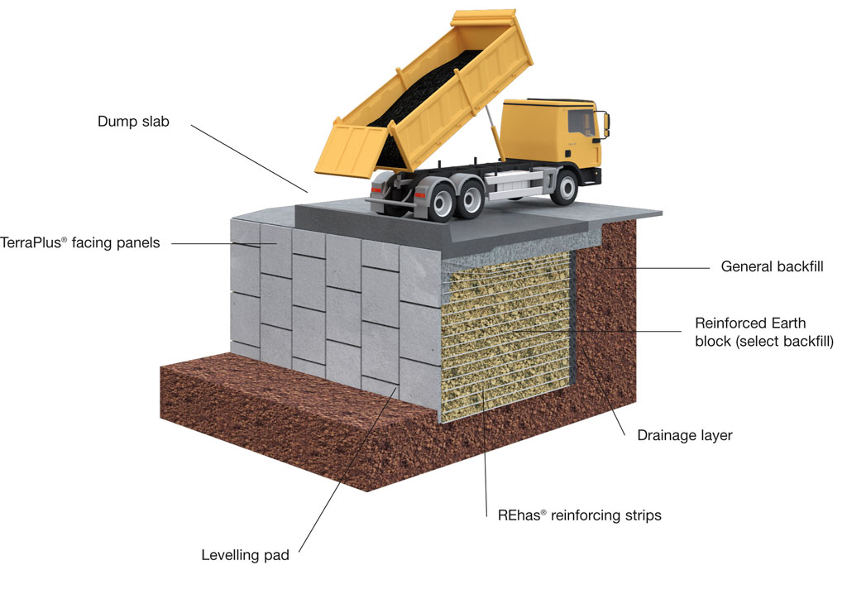

Slide 38
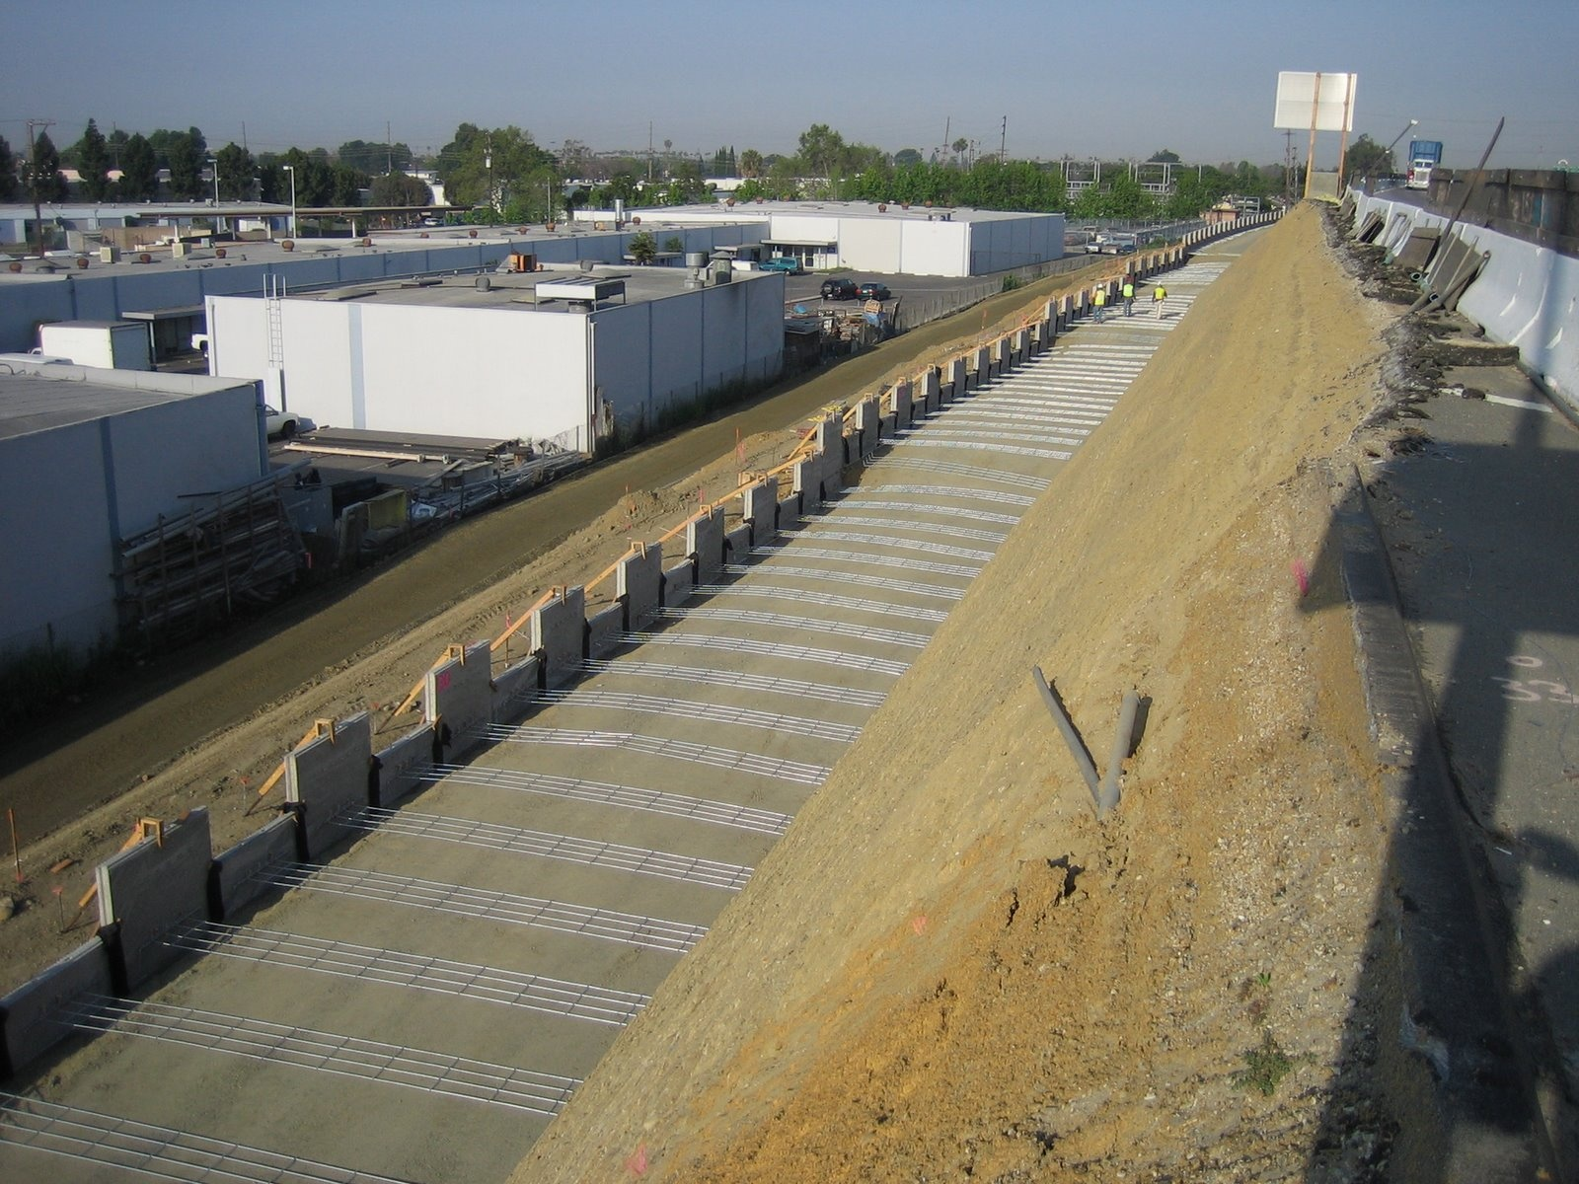

Slide 39
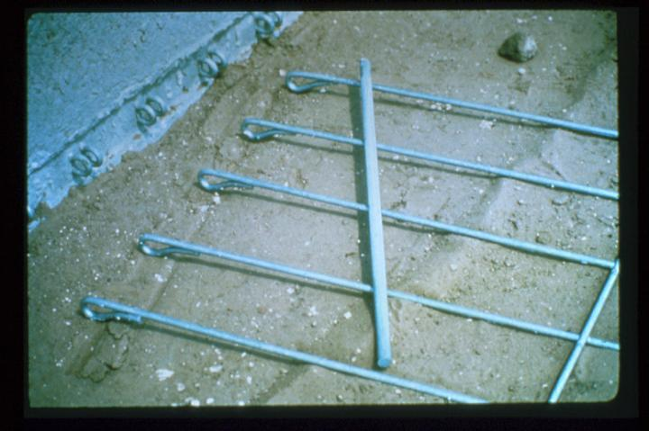

Slide 40


Slide 41


Using Geogrids

Slide 42


Slide 43


Slide 44

Tom Landry Highway, TX

Slide 45
Stability of MSE Walls

Slide 46


Stability of MSE Walls

Slide 47

Block Failure

Slide 48

Geotechnical Design
CEG 4801
Fall 2004
By: Dr. Kamal Tawfiq
Mechanically Stabilized Earth Wall (MSE Wall)

Slide 49

Mechanically Stabilized Earth Wall (MSE Wall)

Slide 50
MSE Key Stone Wall

Slide 51



MSE Key Stone Wall

Slide 52


Slide 53





Slide 54


Slide 55



Slide 56


Slide 57



Slide 58





Slide 59


Geotextile Walls

Slide 60




Gabion Walls
Gabion Retaining Wall Design

Slide 61





Gabion Walls

Slide 62

Gabion Walls
HESCO CONCERTAINER
Military Accommodation Roofing, Personnel & Material Bunker Sets

Slide 63


Interior of Fort Sumter with gabions
Petersburg, Virginia. Fort Sedgwick. Gabions

Slide 64


Slide 65

Rebel fortifications in front of Atlanta, Georgia, in 1863 or 1864

Slide 66

Gabions with cannon, from a late 16th century illustration.

Slide 67
MSE Wall
Analysis and Design

Slide 68

A reinforced earth retaining wall is to be 30 ft high. The properties of the backfill material are γ = 110 lb/ft³ and φ = 30^{ο}. Galvanized steel ties are to be used for the construction of the wall. Design the Reinforcements with FS_{(B)} = 3, FS_{(p)} = 3, f_{y} = 29,000psi and φ_{tie}= 20^{ο}. The properties of the in-situ soil below the retaining wall are γ = 120 lb/ft³, φ = 30^{ο}, and c = 150 lb/ft². Design the panels and the ties of the wall.

Slide 69


Slide 70
A reinforced earth retaining wall is to be 30 ft high. The properties of the backfill material are γ = 110 lb/ft³ and φ = 30^{ο}. Galvanized steel ties are to be used for the construction of the wall. Design the Reinforcements with FS_{(B)} = 3, FS_{(p)} = 3, f_{y} = 29,000psi and φ_{tie}= 20^{ο}. The properties of the in-situ soil below the retaining wall are γ = 120 lb/ft³, φ = 30^{ο}, and c = 150 lb/ft². Design the panels and the ties of the wall.

Slide 71
MSE Wall Project
Geotechnical Design
CEG 4801
Fall 2016
Kamal Tawfiq, Ph.D., P.E.

Slide 72








Slide 73

Design Concept
Extend the tie beyond the active wedge to provide enough support against earth pressure of the panel
A reinforced earth retaining wall is to be 30 ft high. The properties of the backfill material are γ = 110 lb/ft³ and φ = 30^{ο}. Galvanized steel ties are to be used for the construction of the wall. Design the Reinforcements with FS_{(B)} = 3, FS_{(p)} = 3, f_{y} = 29,000psi and φ_{tie}= 20^{ο}. The properties of the in-situ soil below the retaining wall are γ = 120 lb/ft³, φ = 30^{ο}, and c = 150 lb/ft². Design the panels and the ties of the wall.
Kamal Tawfiq, Ph.D., P.E.

Slide 74
Yield Strength of Steel
t = thickness of tie
Friction angle between steel and soil (given)

Slide 75


Slide 76


Tie 1
Panel 1
0.5S_{v}
W = width of the tie = 4”
L_{R1} =
(H- 0.5 S_{v}) tan (45-φ/2)
L_{R1} = Rankine Length
L_{e1} = Effective Length
2.5(σ_{a}.S_{v}.S_{H})
L_{e1}=
Panel 2
2 w σ_{v} tanφ_{μ}
L₁ = L_{R1} + L_{e1}
Panel 3
H
Panel 4
Panel 5
L_{R5}
L_{e5}
H = 30 ft
φ = 30o
γ = 110 pcf
Panel 6
45 - φ/2
Panel 7
45 + φ/2
Kamal Tawfiq, Ph.D., P.E.

Slide 77
σ_{a1}
σ_{v1}
L_{R1} =
(H- 0.5 S_{v}) tan (45 - φ/2)
(σ_{a1 +} σ_{a2})_{/2}
2.5(σ_{a}.S_{v}.S_{H})
σ_{a2}
σ_{v2}
L_{e1}=
2 w σ_{v} tanφ_{μ}
Tie width
L₁ = L_{R1} + L_{e1}
σ_{a3}
σ_{v3}
H
σ_{a4}
S_{H}
σ_{a3}
σ_{a5}
S_{v}
Tie
σ_{a6}
σ_{a4}
σ_{a7}
(σ_{a3 +} σ_{a4})_{/2}
σ_{a8}
Kamal Tawfiq, Ph.D., P.E.

Slide 78


Example:
A reinforced earth retaining wall is to be 30 ft high. The properties of the backfill material are γ = 110 lb/ft³ and φ = 30^{ο}. Galvanized steel ties are to be used for the construction of the wall. Design the Reinforcements with FS_{(B)}= 3, FS_{(p)} = 3, f_{y}= 29,000 psi and φ_{tie}= 20^{ο}. The properties of the in-situ soil below the retaining wall are γ = 120 lb/ft³, φ = 30^{ο}, and c = 150 lb/ft². Design the panels and the ties of the wall.
σ_{a1}
σ_{v1}
L_{R1}= 47.6 ft
L_{e1}= 30 ft
5’
γ = 110 lb/ft³
φ = 30º
L_{R1} = Rankine Length
L_{e1} = Effective Length
σ_{a2}
σ_{v2}
S_{H} = 5’
σ_{a3}
σ_{v3}
σ_{a3}
S_{v} = 5’
H
σ_{a4}
σ_{a5}
σ_{a4}
σ_{a6}
σ_{a7}
45 + φ/2
σ_{a8}

Slide 81
Kamal Tawfiq, Ph.D., P.E.

Slide 82
Kamal Tawfiq, Ph.D., P.E.

Slide 83
Kamal Tawfiq, Ph.D., P.E.

Slide 84
Kamal Tawfiq, Ph.D., P.E.

Slide 85
H = 30 ft
φ = 30o
γ = 110 pcf

Slide 86
Abutments and Retaining Structures
Mechanical Stabilized Earth (MSE).

Slide 87
MSE Walls
The loading and earth pressure diagram for an MSE wall shall be developed in accordance
with LRFD [11.11.2]
MSE Wall with Horizontal Backslope and Traffic Surcharge
Figure 14.4-2 shows a procedure to estimate the earth pressure. The active earth
pressure for horizontal backslope is computed using a simplified version of Coulomb theory
tan2 (45 / 2)
K a = −φ f
Where:
Ka = Coefficient of active earth pressure
φf = Angle of internal friction of retained earth
MSE Walls Earth Pressure for Horizontal Backslope with Traffic Surcharge
LRFD Figure 11.10.5.2-1

Slide 90
MSE Wall with Sloping Surcharge
The active earth pressure coefficient Ka is computed using Coulomb’s equation. The force on
the rear of the reinforced soil mass (Ft) and the resulting horizontal (Fh) and vertical (Fv)
forces are determined from the following equations:
FT = 1/2 γfh2Kaf
Fh = Ft cos β
Fv = Ft sin β
Where:
γf = Unit weight of retained fill material
β = Slope angle of backfill behind wall
δ = Angle of friction between retained backfill and reinforced backfill
h = See Figure 14.4-3
Kaf = Use Coulomb’s equation

Slide 92
Variation of the Coefficient of Lateral Stress Ratio with Depth
(Source AASHTO LRFD Figure 11.10.6.2.1-3)

Slide 95
Modular Block Gravity Wall with Sloping Surcharge
When designing a “Modular Block Gravity Wall” without setback and with level backfill, the
active earth pressure coefficient may be determined using Rankine theory from the following
formula.
tan2 (45 / 2)
When designing a "Modular Block Gravity Wall" with setback, the active earth pressure
coefficient Ka shall be determined from the following Coulomb formula. The interface friction
angle between the blocks and soil behind the blocks is assumed to be zero.
No live load traffic and live load surcharge shall be allowed on modular block gravity walls
although they are designed for a minimum live load of 100psf. The density of the blocks is
assumed to be 135 pcf and the drainage aggregate inside or between the blocks 120 pcf.
The forces acting on a modular block gravity wall are shown in Figure 14.4-5.

Slide 96


Slide 97


Slide 98


Slide 99


Slide 100


Slide 101


Slide 102


Slide 103


Slide 104


Slide 105


Slide 106


Slide 107


Slide 108


Slide 109


Slide 110


Slide 111


Slide 112


Slide 113


Slide 114


Slide 115

F* = COEFFICIENT OF FRICTION

Slide 116


Slide 117


Slide 118


