Slide 1
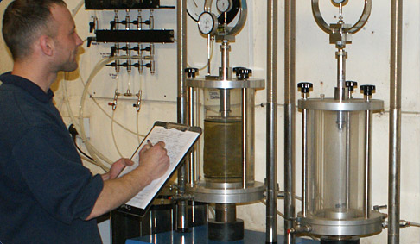
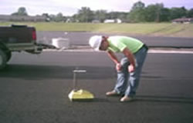
MEASUREMENTS OF MATERIAL PROPERTIES
Methods of Measurement
1- Laboratory Testing Methods
2- In-Situ Testing Methods
3- Empirical Correlation's
Terzaghi & Peck (1948): Cc = 0.009 (w_{c} – 10%)
Skempton (1944): Cc 0.007 (w_{c} – 7%)

Slide 2
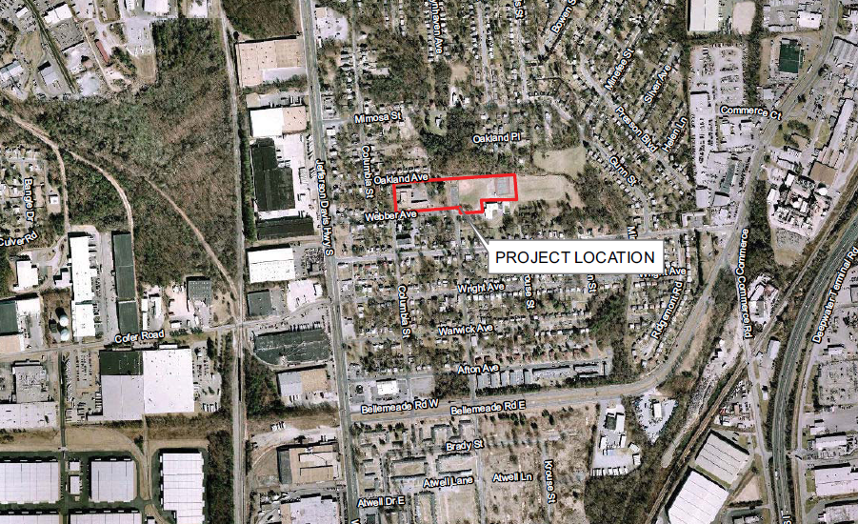
Geotechnical Report Production
1- Map of the Project Location

Slide 3
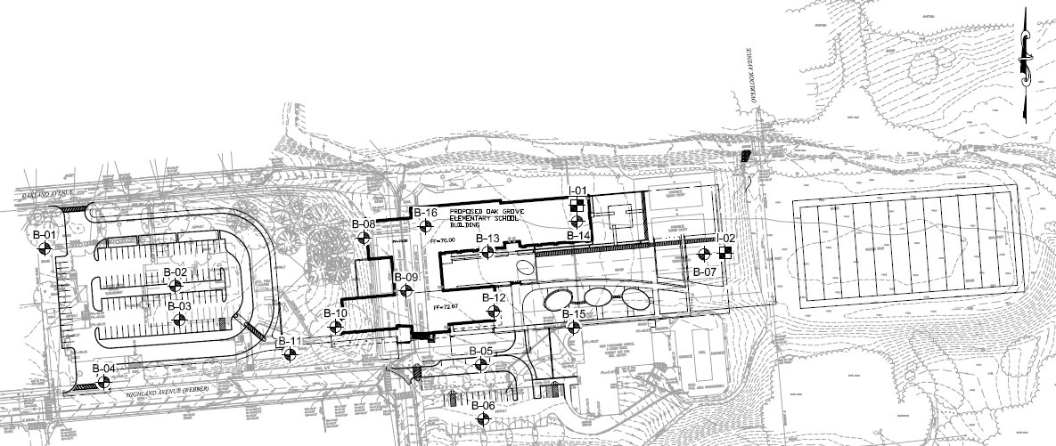
Geotechnical Report Production

Slide 4
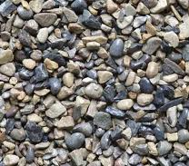
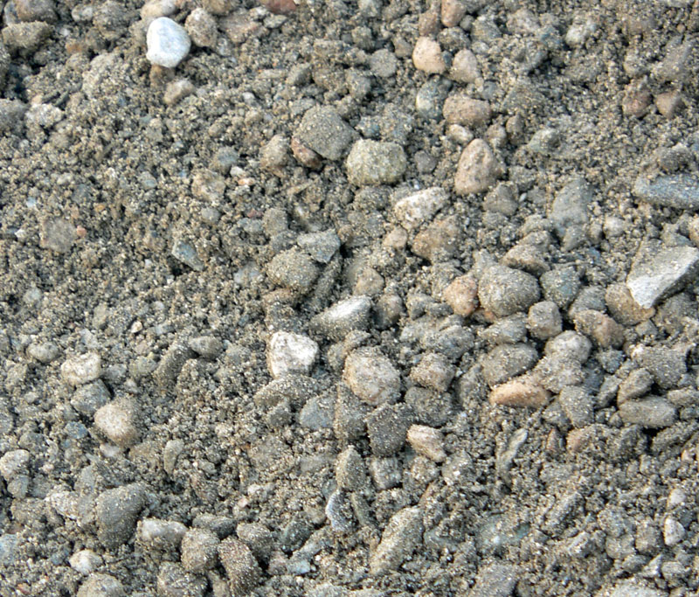
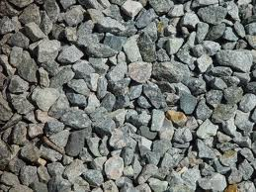
Geotechnical Investigation
MEASUREMENTS OF MATERIAL PROPERTIES
Soil Properties
Physical properties
Index Properties
Hydraulic Properties
Mechanical Properties

Slide 5
MEASUREMENTS OF MATERIAL PROPERTIES
Methods of Measurement
1- Laboratory Testing Methods
- Provide better control over the boundary conditions
- Different parameters can be determined individually or in
combination
- Results can be produced

Slide 6
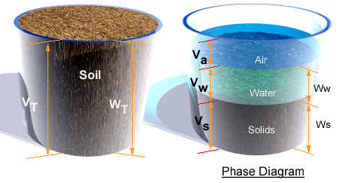
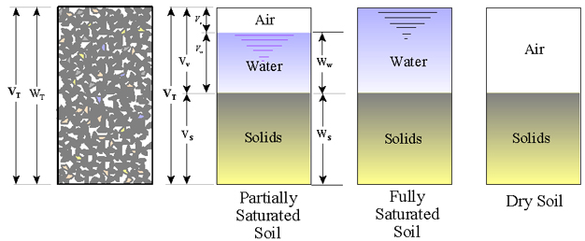
MEASUREMENTS OF MATERIAL PROPERTIES
Soil Properties
1- Physical properties: Used to describe the soil. These properties are incorporated with the soil classification systems, and in some cases they are related to the mechanical properties
- Specific gravity
- Grain size
- Density (Saturated, Partially saturated, submerged, minimum,
maximum, relative, optimum moisture content)
- Porosity
- Degree of saturation
- Void ratio
- Moisture content
- Hardness (for rocks)
- Durability (for rocks)
- Reactivity (for rocks)

Slide 7
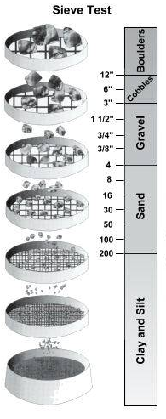
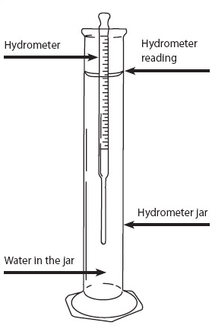
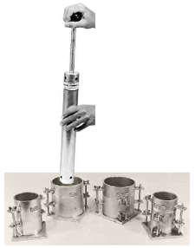
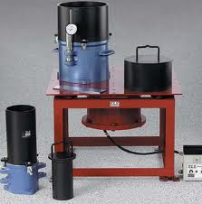
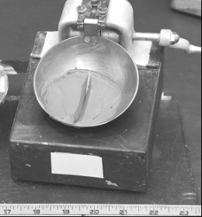
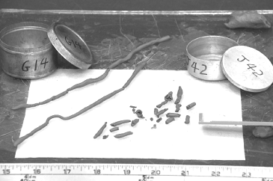
MEASUREMENTS OF MATERIAL PROPERTIES
Soil Properties
2- Index Properties: Used to classify the soil or to correlate with the mechanical properties.
- Atterberg Limits or Consistency Limits (LL, PL SL) - Moisture Content vs. Unit Weight Relationship (Compaction) - Grain Size Distribution
- Relative Density D_{r}
Grain Size Distribution
Proctor Test
Relative Density D_{r}
LL
PL

Slide 8
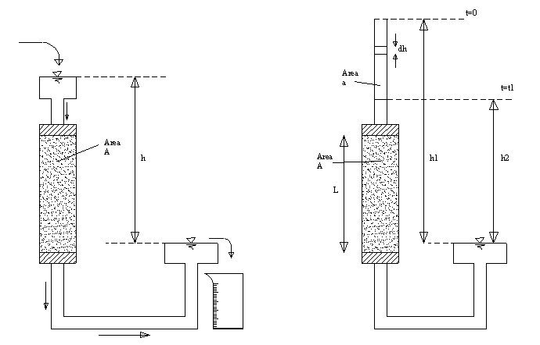
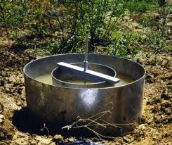
MEASUREMENTS OF MATERIAL PROPERTIES
Soil Properties
3- Hydraulic Properties
- Permeability or Hydraulic Conductivity (k)
Infiltration Rate
Double Ring Infiltrometer

Slide 9
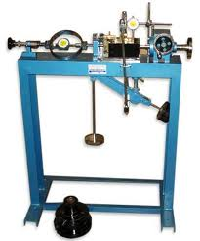
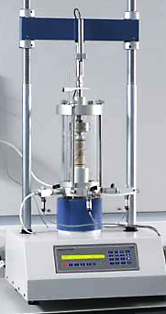
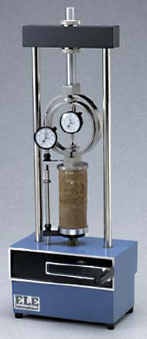
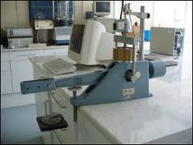
MEASUREMENTS OF MATERIAL PROPERTIES
Soil Properties
4- Mechanical Properties: To describe the behavior of the soil under different types of stresses
-Deformation Moduli – Young's Modulus (E) & Shear Modulus (G)
Consolidation (C_{c}, C_{s}, C_{v}, P_{c}, m_{v}, K)
Strength (c, φ) Unconfined Compression
Direct Shear,
Triaxial Compression
California Bearing Ratio (CBR) or
Lime Rock Bearing Ration (LBR)
used for pavement design
Direct Shear
Consolidation Test
Unconfined
Compression
Triaxial Compression

Slide 10
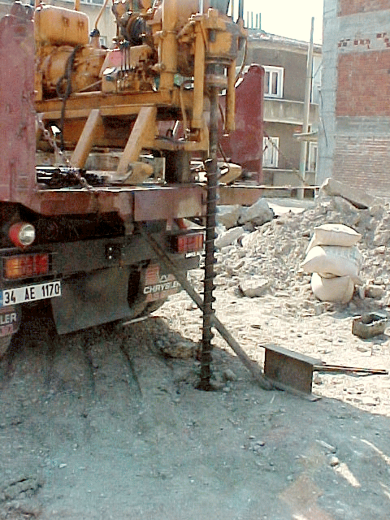
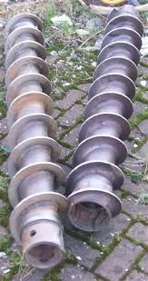
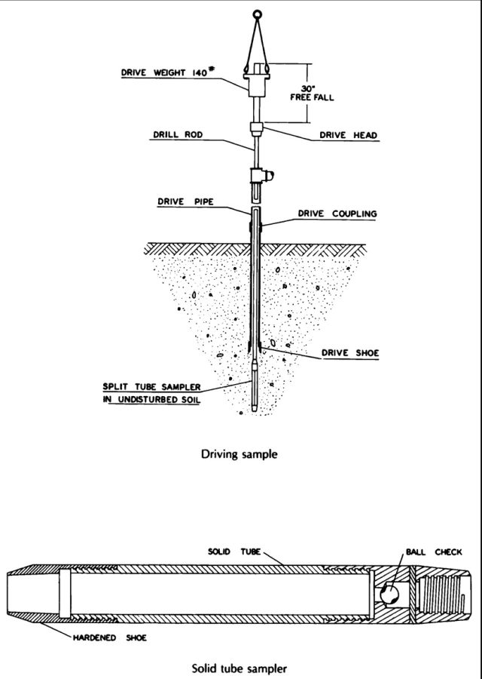
Geotechnical Investigation
THE STANDARD PENETRATION TEST (SPT) ASTM D1586
- The SPT is one of the most popular and economical means to obtain subsurface information.
- The testing method was standardized in 1958 as ASTM D1568
The test consists of:
* A 140 lb driving mass falling from a height of 30 in.
* Drive the standard split spoon sampler a distance of 18 in. into the soil
* Counting the number of blows (N) to drive the sampler 12 in.
(6 in. + 6 in.)
* The boring log should show "refusal" and should be halted if:
a- 50 blows are required for any 150 mm increment
b- 100 blows are obtained
c- 10 successful blows produce no advance
* N should be corrected for the increase of the overburden pressure
Hollow Stem Auger

Slide 11
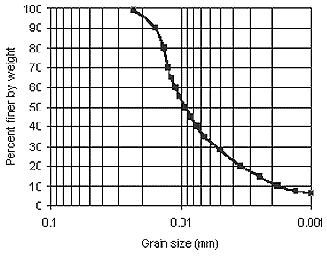
MEASUREMENTS OF MATERIAL PROPERTIES
Methods of Measurement
3- Empirical Correlations
- Correlations are usually based on basic or index properties
- These properties are correlated with the mechanical & hydraulic properties
- Used to provide basis for all engineering analysis
- Reduce the cost of geotechnical investigation
- Presented as ----- Tables, Charts, and Equations
For example Beyer formula for coefficient of permeability (k)
K = C . (d₁₀)²
Where :
C = 4.5x10⁻³ log
U = Uniformity coefficient = d₆₀/d₁₀
d₁₀ = Effective diameter (mm)
500
U
10%
Passing
d₁₀

Slide 12
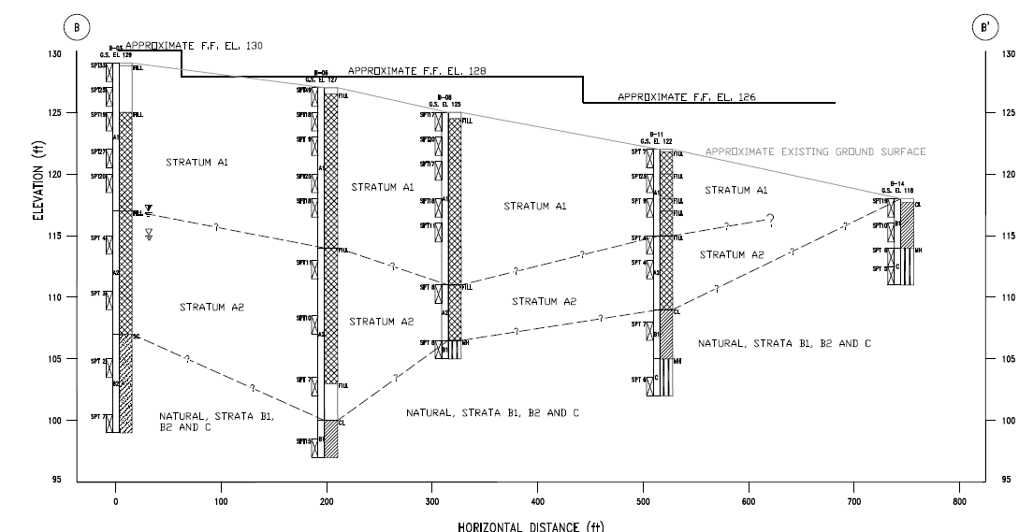
4- Profile of Soil Layers:

