Slide 1
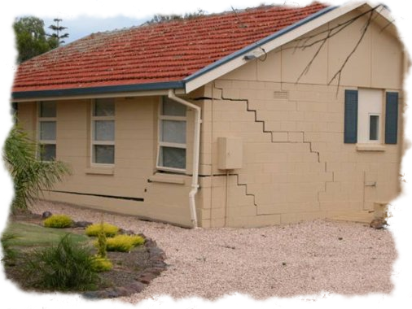
Shallow Foundations
By
Kamal Tawfiq, Ph.D., P.E., F.ASCE

Slide 2
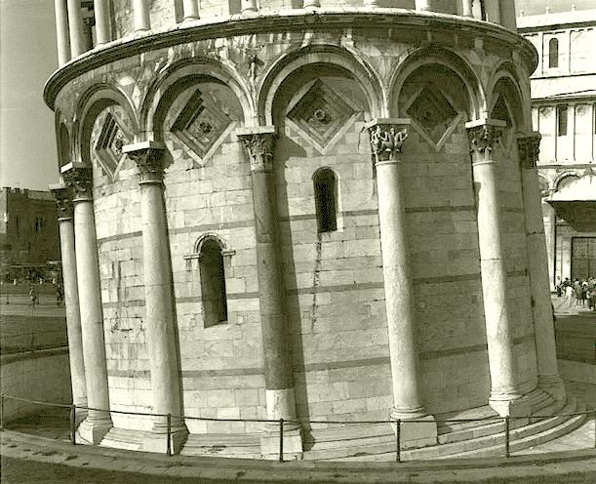
3- Foundation Design
Differential Settlement

Slide 3
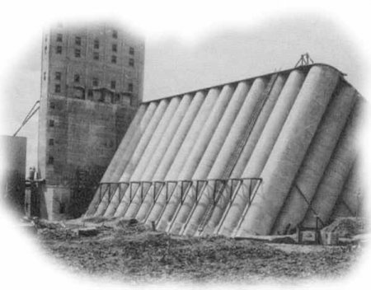

Slide 4
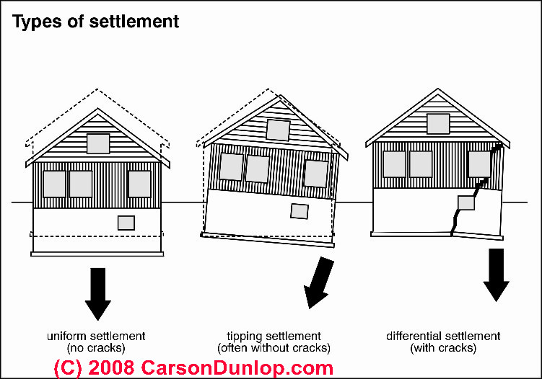

Slide 5
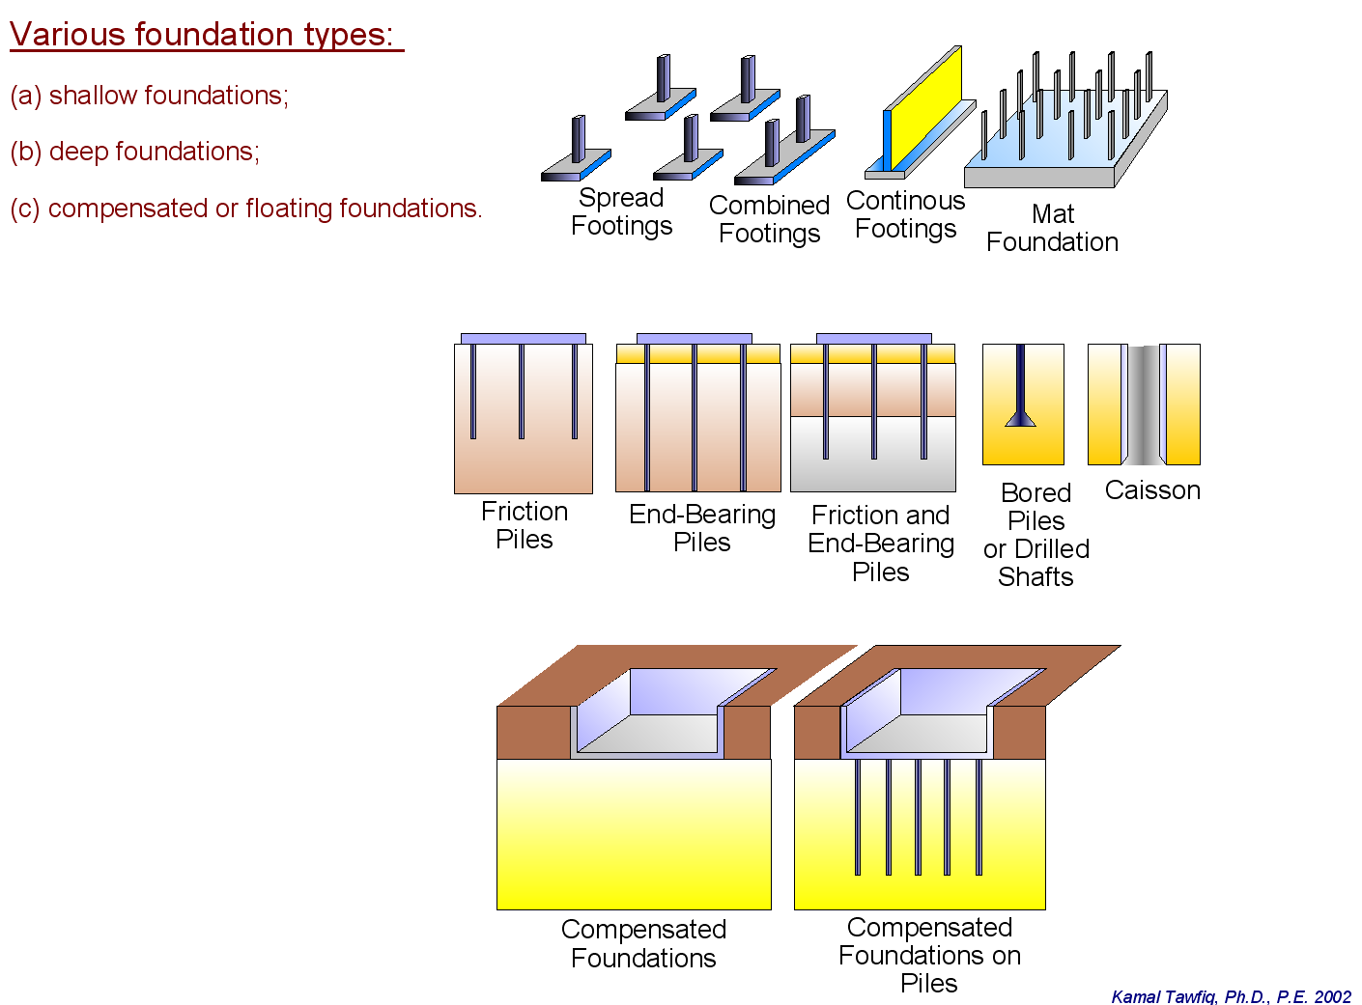
Structural Foundations are grouped into two main groups.
1- Shallow Foundation
  Spread Footings
  Continuous Footings
  Combined Footings
  Mat Foundation
2- Deep Foundation
  Driven Piles
  Drilled Shaft
  Auger Cat Piles
3- Compensated or floating foundations

Slide 6
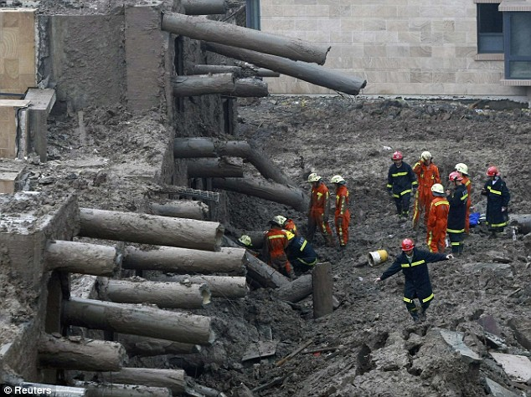

Slide 7
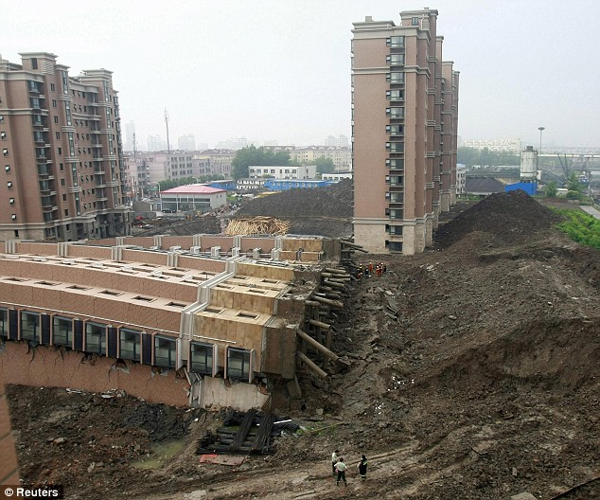

Slide 8

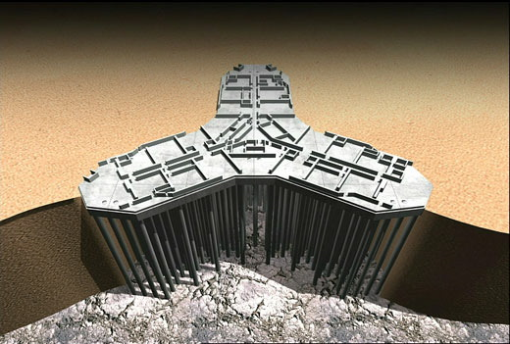

Slide 9
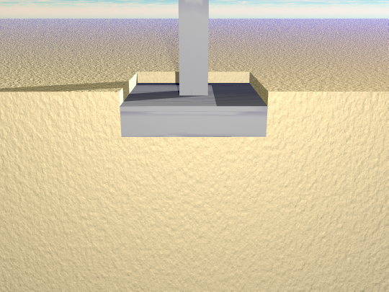
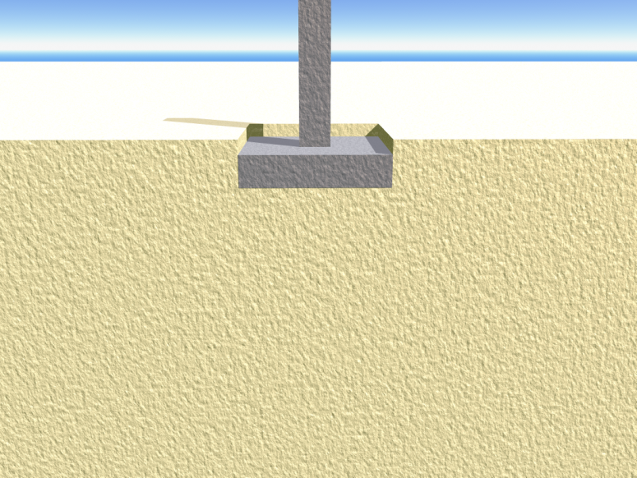
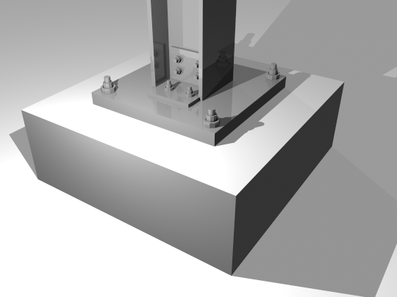
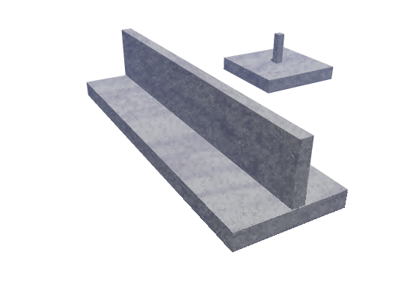
Shallow Foundation
  Spread Footings
  Spread Footings
  Continuous Footings
  Spread Footings

Slide 10
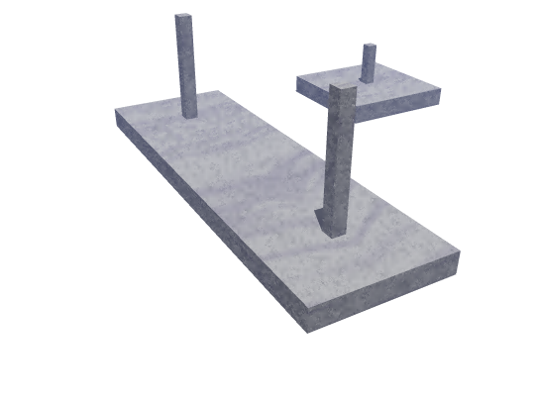
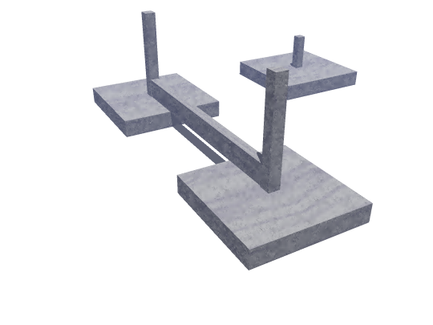
  Spread Footings
Combined Footings
Combined Footings

Slide 11
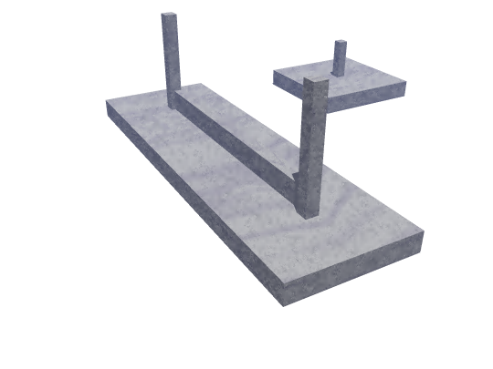
  Spread Footings
Combined Footings

Slide 12
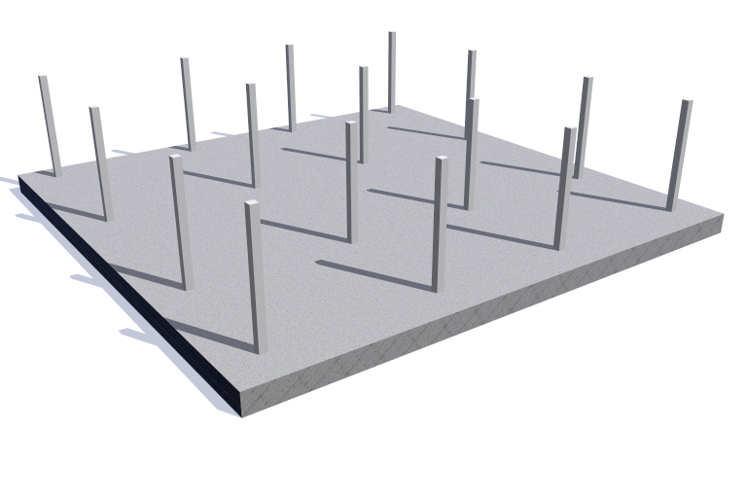
Mat Foundation

Slide 13
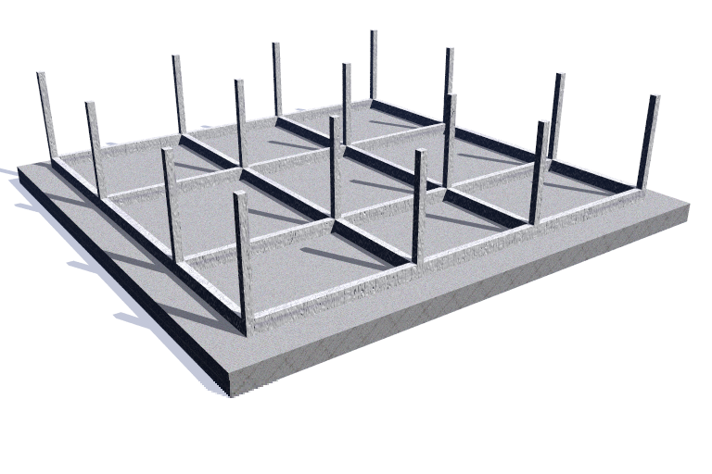
Mat Foundation

Slide 14
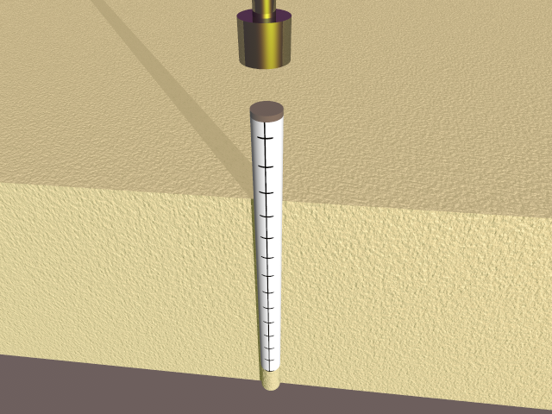
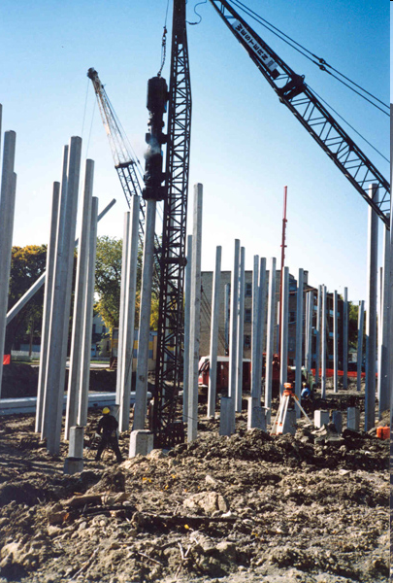
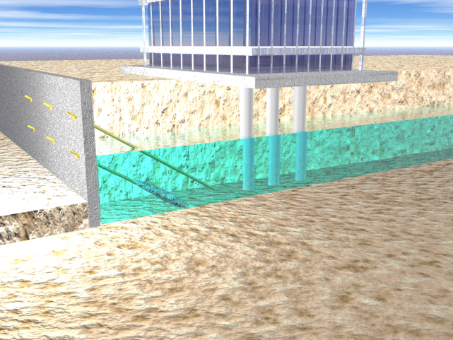
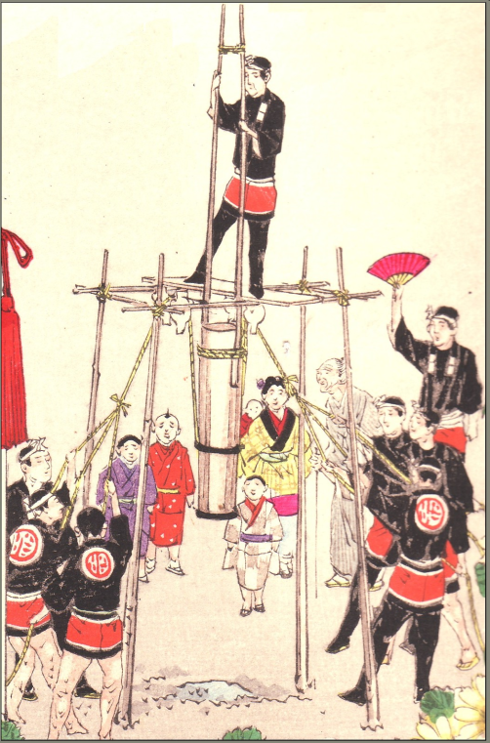
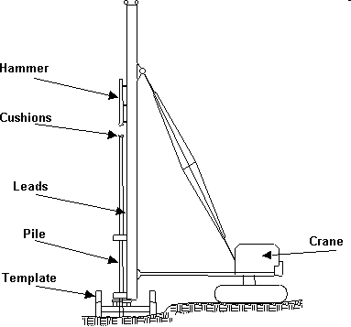
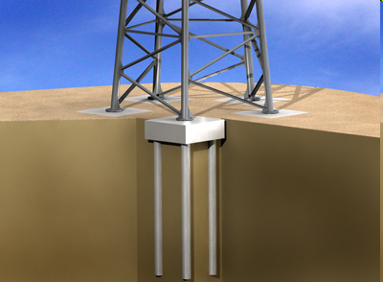
Deep Foundation
Driven Piles

Slide 15
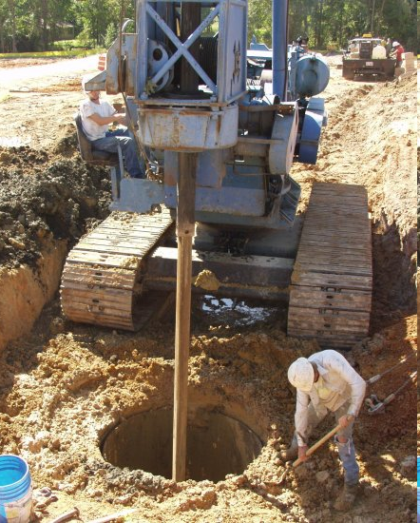
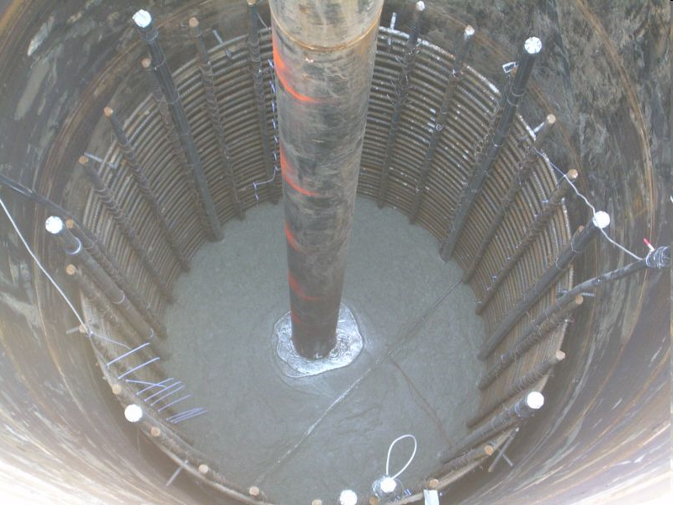
Drilled Shafts

Slide 16
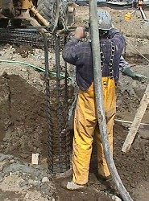
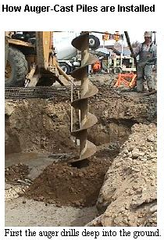
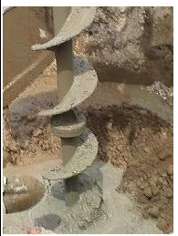
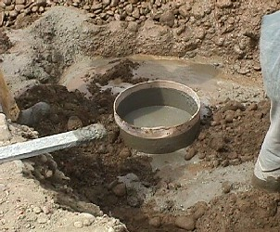
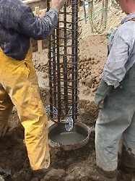
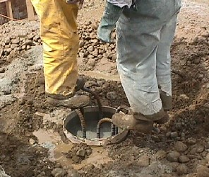
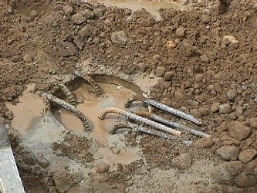
Auger Cast Pile

Slide 17
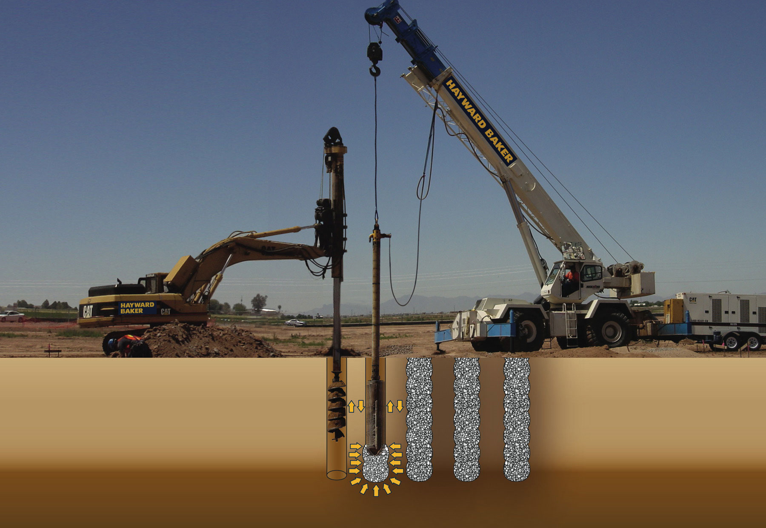
Vibro Piers

Slide 18
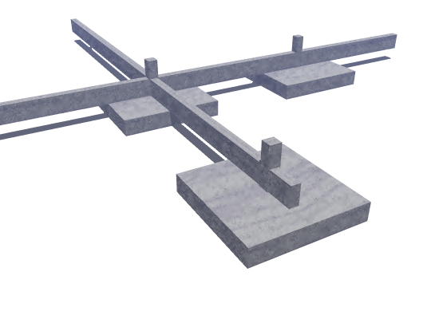
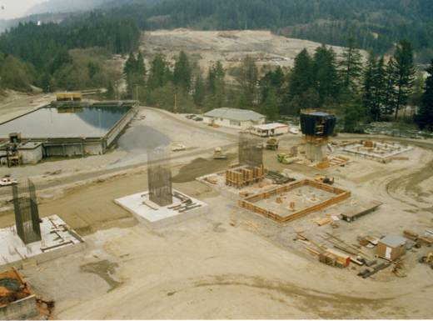
Analysis and Design of Shallow Foundation
I- Bearing Capacity
II- Settlement
I- ULTIMATE BEARING CAPACITY THEORIES:
TERZAGHI’S BEARING CAPACITY THEORY
GENERAL BEARING CAPACITY EQUATION

Slide 19
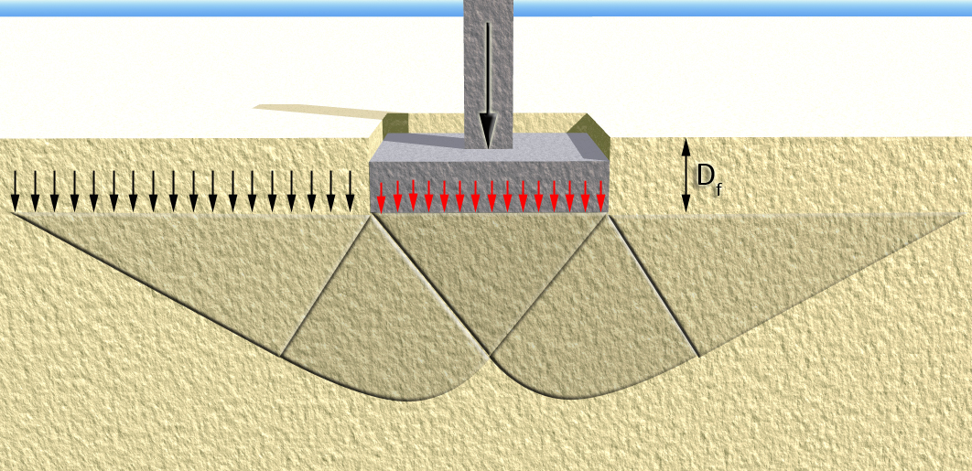
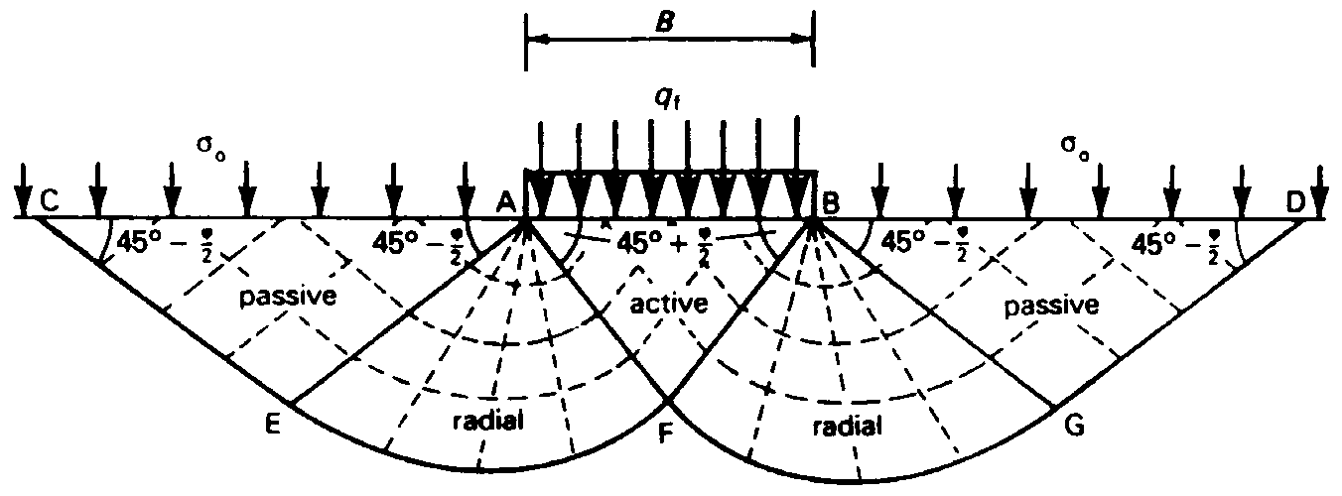
I- Bearing Capacity
TERZAGHI’S BEARING CAPACITY THEORY
Terzaghi's Equation (1943)
Utilizing Prandtl's theory, Buisman (1940) expressed the maximum bearing capacity of soils by superimposing the contribution of cohesion, overburden pressure, and density of the soil, His expression is commonly referred to as Terzaghi's equation. Presumably, it was associated with Terzaghi's in the English speaking countries following the publication of his book (Theoretical Soil Mechanics) in 1943.
- Based on Prandtl's theory of plastic failure, Terzaghi presented a modified system as illustrated below.
Q_{design}
B
q = γD_{f}
q_{ult}
q_{ult}
45^{ο}+φ/2
45 − φ/2
45 − φ/2

Slide 20
Name:_____________
ID:_____________
FAMU-FSU College of Engineering
Department of Civil and Environmental Engineering
Spring 2019
Quiz # 6
Question:
Name the three zones under the shallow foundation shown in the figure below.
Q_{design}
B
q = γD_{f}
q_{ult}
q_{ult}
2
1
2
3
3
1:_______
2:_________
3:__________

Slide 21
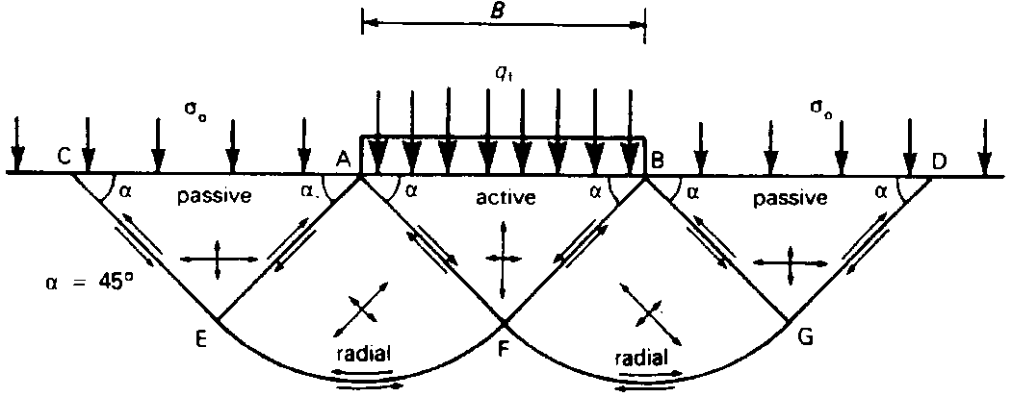
q_{u} = q_{c} + q_{q} + q_{γ}

Slide 22
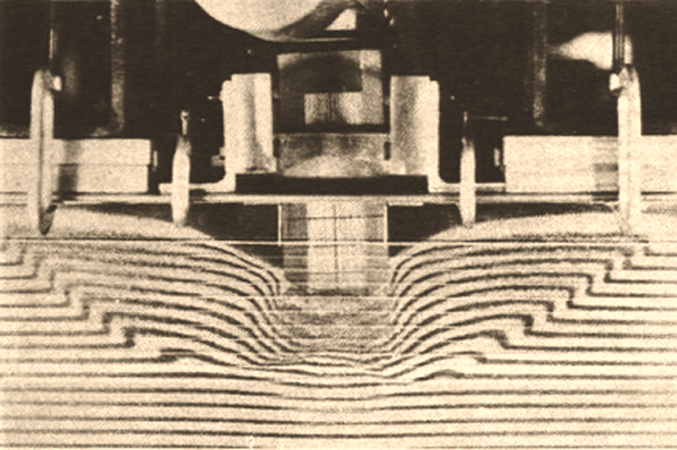
Laboratory Testing on Bearing capacity failures of foundations
General shear foundation failure

Slide 23
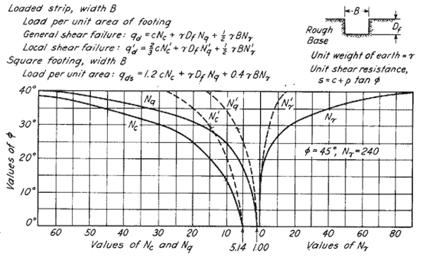
Ultimate Bearing Capacity
q_{u} = q_{c} + q_{q} + q_{γ}

Slide 24
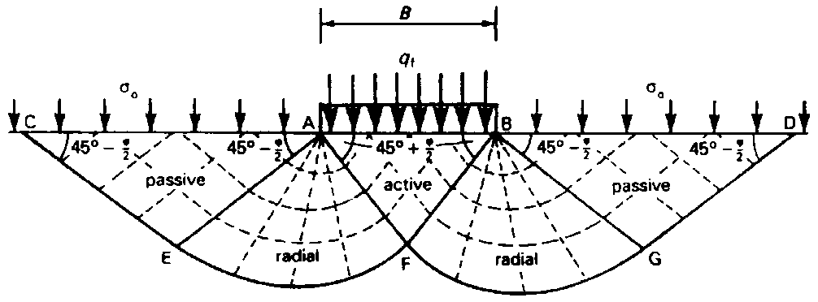
1- TERZAGHI’S BEARING CAPACITY THEORY

Slide 26
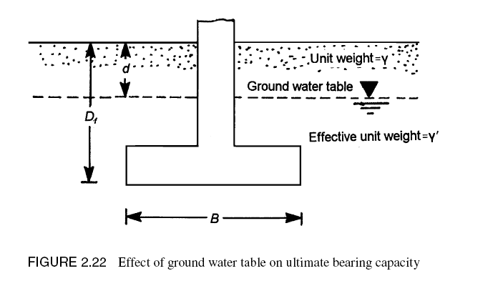









$$γd+{γ(D}_{f}−d)$$
1
$$q_{ult}=cN_{c}+qN_{q}+0.5 γBN_{γ}$$
2
4
$${γ(D}_{f})$$
$$q_{ult}=cN_{c}+qN_{q}+0.5 γBN_{γ}$$
3
$${γ(D}_{f})$$
2
$$q_{ult}=cN_{c}+qN_{q}+0.5 γBN_{γ}$$
$$γ$$
$$γ_{sub}$$
4
$$The same as case 2$$

Slide 27
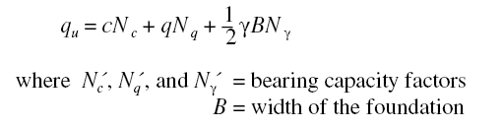
Factors
Factors
Factors

Slide 28
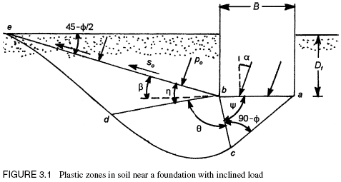

2- GENERAL BEARING CAPACITY EQUATION

Slide 30
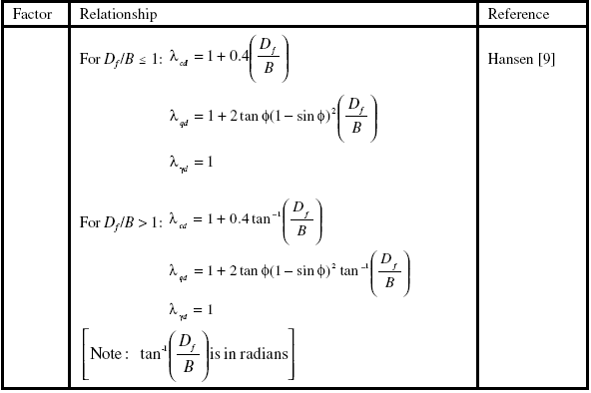

Slide 32
Name:_____________
ID:_____________
FAMU-FSU College of Engineering
Department of Civil and Environmental Engineering
Geotechnical Design CEG 4801
Spring 2019
Quiz 7
5 min Quiz
1- The following bearing capacity equation was used by both Terzaghi and Meyerhof. Describe the three terms in the equation.
q_{ult} = cN_{c} + qN_{q} + 0.5 γΒNγ
2- The above equation for bearing capacity of foundation was first developed Terzaghi. Later on, Meyerhof and others improved the equation by adding what factors
λ_{cs}
λ_{cd}
λ_{ci}
λ_{qs}
λ_{qd}
λ_{qi}
λ_{γs}
λ_{γd}
λ_{γi}
q_{ult} = cN_{c} + qN_{q} + 0.5 γΒNγ
λ_{cs}
λ_{qs}
λ_{γs}
_____________
λ_{cd}
λ_{qd}
λ_{γd}
_____________
λ_{ci}
λ_{qi}
λ_{γi}
_____________

Slide 33
Terzaghi’s bearing capacity equation was based on his assumptions of the plastic zones developed under foundation. On the other hand, the general bearing capacity equation was also developed based on assumptions made by Meyerhof for the plastic zones under foundations.
Indicate od the given figure which of the assumptions are those for Terzaghi or Meyerhof.
1
B
D_{f}
2
1
2

