Slide 1

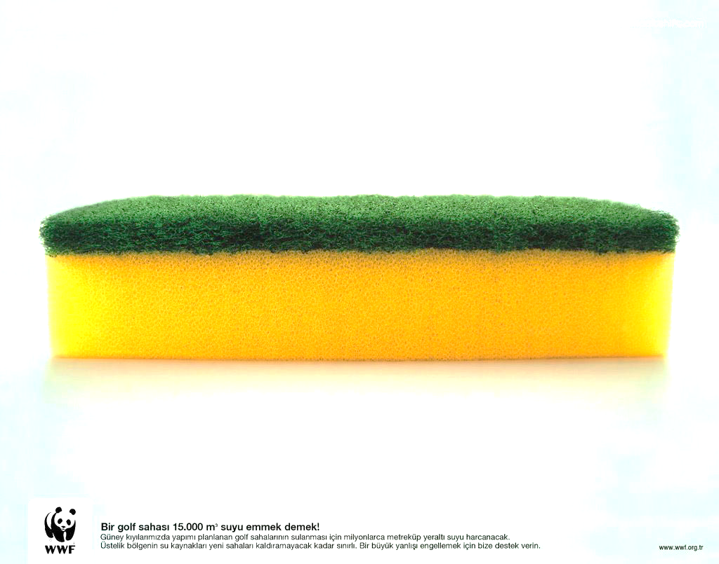
Section 4 Lecture 9
Consolidation Settlement
Time Dependent Settlement
Assume a fully saturated Sponge
H/2
H
Two way
drainage path

Slide 2
Consolidation Settlement
Assume a fully saturated Sponge
Settlement
ΔH
H
One way
drainage
path

Slide 3
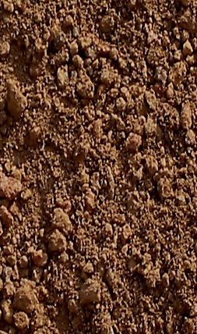
Consolidation Settlement
p
Sand
Sand
H
Settlement
ΔH
Clay
Sand
Sand
p
p
Δe
ΔH
p
Δu
p
V_{v}
e_{o}
p
p
Water
Water
Δu
1+e_{o}
Δu
H
H
V_{s}
1
Solids
Solids
p
Δu
Δu
p
Δu
Δu
p
Soil Block
Phase Diagram
p
p
p

Slide 4
P_{n}
.
.
.
.
Δe
P
ΔH
e
e
Water
Virgin
Consolidation
Curve
slope = c_{c}
Solids
e₁
c_{c}
Δe
e₂
Δp
p
p₁
p₂
log p

Slide 5
Section 5 Lecture 9
Consolidation Settlement
p
Void Ration
before loading
e
Sand
e_{o}
Clay
Δp or p
P_{o} + Δp
e₁
c_{c}
H
p_{o}
Δe
e₂
Δp
Sand
p₁
p₂
log p
p_{o}
P_{o} + Δp

Slide 6
Consolidation Settlement
Void Ration
before loading
p
e
Sand
e_{o}
Clay
2
2
e₁
c_{c}
H
Δp
p_{o}
1
1
Δe
e₂
Δp
Sand
p₁
p₂
log p
p_{o}
P_{o} + Δp

Slide 7
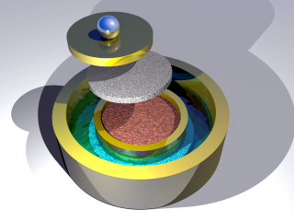
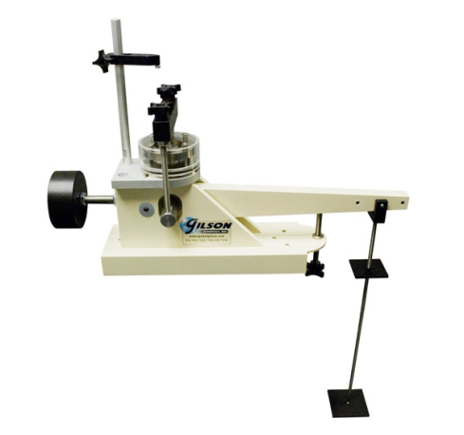
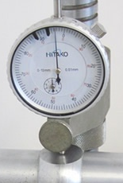


Section 1 Lecture 10
consolidation curve:
Sample was sent to the lab
And placed in the consolidometer
Soil
Sample
Sample was removed
No pressure on the sample
G.S.
Sand
3 ft
γ_{sand} = 96 pcf
W.T.
4 ft
γ_{clay} = 110 pcf
P_{o}
Clay
w_{c} = 0.3
16 ft
Dial gauge to determine ΔH
Soil
Sample
e
Δp₇
Δp₁
Δp₂
Δp
Δp₃
Stress
Increments
Δp₃
Δp
Δp₄
Δp₁
Void Ratio
C_{c}
Δp₅
C_{s}
In the lab the stresses are
added to the soil sample
Δp₆
log p
P_{o}
http://www.youtube.com/watch?v=sLyzsM-g9yw

Slide 8
Dr. Kamal Tawfiq
Example:
Figure 1
G.S.
Soil sample was obtained from the clay layer
Conduct consolidation test [9 load increments ]
Plot e vs. log (p) (Figure 2)
Determine Compression Index (C_{c} ) & Swelling Index (C_{s})
γ_{sand} = 96 pcf
W.T.
3 ft
Sand
4 ft
Clay
P_{o}
γ_{clay} = 110 pcf
w_{c} = 0.3
16 ft
Soil Sample
In the lab and after removing
the soil sample from the ground,
the stresses on the soil sample = 0
Δp₁
Δp₂
In the ground, the sample was subjected to geostatic stresses.
In the lab and before the consolidation test the stresses on the sample = 0.
During testing, the geostatic stress is gradually recovered
e_{o} = 0.795
Δp₁
C_{c} = 0.72
C_{s} = 0.1
Stress
Increments
Δp
Δp₇
Void Ratio (e)
Δp
Δp₉
C_{c}
In the lab the stresses are
added to the soil sample
C_{s}
Δp₉
P_{o}
Log (p)
Figure 2
5. Determine P_{o} = 3.(96) + 4.(96-62.4) + 8.(110-62.4) = 803.2 lb/ft²

Slide 9

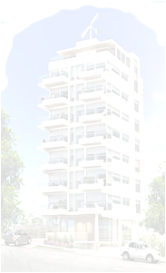

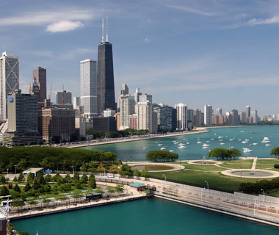
Normally Consolidated and Overconsolidated Clay
When clay particles are deposited by deposition agents like water, wind, ice or gravity, layers after layers are deposited with time which induces effective stresses in the clay layer below. The clay layer in this case is called “Normally Consolidated Clay.”
If the to soil layers experienced cycles of erosion and deposition
with time such as case 1, the clay layer will be called “Over Consolidated Clay.”
Overconsolidation can also be developed from loading and unloading the clay layer such as
case 2.
Case 2
Past
Case 1
Past
Today
G.S.
Sand
Clay
Past
Glacial covered Chicago
P_{o}

Slide 10


Normally Consolidated and Overconsolidated Clay
Question
How do you know if the clay layer at the site is
normally consolidated or
overconsolidated ?????
Case 2
Past
Case 1
Past
Today
G.S.
Sand
P_{o}
Clay

Slide 11
Normally Consolidated and Overconsolidated Clay
Casagrande’s Method to Determine Preconsolidation Pressure (Pc)
1
Normally Consolidated Soil
G.S.
γ_{sand} = 96 pcf
W.T.
3 ft
Sand
4 ft
γ_{clay} = 110 pcf
w_{c} = 0.3
P_{o}
Clay
16 ft
Void Ratio (e)
P_{c}
Log (p)
Overconsolidation Ratio OCR = = 1
The soil is Normally Consolidated (N.C.) soil
P_{o}

Slide 12
Section 2 Lecture 10
Normally Consolidated and Overconsolidated Clay
G.S.
Casagrande’s Method to Determine Pc
γ_{sand} = 96 pcf
W.T.
3 ft
2
Overconsolidated Soil
Sand
4 ft
γ_{clay} = 110 pcf
w_{c} = 0.3
P_{o}
Clay
16 ft
Void Ratio (e)
P_{c}
Overconsolidation Ratio OCR = > 1
The soil is oversonsolidated (O.C.) soil
Log (p)
P_{o}

Slide 13
Normally Consolidated and Overconsolidated Clay
Example:
G.S.
γ_{sand} = 96 pcf
W.T.
3 ft
Using Casagrande’s Method to determine Pc
Sand
4 ft
γ_{clay} = 110 pcf
w_{c} = 0.3
P_{o}
Clay
Find:
Oveconsolidation Ratio (OCR)
16 ft
Void Ratio (e)
Log (p)

Slide 14
Building
Example:
q_{design}
G.S.
γ_{sand} = 96 pcf
W.T.
3 ft
A 150’ x 100’ building will be constructed at the site.
The vertical stress due to the addition of the building
q_{design} =1000 lb/ft²
The weight of the building Q_{design} will be transferred
to the mid height of the clay layer
Q_{design} = 15,000,000 lb
The added stress at 15’ from
the ground surface is
Δp =
Sand
4 ft
Normally Consolidated
Clay
ΔP₁
P_{o}
P_{o}
16 ft
e_{o} = w_{c} . G_{s} = 0.3 x 2.65 = 0.795
Δp₁
15,000,000 lb
(150+15) x (100+15)
Void Ratio (e)
ΔP = 790.51 lb/ft₂
ΔP + P_{o} =
790.51 + 803 = 1593.51 lb/ft²
P_{o}
Log (p)

Slide 15

Section 3 Lecture 10
Demolished
When the building was removed, the soil has become
an overconsolidated clay.
The rebound has taken place through
swelling from pint 1 to point 2
q_{design}
G.S.
γ_{sand} = 96 pcf
W.T.
3 ft
Sand
4 ft
Clay
P_{o}
P_{o}
16 ft
e_{o} = w_{c} . G_{s} = 0.3 x 2.65 = 0.795
Δp₁
ΔP₁
Void Ratio (e)
2
1
P_{o}
P_{o} + ΔP
Log (p)

Slide 16
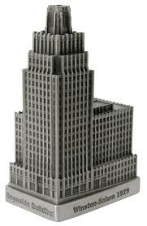
Scenario #1
The soil now is overconsolidated Soil:
The new building is heavier in weight
Large Building
Constructing a new building
q_{design}
G.S.
γ_{sand} = 96 pcf
W.T.
3 ft
C_{S} H
P_{C}
C _{C} H
P_{o} + ΔP
Sand
4 ft
ΔΗ = log ( ) +
log ( )
Clay
ΔP₂
1 + e_{O}
P_{o}
1 + e_{O}
P_{C}
P_{o}
P_{o}
16 ft
e_{o} = w_{c} . G_{s} = 0.3 x 2.65 = 0.795
e_{o} = 0.61
Δp₁
ΔP₂
Assume P_{o} + Δp₂ = 2100 psf
ΔP₁
Void Ratio (e)
0.1 x 16
1593.51
ΔH =
log
( )
1 + 0.61
803
C_{S}
+
0.72 x 16
2100
C_{C}
log
( )
1 + 0.61
1593.51
=
P_{o}
P_{c}
P_{o} + ΔP
Log (p)
New Building

Slide 17
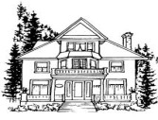
Dr. Kamal Tawfiq
Scenario # 2
The soil now is overconsolidated Soil:
The new building is lighter in weight
Constructing a new building
q_{design}
Small house
G.S.
γ_{sand} = 96 pcf
W.T.
3 ft
Sand
4 ft
Clay
P_{o}
ΔP₂
P_{o}
16 ft
e_{o} = w_{c} . G_{s} = 0.3 x 2.65 = 0.795
ΔΗ =
C_{S} H
P_{o} + ΔP
log ( )
1 + e_{O}
P₀
Δp₁
ΔP₂
e_{o} = 0.61
ΔP₁
Assume P_{o} + Δp₂ = 1600 psf
Void Ratio (e)
ΔH =
0.1 x 16
1600
C_{S}
log
( )
1 + 0.61
1593.51
=
P_{o}
P_{o} + ΔP
Log (p)
New Building

Slide 18
Example of Semi-log Scale

Slide 19
Demolish the Building
Δp
Δp
Δp
Δp
Δp
Δp
P_{c}

Slide 20
Large Building
Δp₂
Δp₂
Δp₂
Δp
Δp
Δp
Δp

Slide 21
Small house
ΔP
Δp₂
Δp₂
Δp₂
Δp
ΔP

Slide 22
Field Curve For Normally Consolidated Clay
e_{o}
Field Virgin
Consolidation
Curve; slope = c_{c}
Laboratory
Consolidation
Curve
C_{c}
C_{s}
P_{o}

Slide 23
Field Curve For Overconsolidated Clay
e_{o}
Laboratory
Consolidation
Curve
Field Virgin
Consolidation
Curve; slope = c_{c}
C_{c}
C_{s}
P_{o}
P_{c}

Slide 24
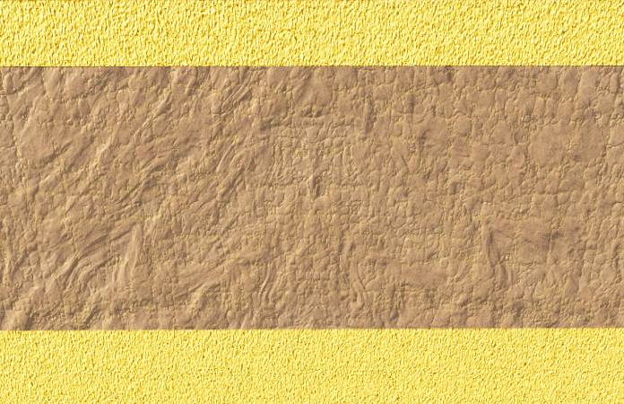
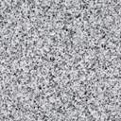

Section 4 Lecture 10
Consolidation Settlement
Rate of consolidation
How long does it take for consolidation settlement to reach ultimate settlement or
100% settlement?
or
How long does it take for 70% consolidation settlement ?
Sand
Sand
Impervious Layer
Clay
Clay
Clay
Sand
Rock
Sand
1
2
3

Slide 25
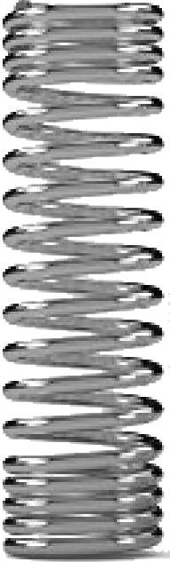


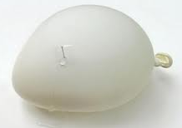
Consolidation Settlement
Rate of consolidation
σ_{total} = σ_{eff} + Δu
Ultimate
Settlement
σ_{total}
σ_{total}
σ_{total}
Water drops
Δh₁
Δh
Δh₂
σ_{eff}
σ_{eff}
σ_{eff}
σ_{eff}
σ_{eff}
σ_{eff}
Δu
Δu
Δu
σ_{eff}
σ_{eff}
σ_{eff}
σ_{eff}
σ_{eff}
σ_{eff}
Water
Time = 0
Time = t
Time =∞
Water drops

Slide 26
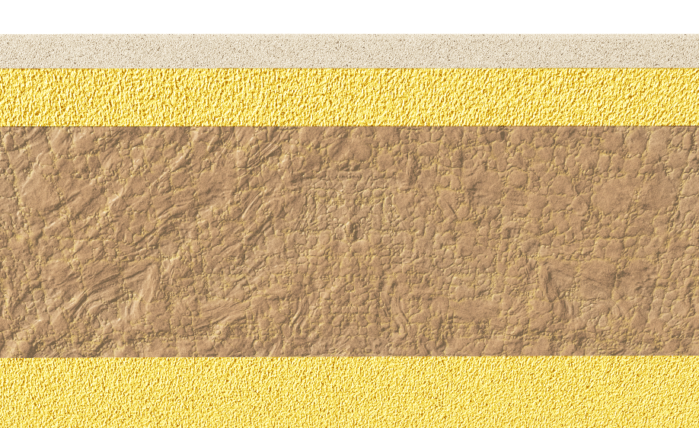

Rate of consolidation
Consolidation Settlement
σ_{total}
σ_{t}
σ_{t}
Δu
Δu
σ_{t}
Δu
σ_{eff}
σ_{t}
Δu
σ_{eff}
σ_{t}
σ_{t}
σ_{eff}
Δu
σ_{t}
σ_{eff}
Δu
σ_{t}
σ_{t}
Δu
Δu
σ_{t}
σ_{t}
σ_{t}
σ_{total} = σ_{eff} + Δu

Slide 27
Rate of consolidation
Consolidation Settlement
σ_{total}
Δu
σ_{eff}
σ_{total} = σ_{eff} + Δu

Slide 28
Rate of consolidation
Consolidation Settlement
Terzaghi’s diffusion equation is derived by considering the continuity of flow out of a soil element, and is:
Where c_{v} = coefficient of consolidation (ft2/day or m2/day), usually determined from a laboratory consolidation test, defined as:
σ_{total}
Δu
σ_{eff}
Δu
Time =∞
Time = t
Time = 0

Slide 29
Section 5 Lecture 10
Consolidation Settlement

Slide 30
Consolidation Settlement
C_{v} (in²/sec)

Slide 31
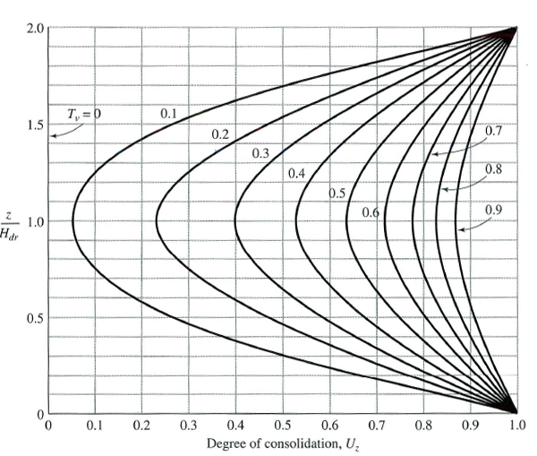
Rate of Consolidation
Consolidation Settlement

Slide 32
Consolidation Settlement
Rate of Consolidation
Relationship between U% and T_{v}
1.0
Initial excess Pore water pressure
0.8
Sand
0.6
Time Factor, T_{v}
Η/2
0.4
Η
Δu_{o}
Η/2
0.2
0.0
Sand
0
10
20
30
40
50
60
70
80
90
Average degree of consolidation, U(%)
Figure 1

Slide 33
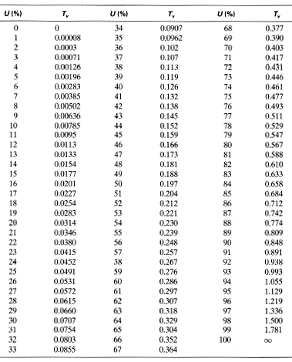
Rate of Consolidation
Relationship between U% and T_{v}
Example:
At U% = 50% T_{v} = 0.197
and
At U% = 90% T_{v} = 0.848
C_{v} = Coefficient of consolidation
k = hydraulic conductivity of the clay
Δe = total change of void ratio caused by an effective stress increase of Δσ_{eff}
e_{av} = average void ration during consolidation
m_{v} = volume coefficient of compressibility =

Slide 34
Rate of Consolidation
Consolidation Settlement
Relationship between U% and T_{v}
Trapezoidal variation of initial excess Pore water pressure
For this case the variation of T_{v} with U% will be the same as shown in Figure 1.
Sand
Η/2
Η
Δu_{o}
Η/2
Sand

Slide 35
Rate of Consolidation
Consolidation Settlement
Relationship between U% and T_{v}
Sinusoidal variation for the initial excess pore water-pressure
1
2
Sand
Sand
Η/2
Η
Δu_{o}
Η
Η/2
Sand
Rock
Δu_{o}

Slide 36
Rate of Consolidation
Consolidation Settlement
Relationship between U% and T_{v}
Sinusoidal variation for the initial excess pore water-pressure
1.0
0.8
1
2
0.6
Time Factor, T_{v}
0.4
0.2
0.0
0
10
20
30
40
50
60
70
80
90
Average degree of consolidation, U(%)

Slide 37
Rate of Consolidation
Consolidation Settlement
Triangular variation for the initial excess pore water-pressure
Sand
Sand
Rock
Δu_{o}
Η/2
Η
Δu_{o}
Η
Η
Η/2
Sand
Rock
Δu_{o}
Sand
1.0
0.8
0.6
Time Factor, T_{v}
0.4
0.2
0.0
0
10
20
30
40
50
60
70
80
90
Average degree of consolidation, U(%)

Slide 38
Rate of Consolidation
Consolidation Settlement
Triangular variation for the initial excess pore water-pressure
Sand
Δu_{o}
Rock
Η
Η
Rock
Sand
Δu_{o}
1.0
0.8
0.6
Time Factor, T_{v}
0.4
0.2
0.0
0
10
20
30
40
50
60
70
80
90
Average degree of consolidation, U(%)

Slide 39
Section 1 Lecture 11
Consolidation Settlement
Rate of Consolidation
Degree of Consolidation Under Ramp Loading
In practical situations, the load increases gradually with time to a maximum value and remains constant thereafter. Figure 1 shows that increase which is called ramp loading.
Δσ
Load per unit area, Δσ
Sand
W.T.
Clay
H
Δσ
Sand
t_{c}
Time, t
Figure 1

Slide 40
Consolidation Settlement
Rate of Consolidation
Load per unit area, Δσ
Degree of Consolidation Under Ramp Loading
Δσ
t_{c}
Time, t
0
T_{c} = 10
0.01
0.04
0.1
0.2
1
2
5
20
0.5
40
U(%)
60
80
100
0.01
0.1
1.0
10
Time Factor, T_{v}

Slide 41
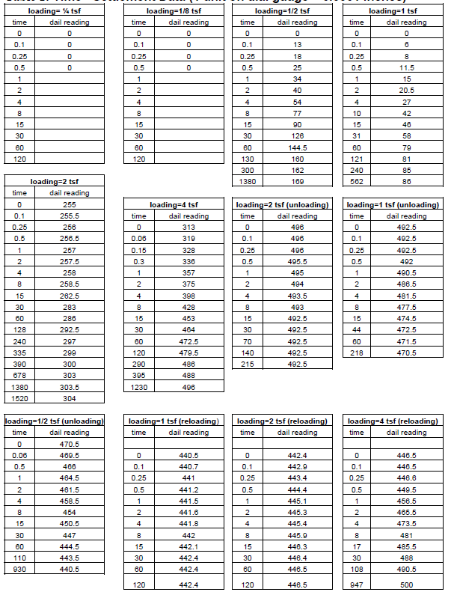
Consolidation Settlement
Rate of Consolidation
Determination of Coefficient of Consolidation C_{v}:
Casagrande Log-of -Time Method
Conduct the one dimensional consolidation test and plot
Settlement (Δh) vs. log (time)
Δh
h₀
Δh
_{Primary}
_{Consolidation}
_{Secondary}
_{Consolidation}
t₁
t₂ = 4 t₁
h₅₀
h₁₀₀
t₅₀ = √
Time

Slide 42
Consolidation Settlement
Rate of Consolidation
Determination of Coefficient of Consolidation C_{v}:
Taylor Square root-of-time Method
Conduct the one dimensional consolidation test and plot
Settlement (Δh) vs. √time
Settlement
(Δh)
Δh
h₀
h₉₀
o
p
Q
√time
1.15 op
√t₉₀
42

Slide 43
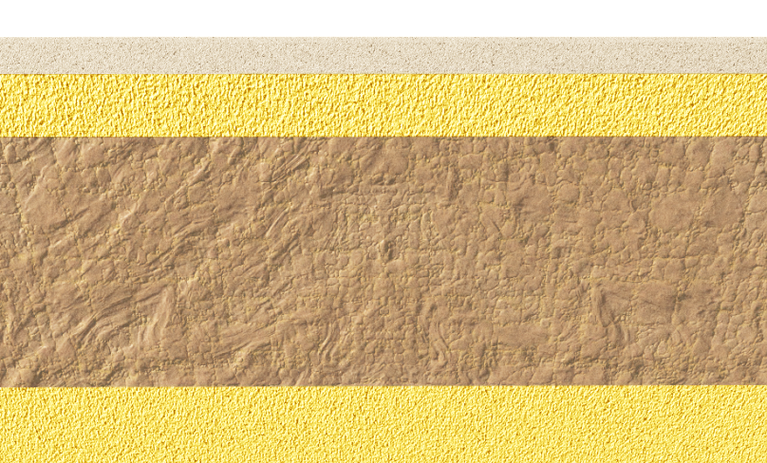
Section 2 Lecture 11
Consolidation Settlement
Example
A laboratory consolidation test on a normally consolidated clay showed the following results:
H=25.4mm
Load, p (kN/m²) | Void ratio at the end of consolidation, e
140 | 0.92
212 | 0.86
0.92
C_{c}
0.86
The specimen tested was 25.4 mm in thickness and drained on both sides. The time required for the specimen to reach 50% consolidation was 4.5 min.
A similar clay layer in the field 2.8 m thick and drained on both sides, is subjected. to a simiiar increase in average effective pressure (i.e., p= 140 kN/m² and p+ Δp = 212 kN/m²).
p₁
p₂
Δp
Sand
W.T.
Clay
H = 2.8 m
Determine:
a. the expected maximum primary consolidation settlement in the field.
b. the length of time required for the total settlement in the field to reach 40 mm.
c. If the increase in Δp would have been ramped, calculate the settlement of the clay layer at t_{construction} = 15 days after the beginning of the surcharge.
Sand
Load per unit area, Δp
Load per unit area, Δp
Settlement = 40 mm
31.6 days
Δp
31.6 days
Time, t
Time, t
t_{c} = 15 days

Slide 44
Consolidation Settlement
Example
Solution:
H=25.4mm
a- Maximum primary consolidation settlement
0.92
C_{c}
0.86
p₁
p₂
Δp
b- Time to 40mm settlement
Sand
W.T.
Clay
H = 2.8 m
Sand
Load per unit area, Δp
Settlement = 40 mm
Δp
31.6 days
Time, t

Slide 45
Consolidation Settlement
Example (Continued)
Solution:
H=25.4mm
0.92
C_{c}
0.86
p₁
p₂
Δp
Sand
W.T.
Clay
H = 2.8 m
Sand
Load per unit area, Δp
Δp
Time, t
t_{c} = 15 days

Slide 46
Consolidation Settlement
Example
Solution (continue):
We need to find the degree of consolidation at
31.6days if the load has been ramped
c- Settlement if the load is ramped for 15 days
Load per unit area, Δp
Δp
Time, t
t_{c} = 15 days
t_{40mm} = 31.6 days
0
T_{c} = 10
20
0.01
0.04
0.1
0.2
1
2
5
Use the figure shown here ….. U = 36%
0.5
40
U(%)
60
80
100
0.01
0.1
1.0
10
Time Factor, T_{v}

Slide 47
Consolidation Settlement
Example (continued):
0
T_{c} = 10
20
0.01
0.04
0.1
0.2
1
2
5
0.5
40
U(%)
60
80
100
0.01
0.1
1.0
10
Time Factor, T_{v}

Slide 48
Section 3 Lecture 11
Consolidation Settlement
Secondary Consolidation Settlement
The end of primary consolidation is recognized by the complete dissipation of excess pore water pressure, Δu. After that stage, consolidation settlement may continue to take place due to plastic adjustment of soil fabrics. This stage of consolidation is called secondary consolidation. During secondary consolidation the plot of deformation against the log of time is practically linear and the secondary compression index is expressed as
Δe_{primary}
C_{c}
p_{o}
p_{o}+Δp
t₁
t₂
Find void ratio at the end of primary consolidation
e_{p} = e_{o} – Δe_{primary}
End of Primary Consolidation,
U% =100%
t₁
t₂
Time
Secondary compression index (Cα)
Overconsolidated clays (OCR > 2 to 3) . . . . . . . . >0.001
Organic soils . . . . . . . . . . . . . . . . . . . . . . 0.025 or more
Normally consolidated clays . . . . . . . . . . . . 0.004–0.025

Slide 49
Consolidation Settlement
Example
Given:
The thickness of a normally consolidated clay layer in the field is 9 ft. The properties of the clay layer are given:
e_{o} = 0.9
Compression index (C_{c} ) = 0.35
Effective geostatic stress at the mid height of the clay layer , p_{o}= 3200 psf
Stress increment at the mid height of the clay layer , Δp = 1050 psf
Secondary compression index (Ca) = 0.045
Find:
What is the consolidation settlement of the clay layer 10 years after the completion of the primary consolidation stage (time at U% = 100% was 3 years)
Δe_{primary}
C_{c}
p_{o}
p_{o}+Δp

Slide 50
Consolidation Settlement
Example (Continue)
Δe_{primary}
C_{c}
p_{o}
p_{o}+Δp

Slide 51
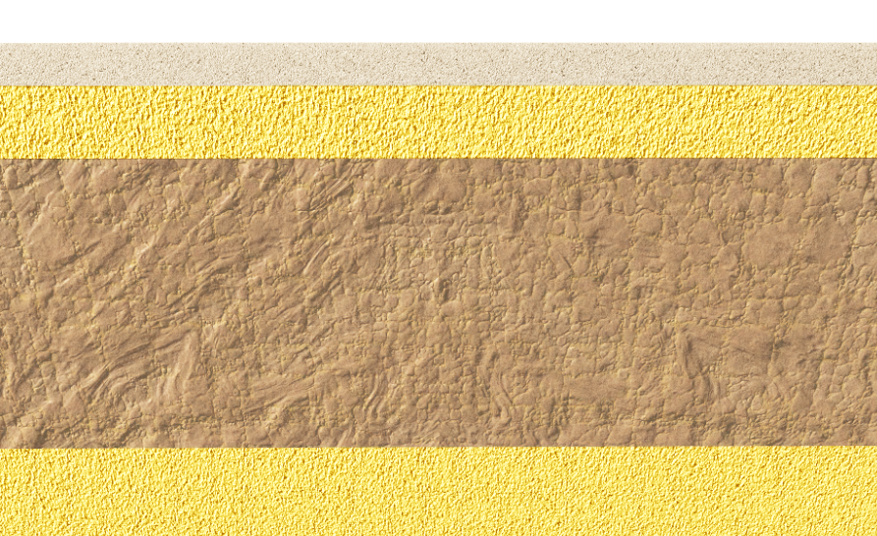
Section 4 Lecture 11
Consolidation Settlement
Example
The time required for 50% consolidation of a 1 in. thick clay layer (two way drainage) in the laboratory is 2 min. 20 sec.
How long (in days) will it take for a 22 ft-thick clay layer (Figure 1) of the same clay in the field under the same pressure increment to reach 50% consolidation?
Δσ
Sand
W.T.
H = 1 in.
Clay
Clay
H = 22 ft
Laboratory
Rock
Field

Slide 52
Consolidation Settlement

Slide 53
Consolidation Settlement
Example:
Given:
A 20 ft thick layer (double drainage) of saturated clay under a surcharge loading underwent 90% primary consolidation in 75 days.
Δσ
Find:
The coefficient of consolidation (c_{v})of clay for the pressure range.
Sand
W.T.
Clay
H = 20 ft
Sand
Field

Slide 54
Consolidation Settlement
Example:
For a normally consolidated laboratory clay specimen drained on both sides, the
following are given:
Vertical stress (psf) | Void Ratio (e)
3000 | 1.1
6000 | 0.9
Thickness of clay specimen = 1 in.
Time for 50% consolidation = 2 min
Find:
Hydraulic conductivity (ft/min) of the clay for the loading range.
How long (in days) will it take for a 10-ft clay layer in the field (drained on one side) to reach 60% consolidation?

Slide 55
Consolidation Settlement

Slide 56
Consolidation Settlement

Slide 57
Section 5 Lecture 11
Consolidation Settlement
Compression index (C_{c})
Rendon-Herrero (1983)
Nagaraj and Murty (1985)
Park and Koumoto (2004):
Worth and Wood (1978):

Slide 58
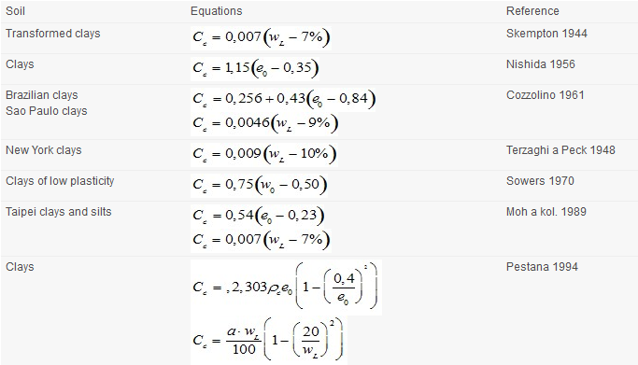
Consolidation Settlement
Compression index (C_{c})

Slide 59
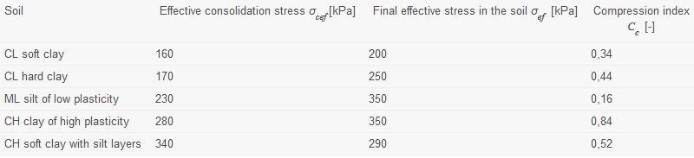
Consolidation Settlement
Compression index (C_{c})

Slide 60
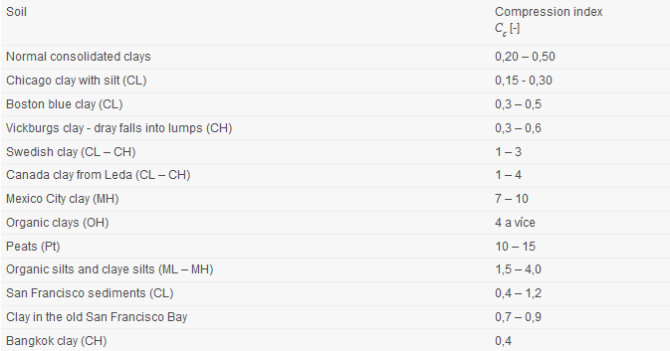
Consolidation Settlement
Compression index (C_{c})

Slide 61
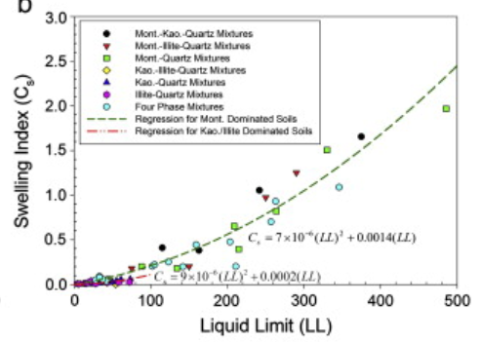
Consolidation Settlement
Swelling index (C_{s})
swelling behavior of major clay minerals

