Slide 1
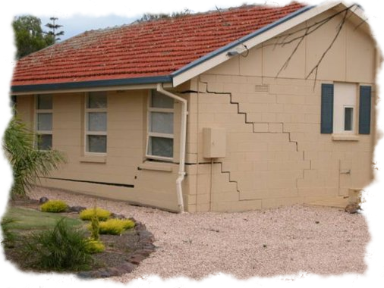
Shallow Foundations
By
Kamal Tawfiq, Ph.D., P.E., F.ASCE

Slide 2
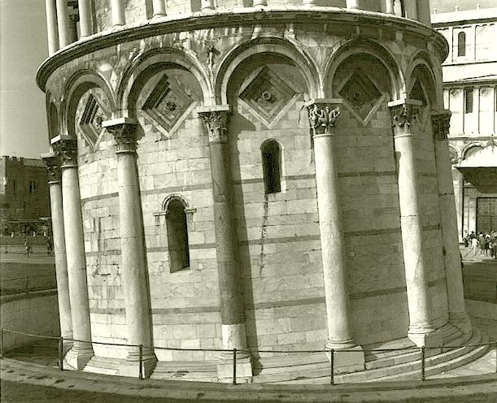
3- Foundation Design
Differential Settlement

Slide 3
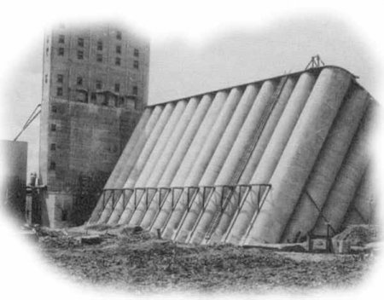

Slide 4
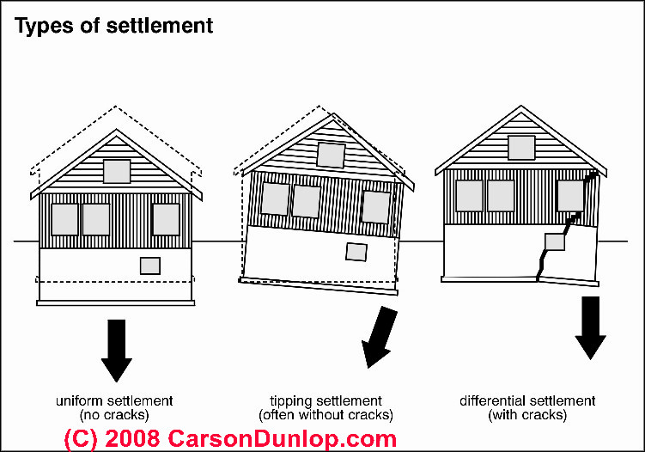

Slide 5
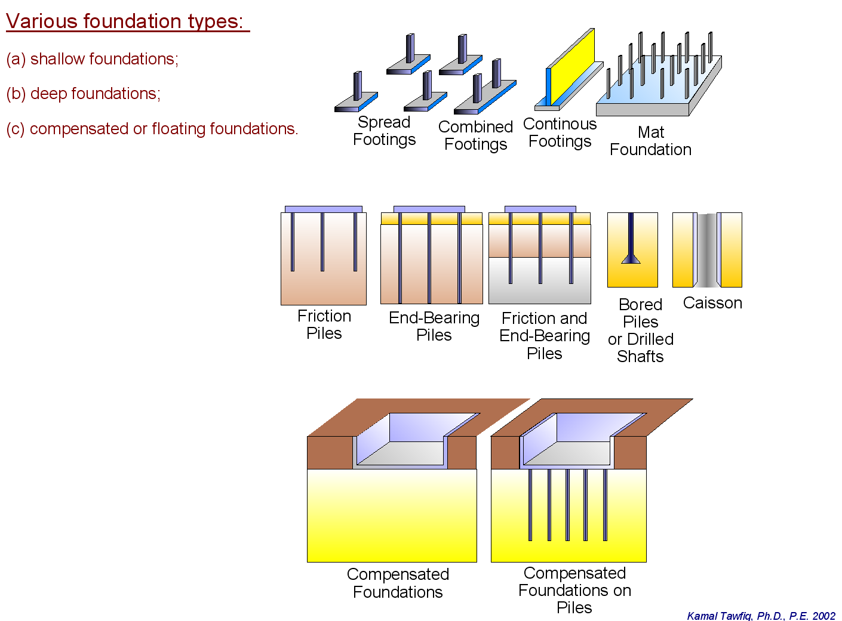
Structural Foundations are grouped into two main groups.
1- Shallow Foundation
Spread Footings
Continuous Footings
Combined Footings
Mat Foundation
2- Deep Foundation
Driven Piles
Drilled Shaft
Auger Cat Piles
3- Compensated or floating foundations

Slide 6
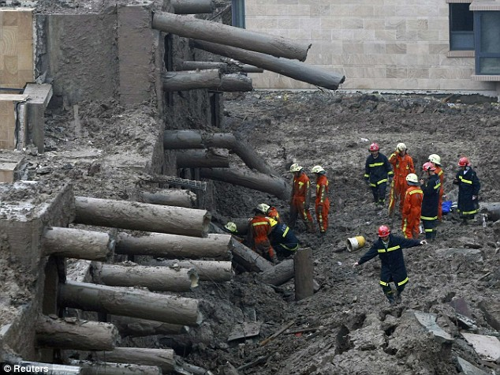

Slide 7
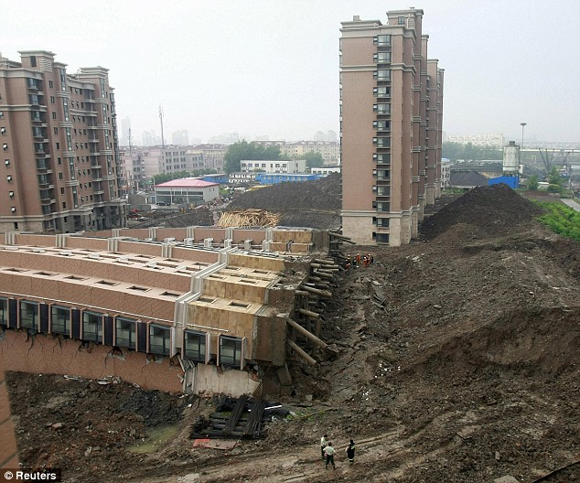

Slide 8

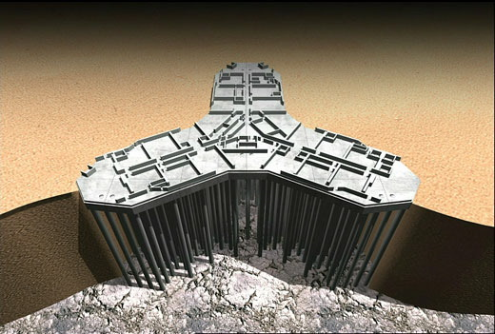

Slide 9
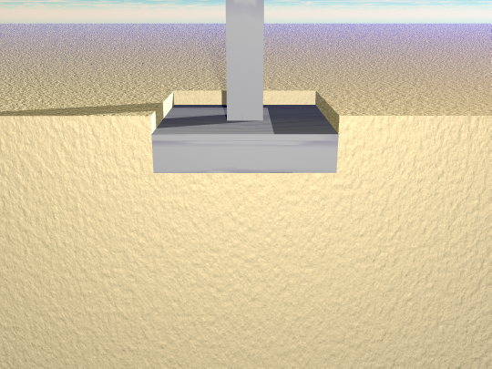
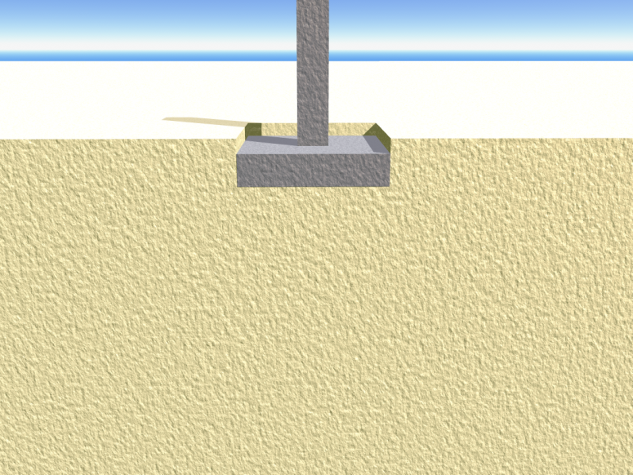
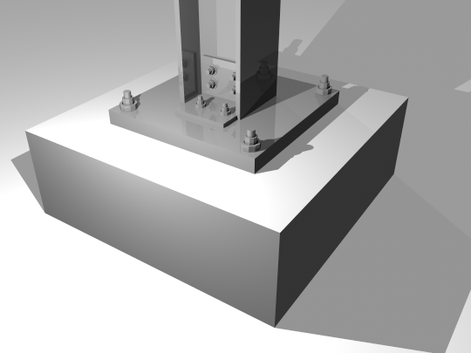
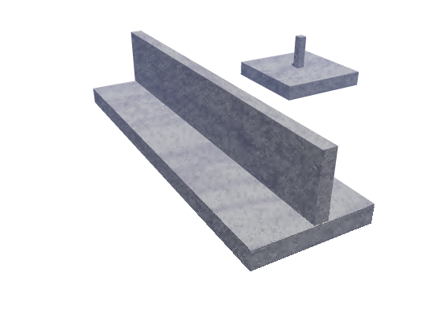
Shallow Foundation
Spread Footings
Spread Footings
Continuous Footings
Spread Footings

Slide 10
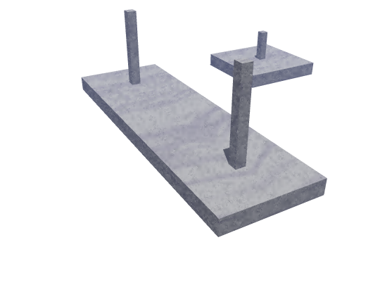
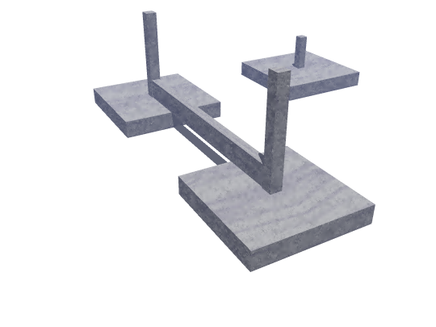
Spread Footings
Combined Footings
Combined Footings

Slide 11
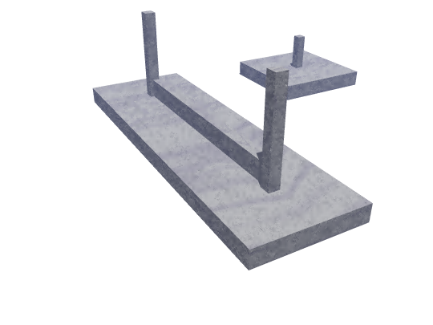
Spread Footings
Combined Footings

Slide 12
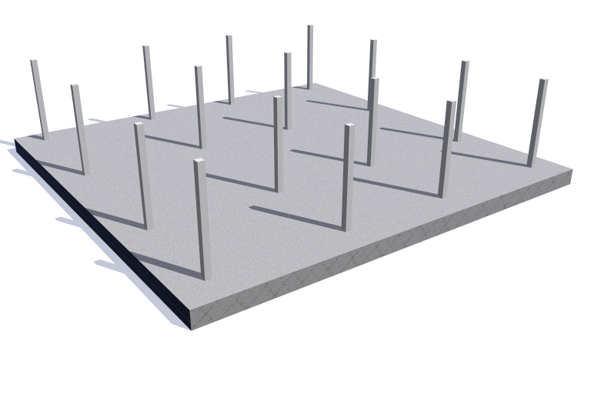
Mat Foundation

Slide 13
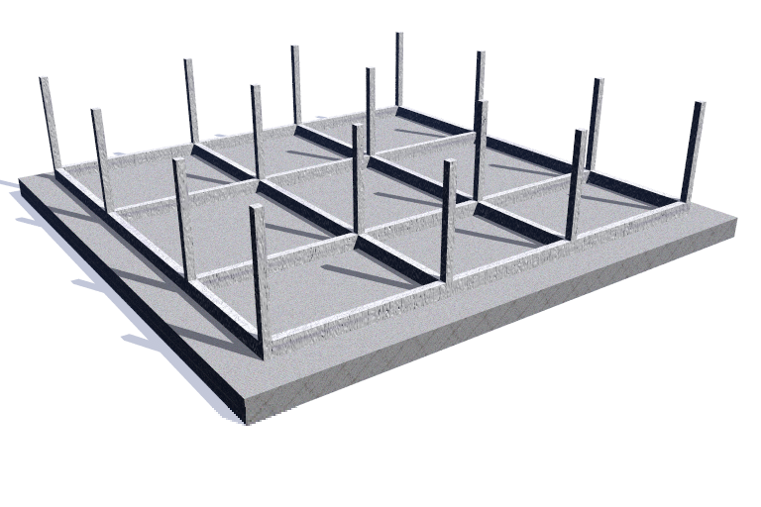
Mat Foundation

Slide 14
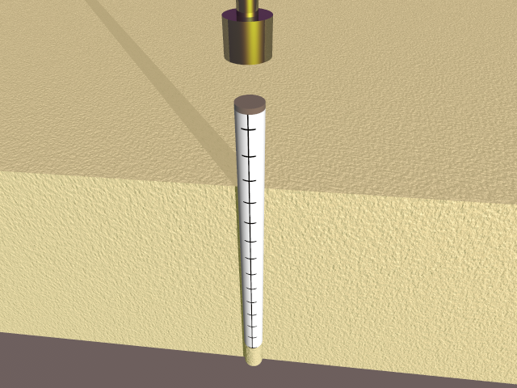
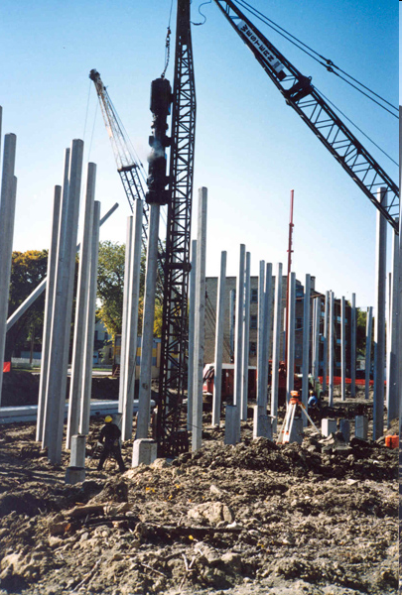
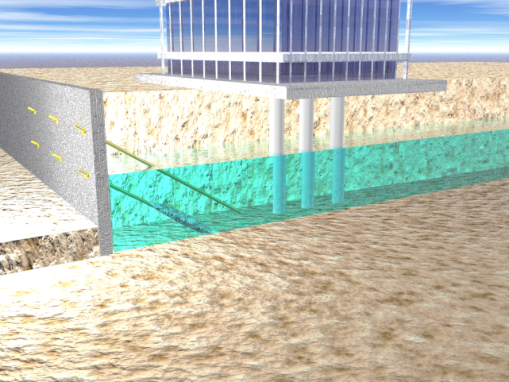
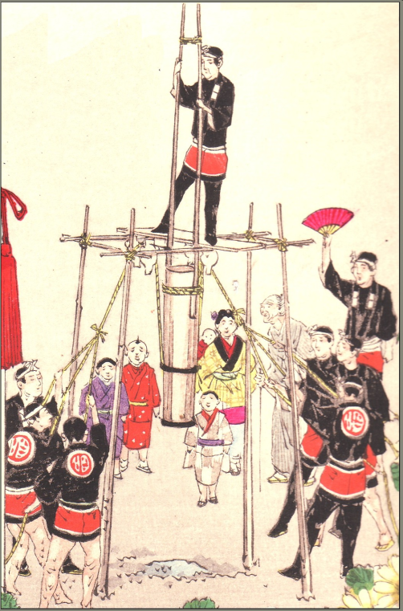
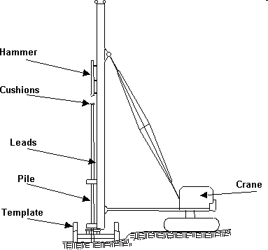
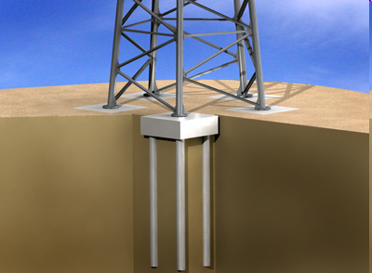
Deep Foundation
Driven Piles

Slide 15
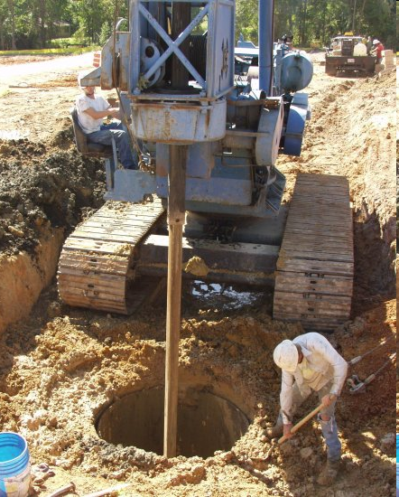
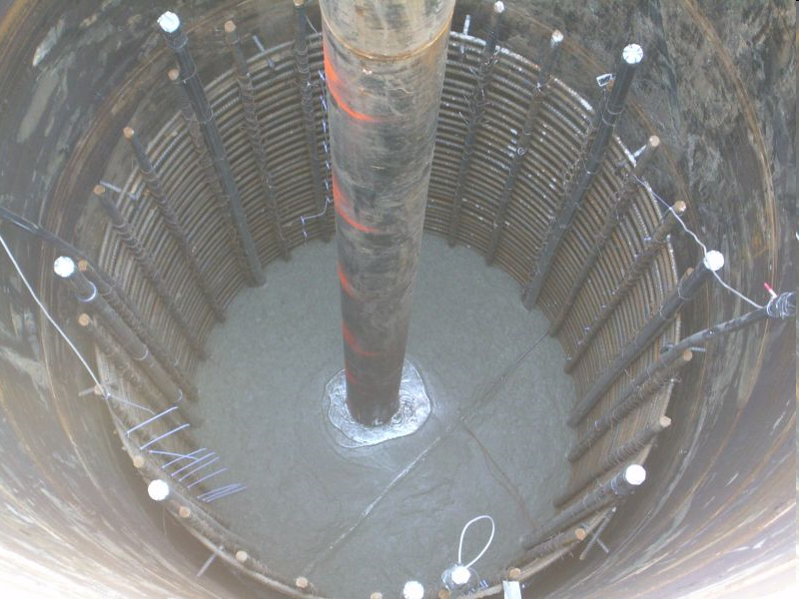
Drilled Shafts

Slide 16
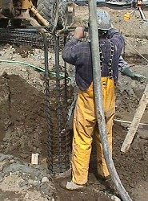
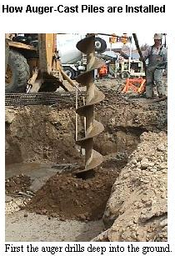
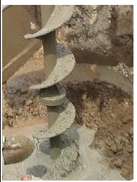
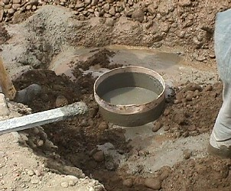
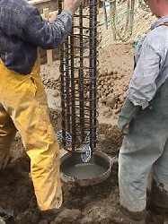
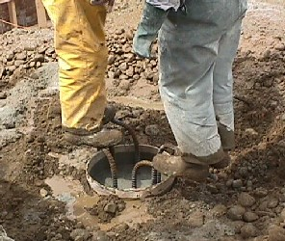
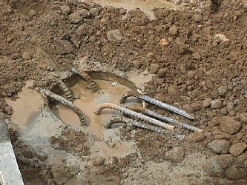
Auger Cast Pile

Slide 17
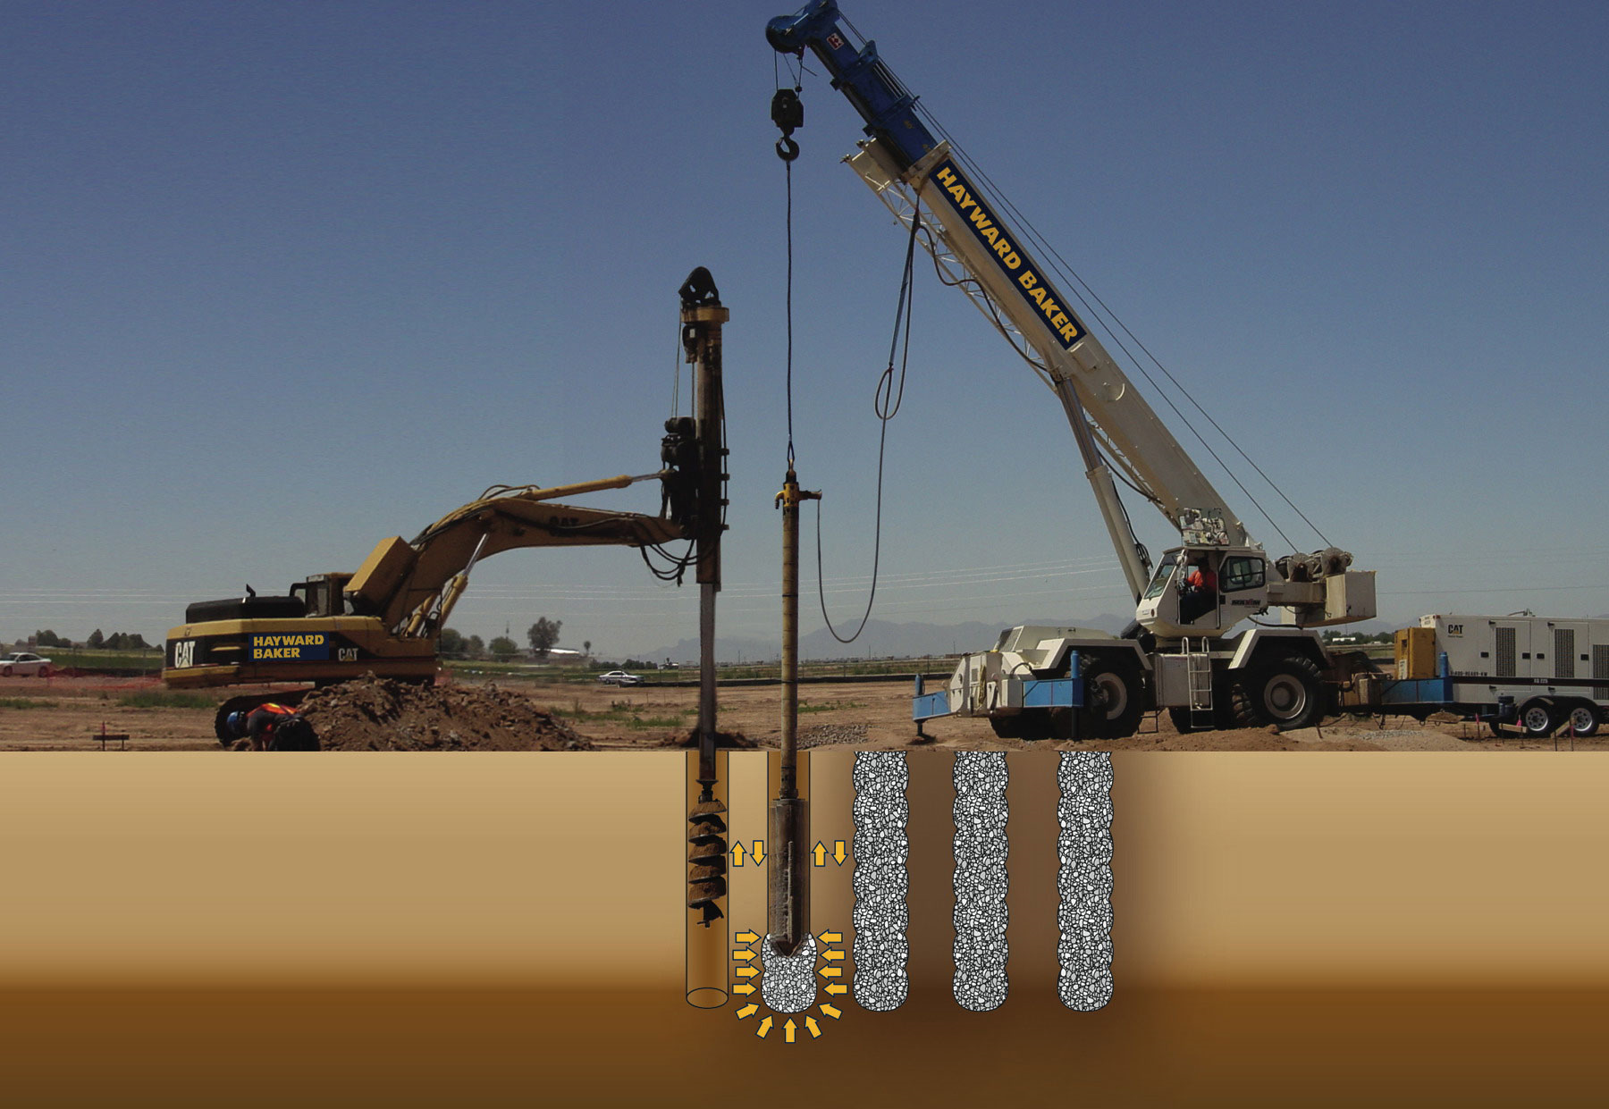
Vibro Piers

Slide 18
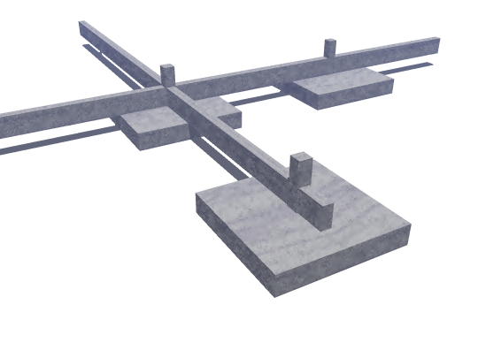
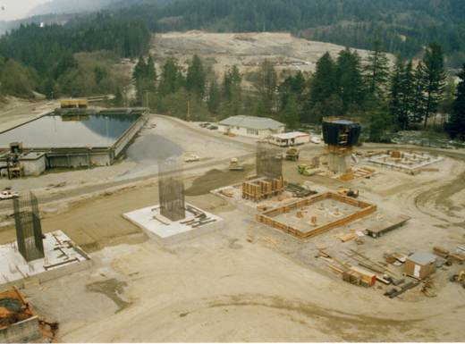
Analysis and Design of Shallow Foundation
I- Bearing Capacity
II- Settlement
I- ULTIMATE BEARING CAPACITY THEORIES:
TERZAGHI’S BEARING CAPACITY THEORY
GENERAL BEARING CAPACITY EQUATION

Slide 19
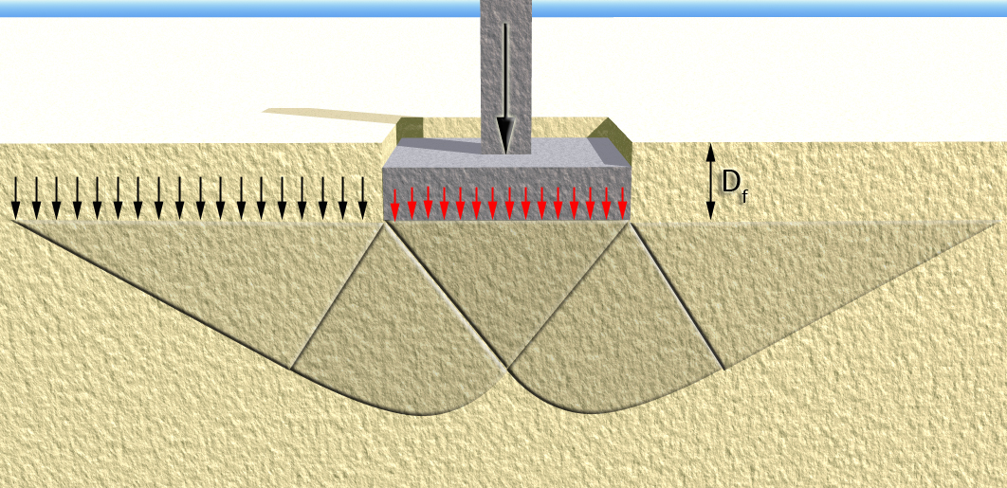
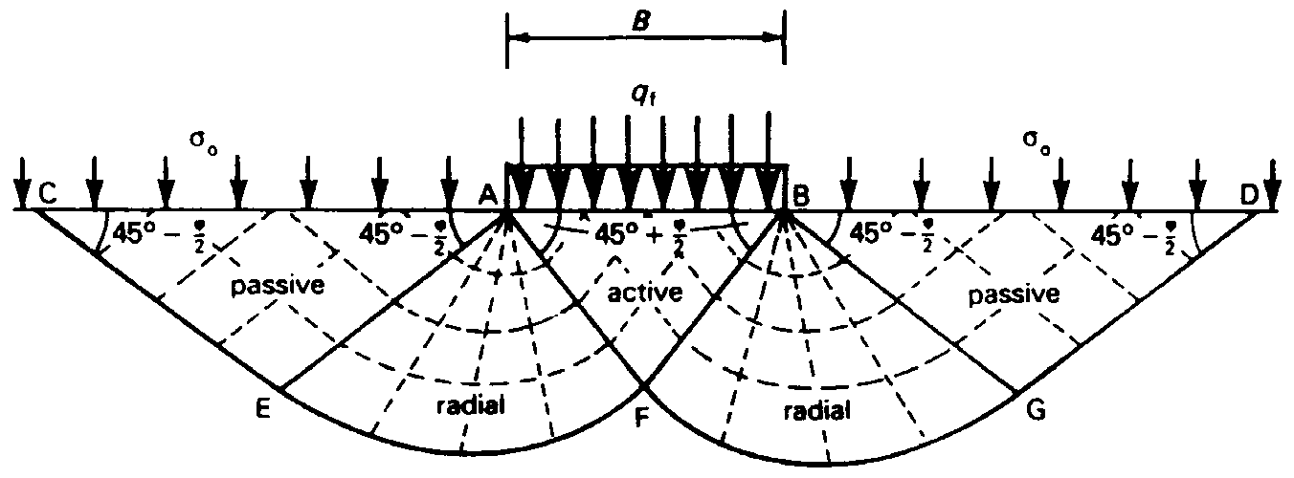
I- Bearing Capacity
TERZAGHI’S BEARING CAPACITY THEORY
Terzaghi's Equation (1943)
Utilizing Prandtl's theory, Buisman (1940) expressed the maximum bearing capacity of soils by superimposing the contribution of cohesion, overburden pressure, and density of the soil, His expression is commonly referred to as Terzaghi's equation. Presumably, it was associated with Terzaghi's in the English speaking countries following the publication of his book (Theoretical Soil Mechanics) in 1943.
- Based on Prandtl's theory of plastic failure, Terzaghi presented a modified system as illustrated below.
Q_{design}
B
q = γD_{f}
q_{ult}
q_{ult}
45^{ο}+φ/2
45 − φ/2
45 − φ/2

Slide 20
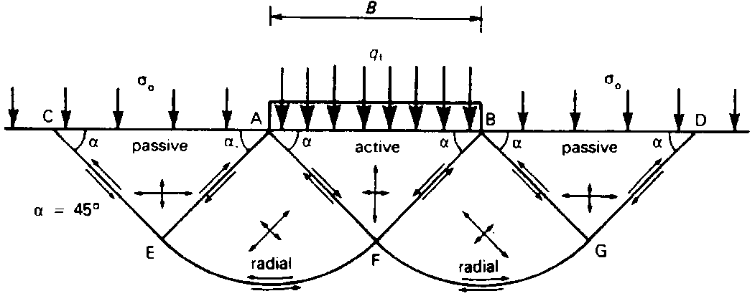
q_{u} = q_{c} + q_{q} + q_{γ}

Slide 21
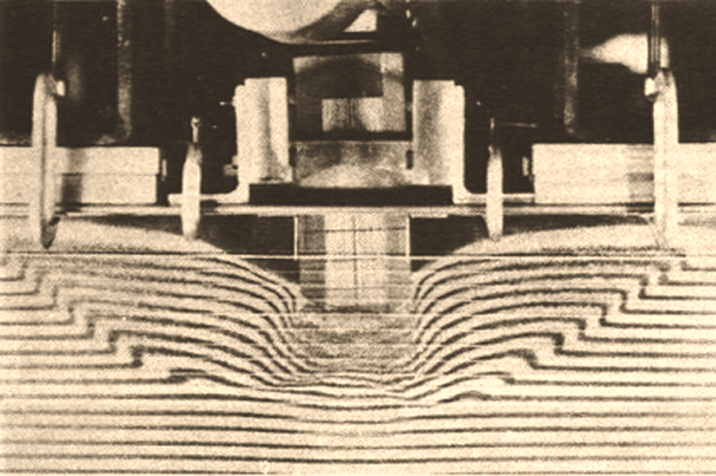
Laboratory Testing on Bearing capacity failures of foundations
General shear foundation failure

Slide 22
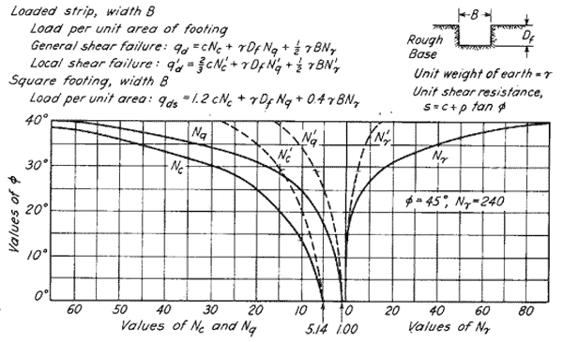
Ultimate Bearing Capacity
q_{u} = q_{c} + q_{q} + q_{γ}

Slide 24
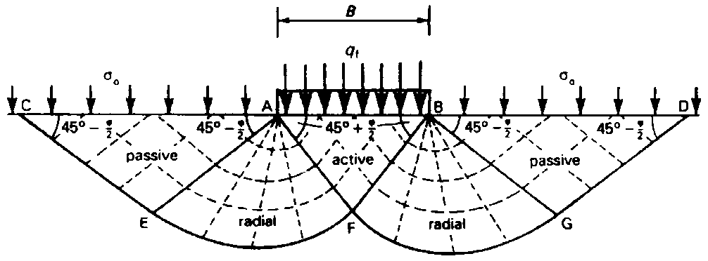
1- TERZAGHI’S BEARING CAPACITY THEORY

Slide 25
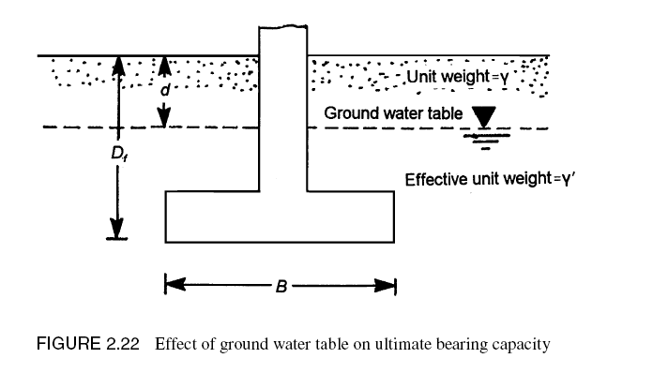
1
2
4
3

Slide 26
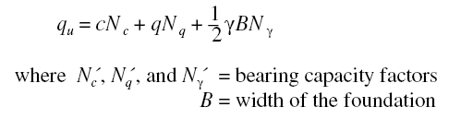

Slide 28
2- GENERAL BEARING CAPACITY EQUATION

Slide 29
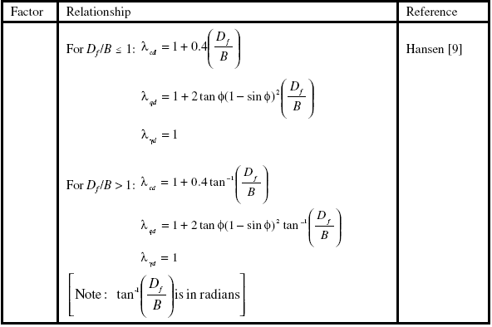

Slide 30


