Slide 1
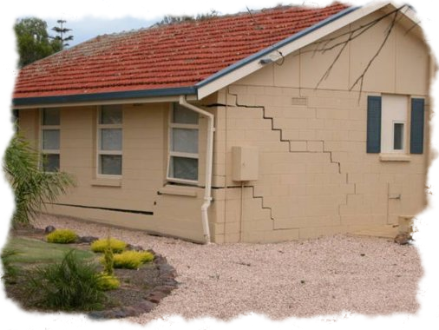
Soil Settlement
By
Kamal Tawfiq, Ph.D., P.E., F.ASCE
Spring 2018

Slide 2
Soil Settlement:
Total Soil Settlement = Elastic Settlement + Consolidation Settlement
S_{total} = S_{e} + S_{c}
{
Load Type (Rigid; Flexible)
Elastic Settlement or Immediate Settlement depends on
Settlement Location (Center or Corner)
{
Theory of Elasticity
Elastic Settlement
Time Depended Elastic Settlement (Schmertman & Hartman Method (1978)
Elastic settlement occurs in sandy, silty, and clayey soils.
By: Kamal Tawfiq, Ph.D., P.E.

Slide 3

By: Kamal Tawfiq, Ph.D., P.E.
Consolidation Settlement (Time Dependent Settlement)
* Consolidation settlement occurs in cohesive soils due to the expulsion of the water from the voids.
* Because of the soil permeability the rate of settlement may varied from soil to another.
* Also the variation in the rate of consolidation settlement depends on the boundary conditions.
S_{Consolidation} = S_{primary} + S_{secondary}
Primary Consolidation Volume change is due to reduction in pore water pressure
Secondary Consolidation Volume change is due to the rearrangement of the soil particles
(No pore water pressure change, Δu = 0, occurs after the primary consolidation)
Water Table (W.T.)
Expulsion of the water
When the water in the voids starts to flow out of the soil matrix due to consolidation of the clay layer. Consequently, the excess pore water pressure (Δu) will reduce, and the void ratio (e) of the soil matrix will reduce too.
Water
Solids
Voids

Slide 4
Elastic Settlement
Bq_{o}
2
S_{e} = (1 - μ_{s}) α
E_{s}
(corner of the flexible foundation)
2
Bq_{o}
2
S_{e} = (1 - μ_{s}) α
(center of the flexible foundation)
E_{s}
1
Where α = [ ln ( √1 + m² + m / √1 + m² - m ) + m. ln ( √1 + m² + 1 / √1 + m² - 1 )
m = B/L
B = width of foundation
L = length of foundation
π
By: Kamal Tawfiq, Ph.D., P.E.

Slide 5
Bq_{o} (1 - μ_{s}) α
S_{e} =
E_{s}
3.0
2.5
α
α_{av}
α_{r}
2.0
α, α_{av}, α_{r}
1.5
For circular foundation
α = 1
α_{av} = 0.85
α_{r} = 0.88
1.0
0.0
1
2
3
4
5
6
7
8
9
10
L / B
Values of α, α_{av}, and α_{r}
By: Kamal Tawfiq, Ph.D., P.E.

Slide 6


Slide 7
Δp
Δp
Δp
Δp
Δp
Δp
ΔΗ =
C_{S} H
P_{o} + ΔP
log ( )
1 + e_{O}
P₀

Slide 8
Δp₂
Δp₂
Δp₂
Δp
Δp
Δp
Δp
C_{S} H
P_{C}
C _{C} H
P_{o} + ΔP
ΔΗ = log ( ) +
log ( )
1 + e_{O}
P_{o}
1 + e_{O}
P_{C}

Slide 9
Δp₂
Δp₂
Δp₂
Δp
Δp₂
C_{S} H
P_{o} + ΔP
( )
ΔΗ = log
1 + e_{O}
P_{o}
2

