Slide 1
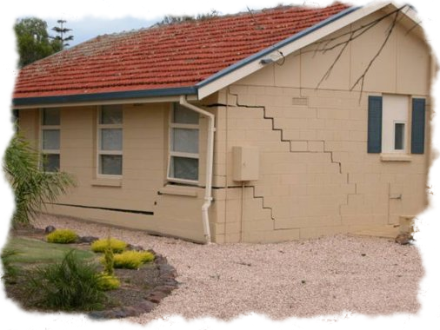
Soil Settlement
By
Kamal Tawfiq, Ph.D., P.E., F.ASCE
Spring 2019

Slide 2
Soil Settlement:
Total Soil Settlement = Elastic Settlement + Consolidation Settlement
S_{total} = S_{e} + S_{c}
{
Load Type (Rigid; Flexible)
Elastic Settlement or Immediate Settlement depends on
Settlement Location (Center or Corner)
{
Theory of Elasticity
Elastic Settlement
Time Depended Elastic Settlement (Schmertman & Hartman Method (1978)
Elastic settlement occurs in sandy, silty, and clayey soils.
By: Kamal Tawfiq, Ph.D., P.E.

Slide 3
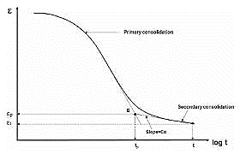

By: Kamal Tawfiq, Ph.D., P.E.
Consolidation Settlement (Time Dependent Settlement)
* Consolidation settlement occurs in cohesive soils due to the expulsion of the water from the voids.
* Because of the soil permeability the rate of settlement may varied from soil to another.
* Also the variation in the rate of consolidation settlement depends on the boundary conditions.
S_{Consolidation} = S_{primary} + S_{secondary}
Primary Consolidation Volume change is due to reduction in pore water pressure
Secondary Consolidation Volume change is due to the rearrangement of the soil particles
(No pore water pressure change, Δu = 0, occurs after the primary consolidation)
_{Primary Consolidation}
Settlement ΔH
_{Secondary Consolidation}
Log Time
Water Table (W.T.)
Expulsion of the water
When the water in the voids starts to flow out of the soil matrix due to consolidation of the clay layer. Consequently, the excess pore water pressure (Δu) will reduce, and the void ratio (e) of the soil matrix will reduce too.
Water
Solids
Voids

Slide 4
Elastic Settlement
Bq_{o}
2
S_{e} = (1 - μ_{s}) α
E_{s}
(corner of the flexible foundation)
2
Bq_{o}
2
S_{e} = (1 - μ_{s}) α
(center of the flexible foundation)
E_{s}
1
Where α = [ ln ( √1 + m² + m / √1 + m² - m ) + m. ln ( √1 + m² + 1 / √1 + m² - 1 )
m = B/L
B = width of foundation
L = length of foundation
π
By: Kamal Tawfiq, Ph.D., P.E.

Slide 5
Bq_{o} (1 - μ_{s}) α
S_{e} =
E_{s}
3.0
2.5
α
α_{av}
α_{r}
2.0
α, α_{av}, α_{r}
1.5
For circular foundation
α = 1
α_{av} = 0.85
α_{r} = 0.88
1.0
0.0
1
2
3
4
5
6
7
8
9
10
L / B
Values of α, α_{av}, and α_{r}
By: Kamal Tawfiq, Ph.D., P.E.

Slide 6
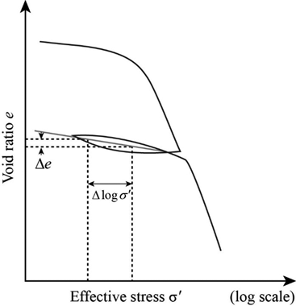
Laboratory Consolidation Test
- One Dimensional Consolidation
Depth of Sampling
Soil Sample
Δe
1
H
e
1st Load Increment
Δe₁ vs. ΔP₁
Δe₁
2st Load Increment
Plot all
Δe vs. Load increments
C_{s}
Δe₂ vs. ΔP₂
C_{c}
C_{c}
4st Load
Increment
ΔP₂

Slide 7

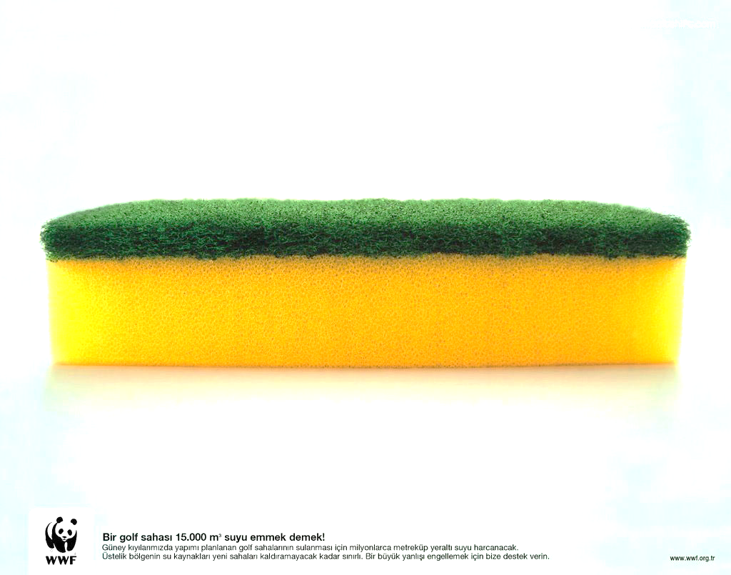

Consolidation Settlement
Assume a fully saturated Sponge
P
$$\frac{H}{2}$$
Δσ
ΔP
H/2
Seepage
H
Two way
drainage path

Slide 9
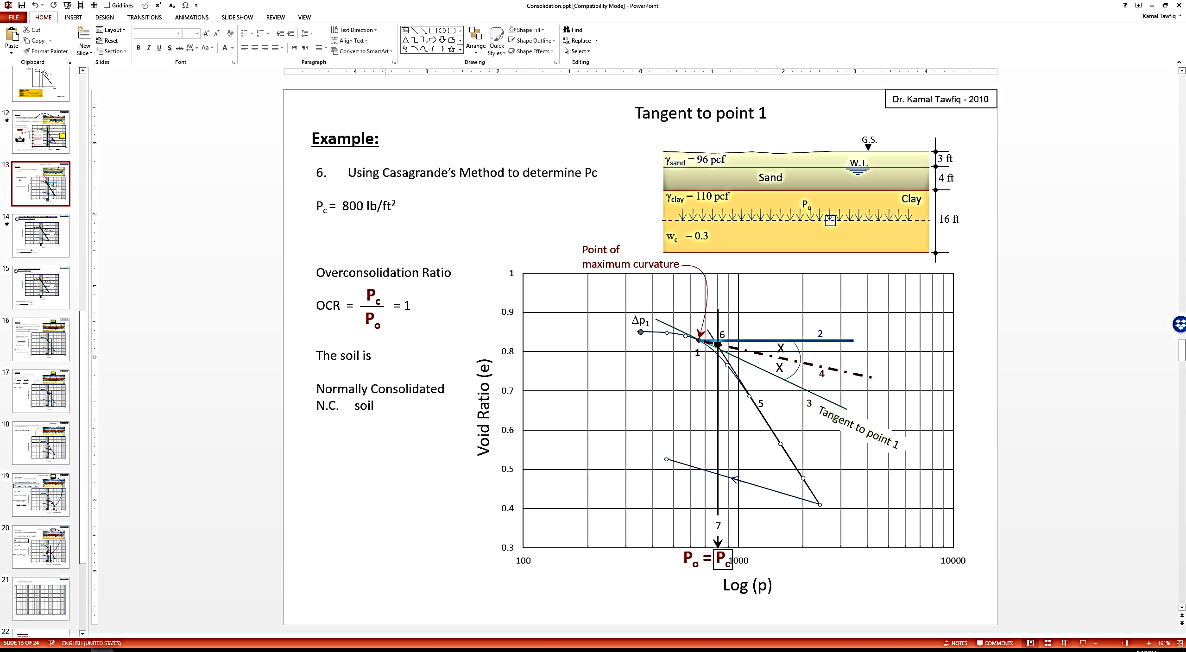
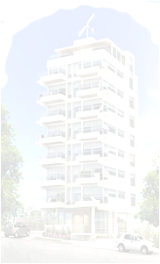



Normally Consolidated and Overconsolidated Clay
Question
How do you know if the clay layer at the site is
normally consolidated or
Over-consolidated ???
Case 2
Past
Case 1
Past
Today
G.S.
Use Casagrande Graphical Method to determine Pc
Sand
P_{o}
Clay
If P_{c} = P_{o} .. Soil is NC
If P_{c} > P_{o} .. Soil is OC
P_{o} = Vertical effective stress at the mid of the clay layer,
It is known

Slide 10
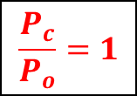
Case 1
Normally Consolidated
Stress of the building at the mid height of the clay layer
Δp₁
ΔP₁
Void Ratio (e)
P_{c} = P_{o}
P_{o} + ΔP
$$\frac{P_{c}}{P_{o}}=1$$
Log (p)

Slide 11
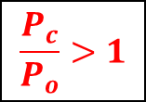
Over-consolidated
Case 2-1
Stress of the building at the mid height of the clay layer
Δp₁
ΔP₂
ΔP₁
Void Ratio (e)
C_{S}
C_{C}
P_{o}
P_{c}
P_{o} + ΔP
$$\frac{P_{c}}{P_{o}}>1$$

Slide 12
Over-consolidated
Case 2-2
Stress of the building at the mid height of the clay layer
Δp₁
ΔP₂
Void Ratio (e)
C_{S}
C_{C}
P_{o}
P_{c}
P_{o} + ΔP
$$\frac{P_{c}}{P_{o}}>1$$

