Slide 1
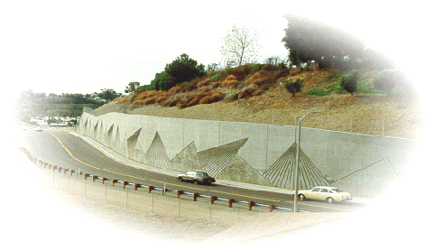
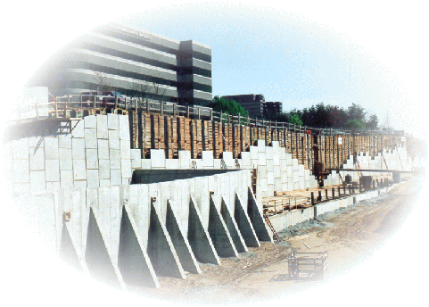
Earth Pre
ssure
&
Retaining W
all Design
By
Kamal Tawfiq,
Ph.D., P.E.
Fall 2018
By: Kamal Tawfiq Fall 2013

Slide 2
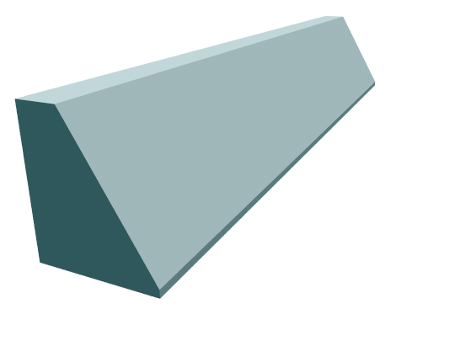
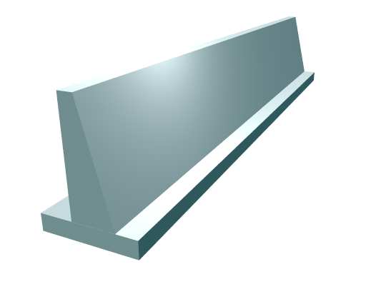
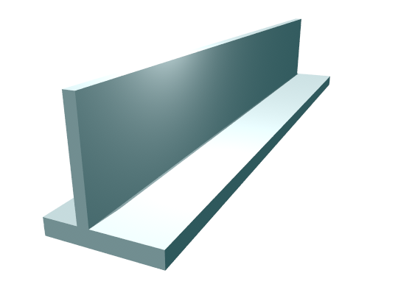
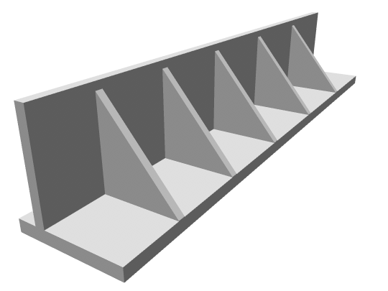
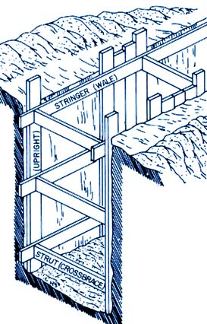
Types of Earth Retaining Walls
I- Permanent Walls
II- Temporary Walls ......
1
I- Permanent Walls
1- Gravity Wall
2
2- Semi-gravity wall
3
3- Cantilever wall
4- Counterfort wall
5-
Sheet pile wall & Braced cuts
4
5
By: Kamal Tawfiq

Slide 3
Common Proportions of Cantilever Wall
12 in Preferable minimum
Minimum batter = 1/50
Vertical
Stem
H
Toe Slab
H/10 to H/8
Thickness
H/12 to H/10
Heel of Slab
D_{f}
_{Thickness = H/12 to H/10}
_{B = 0.4 to 0.7 H}
Base of footing

Slide 4
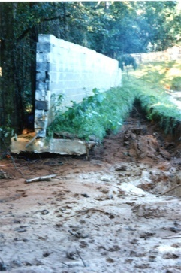
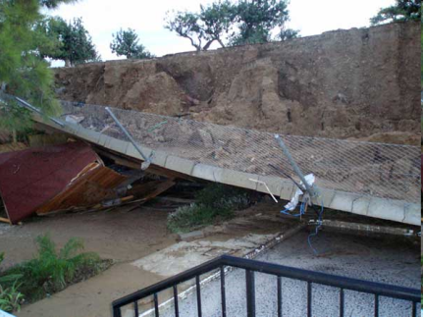
Design of Retaining Wall
1- External Stability
2- Internal Stability
1
2
1. External Stability
1- Sliding
2- Overturning
3- Settlement
4- Overall Failure
3
4
By Kamal Tawfiq, Ph.D., P.E

Slide 5
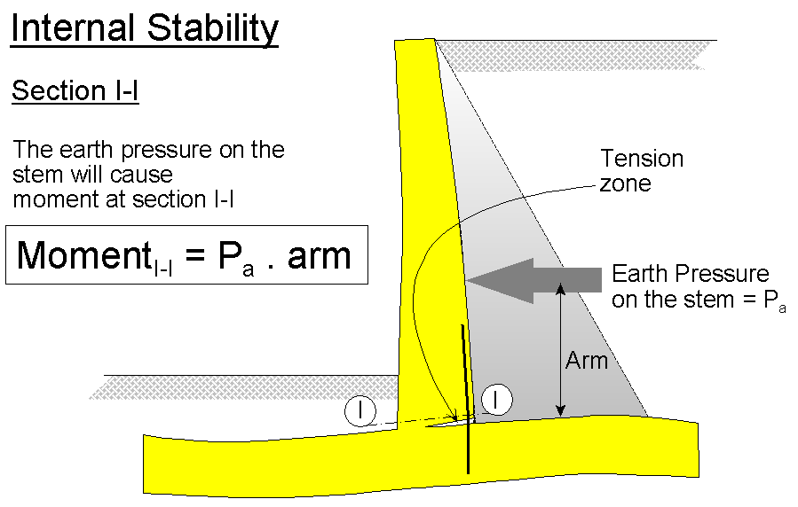
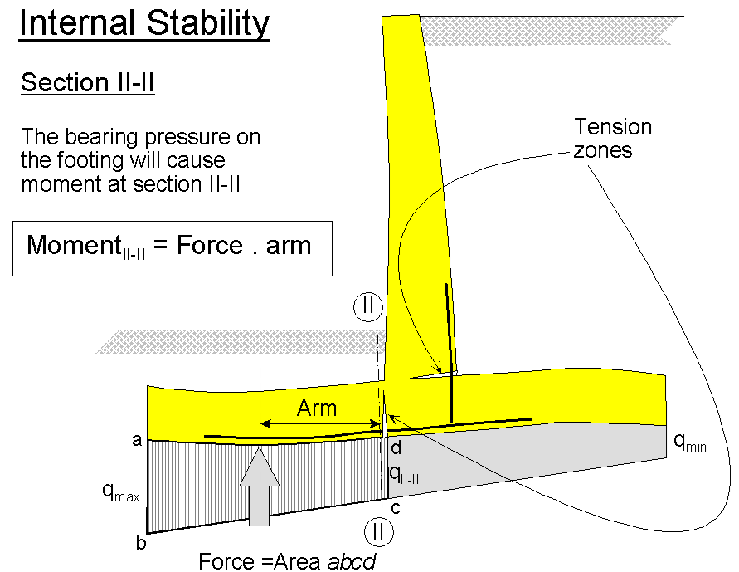
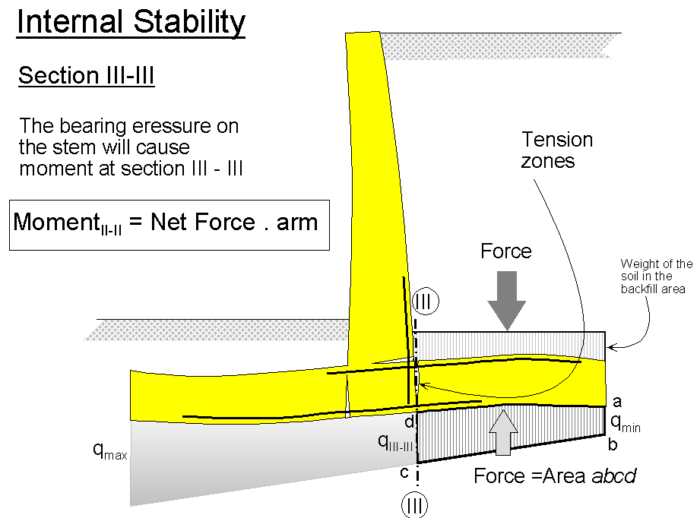
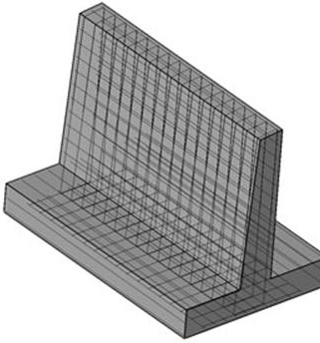
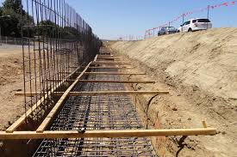
Internal Stability
Structural Design
Steel Reinforcement
and Thicknesses
Structural Design
2-
Kamal Tawfiq

Slide 6
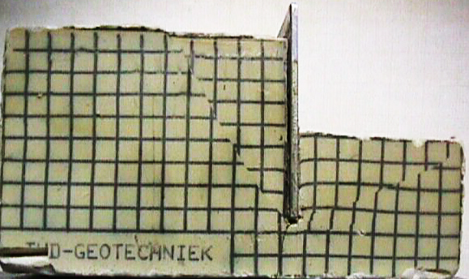













Rankine’s Earth Pressure Method for (c- φ) Soil
Rankine’s Active Earth Pressure in ( φ) Soil with inclined backfill
Rankine’s Active and Passive Earth Pressure in (c- f) Soil
Rankine’s Active Earth Pressure in ( φ) Soil
α
Active Wedge
Fig.1
$$σ_{h1}=0$$
Fig.2
1
√
1
γ =
φ =
θ = 45 ⁰− φ/2
φ
δ = 0
$$K_{a}=\frac{1−sin∅}{1+sin∅}$$
$$σ_{h1}=0$$
√
τ
θ = 45 ⁰ + φ/2
Passive Earth Pressure
Active
Earth Pressure
H
δ = 0
τ = c + σ_{n} tan φ
Passive Wedge
P_{a} = 0.5 γ H² K_{a}
P_{a} = 0.5 γ H² K_{a}
H
α
c
Passive
Earth Pressure
H/3
σ_{f}’
σ_{h}’
σ_{v}’
σ_{f}’
Active Earth Pressure
σ_{h} is increasing until failure
2
$$σ_{h2}=γHK_{a}$$
α
2
$$σ_{h2}=γHK_{a}$$
√
Effect of Cohesion of the Rankine’s Active and Passive Earth Pressure for c-φ Soil
Rankine’s Active Earth Pressure in φ - Soil & Water Table
K_{a} = cosα .
Cosα – (cos²α – cos² φ)
Cosα + (cos²α – cos² φ)
Active Earth Pressure
-2c K_{a}
-2c K_{a}
G.S.
√
$σ_{f}^{′}$= $σ_{V}^{′} \tan^{2}\left({45}^{o}−\frac{∅}{2}\right)+2 c \tan\left({45}^{o}−\frac{∅}{2}\right)$
Flexible Wall
γ_{soil}
φ
Active Pressure
-
Tension Crack Z_{cr} = $\frac{2c}{γ\sqrt{K_{a}}}$
h₁
+
W.T.
Effect of Two Soil Layers on Active Earth Pressure
Or
+
P_{w}
σ_{h} = γ_{soil}h₁ K_{a}
K_{a1} < K_{a2}
G.S.
$σ_{f}^{′}$= $σ_{V}^{′} K_{a}−2 c \sqrt{Ka}$
-
h₂
+
+
+
σ_{h} = γ_{soil}h₁K_{a1}
γ₁
φ₁
+
+
=
+
P_{w} = 0.5 γ_{w} (h₂)²
h₁
K_{a1}
$K_{a }$= $\tan^{2}\left({45}^{o}−\frac{∅}{2}\right)= \frac{1− \sin{∅}}{1+ \sin{∅}}$
σ_{h} = γ_{soil}h₁K_{a2}
Coefficient of active earth pressure
+
$σ_{h}= h_{1}γsoil k_{a}$ +
$$h_{2 }\left(γsoil− γwater\right)k_{a}$$
σ_{w} = γ_{w}h₂
γ₂
φ₂
h₂
K_{a2}
Passive Earth Pressure
-2c K_{a}
γ H K_{a}
γ H K_{a} -
2c K_{a}
$σ_{f}^{′}$= $σ_{V}^{′} \tan^{2}\left({45}^{o}+\frac{∅}{2}\right)+2 c \tan\left({45}^{o}+\frac{∅}{2}\right)$
+2c K_{p}
+2c K_{p}
Effect of Surcharge (q) Load on Active Earth Pressure
σ_{h} = (γ₁ h₁ + γ₂ h₂) k_{a2}
Or
qk_{a}
q
K_{a1} > K_{a2}
G.S.
$σ_{f}^{′}$= $σ_{V}^{′} K_{p}+2 c \sqrt{Kp}$
Passive Pressure
qk_{a}
γ₁
φ₁
h₁
σ_{h} = γ_{soil}h₁K_{a1}
$K_{p }$= $\tan^{2}\left({45}^{o}+\frac{∅}{2}\right)= \frac{1+ \sin{∅}}{1 − \sin{∅}}$
σ_{h} = γ_{soil}h₁K_{a2}
K_{a1}
Coefficient of passive earth pressure
+
+
+
=
+
+
+
+
+
=
+
γ₂
φ₂
h₂
K_{a2}
qk_{a}
γ H K_{a}
qk_{a}
+2c K_{p}
γ H K_{p}
γ H K_{p} +
2c K_{p}
Effect of Surcharge Load
Effect of Soil Pressure
+ γ H K_{a}
σ_{h} = (γ₁ h₁ + γ₂ h₂) k_{a2}
Kamal Tawfiq – Fall 2018

Slide 7
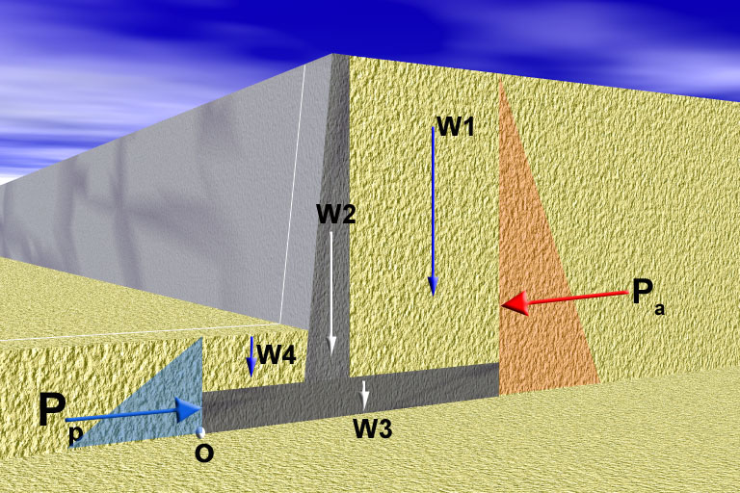
I. External Stability
Factor of Safety Against Sliding =
Resisting Force
=
F_{R}
1- Sliding
Driving Force
F_{D}
δ = 0.5 to 2/3 φ
Cohesion
Friction = (∑W) tan δ + B.c
B
If the soil is cohesive, add (BC) to the shear resistance
F_{D} = P_{a}
F_{R} = P_{p} + Friction
By: Kamal Tawfiq

Slide 8
I. External Stability
Factor of Safety Against Sliding =
Resisting Moment
=
M_{R}
2- Overturning
Driving Moment
M_{D}
Resisting Moment
M_{R}
Driving Moment
M_{D}
a₁
a₂
a₄
y_{a}
a₃
y_{p}
B
Moment About o
M_{D} = P_{a} . y_{a}
M_{R} = P_{p}.y_{p} + W₁ a₁ + W₂ a₂ +W₃ a₃ +W₄ a₄
By: Kamal Tawfiq

Slide 9
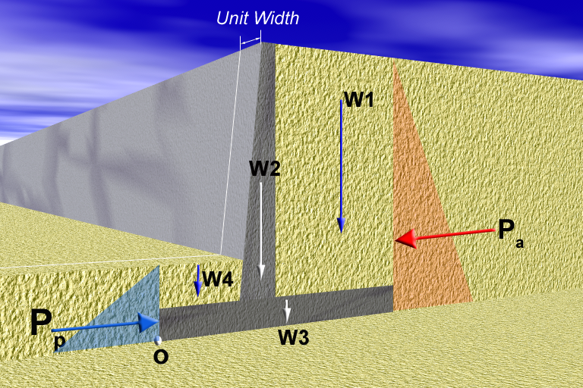
I. External Stability
3- Bearing Capacity Failure
q_{min}
q_{max}
B
Kamal Tawfiq

Slide 10
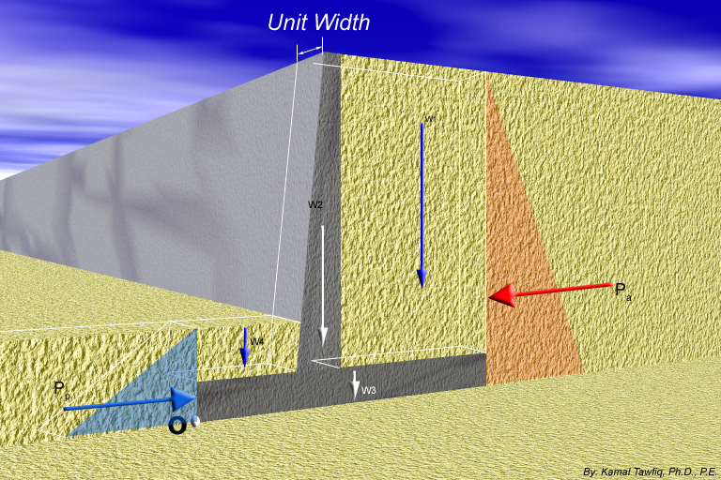
q_{all}
3- Check for Bearing Capacity Failure
Factor of Safety Against Bearing Capacity Failure =
q_{max}
q_{min} = 0
√
q_{max}
+
q_{min} = +
√
q_{min} = 0
q_{max}
+
X
q_{max}
+
1
-
q_{min} = -
q_{max}
+
q_{min} = +
q_{max}
+
ΣV
2
-
q_{min} = -
R
q_{max}
+
3
L
B/3
X
3
1
2
L/3
B
ΣH
q_{min}
Kern
B
q_{max}
e
x
V = sum of all vertical loads
ΣH = sum of all horizontal loads
R = (ΣV)² ⁺ (ΣH)²
M_{net} = ΣM_{R} – ΣM_{D}
ΣV X =
B
e = - X
2
M_{net}
ΣV
M_{net} y
q
ΣV
(
+
6e
)
+
=
1
-
q =
A
-
I
max
B
B
min
Kamal Tawfiq

Slide 11
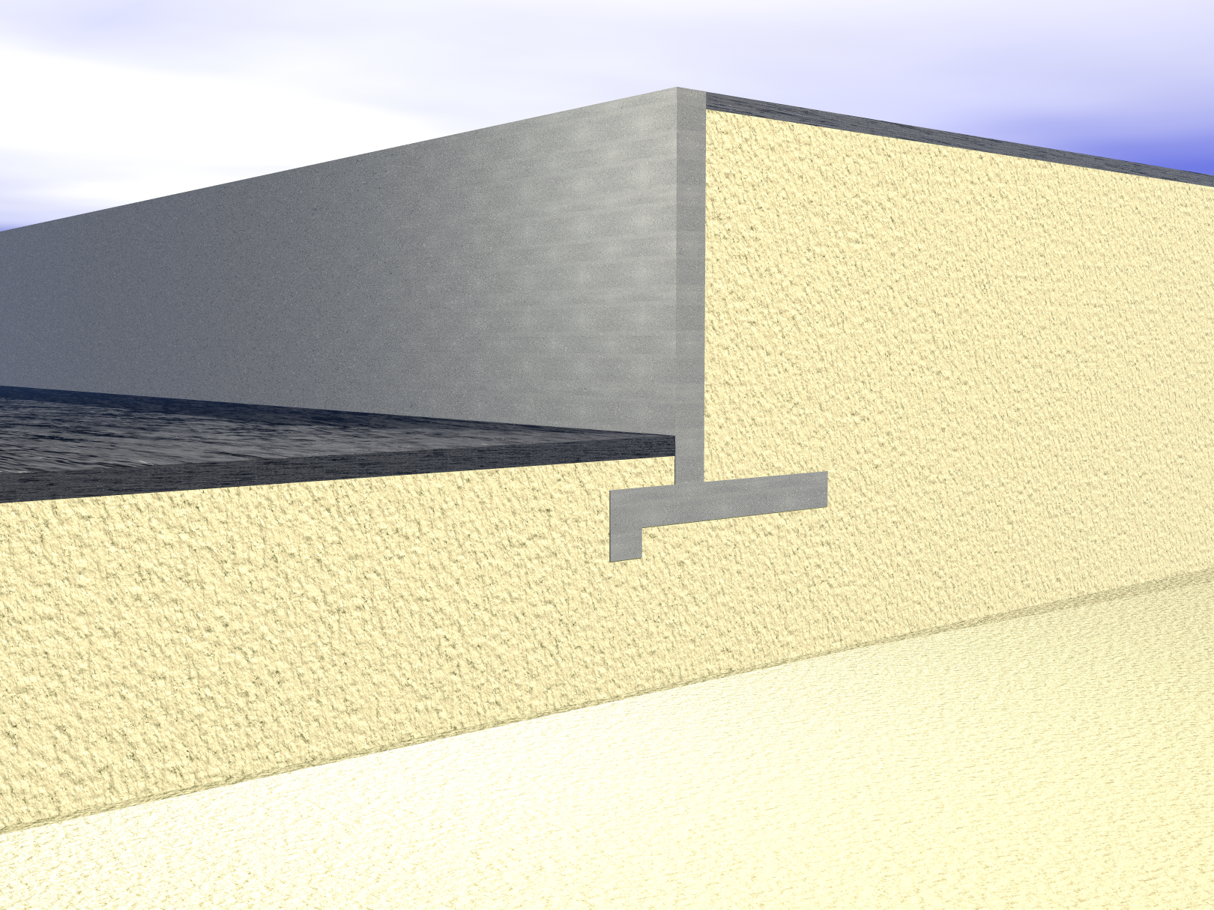
Retaining wall with a key at the base:
x₂
Pavement
W₂
x₃
x₁
Sand
γ =
φ =
Cantilever Retaining Wall
H
P₁
W₃
x₄
W₁
x₅
P₂
W₅
Y₁
Pavement
Y₂
W₆
P₄
W₄
D
P₃
D/2
D/3
W₇
F = Friction
Sand
γ =
φ =
O
x₇
Surcharge
Stem
Backfill
Toe
Heel
key
Kamal Tawfiq

Slide 12
Using Key at the Base to Improve Sliding Resistance
Extent of the Passive
Pressure
Key
Friction Surface of along the Base
Kamal Tawfiq

Slide 13
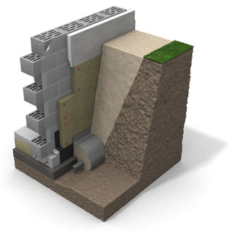
Masonry wall
Coarse soil
insulate the footing externally
In situ soil
Plain
concrete
or
4” gravel
Geofabric
Geofabric
French drain

Slide 14
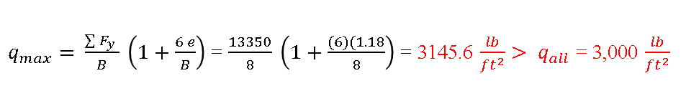

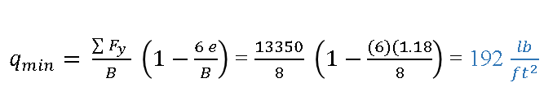
Active Earth Pressure in φ − Soil
3 ft
Rigid Wall
Example -1
q_{max} = +
+
q_{min} = 0
Δ = 0
1
q_{min} = +
Given:
Vertical retaining wall (Rigid)
Wall height (H) = 12 ft
Backfill unit weight (γ) = 115 pcf
Angle of soil friction (φ) = 30º
Assume wall to be smooth
Angle of friction between the base and the soil δ = 20º
Determine:
The stability of the wall
Solution:
q_{max} = +
+
2
-
q_{min} = -
x₁ = 6.33’
γ = 115 pcf
φ = 30º
q_{max} = +
+
3
B/3
H = 12 ft
L
L/3
W1
P_{a}=γ H k_{o}
3
1
2
x₃ = 1.5’
2
B
1- Factor of Safety Against Sliding
FS_{(sliding)} = $\frac{\sum{V\tan\left(20\right)+Pp}}{Pa}$ P_{p} = 0
= $\frac{[\left(13350\right)\tan{20o]}}{4140}=1.2>1.5 Not OK$
2- Factor of Safety Against Overturning
FS_{(overturning)} = $\frac{\sum{M_{R}}}{M_{D}}$ = $\frac{50908.5}{16560}=3.1>2 OK$
x₂ = 4.66’
W3
y_{a} = 4’
W2
σ_{h} = σ_{v}k_{o}
σ_{h} = σ_{v} k_{o} For Rigid Wall use k_{o}
O
Friction
P_{o} = 0.5 γ H² k_{o}
8 ft
K_{o}
1 - sinφ
=
P_{o} = 0.5x115x12²x0.5 = 4,140 lb/ft
3- Factor of Safety Bearing Capacity Failure = FS_{(BC)}
X - Force (lb)/ft) | Vertical Distance (ft) | F_{y} (lb)/ft | Moment Arm X (ft) | Driving Moment (ft.lb)/ft | Resisting Moment (ft.lb)/ft
P_{a}= 4,140 | 4 |  |  | 4,140 x 4 = 16,560
 |  | W₁= 0.5x5x12x115 = 3,450 | 6.33 |  | 3,450x6.33=21,838.5
 |  | W₂ =0.5x5x12x150 = 4,500 | 4.66 |  | 4,500x4.66 = 20,970
 |  | W₃ = 3x12x150 = 5400 | 1.5 |  | 5,400 x 1.5 = 8,100
P_{p} = 0 | 0 |  |  |  | o
 |  | 13,350 |  | 16,560 | 50,908.5
M_{net} = ∑M_{R} - ∑M_{D} = 50908.5 -13350 = 37558.5 ft.lb/ft
M_{net} = 37,558.5 = ∑F_{y}(X) = 13350 (X)
X = (M_{net} / ∑F_{y} ) = 2.81 ft
e = (8/2) – 2.81 = 1.18 ft < B/6 or 8/6 = 1.33 (Full contact)
$q_{max}= \frac{\sum{F_{y}} }{B} \left(1+\frac{6 e}{B}\right)$ = $\frac{13350}{8} \left(1+\frac{(6)(1.18}{8}\right)$ = 3145.6 $\frac{lb}{{ft}^{2}}> q_{all}$ = 3,000 $\frac{lb}{{ft}^{2}}$
$q_{min}= \frac{\sum{F_{y}} }{B} \left(1−\frac{6 e}{B}\right)$ = $\frac{13350}{8} \left(1−\frac{(6)(1.18}{8}\right)$ = 192 $\frac{lb}{{ft}^{2}}$
Kamal Tawfiq

Slide 15
Active & Passive Earth Pressure in φ − Soil
Example -2
Given:
Vertical retaining wall (flexible)
Wall height (H) = 12 ft
Backfill unit weight (γ) = 115 pcf
Angle of soil friction (φ) = 30º
Assume wall to be smooth
γ_{concrete} = 150 lb/ft³
D = 4 ft
Find:
Resultant Force of the Wall
Solution:
t = 1 ft
W
H=12 ft
D = 4 ft
P_{a}=0.5 H² γ k_{a}
P_{p}= 0.5 D² γ k_{p}
L = 4 ft
σ_{h} = σ_{v} k_{p}
σ_{h} = σ_{v} k_{a}
σ_{h} = σ_{v} k_{a}
B = 8 ft
1 - sinφ
1+ sinφ
K_{a}
=
K_{p}
=
1 + sinφ
1- sinφ
P_{a} = 0.5 γ H² k_{a}
P_{p} = 0.5 D² γ k_{p}
P_{a} = 0.5 x 12² x115x 0.33 = 2,732.4 lb/ft²
P_{p} = 0.5x 4² x115x3 = 2,760 lb/ft²
Kamal Tawfiq

Slide 16
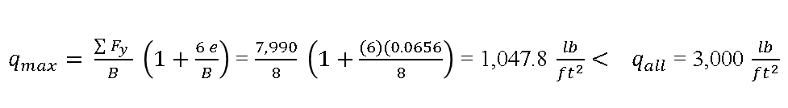
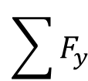
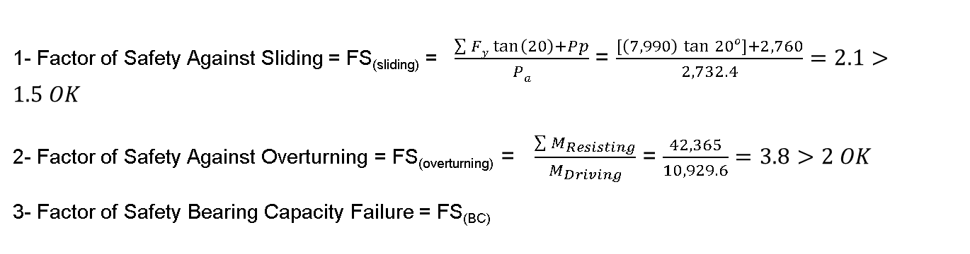


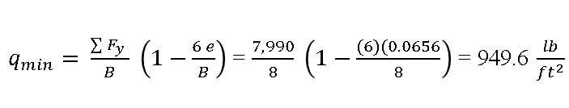
t = 1 ft
F_{x} (lb)/ft | Y (ft) | F_{y} (lb)/ft | Moment Arm X (ft) | Driving Moment (ft.lb)/ft | Resisting M (ft.lb)/ft
P_{a}= 2,732.4 | 4 |  |  | 2,732.4x4 = 10,929.6
 |  | W₁= 4x10x115 = 4,600 | 6 |  | 4600x6=27,600
 |  | W₂ =1x10x150 = 1,500 | 3.5 |  | 1,500x3.5=5,250
 |  | W₃ = 8x1x150=1,200 | 4 |  | 1,200x4=4,800
 |  | W₄ =2x3x115 = 690 | 1.5 |  | 690x1.5= 1,035
P_{p}= 2,760 | 1.33 |  |  |  | 2,760x1.33= 3,680
 |  | 7,990 |  | 10,929.6 | 42,365
q_{max}
+
q_{min} = 0
1
q_{min} = +
q_{max}
+
2
-
q_{max}
q_{min} = -
W₁
+
3
L
B/3
R
3
1
2
L/3
W₂
B
P_{a}= 2,732.4 lb/ft²
h = 2 ft
P_{p}= 2,760 lb/ft²
W₄
Y_{a} = 4 ft
∑F_{y}
L = 4 ft
1- Factor of Safety Against Sliding = FS_{(sliding)} = $\frac{\sum{Fy\tan\left(20\right)+Pp}}{Pa}$ = $\frac{[\left(7,990\right)\tan{20o]+2,760}}{2,732.4}=2.1>1.5 OK$
2- Factor of Safety Against Overturning = FS_{(overturning)} = $\frac{\sum{M_{Resisting}}}{M_{Driving}}$ = $\frac{42,365}{10,929.6}=3.8>2 OK$
3- Factor of Safety Bearing Capacity Failure = FS_{(BC)}
∑F_{x}
O
Friction
= (∑V)tanδ
W₃
B = 8 ft
X
e
$$\sum{F_{y}}$$
M_{net} = ∑M_{r} - ∑M_{o} = 42,365 -10,929.6 = 31,435.4 ft.lb/ft
M_{net} = 31,435.4 = ∑F_{y}(X) = 7,990.(X)
X = (M_{net} / ∑F_{y} ) = 3.93 ft
e = (8/2) – 3.93 = 0.0656 ft < B/6 or 8/6 = 1.33 (Full contact)
e
O
x
q_{min}
q_{max}
+
Kern
$q_{max}= \frac{\sum{F_{y}} }{B} \left(1+\frac{6 e}{B}\right)$ = $\frac{7,990}{8} \left(1+\frac{(6)(0.0656}{8}\right)$ = 1,047.8 $\frac{lb}{{ft}^{2}}< q_{all}$ = 3,000 $\frac{lb}{{ft}^{2}}$
B/3
$q_{min}= \frac{\sum{F_{y}} }{B} \left(1−\frac{6 e}{B}\right)$ = $\frac{7,990}{8} \left(1−\frac{(6)(0.0656}{8}\right)$ = 949.6 $\frac{lb}{{ft}^{2}}$
O
L/3
$q_{max}$ = 1,047 $\frac{lb}{{ft}^{2}}$
+
$q_{min}$ = 949.6 $\frac{lb}{{ft}^{2}}$
x
e
B = 8 ft

Slide 17
Example 1
Given
The cross section of a cantilever retaining wall is shown in Figure 1. Calculate the factors of safety with respect to overturning, sliding, and bearing capacity.
Solution
From the figure,
H* = H₁ + H₂ + T₁ = 8 tan 10° + 19.5 + 2 = 22.91 ft
The Rankine active force per unit length of wall =
q = 120 lb/ft
1 ft
10º
3
H₁ = 1.41 ft
a₁
W₁
W₃
γ₁ = 115 lb/ft³
φ₁ = 30º
c₁ = 0
a₃
P_{v1}
H₂ = 19.5 ft
a₂
P_{a1}
a_{v}
W₂
P_{v}
10º
P_{h1}
a₄
4
2
P_{v2}
P_{a2}
10º
P_{h2}
a₆
6
W₄
W₆
y_{a}
4.5 ft
a₅
W₅
5
T₁ = 2 ft
O
γ₂ = 112 lb/ft³
φ₂ = 20º
c₂ = 800 lb/ft²
2.25 ft
2.25 ft
8 ft

Slide 18
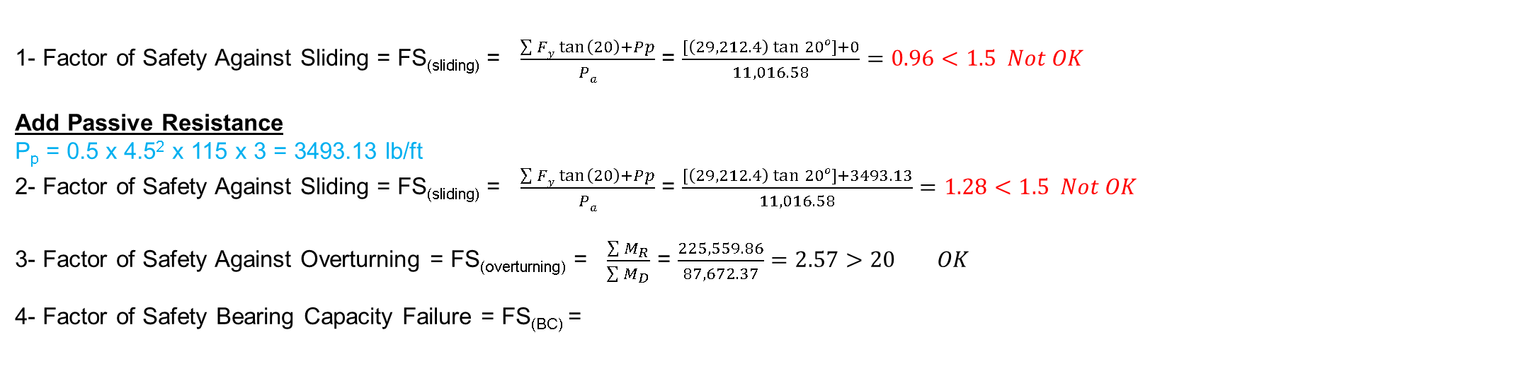
Driving Pressure (lb/ft²)/ft | Resisting Pressure (lb/ft²)/ft | Weight/Unit Length (lb/ft) | Moment Arm from Point O (ft) | Driving Moment (ft.lb/ft) | Resisting Moment (ft.lb/ft)
P_{h1} = 920.13 |  |  | 11.45 | 920.13x11.45 = 10535.49
P_{h2} = 10096.45 |  |  | 7.64 | 10096.45x7.64 = 77136.88
 |  | W₁ = 120 x 8 = 960 | 8.5 |  | 960x8.5 = 8,160
 |  | W₂ = 8X19.2X112 = 17,203.2 | 8.5 |  | 17,203.2x8.5 = 146,227.2
 |  | W₃ = 0.5X1.41X8X112 = 631.7 | 9.83 |  | 631.7x9.83 = 6,209.6
 |  | W₄ = 1X19.5X150 = 2,925 | 4.0 |  | 2925x4 = 11,700
 |  | W₅ = 12.5X2X150 = 3,750 | 6.25 |  | 3750x6.25 = 23,437.5
 |  | W₆ = 0.5X1.25X19.2X150 = 1,800 | 3.08 |  | 1800x3.08 = 5,544
 |  | ∑Pv = 162.24+1780.28 = 1,942.52 | 12.5 |  | 1942.52x12.5 = 24,281.5
∑P_{h} = 11,016.58 | 0 | ∑ F_{y} = 29,212.4 |  | ∑M_{D} = 87,672.37 | ∑M_{R} = 225,559.86
1- Factor of Safety Against Sliding = FS_{(sliding)} = $\frac{\sum{Fy\tan\left(20\right)+Pp}}{Pa}$ = $\frac{[\left(29,212.4\right)\tan{20o]+0}}{11,016.58}=0.96<1.5 Not OK$
Add Passive Resistance
P_{p} = 0.5 x 4.5² x 115 x 3 = 3493.13 lb/ft
2- Factor of Safety Against Sliding = FS_{(sliding)} = $\frac{\sum{Fy\tan\left(20\right)+Pp}}{Pa}$ = $\frac{[\left(29,212.4\right)\tan{20o]+3493.13}}{11,016.58}=1.28<1.5 Not OK$
3- Factor of Safety Against Overturning = FS_{(overturning)} = $\frac{\sum{M_{R}}}{\sum{M_{D}}}$ = $\frac{225,559.86}{87,672.37}=2.57>20 OK$
4- Factor of Safety Bearing Capacity Failure = FS_{(BC)} =
Kamal Tawfiq

Slide 19
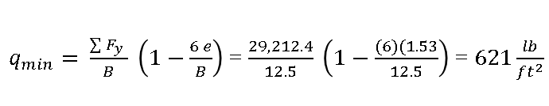
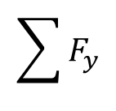
M_{net} = ∑M_{R} - ∑M_{D} = 225,559.86 - 87,672.37 = 137,887.5 ft.lb/ft
M_{net} = 137,887.5 = ∑F_{y}(X) = 29,212.4 (X)
X = (M_{net} / ∑F_{y} ) = 4.72 ft
e = (12.5/2) – 4.72 = 1.53 ft < B/6 or 12.5/6 = 2.083 (Full contact)
q = 120 lb/ft
10º
3
H₁ = 1.41 ft
W₁
W₃
γ₁ = 115 lb/ft³
φ₁ = 30º
c₁ = 0
$q_{max}= \frac{\sum{F_{y}} }{B} \left(1+\frac{6 e}{B}\right)$ = $\frac{29,212.4}{12.5} \left(1+\frac{(6)(1.53)}{12.5}\right)$ = 4053.28 $\frac{lb}{{ft}^{2}}> q_{all}$ = 3,000 $\frac{lb}{{ft}^{2}}$ No good
P_{v1}
H₂ = 19.5 ft
$q_{min}= \frac{\sum{F_{y}} }{B} \left(1−\frac{6 e}{B}\right)$ = $\frac{29,212.4}{12.5} \left(1−\frac{(6)(1.53}{12.5}\right)$ = $621\frac{lb}{{ft}^{2}}$
P_{a1}
$$\sum{F_{y}}$$
W₂
P_{v}
10º
P_{h1}
e
4
2
P_{v2}
P_{a2}
x
10º
P_{h2}
O
6
W₄
q_{min} = 621 lb/ft²
R
q_{max} ⁼
4053.28 lb/ft²
+
∑F_{y}
y_{a}
W₆
4.5 ft
a₅
W₅
5
T₁ = 2 ft
B/3
O
∑F_{x}
L = 1 ft
γ₂ = 112 lb/ft³
φ₂ = 20º
c₂ = 800 lb/ft²
O
2.25 ft
2.25 ft
8 ft
x
e
B = 12.5 ft
Kern
Kamal Tawfiq

Slide 20
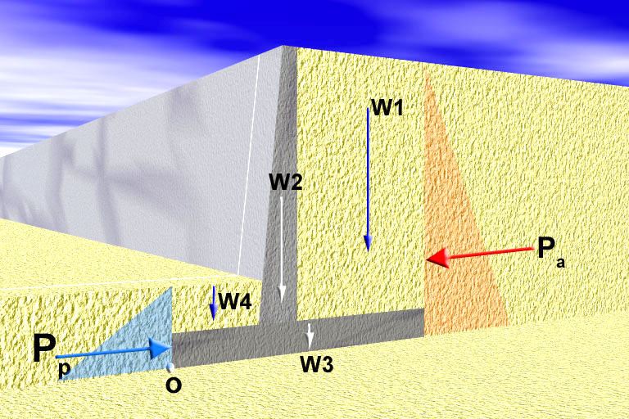
I. External Stability
Factor of Safety Against Sliding =
Resisting Force
=
F_{R}
1- Sliding
Driving Force
F_{D}
δ = 0.5 to 2/3 φ
Cohesion
Friction = (∑W) tan δ + B.c
B
If the soil is cohesive, add (BC) to the shear resistance
F_{D} = P_{a}
F_{R} = P_{p} + Friction
By: Kamal Tawfiq

Slide 21
I. External Stability
Factor of Safety Against Sliding =
Resisting Moment
=
M_{R}
2- Overturning
Driving Moment
M_{D}
Resisting Moment
M_{R}
Driving Moment
M_{D}
a₁
a₂
a₄
y_{a}
a₃
y_{p}
B
Moment About o
M_{D} = P_{a} . y_{a}
M_{R} = P_{p}.y_{p} + W₁ a₁ + W₂ a₂ +W₃ a₃ +W₄ a₄
By: Kamal Tawfiq

Slide 22
I. External Stability
3- Bearing Capacity Failure
q_{min}
q_{max}
B
Kamal Tawfiq

Slide 23
q_{all}
3- Check for Bearing Capacity Failure
Factor of Safety Against Bearing Capacity Failure =
q_{max}
q_{min} = 0
√
q_{max}
+
q_{min} = +
√
q_{min} = 0
q_{max}
+
X
q_{max}
+
1
-
q_{min} = -
q_{max}
+
q_{min} = +
q_{max}
+
ΣV
2
-
q_{min} = -
R
q_{max}
+
3
L
B/3
X
3
1
2
L/3
B
ΣH
q_{min}
Kern
B
q_{max}
e
x
V = sum of all vertical loads
ΣH = sum of all horizontal loads
R = (ΣV)² ⁺ (ΣH)²
M_{net} = ΣM_{R} – ΣM_{D}
ΣV X =
B
e = - X
2
M_{net}
ΣV
M_{net} y
q
ΣV
(
+
6e
)
+
=
1
-
q =
A
-
I
max
B
B
min
Kamal Tawfiq

Slide 24
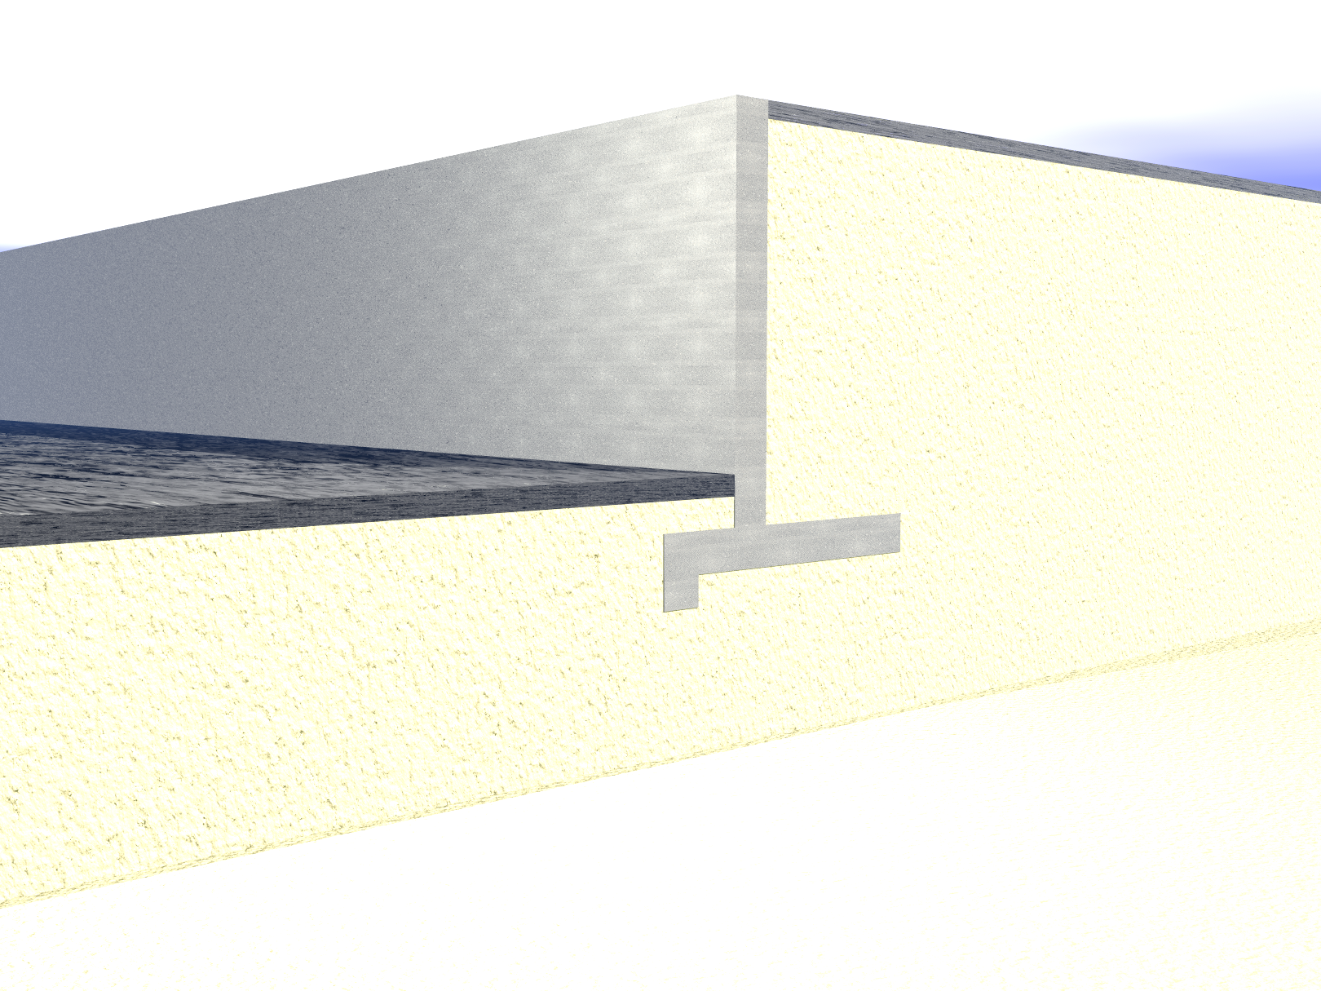
Retaining wall with a key at the base:
x₂
Pavement
W₂
x₃
x₁
Sand
γ =
φ =
Cantilever Retaining Wall
H
P₁
W₃
x₄
W₁
x₅
P₂
W₅
Y₁
Pavement
Y₂
W₆
P₄
W₄
D
P₃
D/2
D/3
W₇
F = Friction
Sand
γ =
φ =
O
x₇
Surcharge
Stem
Backfill
Toe
Heel
key
Kamal Tawfiq

Slide 25
Design of Cantilever Retaining Wall (External Stability)
1- Sliding Stability
2- Overturning Stability
3- Foundation Stability
4- Overall Stability
Kamal Tawfiq

Slide 26
Design of Cantilever Retaining Wall (External Stability)
1- Sliding Stability
2- Overturning Stability
3- Foundation Stability
4- Overall Stability
Kamal Tawfiq

