Slide 1
Slope Stability Analysis
for Landfills and Embankments
Geotechnical Design
CGN 4801
By
Kamal Tawfiq, Ph.D., P.E.

Slide 2
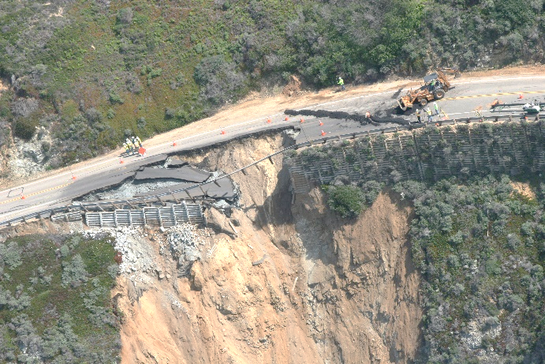
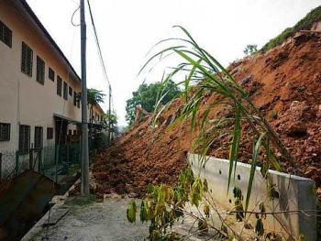
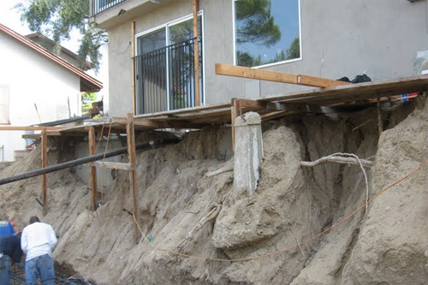
Slope Stability Analysis and Design
Slope stability analysis is performed to assess the safe design of a human-made or natural slopes (e.g. embankments, road cuts, open-pit mining, excavations, landfills etc.) and the equilibrium conditions.
The main objectives of slope stability analysis are finding endangered areas, investigation of potential failure mechanisms, determination of the slope sensitivity to different triggering mechanisms, designing of optimal slopes with regard to safety, reliability and economics, designing possible remedial measures, e.g. barriers and stabilization.

Slide 3
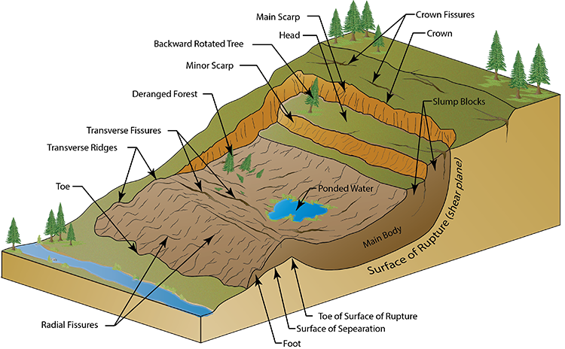
FACTORS AFFECTING SLOPE STABILITY
1- Soil Type
2- Geometry of the cross section (Height, slope angle, etc.)
3- Moisture Content
4- Pore water pressure
5- Additional loads
6- Shear Strength reduction
7- Vibrations and Earthquake
By Kamal Tawfiq, Ph.D., P.E.

Slide 4
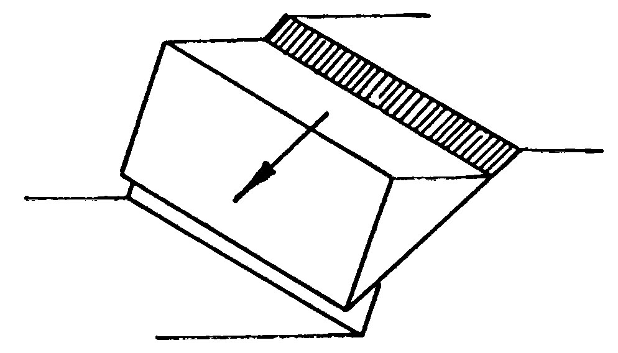
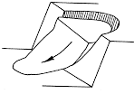
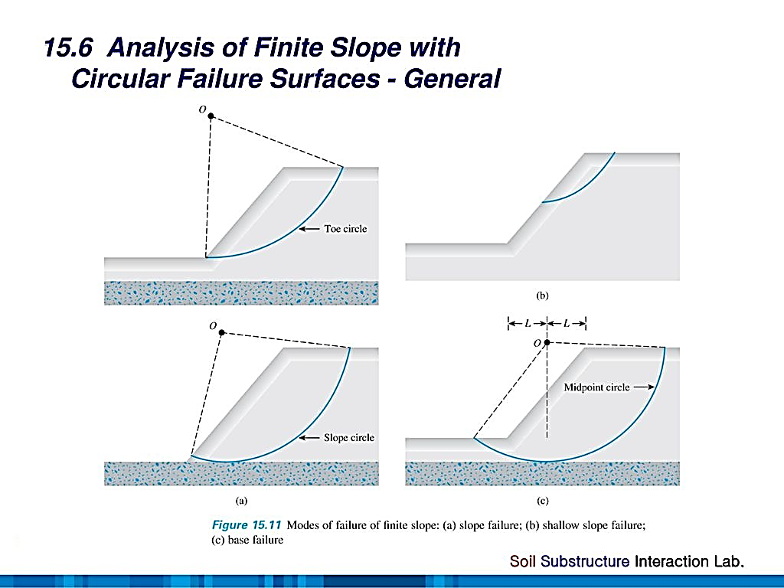
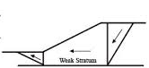
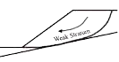
To Analyze and Design Slopes:
Depth
1- Planar Failures (Determinate Problems)
Infinite Failures Small depth, Long failure surface
Finite Slope Failures Simple wedge
H
β
H
β
2- Circular Failures (Determinate & Indeterminate Problems)
Above Toe
Through Toe
Deep seated
3- Wedge Failures Multiple Planer Failure
4- Complex Failures Combination of Planar & Circular

Slide 5
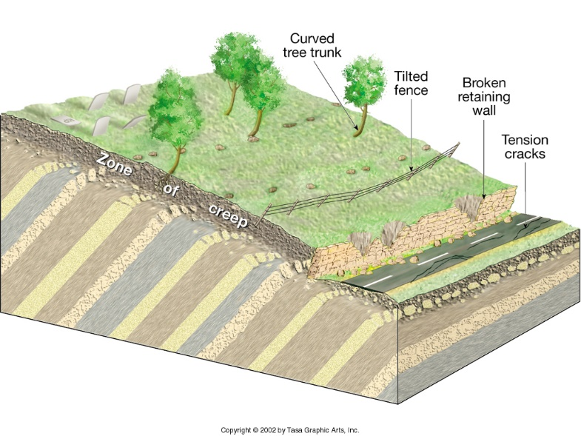
1. Planar Failures
The Concept of Developed Friction
Driving Force = T = W . sinβ
Developed Friction
Resisting Force = F = N tanδ = (W.cosβ) tanδ
F.S. = F_{resisting}/F_{driving}
T
Resisting Force
W
N
F.S. = 2.5 =
Driving Force
Friction = N tan δ_{developed}
β
F.S. = 1 =
Resisting Force
Driving Force
On the verge of failure

Slide 6
INFINITE SLOPE
I. PLANAR FAILURE or Transitional Failure
H
b = 1 cosβ
A- Dry Soil (ϕ soil)
1
b = 1 cosβ
β
W = γ H cosβ
Normal Component, F_{V} = W cos β
Driving Force, F_{D} = W sin β
β
Failure
Surface
H
Weight = W
τ = N tanϕ
Shear Resistance
N = Fv = W cos β
By Kamal Tawfiq, Ph.D., P.E.

Slide 7
A- Dry Soil (ϕ soil)
W = γ H cosβ
b = 1 cosβ
Driving Force = F_{D} = γ H cos β sinβ
Resisting Force = F_{R} = γ H cos β cosβ tanϕ
FS = F_{R}/F_{D}
G.S.
β
γ H cos β cosβ tanϕ
b = 1 cosβ
FS =
1
γ H cos β sinβ
tanϕ
FS =
β
tanβ
Normal Component, F_{V} = W cos β
Driving Force, F_{D} = W sin β
β
Failure
Surface
H
Weight = W
τ = N tanϕ
N = Fv = W cos β
By Kamal Tawfiq, Ph.D., P.E.

Slide 8
B- Submerged Soil (ϕ soil)
W = γ H cosβ
_
Driving Force = F_{D} = γ H cos β sinβ
Resisting Force = F_{R} = γ H cos β cosβ tanϕ
FS = F_{R} / F_{D}
_
W.T
_
G.S.
γ H cos β cosβ tanϕ
FS =
_
b = 1 cosβ
γ H cos β sinβ
1
tanϕ
FS =
β
tanβ
Normal Component, F_{V} = W cos β
Driving Force, F_{D} = W sin β
H
β
Failure
Surface
Weight = W
τ = N tanϕ
N = Fv = W cos β

Slide 9
C- Seepage Parallel to Slope (ϕ soil)
Pore Water Pressure (u)
tanϕ
γ_{w} Z
FS =
(1-
)
tanβ
γ_{soil}H cos²β
G.S.
Seepage
b = 1 cosβ
1
Z = Pressure Head
What is Pressure Head?
What is Total Head?
What is Elevation Head?
Total Head = Elevation Head+ Pressure Head
Go to Next Page
Normal Component, N_{eff} = (W – u) cos β
β
Driving Force, F_{D} = W sin β
H
β
Failure
Surface
Weight = W
τ = N_{eff} tanϕ
N_{eff} = (W-u) cos β
By Kamal Tawfiq, Ph.D., P.E.

Slide 10
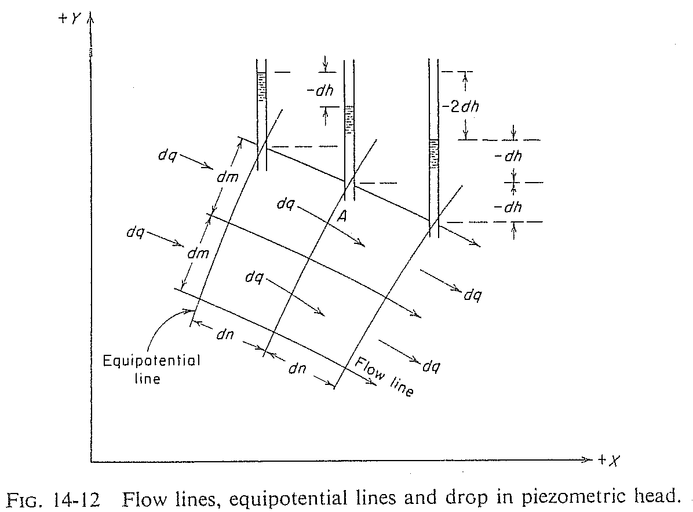
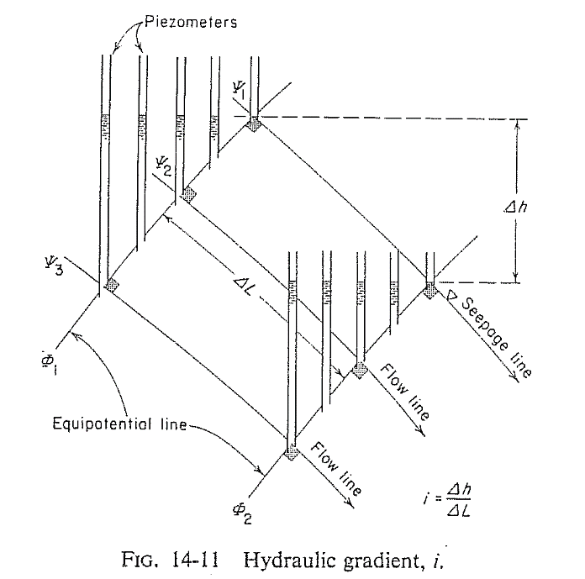
Total Head, Elevation Head and Pressure Head
Total Head = Elevation Head+ Pressure Head
Head Loss
Pressure
Head
Elevation
Head
phreatic line
Atmospheric Pressure Line
Flow Line
Ground Surface
Flow Line
Datum
Flow Line
Failure Surface
Pressure
Head
Elevation
Head
Pressure
Head
Pore Water Pressure (u)
=
Pressure head *( γ_{water} )
=
γ z
Elevation
Head
Elevation
Head
Equipotential Line
Datum

Slide 11
For the infinite slope shown below, what is the pore water pressure at point A ?
Z = d_{w} cos α (cos α)
b
Soil Surface
b/cos α
Water Table
Z = Pressure Head
Pore Water Pressure (u) = γ_{water} * γ z
W
Assumed failure surface
d
d_{w}
T
Z
N’
α
d_{w}cos α
Z
A
U
B
α

Slide 12
D- Infinite Slope in c - ϕ soil (with seepage)
c
+
u
tanϕ
FS =
(1-
)
γ_{soil} H cosβ sinβ
γ_{soil} H cos²β
tanβ
If no seepage:
u = 0
If Submerged Slope:
u = 0 γ = γ’
G.S.
b = 1 cosβ
1
Normal Component, F_{V} = W cos β
β
Driving Force, F_{D} = W sin β
H
β
Failure
Surface
Weight = W
τ = C + N tanϕ
N = Fv = W cos β
By Kamal Tawfiq, Ph.D., P.E.

Slide 13
Planar Slope Failure
Infinite Slope
(with seepage)
Critical Height H_{c} at FS = 1
seepage
H
c
+
u
)
tanϕ
= 1
FS =
(1-
β
γ_{soil} H cosβ sinβ
γ_{soil} H cos²β
tanβ
W sinβ
β
W cosβ
c
- u tanϕ
Weight = W
H_{c} =
τ = C + N tanϕ
γ_{soil} cos²β (tanβ - tanϕ)
1
N = Fv = W cos β
Stability Number N_{s} and Pore Water Pressure Ration r_{u}
c
u
Ns =
r_{u} =
= pore water pressure ratio
γHc
γH
c
2
3
c_{dev} =
Developed (d)
or
Mobilized (m)
FS_{c}
General Equation:
c
tanφ
tanφ_{dev} =
H_{c} =
FS_{φ}
γ_{soil} [sinβ cosβ - tanϕ (cos²β - r_{u})]
tanφ
Or
φ_{dev} = tan⁻¹ ( )
FS_{φ}
c_{d}
H =
γ_{soil} [sinβ cosβ - tanϕ_{d} (cos²β - r_{u})]
By Kamal Tawfiq, Ph.D., P.E.

Slide 14
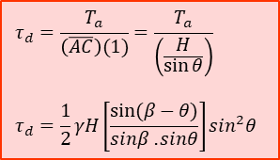
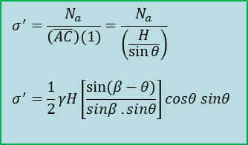

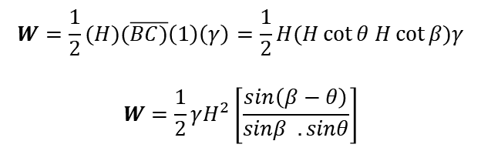

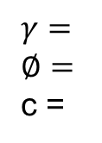

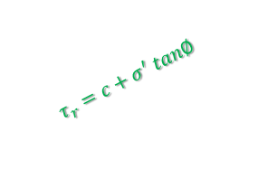

Planar Slope Failure
Finite Slope
$$W=\frac{1}{2}(H)(\overline{BC)}\left(1\right)\left(γ\right)=\frac{1}{2}H(H\cot{θ H\cot{β)γ}}$$
$$W=\frac{1}{2}γH^{2}\left[\frac{sin\left(β−θ\right)}{sinβ . sinθ}\right]$$
N_{a} = normal component = $W\cos{θ}$
T_{a} = tangential component = $W\sin{θ}$
B
C
$$γ=$$
$$∅=$$
c =
N_{a} = W.cosθ
W
T_{a} = W.sinθ
$$τd$$
H
T_{r}
$$τr$$
N_{a} = N_{r}
$$τ_{r}=c+σ^{′} tan∅$$
$$τ_{d}=\frac{T_{a}}{\left(\overline{AC}\right)(1)}=\frac{T_{a}}{\left(\frac{H}{\sin{θ}}\right)}$$
$$τ_{d}=\frac{1}{2}γH\left[\frac{sin⁡(β−θ)}{sinβ . sinθ}\right]\sin^{2}θ$$
β
θ
A
$$σ^{′}=\frac{N_{a}}{\left(\overline{AC}\right)(1)}=\frac{N_{a}}{\left(\frac{H}{\sin{θ}}\right)}$$
$$σ^{′}=\frac{1}{2}γH\left[\frac{sin⁡(β−θ)}{sinβ . sinθ}\right]cosθ sinθ$$

Slide 15

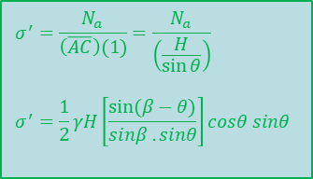
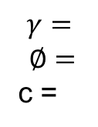
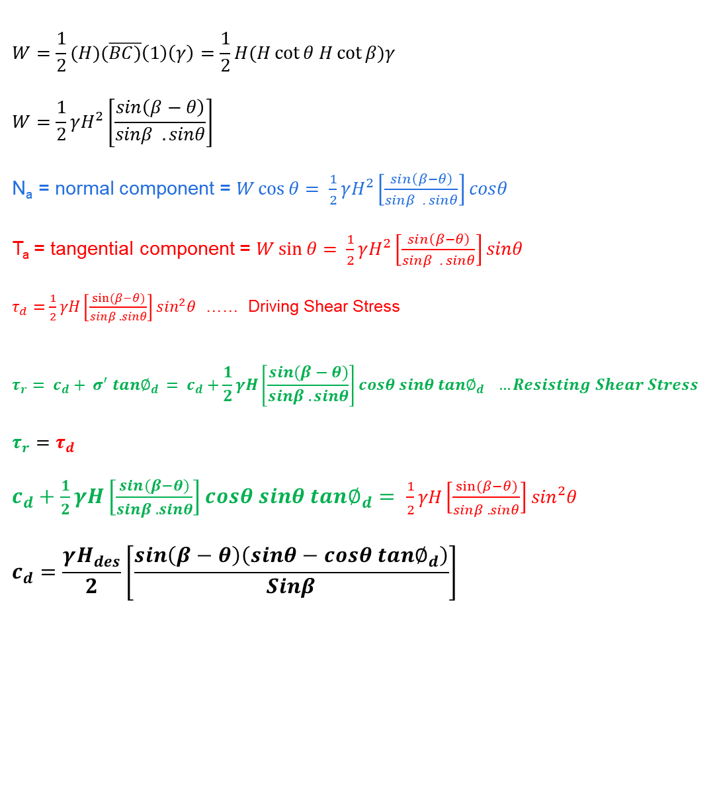
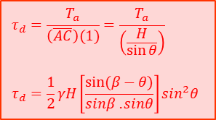
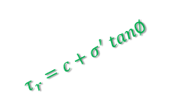

Planar Slope Failure
Finite Slope
B
C
W
N_{a} = W.cosθ
T_{a} = W.sinθ
$$γ=$$
$$∅=$$
c =
$$τd$$
H
T_{r}
$$W=\frac{1}{2}(H)(\overline{BC)}\left(1\right)\left(γ\right)=\frac{1}{2}H(H\cot{θ H\cot{β)γ}}$$
$$W=\frac{1}{2}γH^{2}\left[\frac{sin\left(β−θ\right)}{sinβ . sinθ}\right]$$
N_{a} = normal component = $W\cos{θ}=$ $\frac{1}{2}γH^{2}\left[\frac{sin\left(β−θ\right)}{sinβ . sinθ}\right]cosθ$
T_{a} = tangential component = $W\sin{θ}=$ $\frac{1}{2}γH^{2}\left[\frac{sin\left(β−θ\right)}{sinβ . sinθ}\right]sinθ$
$τ_{d}=\frac{1}{2}γH\left[\frac{sin⁡(β−θ)}{sinβ . sinθ}\right]\sin^{2}θ$ …… Driving Shear Stress
$$τ_{r}= c_{d}+ σ^{′} tan∅_{d }= c_{d}+\frac{1}{2}γH\left[\frac{sin⁡(β−θ)}{sinβ . sinθ}\right]cosθ sinθ tan∅_{d} …Resisting Shear Stress$$
$$τ_{r}{=τ}_{d}$$
$c_{d}+\frac{1}{2}γH\left[\frac{sin⁡(β−θ)}{sinβ . sinθ}\right]cosθ sinθ tan∅_{d}= \frac{1}{2}γH\left[\frac{sin⁡(β−θ)}{sinβ . sinθ}\right]\sin^{2}θ$
$$c_{d}=\frac{γH_{des}}{2}\left[\frac{sin\left(β−θ\right)\left(sinθ−cosθ tan∅_{d}\right)}{Sinβ}\right]$$
$$τr$$
N_{a} = N_{r}
A
β
θ
$$τ_{d}=\frac{T_{a}}{\left(\overline{AC}\right)(1)}=\frac{T_{a}}{\left(\frac{H}{\sin{θ}}\right)}$$
$$τ_{d}=\frac{1}{2}γH\left[\frac{sin⁡(β−θ)}{sinβ . sinθ}\right]\sin^{2}θ$$
$$τ_{r}=c+σ^{′} tan∅$$
$$σ^{′}=\frac{N_{a}}{\left(\overline{AC}\right)(1)}=\frac{N_{a}}{\left(\frac{H}{\sin{θ}}\right)}$$
$$σ^{′}=\frac{1}{2}γH\left[\frac{sin⁡(β−θ)}{sinβ . sinθ}\right]cosθ sinθ$$

Slide 16


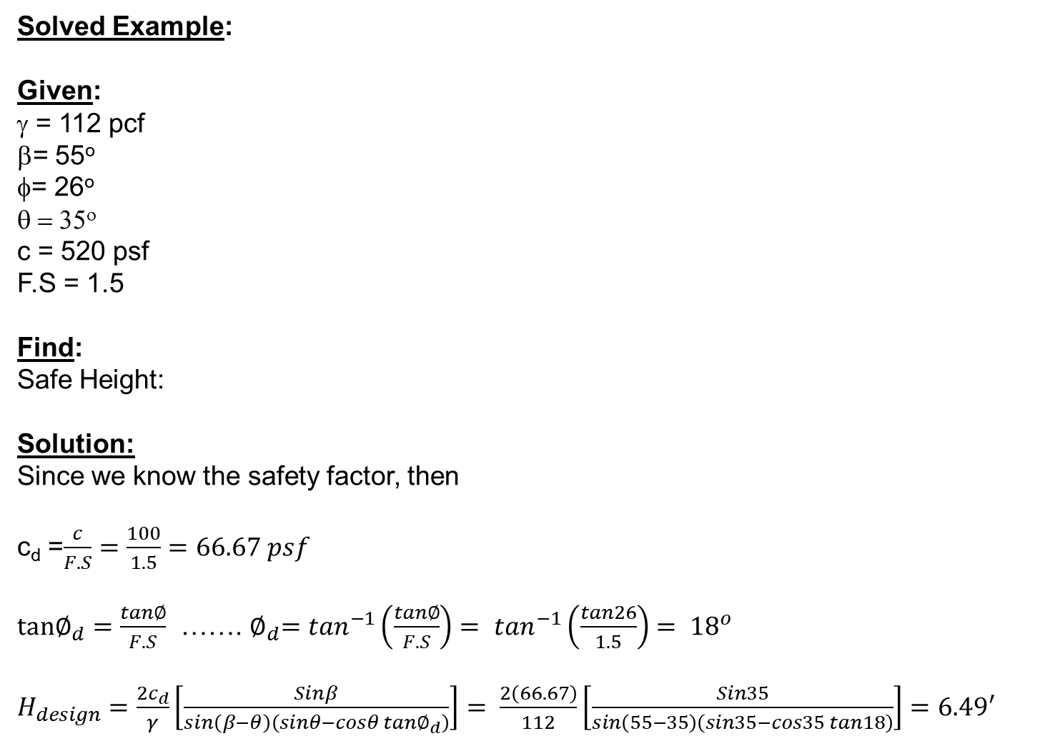
B
C
Solved Example:
Given:
γ = 112 pcf
β= 55º
= 26º
θ = 35^{ο}
c = 520 psf
F.S = 1.5
Find:
Safe Height:
Solution:
Since we know the safety factor, then
c_{d} =$\frac{c}{F.S}=\frac{100}{1.5}=66.67 psf$
$tan∅_{d}=\frac{tan∅}{F.S}$ …….${ ∅}_{d}=\tan^{−1}\left(\frac{tan∅}{F.S}\right)=$ $\tan^{−1}\left(\frac{tan26}{1.5}\right)= {18}^{o}$
$H_{design}=\frac{2c_{d}}{γ}\left[\frac{Sinβ}{sin\left(β−θ\right)\left(sinθ−cosθ tan∅_{d}\right)}\right]= \frac{2\left(66.67\right)}{112}\left[\frac{Sin35}{sin\left(55−35\right)\left(sin35−cos35 tan18\right)}\right]=6.49′$
W
N_{a} = W.cosθ
T_{a} = W.sinθ
$$τd$$
$$γ=$$
$$∅=$$
c =
H
T_{r}
$$τr$$
N_{a} = N_{r}
A
β
θ
$$H_{cr}=\frac{2c}{γ}\left[\frac{Sinβ}{sin\left(β−θ\right)\left(sinθ−cosθtan∅\right)}\right]$$
$$H_{des}=\frac{2c_{d}}{γ}\left[\frac{Sinβ}{sin\left(β−θ\right)\left(sinθ−cosθ tan∅_{d}\right)}\right]$$
$$c_{d}=\frac{γHdes}{2}\left[\frac{sin\left(β−θ\right)\left(sinθ−cosθ tan∅_{d}\right)}{Sinβ}\right]$$

Slide 17

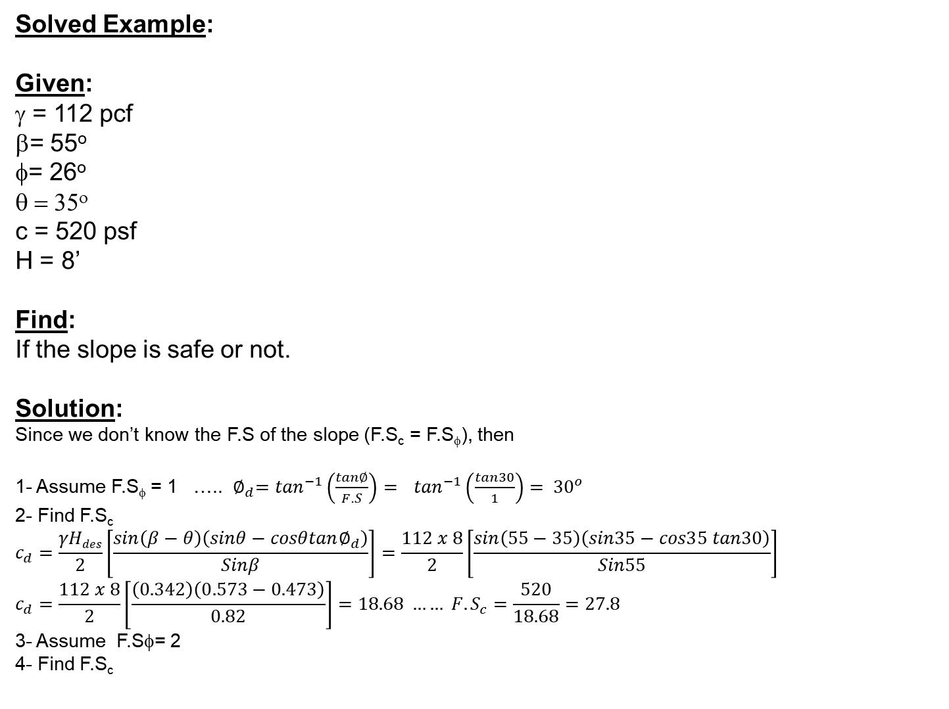
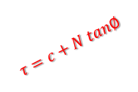
Solved Example:
Given:
γ = 112 pcf
β= 55º
= 26º
θ = 35^{ο}
c = 520 psf
H = 8’
Find:
If the slope is safe or not.
Solution:
Since we don’t know the F.S of the slope (F.S_{c} = F.S_{φ}), then
1- Assume F.S_{φ} = 1 ….. ${ ∅}_{d}=\tan^{−1}\left(\frac{tan∅}{F.S}\right)= \tan^{−1}\left(\frac{tan30}{1}\right)= {30}^{o}$
2- Find F.S_{c}
$$c_{d}=\frac{γHdes}{2}\left[\frac{sin\left(β−θ\right)\left(sinθ−cosθtan∅_{d}\right)}{Sinβ}\right]=\frac{112 x 8}{2}\left[\frac{sin\left(55−35\right)\left(sin35−cos35 tan30\right)}{Sin55}\right]$$
$$c_{d}=\frac{112 x 8}{2}\left[\frac{\left(0.342\right)\left(0.573−0.473\right)}{0.82}\right]=18.68 …… {F.S}_{c}=\frac{520}{18.68}=27.8$$
3- Assume F.Sφ= 2
4- Find F.S_{c}
C
B
$$γ=$$
$$∅=$$
c =
H
F_{d} = W.sinθ
N = W.cosθ
W
$$τ=c+N tan∅$$
A
β
θ
$$H_{cr}=\frac{2c}{γ}\left[\frac{Sinβ}{sin\left(β−θ\right)\left(sinθ−cosθtan∅\right)}\right]$$
$$H_{des}=\frac{2c_{d}}{γ}\left[\frac{Sinβ}{sin\left(β−θ\right)\left(sinθ−cosθtan∅_{d}\right)}\right]$$
$$c_{d}=\frac{γHdes}{2}\left[\frac{sin\left(β−θ\right)\left(sinθ−cosθtan∅_{d}\right)}{Sinβ}\right]$$

Slide 18
Circular Failure Surface (Cohesive Soil)
Determinate Problem
Number of Unknowns = Number of Equilibrium Equations
M_{resisting}
F.S. =
M_{driving}
Center
R
θ
C
B
R
M_{driving} = W₁ . a₁
W₁ = Area (BCDE) . γ_{soil}
R
R
D
a₁
A
W₂
a₂
W₁
c . L
E
M_{resisting} = c . L + W₂ . a₂ = c . (R.θ) R + W₂ . a₂
By Kamal Tawfiq, Ph.D., P.E.

Slide 19
Circular Method in Clayey Soil (φ = 0)
Resisting Moment (M_{R})
Factor of Safety =
Driving Moment (M_{D})
Case 1
center
center
Case 2
Radius = R
Radius = R
θ
a₁
a₂
CG₁
W₁
R.θ
CG₂
W₂
Shear Resistance = C = c L
Yellow Area x Soil Unit Weigh
How to find W₁, W_{2 ,} CG_{1 and} CG₂ ?
Resisting Moment (M_{R}) = W₂ x a₂ + C x R
Refer to your Eng. Mechanics course
Driving Moment (M_{D}) = W₁ x a₁
Green Area x Soil Unit Weigh

Slide 20
Resisting Moment (M_{R})
Factor of Safety =
Driving Moment (M_{D})
center
Radius = R
θ
a₃
A₃
CG₃
Resisting Moment (M_{R}) = W₄ x a₄ + C x R
a₂
Driving Moment (M_{D})=W₁xa₁+W₂xa₂₊+W₃xa₃
CG₂
W₃
a₄
A₂
CG₁
A₁
C = c L
A₄
CG₄
W₂
a₁
W₁
W₄

Slide 21
Circuler Failure Surface in C - φ Soil
Indeterminate Problem
Number of Unknowns ≠ Number of Equilibrium Equations
W varies from point to point. Therefore, N & F will vary from point to point
Center
R
W1
W2

Slide 22
Circuler Failure Surface in C - φ Soil
Indeterminate Problem
Number of Unknowns ≠ Number of Equilibrium Equations
W varies from point to point. Therefore, N & F will vary from point to point
Center
R
W
W cosθ
W sinθ
θ
τ_{r}
φ
N
θ
F
$$τ_{r}=c+σ^{′} tan∅$$

Slide 23
Stability Number
A variety of charted solutions exist for the simple geometry considered above.
For the undrained (total stress) analysis of slopes charts produced by Taylor are often used.
The charts are based on the analysis of circular failure surfaces, and assume that soil strength is given by a Mohr-Coulomb analysis
Tension cracks are not considered

Slide 24
Taylor’s Method
H
nH
DH
αi
By Kamal Tawfiq, Ph.D., P.E.

Slide 25
Taylor’s Chart

Slide 27
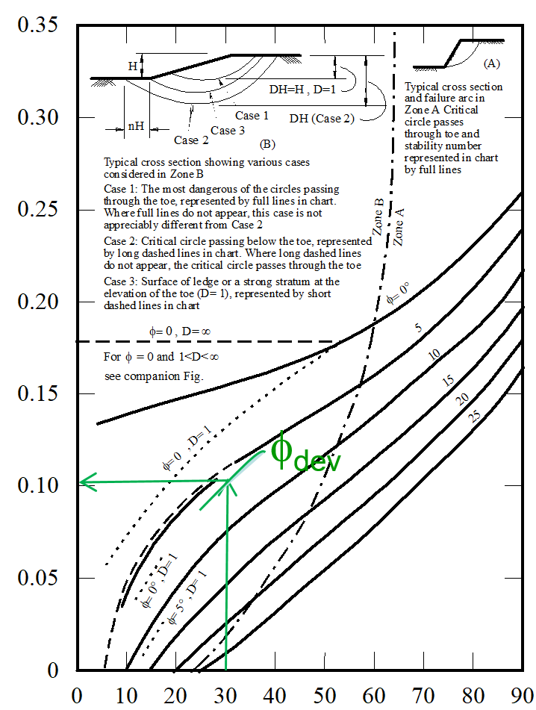
Example 1:
Given:
c_{u} = 20 kN/m²
φ_{u} = 10º
γ_{bulk} = 15 kN/m³
F.S. = 1.5
Find:
Safe Height (H)
H_{design}=?
β=30^{ο}
Solution:
or β=30^{ο}
tan 10º
Use the chart with i = 30º, and φ_{dev} = tan⁻¹ (
)
Stability Number (c / γH)
= 6.7º
1.5
20/1.5
SN = 0.1 =
15 x H_{design}
SN = 0.1
20/1.5
H_{design} = = 8.88 m
15 x 0.1
Slope Angle β (deg)

Slide 28
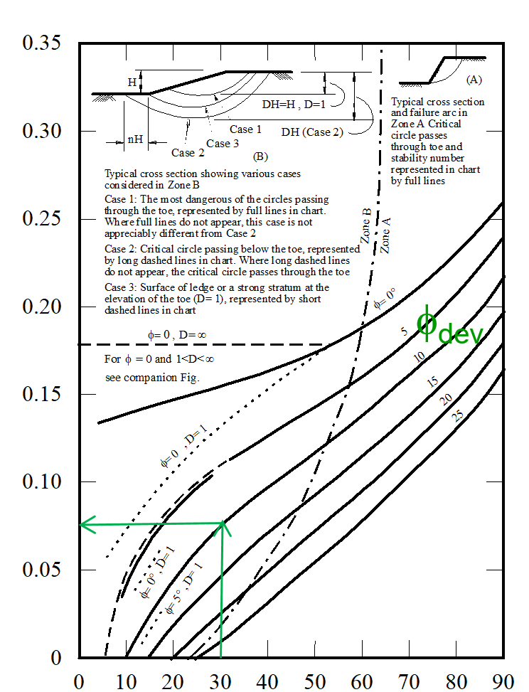
Example 2:
Given:
c_{u} = 20 kN/m²
φ_{u} = 10º
γ_{bulk} = 15 kN/m³
H = 7 m
β= 30º
Find:
F.S.
H= 7m
β=30^{ο}
Solution:
Trial # 1
1- Assume FS_{φ} = 1
Stability Number (c / γH)
tan 10º
2- Use the chart with β = 30º, and φ_{dev} = tan⁻¹ (
)
= 10º
1.0
3- Go to the chart and find SN for φ_{dev} = 10º
SN=0.075
c_{dev}
SN = 0.075 =
15 x 7
4- c_{dev} = 15 x 7 x 0.075 = 7.87 kN/m²
5- FS_{c} = c / c_{dev} = 20 / 7.87 = 2.5
Therefore the Assumed FSφ = the calculated FS_{c}
Slope Angle β (deg)

Slide 29
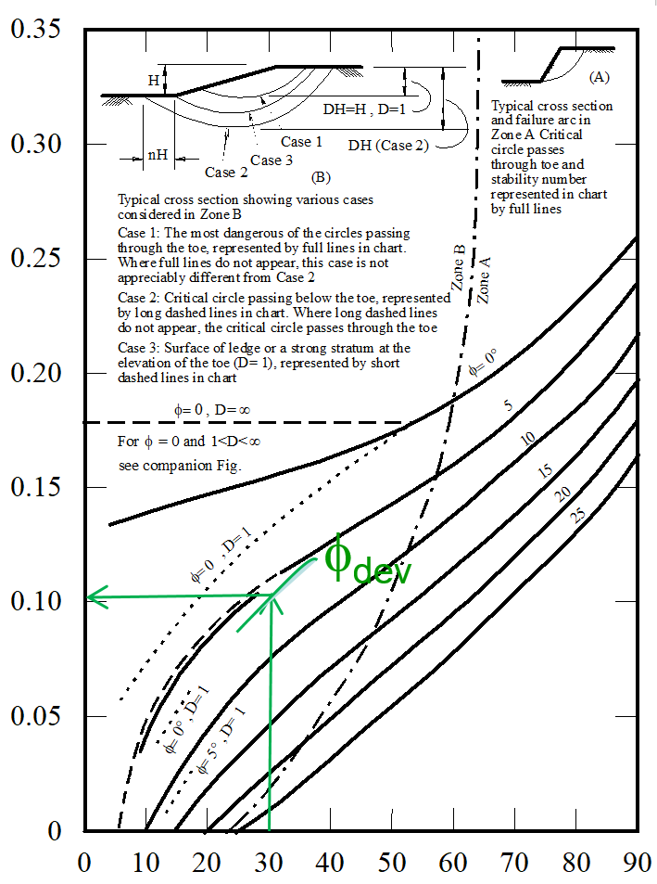
This means the assumed factor of safety was not the right one. So we need
to assume another FSφ and solve the problem again for FS_{c}.
Trial # 2
1- Assume FS_{φ} = 1.5
tan 10º
2- Use the chart with i = 30º, and φ_{dev} = tan⁻¹ (
)
= 6.7º
1.5
3- Go to the chart and find SN for φ_{dev} = 6.7º
c_{dev}
SN = 0.1 =
15 x 7
4- c_{dev} = 15 x 7 x 0.10 = 10.5 kN/m²
5- FS_{c} = c / c_{dev} = 20/10.5 = 1.9
Therefore the Assumed FSφ = the calculated FS_{c}
Stability Number (c / γH)
This means the assumed factor of safety was not the right one. So we need to assume another FSφ and solve the problem again for FS_{c}.
Slope Angle β (deg)

Slide 30
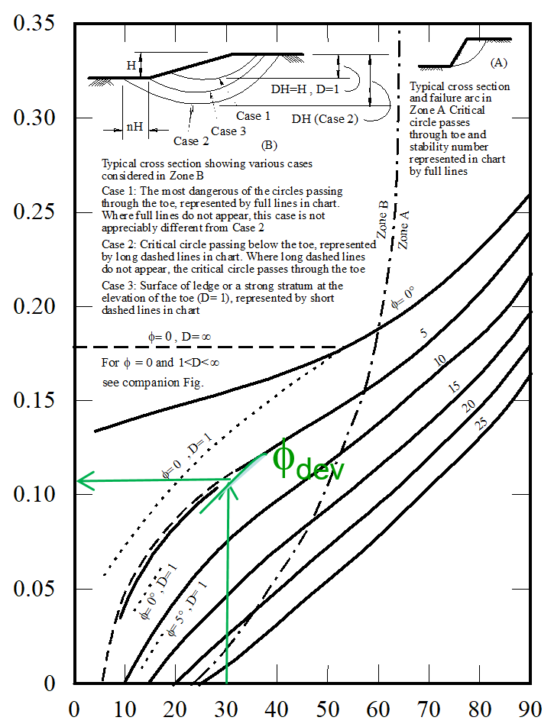
Trial # 3
1- Assume FS_{φ} = 1.8
tan 10º
2- Use the chart with i = 30º, and φ_{dev} = tan⁻¹ (
)
= 5.5º
1.8
3- Go to the chart and find SN for φ_{dev} = 5.5º
c_{dev}
SN = 0.11 =
15 x 7
4- c_{dev} = 15 x 7 x 0.11 = 11.55 kN/m²
5- FSc = c / c_{dev} = 20/11.55 = 1.73
Therefore the Assumed FSφ = the calculated FS_{c}
Stability Number (c / γH)
This means the assumed factor of safety was not the right one. So we need to assume another FSφ and solve the problem again for FS_{c}.
Slope Angle β (deg)

Slide 31
Since we complied three different trials, we are ready to find the right
factor of safety by using the 45º line method
Assumed FSφ Calculated FS_{c}
1.0 2.5
1.5 1.9
1.8 1.73
So the correct FS is 1.75
1.75
1.75

Slide 32
Taylor’s Chart - example
Zones are marked on the chart indicating whether the failure mode will be shallow or deep-seated.
If a deep-seated failure is indicated the soil layer must be sufficiently deep to enable this mechanism to occur.
There is a second chart due to Taylor which can be used when the depth of soil below the base of the slope is limited
This chart is only valid for φ = 0

Slide 33
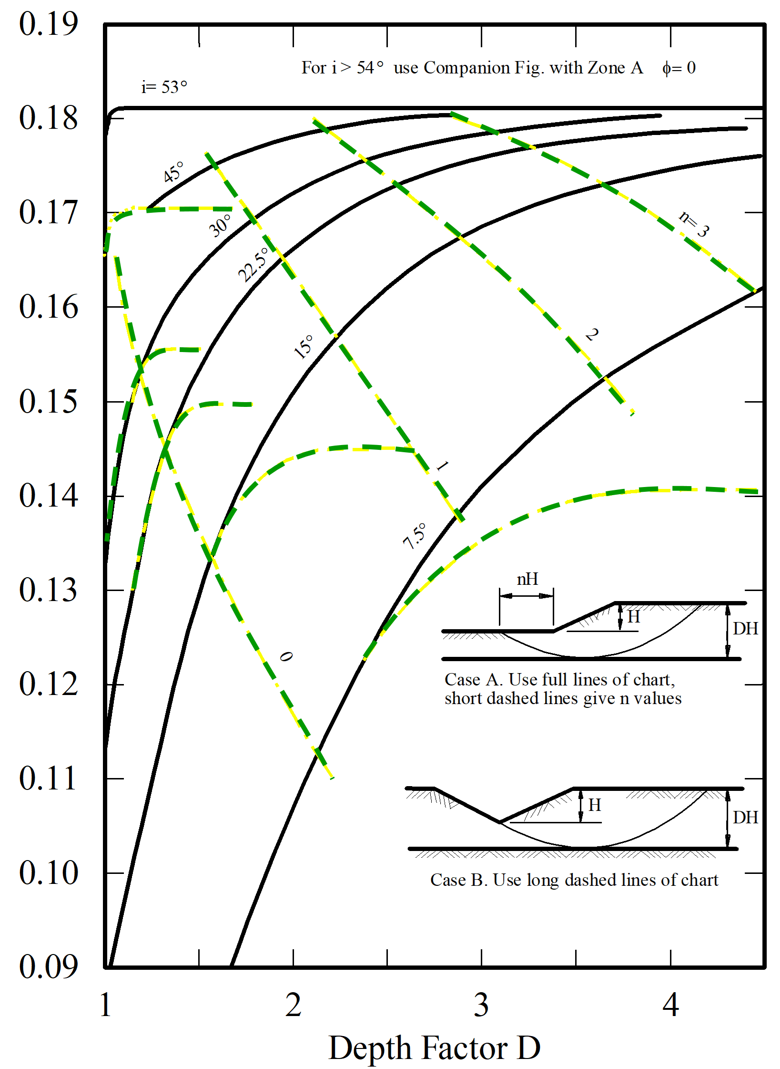
Stability Number (c / γH)

Slide 34
Example 3:
Given:
c_{u} = 20 kN/m²
φ_{u} = 0
γ_{bulk} = 15 kN/m³
F.S. = 1.5
Find:
Calculate the depth factor D
Solution
DH = 8+2 = 10 m
D= 1.25
H= 8m
β=30^{ο}
H= 2m
Rock

Slide 35
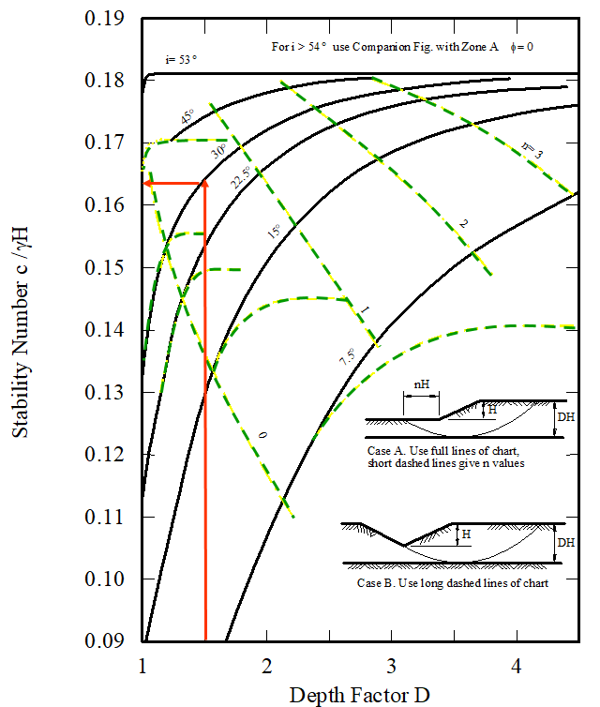
Example 3:
Given:
c_{u} = 20 kN/m²
φ_{u} = 0
γ_{bulk} = 15 kN/m³
DH = 10 m
Find:
Factor of Safety
Solution
D = 10/8 = 1.25
$$SN=\frac{c_{dev}}{γH}= \frac{c_{dev}}{15 x 8}=0.165$$
$$c_{dev}=0.165 x 15 x 8=19.8 kN/m2$$
FS_{c} = 1.01
H= 8m
β=30^{ο}
H= 2m
Rock

Slide 36
STATICALLY INDETERMINATE PROBLEMS
METHOD OF SLICES
Center
Xi
Center
Δx_{i}
3
2
1
5
4
6
11
8
7
R
10
9
S + ΔS
Si
αi
ϕ
Ei
θ_{i}
E_{i} + ΔE
Wi
T_{i} = c.L_{i} + N_{effi} tan ϕ
L_{i}
bi
N_{i} = N_{effi} + u_{i} L_{i}
ϕ
α_{i}
αi
αi
α_{i}
Resultant
ai
By Kamal Tawfiq, Ph.D., P.E

Slide 37
Unknowns Associated with Force Equilibrium
n = Resultant normal forces N_{i} on the base of each slice or wedge
1 = Safety factor, which permits the shear forces T_{i} on the base of each
slice to be expressed in terms of Ni
n-1 = Resultant normal forces E_{i} on each interface between slices or wedges
n-1 = Angles α_{i} which express the relationships between the shear force Si
and the normal force E_{i} on each interface
Center
Xi
Δx_{i}
R
S + ΔS
Si
Ei
θ_{i}
E_{i} + ΔE
Wi
T_{i} = c.L_{i} + N_{effi} tan ϕ
L_{i}
bi
N_{i} = N_{effi} + u_{i} L_{i}
ϕ
α_{i}
αi
αi
α_{i}
Resultant
ai
By Kamal Tawfiq, Ph.D., P.E

Slide 38
FELLENIUS METHOD (ORDINARY METHOD, SWEDISH METHOD)
METHOD OF SLICES
Center
3
2
1
Center
5
4
Xi
6
11
8
7
10
9
Δx
αi
ϕ
W_{i} cos α
R
Wi
αi
Wi sin α
Wi
T_{i} = c.L + N_{eff} tan ϕ
L
N_{i} = N_{eff} + u_{i} L
Effective Normal Stress
F
M_{R} ∑CL_{i} +(w_{i}cosθ_{i} -u_{i}L_{i})tanϕ
T_{i} = c.L + N_{eff} tan ϕ
ϕ
N_{i} = N_{effi} + u_{i} L
=
=
αi
M_{D} ∑w_{i} sinθ_{i}
αi
Resultant
By Kamal Tawfiq, Ph.D., P.E

Slide 39
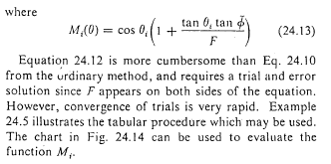

Slide 40
This example is from Lambe and Whitman (1969), John Wiley & Sons Publisher
Center of failure Surface
R = 30 ft
= 125 lb/ft³
c = 90 lb/ft²
φ = 32^{ο}
8
9
7
20 ft
1.5
6
1.0
5
h_{w7}
4
h_{w6}
3
2
1
Drain
Stiff Layer
Pore Water Pressure = u₆ = h_{w6} x γ _{water}
Kamal Tawfiq, Ph.D., P.E.

Slide 41
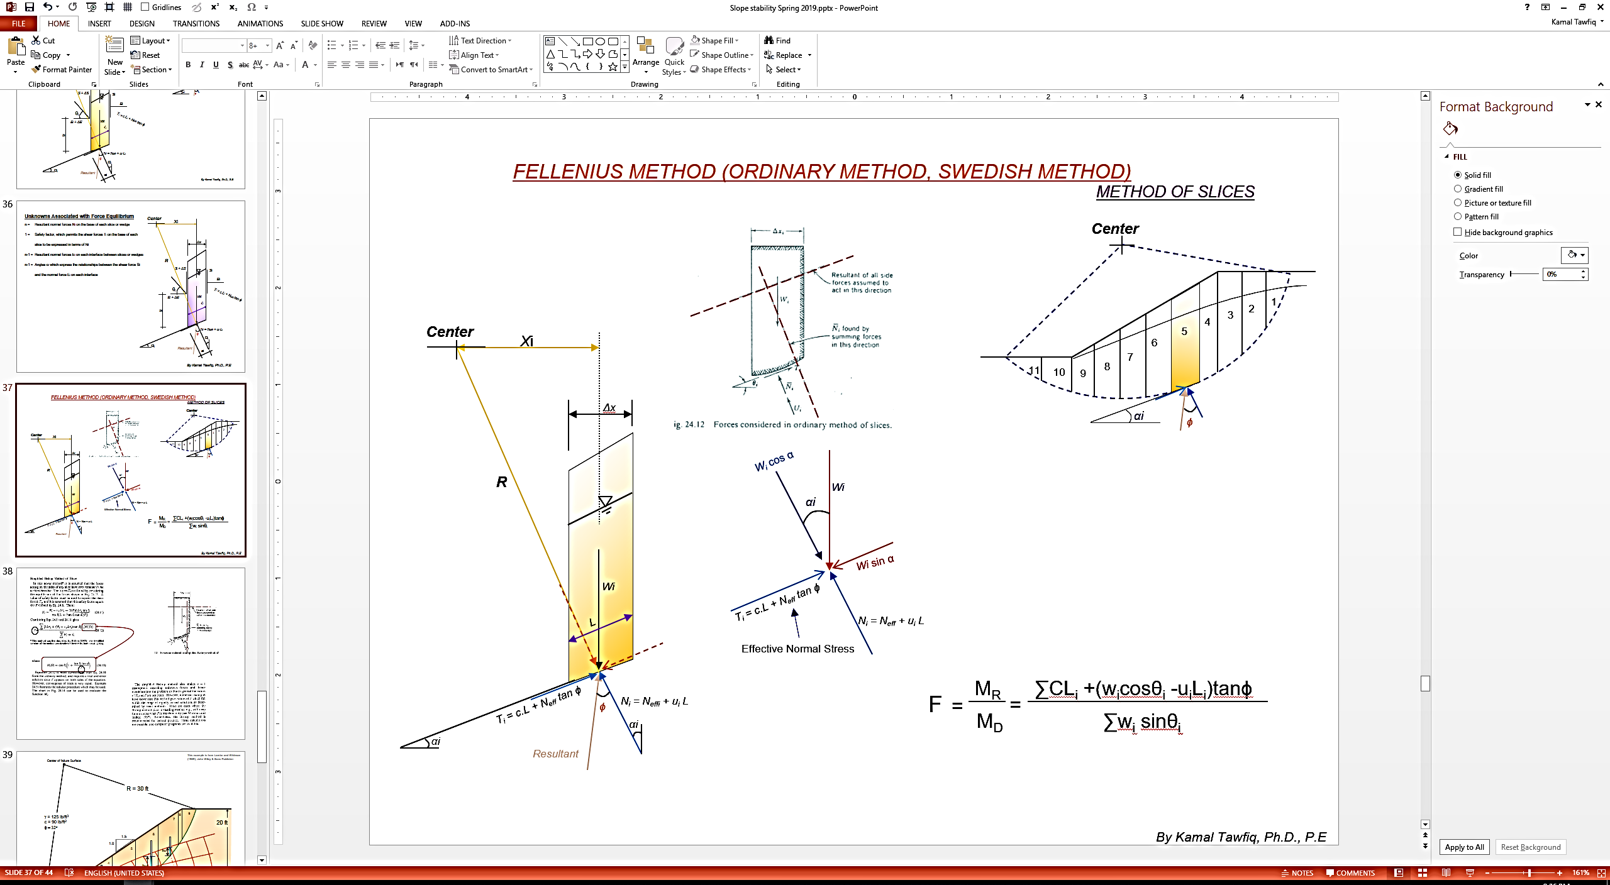
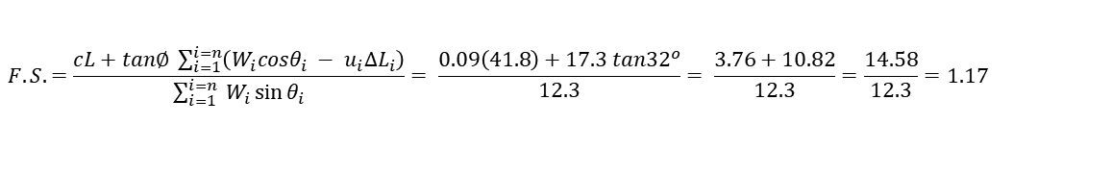
1- Using Ordinary Method of Slices (Swedish Method)
Slice | Width Δx (ft) | Ave Height (ft) | Weight (Kips) | θ_{i} | W_{i} sin θ_{i} | W_{i} cos θ_{i} | u_{i} | Δl_{i} | U_{i} = u_{i} Δl_{i} | N_{i} = W_{i} cosθ_{i} - U_{i}
1 | 4.5 | 1.6 | 0.9 | -1.7 | 0 | 0.9 | 0 | 4.4 | 0 | 0.9
2 | 3.2 | 4.2 | 1.7 | 2.9 | 0.1 | 1.7 | 0 | 3.2 | 0 | 1.7
3 | 1.8 | 5.8 | 1.3 | 8.05 | 0.2 | 1.3 | 0.03 | 1.9 | 0.05 | 1.25
4 | 5.0 | 7.4 | 4.6 | 14.5 | 1.2 | 4.5 | 0.21 | 5.3 | 1.1 | 3.4
5 | 5.0 | 9.0 | 5.6 | 24.8 | 2.3 | 5.1 | 0.29 | 5.6 | 1.6 | 3.5
6 | 5.0 | 9.3 | 5.8 | 35.4 | 3.4 | 4.7 | 0.25 | 6.2 | 1.55 | 3.15
7 | 4.4 | 8.4 | 4.6 | 47.7 | 3.4 | 3.1 | 0.11 | 6.7 | 0.7 | 2.4
8 | 0.6 | 6.7 | 0.5 | 55.1 | 0.4 | 0.3 | 0 | 1.2 | 0 | 0.3
9 | 3.2 | 3.8 | 1.5 | 60.4 | 1.3 | 0.7 | 0 | 7.3 | 0 | 0.7
 |  |  |  |  | 12.3 |  |  | 41.8 |  | 17.3
Δ
ksf
$$F.S.=\frac{cL+tan∅ \sum_{i=1}^{i=n}{\left(W_{i}cosθ_{i} − u_{i}∆L_{i}\right)}}{\sum_{i=1}^{i=n}{ W_{i}\sin{θ_{i}}}}= \frac{0.09\left(41.8\right)+17.3 tan{32}^{o}}{12.3}= \frac{3.76+10.82}{12.3}=\frac{14.58}{12.3}=1.17$$
Kamal Tawfiq, Ph.D., P.E.

Slide 42
2- Using Simplified Bishop Method
(1) | (2) | (3) | (4) | (5) | (6) | (7) | (8) |  | (9)
 |  |  |  |  |  |  | M_{i} |  | (7)/(8)
Slice | Width Δx (ft) | C Δx_{i} (kips) | u_{i} Δx_{i} (Kips) | W_{i}-u_{i} Δx_{i} (Kips) | (5).(tan φ) (Kips) | (3)+(6) (Kips) | Assume _{F=1.25} | Assume _{F=1.35} | _{F=1.25} | _{F=1.35}
1 | 4.5 | 0.4 | 0 | 0.9 | 0.55 | 0.95 | 0.97 | 0.97 | 1.0 | 1.0
2 | 3.2 | 0.29 | 0 | 1.7 | 1.05 | 1.35 | 1.02 | 1.02 | 1.3 | 1.3
3 | 1.8 | 0.16 | 0.05 | 1.25 | 0.8 | 0.95 | 1.06 | 1.05 | 0.9 | 0.9
4 | 5.0 | 0.45 | 1.05 | 3.55 | 2.25 | 2.7 | 1.09 | 1.08 | 2.5 | 2.5
5 | 5.0 | 0.45 | 1.45 | 4.15 | 2.55 | 3.00 | 1.12 | 1.10 | 2.7 | 2.75
6 | 5.0 | 0.45 | 1.25 | 4.55 | 2.7 | 3.15 | 1.1 | 1.08 | 2.85 | 2.9
7 | 4.4 | 0.4 | 0.5 | 4.1 | 2.65 | 3.05 | 1.05 | 1.02 | 2.9 | 2.95
8 | 0.6 | 0.05 | 0 | 0.5 | 0.3 | 0.35 | 0.98 | 0.95 | 0.35 | 0.4
9 | 3.2 | 0.29 | 0 | 1.5 | 0.95 | 1.25 | 0.93 | 0.92 | 1.3 | 1.35
 |  |  |  |  |  |  |  |  | 15.8 | 16.09
From the previous solution
Kamal Tawfiq, Ph.D., P.E.

Slide 44
C
R

Slide 45
Name:__________ ID:________
CEG 4801 Geotechnical Design
Spring 2019
What is the pore water pressure at points A and B?
Center of failure Surface
R = 30 ft
= 125 lb/ft³
c = 90 lb/ft²
φ = 32^{ο}
B
1.5
1.0
20 ft
A
Drain
Stiff Layer

