Slide 1
Stresses in Soil
By
Kamal Tawfiq, Ph.D., P.E.
Spring 2019

Slide 2
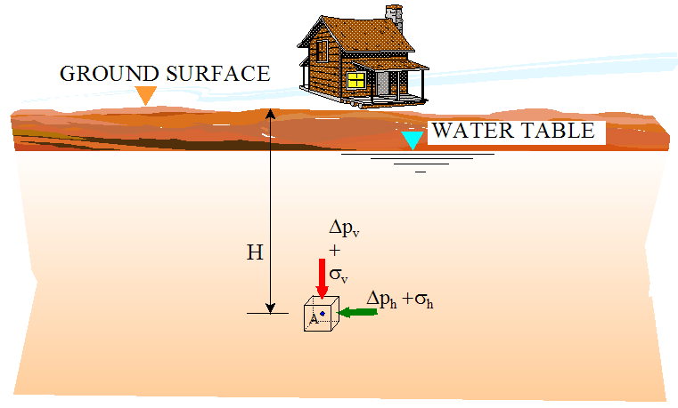
There are two types of lateral stresses in soil.
Added Stress
Due to the
weight of the
house
Geostatic Stress
Total Stress
Effective Stress
Pore Water Pressure

Slide 3
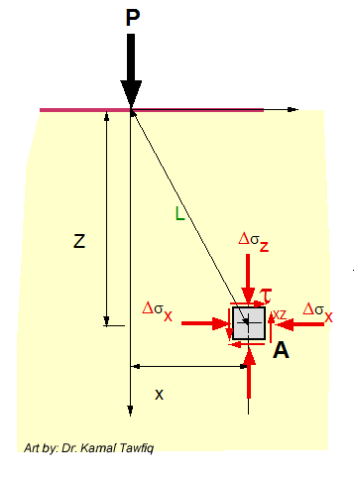
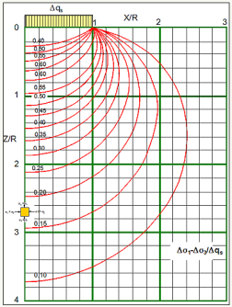
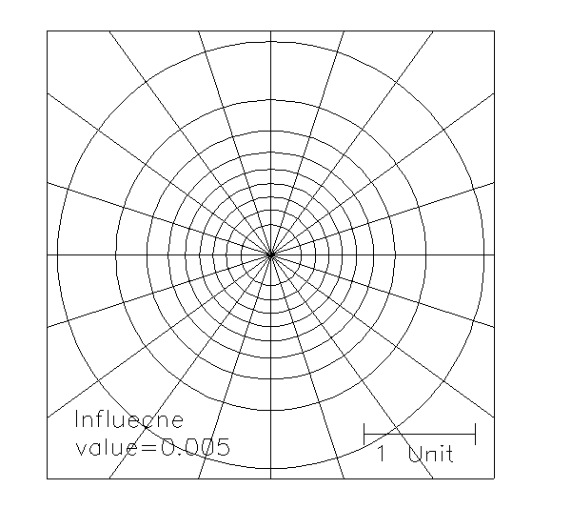
Added
Stress
By: Kamal Tawfiq, Ph.D., P.E
Stress Distribution in Soils
Geostatic
Stress
Geostatic Stresses
Added Stresses (Point, line, strip, triangular, circular, rectangular)
Total Stress
Effective Stress
Pore Water Pressure
Westergaard’s Method
(For Pavement)
Bossinisque Equations
Point Load
Line Load
Strip Load
Triangular Load
Circular Load
Rectangular Load
σ_{y}
σ_{x}
τ_{xy}
Approximate Method
1:2 Method
Total Stress= Effective Stress+ Pore Water Pressure
σ_{total} = σ_{eff} + u
Stress Bulbs
Newmark Charts
Influence Charts
A

Slide 4
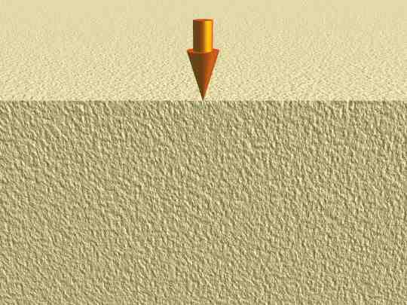
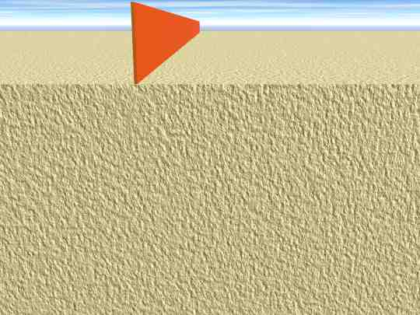
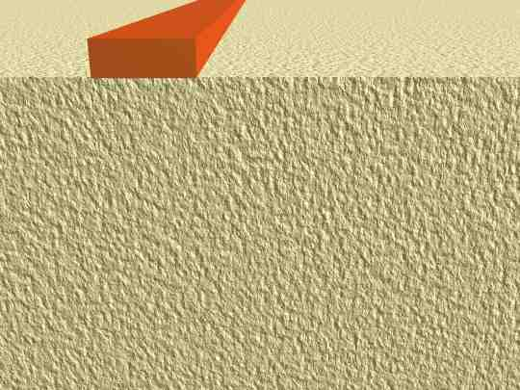
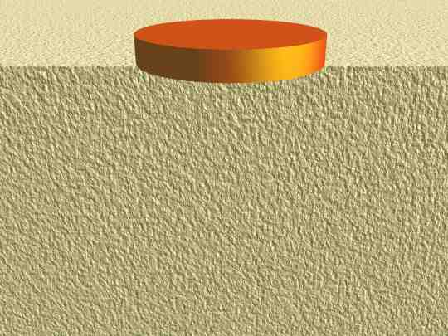
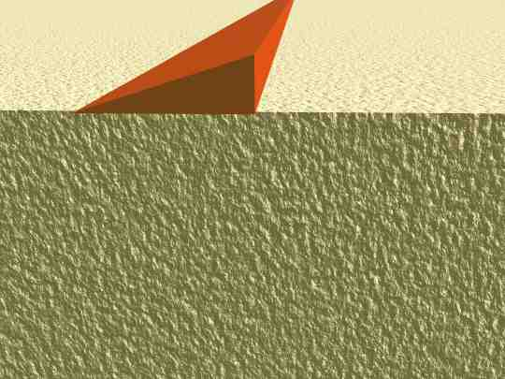
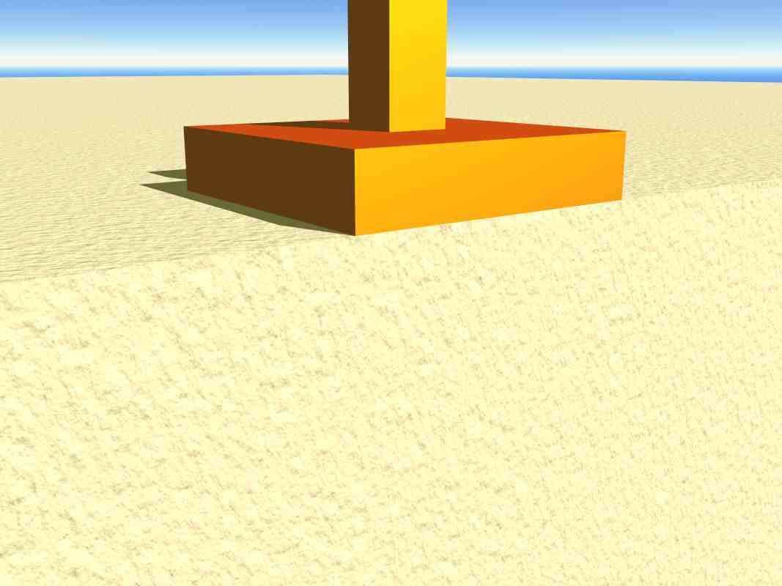



Types of Loads
Point Load
Line Load
Strip Load
$$∞$$
wall
$$∞$$
x
x
x
Z
Z
Z
Circular Load
Triangular Load
Rectangular Load
$$∞$$
x
x
x
Z
Z
Z

Slide 7
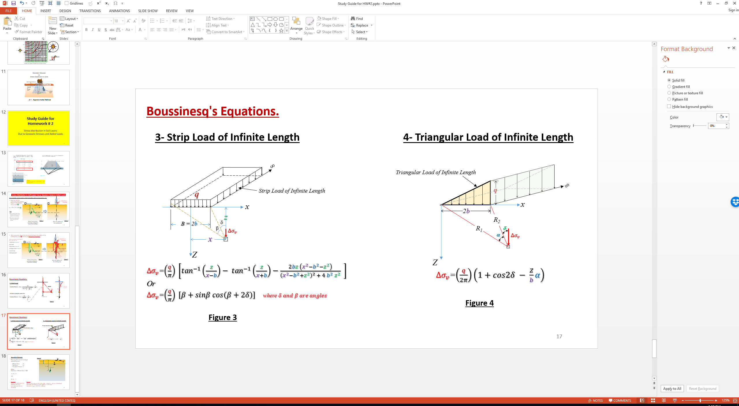
See page 17
See page 17

Slide 10
Stress Bulbs
q_{s}
Circular Load
1
X/R
2
3
0
R
Δq_{s}
0.95
0.90
X
0.80
Z
0.70
1
0.60
0.50
σ_{z}
0.40
σ₁
σ₂
Z/R
τ_{xy}
0.30
σ_{x}
σ_{x}
2
σ_{z} = σ₁
σ₁
σ_{z}
τ_{xy}
σ₂
σ_{x} = σ₂
σx = σ₂
0.20
σ_{x}
σ_{x}
σ_{z}
σ_{z} = σ₁
σ_{z}
θ
σ_{z} = σ₁
σ_{x} = σ₂
σx = σ₂
σ_{z} = σ₁
0.15
3
q_{s}
Δσ₁/q_{s}
A
3 ft
0.10
9 ft
4
Circular Load: (Major Principal Stress)/(Surface Stress)

Slide 11
Geostatic Stresses
&
Stress Distribution in Soils
Self-weight of the soil
Or
Geostatic Stress
2
1
Stresses from the house
2:1 Approximate Method

Slide 12
Study Guide for Homework # 2
Stress distribution in Soil Layers
Due to Geostatic Stresses and Added Loads

Slide 13
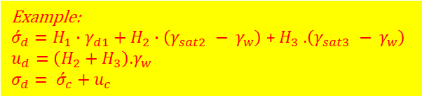
Strip
Load
Triangular Load -1
Triangular Load -2
Example:
${\acute{σ}}_{d}=H_{1}∙γ_{d1}+H_{2}∙\left(γ_{sat2} − γ_{w}\right)$ +${ H}_{3}$ .$\left(γ_{sat3} − γ_{w}\right)$
$u_{d}=\left(H_{2}+H_{3}\right)$.$γ_{w}$
$σ_{d}= {\acute{σ}}_{c}+$ $u_{c}$

Slide 14





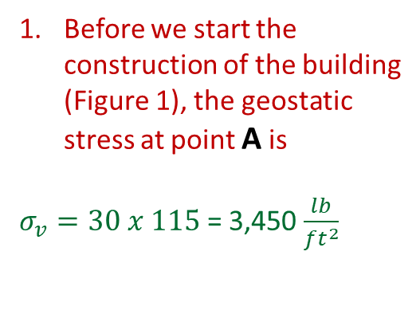

Stress Distribution in Soil Layers Due to Geoststic Stress & Added Loads
Let us consider a project where a high rise building will be constructed at a site
Building
Before we start the construction of the building
(Figure 1), the geostatic stress at point A is
$σ_{v}=30 x 115$= 3,450 $\frac{lb}{{ft}^{2}}$
P = Added Stress
(Building)
1
Project Site
G.S.
2
$$Z$$
$$γ_{soil}$$
$$γ_{soil}=115\frac{lb}{{ft}^{3}}$$
Column of Soil
Z = 30’
Note:
We used the weight of the soil particles only (i.e. the effective vertical stress)
See Figure 6 (page 7) for other vertical geoststic stresses
$$σ_{v}$$
Vertical geoststic stress ($σ_{v})$
=
Selfweight of the column of soil at point A
A
Center line
of the load
Before Construction and before adding the load of the building
Figure 1
Figure 2
After the addition 0f the building load

Slide 15





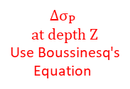
After construction, the vertical stress at point A due to the addition of the building load can be determined using Boussinesq's Equations.
Building
There are equations for each type of load. These loads are:
Point Load (See Figure 3)
Line Load
Strip Load (See Figure 4)
Triangular Load (See Figure 5)
Circular Load
Rectangular Load
P = Added Stress
(Building)
1
Project Site
G.S.
$$γ_{soil}=115\frac{lb}{{ft}^{3}}$$
Z
Column of Soil
Z = 30’
Z = 30’
$∆σ_{P}=$Change in the vertical stress due to added stress P, according to Bussinesq’s equations
$$σ_{v}$$
$${∆σ}_{p}$$
Vertical geoststic stress ($σ_{v})$
=
Selfweight of the column of soil at point A
A
A
$$∆σ_{P}$$
$$at depth Z$$
Use Boussinesq's
Equation
Before Construction and before adding the load of the building
Figure 1
Figure 2
After the addition 0f the building load

Slide 16
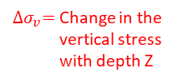



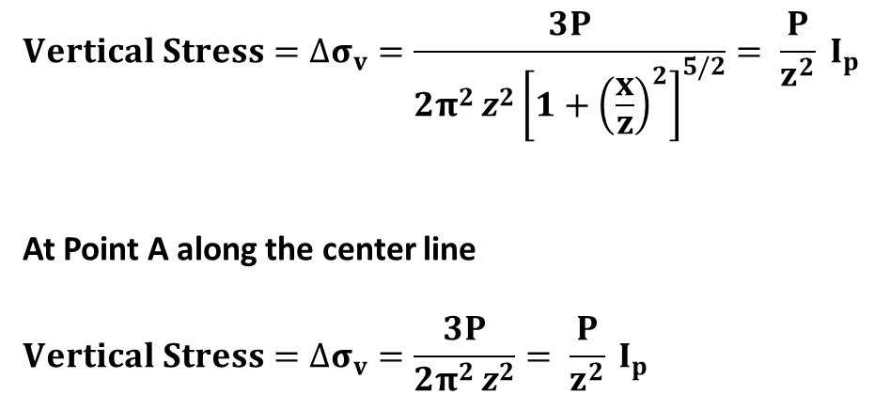

P
P
Boussinesq's Equations.
1- Point Load
$${Vertical Stress=∆σ}_{v}=\frac{3P}{2π^{2 }z^{2}{\left[1+{\left(\frac{x}{z}\right)}^{2}\right]}^{5/2}}= \frac{P}{z^{2}} I_{p}$$
At Point A along the center line
$${Vertical Stress=∆σ}_{v}=\frac{3P}{2π^{2 }z^{2}}= \frac{P}{z^{2}} I_{p}$$
z
${∆σ}_{v}=$Change in the vertical stress
with depth Z
R=$\sqrt{z^{2}+x^{2}}$
$${∆σ}_{v}$$
$${∆σ}_{v}$$
$${∆σ}_{v}$$
A
x
B
A
Z
Center Line
Center Line
Z
Figure 3

Slide 17


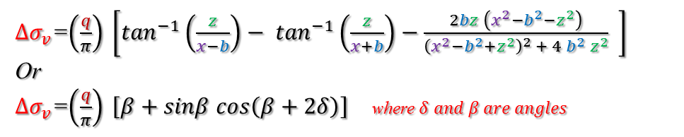



Boussinesq's Equations.
3- Strip Load of Infinite Length
4- Triangular Load of Infinite Length
$$∞$$
Triangular Load of Infinite Length
q
$$∞$$
q
Strip Load of Infinite Length
x
x
z
2b
B = 2b
δ
R₂
z
β
$${∆σ}_{v}$$
R₁
δ
x
α
$${∆σ}_{v}$$
Z
To use this equation see next page
Z
${∆σ}_{v}$=$\left(\frac{q}{π}\right) \left[\tan^{−1}\left(\frac{z}{x−b}\right)− \tan^{−1}\left(\frac{z}{x+b}\right)−\frac{2bz \left(x^{2}−b^{2}−z^{2}\right)}{{\left(x^{2}−b^{2}+z^{2}\right)}^{2} + 4{ b}^{2}{ z}^{2}} \right]$
Or
${∆σ}_{v}$=$\left(\frac{q}{π}\right) \left[β+sinβ cos\left(β+2δ\right)\right]$ where $δ and β are angles$
${∆σ}_{v}$=$\left(\frac{q}{2π}\right)\left(1+cos2δ − \frac{Z}{b}α\right)$
Figure 4
Figure 3

Slide 18
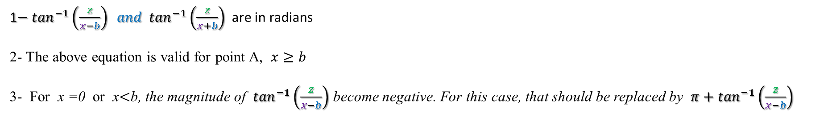

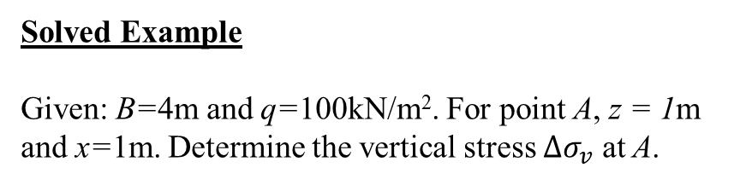
3- Strip Load of Infinite Length
${∆σ}_{v}$=$\left(\frac{q}{π}\right) \left[\tan^{−1}\left(\frac{z}{x−b}\right)− \tan^{−1}\left(\frac{z}{x+b}\right)−\frac{2bz \left(x^{2}−b^{2}−z^{2}\right)}{{\left(x^{2}−b^{2}+z^{2}\right)}^{2} + 4{ b}^{2}{ z}^{2}} \right]$
Note:
1$− \tan^{−1}\left(\frac{z}{x−b}\right) and \tan^{−1}\left(\frac{z}{x+b}\right)$ are in radians
2- The above equation is valid for point A, $x≥b$
3- For x =0 or x$<$b, the magnitude of $\tan^{−1}\left(\frac{z}{x−b}\right)$ become negative. For this case, that should be replaced by $π+\tan^{−1}\left(\frac{z}{x−b}\right)$
$$∞$$
Solved Example
Given: B=4m and q=100kN/m². For point A, z = 1m and x=1m. Determine the vertical stress $∆σ_{v}$ at A.
B = 2b
Strip Load of Infinite Length
q=100kN/m²
x
Z = 1m
A
X=1m
Z

Slide 19
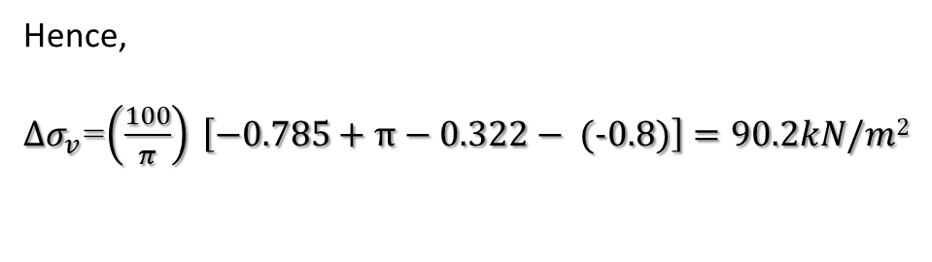
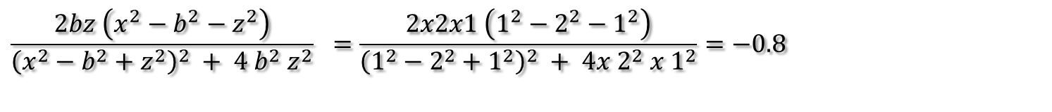
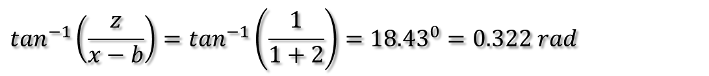
Solution
Since x=1m < b =2m
${∆σ}_{v}$=$\left(\frac{q}{π}\right) \left[\tan^{−1}\left(\frac{z}{x−b}\right)+π− \tan^{−1}\left(\frac{z}{x+b}\right)−\frac{2bz \left(x^{2}−b^{2}−z^{2}\right)}{{\left(x^{2}−b^{2}+z^{2}\right)}^{2} + 4{ b}^{2}{ z}^{2}} \right]$
$\tan^{−1}\left(\frac{z}{x−b} \right)= \tan^{−1}\left(\frac{1}{1−2}\right)=−{45}^{0}=−0.785 rad$
$$\tan^{−1}\left(\frac{z}{x−b}\right)=\tan^{−1}\left(\frac{1}{1+2}\right)={18.43}^{0}=0.322 rad$$
$$\frac{2bz \left(x^{2}−b^{2}−z^{2}\right)}{{\left(x^{2}−b^{2}+z^{2}\right)}^{2} + 4{ b}^{2}{ z}^{2}} =\frac{2x2x1 \left(1^{2}−2^{2}−1^{2}\right)}{{\left(1^{2}−2^{2}+1^{2}\right)}^{2} + 4{x 2}^{2}{ x 1}^{2}}=−0.8$$
Hence,
${∆σ}_{v}$=$\left(\frac{100}{π}\right) \left[−0.785+π−0.322−\text{ (−0.8)}\right]=90.2kN/m2$

Slide 20


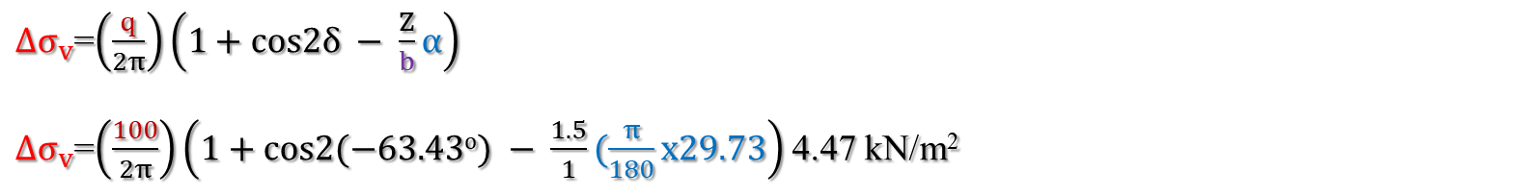
Solved Example
Foe linearly increasing vertical loading on an infinite Strip,
Given:
B=2m; q=100kN/m2.
Find:
the vertical stress Δσ_{v} at A (x = -1m, z =1.5m)
Solution:
1- Find δ and α
δ = − 63.43^{ο}
α = 29.73^{ο}
$$∞$$
q=100 kN/m²
X=-1m
x
$${∆σ}_{v}$$
R₁
B=2b
X=-1.5m
δ
α
R₂
A(-1, 1.5)
z
${∆σ}_{v}$=$\left(\frac{q}{2π}\right)\left(1+cos2δ − \frac{Z}{b}α\right)$
${∆σ}_{v}$=$\left(\frac{100}{2π}\right)\left(1+cos2(−63.43o) − \frac{1.5}{1}(\frac{π}{180}x29.73\right)$ 4.47 kN/m²

Slide 21

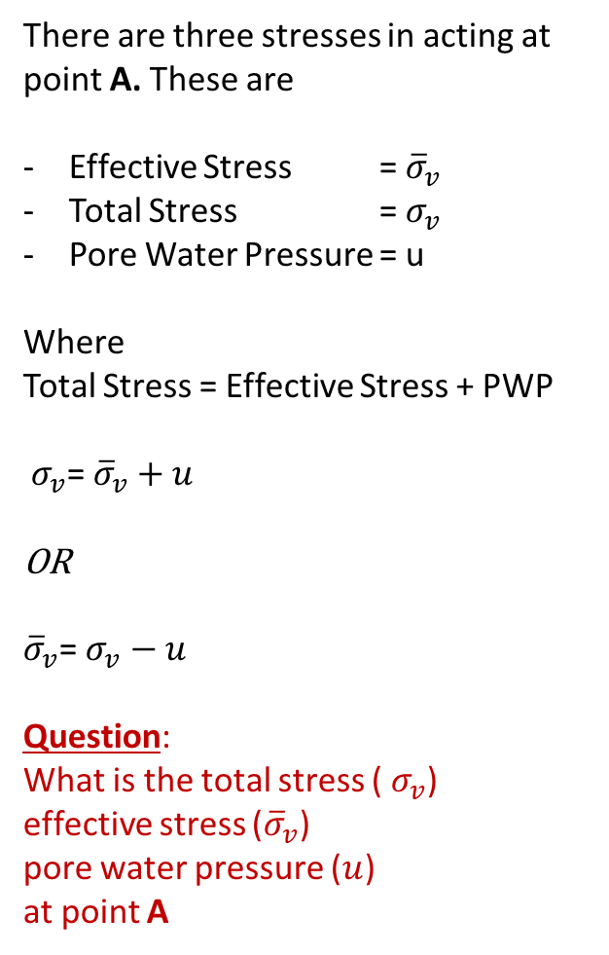
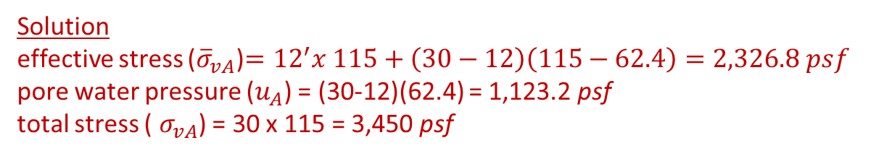

Geoststic Stresses
Figure 6
G.S.
There are three stresses in acting at point A. These are
Effective Stress = ${\overline{σ}}_{v}$
Total Stress = $σ_{v}$
Pore Water Pressure = u
Where
Total Stress = Effective Stress + PWP
${ σ}_{v}$= ${\overline{σ}}_{v}+u$
OR
${\overline{σ}}_{v}$= $σ_{v}−u$
Question:
What is the total stress (${ σ}_{v}$)
effective stress (${\overline{σ}}_{v}$)
pore water pressure ($u$)
at point A
d_{w}=12’
$$γ_{soil}=115\frac{lb}{{ft}^{3}}$$
W.T.
Z = 30’
$${\overline{σ}}_{v}, σ_{v}, u$$
A
Solution
effective stress (${\overline{σ}}_{vA}$)$={12}^{′}x 115+\left(30−12\right)\left(115−62.4\right)=2,326.8 psf$
pore water pressure ($u_{A}$) = (30-12)(62.4) = 1,123.2 psf
total stress (${ σ}_{vA}$) = 30 x 115 = 3,450 psf

