Slide 1
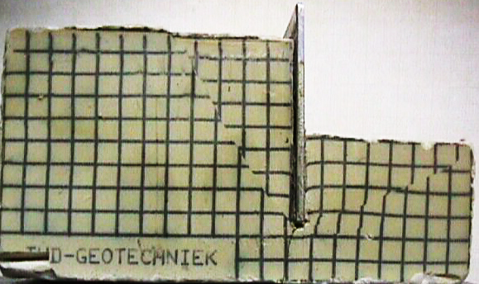








Rankine’s Earth Pressure Method for (c- φ) Soil
Rankine’s Active and Passive Earth Pressure in (c- f) Soil
Active Wedge
Rankine’s Active Earth Pressure in ( f) Soil with inclined backfill
√
β
θ = 45 ⁰− φ/2
K_{a} = cosβ .
Cosβ – (cos²β – cos² φ)
φ
Cosβ + (cos²β – cos² φ)
√
√
γ =
φ =
τ
θ = 45 ⁰ + φ/2
τ = c + σ_{n} tan φ
Passive Earth Pressure
Active
Earth Pressure
Passive Wedge
√
δ = 0
c
Passive
Earth Pressure
P_{a} = 0.5 γ H² K_{a}
σ_{f}’
σ_{h}’
σ_{v}’
σ_{f}’
H
β
Active Earth Pressure
σ_{h} is increasing until failure
Effect of Cohesion of the Rankine’s Active and Passive Earth Pressure
Rankine’s Active Earth Pressure in f - Soil & Water Table
β
Active Earth Pressure
-2c K_{a}
-2c K_{a}
Flexible Wall
G.S.
Fig.1
$σ_{f}^{′}$= $σ_{V}^{′} \tan^{2}\left({45}^{o}−\frac{∅}{2}\right)+2 c \tan\left({45}^{o}−\frac{∅}{2}\right)$
-
h₁
γ_{soil}
φ
Effect of Two Soil Layers on Active Earth Pressure
Or
Tension Crack Z_{cr} = $\frac{2c}{γ\sqrt{K_{a}}}$
+
+
σ_{h} = γ_{soil}h₁ K_{a}
W.T.
P_{w}
K_{a1} < K_{a2}
G.S.
$σ_{f}^{′}$= $σ_{V}^{′} K_{a}−2 c \sqrt{Ka}$
-
h₂
+
+
+
σ_{h} = γ_{soil}h₁K_{a1}
γ₁
φ₁
+
+
=
+
P_{w} = 0.5 γ_{w} (h₂)²
h₁
K_{a1}
$K_{a}^{}$= $\tan^{2}\left({45}^{o}−\frac{∅}{2}\right)= \frac{1− \sin{∅}}{1+ \sin{∅}}$
σ_{h} = γ_{soil}h₁K_{a2}
Coefficient of active earth pressure
+
$σ_{h}= h_{1}γsoil k_{a}$ +
$$h_{2 }\left(γsoil− γwater\right)k_{a}$$
σ_{w} = γ_{w}h₂
γ₂
φ₂
h₂
K_{a2}
Passive Earth Pressure
-2c K_{a}
γ H K_{a}
γ H K_{a} -
2c K_{a}
$σ_{f}^{′}$= $σ_{V}^{′} \tan^{2}\left({45}^{o}+\frac{∅}{2}\right)+2 c \tan\left({45}^{o}+\frac{∅}{2}\right)$
+2c K_{p}
+2c K_{p}
Effect of Surcharge (q) Load on Active Earth Pressure
σ_{h} = (γ₁ h₁ + γ₂ h₂) k_{a2}
Or
q
K_{a1} > K_{a2}
G.S.
$σ_{f}^{′}$= $σ_{V}^{′} K_{p}+2 c \sqrt{Kp}$
qk_{a}
qk_{a}
σ_{h} = γ_{soil}h₁K_{a1}
γ₁
φ₁
h₁
K_{a1}
$K_{p}^{}$= $\tan^{2}\left({45}^{o}+\frac{∅}{2}\right)= \frac{1+ \sin{∅}}{1 − \sin{∅}}$
σ_{h} = γ_{soil}h₁K_{a2}
Coefficient of passive earth pressure
+
+
+
=
+
+
+
+
+
=
+
γ₂
φ₂
h₂
K_{a2}
qk_{a}
γ H K_{a}
qk_{a}
+2c K_{p}
γ H K_{p}
γ H K_{p} +
2c K_{p}
Effect of Surcharge Load
Effect of Soil Pressure
+ γ H K_{a}
σ_{h} = (γ₁ h₁ + γ₂ h₂) k_{a2}
Kamal Tawfiq

Slide 2
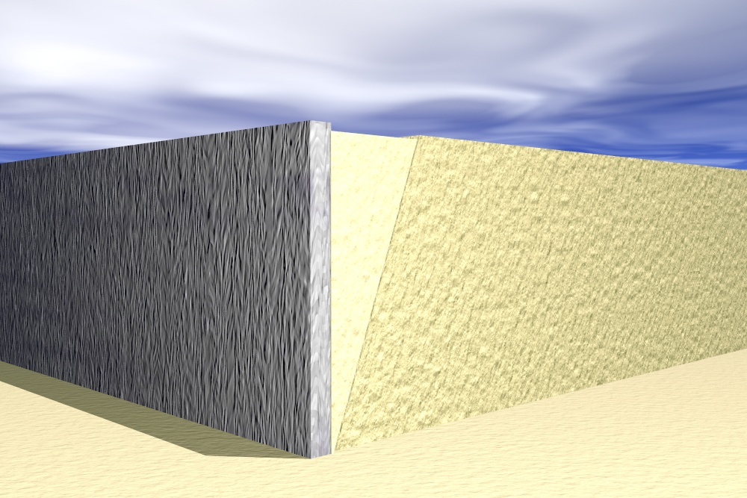
Coulomb Earth Pressure Method
Forces acting on the wall.
Wall Displacement = Δ
This active wedge will slide along the failure surface and will exert pressure on the wall. Also, the sliding wedge will push the wall away from the backfill.
W
Failure surface
Pressure from the sliding wedge
By: Kamal Tawfiq, Ph.D., P.E.

Slide 3

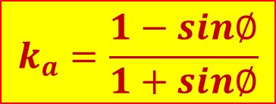
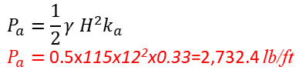
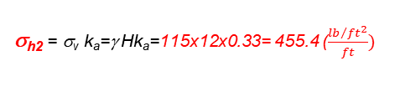
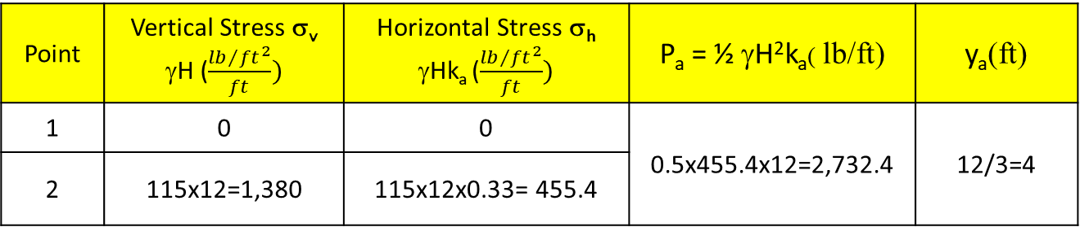
Active Earth Pressure in φ − Soil (Using Rankine’s Method)
Rankine’s Method
always assumes δ = 0
Example - 1
Given:
Vertical retaining wall (flexible)
Wall height (H) = 12 ft
Backfill unit weight (γ) = 115 pcf
Angle of soil friction (φ) = 30º
Assume wall to be smooth (δ=0)
Find:
Lateral force P_{a} acting on the wall
Solution:
$$k_{a}=\frac{1−sin∅}{1+sin∅}$$
1
β = 0
= 115 pcf
φ= 30º
Friction between wall and soil
(δ=0)
H=12ft
$$P_{a}=\frac{1}{2}γ H^{2}k_{a}$$
$P_{a}=$0.5x115x12²x0.33=2,732.4 lb/ft
$k_{a}=\frac{1−sin∅}{1+sin∅}$ = $\frac{1−sin30}{1+sin30}=0.33$
y_{a} = 12/3 = 4’
Point | Vertical Stress σ_{v} γH ($\frac{{lb}/{{ft}^{2}}}{ft})$ | Horizontal Stress σ_{h} γHk_{a} ($\frac{{lb}/{{ft}^{2}}}{ft})$ | P_{a} = ½ γH²k_{a}( lb/ft) | y_{a}(ft)
1 | 0 | 0 | 0.5x455.4x12=2,732.4 | 12/3=4
2 | 115x12=1,380 | 115x12x0.33= 455.4
2
σ_{h2} = σ_{v} k_{a}=γ Hk_{a}=115x12x0.33= 455.4 ($\frac{{lb}/{{ft}^{2}}}{ft})$

Slide 4





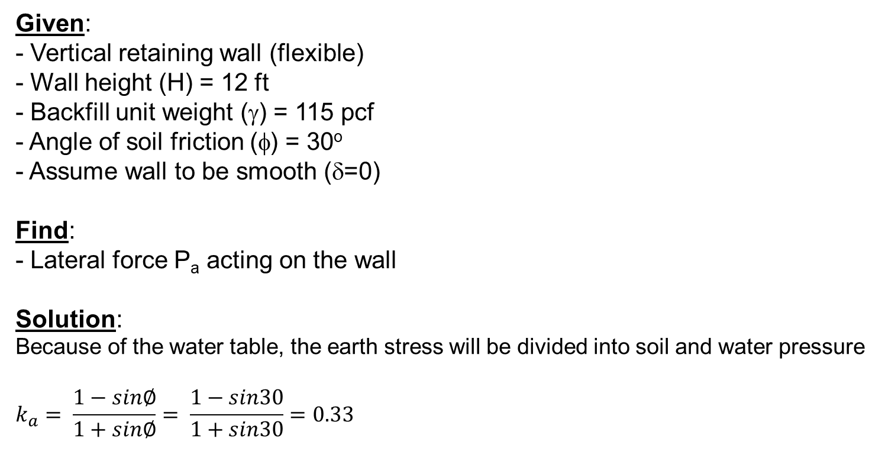


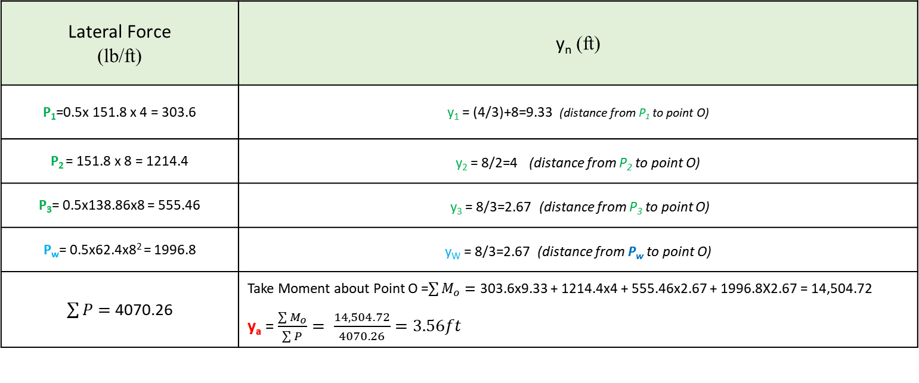
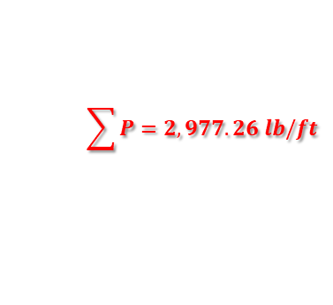
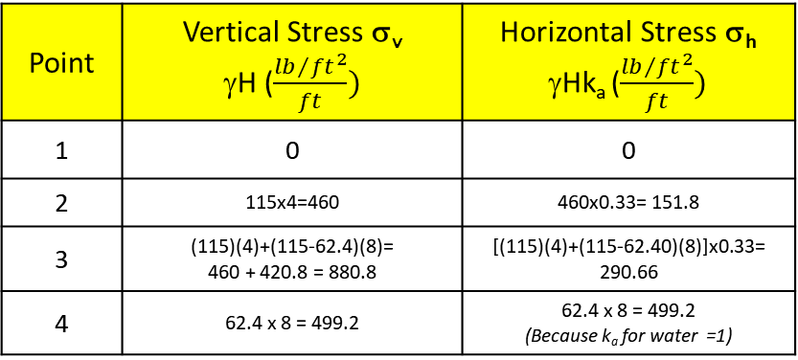


Active Earth Pressure in φ − Soil (Using Rankine’s Method)
Rankine’s Method
always assumes δ = 0
Example -2
$$k_{a}=\frac{1−sin∅}{1+sin∅}$$
Given:
Vertical retaining wall (flexible)
Wall height (H) = 12 ft
Backfill unit weight (γ) = 115 pcf
Angle of soil friction (φ) = 30º
Assume wall to be smooth (δ=0)
Find:
Lateral force P_{a} acting on the wall
Solution:
Because of the water table, the earth stress will be divided into soil and water pressure
$$k_{a}= \frac{1−sin∅}{1+sin∅}= \frac{1−sin30}{1+sin30}=0.33$$
G.S.
1
= 115 pcf
φ= 30º
h_{w}= 4ft
$$P_{1}$$
W.T.
2
151.8
H=12ft
$$y_{1}$$
$$P_{2}$$
$$\sum{P=2,977.26 lb/ft }$$
$$P_{3}$$
$$P_{w}$$
Y_{a} = 3.567’
$$y2$$
$$y_{3}$$
$$y_{w}$$
3
151.8
420.8
o
σ_{h} = σ_{v} k_{a}
4
499.2
To determine the resultant Force and its point of action
Lateral Force (lb/ft) | y_{n} (ft)
P₁=0.5x 151.8 x 4 = 303.6 | y₁ = (4/3)+8=9.33 (distance from P₁ to point O)
P₂ = 151.8 x 8 = 1214.4 | y₂ = 8/2=4 (distance from P₂ to point O)
P₃= 0.5x138.86x8 = 555.46 | y₃ = 8/3=2.67 (distance from P₃ to point O)
P_{w}= 0.5x62.4x8² = 1996.8 | y_{W} = 8/3=2.67 (distance from P_{w} to point O)
$\sum{P= }$4070.26 | Take Moment about Point O =$\sum{M_{o}=}$ 303.6x9.33 + 1214.4x4 + 555.46x2.67 + 1996.8X2.67 = 14,504.72 y_{a} = $\frac{\sum{M_{o}}}{\sum{P}}= \frac{14,504.72}{4070.26}=3.56ft$
Point | Vertical Stress σ_{v} γH ($\frac{{lb}/{{ft}^{2}}}{ft})$ | Horizontal Stress σ_{h} γHk_{a} ($\frac{{lb}/{{ft}^{2}}}{ft})$
1 | 0 | 0
2 | 115x4=460 | 460x0.33= 151.8
3 | (115)(4)+(115-62.4)(8)= 460 + 420.8 = 880.8 | [(115)(4)+(115-62.40)(8)]x0.33= 290.66
4 | 62.4 x 8 = 499.2 | 62.4 x 8 = 499.2 (Because k_{a} for water =1)

Slide 5

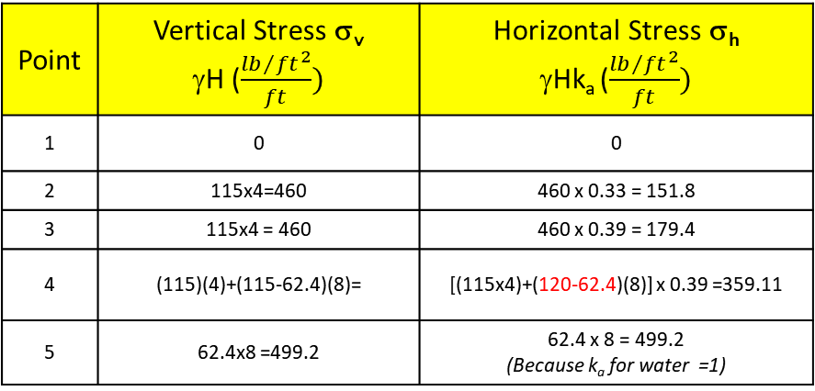

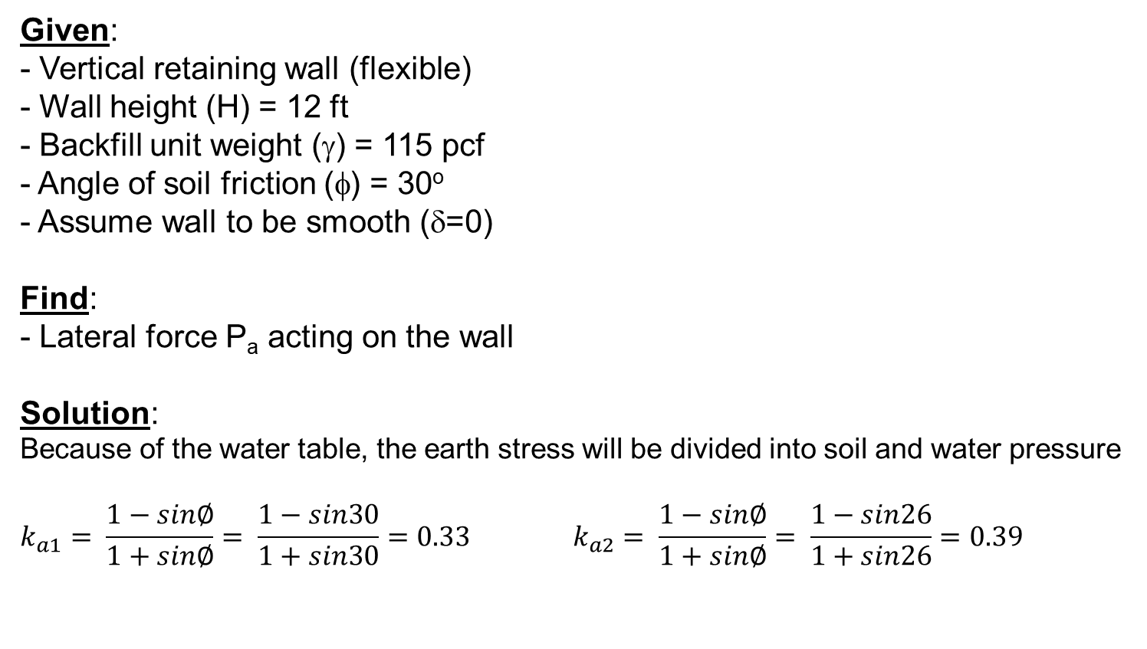



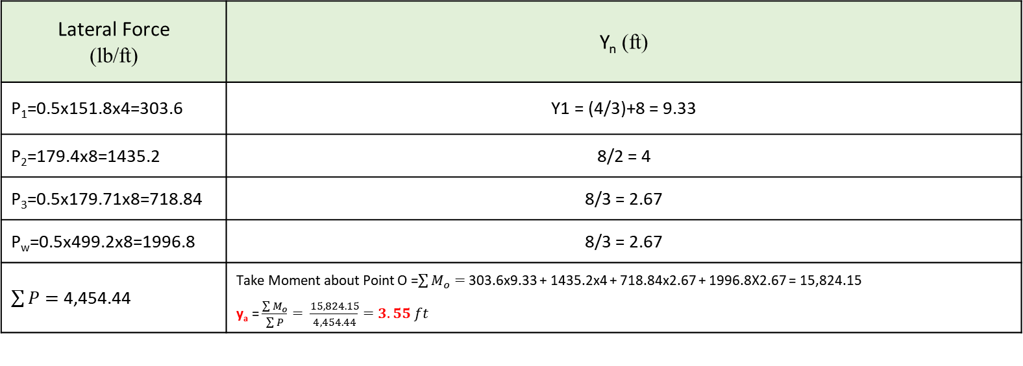

Active Earth Pressure in φ − Soil (Using Rankine’s Method)
Rankine’s Method
always assumes δ = 0
Example -3
Given:
Vertical retaining wall (flexible)
Wall height (H) = 12 ft
Backfill unit weight (γ) = 115 pcf
Angle of soil friction (φ) = 30º
Assume wall to be smooth (δ=0)
Find:
Lateral force P_{a} acting on the wall
Solution:
Because of the water table, the earth stress will be divided into soil and water pressure
$$k_{a1}= \frac{1−sin∅}{1+sin∅}= \frac{1−sin30}{1+sin30}=0.33 k_{a2}= \frac{1−sin∅}{1+sin∅}= \frac{1−sin26}{1+sin26}=0.39$$
G.S.
1
₁= 115 pcf
φ₁ = 30º
h_{w}= 4ft
$$P_{1}$$
W.T.
2
3
H=12ft
₂= 120 pcf
φ₂ = 26º
$$P_{2}$$
$$\sum{P=4,454.44 lb/ft }$$
$$P_{3}$$
$$P_{w}$$
Y_{a} = 3.55’
4
179.4
179.711
o
5
499.2
σ_{h} = ${\overline{σ}}_{v}$ k_{a} =
σ_{h =} [(115x4)+(120-62.4)(8)] x 0.39
σ_{h} = 179.4 + 179.71 = 359.11 (lb / ft² / ft)
Point | Vertical Stress σ_{v} γH ($\frac{{lb}/{{ft}^{2}}}{ft})$ | Horizontal Stress σ_{h} γHk_{a} ($\frac{{lb}/{{ft}^{2}}}{ft})$
1 | 0 | 0
2 | 115x4=460 | 460 x 0.33 = 151.8
3 | 115x4 = 460 | 460 x 0.39 = 179.4
4 | (115)(4)+(115-62.4)(8)= | [(115x4)+(120-62.4)(8)] x 0.39 =359.11
5 | 62.4x8 =499.2 | 62.4 x 8 = 499.2 (Because k_{a} for water =1)
Lateral Force (lb/ft) | Y_{n} (ft)
P₁=0.5x151.8x4=303.6 | Y1 = (4/3)+8 = 9.33
P₂=179.4x8=1435.2 | 8/2 = 4
P₃=0.5x179.71x8=718.84 | 8/3 = 2.67
P_{w}=0.5x499.2x8=1996.8 | 8/3 = 2.67
$\sum{P= }$4,454.44 | Take Moment about Point O =$\sum{M_{o}=}$ 303.6x9.33 + 1435.2x4 + 718.84x2.67 + 1996.8X2.67 = 15,824.15 y_{a} = $\frac{\sum{M_{o}}}{\sum{P}}= \frac{15,824.15}{4,454.44}=3.55 ft$
γ_{sub}

Slide 6
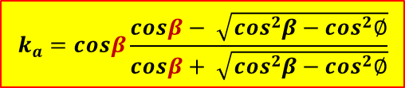
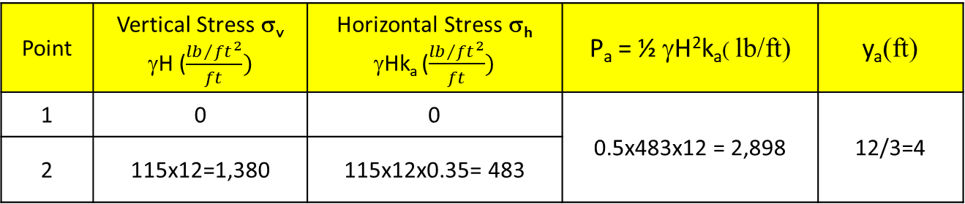
Active Earth Pressure in φ − Soil (Using Rankine’s Method)
Rankine’s Method
always assumes δ = 0
Example - 4
Given:
Vertical retaining wall (flexible)
Wall height (H) = 12 ft
Backfill unit weight (γ) = 115 pcf
Angle of soil friction (φ) = 30º
- Ground surface slope α = 10º
Assume wall to be smooth (δ=0)
Find:
Lateral force P_{a} acting on the wall
Solution:
$$k_{a}=cosβ\frac{cosβ− \sqrt{\cos^{2}β−\cos^{2}∅}}{cosβ+ \sqrt{\cos^{2}β−\cos^{2}∅}}$$
β = 10
1
Friction between wall and soil
(δ=0)
P_{a}=γH k_{a}
2
β = 10
$k_{a}=cosβ\frac{cosβ− \sqrt{\cos^{2}β−\cos^{2}∅}}{cosβ+ \sqrt{\cos^{2}β−\cos^{2}∅}}= cos10 \frac{cos10− \sqrt{\cos^{2}10−\cos^{2}30}}{cos10+ \sqrt{\cos^{2}10−\cos^{2}}30}$ = 0.35
y_{a} = 12/3
β = 10
σ_{h} = σ_{v} k_{a}
2
Point | Vertical Stress σ_{v} γH ($\frac{{lb}/{{ft}^{2}}}{ft})$ | Horizontal Stress σ_{h} γHk_{a} ($\frac{{lb}/{{ft}^{2}}}{ft})$ | P_{a} = ½ γH²k_{a}( lb/ft) | y_{a}(ft)
1 | 0 | 0 | 0.5x483x12 = 2,898 | 12/3=4
2 | 115x12=1,380 | 115x12x0.35= 483

Slide 7
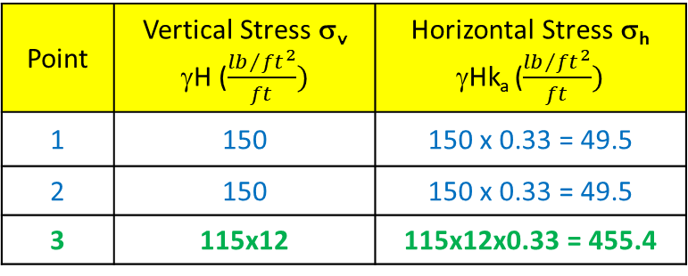

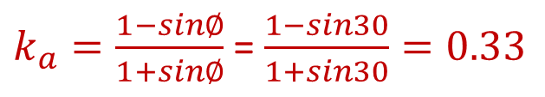
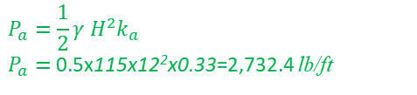
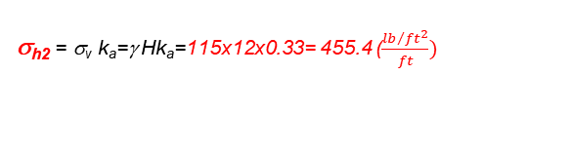
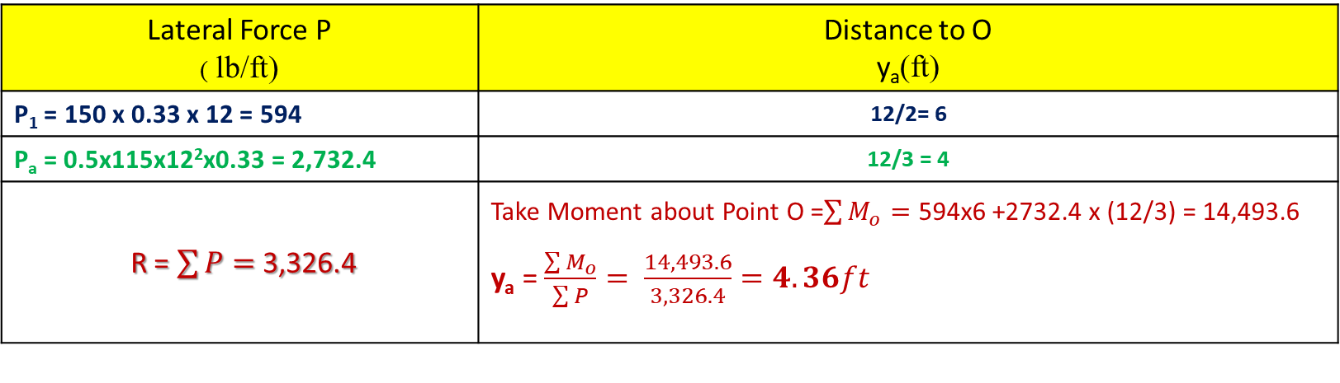
Active Earth Pressure in φ − Soil (Using Rankine’s Method)
Rankine’s Method
always assumes δ = 0
Example - 5
Given:
Vertical retaining wall (flexible)
Wall height (H) = 12 ft
Backfill unit weight (γ) = 115 pcf
Angle of soil friction (φ) = 30º
Assume wall to be smooth (δ=0)
Find:
Lateral force P_{a} acting on the wall
Solution:
q =150 lb/ft
1
β = 0
= 115 pcf
φ= 30º
H=12ft
P₁ = q x H x k_{a}
$$R=3,326.4 lb/ft$$
$$P_{a}=\frac{1}{2}γ H^{2}k_{a}$$
$P_{a}=$0.5x115x12²x0.33=2,732.4 lb/ft
y_{a} = 12/3 = 4’
$k_{a}=\frac{1−sin∅}{1+sin∅}$ = $\frac{1−sin30}{1+sin30}=0.33$
Y_{a} = 4.36’
O
σ_{h2} = σ_{v} k_{a}=γ Hk_{a}=115x12x0.33= 455.4 ($\frac{{lb}/{{ft}^{2}}}{ft})$
2
Point | Vertical Stress σ_{v} γH ($\frac{{lb}/{{ft}^{2}}}{ft})$ | Horizontal Stress σ_{h} γHk_{a} ($\frac{{lb}/{{ft}^{2}}}{ft})$
1 | 150 | 150 x 0.33 = 49.5
2 | 150 | 150 x 0.33 = 49.5
3 | 115x12 | 115x12x0.33 = 455.4
Lateral Force P ( lb/ft) | Distance to O y_{a}(ft)
P₁ = 150 x 0.33 x 12 = 594 | 12/2= 6
P_{a} = 0.5x115x12²x0.33 = 2,732.4 | 12/3 = 4
R = $\sum{P= }$3,326.4 | Take Moment about Point O =$\sum{M_{o}=}$ 594x6 +2732.4 x (12/3) = 14,493.6 y_{a} = $\frac{\sum{M_{o}}}{\sum{P}}= \frac{14,493.6}{3,326.4}=4.36ft$

Slide 8
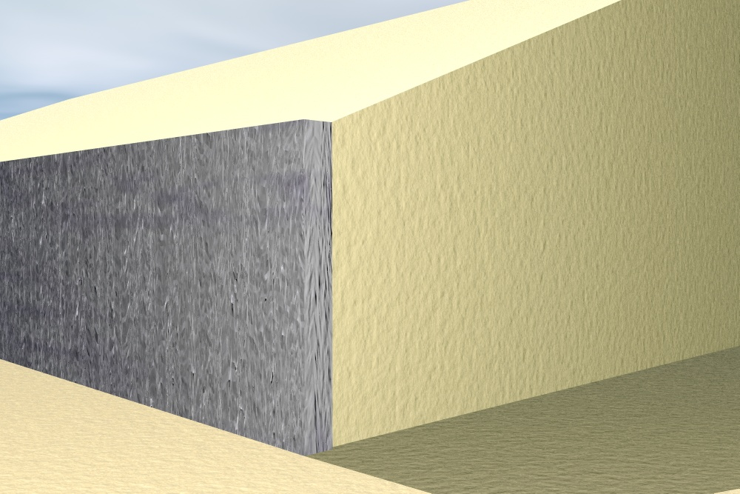
Coulomb Earth Pressure Method
Forces acting on an inclined wall.
β
Active Wedge. Exerting pressure on the wall
W
α
γ
φ
φ
Normal
θ
Normal
δ
Shear
F
Pa
Shear
δ
P_{a}
By: Kamal Tawfiq, Ph.D., P.E.

Slide 9

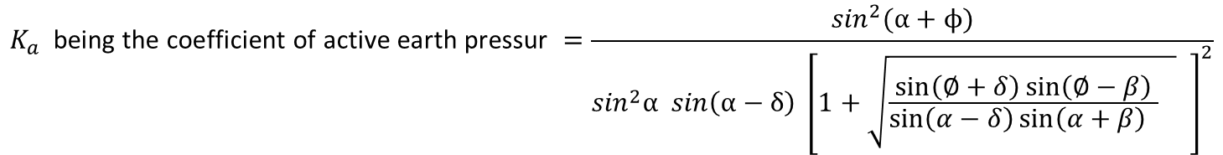


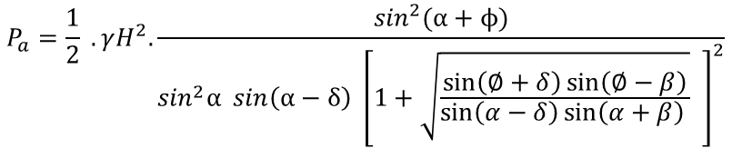

COULOMB’S WEDGE THEORY
C
P_{a}
B
β
Sliding
Surface
ψ
W = weight of the soil wedge
R = resultant of the shear and normal forces on the failure surface BC
P_{a} = the active force per unit length of the wall. The direction of Pa is inclined at an angle δ to the normal drawn and the face of the wall that supports the soil
δ = the angle of friction between the soil and the wall
Sliding
Wedge
ψ =(α − δ)
Friction
Wall
Friction
(180^{ο} − ψ − θ + φ)
H
W
S
R
W = g (area of wedge ABC)
δ
N
From the triangles of forces,
H/3
P_{a}
ψ
S
φ
(θ − φ)
W
α
θ
$$\frac{P_{a}}{\sin{(θ−∅)}}= \frac{W}{sin⁡({180}^{o}−ψ−θ+ϕ)}$$
A
(θ − φ)
R
Force Triangle
$$P_{a}= \frac{W\sin{(θ−∅)}}{sin⁡({180}^{o}−ψ−θ+ϕ)}$$
Sliding Wedge
δ = 0.5φ to 0.7φ
β
Sand
γ = ̸
φ = ̸
Substituting for W,
Draw this perpendicular line first
Then draw P_{a} with an angle = α
$$P_{a}=\frac{1}{2} .\frac{γH^{2}}{\sin^{2}{α }}.\frac{sin (θ −∅)}{sin⁡({180}^{o}−ψ−θ+ϕ)}.\frac{\sin{(θ+α)}.sin(α+β)}{sin⁡(θ−β)}$$
P_{a}
P_{v}
The maximum value of Pa is obtained by equating the first derivative of Pa with respect
to θ to zero; or
H
δ
P_{h} = cos [δ + (90^{ο}−α)]
(∂P_{a})/∂θ = 0, and substituting the corresponding value of θ.
σ_{h} = γHK_{a}
The value of P_{a} so obtained is written as
H/3
α
$$P_{a}=\frac{1}{2} .γH^{2}.\frac{\sin^{2}(α+ϕ)}{\sin^{2}α sin\left(α−δ\right) {\left[1+\sqrt{\frac{\sin\left(∅+δ\right)\sin\left(∅−β\right)}{\sin\left(α−δ\right)\sin\left(α+β\right) }} \right]}^{2}}$$
q
qk_{a}
β
This is usually written as
Sand
γ = ̸
φ = ̸
$P_{a}=\frac{1}{2} .γH^{2}.$ $K_{a}$
P₁
P_{a}
$$K_{a} \text{being} \text{the} \text{coefficient} \text{of} \text{active} \text{earth} \text{pressur} =\frac{\sin^{2}(α+ϕ)}{\sin^{2}α sin\left(α−δ\right) {\left[1+\sqrt{\frac{\sin\left(∅+δ\right)\sin\left(∅−β\right)}{\sin\left(α−δ\right)\sin\left(α+β\right) } } \right]}^{2}}$$
H
δ
Where
+
δ
H/3
H/2
σ_{h} = γHK_{a}
α
qk_{a}
δ + (90^{ο}−α)
Kamal Tawfiq

Slide 10
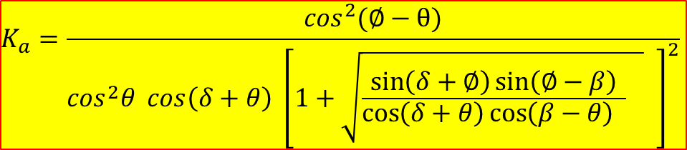
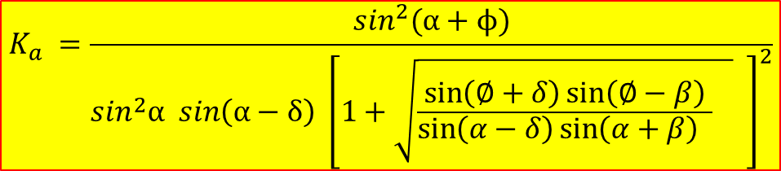
COULOMB’S WEDGE THEORY
C
P_{a}
B
β
Sliding
Surface
ψ
Sliding
Wedge
ψ =(α − δ)
Friction
$$K_{a} =\frac{\sin^{2}(α+ϕ)}{\sin^{2}α sin\left(α−δ\right) {\left[1+\sqrt{\frac{\sin\left(∅+δ\right)\sin\left(∅−β\right)}{\sin\left(α−δ\right)\sin\left(α+β\right) } } \right]}^{2}}$$
Friction
Wall
(180^{ο} − ψ − θ + φ)
H
W
S
R
δ
N
H/3
P_{a}
ψ
S
φ
(θ − φ)
W
α
θ
A
(θ − φ)
R
Force Triangle
Sliding Wedge
δ = 0.5φ to 0.7φ
OR
β
Sand
γ = ̸
φ = ̸
Draw this perpendicular line first
Then draw P_{a} with an angle = α
$$K_{a}=\frac{\cos^{2}(∅−θ)}{\cos^{2}θ cos\left(δ+θ\right) {\left[1+\sqrt{\frac{\sin\left(δ+∅\right)\sin\left(∅−β\right)}{\cos\left(δ+θ\right)\cos\left(β−θ\right) } } \right]}^{2}}$$
P_{v}
P_{a} = 0.5γ H² k_{a}
H
δ
P_{h} = cos [δ + (90^{ο}−α)]
H/3
σ_{h} = γHK_{a}
α
β
q
Sand
γ = ̸
φ = ̸
qk_{a}
β
θ
Sand
γ = ̸
φ = ̸
P_{v}
P_{a} = 0.5γ H² k_{a}
P₁
P_{a}
H
δ
δ
P_{h} = cos [δ + (90^{ο}−α)]
H
+
δ
H/3
σ_{h} = γHK_{a}
H/3
H/2
σ_{h} = γHK_{a}
α
qk_{a}
δ + (90^{ο}−α)
Kamal Tawfiq

Slide 11
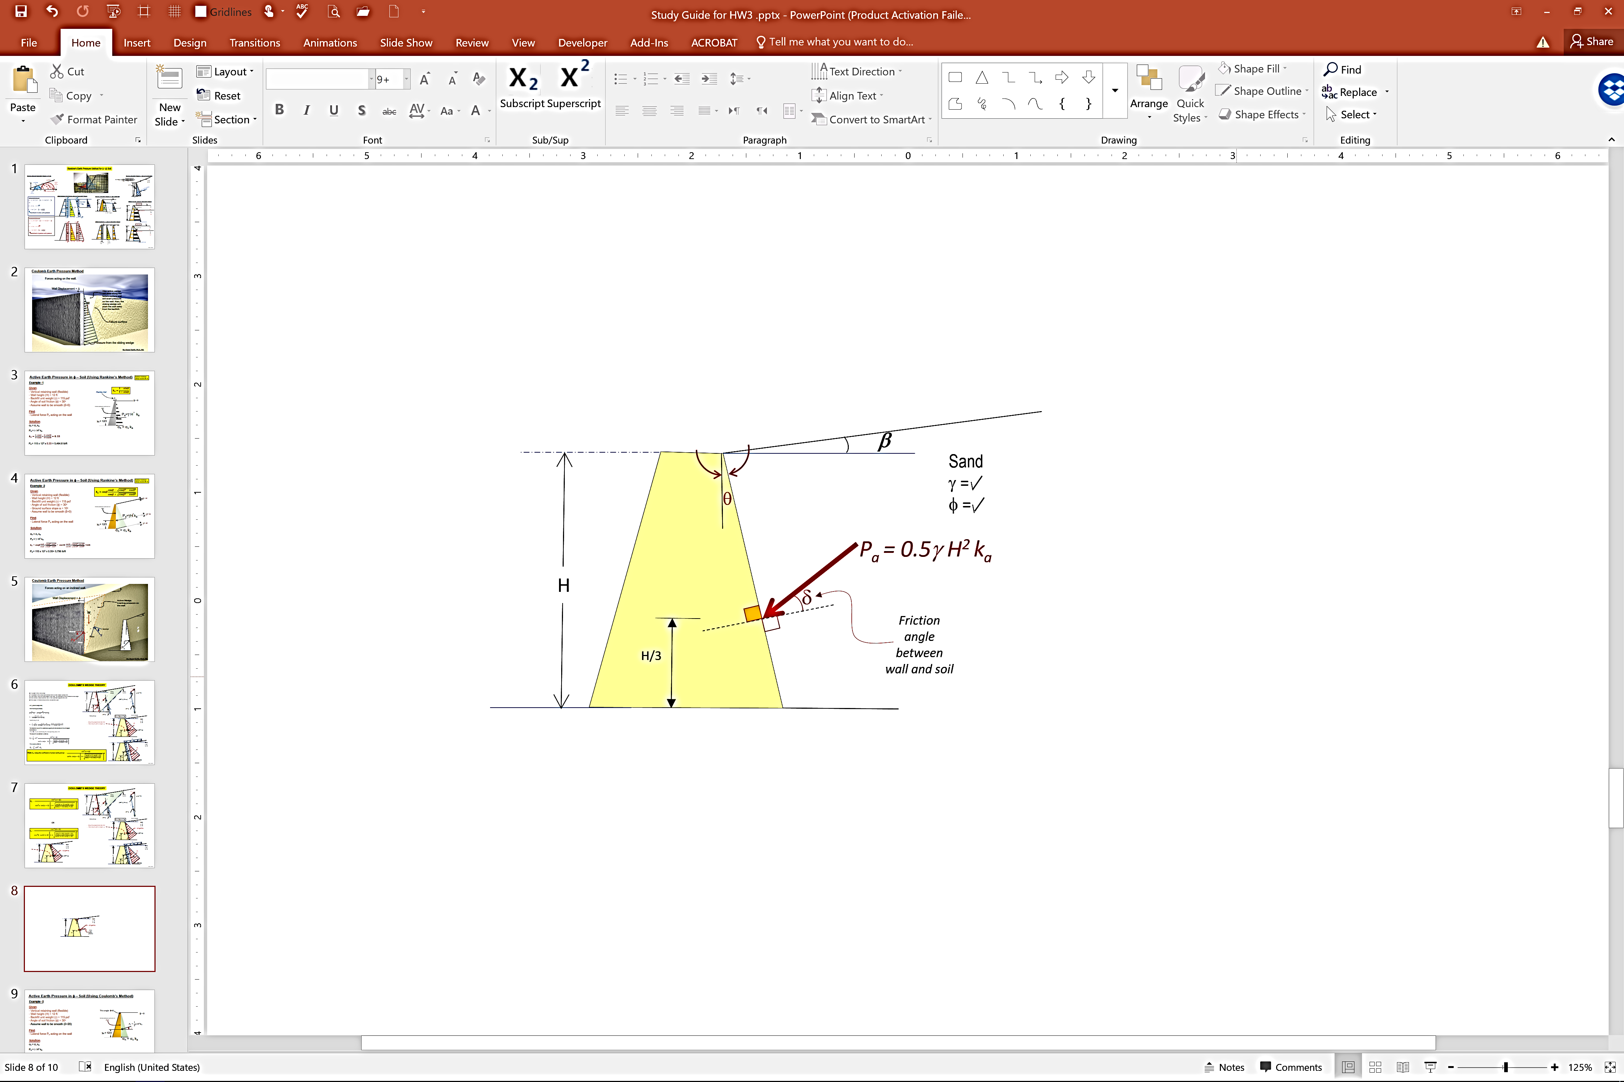
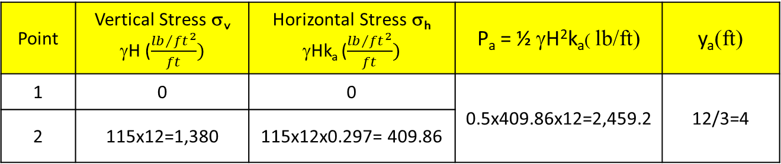
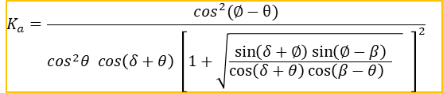
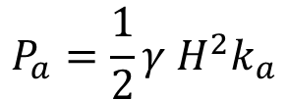
Active Earth Pressure in φ − Soil (Using Coulomb’s Method)
Example - 6
$$K_{a}=\frac{\cos^{2}(∅−θ)}{\cos^{2}θ cos\left(δ+θ\right) {\left[1+\sqrt{\frac{\sin\left(δ+∅\right)\sin\left(∅−β\right)}{\cos\left(δ+θ\right)\cos\left(β−θ\right) } } \right]}^{2}}$$
Given:
Vertical retaining wall (flexible)
Wall height (H) = 12 ft
Backfill unit weight (γ) = 115 pcf
Angle of soil friction (φ) = 30º
Assume wall to be smooth (δ=20)
Find:
Lateral force P_{a} acting on the wall
Solution:
$$K_{a}=\frac{\cos^{2}(∅−θ)}{\cos^{2}θ cos\left(δ+θ\right) {\left[1+\sqrt{\frac{\sin\left(δ+∅\right)\sin\left(∅−β\right)}{\cos\left(δ+θ\right)\cos\left(β−θ\right) } } \right]}^{2}}=\frac{\cos^{2}(30−0)}{\cos^{2}0 cos\left(20+0\right) {\left[1+\sqrt{\frac{\sin\left(20+30\right)\sin\left(30−0\right)}{\cos\left(20+0\right)\cos\left(0−0\right) } } \right]}^{2}}=0.297$$
This angle θ=0
β = 0
Friction between wall and soil
(δ=20)
$$P_{a}=\frac{1}{2}γ H^{2}k_{a}$$
Point | Vertical Stress σ_{v} γH ($\frac{{lb}/{{ft}^{2}}}{ft})$ | Horizontal Stress σ_{h} γHk_{a} ($\frac{{lb}/{{ft}^{2}}}{ft})$ | P_{a} = ½ γH²k_{a}( lb/ft) | y_{a}(ft)
1 | 0 | 0 | 0.5x409.86x12=2,459.2 | 12/3=4
2 | 115x12=1,380 | 115x12x0.297= 409.86
δ = 20º
y_{a} = 12/3
σ_{h} = σ_{v} k_{a}
About 10% less than the Rankine’s Earth Pressure

Slide 12


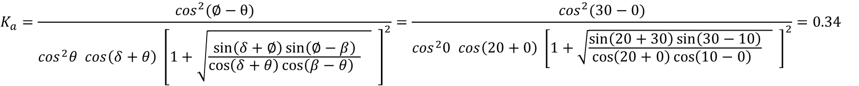

Active Earth Pressure in φ − Soil (Using Coulomb’s Method)
Example - 7
$$K_{a}=\frac{\cos^{2}(∅−θ)}{\cos^{2}θ cos\left(δ+θ\right) {\left[1+\sqrt{\frac{\sin\left(δ+∅\right)\sin\left(∅−β\right)}{\cos\left(δ+θ\right)\cos\left(β−θ\right) } } \right]}^{2}}$$
Given:
Vertical retaining wall (flexible)
Wall height (H) = 12 ft
Backfill unit weight (γ) = 115 pcf
Angle of soil friction (φ) = 30º
- Ground surface slope α = 10º
Assume wall to be smooth (δ=20)
Find:
Lateral force P_{a} acting on the wall
Solution:
β = 10
This angle θ=0
Friction between wall and soil
(δ=20)
$$P_{a}=\frac{1}{2}γ H^{2}k_{a}$$
$$K_{a}=\frac{\cos^{2}(∅−θ)}{\cos^{2}θ cos\left(δ+θ\right) {\left[1+\sqrt{\frac{\sin\left(δ+∅\right)\sin\left(∅−β\right)}{\cos\left(δ+θ\right)\cos\left(β−θ\right) } } \right]}^{2}}=\frac{\cos^{2}(30−0)}{\cos^{2}0 cos\left(20+0\right) {\left[1+\sqrt{\frac{\sin\left(20+30\right)\sin\left(30−10\right)}{\cos\left(20+0\right)\cos\left(10−0\right) } } \right]}^{2}}=0.34$$
δ = 10
Point | Vertical Stress σ_{v} γH ($\frac{{lb}/{{ft}^{2}}}{ft})$ | Horizontal Stress σ_{h} γHk_{a} ($\frac{{lb}/{{ft}^{2}}}{ft})$ | P_{a} = ½ γH²k_{a}( lb/ft) | y_{a}(ft)
1 | 0 | 0 | 0.5x469.2x12 = 2,815.2 | 12/3 = 4
2 | 115x12=1,380 | 115x12x0.34= 469.2
y_{a} = 12/3
90º
σ_{h} = σ_{v} k_{a}
δ = 10
About 3% less than the Rankine’s Earth Pressure

Slide 13
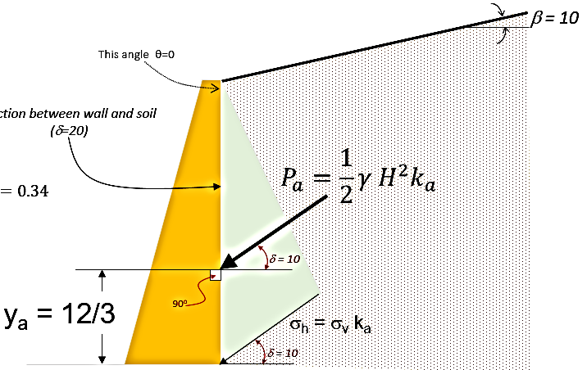


Active Earth Pressure in φ − Soil (Using Coulomb’s Method)
Example - 8
$$K_{a}=\frac{\cos^{2}(∅−θ)}{\cos^{2}θ cos\left(δ+θ\right) {\left[1+\sqrt{\frac{\sin\left(δ+∅\right)\sin\left(∅−β\right)}{\cos\left(δ+θ\right)\cos\left(β−θ\right) } } \right]}^{2}}$$
Given:
Vertical retaining wall (flexible)
Wall height (H) = 12 ft
Backfill unit weight (γ) = 115 pcf
Angle of soil friction (φ) = 30º
- Ground surface slope α = 10º
Assume wall to be smooth (δ=20)
The wall batter angle θ = 10º
Find:
Lateral force P_{a} acting on the wall
Solution:
β = 10
Friction between wall and soil
(δ=20)
θ
$K_{a}=\frac{\cos^{2}(∅−θ)}{\cos^{2}θ cos\left(δ+θ\right) {\left[1+\sqrt{\frac{\sin\left(δ+∅\right)\sin\left(∅−β\right)}{\cos\left(δ+θ\right)\cos\left(β−θ\right) } } \right]}^{2}}=\frac{\cos^{2}(30−10)}{\cos^{2}10 cos\left(20+10\right) {\left[1+\sqrt{\frac{\sin\left(20+30\right)\sin\left(30−10\right)}{\cos\left(20+10\right)\cos\left(10−10\right) } } \right]}^{2}}=$0.475
$$P_{a}=\frac{1}{2}γ H^{2}k_{a}$$
Point | Vertical Stress σ_{v} γH ($\frac{{lb}/{{ft}^{2}}}{ft})$ | Horizontal Stress σ_{h} γHk_{a} ($\frac{{lb}/{{ft}^{2}}}{ft})$ | P_{a} = ½ γH²k_{a}( lb/ft) | y_{a}(ft)
1 | 0 | 0 | 0.5x655.5x12 = 3,933 | 12/3 = 4
2 | 115x12=1,380 | 115x12x0.475= 655.5
δ = 10
y_{a} = 12/3
90º
σ_{h} = σ_{v} k_{a}
δ = 10
About 28% more than Vertical wall (θ = 0)

