Slide 1
Consolidation Settlement
Time Dependent Settlement
Assume a fully saturated Sponge
H/2
H
Two way
drainage path

Slide 2
By: Kamal Tawfiq, Ph.D., P.E.
Consolidation Settlement (Time Dependent Settlement)
* Consolidation settlement occurs in cohesive soils due to the expulsion of the water from the voids.
* Because of the soil permeability the rate of settlement may varied from soil to another.
* Also the variation in the rate of consolidation settlement depends on the boundary conditions.
S_{Consolidation} = S_{primary} + S_{secondary}
Primary Consolidation Volume change is due to reduction in pore water pressure
Secondary Consolidation Volume change is due to the rearrangement of the soil particles
(No pore water pressure change, Δu = 0, occurs after the primary consolidation)
Water Table (W.T.)
Expulsion of the water
When the water in the voids starts to flow out of the soil matrix due to consolidation of the clay layer. Consequently, the excess pore water pressure (Δu) will reduce, and the void ratio (e) of the soil matrix will reduce too.
Water
Solids
Voids

Slide 3
Consolidation Settlement
p
Sand
Sand
H
Settlement
ΔH
Clay
Sand
Sand
p
p
Δe
ΔH
p
Δu
p
V_{v}
e_{o}
p
p
Water
Water
Δu
1+e_{o}
Δu
H
H
V_{s}
1
Solids
Solids
p
Δu
Δu
p
Δu
Δu
p
Soil Block
Phase Diagram
p
$$\frac{∆e}{1+e_{o}}=\frac{∆H}{H}$$
p
p

Slide 4
P_{n}
.
.
.
.
Δe
P
ΔH
e
Water
e
Virgin
Consolidation
Curve
slope = c_{c}
Solids
e₁
c_{c}
Δe
e₂
Δp
p
p₁
p₂
log p

Slide 5
Normally Consolidated Clay
e
Compression Index
e₁
c_{c}
Δe
e₂
Δp
c_{s}
Swelling Index
p₁
p₂
log p

Slide 6
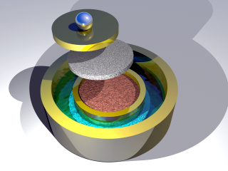
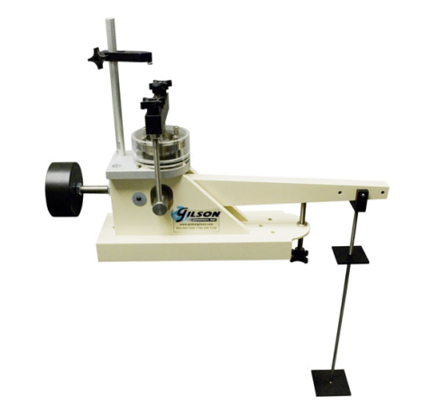
Consolidation Test:
Soil
Sample
Sample was sent to the lab
And placed in the consolidometer
Sample was removed
No pressure on the sample
G.S.
Sand
3 ft
γ_{sand} = 96 pcf
W.T.
4 ft
γ_{clay} = 110 pcf
P_{o}
Clay
w_{c} = 0.3
16 ft
Dial gauge to determine ΔH
Soil
Sample
e
Stress
Increments
Δp₇
Δp
Δp₁
Δp₂
Δp₃
Δp₃
Porous Stones
Δp
Δp₁
Soil Sample
Δp₄
Void Ratio
C_{c}
Δp₅
In the lab the stresses are
added to the soil sample
C_{s}
Δp₆
log p
P_{o}

Slide 7
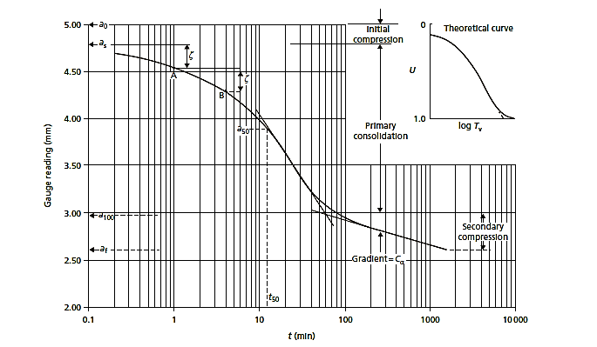
Coefficient of Consolidation (C_{v})
$$C_{v}= \frac{0.196 {Hdr}^{2}}{t_{50}}$$
U% = 0
A
B
U% = 100%
t
4t
t_{100%}
t_{50%}

Slide 8
Dr. Kamal Tawfiq
Example:
Figure 1
G.S.
Soil sample was obtained from the clay layer
Conduct consolidation test [9 load increments ]
Plot e vs. log (p) (Figure 2)
Determine Compression Index (C_{c} ) & Swelling Index (C_{s})
γ_{sand} = 96 pcf
W.T.
3 ft
Sand
4 ft
Clay
P_{o}
γ_{clay} = 110 pcf
w_{c} = 0.3
16 ft
Soil Sample
In the lab and after removing
the soil sample from the ground,
the stresses on the soil sample = 0
Δp₁
Δp₂
Soil Sample
In the ground, the sample was subjected to geostatic stresses.
In the lab and before the consolidation test the stresses on the sample = 0.
During testing, the geostatic stress is gradually recovered
e_{o} = 0.795
Δp₁
C_{c} = 0.72
C_{s} = 0.1
Stress
Increments
Δp
Δp₇
Void Ratio (e)
Δp
Δp₉
C_{c}
Soil Sample
In the lab the stresses are
added to the soil sample
C_{s}
Δp₉
P_{o}
Log (p)
Figure 2
5. Determine P_{o} = 3.(96) + 4.(96-62.4) + 8.(110-62.4) = 803.2 lb/ft²

Slide 9
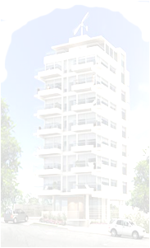
Normally Consolidated and Overconsolidated Clay
When clay particles are deposited by deposition agents like water, wind, ice or gravity, layers after layers are deposited with time which induces effective stresses in the clay layer below. The clay layer in this case is called “Normally Consolidated Clay.”
If the to soil layers experienced cycles of erosion and deposition
with time such as case 1, the clay layer will be called “Over Consolidated Clay.”
Overconsolidation can also be developed from loading and unloading the clay layer such as
case 2.
Case 2
Past
Case 1
Past
Today
G.S.
Sand
Clay
Past
Glacial covered Chicago
P_{o}

Slide 10
Consolidation Settlement
p
Void Ratio
Before Loading
e
Sand
e_{o}
Clay
Δp = p
P_{o} + Δp
e₁
c_{c}
H
p_{o}
Δe
e₂
Δp
Sand
p₁
p₂
log p
p_{o}
P_{o} + Δp

Slide 12
Consolidation Settlement
Void Ratio
Before Loading
p
e
Sand
e_{o}
Clay
2
2
e₁
c_{c}
H
Δp
p_{o}
1
1
Δe
e₂
Δp
Sand
p₁
p₂
log p
p_{o}
P_{o} + Δp

Slide 13
Normally Consolidated Clay
e
Compression Index
e₁
c_{c}
Δe
e₂
Δp
c_{s}
Swelling Index
p₁
p₂
log p

Slide 14
Normally Consolidated and Overconsolidated Clay
Casagrande’s Method to Determine Preconsolidation Pressure (Pc)
1
Normally Consolidated Soil
G.S.
γ_{sand} = 96 pcf
W.T.
3 ft
Sand
4 ft
γ_{clay} = 110 pcf
w_{c} = 0.3
Gs = 2.65
P_{o}
Clay
P_{o} = 3x (96) + 4 (96-62.4) + 8 (110-62.4) = 803.2 psf
16 ft
_{Soil Sample}
P_{o}
Void Ratio (e)
803.2 psf
P_{c}
Log (p)
Overconsolidation Ratio OCR = = 1
The soil is Normally Consolidated (N.C.) soil
P_{o}

Slide 15
Casagrande’s Method to Determine Preconsolidation Pressure (Pc)
1
Normally Consolidated Soil
γ_{sand} = 96 pcf
W.T.
3 ft
Sand
4 ft
γ_{clay} = 110 pcf
w_{c} = 0.3
Gs = 2.65
P_{o}
Clay
_{Soil Sample}
16 ft
Point of
maximum curvature
6 Intersection of 4 & 5
2 Horizontal line
1
X
X
Void Ratio (e)
4 divide the angle between 2 & 3
3
Tangent to point 1
Extend the straight line
7
P_{o} = P_{c}
Log (p)
P_{c}
Overconsolidation Ratio OCR = = 1
The soil is Normally Consolidated (N.C.) soil
P_{o}

Slide 16
Casagrande’s Method to Determine Pc
2
Overconsolidated Soil
γ_{sand} = 96 pcf
W.T.
1.5 ft
Sand
3 ft
γ_{clay} = 110 pcf
w_{c} = 0.3
Gs = 2.65
P_{o}
Clay
P_{o} = 1.5 x (96) + 3 (96-62.4) + 7 (110-62.4) = 803.2 psf
14 ft
_{Soil Sample}
Point of
maximum curvature
578 psf
6 Intersection of 4 & 5
2 Horizontal line
1
X
X
Void Ratio (e)
4 divide the angle between 2 & 3
3
Tangent to point 1
5 Extend the stright line
7
100
P_{o}
P_{c}
1000
10000
P_{c}
Log (p)
Overconsolidation Ratio OCR = > 1
The soil is oversonsolidated (O.C.) soil
P_{o}

Slide 17
Δp
Δp
Δp
Δp
Δp
Δp
ΔΗ =
Cc H
P_{o} + ΔP
log ( )
1 + e_{O}
P₀

Slide 18
Δp₂
Δp₂
Δp₂
Δp
Δp
Δp
Δp
2
C_{S} H
P_{C}
C _{C} H
P_{o} + ΔP
ΔΗ = log ( ) +
log ( )
P_{o}
P_{C}
2
1 + e_{O}
1 + e_{O}

Slide 19
Δp₂
Δp₂
Δp₂
Δp
Δp₂
C_{S} H
P_{o} + ΔP
( )
ΔΗ = log
1 + e_{O}
P_{o}
2

Slide 21
Dr. Kamal Tawfiq - 2010
Example:
Figure 1
G.S.
Soil sample was obtained from the clay layer
Conduct consolidation test [9 load increments ]
Plot e vs. log (p) (Figure 2)
Determine Compression Index (C_{c} ) & Swelling Index (C_{s})
γ_{sand} = 96 pcf
W.T.
3 ft
Sand
4 ft
Clay
P_{o}
γ_{clay} = 110 pcf
w_{c} = 0.3
16 ft
Soil Sample
In the lab and after removing
the soil sample from the ground,
the stresses on the soil sample = 0
Δp₁
Δp₂
In the ground, the sample was subjected to geostatic stresses.
In the lab and before the consolidation test the stresses on the sample = 0.
During testing, the geostatic stress is gradually recovered
e_{o} = 0.795
Δp₁
C_{c} = 0.72
C_{s} = 0.1
Stress
Increments
Δp
Δp₇
Void Ratio (e)
Δp
Δp₉
C_{c}
In the lab the stresses are
added to the soil sample
C_{s}
Δp₉
P_{o}
Log (p)
Figure 2
5. Determine P_{o} = 3.(96) + 4.(96-62.4) + 8.(110-62.4) = 803.2 lb/ft²

Slide 22
Tangent to point 1
Dr. Kamal Tawfiq - 2010
Example:
G.S.
γ_{sand} = 96 pcf
W.T.
3 ft
6. Using Casagrande’s Method to determine Pc
P_{c} = 800 lb/ft²
Overconsolidation Ratio
OCR = = 1
The soil is
Normally Consolidated
N.C. soil
Sand
4 ft
γ_{clay} = 110 pcf
w_{c} = 0.3
P_{o}
Clay
16 ft
Point of
maximum curvature
P_{c}
P_{o}
Δp₁
6
2
1
X
X
4
Void Ratio (e)
5
3
Tangent to point 1
7
P_{o} = P_{c}
Log (p)

Slide 23
Casagrande’s Method to Determine Preconsolidation Pressure (Pc)
Dr. Kamal Tawfiq - 2010
1
Normally Consolidated Soil
Point of
maximum curvature
6 Intersection of 4 & 5
2 Horizontal line
1
X
X
Void Ratio (e)
4 divide the angle between 2 & 3
3
Tangent to point 1
Extend the straight line
7
P_{o} = P_{c}
Log (p)
P_{c}
Overconsolidation Ratio OCR = = 1
The soil is Normally Consolidated (N.C.) soil
P_{o}

Slide 24
Dr. Kamal Tawfiq - 2010
Casagrande’s Method to Determine Pc
2
Overconsolidated Soil
Point of
maximum curvature
6 Intersection of 4 & 5
2 Horizontal line
1
X
X
Void Ratio (e)
4 divide the angle between 2 & 3
3
Tangent to point 1
5 Extend the stright line
7
P_{o}
P_{c}
Log (p)
P_{c}
Overconsolidation Ratio OCR = > 1
The soil is oversonsolidated (O.C.) soil
P_{o}

Slide 25
Building
Dr. Kamal Tawfiq - 2010
Example:
q_{design}
G.S.
γ_{sand} = 96 pcf
W.T.
3 ft
A 150’ x 100’ building will be constructed at the site.
The vertical stress due to the addition of the building
q_{design} =1000 lb/ft²
The weight of the building Q_{design} will be transferred
to the mid height of the clay layer
Q_{design} = 15,000,000 lb
The added stress at 15’ from
the ground surface is
Δp =
Sand
4 ft
Clay
P_{o}
ΔP₁
P_{o}
16 ft
e_{o} = w_{c} . G_{s} = 0.3 x 2.65 = 0.795
Δp₁
15,000,000 lb
(150+15) x (100+15)
Void Ratio (e)
ΔP = 790.51 lb/ft₂
ΔP + P_{o} =
790.51 + 803 = 1593.51 lb/ft²
P_{o}
Log (p)

Slide 26
Building
Dr. Kamal Tawfiq - 2010
Example:
q_{design}
ΔP + P_{o} = 790.51 + 803 = 1593.51 lb/ft²
G.S.
γ_{sand} = 96 pcf
W.T.
3 ft
Consolidation Settlement
ΔΗ = log ( )
Sand
4 ft
C_{c} H
P_{o} + ΔP
Clay
P_{o}
ΔP₁
P_{o}
1 + e_{O}
P_{o}
16 ft
ΔΗ = log ( )
e_{o} = w_{c} . G_{s} = 0.3 x 2.65 = 0.795
0.72 x 16
1593.51
1 + 0.795
803
ΔH = 1.9 ft
Δp₁
ΔP₁
Void Ratio (e)
P_{o}
P_{o} + ΔP
Log (p)

Slide 27
Demolished
Dr. Kamal Tawfiq - 2010
When the building was removed, the soil has become
an overconsolidated clay.
The rebound has taken place through
swelling from pint 1 to point 2
q_{design}
G.S.
γ_{sand} = 96 pcf
W.T.
3 ft
Sand
4 ft
Clay
P_{o}
P_{o}
16 ft
e_{o} = w_{c} . G_{s} = 0.3 x 2.65 = 0.795
Δp₁
ΔP₁
Void Ratio (e)
2
1
P_{o}
P_{o} + ΔP
Log (p)

Slide 28
Constructing a new building
Dr. Kamal Tawfiq - 2010
Scenario #1
The soil now is overconsolidated Soil:
The new building is heavier in weight
q_{design}
G.S.
γ_{sand} = 96 pcf
W.T.
3 ft
Sand
4 ft
Clay
P_{o}
ΔP₂
P_{o}
C_{S} H
P_{C}
C _{C} H
P_{o} + ΔP
16 ft
ΔΗ = log ( ) +
log ( )
e_{o} = w_{c} . G_{s} = 0.3 x 2.65 = 0.795
1 + e_{O}
P_{o}
1 + e_{O}
P_{C}
e_{o} = 0.61
Δp₁
ΔP₂
Assume P_{o} + Δp₂ = 2100 psf
ΔP₁
Void Ratio (e)
0.1 x 16
1593.51
ΔH =
log
( )
1 + 0.61
803
C_{S}
+
0.72 x 16
2100
C_{C}
log
( )
1 + 0.61
1593.51
=
P_{o}
P_{c}
P_{o} + ΔP
Log (p)
New Building

Slide 29
Dr. Kamal Tawfiq - 2010
Constructing a new building
q_{design}
Scenario # 2
The soil now is overconsolidated Soil:
The new building is lighter in weight
G.S.
γ_{sand} = 96 pcf
W.T.
3 ft
Sand
4 ft
Clay
P_{o}
ΔP₂
P_{o}
16 ft
e_{o} = w_{c} . G_{s} = 0.3 x 2.65 = 0.795
ΔΗ =
C_{S} H
P_{o} + ΔP
log ( )
1 + e_{O}
P₀
Δp₁
ΔP₂
e_{o} = 0.61
ΔP₁
Assume P_{o} + Δp₂ = 1600 psf
Void Ratio (e)
ΔH =
0.1 x 16
1600
C_{S}
log
( )
1 + 0.61
1593.51
=
P_{o}
P_{o} + ΔP
Log (p)
New Building

Slide 30
Dr. Kamal Tawfiq - 2010
Semi-log Scale

