Slide 1
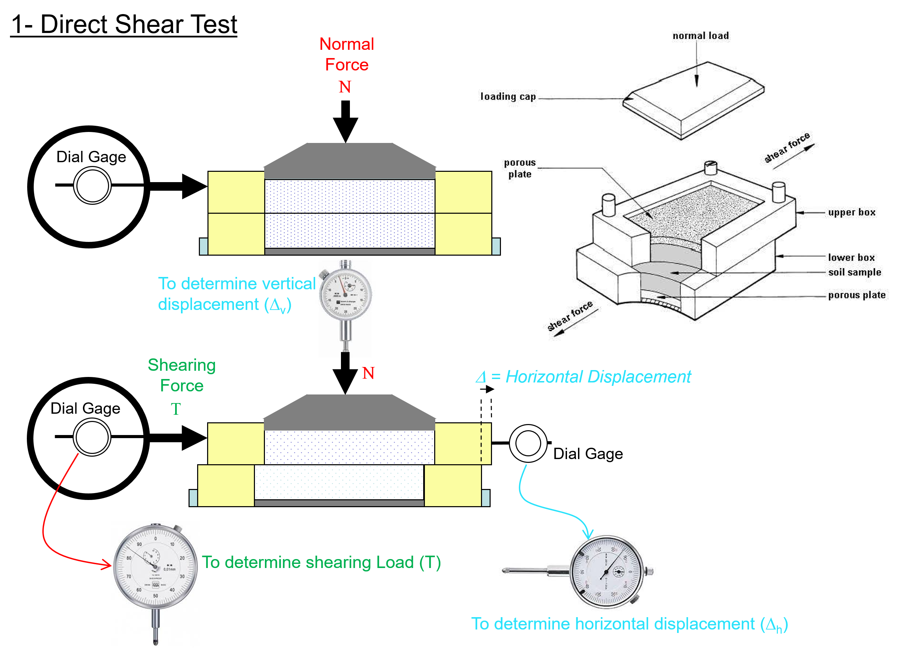
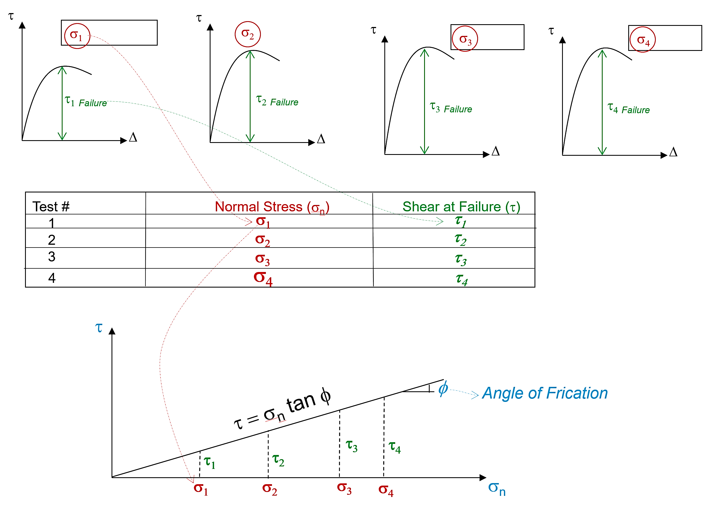
FAMU-FSU College of Engineering
Department of Civil and Environmental Engineering
CEG 3011
Soil Mechanics
Fall 2019
Homework # 8
Soil Strength
Solved the Following Problems
The following are the results of four direct shear tests on sandy soil. If the size of each specimen is 44 mm x 44 mm, draw a graph for the shear stress at failure against the normal stress, and determine the shear strength parameter of the soil.
Test No. | Normal Force (N) | Shear Force at Failure (N)
1 | 200 | 82
2 | 300 | 120
3 | 400 | 160
4 | 550 | 220

Slide 2
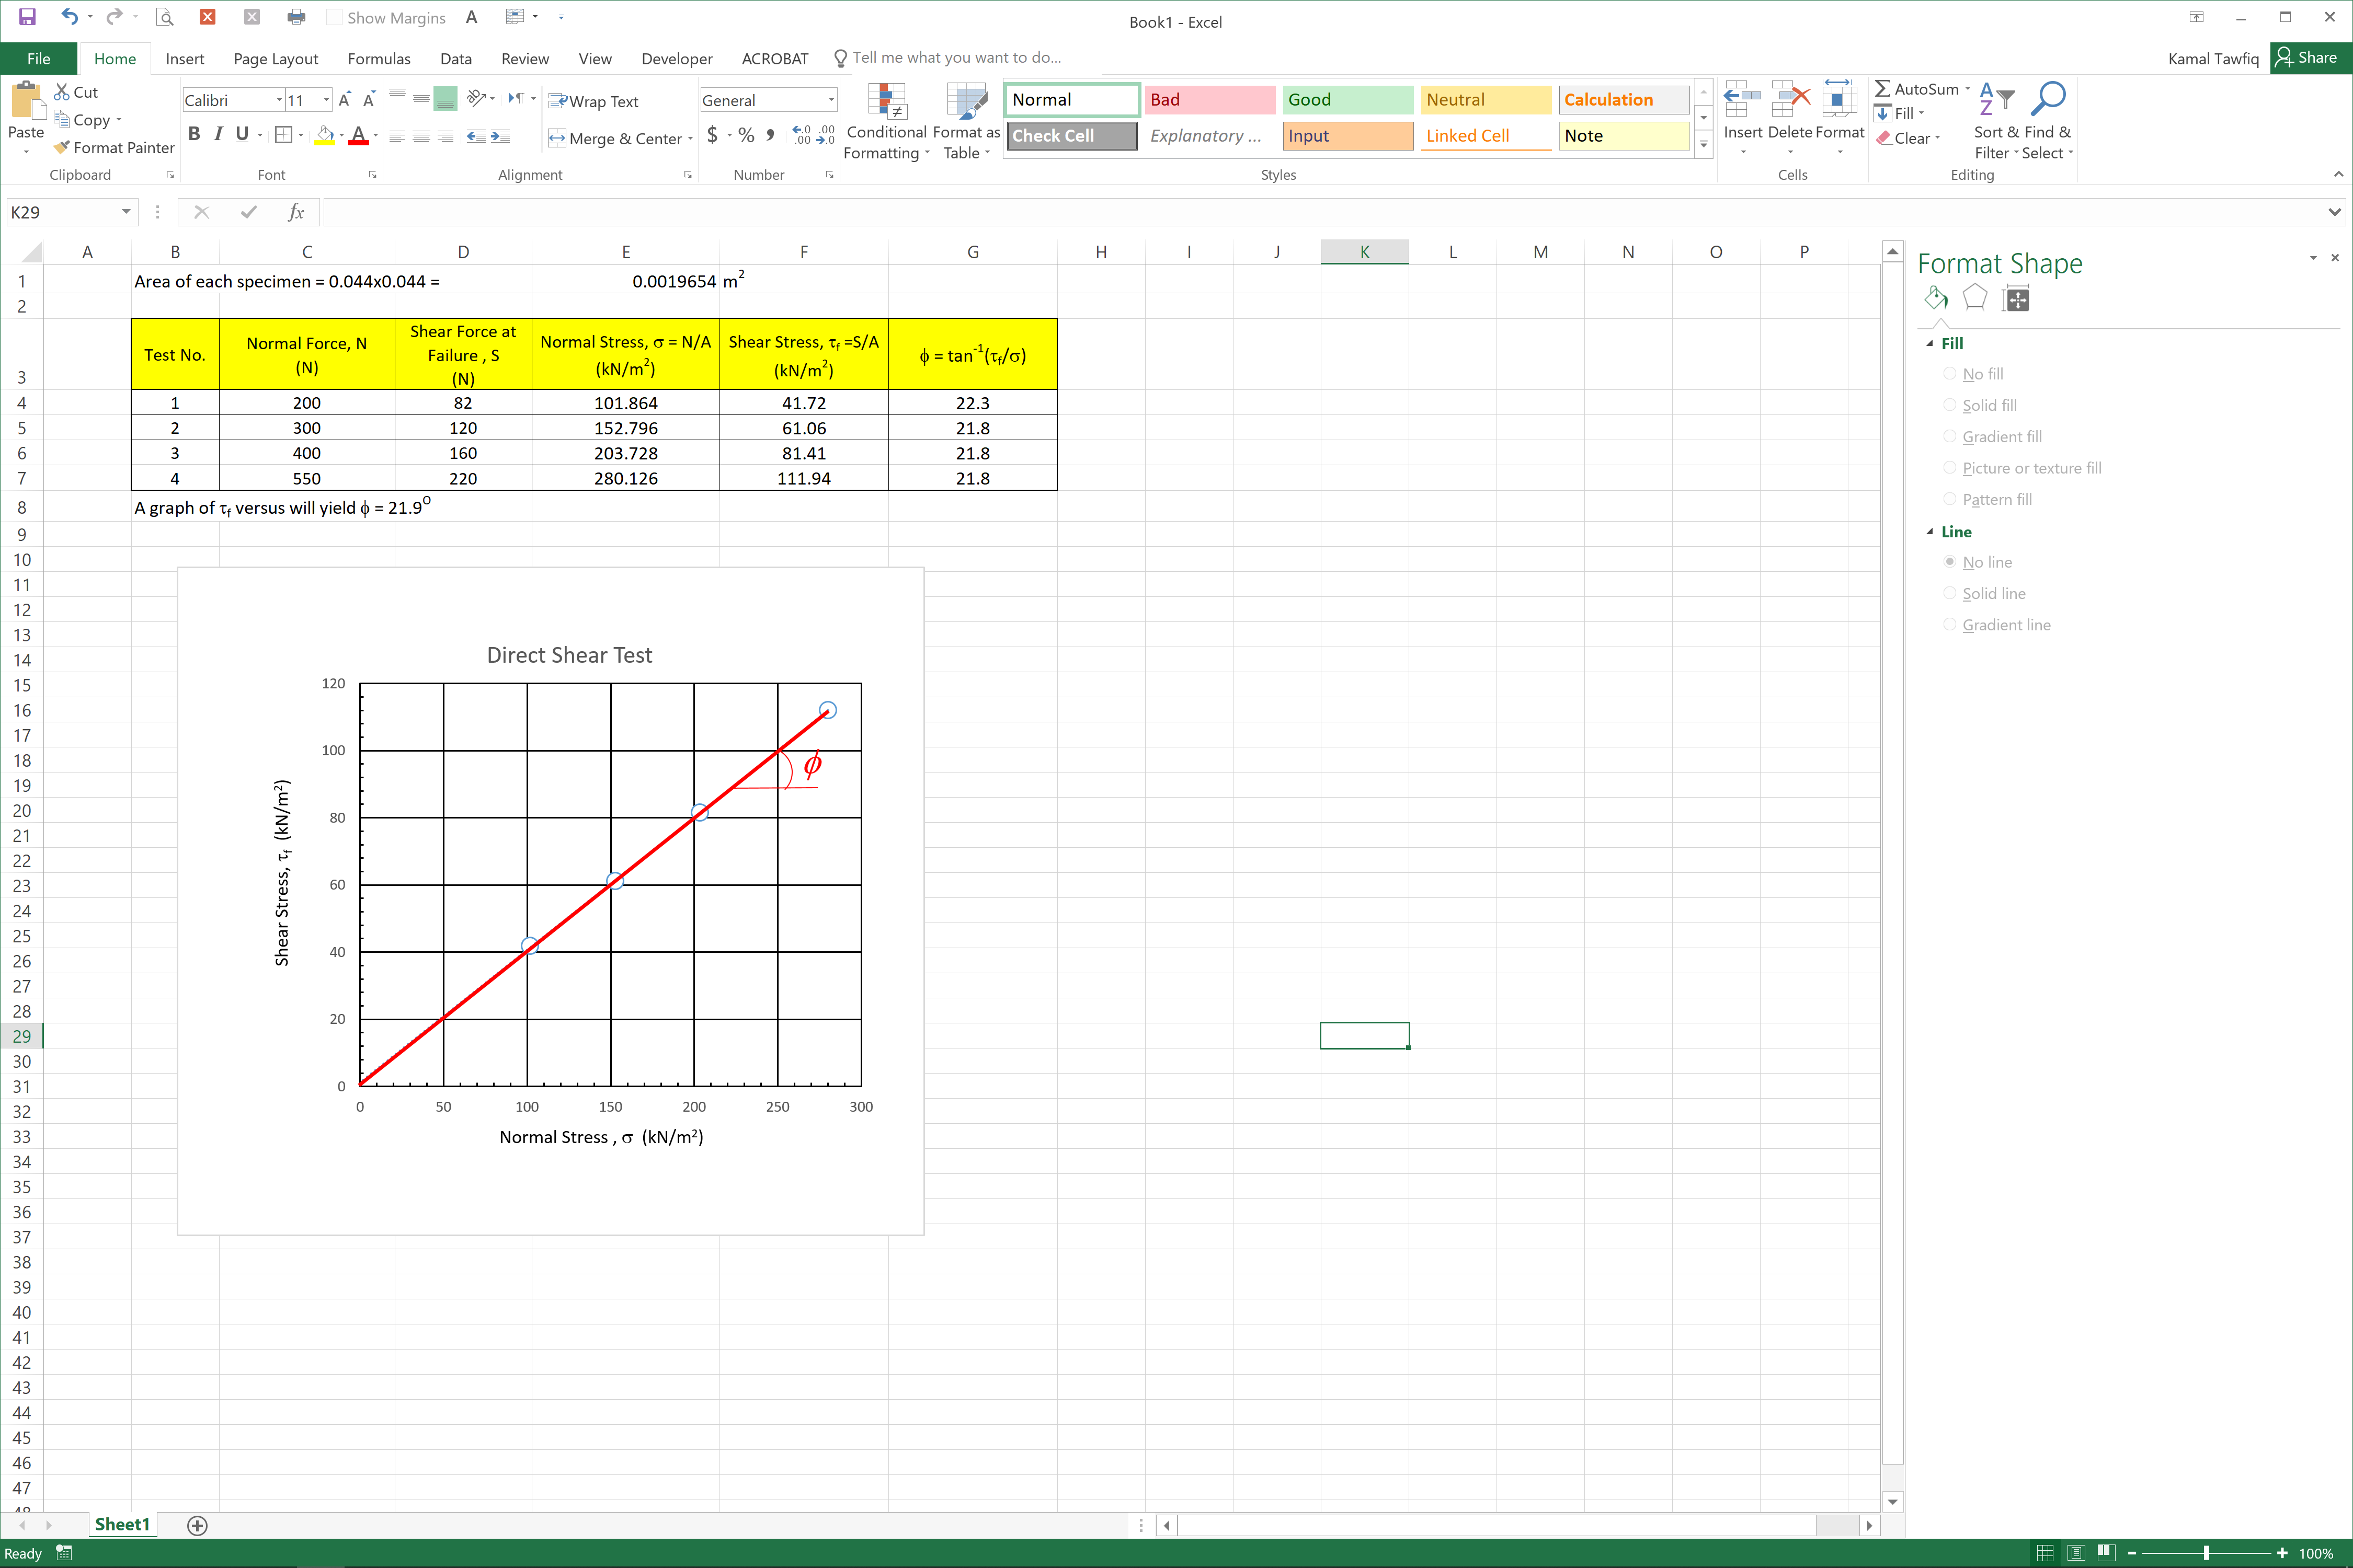
Solution

Slide 6
Δp = Deviator Stress
Triaxial Shear Test
σ₃= Confining Stress
σ₁= Vertical Stress
σ₁ =σ₃+Δp
σ₁ = σ₃+ Δp
Δp
σ₃
σ₃
σ₃
σ₁ = σ₃+ Δp
σ₃
Δp
φ
φ = Angle of Friction of the Soil (Friction between soil particles)
c=Soil Cohesion
τ = c + σ_{n} tanφ
c and φ = soil strength parameters

Slide 7
τ = c + σ_{n} tanφ
1.44
2.88
4.32
1.44+5.76
2.88+6.85
4.32+7.50

