Slide 1
Shear Strength of Soil
By
Kamal Tawfiq
Fall 2019

Slide 2
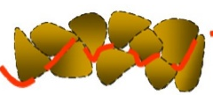
Shear Strength
Questions:
What are the stress vs. strain relationships for materials ????????
Linear Elastic
Nonlinear Elastic
Elastic Plastic
Plastic
Rigid Plastic
What is the strength of any material ????????
Upper limit of the stress – Strain relationship
Why shear strength in soil ?????????
Compressive strength of soil is good
No tensile strength
Shear strength is the most critical
Pick strength
Two types of Soil when it comes to stress vs. strain relationships
Stress = σ
Soft Soil
(Loose sand & normally consolidated Clay)
Stiff Soil (Stiff sand and overconsolidated soil)
Peak Strength
Strain = ε
Residual Strength
Normal Stresses
Shear Stresses

Slide 3
Soil Shear Strength
What is shear strength ????
τ
Soil in weak in shear
To determine the shear strength of soil Mohr-Coulomb Yield Criterion is used
τ = c + σ_{n} tan φ
σ_{n}
Mohr-Coulomb Domain
τ
Yield Surface
Or
Failure Envelope
Mohr-Cuolomb
Yield Criterion
Soil Cohesion
Angle of Friction
Normal Stress
τ = c + σ_{n} tan φ
φ
c
σ_{n}
Determination of Soil Strength Parameters ( c and φ ) in the Lab
1- Direct Shear Test
2- Unconfined Compression Test
3- Triaxial Compression Test
Fine Soils
1- Unconsolidated Undrained Test (UU) – Quick Test – Short Term Analysis
2- Consolidated Undrained Test (CU)
3- Consolidated Drained Test (CD) – Slow Test – Long Term Analysis

Slide 4
I – Direct Shear Test

Slide 5
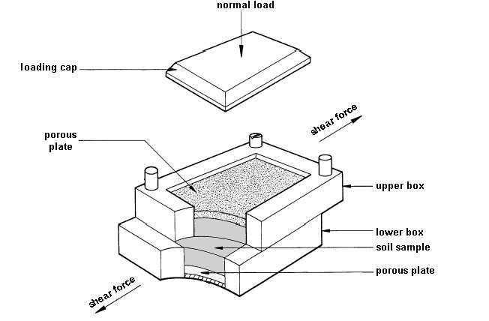
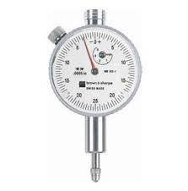
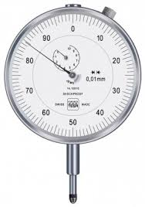
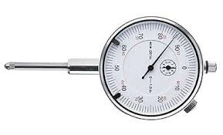
1- Direct Shear Test
Normal Force
Ν
Dial Gage
To determine vertical displacement (Δ_{v})
Shearing Force
Ν
Δ = Horizontal Displacement
Dial Gage
Τ
Dial Gage
To determine shearing Load (T)
To determine horizontal displacement (Δ_{h})

Slide 6
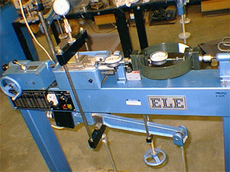
Normal Force = N
Direct Shear Test
Δ = displacement
Shearing Force = T
Shear Resistance
Repeat this test three times.
Each time increase “N”
- Record σ_{n} and τ_{max} for each test
Plot σ_{n} and τ_{max} for each test
Fit a straight line through the 3 points
Find c and φ
τ = T/A
σ_{n1} = N/A
Soil
τ_{max}
τ
Δ
φ
= Angle of
Internal
Friction
τ = c + σ tan ϕ
τ_{max2}
Cohesion = c
τ_{max1}
τ_{max3}
σ_{n}
σ_{n1}
σ_{n2}
σ_{n3}
By Kamal Tawfiq, Ph.D., P.E.

Slide 7
Direct Shear Test
τ
τ
τ
σ₃
σ₁
σ₂
τ = Τ/Α
σ_{n} = N/A
τ₁ _{Failure}
τ₂ _{Failure}
τ₃ _{Failure}
Δ
Δ
Δ
τ _{peak}
τ _{Failure}
τ _{res}
Δ
Test # Normal Stress (σ_{n}) Shear at Failure (τ)
1
2
3
σ₁
τ₁
σ₂
τ₂
σ₃
τ₃
τ
c - φ Soil
τ = c + σ_{n} tan φ
φ
Angle of Frication
Cohesion
τ₁
τ₂
τ₃
Example: Sandy - Clay
c
σ₁
σ₂
σ₃
σ_{n}

Slide 8
Direct Shear Test
τ
τ
σ₁
σ₂
τ
σ₃
τ₁ _{Failure}
τ₂ _{Failure}
τ₃ _{Failure}
Δ
Δ
Δ
Test # Normal Stress (σ_{n}) Shear at Failure (τ)
1
2
3
σ₁
τ₁
σ₂
τ₂
σ₃
τ₃
τ
φ Soil
φ
Angle of Frication
τ = σ_{n} tan φ
Example: Sand
τ₃
τ₄
C = 0
τ₁
τ₂
σ₁
σ₂
σ₃
σ₄
σ_{n}

Slide 9
Direct Shear Test
τ
τ
τ
σ₁
σ₂
σ₃
τ₁ _{Failure}
τ₂ _{Failure}
τ₃ _{Failure}
Δ
Δ
Δ
Test # Normal Stress (σ_{n}) Shear at Failure (τ)
1
2
3
σ₁
τ₁
σ₂
τ₂
σ₃
τ₃
τ
c - Soil
τ = c
φ =0
Example: Clay
C
τ₁
τ₂
τ₃
σ₁
σ₂
σ₃
σ₄
σ_{n}

Slide 10
II - Unconfined Compression Test

Slide 11
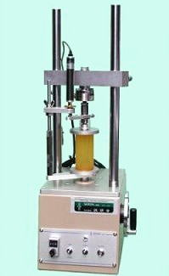
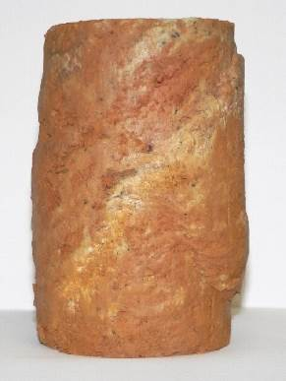
Unconfined Compression Test
Deviator Stress
Δσ
Δσ _{Failure}
ε
τ
α = 45º
Failure Surface
τ = c_{u}
φ = 0
C_{u} = q_{u}/2
= 0
α = 45º + φ/2
σ₁
σ_{n}
q_{u} = Unconfined compressive strength
C_{u} = Unconfined shear strength
C_{u} = q_{u}/2
q_{u} = σ₁

Slide 12
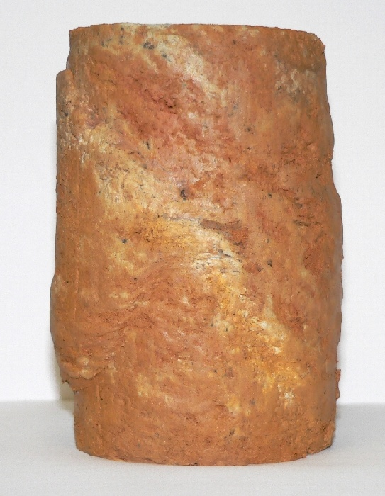
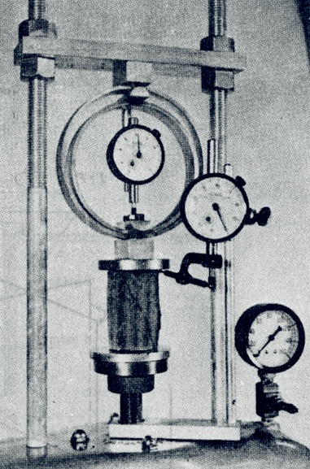
Unconfined Compression Test

Slide 13
III - TRIAXIAL COMPRESSION TEST

Slide 14
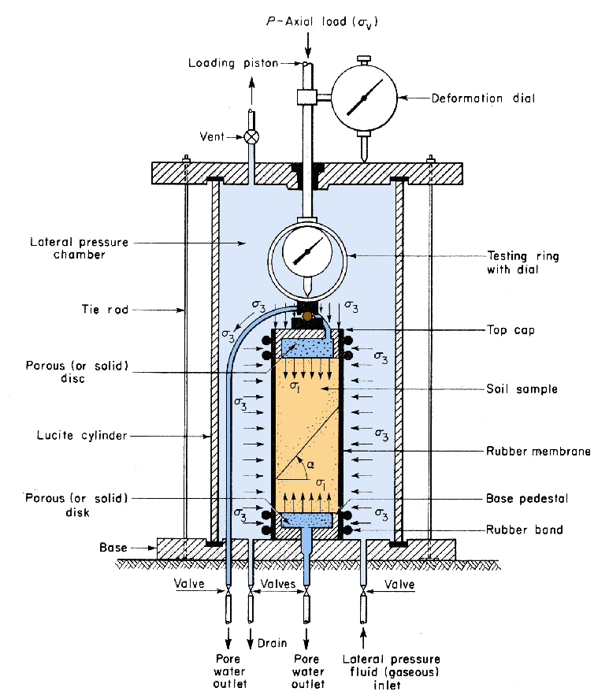
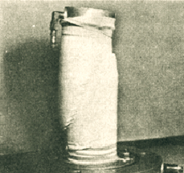
TRIAXIAL COMPRESSION TEST
α = 45º + φ/2
Failure Surface
By Kamal Tawfiq, Ph.D., P.E.

Slide 15

Triaxial Compression Test
1- Applying
2- Loading
3- At Failure
Confining
Stresses
=
F
1
Axial
)
F
Deviator stress
=
)
F
stress
+
f
+
F
2
F
2
Confining stress
=
F
2
Each Circle
F
F
F
F
F
F
=
2
2
2
2
2
2
2
One Test
F
2
F
2
F
2
Failure
+
+
Surface
F
= Major
Principle Stress
)
F
)
F
f
F
F
1
= Minor Prencipal Stress
)F
= deviator stress
=
1
J
2
Failure Surface
Cohesion =
c
2
F
F
F
F
2
F
2
1
F
1
F
1
2
n
By Kamal Tawfiq, Ph.D., P.E.

Slide 16
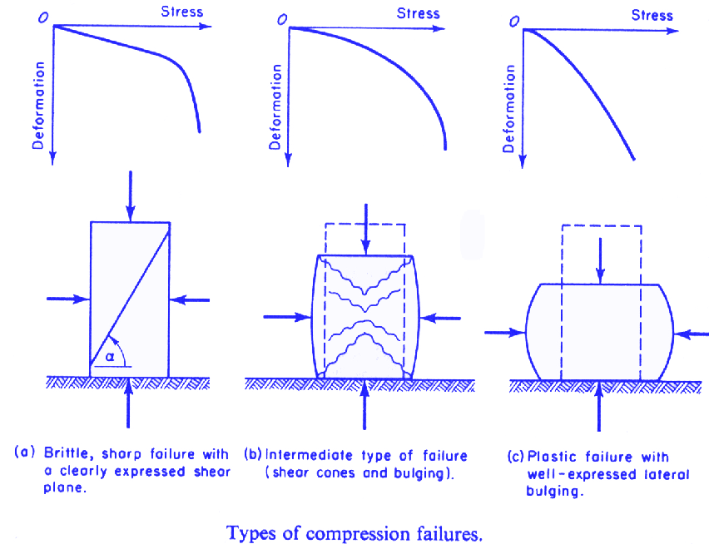

Slide 17
Triaxial Compression Test
1- Consolidated Undrained Test (CU)
Deviator Stress
Δσ
Step 1
Step 2
σ₂
Δσ _{Failure}
ε
τ
σ₁ = Δσ + σ₂
Confining
Pressure
Δσ
Δσ
φ_{u}
σ₂
σ₂
τ= c + σ_{n} tan φ
σ₂
σ₂
σ₂
σ₂
σ₂
σ₂
σ₂
σ₂
c_{u}
σ₁
σ₂
σ₂
σ₂
σ₁
σ₁
σ_{n}
σ₂
σ₂
σ₁ − σ₂
σ₁ − σ₂
Δσ

Slide 18
Triaxial Compression Test
2- Consolidated Drained Test (CD)
Deviator Stress
Δσ
Step 1
Step 2
σ₂
Δσ _{Failure}
ε
σ₁ = Δσ + σ₂
Confining
Pressure
Δσ
τ
σ₂
σ₂
φ_{d}
σ₂
σ₂
σ₂
τ= c + σ_{n} tan φ
σ₂
σ₂
c_{d}
σ₂
σ₂
σ₂
σ₁
σ₁
σ₁
σ_{n}
Δσ
σ₁ − σ₂
σ₁ − σ₂

Slide 19
Triaxial Compression Test
3- Unconsolidated Undrained Test (UU)
Deviator Stress
Δσ
Step 1
Step 2
σ₂
Δσ _{Failure}
ε
τ
σ₁ = Δσ + σ₂
Confining
Pressure
Δσ
σ₂
σ₂
τ= c
c_{u}
σ₂
σ₂
σ₂
σ₂
σ₂
σ₂
σ₁
σ₁
σ₁
σ_{n}
σ₂
σ₂
σ₁ − σ₂
σ₁ − σ₂
Δσ

Slide 21
