Slide 1
Slope Stability Analysis
for Landfills and Embankments
Geotechnical Design
CGN 4801
By
Kamal Tawfiq, Ph.D., P.E.

Slide 2
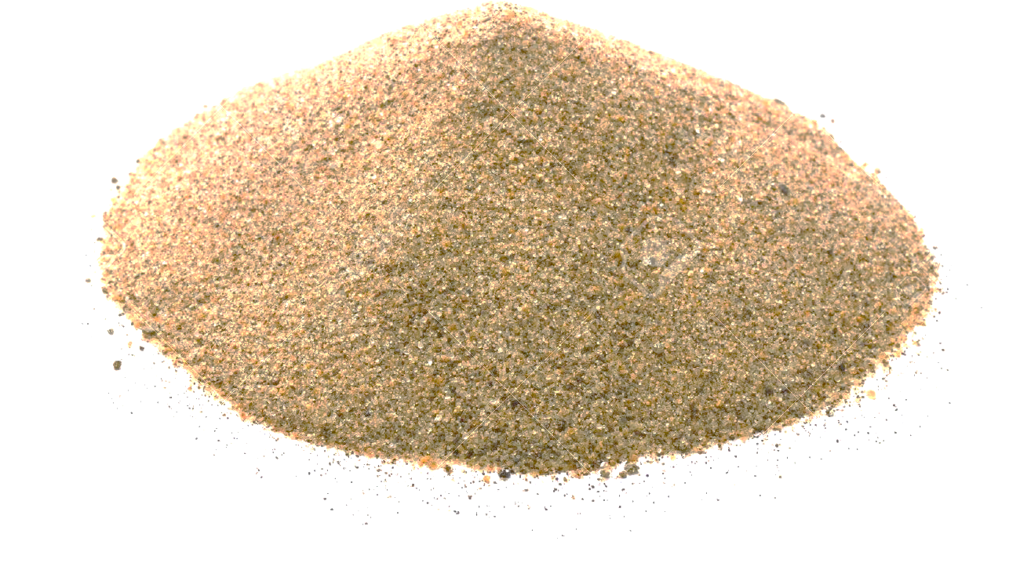

Slide 3
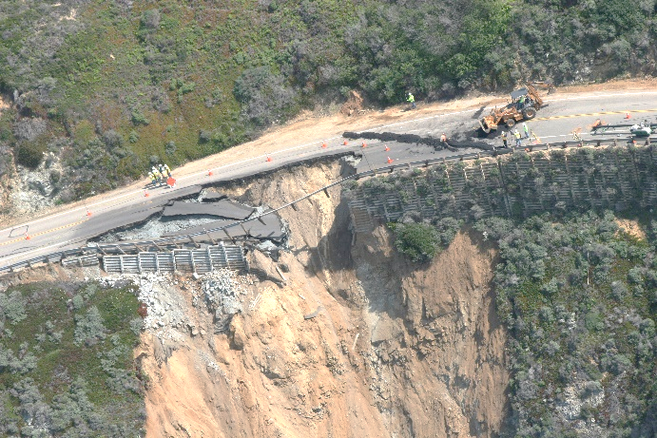
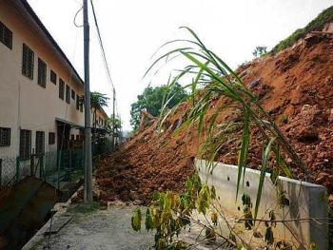
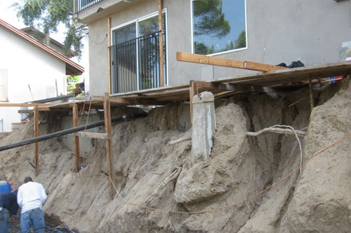
Slope Stability Analysis and Design
Slope stability analysis is performed to assess the safe design of a human-made or natural slopes (e.g. embankments, road cuts, open-pit mining, excavations, landfills etc.) and the equilibrium conditions.
The main objectives of slope stability analysis are finding endangered areas, investigation of potential failure mechanisms, determination of the slope sensitivity to different triggering mechanisms, designing of optimal slopes with regard to safety, reliability and economics, designing possible remedial measures, e.g. barriers and stabilization.

Slide 4
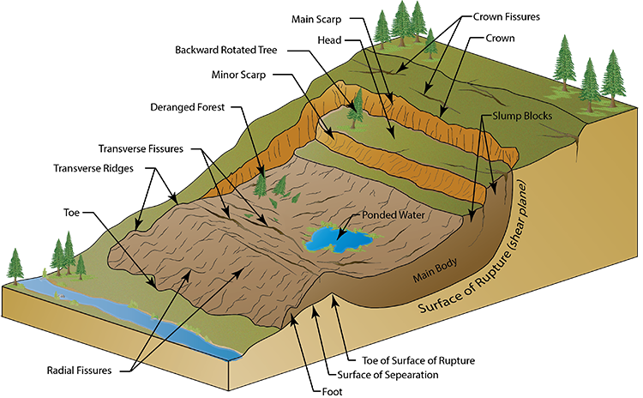
FACTORS AFFECTING SLOPE STABILITY
1- Soil Type
2- Geometry of the cross section (Height, slope angle, etc.)
3- Moisture Content
4- Pore water pressure
5- Additional loads
6- Shear Strength reduction
7- Vibrations and Earthquake
By Kamal Tawfiq, Ph.D., P.E.

Slide 5
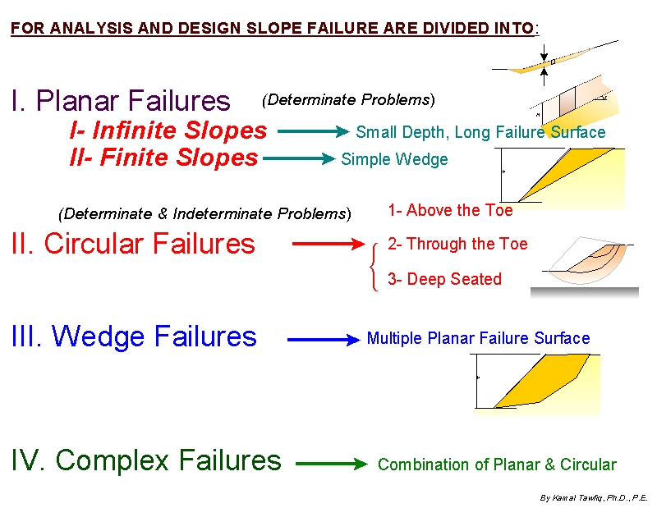
To Analyze and Design Slopes, We use the Following Categories

Slide 6
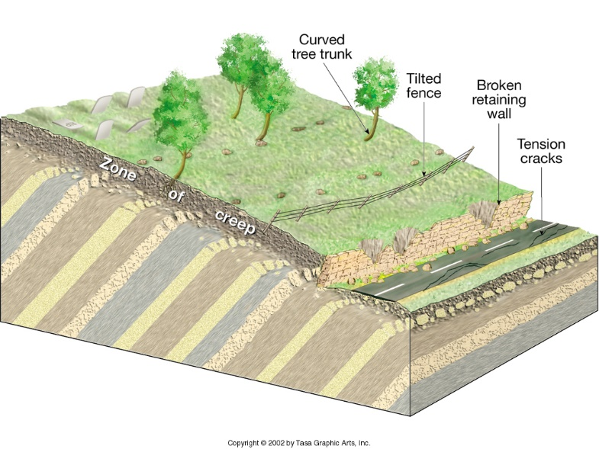
Driving Force = T = W . sinβ
Resisting Force = F = N tanδ = (W.cosβ) tanδ
F.S. = F_{resisting}/F_{driving}
T
W
N
Friction = N tan δ
β
T
W
N
Friction = N tan δ
β

Slide 7
The Concept of Developed Friction
Driving Force = T = W . sinβ
Developed Friction
Resisting Force = F = N tanδ = (W.cosβ) tanδ
F.S. = F_{resisting}/F_{driving}
T
F.S. = 2.5 =
Resisting Force
N
W
Driving Force
Friction = N tan δ_{developed}
β
F.S. = 1 =
Resisting Force
T
Driving Force
W
N
Friction = N tan δ
On the verge of failure
β

Slide 8
FACTOR OF SAFETY
1- For Shear Strength
τ_{developed} = τ / F.S.
τ_{developed} = (c + σ tanϕ) / F.S.
2- For Shear Parameters
c_{d} = c / F.S.
tanϕ_{d} = tanϕ / F.S.
3- For Height of the Slope
H_{design} = H_{c} / F.S.
Developed cohesion or
Mobilized cohesion
Developed angle of friction

Slide 9
H
INFINITE SLOPE
I. PLANAR FAILURE or Transitional Failure
b = 1 cosβ
A- Dry Soil (ϕ soil)
1
b = 1 cosβ
β
W = γ H cosβ
Normal Component, F_{V} = W cos β
Driving Force, F_{D} = W sin β
β
Failure
Surface
H
Weight = W
τ = N tanϕ
Shear Resistance
N = Fv = W cos β
By Kamal Tawfiq, Ph.D., P.E.

Slide 10
A- Dry Soil (ϕ soil)
W = γ H cosβ
b = 1 cosβ
Driving Force = F_{D} = γ H cos β sinβ
Resisting Force = F_{R} = γ H cos β cosβ tanϕ
FS = F_{R}/F_{D}
G.S.
β
γ H cos β cosβ tanϕ
b = 1 cosβ
FS =
1
γ H cos β sinβ
tanϕ
FS =
β
tanβ
Normal Component, F_{V} = W cos β
Driving Force, F_{D} = W sin β
β
Failure
Surface
H
Weight = W
τ = N tanϕ
N = Fv = W cos β
By Kamal Tawfiq, Ph.D., P.E.

Slide 11
B- Submarged Soil (ϕ soil)
W = γ H cosβ
_
Driving Force = F_{D} = γ H cos β sinβ
Resisting Force = F_{R} = γ H cos β cosβ tanϕ
FS = F_{R} / F_{D}
_
W.T
_
G.S.
γ H cos β cosβ tanϕ
FS =
_
b = 1 cosβ
γ H cos β sinβ
1
tanϕ
Driving Force, F_{D} = W sin β
FS =
β
tanβ
Normal Component, F_{V} = W cos β
H
β
Failure
Surface
Weight = W
τ = N tanϕ
N = Fv = W cos β

Slide 12
C- Seepage Parallel to Slope (ϕ soil)
Pore Water Pressure (u)
tanϕ
γ_{w} Z
FS =
(1-
)
tanβ
γ_{soil}H cos²β
G.S.
Seepage
b = 1 cosβ
1
Normal Component, N_{eff} = (W – u) cos β
β
Driving Force, F_{D} = W sin β
Z = Pressure Head
What is Pressure Head?
What is Total Head?
What is Elevation Head?
Total Head = Elevation Head+ Pressure Head
Go to Next Page
H
β
Failure
Surface
Weight = W
τ = N_{eff} tanϕ
N_{eff} = (W-u) cos β
By Kamal Tawfiq, Ph.D., P.E.

Slide 13
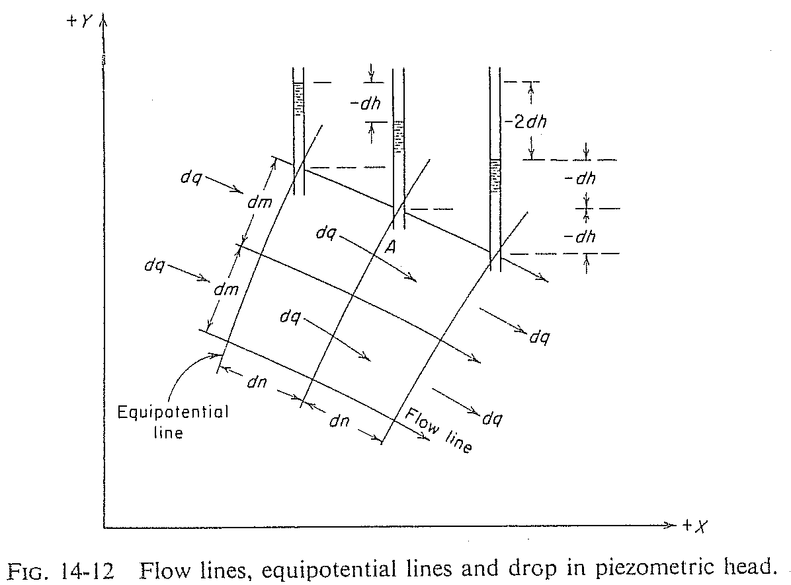
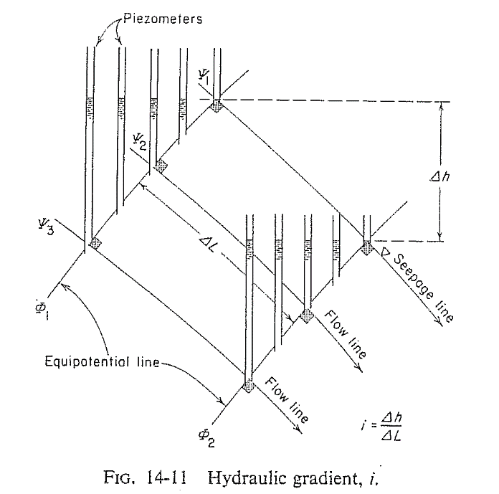
Total Head, Elevation Head and Pressure Head
Total Head = Elevation Head+ Pressure Head
Head Loss
Pressure
Head
Elevation
Head
phreatic line
Atmospheric Pressure Line
Flow Line
Ground Surface
Flow Line
Datum
Flow Line
Failure Surface
Pressure
Head
Elevation
Head
Pressure
Head
Pore Water Pressure (u)
=
Pressure head *( γ_{water} )
=
γ z
Elevation
Head
Elevation
Head
Equipotential Line
Datum

Slide 14
For the infinite slope shown below, what is the pore water pressure at point A ?
Z = d_{w} cos α (cos α)
b
Soil Surface
b/cos α
Water Table
Z = Pressure Head
Pore Water Pressure (u) = γ_{water} * γ z
W
Assumed failure surface
d
d_{w}
T
Z
N’
α
d_{w}cos α
Z
A
U
B
α

Slide 15
D- Infinite Slope in c - ϕ soil (with seepage)
c
+
u
tanϕ
FS =
(1-
)
γ_{soil} H cosβ sinβ
γ_{soil} H cos²β
tanβ
If no seepage:
u = 0
If Submerged Slope:
u = 0 γ = γ’
G.S.
b = 1 cosβ
1
Normal Component, F_{V} = W cos β
β
Driving Force, F_{D} = W sin β
H
β
Failure
Surface
Weight = W
τ = C + N tanϕ
N = Fv = W cos β
By Kamal Tawfiq, Ph.D., P.E.

Slide 16
(with seepage)
Critical Height H_{c} at FS = 1
seepage
c
+
u
)
tanϕ
= 1
H
FS =
(1-
γ_{soil} H cosβ sinβ
γ_{soil} H cos²β
tanβ
β
c
- u tanϕ
W sinβ
β
H_{c} =
W cosβ
γ_{soil} cos²β (tanβ - tanϕ)
Weight = W
τ = C + N tanϕ
N = Fv = W cos β
Stability Number Ns
c
u
Ns =
r_{u} =
= pore water pressure ratio
γHc
γH
c
c_{dev} =
FS_{c}
General Equation:
c
tanφ
tanφ_{dev} =
H_{c} =
FS_{φ}
γ_{soil} [sinβ cosβ - tanϕ (cos²β - r_{u})]
tanφ
Or
φ_{dev} = tan⁻¹ ( )
FS_{φ}
c_{dev}
H =
γ_{soil} [sinβ cosβ - tanϕ_{dev} (cos²β - r_{u})]
By Kamal Tawfiq, Ph.D., P.E.

Slide 17
General Equation:
c
H_{c} =
γ_{soil} [sinβ cosβ - tanϕ (cos²β - r_{u})]
seepage
H
β
c
β
N_{s} =
= sinβ cosβ - tanϕ (cos²β - r_{u})
γH_{c}
N_{s} =
c_{d}
= sinβ cosβ - tanϕ_{d} (cos²β - r_{u})
γH
Ns =
c_{d}
= sinβ cosβ - tanϕ_{d} (cos²β - r_{u})
γH
c
ϕ = 15º
c_{d} =
c
FS_{c}
N_{s} =
ϕ = 25º
γH_{c}
ϕ = 35º
tanϕ
ϕ = 45º
tanϕ_{d} =
FS_{φ}
β

Slide 18
To Analyze and Design Slopes, We use the Following Categories

Slide 19
Finite Failure Planar Failure
γH
1- cos (β -ϕ_{d})
Sin β cos ϕ_{d}
C_{d} =
4
4c
Sin β cos ϕ
1- cos (β - ϕ)
4c_{d}
Sin β cos ϕ_{d}
1- cos (β - ϕ_{d})
H_{cr} =
or
H =
γ
γ
C
B
Driving Force = F_{d} = W sinβ
β
N = W cos β
W
γ = ✓
ϕ = ✓
c = ✓
H
τ = c + σ tanϕ
A
θ
β

Slide 20
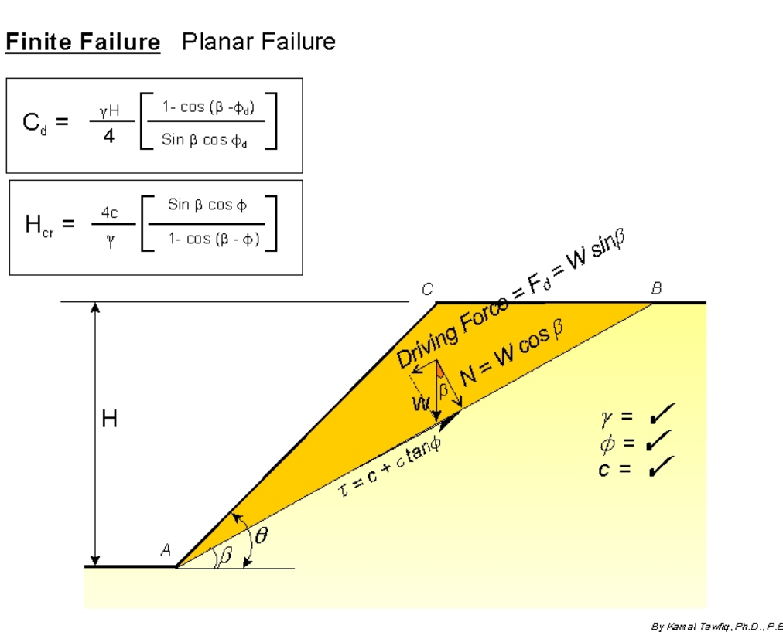
Example:
Given:
β= 30º
H = 10 ft
= 32º
c = 180 psf
Find:
F.S. of the Slope
4c_{d}
Sin β cos ϕ_{d}
1- cos (β - ϕ_{d})
H =
γ

Slide 21
Circular Failure Surface (Cohesive Soil)
Determinate Problem
Number of Unknowns = Number of Equilibrium Equations
M_{resisting}
F.S. =
M_{driving}
Center
R
θ
C
B
R
M_{driving} = W₁ . a₁
W₁ = Area (BCDE) . γ_{soil}
R
R
D
a₁
A
W₂
a₂
W₁
c . L
E
M_{resisting} = c . L + W₂ . a₂ = c . (R.θ) R + W₂ . a₂
By Kamal Tawfiq, Ph.D., P.E.

Slide 22
Circuler Failure Surface in C - φ Soil
Indeterminate Problem
Number of Unknowns ≠ Number of Equilibrium Equations
W varies from point to point. Therefore, N & F will vary from point to point
Center
R
W1
W2

Slide 23
Circuler Failure Surface in C - φ Soil
Indeterminate Problem
Number of Unknowns ≠ Number of Equilibrium Equations
W varies from point to point. Therefore, N & F will vary from point to point
Center
R
W
W cosθ
W sinθ
θ
τ
φ
N
θ
F

Slide 24
Stability Number
A variety of charted solutions exist for the simple geometry considered above.
For the undrained (total stress) analysis of slopes charts produced by Taylor are often used.
The charts are based on the analysis of circular failure surfaces, and assume that soil strength is given by a Mohr-Coulomb analysis
Tension cracks are not considered

Slide 25
Taylor’s Method
H
nH
DH
αi
By Kamal Tawfiq, Ph.D., P.E.

Slide 26
Taylor’s Chart

Slide 28
Taylor’s Chart
Example - 1
c_{u} = 20 kN/m²
φ_{u} = 10º
γ_{bulk} = 15 kN/m³
F.S. = 1.5
H = ?
o
30
Since the factor of safety is given, then the problem indicates a design of a new slope
Solution:
φ_{mobilized} = φ_{developed}
tan 10º
Use the chart with i = 30º, and φ_{mob} = tan⁻¹ (
)
= 6.7º
1.5
20/1.5
SN = 0.1 =
15 x H_{design}
20/1.5
H_{design} = = 8.88 m
15 x 0.1
φ_{mob}
SN = 0.1

Slide 29
Taylor’s Chart
Example - 2
c_{u} = 20 kN/m²
φ_{u} = 10º
γ_{bulk} = 15 kN/m³
F.S. = ????
H = 7 m
o
30
Since the factor of safety is not given, then the problem indicates an existing slope that we need
to analyze its safety.
φ_{mobilized} = φ_{developed}
Solution:
Trial # 1
1- Assume FS_{φ} = 1
tan 10º
2- Use the chart with i = 30º, and φ_{mob} = tan⁻¹ (
)
= 10º
1.0
3- Go to the chart and find SN for φ_{mob} = 10º
c_{mob}
φ_{mob}
SN = 0.075 =
15 x 7
4- c_{mob} = 15 x 7 x 0.075 = 7.87 kN/m²
5- FSc = c / c_{mob} = 20/7.87 = 2.5
Therefore the Assumed FSφ = the calculated FS_{c}
SN = 0.075

Slide 30
This means the assumed factor of safety was not the right one. So we need
to assume another FSφ and solve the problem again for FS_{c}.
Trial # 2
1- Assume FS_{φ} = 1.5
tan 10º
2- Use the chart with i = 30º, and φ_{mob} = tan⁻¹ (
)
= 6.7º
1.5
3- Go to the chart and find SN for φ_{mob} = 6.7º
c_{mob}
SN = 0.1 =
15 x 7
4- c_{mob} = 15 x 7 x 0.10 = 10.5 kN/m²
5- FSc = c / c_{mob} = 20/10.5 = 1.9
Therefore the Assumed FSφ = the calculated FS_{c}
φ_{mob}
This means the assumed factor of safety was not the right one. So we need
to assume another FSφ and solve the problem again for FS_{c}.
SN = 0.1

Slide 31
Trial # 3
1- Assume FS_{φ} = 1.8
tan 10º
2- Use the chart with i = 30º, and φ_{mob} = tan⁻¹ (
)
= 5.5º
1.8
3- Go to the chart and find SN for φ_{mob} = 5.5º
c_{mob}
SN = 0.11 =
15 x 7
4- c_{mob} = 15 x 7 x 0.11 = 11.55 kN/m²
5- FSc = c / c_{mob} = 20/11.55 = 1.73
Therefore the Assumed FSφ = the calculated FS_{c}
This means the assumed factor of safety was not the right one. So we need
to assume another FSφ and solve the problem again for FS_{c}.
φ_{mob}
SN = 0.11

Slide 32
Since we complied three different trials, we are ready to find the right
factor of safety by using the 45º line method
Assumed FSφ Calculated FS_{c}
1.0 2.5
1.5 1.9
1.8 1.73
So the correct FS is 1.75
1.75
1.75

Slide 33
Taylor’s Chart - example
Zones are marked on the chart indicating whether the failure mode will be shallow or deep-seated.
If a deep-seated failure is indicated the soil layer must be sufficiently deep to enable this mechanism to occur.
There is a second chart due to Taylor which can be used when the depth of soil below the base of the slope is limited
This chart is only valid for φ = 0

Slide 35
Taylor’s Chart - example with finite depth
8 m
o
30
2 m
Rock
Calculate the Depth Factor D

Slide 36
Taylor’s Chart - example with finite depth
8 m
o
DH
30
2 m
Rock
Calculate the Depth Factor D
DH = 10 m

Slide 37
Taylor’s Chart - example with finite depth
8 m
o
DH
30
2 m
Rock
Calculate the Depth Factor D
DH = 10 m, H = 8m
D = 1.25

Slide 39
Taylor’s Chart - example with finite depth
8 m
o
DH
30
2 m
D = 1.25
Rock
C_{dev}
= 0.165
15 x 8
C_{dev} = 0.165 x 15 x 8 = 19.8 kN/m² FS = 1.01

Slide 40
STATICALLY INDETERMINATE PROBLEMS
METHOD OF SLICES
Center
Center
Xi
Δx
3
2
1
5
4
6
R
11
8
7
10
9
Si
αi
Ei
ϕ
S + ΔS
W_{i} cos α
E + ΔE
T_{i} = c.L + N_{effi} tan ϕ
Wi
αi
Wi
L
Wi sin α
ϕ
N_{i} = N_{effi} + u_{i} L
T_{i} = c.L + N_{eff} tan ϕ
αi
N_{i} = N_{eff} + u_{i} L
αi
Resultant
By Kamal Tawfiq, Ph.D., P.E

Slide 41
Center
Xi
Unknowns Associated with Force Equilibrium
n = Resultant normal forces N_{i} on the base of each slice or wedge
1 = Safety factor, which permits the shear forces Ti on the base of each
slice to be expressed in terms of Ni
n-1 = Resultant normal forces Ei on each interface between slices or wedges
n-1 = Angles αi which express the relationships between the shear force Si
and the normal force Ei on each interface
Δx_{i}
R
S + ΔS
Si
Ei
θ_{i}
E_{i} + ΔE
Wi
T_{i} = c.L_{i} + N_{effi} tan ϕ
L_{i}
bi
N_{i} = N_{effi} + u_{i} L_{i}
ϕ
α_{i}
αi
αi
α_{i}
Resultant
ai
By Kamal Tawfiq, Ph.D., P.E

Slide 42
FELLENIUS METHOD (ORDINARY METHOD, SWEDISH METHOD)
Wi cos α
Center
Xi
Wi
T_{i} = c.L + N_{effi} tan ϕ
αi
Wi sin α
Δx_{i}
R
Si
N_{i} = N_{effi} + u_{i} L
S + ΔS
Ei
E_{i} + ΔE
Wi
T_{i} = c.L_{i} + N_{effi} tan ϕ
L_{i}
F
M_{R} ∑CL_{i} +(w_{i}cosθ_{i} -u_{i}L_{i})tanϕ
bi
=
=
M_{D} ∑w_{i} sinθ_{i}
N_{i} = N_{effi} + u_{i} L_{i}
ϕ
α_{i}
αi
αi
α_{i}
Resultant
ai
By Kamal Tawfiq, Ph.D., P.E

Slide 43
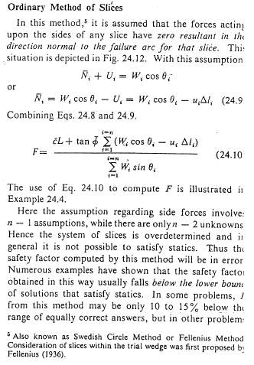

Slide 44
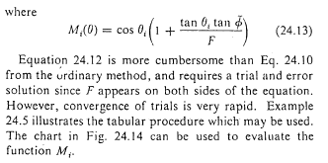

Slide 45
This example is from Lambe and Whitman (1969), John Wiley & Sons Publisher
Center of failure Surface
R = 30 ft
= 125 lb/ft³
c = 90 lb/ft²
φ = 32^{ο}
8
9
7
20 ft
1.5
6
1.0
5
h_{w7}
4
h_{w6}
3
2
1
Drain
Stiff Layer
Pore Water Pressure = u₆ = h_{w6} x γ _{water}
Kamal Tawfiq, Ph.D., P.E.

Slide 46
1- Using Ordinary Method of Slices (Swedish Method)
Slice | Width Δx (ft) | Ave Height (ft) | Weight (Kips) | θ_{i} | W_{i} sin θ_{i} | W_{i} cos θ_{i} | u_{i} | Δl_{i} | U_{i} = u_{i} Δl_{i} | N_{i} = W_{i} cosθ_{i} - U_{i}
1 | 4.5 | 1.6 | 0.9 | -1.7 | 0 | 0.9 | 0 | 4.4 | 0 | 0.9
2 | 3.2 | 4.2 | 1.7 | 2.9 | 0.1 | 1.7 | 0 | 3.2 | 0 | 1.7
3 | 1.8 | 5.8 | 1.3 | 8.05 | 0.2 | 1.3 | 0.03 | 1.9 | 0.05 | 1.25
4 | 5.0 | 7.4 | 4.6 | 14.5 | 1.2 | 4.5 | 0.21 | 5.3 | 1.1 | 3.4
5 | 5.0 | 9.0 | 5.6 | 24.8 | 2.3 | 5.1 | 0.29 | 5.6 | 1.6 | 3.5
6 | 5.0 | 9.3 | 5.8 | 35.4 | 3.4 | 4.7 | 0.25 | 6.2 | 1.55 | 3.15
7 | 4.4 | 8.4 | 4.6 | 47.7 | 3.4 | 3.1 | 0.11 | 6.7 | 0.7 | 2.4
8 | 0.6 | 6.7 | 0.5 | 55.1 | 0.4 | 0.3 | 0 | 1.2 | 0 | 0.3
9 | 3.2 | 3.8 | 1.5 | 60.4 | 1.3 | 0.7 | 0 | 7.3 | 0 | 0.7
 |  |  |  |  | 12.3 |  |  | 41.8 |  | 17.3
Kamal Tawfiq, Ph.D., P.E.

Slide 47
2- Using Simplified Bishop Method
(1) | (2) | (3) | (4) | (5) | (6) | (7) | (8) |  | (9)
 |  |  |  |  |  |  | M_{i} |  | (7)/(8)
Slice | Width Δx (ft) | C Δx_{i} (kips) | u_{i} Δx_{i} (Kips) | W_{i}-u_{i} Δx_{i} (Kips) | (5).(tan φ) (Kips) | (3)+(6) (Kips) | Assume _{F=1.25} | Assume _{F=1.35} | _{F=1.25} | _{F=1.35}
1 | 4.5 | 0.4 | 0 | 0.9 | 0.55 | 0.95 | 0.97 | 0.97 | 1.0 | 1.0
2 | 3.2 | 0.29 | 0 | 1.7 | 1.05 | 1.35 | 1.02 | 1.02 | 1.3 | 1.3
3 | 1.8 | 0.16 | 0.05 | 1.25 | 0.8 | 0.95 | 1.06 | 1.05 | 0.9 | 0.9
4 | 5.0 | 0.45 | 1.05 | 3.55 | 2.25 | 2.7 | 1.09 | 1.08 | 2.5 | 2.5
5 | 5.0 | 0.45 | 1.45 | 4.15 | 2.55 | 3.00 | 1.12 | 1.10 | 2.7 | 2.75
6 | 5.0 | 0.45 | 1.25 | 4.55 | 2.7 | 3.15 | 1.1 | 1.08 | 2.85 | 2.9
7 | 4.4 | 0.4 | 0.5 | 4.1 | 2.65 | 3.05 | 1.05 | 1.02 | 2.9 | 2.95
8 | 0.6 | 0.05 | 0 | 0.5 | 0.3 | 0.35 | 0.98 | 0.95 | 0.35 | 0.4
9 | 3.2 | 0.29 | 0 | 1.5 | 0.95 | 1.25 | 0.93 | 0.92 | 1.3 | 1.35
 |  |  |  |  |  |  |  |  | 15.8 | 16.09
From the previous solution
Kamal Tawfiq, Ph.D., P.E.

Slide 48
Name:__________ ID:________
CEG 4801 Geotechnical Design
Spring 2018
What is the pore water pressure at point A?
Center of failure Surface
R = 30 ft
= 125 lb/ft³
c = 90 lb/ft²
φ = 32^{ο}
1.5
1.0
20 ft
A
Drain
Stiff Layer

