Slide 1
MODULE 7
Section I
Slope Stability Analysis & Design

Slide 2
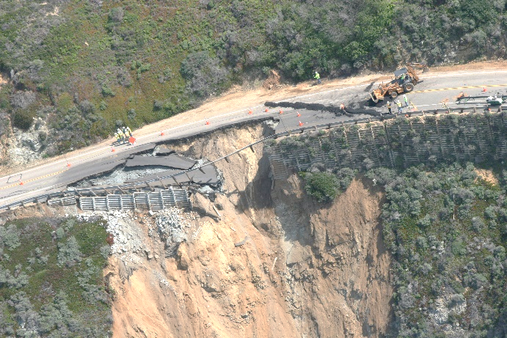
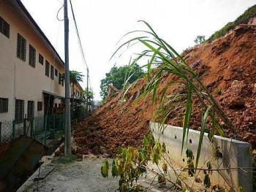
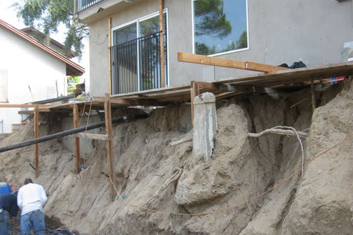
Slope Stability Analysis and Design
Slope stability analysis is performed to assess the safe design of a human-made or natural slopes (e.g. embankments, road cuts, open-pit mining, excavations, landfills etc.) and the equilibrium conditions.
The main objectives of slope stability analysis are finding endangered areas, investigation of potential failure mechanisms, determination of the slope sensitivity to different triggering mechanisms, designing of optimal slopes with regard to safety, reliability and economics, designing possible remedial measures, e.g. barriers and stabilization.

Slide 3
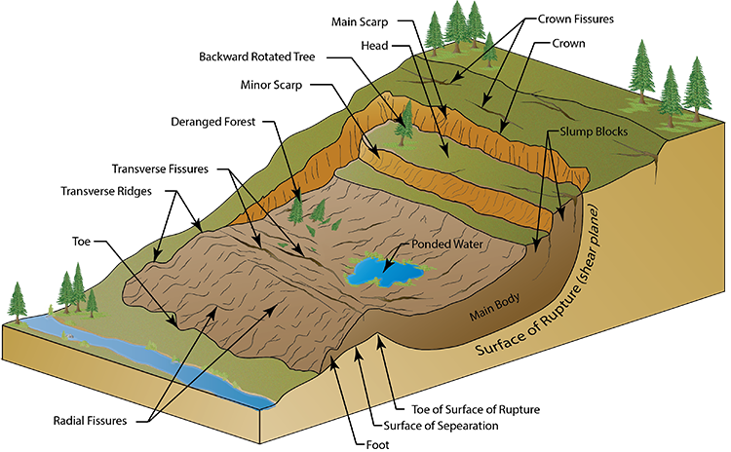
FACTORS AFFECTING SLOPE STABILITY
1- Soil Type
2- Geometry of the cross section (Height, slope angle, etc.)
3- Moisture Content
4- Pore water pressure
5- Additional loads
6- Shear Strength reduction
7- Vibrations and Earthquake
By Kamal Tawfiq, Ph.D., P.E.

Slide 4
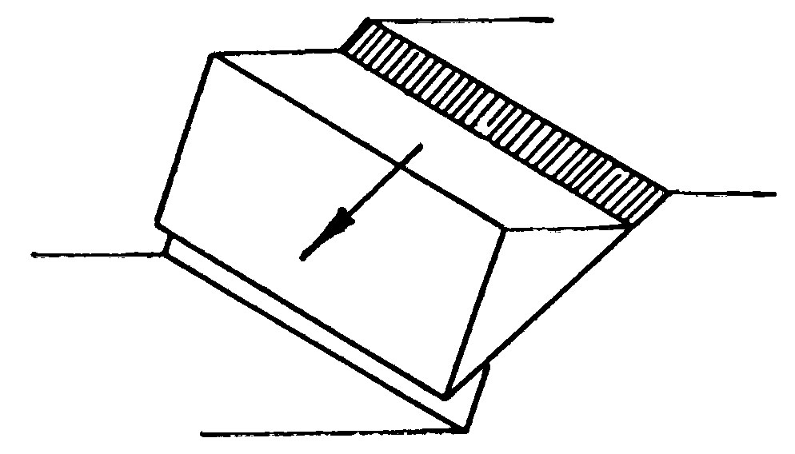
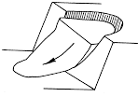
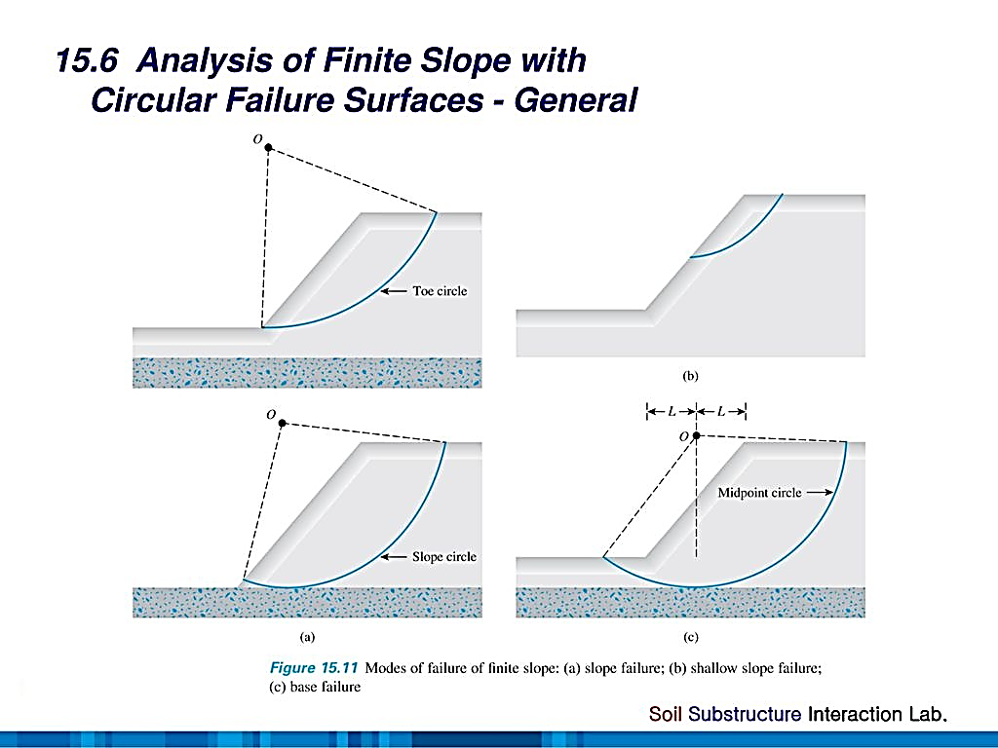
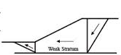
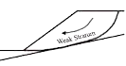
To Analyze and Design Slopes:
Depth
1- Planar Failures (Determinate Problems)
Infinite Failures Small depth, Long failure surface
Finite Slope Failures Simple wedge
H
β
H
β
2- Circular Failures (Determinate & Indeterminate Problems)
Above Toe
Through Toe
Deep seated
3- Wedge Failures Multiple Planer Failure
4- Complex Failures Combination of Planar & Circular

Slide 5
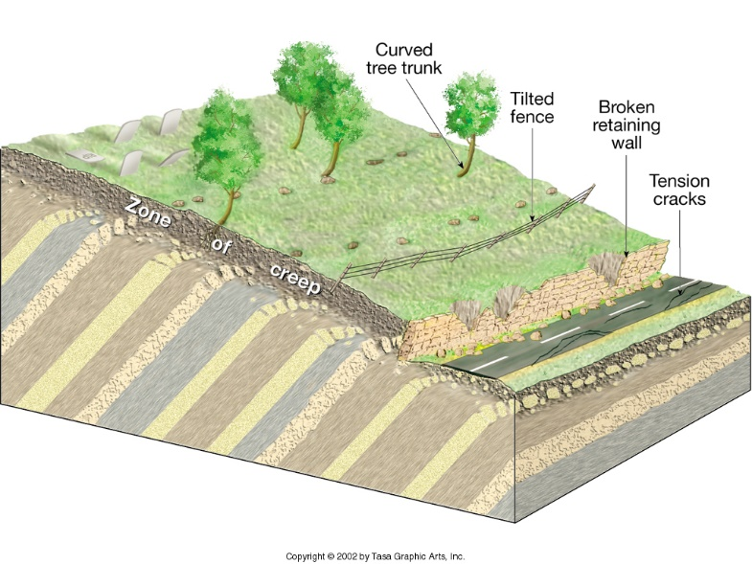
1. Planar Failures
The Concept of Developed Friction
Driving Force = T = W . sinβ
Developed Friction
Resisting Force = F = N tanδ = (W.cosβ) tanδ
F.S. = F_{resisting}/F_{driving}
T
Resisting Force
W
N
F.S. = 2.5 =
Driving Force
Friction = N tan δ_{developed}
β
F.S. = 1 =
Resisting Force
Driving Force
On the verge of failure

Slide 6
FACTOR OF SAFETY
1- For Shear Strength
τ_{developed} = τ / F.S.
τ_{developed} = (c + σ tanϕ) / F.S.
2- For Shear Parameters
c_{d} = c / F.S.
tanϕ_{d} = tanϕ / F.S.
3- For Height of the Slope
H_{design} = H_{c} / F.S.
Developed cohesion or
Mobilized cohesion
Developed angle of friction

Slide 7
INFINITE SLOPE
I. PLANAR FAILURE or Transitional Failure
H
b = 1 cosβ
A- Dry Soil (ϕ soil)
1
b = 1 cosβ
β
W = γ H cosβ
Normal Component, F_{V} = W cos β
Driving Force, F_{D} = W sin β
β
Failure
Surface
H
Weight = W
τ = N tanϕ
Shear Resistance
N = Fv = W cos β
By Kamal Tawfiq, Ph.D., P.E.

Slide 8
A- Dry Soil (ϕ soil)
W = γ H cosβ
b = 1 cosβ
Driving Force = F_{D} = γ H cos β sinβ
Resisting Force = F_{R} = γ H cos β cosβ tanϕ
FS = F_{R}/F_{D}
G.S.
β
γ H cos β cosβ tanϕ
b = 1 cosβ
FS =
1
γ H cos β sinβ
tanϕ
FS =
β
tanβ
Normal Component, F_{V} = W cos β
Driving Force, F_{D} = W sin β
β
Failure
Surface
H
Weight = W
τ = N tanϕ
N = Fv = W cos β
By Kamal Tawfiq, Ph.D., P.E.

Slide 9
B- Submerged Soil (ϕ soil)
W = γ H cosβ
_
Driving Force = F_{D} = γ H cos β sinβ
Resisting Force = F_{R} = γ H cos β cosβ tanϕ
FS = F_{R} / F_{D}
_
W.T
_
G.S.
γ H cos β cosβ tanϕ
FS =
_
b = 1 cosβ
γ H cos β sinβ
1
tanϕ
Driving Force, F_{D} = W sin β
FS =
β
tanβ
Normal Component, F_{V} = W cos β
H
β
Failure
Surface
Weight = W
τ = N tanϕ
N = Fv = W cos β

Slide 10
C- Seepage Parallel to Slope (ϕ soil)
Pore Water Pressure (u)
tanϕ
γ_{w} Z
FS =
(1-
)
tanβ
γ_{soil}H cos²β
G.S.
Seepage
b = 1 cosβ
1
Z = Pressure Head
What is Pressure Head?
What is Total Head?
What is Elevation Head?
Total Head = Elevation Head+ Pressure Head
Go to Next Page
Normal Component, N_{eff} = (W – u) cos β
β
Driving Force, F_{D} = W sin β
H
β
Failure
Surface
Weight = W
τ = N_{eff} tanϕ
N_{eff} = (W-u) cos β
By Kamal Tawfiq, Ph.D., P.E.

Slide 11
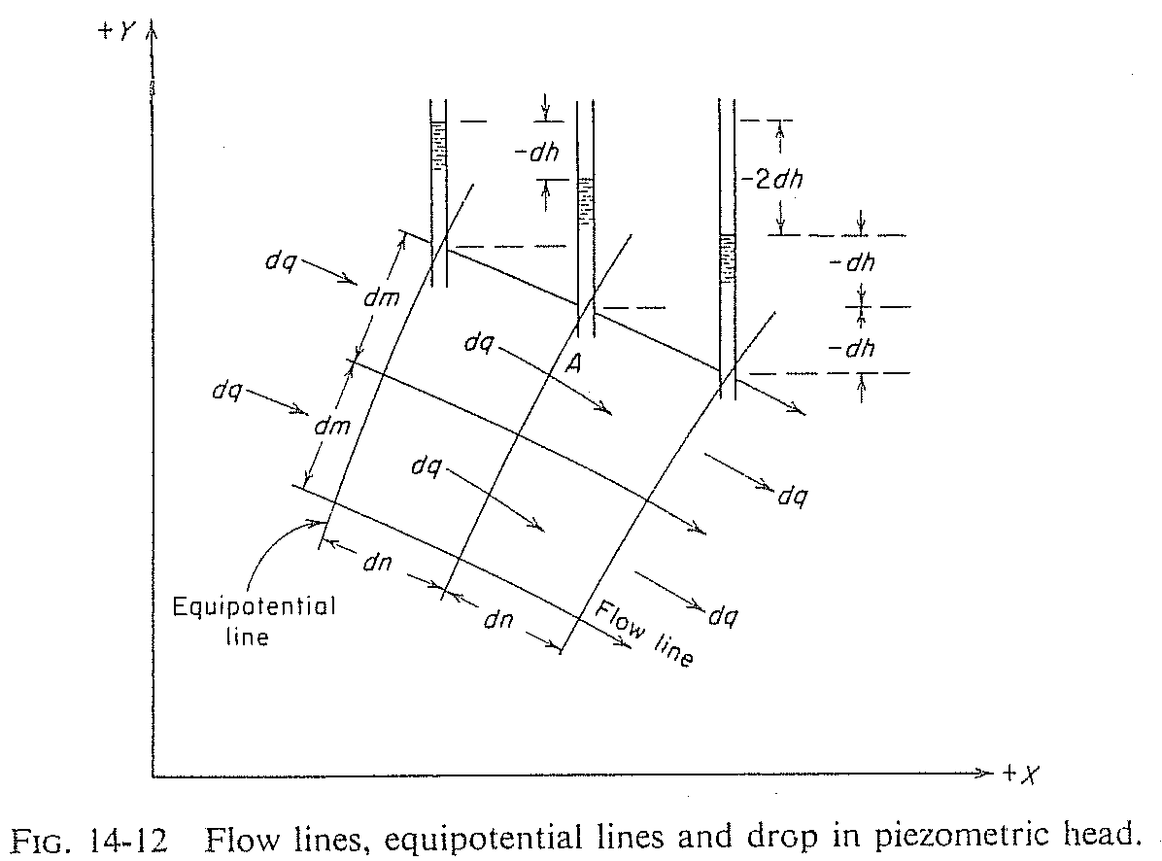
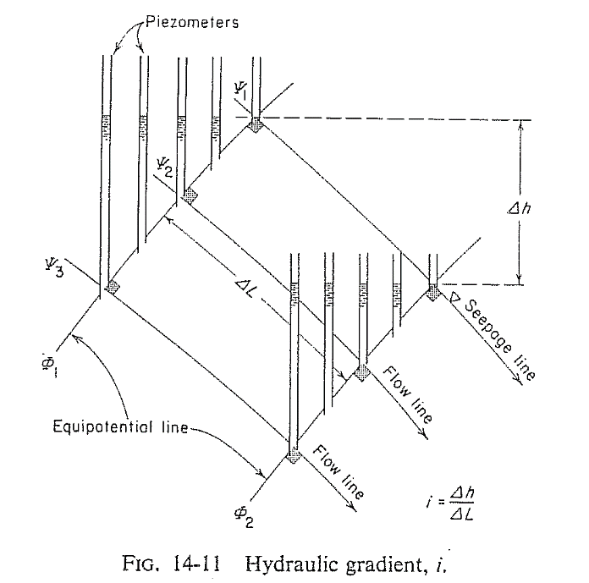
Total Head, Elevation Head and Pressure Head
Total Head = Elevation Head+ Pressure Head
Head Loss
Pressure
Head
Elevation
Head
phreatic line
Atmospheric Pressure Line
Flow Line
Ground Surface
Flow Line
Datum
Flow Line
Failure Surface
Pressure
Head
Elevation
Head
Pressure
Head
Pore Water Pressure (u)
=
Pressure head *( γ_{water} )
=
γ z
Elevation
Head
Elevation
Head
Equipotential Line
Datum

Slide 12
For the infinite slope shown below, what is the pore water pressure at point A ?
Z = d_{w} cos α (cos α)
b
Soil Surface
b/cos α
Water Table
Z = Pressure Head
Pore Water Pressure (u) = γ_{water} * γ z
W
Assumed failure surface
d
d_{w}
T
Z
N’
α
d_{w}cos α
Z
A
U
B
α

Slide 13
D- Infinite Slope in c - ϕ soil (with seepage)
c
+
u
tanϕ
FS =
(1-
)
γ_{soil} H cosβ sinβ
γ_{soil} H cos²β
tanβ
If no seepage:
u = 0
If Submerged Slope:
u = 0 γ = γ’
G.S.
b = 1 cosβ
1
Normal Component, F_{V} = W cos β
β
Driving Force, F_{D} = W sin β
H
β
Failure
Surface
Weight = W
τ = C + N tanϕ
N = Fv = W cos β
By Kamal Tawfiq, Ph.D., P.E.

Slide 14
Critical Height H_{c} at FS = 1
(with seepage)
seepage
c
+
u
)
tanϕ
= 1
H
FS =
(1-
γ_{soil} H cosβ sinβ
γ_{soil} H cos²β
tanβ
β
c
- u tanϕ
W sinβ
β
H_{c} =
W cosβ
γ_{soil} cos²β (tanβ - tanϕ)
Weight = W
τ = C + N tanϕ
N = Fv = W cos β
Stability Number Ns
c
u
Ns =
r_{u} =
= pore water pressure ratio
γHc
γH
c
c_{dev} =
FS_{c}
General Equation:
c
tanφ
tanφ_{dev} =
H_{c} =
FS_{φ}
γ_{soil} [sinβ cosβ - tanϕ (cos²β - r_{u})]
tanφ
Or
φ_{dev} = tan⁻¹ ( )
FS_{φ}
c_{dev}
H =
γ_{soil} [sinβ cosβ - tanϕ_{dev} (cos²β - r_{u})]
By Kamal Tawfiq, Ph.D., P.E.

Slide 15
General Equation:
c
H_{c} =
γ_{soil} [sinβ cosβ - tanϕ (cos²β - r_{u})]
seepage
H
β
c
β
N_{s} =
= sinβ cosβ - tanϕ (cos²β - r_{u})
γH_{c}
N_{s} =
c_{d}
= sinβ cosβ - tanϕ_{d} (cos²β - r_{u})
γH
Ns =
c_{d}
= sinβ cosβ - tanϕ_{d} (cos²β - r_{u})
γH
c
ϕ = 15º
c_{d} =
c
FS_{c}
N_{s} =
ϕ = 25º
γH_{c}
ϕ = 35º
tanϕ
ϕ = 45º
tanϕ_{d} =
FS_{φ}
β

Slide 16
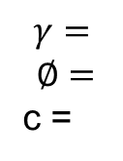
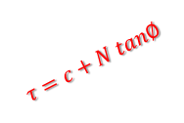
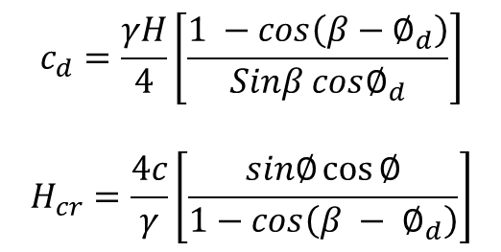
Planar Slope Failure
Finite Slope
C
B
$$c_{d}=\frac{γH}{4}\left[\frac{1 −cos\left(β−∅_{d}\right)}{Sinβ cos∅_{d}}\right]$$
$$H_{cr}=\frac{4c}{γ}\left[\frac{sin∅\cos{∅}}{1−cos\left(β − ∅_{d}\right)}\right]$$
$$γ=$$
$$∅=$$
c =
H
F_{d} = W.sinβ
N = W.cosβ
W
$$τ=c+N tan∅$$
β
θ
A

Slide 17
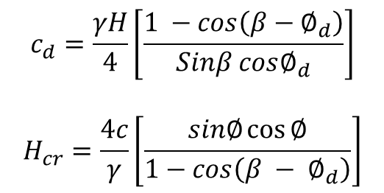
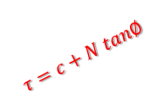
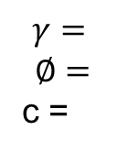
Example:
Given:
β= 30º
H = 10 ft
= 32º
c = 180 psf
Find:
F.S. of the Slope
C
B
$$γ=$$
$$∅=$$
c =
H
F_{d} = W.sinβ
N = W.cosβ
W
$$τ=c+N tan∅$$
β
θ
A
$$c_{d}=\frac{γH}{4}\left[\frac{1 −cos\left(β−∅_{d}\right)}{Sinβ cos∅_{d}}\right]$$
$$H_{cr}=\frac{4c}{γ}\left[\frac{sin∅\cos{∅}}{1−cos\left(β − ∅_{d}\right)}\right]$$

