Slide 1
MODULE 7
Section II
Slope Stability Analysis & Design

Slide 2
Circular Failure Surface (Cohesive Soil)
Determinate Problem
Number of Unknowns = Number of Equilibrium Equations
M_{resisting}
F.S. =
M_{driving}
Center
R
θ
C
B
R
M_{driving} = W₁ . a₁
W₁ = Area (BCDE) . γ_{soil}
R
R
D
a₁
A
W₂
a₂
W₁
c . L
E
M_{resisting} = c . L + W₂ . a₂ = c . (R.θ) R + W₂ . a₂
By Kamal Tawfiq, Ph.D., P.E.

Slide 3
Circular Method in Clayey Soil (φ = 0)
Resisting Moment (M_{R})
Factor of Safety =
Driving Moment (M_{D})
Case 1
center
center
Case 2
Radius = R
Radius = R
θ
a₁
a₂
CG₁
W₁
R.θ
CG₂
W₂
Shear Resistance = C = c L
Yellow Area x Soil Unit Weigh
How to find W₁, W_{2 ,} CG_{1 and} CG₂ ?
Resisting Moment (M_{R}) = W₂ x a₂ + C x R
Refer to your Eng. Mechanics course
Driving Moment (M_{D}) = W₁ x a₁
Green Area x Soil Unit Weigh

Slide 4
Circuler Failure Surface in C - φ Soil
Indeterminate Problem
Number of Unknowns ≠ Number of Equilibrium Equations
W varies from point to point. Therefore, N & F will vary from point to point
Center
R
W1
W2

Slide 5
Circuler Failure Surface in C - φ Soil
Indeterminate Problem
Number of Unknowns ≠ Number of Equilibrium Equations
W varies from point to point. Therefore, N & F will vary from point to point
Center
R
W
W cosθ
W sinθ
θ
τ
φ
N
θ
F

Slide 6
Stability Number
A variety of charted solutions exist for the simple geometry considered above.
For the undrained (total stress) analysis of slopes charts produced by Taylor are often used.
The charts are based on the analysis of circular failure surfaces, and assume that soil strength is given by a Mohr-Coulomb analysis
Tension cracks are not considered

Slide 7
Taylor’s Method
H
nH
DH
αi
By Kamal Tawfiq, Ph.D., P.E.

Slide 8
Taylor’s Chart

Slide 10
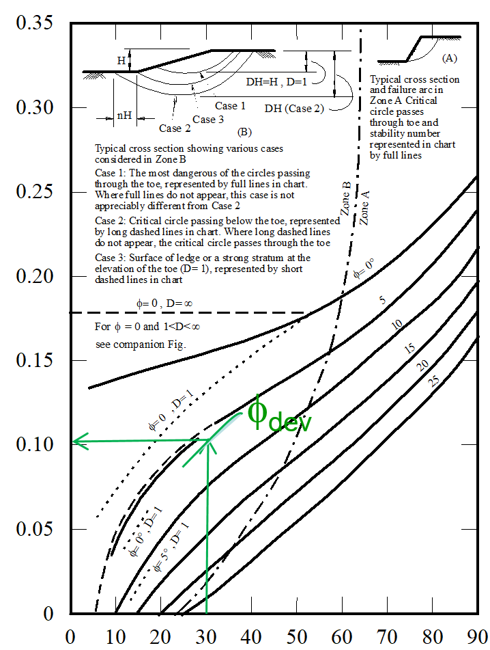
Example 1:
Given:
c_{u} = 20 kN/m²
φ_{u} = 10º
γ_{bulk} = 15 kN/m³
F.S. = 1.5
Find:
Safe Height (H)
H_{design}=?
β=30^{ο}
Solution:
or β=30^{ο}
tan 10º
Use the chart with i = 30º, and φ_{dev} = tan⁻¹ (
)
Stability Number (c / γH)
= 6.7º
1.5
20/1.5
SN = 0.1 =
15 x H_{design}
SN = 0.1
20/1.5
H_{design} = = 8.88 m
15 x 0.1
Slope Angle β (deg)

Slide 11
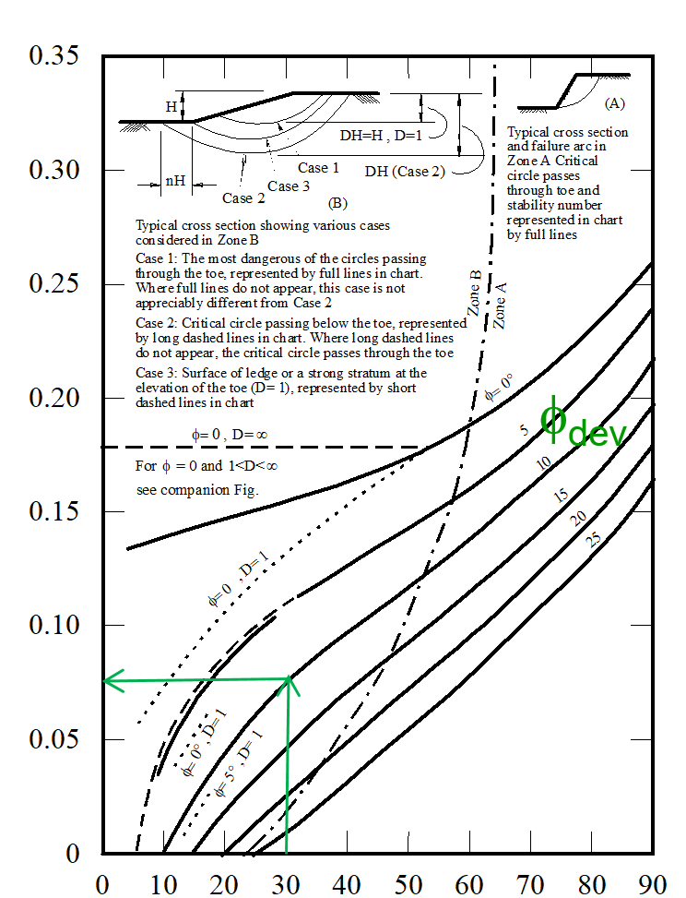
Example 2:
Given:
c_{u} = 20 kN/m²
φ_{u} = 10º
γ_{bulk} = 15 kN/m³
H = 7 m
β= 30º
Find:
F.S.
H= 7m
β=30^{ο}
Solution:
Trial # 1
1- Assume FS_{φ} = 1
Stability Number (c / γH)
tan 10º
2- Use the chart with β = 30º, and φ_{dev} = tan⁻¹ (
)
= 10º
1.0
3- Go to the chart and find SN for φ_{dev} = 10º
SN=0.075
c_{dev}
SN = 0.075 =
15 x 7
4- c_{dev} = 15 x 7 x 0.075 = 7.87 kN/m²
5- FS_{c} = c / c_{dev} = 20 / 7.87 = 2.5
Therefore the Assumed FSφ = the calculated FS_{c}
Slope Angle β (deg)

Slide 12
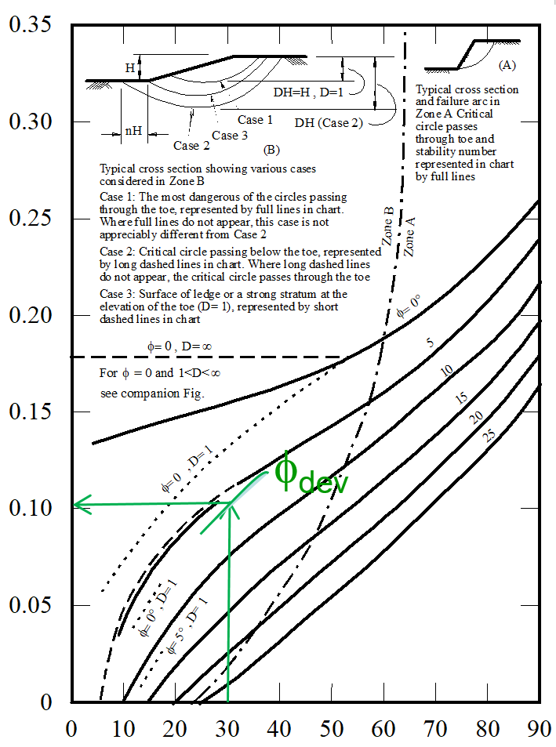
This means the assumed factor of safety was not the right one. So we need
to assume another FSφ and solve the problem again for FS_{c}.
Trial # 2
1- Assume FS_{φ} = 1.5
tan 10º
2- Use the chart with i = 30º, and φ_{dev} = tan⁻¹ (
)
= 6.7º
1.5
3- Go to the chart and find SN for φ_{dev} = 6.7º
c_{dev}
SN = 0.1 =
15 x 7
4- c_{dev} = 15 x 7 x 0.10 = 10.5 kN/m²
5- FS_{c} = c / c_{dev} = 20/10.5 = 1.9
Therefore the Assumed FSφ = the calculated FS_{c}
Stability Number (c / γH)
This means the assumed factor of safety was not the right one. So we need to assume another FSφ and solve the problem again for FS_{c}.
Slope Angle β (deg)

Slide 13
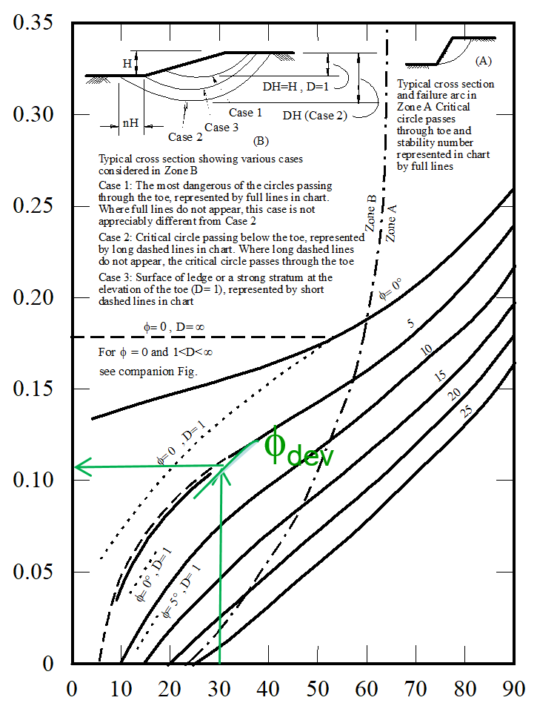
Trial # 3
1- Assume FS_{φ} = 1.8
tan 10º
2- Use the chart with i = 30º, and φ_{dev} = tan⁻¹ (
)
= 5.5º
1.8
3- Go to the chart and find SN for φ_{dev} = 5.5º
c_{dev}
SN = 0.11 =
15 x 7
4- c_{dev} = 15 x 7 x 0.11 = 11.55 kN/m²
5- FSc = c / c_{dev} = 20/11.55 = 1.73
Therefore the Assumed FSφ = the calculated FS_{c}
Stability Number (c / γH)
This means the assumed factor of safety was not the right one. So we need to assume another FSφ and solve the problem again for FS_{c}.
Slope Angle β (deg)

Slide 14
Since we complied three different trials, we are ready to find the right
factor of safety by using the 45º line method
Assumed FSφ Calculated FS_{c}
1.0 2.5
1.5 1.9
1.8 1.73
So the correct FS is 1.75
1.75
1.75

Slide 15
Taylor’s Chart - example
Zones are marked on the chart indicating whether the failure mode will be shallow or deep-seated.
If a deep-seated failure is indicated the soil layer must be sufficiently deep to enable this mechanism to occur.
There is a second chart due to Taylor which can be used when the depth of soil below the base of the slope is limited
This chart is only valid for φ = 0

Slide 16
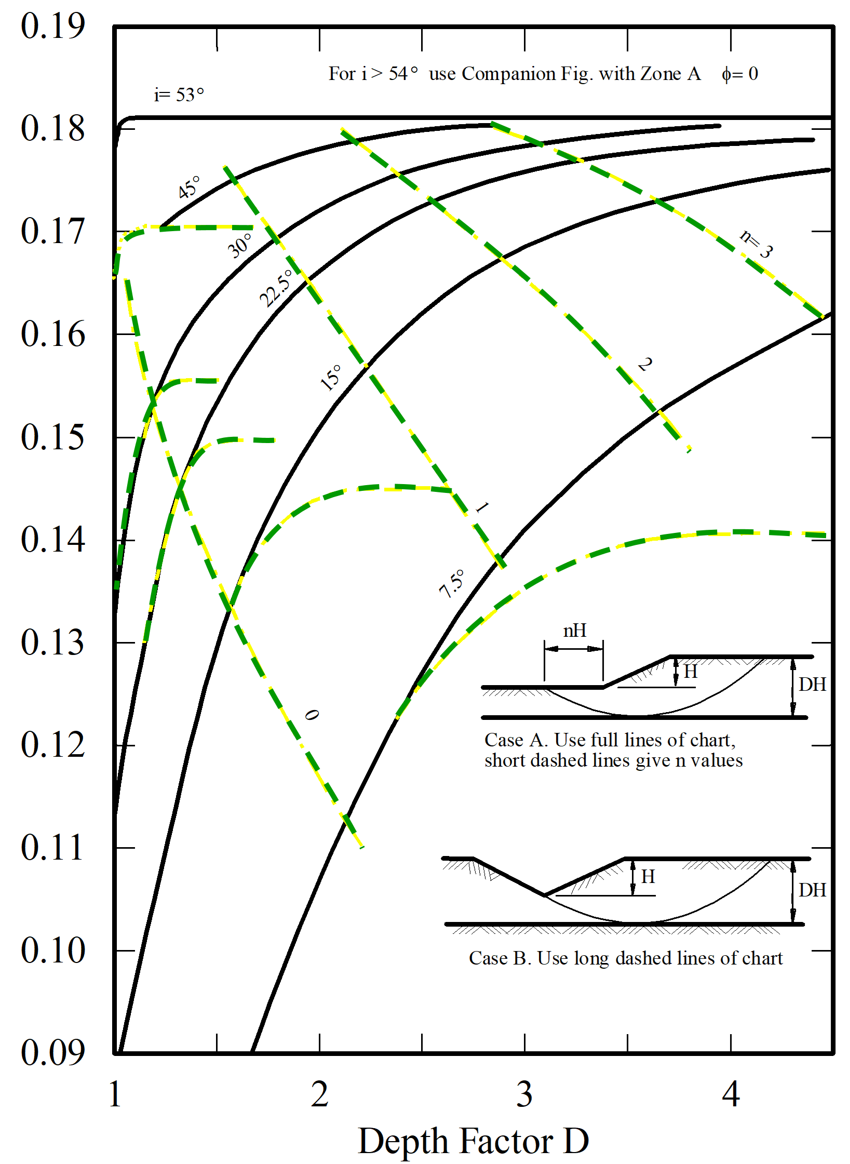
Stability Number (c / γH)

Slide 17
Example 3:
Given:
c_{u} = 20 kN/m²
φ_{u} = 0
γ_{bulk} = 15 kN/m³
F.S. = 1.5
Find:
Calculate the depth factor D
Solution
DH = 8+2 = 10 m
D= 1.25
H= 8m
β=30^{ο}
H= 2m
Rock

Slide 18
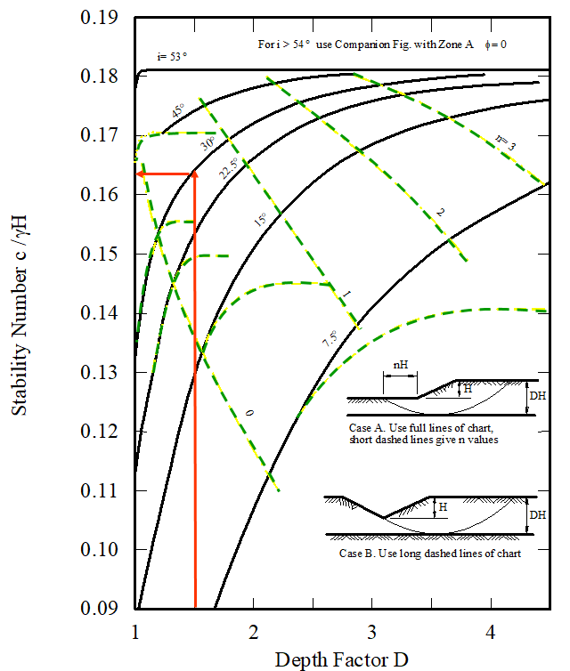
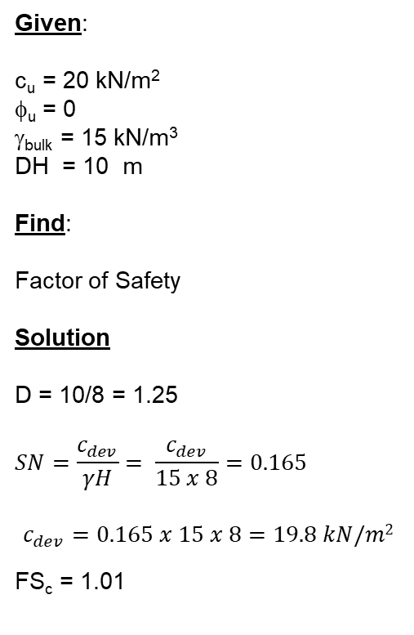
Example 3:
Given:
c_{u} = 20 kN/m²
φ_{u} = 0
γ_{bulk} = 15 kN/m³
DH = 10 m
Find:
Factor of Safety
Solution
D = 10/8 = 1.25
$$SN=\frac{c_{dev}}{γH}= \frac{c_{dev}}{15 x 8}=0.165$$
$$c_{dev}=0.165 x 15 x 8=19.8 kN/m2$$
FS_{c} = 1.01
H= 8m
β=30^{ο}
H= 2m
Rock

