Slide 1
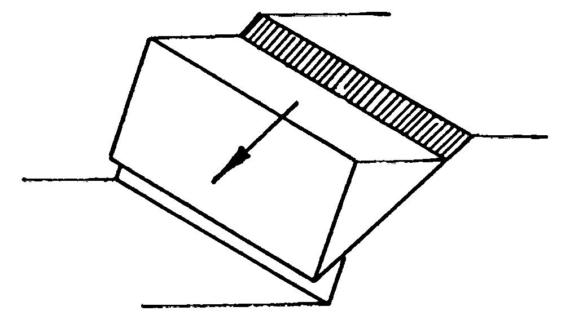
To Analyze and Design Slopes:
Depth
1- Planar Failures (Determinate Problems)
Infinite Failures Small depth, Long failure surface
Finite Slope Failures Simple wedge
H
β
H
β
2- Circular Failures (Determinate & Indeterminate Problems)
Above Toe
Through Toe
Deep seated
3- Wedge Failures Multiple Planer Failure
4- Complex Failures Combination of Planar & Circular

Slide 2
D- Infinite Slope in c - ϕ soil (with seepage)
c
+
u
tanϕ
FS =
(1-
)
γ_{soil} H cosβ sinβ
γ_{soil} H cos²β
tanβ
If no seepage:
u = 0
If Submerged Slope:
u = 0 γ = γ’
G.S.
b = 1 cosβ
1
Normal Component, F_{V} = W cos β
β
Driving Force, F_{D} = W sin β
H
β
Failure
Surface
Weight = W
τ = C + N tanϕ
N = Fv = W cos β
By Kamal Tawfiq, Ph.D., P.E.

Slide 3
Planar Slope Failure
Infinite Slope
(with seepage)
Critical Height H_{c} at FS = 1
seepage
H
c
+
u
)
tanϕ
= 1
FS =
(1-
β
γ_{soil} H cosβ sinβ
γ_{soil} H cos²β
tanβ
W sinβ
β
W cosβ
c
- u tanϕ
Weight = W
H_{c} =
τ = C + N tanϕ
γ_{soil} cos²β (tanβ - tanϕ)
1
N = Fv = W cos β
Stability Number N_{s} and Pore Water Pressure Ration r_{u}
c
u
Ns =
r_{u} =
= pore water pressure ratio
γHc
γH
c
2
3
c_{dev} =
Developed (d)
or
Mobilized (m)
FS_{c}
General Equation:
c
tanφ
tanφ_{dev} =
H_{c} =
FS_{φ}
γ_{soil} [sinβ cosβ - tanϕ (cos²β - r_{u})]
tanφ
Or
φ_{dev} = tan⁻¹ ( )
FS_{φ}
c_{d}
H =
γ_{soil} [sinβ cosβ - tanϕ_{d} (cos²β - r_{u})]
By Kamal Tawfiq, Ph.D., P.E.

Slide 4
Planar Slope Failure
Finite Slope
$$W=\frac{1}{2}(H)(\overline{BC)}\left(1\right)\left(γ\right)=\frac{1}{2}H(H\cot{θ H\cot{β)γ}}$$
$$W=\frac{1}{2}γH^{2}\left[\frac{sin\left(β−θ\right)}{sinβ . sinθ}\right]$$
N_{a} = normal component = $W\cos{θ}$
T_{a} = tangential component = $W\sin{θ}$
B
C
$$γ=$$
$$∅=$$
c =
N_{a} = W.cosθ
W
T_{a} = W.sinθ
$$τd$$
H
T_{r}
$$τr$$
N_{a} = N_{r}
$$τ_{r}=c+σ^{′} tan∅$$
$$τ_{d}=\frac{T_{a}}{\left(\overline{AC}\right)(1)}=\frac{T_{a}}{\left(\frac{H}{\sin{θ}}\right)}$$
$$τ_{d}=\frac{1}{2}γH\left[\frac{sin⁡(β−θ)}{sinβ . sinθ}\right]\sin^{2}θ$$
β
θ
A
$$σ^{′}=\frac{N_{a}}{\left(\overline{AC}\right)(1)}=\frac{N_{a}}{\left(\frac{H}{\sin{θ}}\right)}$$
$$σ^{′}=\frac{1}{2}γH\left[\frac{sin⁡(β−θ)}{sinβ . sinθ}\right]cosθ sinθ$$

Slide 5
Planar Slope Failure
Finite Slope
B
C
W
N_{a} = W.cosθ
T_{a} = W.sinθ
$$γ=$$
$$∅=$$
c =
$$τd$$
H
T_{r}
$$W=\frac{1}{2}(H)(\overline{BC)}\left(1\right)\left(γ\right)=\frac{1}{2}H(H\cot{θ H\cot{β)γ}}$$
$$W=\frac{1}{2}γH^{2}\left[\frac{sin\left(β−θ\right)}{sinβ . sinθ}\right]$$
N_{a} = normal component = $W\cos{θ}=$ $\frac{1}{2}γH^{2}\left[\frac{sin\left(β−θ\right)}{sinβ . sinθ}\right]cosθ$
T_{a} = tangential component = $W\sin{θ}=$ $\frac{1}{2}γH^{2}\left[\frac{sin\left(β−θ\right)}{sinβ . sinθ}\right]sinθ$
$τ_{d}=\frac{1}{2}γH\left[\frac{sin⁡(β−θ)}{sinβ . sinθ}\right]\sin^{2}θ$ …… Driving Shear Stress
$$τ_{r}= c_{d}+ σ^{′} tan∅_{d }= c_{d}+\frac{1}{2}γH\left[\frac{sin⁡(β−θ)}{sinβ . sinθ}\right]cosθ sinθ tan∅_{d} …Resisting Shear Stress$$
$$τ_{r}{=τ}_{d}$$
$c_{d}+\frac{1}{2}γH\left[\frac{sin⁡(β−θ)}{sinβ . sinθ}\right]cosθ sinθ tan∅_{d}= \frac{1}{2}γH\left[\frac{sin⁡(β−θ)}{sinβ . sinθ}\right]\sin^{2}θ$
$$c_{d}=\frac{γH_{des}}{2}\left[\frac{sin\left(β−θ\right)\left(sinθ−cosθ tan∅_{d}\right)}{Sinβ}\right]$$
$$τr$$
N_{a} = N_{r}
A
β
θ
$$τ_{d}=\frac{T_{a}}{\left(\overline{AC}\right)(1)}=\frac{T_{a}}{\left(\frac{H}{\sin{θ}}\right)}$$
$$τ_{d}=\frac{1}{2}γH\left[\frac{sin⁡(β−θ)}{sinβ . sinθ}\right]\sin^{2}θ$$
$$τ_{r}=c+σ^{′} tan∅$$
$$σ^{′}=\frac{N_{a}}{\left(\overline{AC}\right)(1)}=\frac{N_{a}}{\left(\frac{H}{\sin{θ}}\right)}$$
$$σ^{′}=\frac{1}{2}γH\left[\frac{sin⁡(β−θ)}{sinβ . sinθ}\right]cosθ sinθ$$

Slide 6
B
C
Solved Example:
Given:
γ = 112 pcf
β= 55º
= 26º
θ = 35^{ο}
c = 520 psf
F.S = 1.5
Find:
Safe Height:
Solution:
Since we know the safety factor, then
c_{d} =$\frac{c}{F.S}=\frac{100}{1.5}=66.67 psf$
$tan∅_{d}=\frac{tan∅}{F.S}$ …….${ ∅}_{d}=\tan^{−1}\left(\frac{tan∅}{F.S}\right)=$ $\tan^{−1}\left(\frac{tan26}{1.5}\right)= {18}^{o}$
$H_{design}=\frac{2c_{d}}{γ}\left[\frac{Sinβ}{sin\left(β−θ\right)\left(sinθ−cosθ tan∅_{d}\right)}\right]= \frac{2\left(66.67\right)}{112}\left[\frac{Sin35}{sin\left(55−35\right)\left(sin35−cos35 tan18\right)}\right]=6.49′$
W
N_{a} = W.cosθ
T_{a} = W.sinθ
$$τd$$
$$γ=$$
$$∅=$$
c =
H
T_{r}
$$τr$$
N_{a} = N_{r}
A
β
θ
$$H_{cr}=\frac{2c}{γ}\left[\frac{Sinβ}{sin\left(β−θ\right)\left(sinθ−cosθtan∅\right)}\right]$$
$$H_{des}=\frac{2c_{d}}{γ}\left[\frac{Sinβ}{sin\left(β−θ\right)\left(sinθ−cosθ tan∅_{d}\right)}\right]$$
$$c_{d}=\frac{γHdes}{2}\left[\frac{sin\left(β−θ\right)\left(sinθ−cosθ tan∅_{d}\right)}{Sinβ}\right]$$

Slide 7
Circular Failure Surface (Cohesive Soil)
Determinate Problem
Number of Unknowns = Number of Equilibrium Equations
M_{resisting}
F.S. =
M_{driving}
Center
R
θ
C
B
R
M_{driving} = W₁ . a₁
W₁ = Area (BCDE) . γ_{soil}
R
R
D
a₁
A
W₂
a₂
W₁
c . L
E
M_{resisting} = c . L + W₂ . a₂ = c . (R.θ) R + W₂ . a₂
By Kamal Tawfiq, Ph.D., P.E.

Slide 8
Circuler Failure Surface in C - φ Soil
Indeterminate Problem
Number of Unknowns ≠ Number of Equilibrium Equations
W varies from point to point. Therefore, N & F will vary from point to point
Center
R
W
W cosθ
W sinθ
θ
τ_{r}
φ
N
θ
F
$$τ_{r}=c+σ^{′} tan∅$$

