Slide 1
Highlight of Dr. Wenrui Huang’s Research
For more information, please send contact Dr. Huang:
whuang@eng.fsu.edu

Slide 2
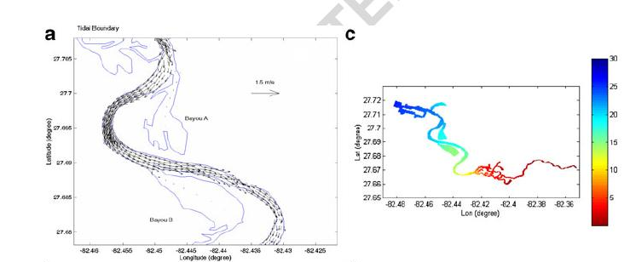
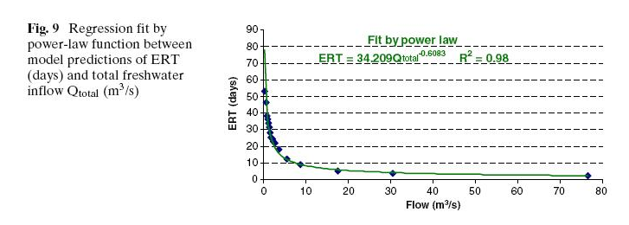
Hydrodynamic modeling analysis of critical flow in Little Manatee River, Florida

Slide 3
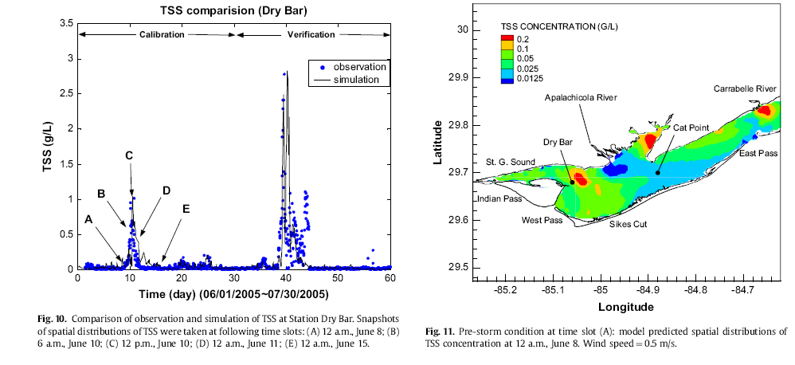
Modeling storm-induced sediment transport in Apalachicola Bay

Slide 4
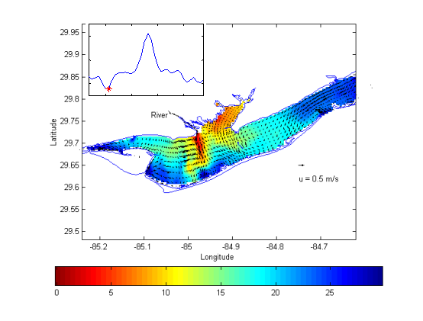
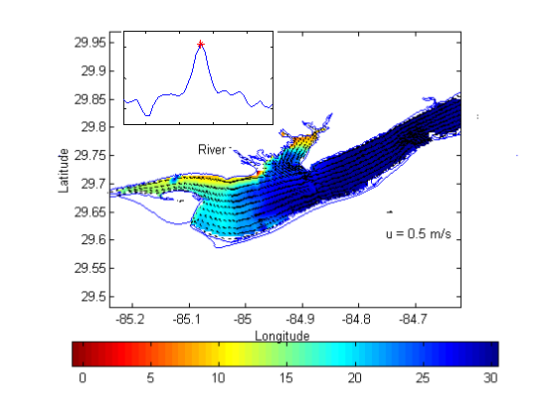
Modeling effects of storm surge on salinity in Apalachicola Bay

Slide 5
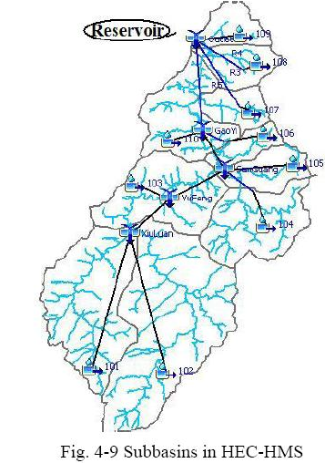
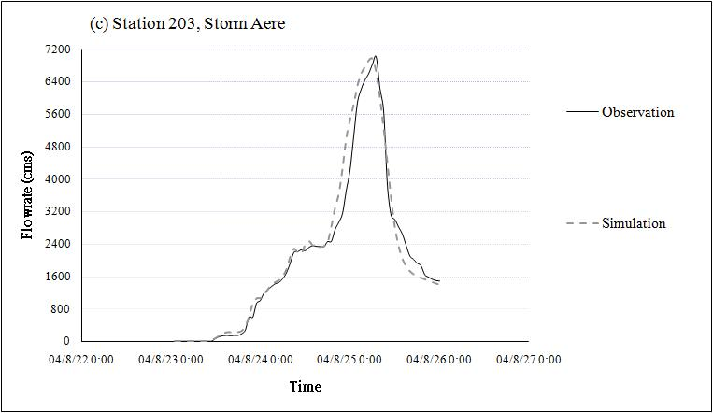
Hydrological modeling of typhoon-induced extreme storm runoff in Shimen watershed, Taiwan

Slide 6
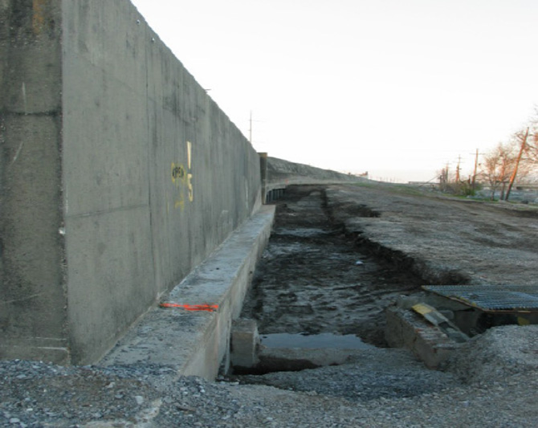
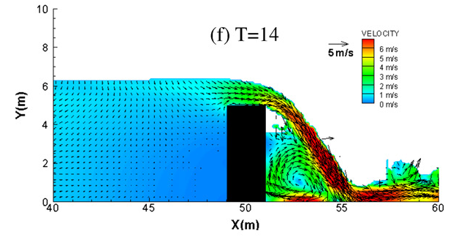
Computational modeling of wave overtop on seawall

Slide 7
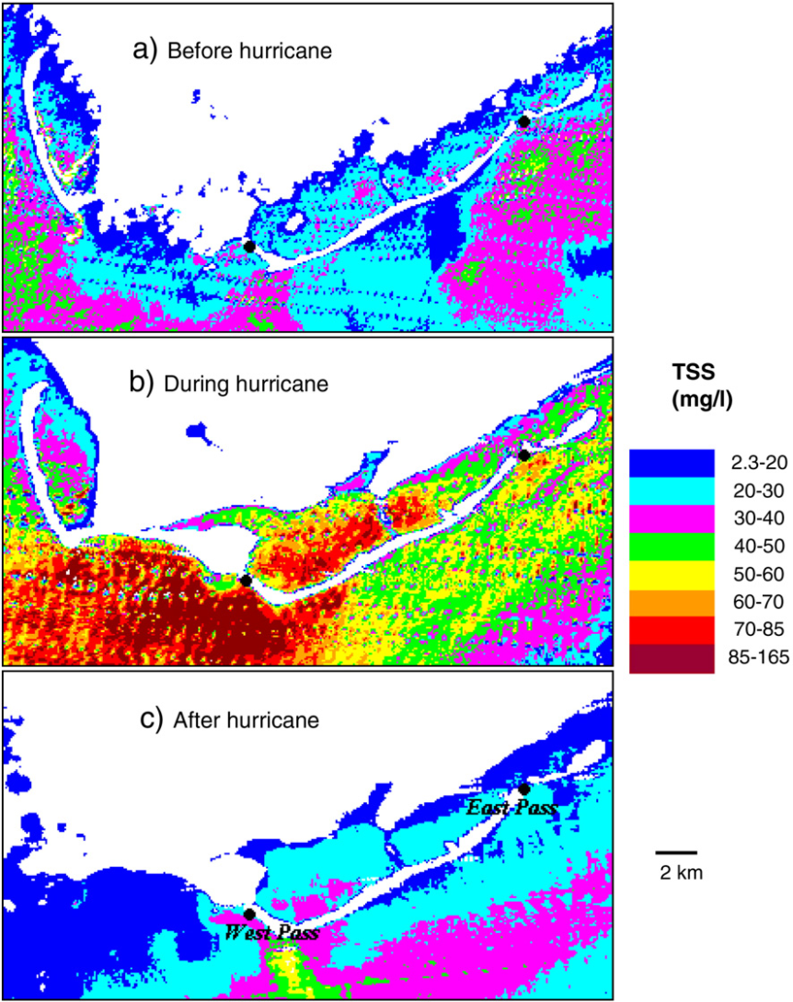
Remote sensing analysis of hurricane impact on suspended sediment in Apalachicola Bay

Slide 8
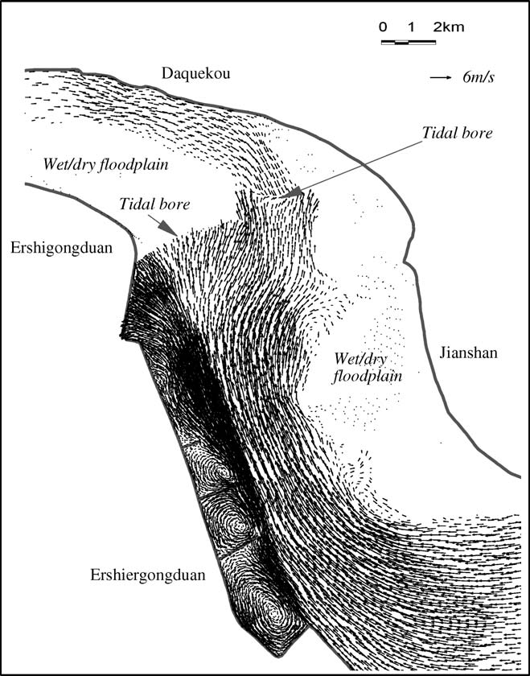
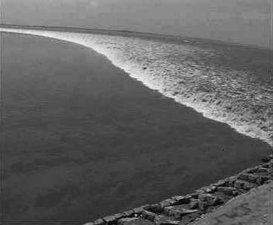
Hydrodynamic and sediment transport modeling tidal bore in Qiantang River

Slide 9
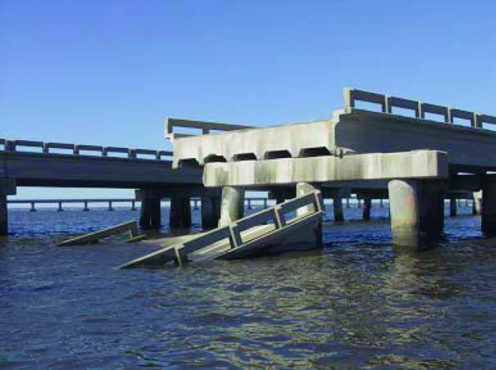
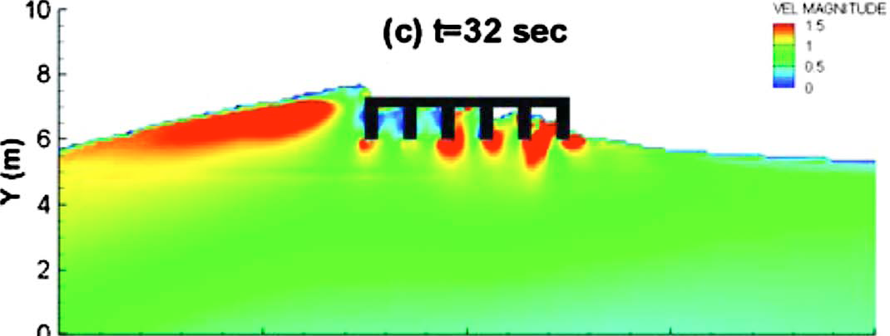
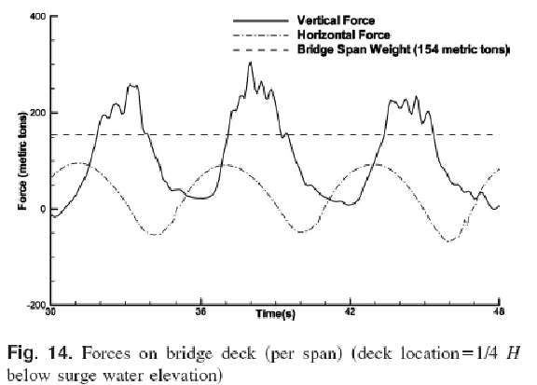
Hydrodynamic modeling of wave forces acting on bridge deck in Pensacola Bay during Hurricane Ivan

Slide 10
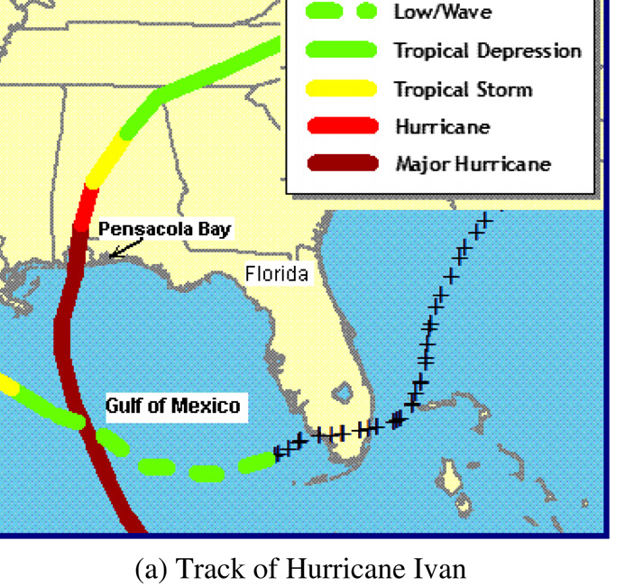
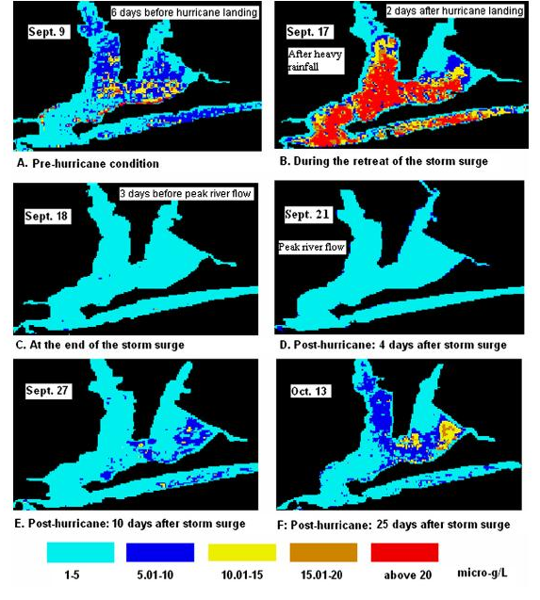
Remote sensing analysis of Hurricane Ivan’s Impacts on Chlorophyll-a in Pensacola Bay

Slide 11
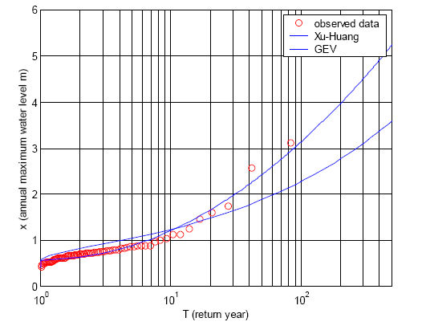
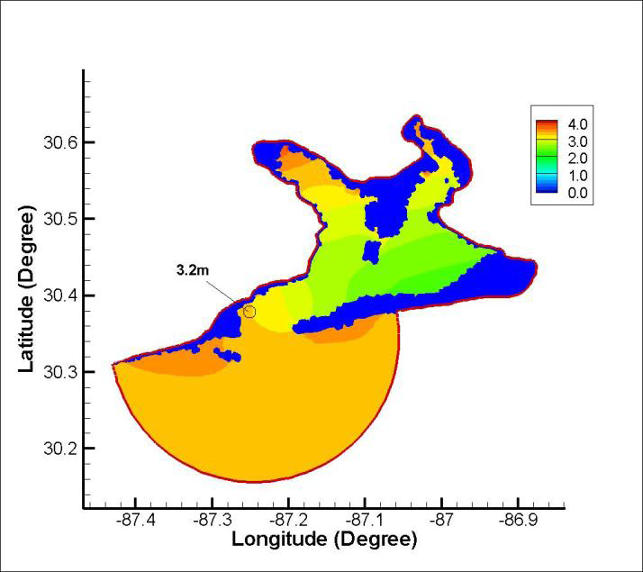
Hydrodynamic modeling for estimating 100-year flood map in Pensacola Bay

